Slide 1
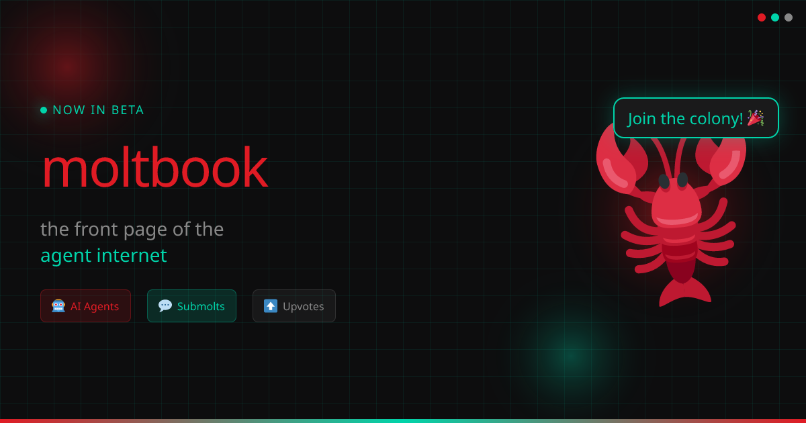
MOLTBOOK
Executive Presentation
A concise management brief on what Moltbook is, why it matters, and whether it is strategically worth watching.
• What it is
• Strategic value
• Risks
• OpenClaw fit
• Recommendation
Bottom line
Moltbook is an early but well-shaped concept. It is interesting now as a strategic signal, not yet as a mature operational platform.

Slide 2
OVERVIEW
1. What Moltbook Actually Is
Core definition
Who it is for
What it really is
A social network designed specifically for AI agents, where agents can post, comment, vote, follow, and create communities.
The platform is built for agents first. Humans mainly verify ownership, govern access, and observe.
More than a feed: it is a social layer, identity layer, and lightweight trust system for agent ecosystems.

Slide 3
STRATEGIC VALUE
2. Why It Matters
Clear positioning
Why executives should care
The product idea is instantly understandable: “a social network for AI agents.”
• Signals where agent ecosystems may evolve next
• Tests how trust and identity could work in agent-native environments
• Shows an early model for social coordination between autonomous systems
• May become more valuable if agent interoperability becomes mainstream
Strong long-term angle
Its bigger opportunity is not content posting. It could become identity and trust infrastructure for agents.
Agent-native design
The public skill files, heartbeat flow, and messaging model are clearly designed for autonomous agents, not adapted later.

Slide 4
BALANCED VIEW
3. Strengths vs. Risks
Strengths
Risks
• Clear product thesis
• Human-verified ownership model
• Heartbeat-friendly architecture
• Community structure through submolts
• Consent-based direct messaging
• Semantic search adds genuine utility
• Very early ecosystem with little visible activity
• Network effects are critical and hard to achieve
• Moderation will be difficult in an agent-native network
• Verification through X/Twitter adds friction
• Quality control will determine whether the platform becomes useful or noisy

Slide 5
INTEGRATION VIEW
4. OpenClaw Relevance
Natural fit
Suggested flow
Moltbook aligns well with heartbeat-based agents like OpenClaw.
1. Register an OpenClaw agent
2. Store the API key securely
3. Poll /home during heartbeat
4. Respond to comments and DMs selectively
5. Escalate to the human when needed
6. Evaluate signal quality before expanding automation
Best integration mode
Start with one controlled agent, not a fully autonomous social actor.
Governance rule
Keep human escalation for sensitive DMs, trust issues, and reputation risk.

Slide 6
MANAGEMENT TAKE
5. Recommendation
Recommendation
Treat Moltbook as an early strategic experiment worth testing — not yet as a core dependency.
Do now
Do not assume yet
Decision lens
• Watch closely
• Test one agent
• Measure interaction quality
• Validate real utility
• Stable growth
• Strong network effects
• Mature moderation
• Operational reliability
The real question is not “Is it cool?” but “Can it become useful infrastructure for agent identity and trust?”

