Slide 1

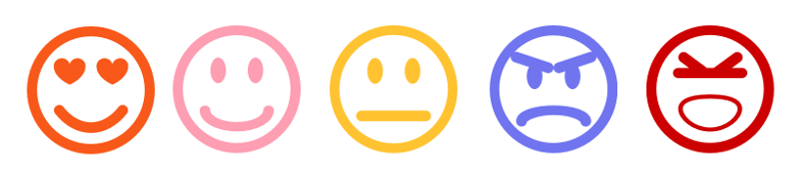
Sentiment Analysis – A Comparative Study
Presentation By Neerajdattu Dudam (101179017) Teja Mallireddy(101180616)
Supervisor: Dr. Lina Chato
April 13th, 2025

Slide 2
Inspiration and Objective
Inspiration: To deepen our understanding of Natural Language Processing by exploring various sentiment analysis techniques. Driven by the need to compare traditional and modern approaches for practical sentiment classification.
Objective: To implement and evaluate lexicon-based, machine learning, and deep learning models for sentiment analysis. To develop a comparative analysis of diverse models and feature extraction techniques on balanced datasets.
Key Goals:
Implement and assess lexicon-based and classical ML sentiment classifiers.
Build and evaluate deep learning models including CNNs, LSTMs, and transformers.
Explore the effect of different feature engineering techniques like TF-IDF, Word2Vec, and GloVe.
Provide a comprehensive performance comparison to guide future sentiment analysis approaches.

Slide 3
Presentation Outline
Introduction
Text Preprocessing
Lexicon and Machine Learning
Workflow
Data
Experiments
Results and Conclusions
Future Directions
References

Slide 4
Introduction
Explosion of Textual Data: In today's digital age, massive amounts of text are generated daily from social media, reviews, blogs, and feedback systems, making manual analysis impractical.
Importance of Sentiment Analysis: A key NLP technique, sentiment analysis helps automatically determine the emotional tone—positive, negative, or neutral—embedded in textual content.
Applications Across Domains: Beyond education, sentiment analysis is used in business for customer reviews, in politics for public opinion mining, and in healthcare for analyzing patient feedback.
Evolution of Techniques: The field has evolved from lexicon-based methods like VADER to machine learning models such as Naive Bayes and SVMs, and now to advanced deep learning and transformer-based models like BERT and GPT.

Slide 5
Text Preprocessing
Level 1: Tokenization, Stop words, Lemmatization
Level 2: Bag of Words, TF IDF, Unigrams, Bigrams, N-Grams.
Level 3: Word embeddings, word2vec, GloVe

Slide 6
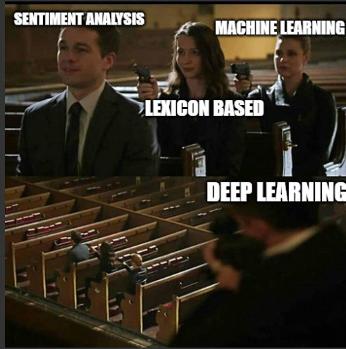
Lexicon and Machine Learning

Slide 7

Lexicon and Machine Learning
Lexicon Based
Do not require training on labeled data.
Rely on predefined sentiment lexicons where each word is associated with a sentiment score.
Sentiment of a sentence or document is calculated based on the aggregate scores of the words it contains.
Simple, interpretable, and useful for domains where labeled data is scarce.
VADER =>
$$Compound Score= \frac{\sum_{i}{s_{i}}}{\sqrt{\sum_{i}{s_{i}^{2}+ α}}}$$

Slide 8
Lexicon and Machine Learning
Machine learning Based
Require labeled data for training models to learn sentiment patterns.
Convert text into numerical features using techniques like CountVectorizer or TF-IDF.
Learn patterns and decision boundaries using algorithms like:
Naive Bayes
Logistic Regression
Support Vector Machines (SVM)
Decision Tree / Random Forest
Can generalize better than lexicon methods on large, diverse datasets.
More flexible and customizable, but may require more computational resources.

Slide 9
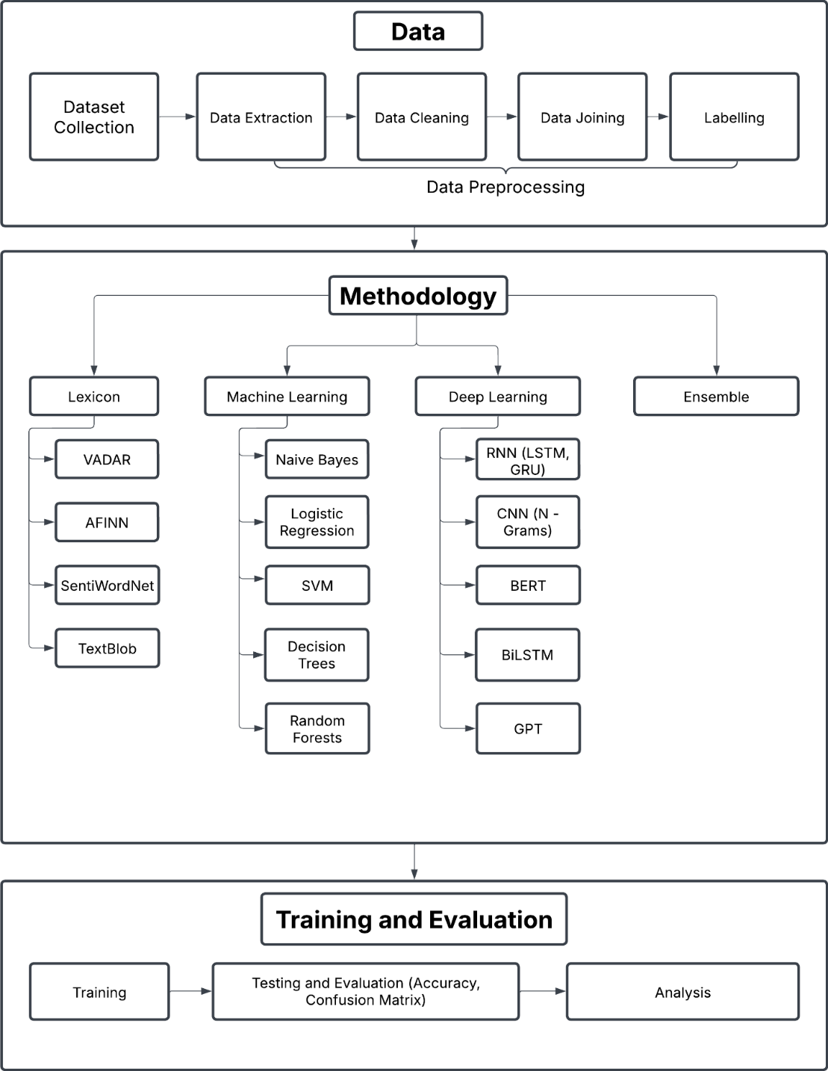
Workflow

Slide 10
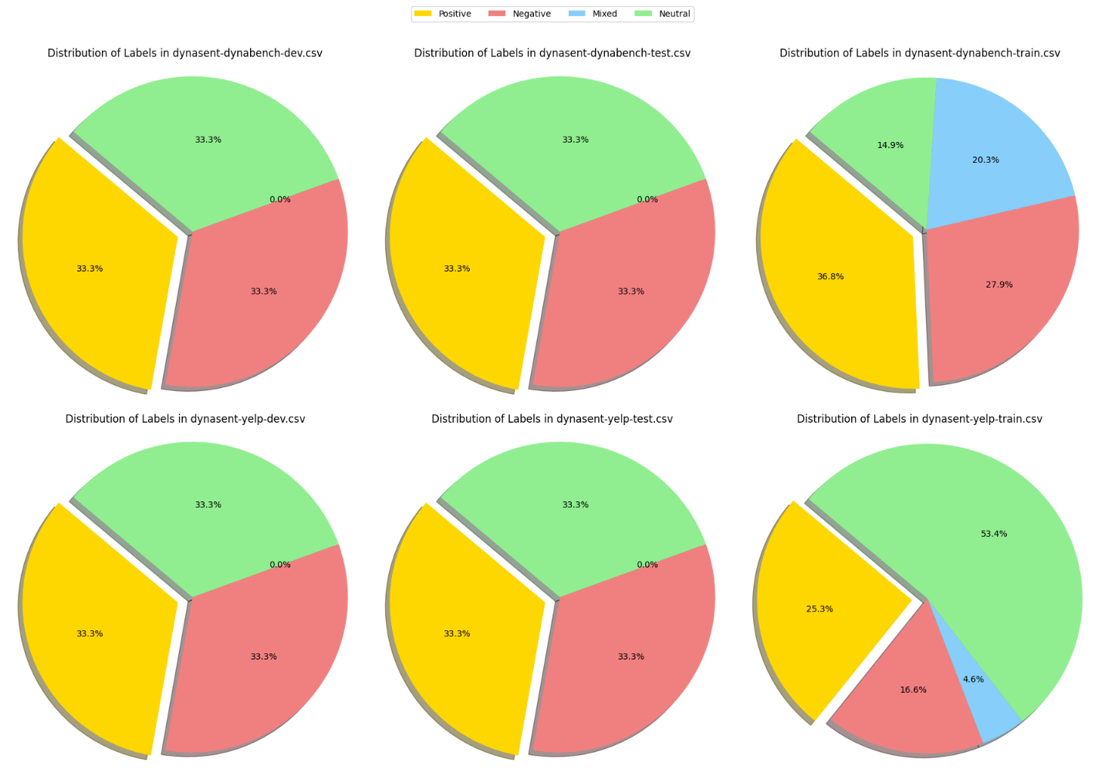
Data

Slide 11
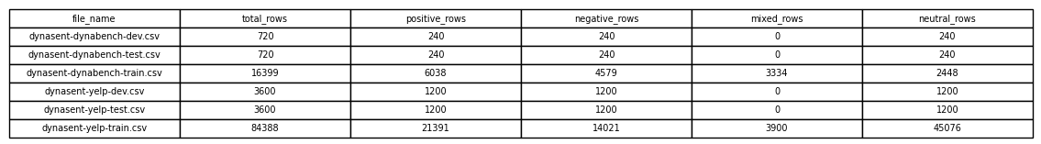
Data
File_name | Total_rows | Positive | Negative | Neutral
Yelp_train | 42063 | 14021 | 14021 | 14021
Yelp_test | 3600 | 1200 | 1200 | 1200
Yelp_val | 3600 | 1200 | 1200 | 1200
dynabench_train | 7344 | 2448 | 2448 | 2448
dynabench_test | 720 | 240 | 240 | 240
dynabench_val | 720 | 240 | 240 | 240
combined_train | 49407 | 16469 | 16469 | 16469
combined_test | 1440 | 480 | 480 | 480
combined_val | 1440 | 480 | 480 | 480

Slide 12

Experiments
Exp 1: Using VADER
$$Compound Score= \frac{\sum_{i}{s_{i}}}{\sqrt{\sum_{i}{s_{i}^{2}+ α}}}$$
Exp 2: Using AFINN
$$Sentiment Score= \sum_{i=1}^{n}{score(w_{i})}$$
Exp 3: Using SentiWordNet
$$Sentiment Score \left(w\right)= \frac{1}{N} \sum_{i=1}^{N}{({Pos}_{i}\left(w\right)− {Neg}_{i}\left(w\right))}$$
Exp 4: Using TextBlob

Slide 13

Experiments
Exp 5, 6: Naïve Bayes
$$P\left(c, d\right)= \frac{P\left(c\right)\prod_{i=1}^{n}{P(w_{i}|c)}}{P(d)}$$
$$\hat{y}={argmax}_{c} (\log{P\left(c\right)}+ \sum_{i=1}^{n}{log P(w_{i}|c)})$$
$$P\left(w_{i} | c\right)= \frac{N_{w_{i,c}}+1}{\sum_{j}{N_{w_{i,c}}+|V|}}$$
Exp 7,8,9: Logistic Regression
Exp 10: SVM
Exp 11: Decision Tree
Exp 12: Random Forest

Slide 14
Results
Test Accuracy (%)
Exp No. | Experiment Name | Yelp Dataset | Dynabench Dataset | Combined Dataset
1 | Using VADER | 53 | 57 | 53
2 | Using AFINN | 52 | 57 | 53
3 | Using SentiWordNet | 43 | 44 | 43
4 | Using TextBlob | 50 | 54 | 51
5 | Naive Bayes from Scratch | 64 | 52 | 57
6 | Multinomial Naive Bayes | 65 | 53 | 57
7 | Logistic Regression 1 | 54 | 49 | 45
8 | Logistic Regression 2 | 60 | 50 | 56
9 | Logistic Regression 3 | 62 | 51 | 57
10 | SVM | 66 | 53 | 61
11 | Decision Tree | 55 | 49 | 52
12 | Random Forest | 62 | 54 | 59

Slide 15
Results

Slide 16
Conclusion and Future Directions
Among the machine learning models, Logistic Regression and SVM with TF-IDF feature extraction showed better performance in sentiment classification.
Lexicon-based methods provided quick and interpretable results but lacked contextual understanding.
Traditional machine learning models performed well with proper preprocessing and feature engineering.
Explore deep learning approaches such as CNN, RNN, LSTM, and transformer-based models like BERT. These models can better capture semantic context, word dependencies, and long-range relationships in text. Fine-tuning pretrained models like BERT on domain-specific data may further improve accuracy.

Slide 17
References
[1] C. Hutto and E. Gilbert, "VADER: A parsimonious rule-based model for sentiment analysis of social media text," Proc. Int. AAAI Conf. Web Soc. Media, vol. 8, no. 1, 2014.
[2] B. Liu, "Sentiment analysis," UIC, [Online]. Available: https://www.cs.uic.edu/~liub/FBS/sentiment-analysis.html. [Accessed: Feb. 6, 2025].
[3] B. Pang, L. Lee, and S. Vaithyanathan, "Thumbs up? Sentiment classification using machine learning techniques," arXiv preprint cs/0205070, 2002.
[4] T. Joachims, "Text categorization with support vector machines: Learning with many relevant features," in Proc. Eur. Conf. Mach. Learn., Berlin, Heidelberg: Springer, 1998, pp. 137–142.
[5] J. P. Vink and G. de Haan, "Comparison of machine learning techniques for target detection," Artif. Intell. Rev., vol. 43, pp. 125–139, 2015.
[6] T. Mikolov et al., "Distributed representations of words and phrases and their compositionality," in Adv. Neural Inf. Process. Syst., vol. 26, 2013.
[7] P. Liu, X. Qiu, and X. Huang, "Recurrent neural network for text classification with multi-task learning," arXiv preprint arXiv:1605.05101, 2016.
[8] A. Rakhlin, "Convolutional neural networks for sentence classification," GitHub, vol. 6, p. 25, 2016.
[9] J. Devlin, M.-W. Chang, K. Lee, and K. Toutanova, "BERT: Pre-training of deep bidirectional transformers for language understanding," in Proc. NAACL-HLT, vol. 1, no. 2, 2019, pp. 4171–4186.
[10] T. Brown et al., "Language models are few-shot learners," in Adv. Neural Inf. Process. Syst., vol. 33, 2020, pp. 1877–1901.
[11] C.-L. Chou, C.-H. Chang, and S.-Y. Wu, "Semi-supervised sequence labeling for named entity extraction based on tri-training: case study on Chinese person name extraction," in Proc. Third Workshop Semantic Web Inf. Extraction, 2014.

Slide 18
Q / A

