Slide 1

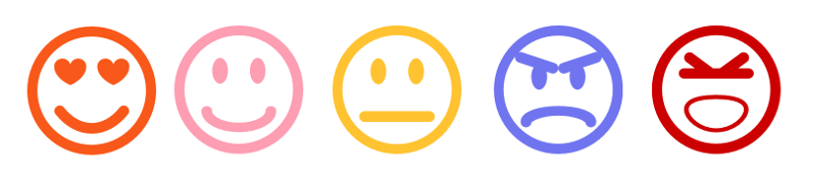
Sentiment Analysis – A Comparative Study
Presentation By Neerajdattu Dudam (101179017) Teja Mallireddy(101180616)
Supervisor: Dr. Longwei Wang
April 20th, 2025

Slide 2
Inspiration and Objective
Inspiration: To deepen our understanding of Natural Language Processing by exploring various sentiment analysis techniques. Driven by the need to compare traditional and modern approaches for practical sentiment classification.
Objective: To implement and evaluate lexicon-based, machine learning, and deep learning models for sentiment analysis. To develop a comparative analysis of diverse models and feature extraction techniques on balanced datasets.
Key Goals:
Implement and assess lexicon-based and classical ML sentiment classifiers.
Build and evaluate deep learning models including CNNs, LSTMs, and transformers.
Explore the effect of different feature engineering techniques like TF-IDF, Word2Vec, and GloVe.
Provide a comprehensive performance comparison to guide future sentiment analysis approaches.

Slide 3
Presentation Outline
Introduction
Text Preprocessing
Lexicon and Machine Learning
Workflow
Data
Experiments
Results and Conclusions
Future Directions
References

Slide 4
Introduction
Explosion of Textual Data: In today's digital age, massive amounts of text are generated daily from social media, reviews, blogs, and feedback systems, making manual analysis impractical.
Importance of Sentiment Analysis: A key NLP technique, sentiment analysis helps automatically determine the emotional tone—positive, negative, or neutral—embedded in textual content.
Applications Across Domains: Beyond education, sentiment analysis is used in business for customer reviews, in politics for public opinion mining, and in healthcare for analyzing patient feedback.
Evolution of Techniques: The field has evolved from lexicon-based methods like VADER to machine learning models such as Naive Bayes and SVMs, and now to advanced deep learning and transformer-based models like BERT and GPT.

Slide 5
Text Preprocessing
Level 1: Basic Cleaning
Lowercasing: Converts all text to lowercase for uniformity.
Punctuation Removal: Deletes unnecessary punctuation (e.g., ! ? . ,).
Stop Word Removal: Removes common words like "the", "is", "and" that add little meaning.
Lemmatization: Reduces words to their dictionary form (e.g., “running” → “run”).
Tokenization: Splits text into individual words or tokens.

Slide 6
Text Preprocessing
Level 2: Feature Extraction
Bag of Words (BoW): Counts word occurrences without considering order.
TF-IDF: Weights words based on importance (more frequent in one doc, less common across corpus).
Unigrams: Single words treated as individual features. Works well when context between words is less important.
Bigra ms: Consecutive word pairs (2-grams).Captures short-term context and helps models detect meaningful phrases (e.g., “not good”, “very bad”).
N-grams: Captures word pairs (bigrams), triplets (trigrams) for more context.

Slide 7
Text Preprocessing
Level 3: Embedding Representations
Word2Vec & GloVe: Convert words into dense vectors capturing meaning and similarity.
Sentence Embeddings: Represent entire sentences (e.g., using Universal Sentence Encoder).

Slide 8
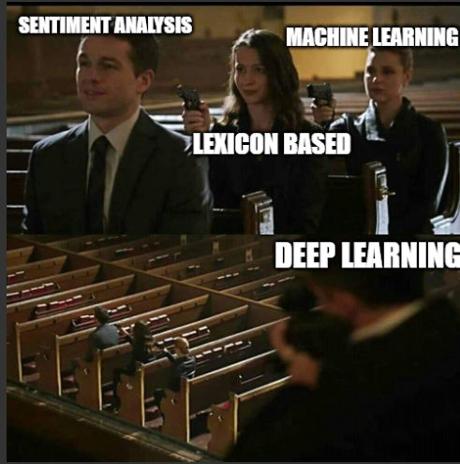
Lexicon and Machine Learning

Slide 9

Lexicon and Machine Learning
Lexicon Based
Do not require training on labeled data.
Rely on predefined sentiment lexicons where each word is associated with a sentiment score.
Sentiment of a sentence or document is calculated based on the aggregate scores of the words it contains.
Simple, interpretable, and useful for domains where labeled data is scarce.
VADER =>
$$Compound Score= \frac{\sum_{i}{s_{i}}}{\sqrt{\sum_{i}{s_{i}^{2}+ α}}}$$

Slide 10
Lexicon and Machine Learning
Machine learning Based
Require labeled data for training models to learn sentiment patterns.
Convert text into numerical features using techniques like CountVectorizer or TF-IDF.
Learn patterns and decision boundaries using algorithms like:
Naive Bayes
Logistic Regression
Support Vector Machines (SVM)
Decision Tree / Random Forest
Can generalize better than lexicon methods on large, diverse datasets.
More flexible and customizable, but may require more computational resources.

Slide 11
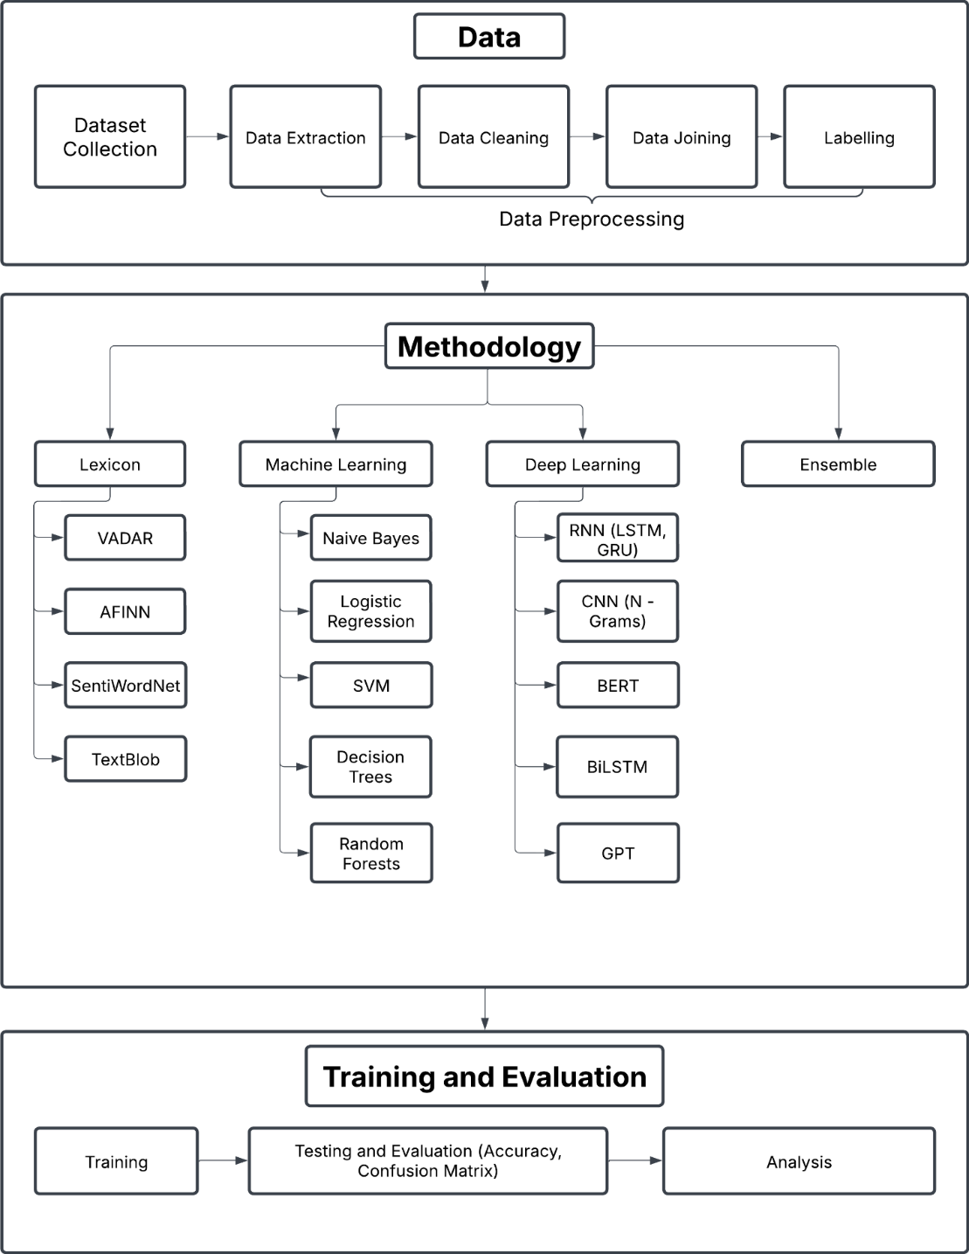
Workflow

Slide 12
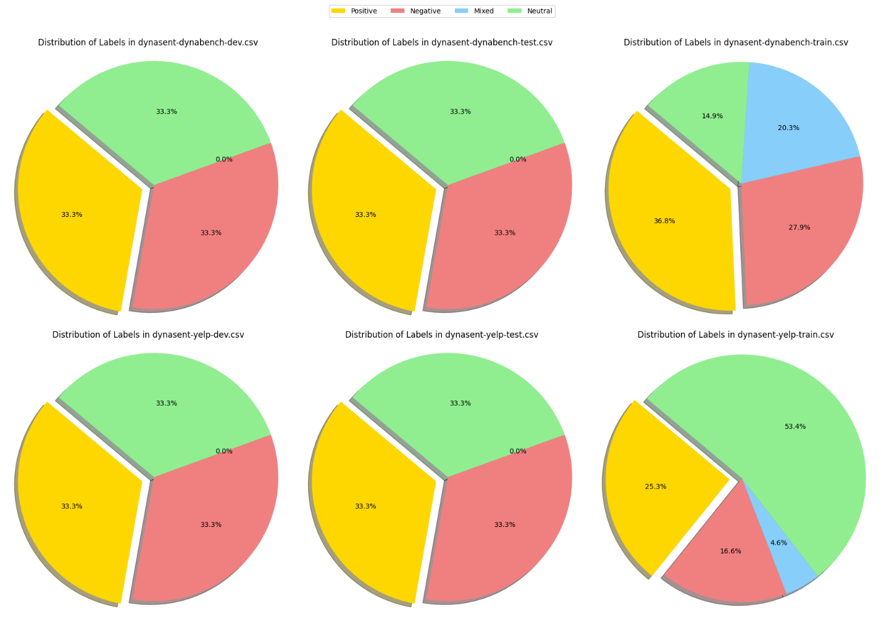
Data

Slide 13
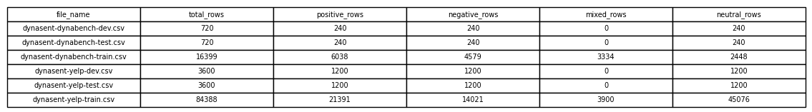
Data
File_name | Total_rows | Positive | Negative | Neutral
Yelp_train | 42063 | 14021 | 14021 | 14021
Yelp_test | 3600 | 1200 | 1200 | 1200
Yelp_val | 3600 | 1200 | 1200 | 1200
dynabench_train | 7344 | 2448 | 2448 | 2448
dynabench_test | 720 | 240 | 240 | 240
dynabench_val | 720 | 240 | 240 | 240
combined_train | 49407 | 16469 | 16469 | 16469
combined_test | 1440 | 480 | 480 | 480
combined_val | 1440 | 480 | 480 | 480

Slide 14
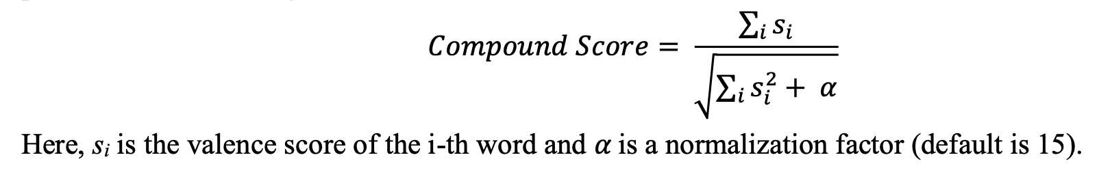
Experiments
Exp 1: Using VADER
The first experiment employed the VADER (Valence Aware Dictionary and sEntiment Reasoner), which
is a lexicon and rule-based sentiment analysis tool, particularly optimized for microtext like tweets. Each
word in the VADER lexicon is assigned a valence score between -4 (most negative) and +4 (most
positive).

Slide 15
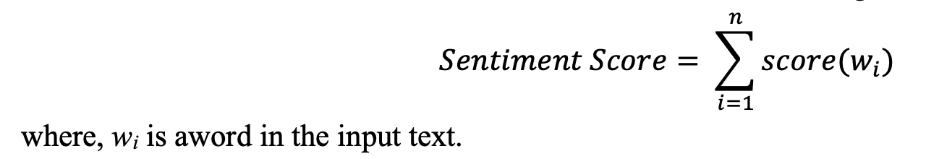
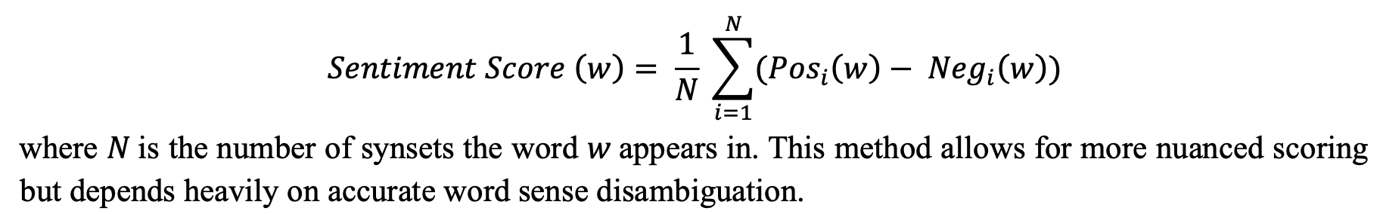
Experiments
Exp 2: Using AFINN
The second experiment used the AFINN lexicon, which assigns integer scores to words ranging from -5
to +5. The overall sentiment of a sentence is computed as the sum of the scores of all matching words in
the text.
Exp 3: Using SentiWordNet
The third experiment utilized SentiWordNet, an extension of WordNet in which each synset (group of
synonyms) is assigned three sentiment scores: positivity, negativity, and objectivity.

Slide 16
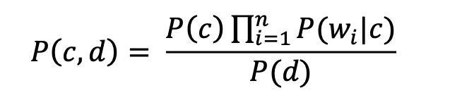
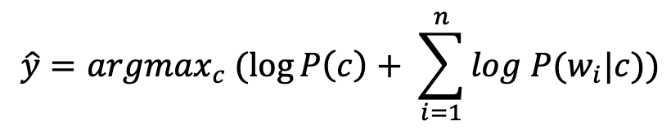
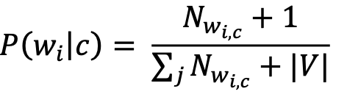
Experiments
Exp 4: Using TextBlob
The fourth experiment applied TextBlob, a lexicon-based model that combines rule-based parsing and a
sentiment lexicon derived from Pattern and NLTK. It outputs two values: polarity (ranging from -1 to
+1) and subjectivity (ranging from 0 to 1). It's a machine learning based approach.
Exp 5: Naïve Bayes from Scratch
In this implementation, we manually computed the class priors, word likelihoods, and prediction probabilities. This approach provided a deep understanding of how the model works internally, including the impact of rare words and class imbalance.

Slide 17
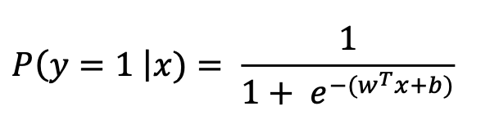
Experiments
Exp 6: Multinomial Naive Bayes with CountVectorizer
In this experiment, we implemented the Multinomial Naive Bayes classifier using CountVectorizer as the feature extractor. CountVectorizer tokenizes the text and creates a feature vector representing the frequency of each word in the document, without accounting for global document frequency.
Exp 7: Logistic Regression with Frequency-Based Features
The seventh experiment involved a Logistic Regression classifier using frequency-based feature extraction. Each word’s frequency in a document was used as the feature.

Slide 18
Experiments
Exp 8: Logistic Regression with CountVectorizer Features
The eighth experiment used Logistic Regression with CountVectorizer as the feature extraction Technique. CountVectorizer was simpler but often effective for short texts.
Exp 9: Logistic Regression with TF-IDF Features
The ninth experiment used TF-IDF (Term Frequency-Inverse Document Frequency) features in Logistic Regression. TF-IDF balances the term frequency of a word in a document with its rarity across the corpus, thereby reducing the impact of commonly occurring words like "the" and "is".
Exp 10: Random Forest Classifier with TF-IDF Features
The tenth experiment implemented a Random Forest classifier with TF-IDF features. Random Forests are ensemble methods that aggregate the predictions of multiple Decision Trees trained on bootstrapped subsets of the data, with random subsets of features considered at each split. This reduces variance and improves robustness. The final class prediction is made by majority voting across the individual trees.

Slide 19

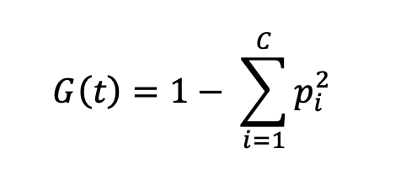
Experiments
Exp 11: Support Vector Machine (SVM) with TF-IDF Features
In the eleventh experiment, we implemented a Support Vector Machine (SVM) classifier using TF-IDF
between the classes. The decision function is defined as:
Exp 12: Decision Tree Classifier with TF-IDF Features
Finally, The twelfth experiment utilized a Decision Tree Classifier, again with TF-IDF features. Decision Trees recursively split the dataset based on the feature that provides the highest information gain or minimizes Gini impurity. The Gini impurity at a node is defined as:

Slide 20
Results
Test Accuracy (%)
Exp No. | Experiment Name | Yelp Dataset | Dynabench Dataset | Combined Dataset
1 | Using VADER | 53 | 57 | 53
2 | Using AFINN | 52 | 57 | 53
3 | Using SentiWordNet | 43 | 44 | 43
4 | Using TextBlob | 50 | 54 | 51
5 | Naive Bayes from Scratch | 64 | 52 | 57
6 | Multinomial Naive Bayes | 65 | 53 | 57
7 | Logistic Regression 1 | 54 | 49 | 45
8 | Logistic Regression 2 | 60 | 50 | 56
9 | Logistic Regression 3 | 62 | 51 | 57
10 | Random Forest | 62 | 54 | 59
11 | SVM | 66 | 53 | 61
12 | Decision Tree | 55 | 49 | 52

Slide 21
Results

Slide 22
Conclusion and Future Directions
Among the machine learning models, Logistic Regression and SVM with TF-IDF feature extraction showed better performance in sentiment classification.
Lexicon-based methods provided quick and interpretable results but lacked contextual understanding.
Traditional machine learning models performed well with proper preprocessing and feature engineering.
Explore deep learning approaches such as CNN, RNN, LSTM, and transformer-based models like BERT. These models can better capture semantic context, word dependencies, and long-range relationships in text. Fine-tuning pretrained models like BERT on domain-specific data may further improve accuracy.

Slide 23
References
[1] C. Hutto and E. Gilbert, "VADER: A parsimonious rule-based model for sentiment analysis of social media text," Proc. Int. AAAI Conf. Web Soc. Media, vol. 8, no. 1, 2014.
[2] B. Liu, "Sentiment analysis," UIC, [Online]. Available: https://www.cs.uic.edu/~liub/FBS/sentiment-analysis.html. [Accessed: Feb. 6, 2025].
[3] B. Pang, L. Lee, and S. Vaithyanathan, "Thumbs up? Sentiment classification using machine learning techniques," arXiv preprint cs/0205070, 2002.
[4] T. Joachims, "Text categorization with support vector machines: Learning with many relevant features," in Proc. Eur. Conf. Mach. Learn., Berlin, Heidelberg: Springer, 1998, pp. 137–142.
[5] J. P. Vink and G. de Haan, "Comparison of machine learning techniques for target detection," Artif. Intell. Rev., vol. 43, pp. 125–139, 2015.
[6] T. Mikolov et al., "Distributed representations of words and phrases and their compositionality," in Adv. Neural Inf. Process. Syst., vol. 26, 2013.
[7] P. Liu, X. Qiu, and X. Huang, "Recurrent neural network for text classification with multi-task learning," arXiv preprint arXiv:1605.05101, 2016.
[8] A. Rakhlin, "Convolutional neural networks for sentence classification," GitHub, vol. 6, p. 25, 2016.
[9] J. Devlin, M.-W. Chang, K. Lee, and K. Toutanova, "BERT: Pre-training of deep bidirectional transformers for language understanding," in Proc. NAACL-HLT, vol. 1, no. 2, 2019, pp. 4171–4186.
[10] T. Brown et al., "Language models are few-shot learners," in Adv. Neural Inf. Process. Syst., vol. 33, 2020, pp. 1877–1901.
[11] C.-L. Chou, C.-H. Chang, and S.-Y. Wu, "Semi-supervised sequence labeling for named entity extraction based on tri-training: case study on Chinese person name extraction," in Proc. Third Workshop Semantic Web Inf. Extraction, 2014.

Slide 24
Q / A

