Slide 1
Getting to GRIPs with pleiotropy in MR
FD, Jack Bowden et al

Slide 2
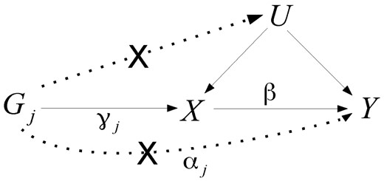
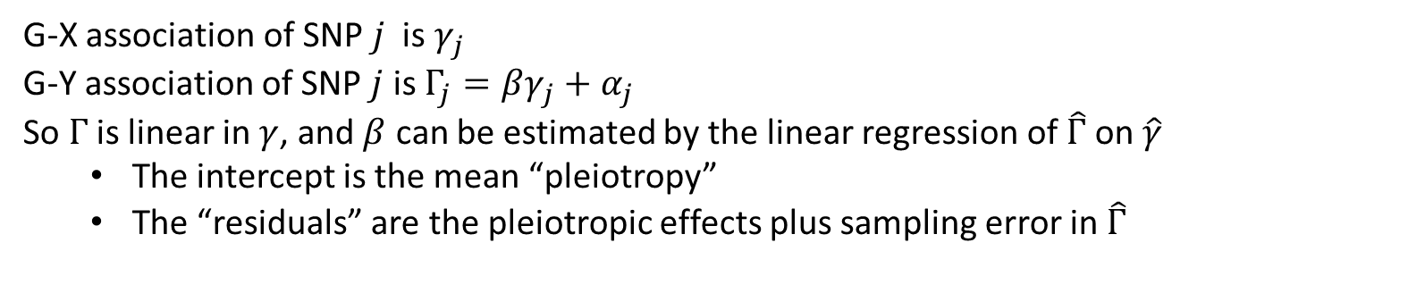
Pleiotropy model
G-X association of SNP $j$ is $γ_{j}$
G-Y association of SNP $j$ is $Γ_{j}=βγ_{j}+α_{j}$
So $Γ$ is linear in $γ$, and $β$ can be estimated by the linear regression of $\hat{Γ}$ on $\hat{γ}$
The intercept is the mean “pleiotropy”
The “residuals” are the pleiotropic effects plus sampling error in $\hat{Γ}$

Slide 3
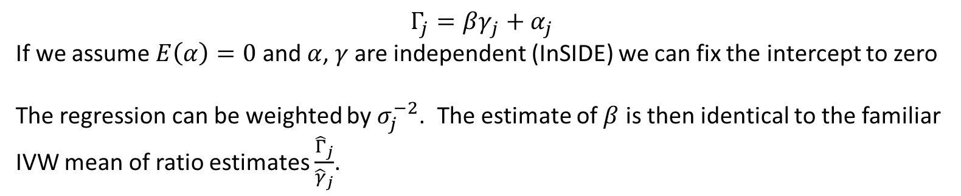
IVW
$$Γ_{j}=βγ_{j}+α_{j}$$
If we assume $E\left(α\right)=0$ and $α$, $γ$ are independent (InSIDE) we can fix the intercept to zero
The regression can be weighted by $σ_{j}^{−2}$. The estimate of $β$ is then identical to the familiar IVW mean of ratio estimates $\frac{{\hat{Γ}}_{j}}{{\hat{γ}}_{j}}$.

Slide 4
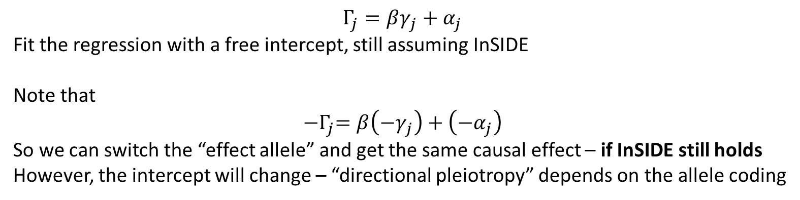
MR-Egger
$$Γ_{j}=βγ_{j}+α_{j}$$
Fit the regression with a free intercept, still assuming InSIDE
Note that
$${−Γ}_{j}=β\left({−γ}_{j}\right)+\left(−α_{j}\right)$$
So we can switch the “effect allele” and get the same causal effect – if InSIDE still holds
However, the intercept will change – “directional pleiotropy” depends on the allele coding

Slide 5
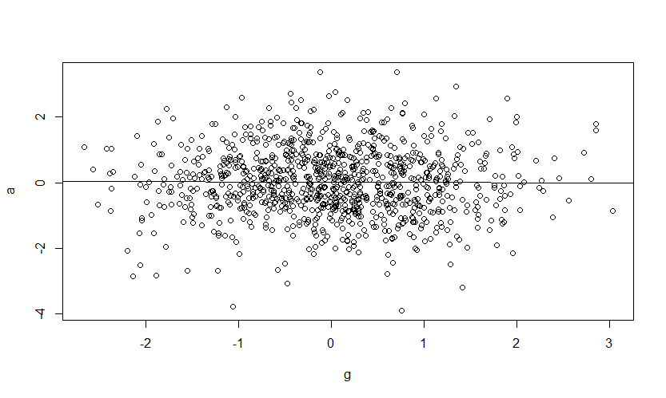
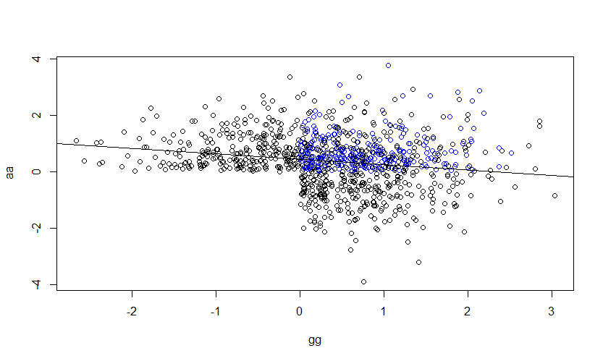
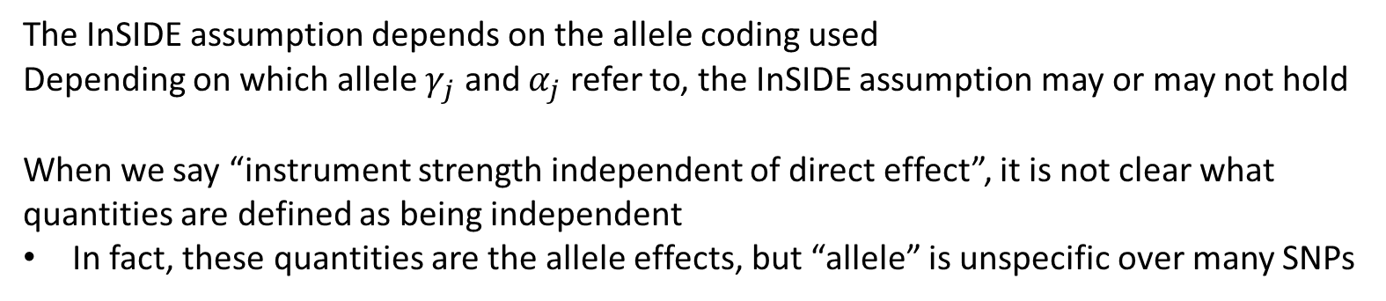
Allele coding
The InSIDE assumption depends on the allele coding used
Depending on which allele $γ_{j}$ and $α_{j}$ refer to, the InSIDE assumption may or may not hold
When we say “instrument strength independent of direct effect”, it is not clear what quantities are defined as being independent
In fact, these quantities are the allele effects, but “allele” is unspecific over many SNPs

Slide 6
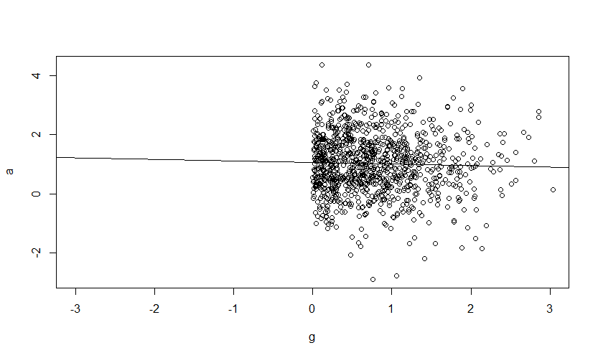
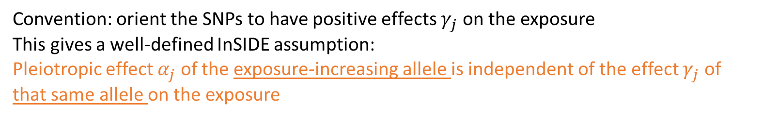
All-positive coding
Convention: orient the SNPs to have positive effects $γ_{j}$ on the exposure
This gives a well-defined InSIDE assumption:
Pleiotropic effect $α_{j}$ of the exposure-increasing allele is independent of the effect $γ_{j}$ of that same allele on the exposure

Slide 7
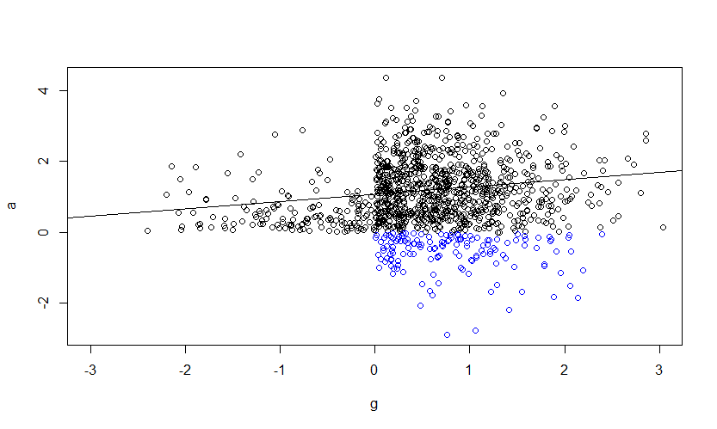



Problem
The all-positive InSIDE assumption is not symmetric
It may not hold if we reverse the roles of $γ_{j}$ and $α_{j}$
All-positive $γ$
All-positive $α$
Negative $α$’s get recoded
Why should the effects on X have a different logical status to those on Y?
The biological effects should be agnostic to the analyses we perform

Slide 8
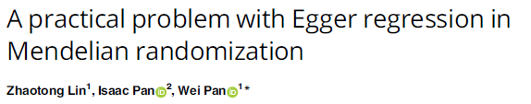
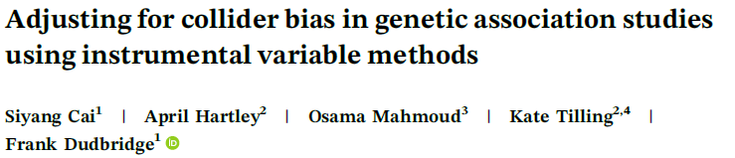
Also
We might have “directional pleiotropy” under all-positive coding, but “balanced pleiotropy” under another coding
IVW might be actually OK, despite MR-Egger suggesting otherwise
“Directional” and “balanced” pleiotropy are meaningless as biological constructs
Yet, any attempt to justify the InSIDE assumption must appeal to biology

Slide 9

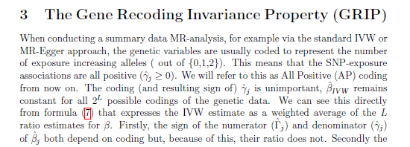
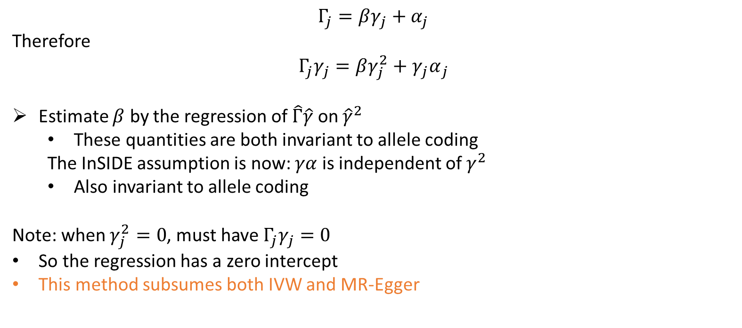
Proposal
$$Γ_{j}=βγ_{j}+α_{j}$$
Therefore
$$Γ_{j}γ_{j}=βγ_{j}^{2}+{γ_{j}α}_{j}$$
Estimate $β$ by the regression of $\hat{Γ}\hat{γ}$ on ${\hat{γ}}^{2}$
These quantities are both invariant to allele coding
The InSIDE assumption is now: $γα$ is independent of $γ^{2}$
Also invariant to allele coding
Note: when $γ_{j}^{2}=0$, must have $Γ_{j}γ_{j}=0$
So the regression has a zero intercept
This method subsumes both IVW and MR-Egger

Slide 10
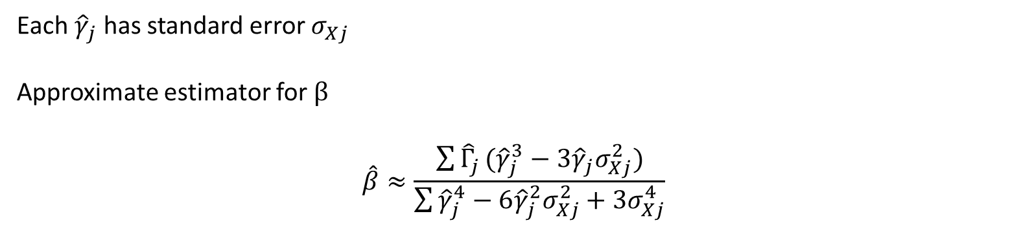
Weak instruments
Each ${\hat{γ}}_{j}$ has standard error $σ_{Xj}$
Approximate estimator for $β$
$$\hat{β}≈\frac{\sum{{\hat{Γ}}_{j}}({\hat{γ}}_{j}^{3}−3{\hat{γ}}_{j}σ_{Xj}^{2})}{\sum{{\hat{γ}}_{j}^{4}−6{\hat{γ}}_{j}^{2}σ_{Xj}^{2}+3σ_{Xj}^{4}}}$$

Slide 11
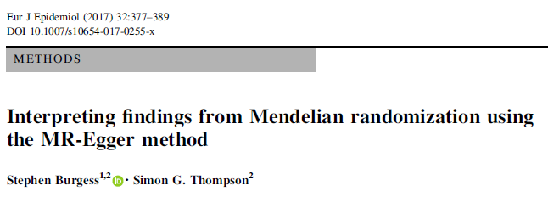
MR of urate on CHD
IVW | 1.11 (1.03, 1.20)
MR-Egger all-positive | 1.00 (0.90, 1.10)
Weighted median | 1.05 (0.99, 1.11)
MR-GRIP | 1.04 (0.88, 1.22)

Slide 12

MR of metformin on aneurysm risk
method | or | or_lci95 | or_uci95 | pval | se
MR Egger | 0.80 | 0.34 | 1.92 | 0.627 | 0.444
Weighted median | 0.47 | 0.31 | 0.73 | 0.001 | 0.217
Inverse variance weighted | 0.57 | 0.38 | 0.88 | 0.010 | 0.216
Simple mode | 0.50 | 0.21 | 1.23 | 0.141 | 0.454
Weighted mode | 0.46 | 0.30 | 0.71 | 0.001 | 0.224
MR GRIP | 0.68 | 0.35 | 1.35 | 0.276 | 0.348
Dr Katie Saxby

Slide 13
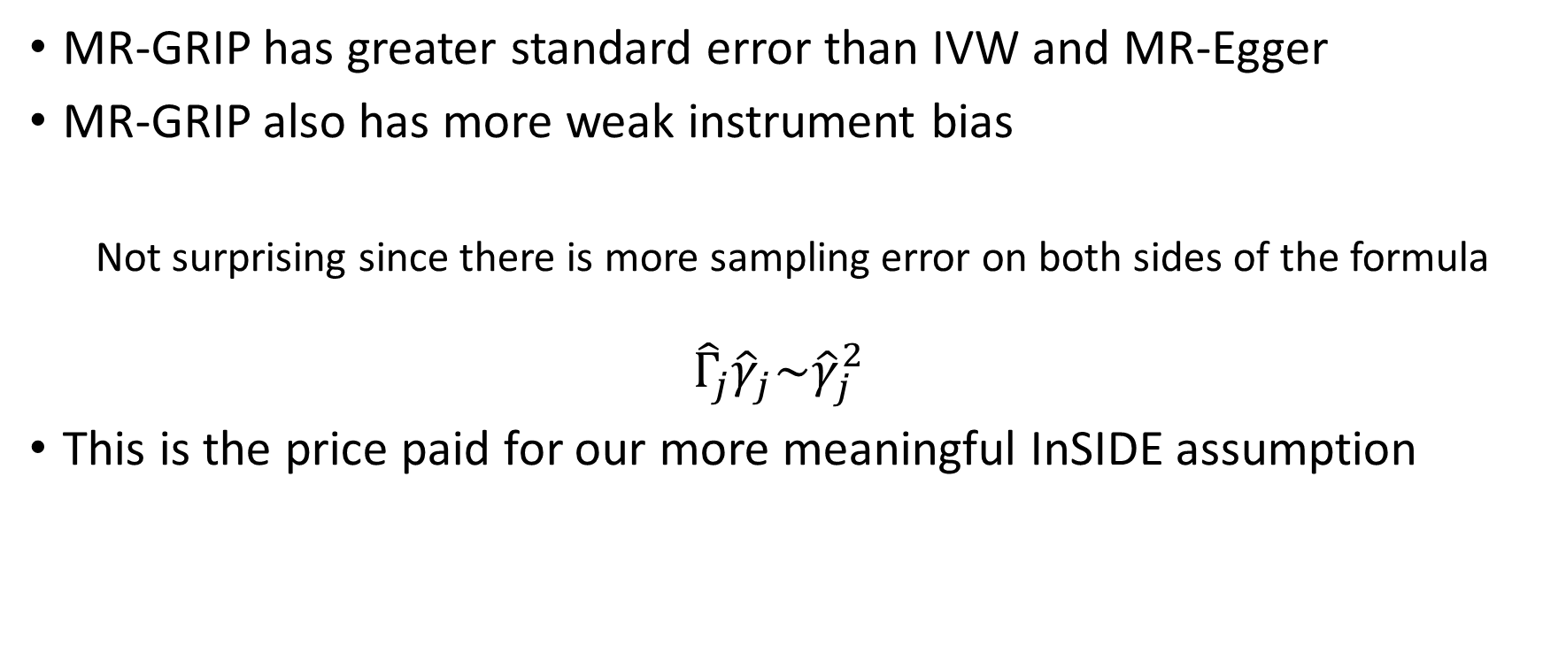
Simulations
MR-GRIP has greater standard error than IVW and MR-Egger
MR-GRIP also has more weak instrument bias
Not surprising since there is more sampling error on both sides of the formula
$${\hat{Γ}}_{j}{\hat{γ}}_{j}\sim {\hat{γ}}_{j}^{2}$$
This is the price paid for our more meaningful InSIDE assumption

Slide 14
Extensions
The idea extends easily to
Multivariable MR
Index event bias
One-sample MR

Slide 15
Summary
IVW is still OK assuming all SNPs are valid instruments
To allow for any pleiotropy, with meaningful assumptions, use median, mode and MR-GRIP
Code compatible with TwoSampleMR package

Slide 16
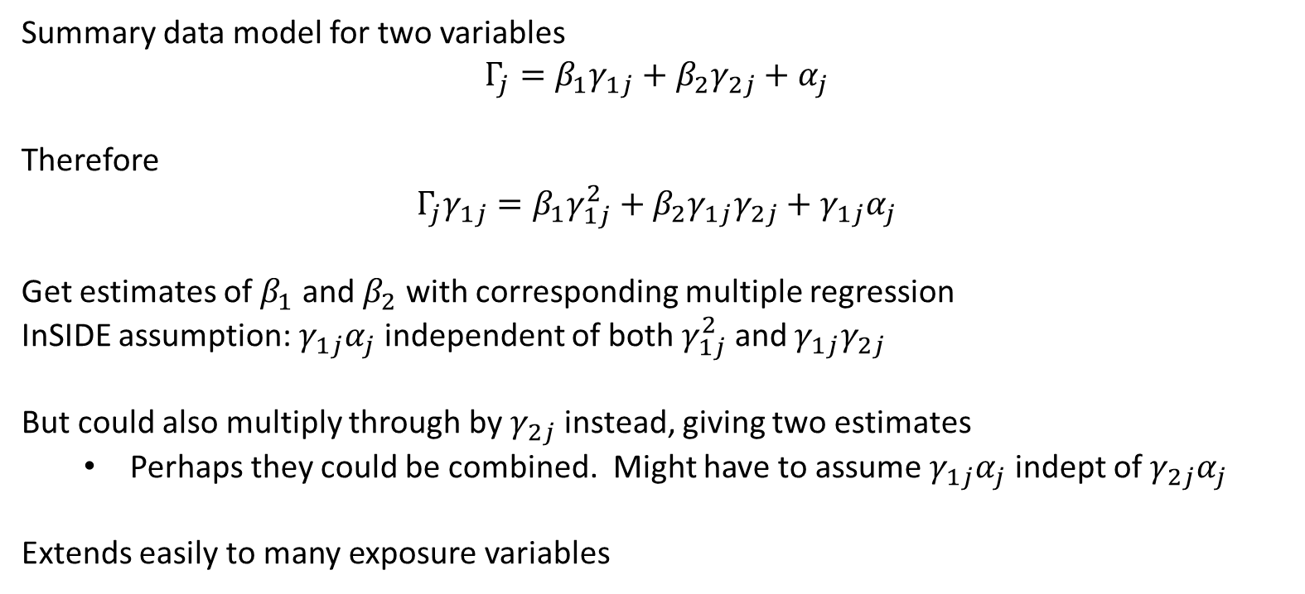
Multivariable MR
Summary data model for two variables
$$Γ_{j}=β_{1}γ_{1j}+β_{2}γ_{2j}+α_{j}$$
Therefore
$$Γ_{j}γ_{1j}=β_{1}γ_{1j}^{2}+β_{2}γ_{1j}γ_{2j}+γ_{1j}α_{j}$$
Get estimates of $β_{1}$ and $β_{2}$ with corresponding multiple regression
InSIDE assumption: $γ_{1j}α_{j}$ independent of both $γ_{1j}^{2}$ and $γ_{1j}γ_{2j}$
But could also multiply through by $γ_{2j}$ instead, giving two estimates
Perhaps they could be combined. Might have to assume $γ_{1j}α_{j}$ indept of $γ_{2j}α_{j}$
Extends easily to many exposure variables

