Slide 1

Getting to GRIPS with MR Egger
Frank Dudbridge, Jack Bowden
Beth Voller, Ruby Woodward, Tim Frayling, Luke Pilling
University of Leicester, University of Exeter

Slide 2
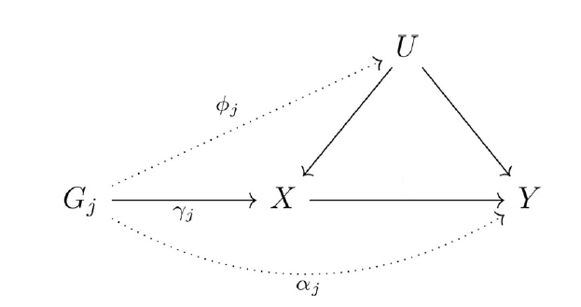
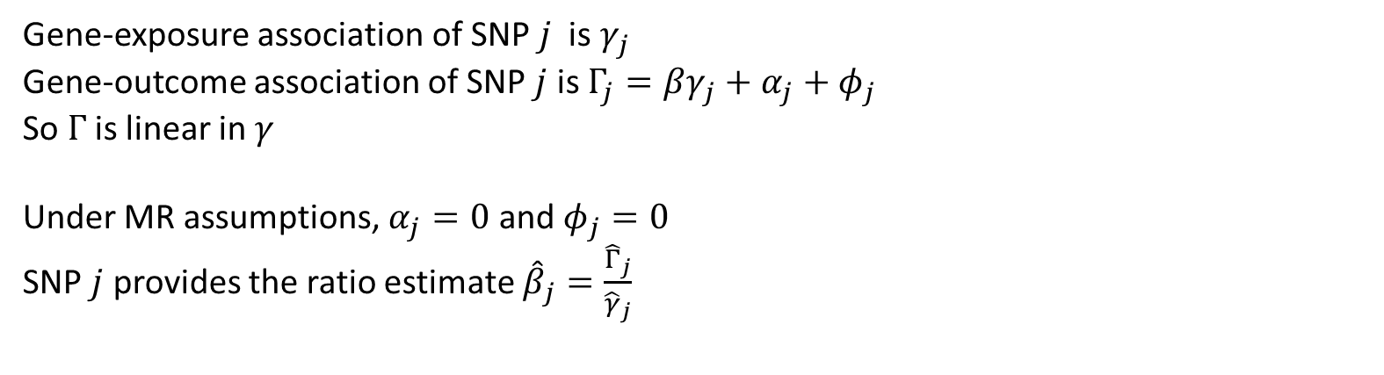

Mendelian randomisation model
$$β$$
Gene-exposure association of SNP $j$ is $γ_{j}$
Gene-outcome association of SNP $j$ is $Γ_{j}=βγ_{j}+α_{j}+φ_{j}$
So $Γ$ is linear in $γ$
Under MR assumptions, $α_{j}=0$ and $φ_{j}=0$
SNP $j$ provides the ratio estimate ${\hat{β}}_{j}=\frac{{\hat{Γ}}_{j}}{{\hat{γ}}_{j}}$

Slide 3
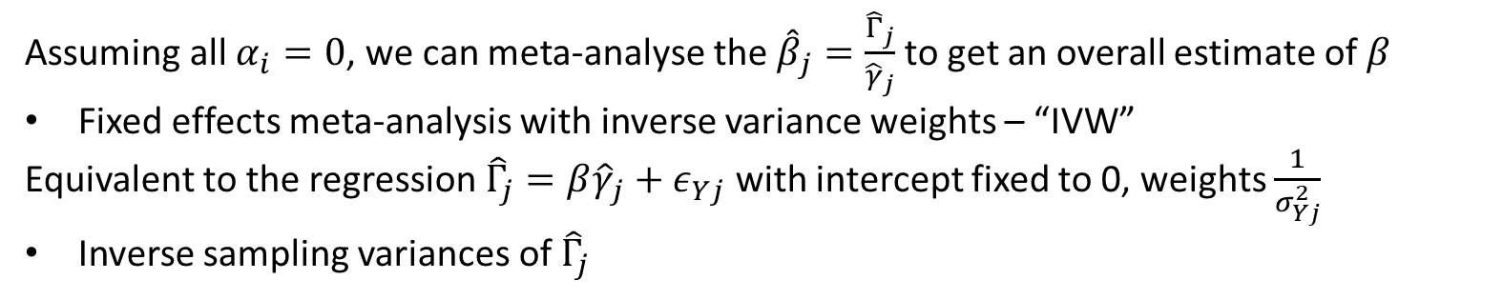
IVW
$$β$$
Assuming all $α_{i}=0$, we can meta-analyse the ${\hat{β}}_{j}=\frac{{\hat{Γ}}_{j}}{{\hat{γ}}_{j}}$ to get an overall estimate of $β$
Fixed effects meta-analysis with inverse variance weights – “IVW”
Equivalent to the regression ${\hat{Γ}}_{j}=β{\hat{γ}}_{j}+ε_{Yj}$ with intercept fixed to 0, weights $\frac{1}{σ_{Yj}^{2}}$
Inverse sampling variances of ${\hat{Γ}}_{j}$

Slide 4
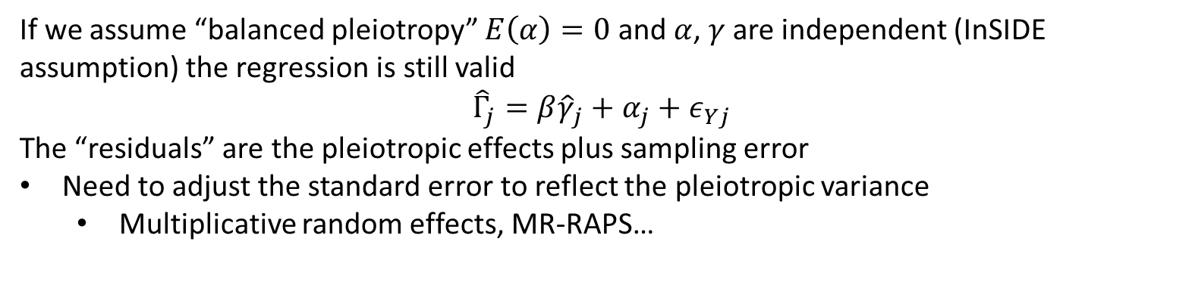
Allowing direct pleiotropy
$$β$$
If we assume “balanced pleiotropy” $E\left(α\right)=0$ and $α$, $γ$ are independent (InSIDE assumption) the regression is still valid
$${\hat{Γ}}_{j}=β{\hat{γ}}_{j}+α_{j}+ε_{Yj}$$
The “residuals” are the pleiotropic effects plus sampling error
Need to adjust the standard error to reflect the pleiotropic variance
Multiplicative random effects, MR-RAPS…

Slide 5
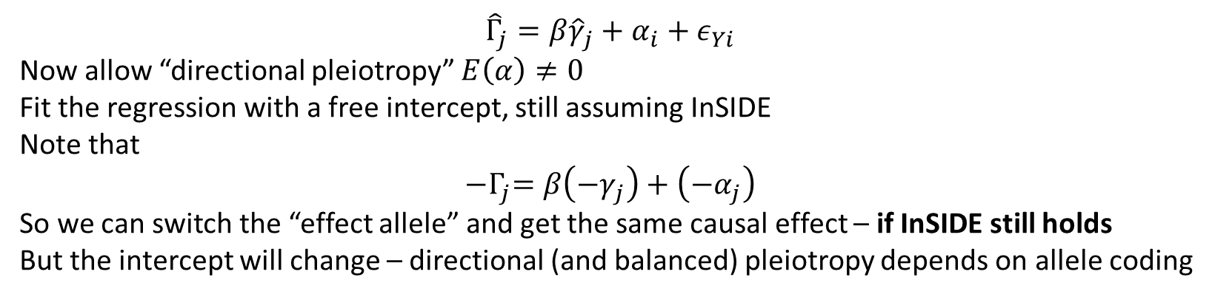
MR-Egger
$$β$$
$${\hat{Γ}}_{j}=β{\hat{γ}}_{j}+α_{i}+ε_{Yi}$$
Now allow “directional pleiotropy” $E\left(α\right)≠0$
Fit the regression with a free intercept, still assuming InSIDE
Note that
$${−Γ}_{j}=β\left({−γ}_{j}\right)+\left(−α_{j}\right)$$
So we can switch the “effect allele” and get the same causal effect – if InSIDE still holds
But the intercept will change – directional (and balanced) pleiotropy depends on allele coding

Slide 6
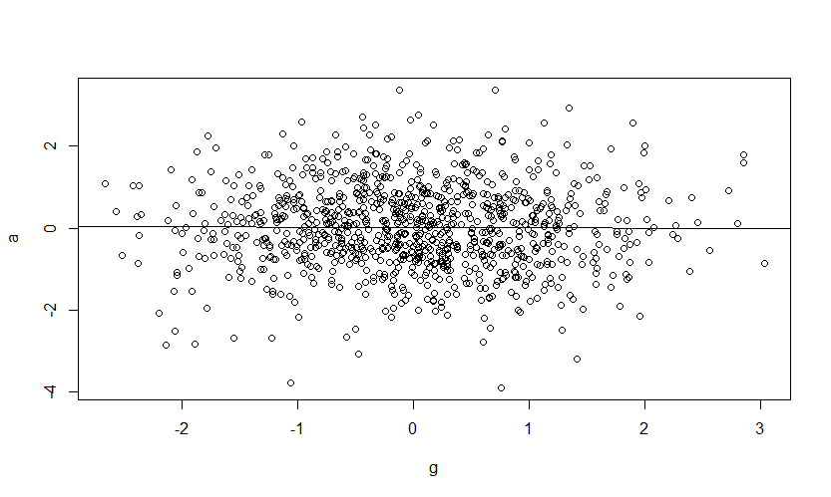
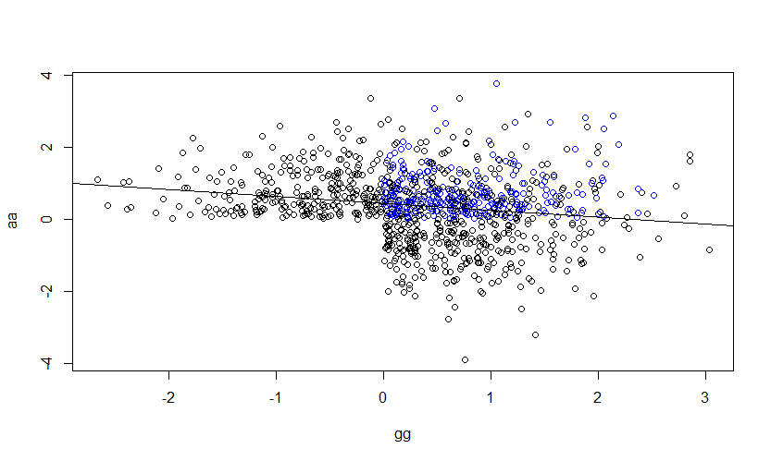
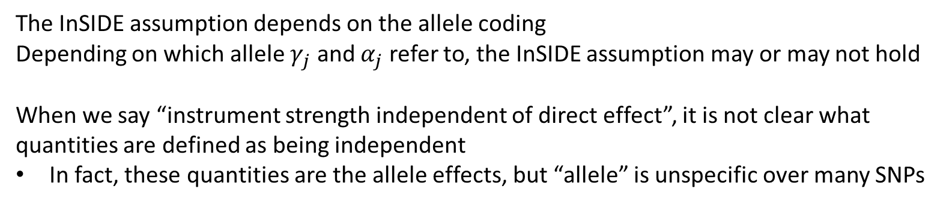
Allele coding
The InSIDE assumption depends on the allele coding
Depending on which allele $γ_{j}$ and $α_{j}$ refer to, the InSIDE assumption may or may not hold
When we say “instrument strength independent of direct effect”, it is not clear what quantities are defined as being independent
In fact, these quantities are the allele effects, but “allele” is unspecific over many SNPs

Slide 7
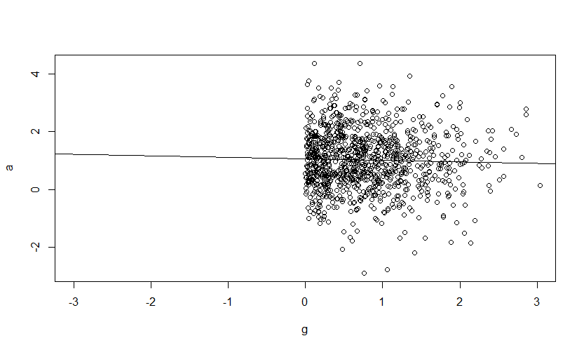
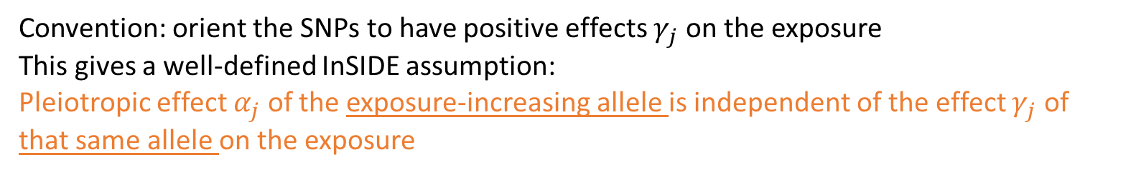
All-positive coding
Convention: orient the SNPs to have positive effects $γ_{j}$ on the exposure
This gives a well-defined InSIDE assumption:
Pleiotropic effect $α_{j}$ of the exposure-increasing allele is independent of the effect $γ_{j}$ of that same allele on the exposure

Slide 8
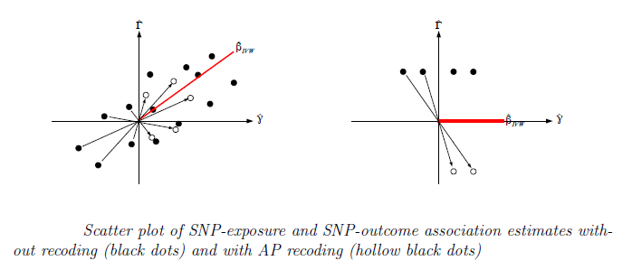
All-positive coding - advantages
Allows an interpretation that all SNPs proxy the same intervention
Similar to using a polygenic score as the instrument
Scatter plot interpretation makes sense

Slide 9
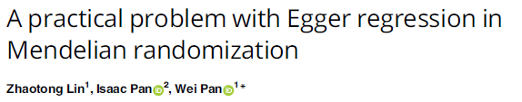
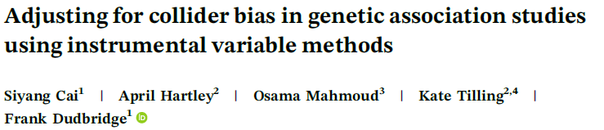
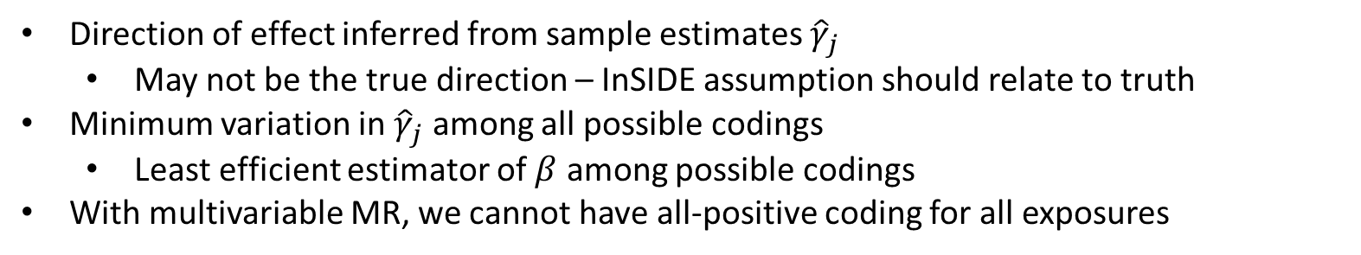
All-positive coding - disadvantages
Direction of effect inferred from sample estimates ${\hat{γ}}_{j}$
May not be the true direction – InSIDE assumption should relate to truth
Minimum variation in ${\hat{γ}}_{j}$ among all possible codings
Least efficient estimator of $β$ among possible codings
With multivariable MR, we cannot have all-positive coding for all exposures

Slide 10
Interpreting the intercept
What if we fit the MR-Egger regression and get a non-zero intercept?
The InSIDE assumption is valid under all-positive coding
There is directional pleiotropy and IVW is invalid.
The InSIDE assumption is invalid under all-positive coding
There may be balanced pleiotropy under a different coding and IVW may be valid.
MR-Egger cannot invalidate IVW, because it has different assumptions

Slide 11
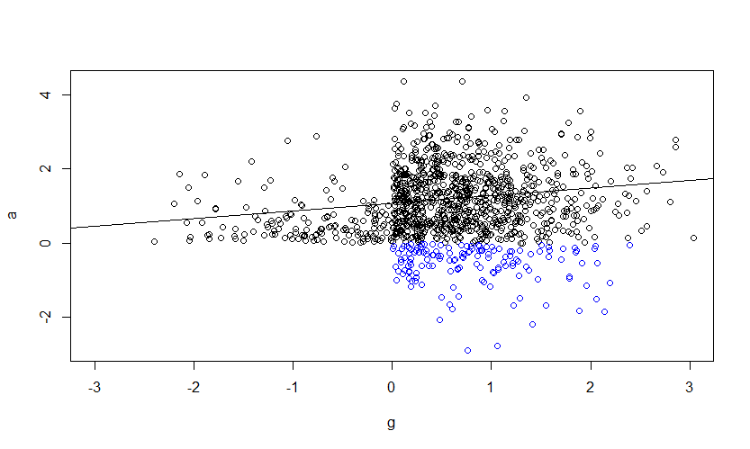





A philosophical flaw
The all-positive InSIDE assumption is not symmetric
It may not hold if we reverse the roles of $γ_{j}$ and $α_{j}$
All-positive $γ$
All-positive $α$
X
Negative $α$’s are recoded
$$γ$$
G
U
Why should the effects on X have a different logical status to those on Y?
Nature should be agnostic to the analyses we perform
$$α$$
Y

Slide 12
Claim
The InSIDE assumption under all-positive coding is untenable, for statistical and philosophical reasons
We have persisted with it for lack of a viable alternative

Slide 13

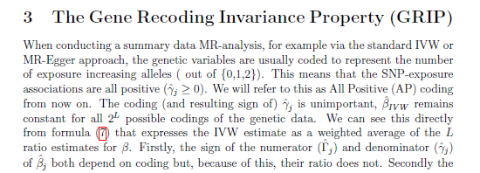
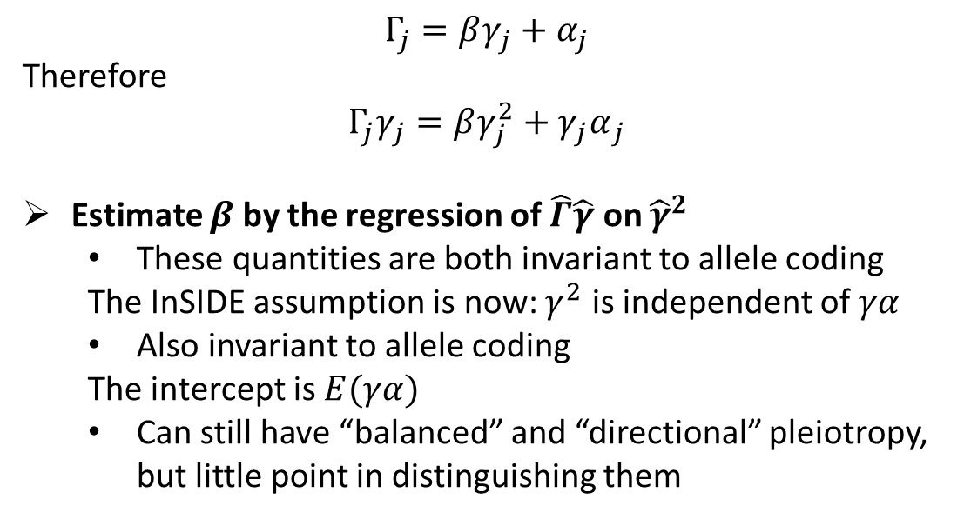

Proposal: MR-GRIP
$$Γ_{j}=βγ_{j}+α_{j}$$
Therefore
$$Γ_{j}γ_{j}=βγ_{j}^{2}+{γ_{j}α}_{j}$$
Estimate $β$ by the regression of $\hat{Γ}\hat{γ}$ on ${\hat{γ}}^{2}$
These quantities are both invariant to allele coding
The InSIDE assumption is now: $γ^{2}$ is independent of $γα$
Also invariant to allele coding
The intercept is $E(γα)$
Can still have “balanced” and “directional” pleiotropy, but little point in distinguishing them
$$β$$

Slide 14
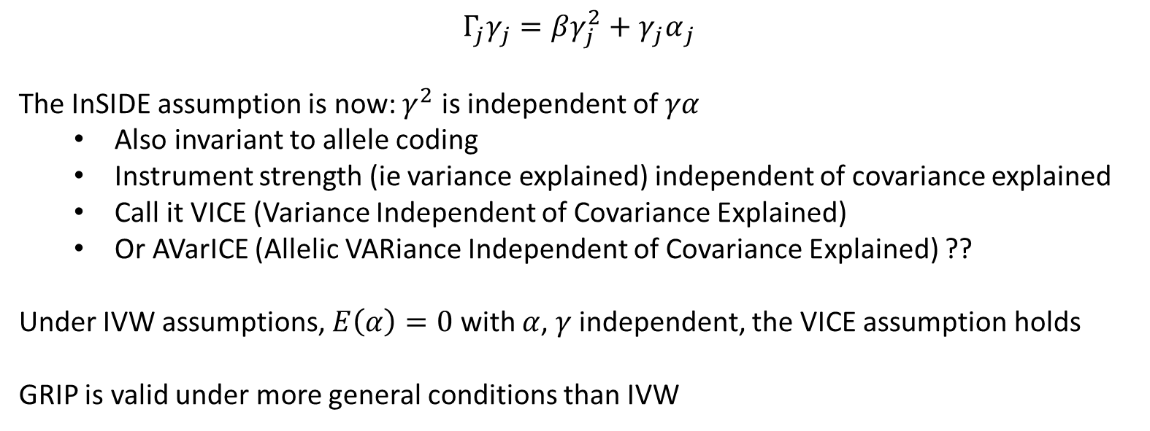

The InSIDE assumption
$$Γ_{j}γ_{j}=βγ_{j}^{2}+{γ_{j}α}_{j}$$
The InSIDE assumption is now: $γ^{2}$ is independent of $γα$
Also invariant to allele coding
Instrument strength (ie variance explained) independent of covariance explained
Call it VICE (Variance Independent of Covariance Explained)
Or AVarICE (Allelic VARiance Independent of Covariance Explained) ??
Under IVW assumptions, $E\left(α\right)=0$ with $α$, $γ$ independent, the VICE assumption holds
GRIP is valid under more general conditions than IVW
$$β$$

Slide 15
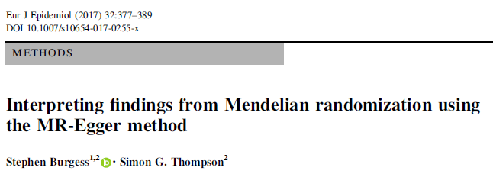
MR of urate on CHD
IVW | 1.11 (1.03, 1.20)
MR-Egger all-positive | 1.00 (0.90, 1.10)
Weighted median | 1.05 (0.99, 1.11)
MR-GRIP | 1.04 (0.96, 1.13)

Slide 16
Simulations
IVW vs MR-Egger vs MR-GRIP
No pleiotropy
All unbiased. Standard error: IVW < MR-GRIP < MR-Egger
Balanced pleiotropy
All unbiased. Standard error: IVW < MR-GRIP < MR-Egger
Directional pleiotropy under all-positive InSIDE
MR-Egger unbiased. Bias: MR-GRIP < IVW
Directional pleiotropy under AVARICE
MR-GRIP unbiased. Bias: MR-Egger < IVW
Correlated pleiotropy (balanced)
Bias: IVW = MR-Egger = MR-GRIP

Slide 17
Extensions
The idea extends easily to
Multivariable MR
Index event bias
One-sample MR

Slide 18
Summary
IVW is OK assuming valid instruments
All-positive coding has statistical and logical limitations
Not aware of any real life examples
MR-GRIP is a more satisfactory model for pleiotropy
Code at DudbridgeLab github
Compatible with TwoSampleMR package

Slide 19
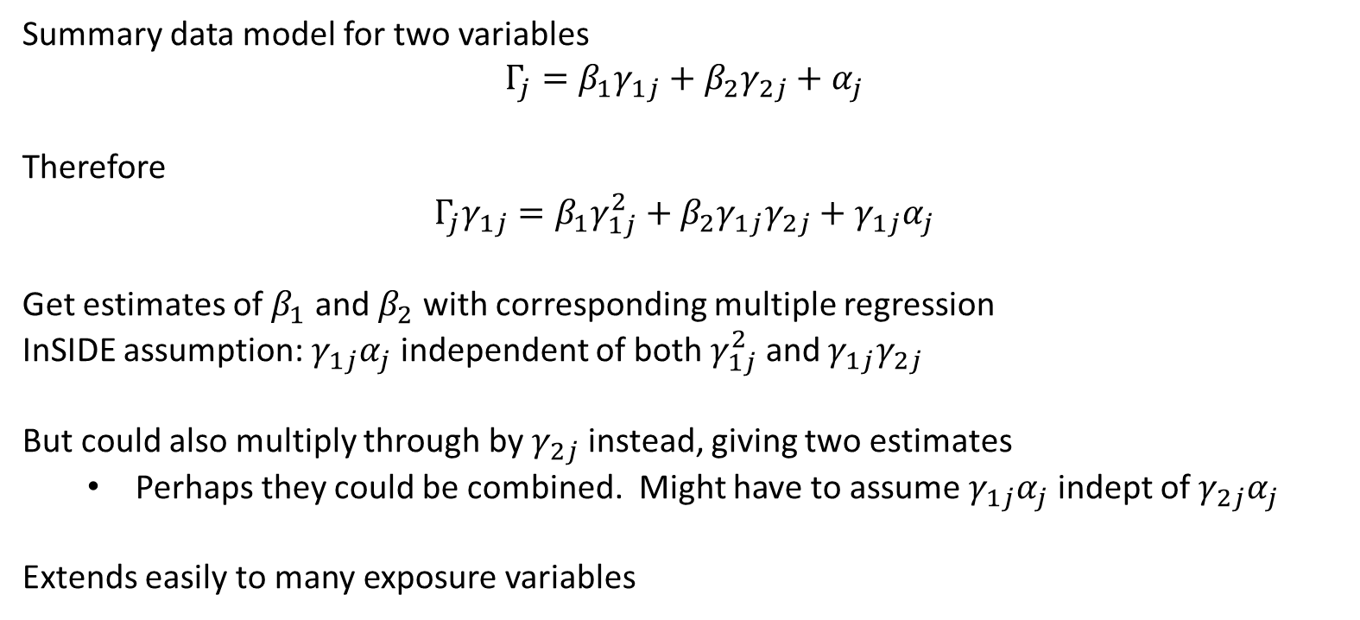
Multivariable MR
Summary data model for two variables
$$Γ_{j}=β_{1}γ_{1j}+β_{2}γ_{2j}+α_{j}$$
Therefore
$$Γ_{j}γ_{1j}=β_{1}γ_{1j}^{2}+β_{2}γ_{1j}γ_{2j}+γ_{1j}α_{j}$$
Get estimates of $β_{1}$ and $β_{2}$ with corresponding multiple regression
InSIDE assumption: $γ_{1j}α_{j}$ independent of both $γ_{1j}^{2}$ and $γ_{1j}γ_{2j}$
But could also multiply through by $γ_{2j}$ instead, giving two estimates
Perhaps they could be combined. Might have to assume $γ_{1j}α_{j}$ indept of $γ_{2j}α_{j}$
Extends easily to many exposure variables

