Slide 1


PRESENTATION ON
Airbnb Pricing Analysis Across
Major Indian Cities
Presented By:
Name : Yaddanapudi V S S Surya Teja
Batch : 456
Branch : DILSUKHNAGAR

Slide 2
About Me
My Name is Yaddanapudi V S S Surya Teja.
I have completed my Bachelor of Technology in Computer Science and Engineering.
LinkedIn : https://www.linkedin.com/in/suryateja-yaddanapudi/
GitHub : https://github.com/DudeAlpha007

Slide 3
Agenda
Introduction
Business Problem
Objectives
The Dataset and Target Variable
Summary of Table
Data Preprocessing
Uni, Bi, Multi Variate Analysis
Key Insights
Conclusions
Recommendations
Challenges

Slide 4
Introduction
• Airbnb is a global online marketplace that connects property owners with travelers seeking short-term accommodation across cities and countries.
• With the rapid growth of online booking platforms, rental prices vary significantly even within the same city for seemingly similar properties.
• This price variation creates confusion for travelers and makes it difficult to understand what factors truly influence listing prices.
• Data-driven analysis can help uncover hidden patterns behind pricing, availability, and property features.
• This project focuses on analyzing Airbnb listings data across major Indian cities to derive meaningful insights using data analytics techniques.

Slide 5

Business Problem
• Airbnb users face difficulty in identifying value-for-money listings due to large price variations across similar properties.
• Properties with comparable location, capacity, and amenities are often priced very differently without clear justification.
• Travelers struggle to understand which features genuinely influence higher prices and which do not.
• Hosts lack data-backed insights to price their properties competitively in the market.
• The absence of structured pricing insights reduces transparency and limits data-driven decision-making.

Slide 6
Project Objectives
Understand why Airbnb prices vary so much within and across cities
Identify which factors truly influence listing prices
Compare weekend and weekday pricing behavior
Analyze how location, amenities, capacity, and ratings affect price
Find listings that are overpriced or offer better value for money
Help guests like Rahul make smarter booking decisions
Provide insights that can help hosts price their listings more effectively

Slide 7
THE DATASET & TARGET VARIABLE
Dataset collected using web scraping from Airbnb listings
Covers four major Indian metro cities:
Hyderabad, Bangalore, Mumbai, and Delhi
Includes both weekend and weekday booking data
Each row represents a single Airbnb listing for a specific date type
Target variable: Price per Night (₹)
Price is analyzed to understand how different factors influence listing costs
Target Variable Explanation (simple):
Price per Night reflects what a guest actually pays
Used to evaluate value for money and pricing behavior

Slide 8
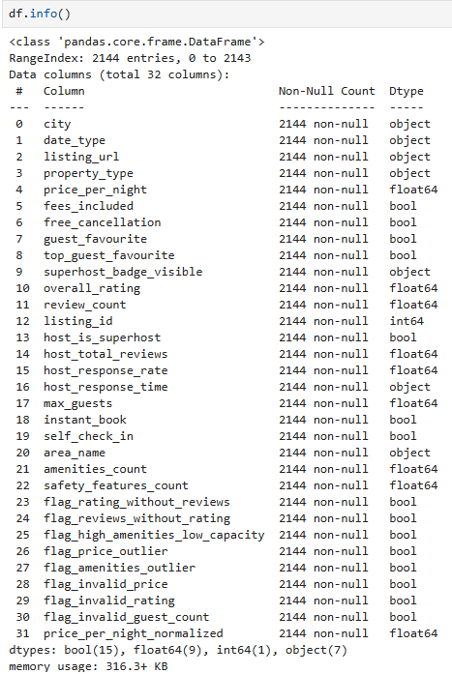
Summary of the table
Final cleaned dataset prepared after preprocessing
Contains listings from four metro cities
Each row represents one listing for a specific date type
Dataset is structured and ready for EDA and hypothesis testing
Key Highlights:
Total listings: ~2,100+
Cities: Hyderabad, Bangalore, Mumbai, Delhi
Target variable: Price per Night
Mix of numeric and categorical features

Slide 9
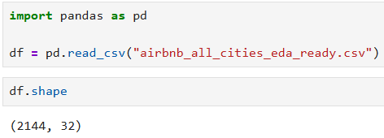
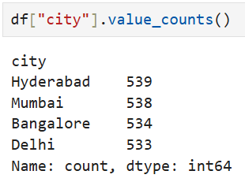
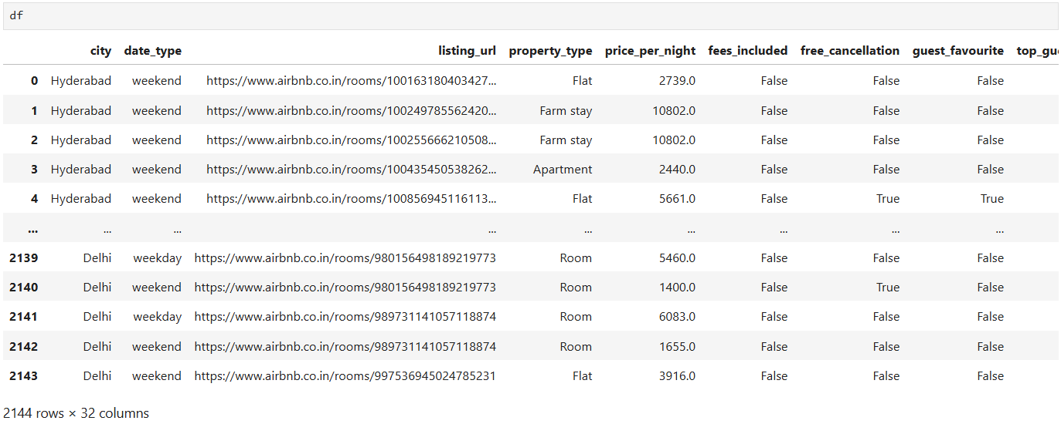

Slide 10
Data Preprocessing
Raw Airbnb data contained missing, inconsistent, and unstructured values
Missing values were handled using logical, context-based rules
Structural missing values (e.g., new listings without reviews) were treated separately from actual nulls
Outliers were intentionally preserved to reflect real luxury and premium listings
Final dataset was cleaned, structured, and made ready for EDA and statistical analysis

Slide 11
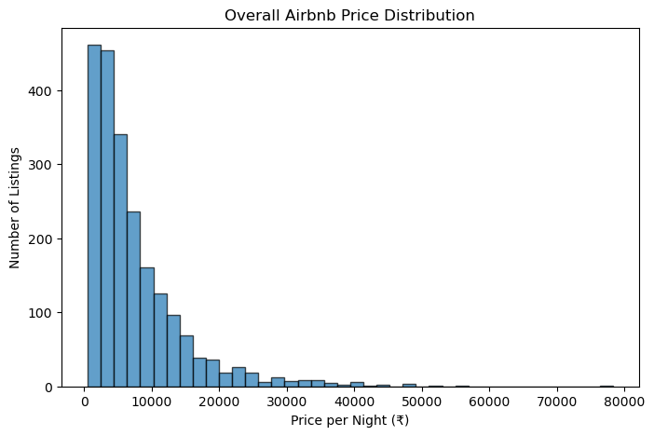
UNIVARIATE ANALYSIS: PRICE DISTRIBUTION
Interpretation
The normalized Airbnb price distribution is strongly right-skewed, with the majority of listings clustered in the low to mid price range and a long tail of high-priced listings.
Most listings fall roughly between ₹1,500–₹4,000 per night, while a small number of premium and luxury listings extend beyond ₹10,000+ per night, creating the long right tail.
This skewness indicates that average (mean) prices are inflated by a small luxury segment, whereas the median price better represents a typical booking experience for most users.

Slide 12
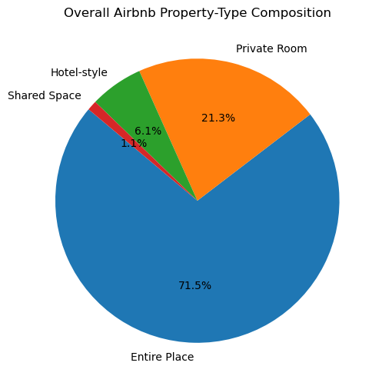
UNIVARIATE ANALYSIS: PRICE DISTRIBUTION
Interpretation:
Entire Place listings dominate the dataset, accounting for ~71.5% of all Airbnb listings.
Private Rooms form the second largest segment at ~21.3%, indicating a significant budget-conscious or solo-traveler market.
Hotel-style listings are limited (~6.1%), showing Airbnb’s positioning as an alternative to traditional hotels.
Shared Spaces are negligible (~1.1%), suggesting low user preference for shared accommodation in metro cities.

Slide 13
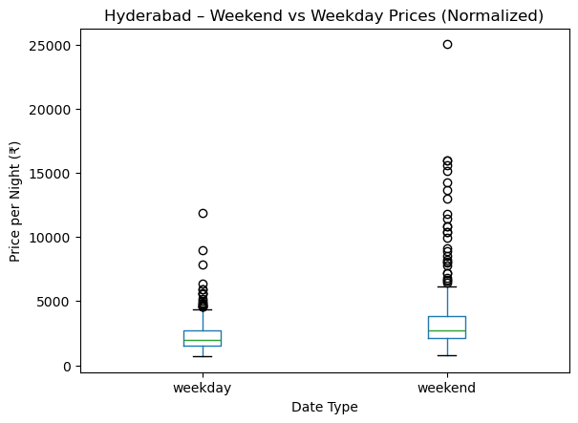
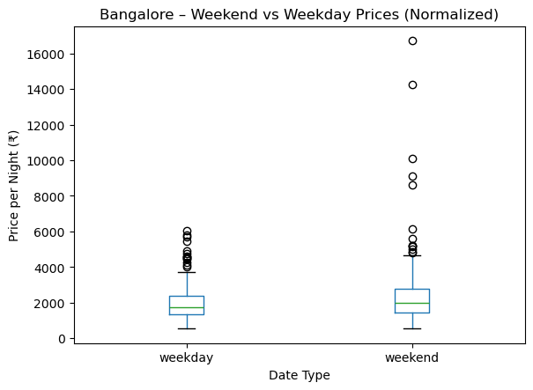
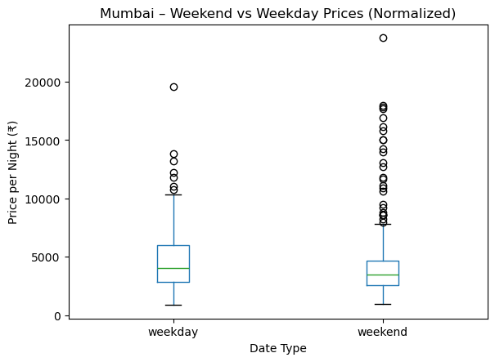
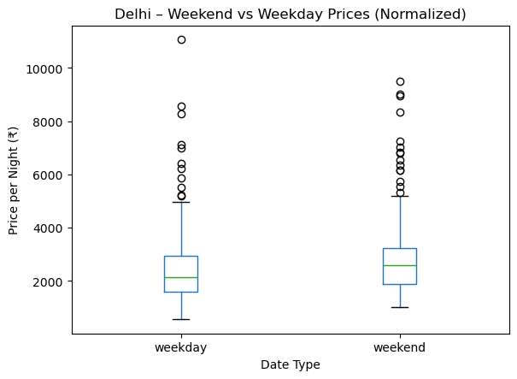
BIVARIATE ANALYSIS
Interpretation (Weekend vs Weekday Pricing by City)
Hyderabad: Weekday prices remain relatively lower, while weekend prices increase sharply, indicating strong leisure-driven demand concentrated on weekends.
Bangalore: Weekday prices are stable and slightly lower, with a moderate weekend uplift, reflecting a balanced mix of business (weekday) and leisure (weekend) stays.
Delhi: Weekday and weekend prices are close, with only a small weekend increase, suggesting consistent demand across the week.
Mumbai: Weekday prices are higher than weekend prices, highlighting strong business-driven weekday demand and comparatively weaker leisure demand on weekends.
Overall Insight:The weekday–weekend price relationship varies by city, driven by local demand structure (business vs leisure) rather than a uniform pricing pattern.

Slide 14
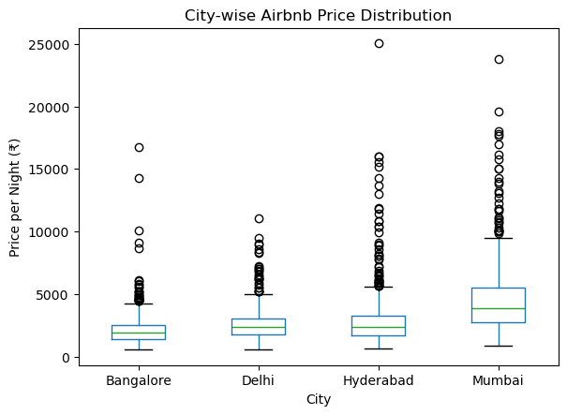
BIVARIATE ANALYSIS
Interpretation:
Bangalore:
Prices are concentrated in the lower range with limited high-end outliers, indicating a largely budget-to-midrange market.
Delhi:
Slightly higher median prices than Bangalore, with moderate upper outliers, suggesting a mixed market with controlled luxury presence.
Hyderabad:
Median prices are comparable to Delhi, but greater price spread and more high-value outliers indicate emerging premium segments.
Mumbai:
Clearly stands out with the highest median prices and extreme outliers, reflecting strong premium positioning and location-driven pricing.
Overall Insight:
Price levels and dispersion increase significantly from Bangalore → Delhi → Hyderabad → Mumbai, highlighting city-specific demand intensity and market maturity.

Slide 15
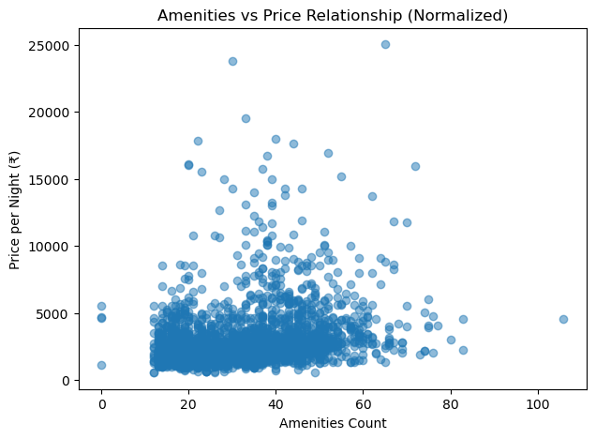
BIVARIATE ANALYSIS
Interpretation:
Positive but weak relationship:
Prices tend to increase as amenities increase, but the trend is not strongly linear.
Diminishing returns effect:
Beyond a moderate amenities count, additional amenities do not proportionally increase price.
High-price listings exist at medium amenities:
Several expensive listings cluster around average amenities levels, showing that amenities alone don’t justify premium pricing.
Other factors dominate pricing:
Location, demand timing, and property type play a larger role than amenities count alone.

Slide 16
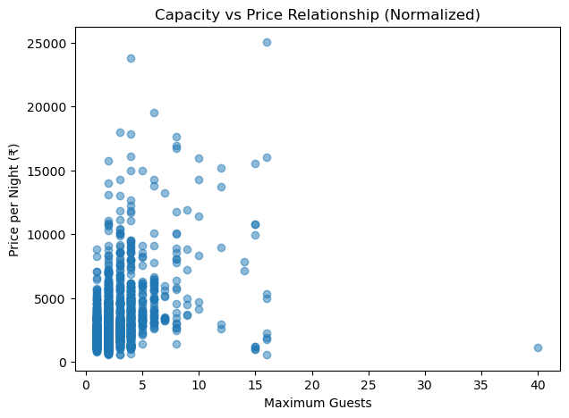
BIVARIATE ANALYSIS
Interpretation:
Moderate positive relationship:
Listings with higher guest capacity generally charge higher prices, but the increase is not proportional.
Strong clustering at low capacity:
Most listings accommodate 1–4 guests, where prices vary widely, indicating other pricing drivers at play.
High-capacity ≠ always expensive:
Several high-capacity listings appear at mid or even low prices, suggesting shared spaces or budget group accommodations.
Capacity is a structural factor, not a premium driver:
Capacity sets a baseline price range, while location, demand, and property type drive the actual premium.

Slide 17
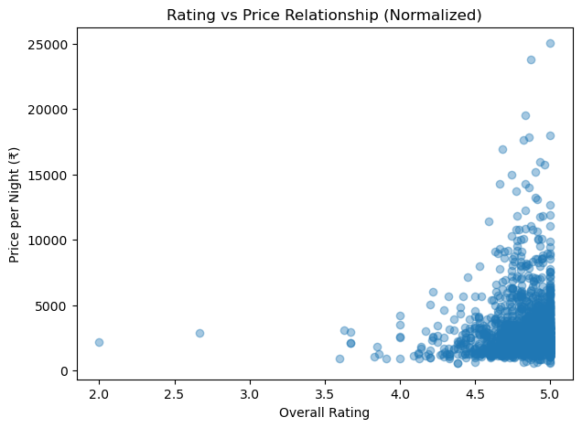
BIVARIATE ANALYSIS
Interpretation:
Weak positive relationship:
Higher-rated listings tend to have slightly higher prices, but the relationship is not strong.
High ratings across all price levels:
Listings rated 4.5–5.0 appear in both budget and premium ranges, showing that good ratings are not exclusive to expensive stays.
Low-rated listings are rare:
Very few listings fall below 4.0, indicating a generally high-quality marketplace or rating inflation.
Ratings act as a trust qualifier, not a price driver:
Ratings help justify prices but do not directly determine premium pricing.

Slide 18
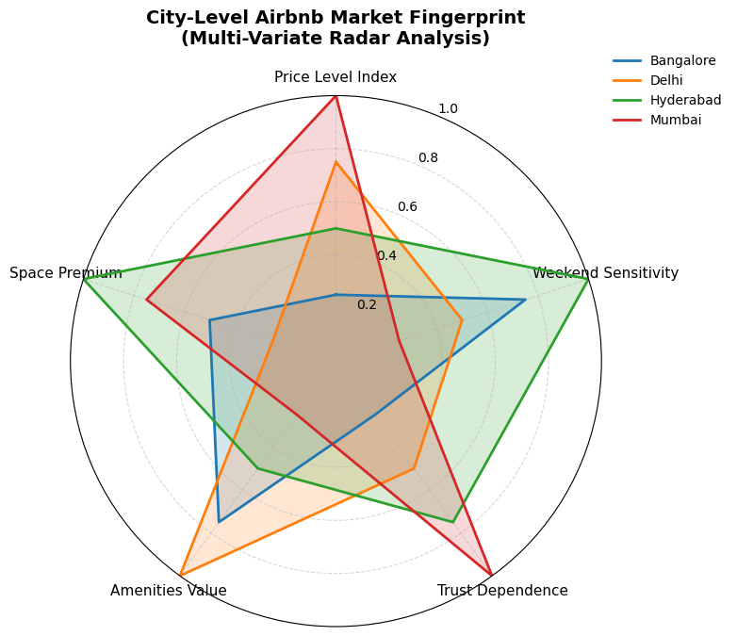
MULTIVARIATE ANALYSIS
Multidimensional Comparison of Pricing Drivers Across Cities
Interpretation:
Mumbai = premium & trust-driven market
Highest Price Level and Trust Dependence, with lower weekend sensitivity, indicating strong weekday business demand and reputation-based pricing.
Hyderabad = leisure-driven & capacity-oriented
Extremely high Weekend Sensitivity and Space Premium, showing demand spikes driven by leisure travel and larger group stays.
Delhi = amenities-led pricing
Strong Amenities Value Index with moderate weekend sensitivity, suggesting guests pay more for features rather than timing alone.
Bangalore = balanced, value-conscious market
Moderate scores across all dimensions, reflecting a stable mix of business and leisure demand without extreme pricing behavior.

Slide 19
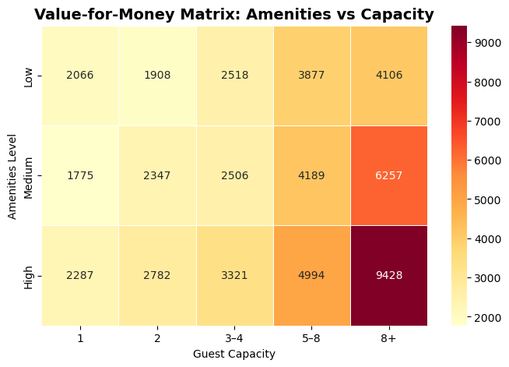
MULTIVARIATE ANALYSIS
Median Price Distribution Across Capacity–Amenity Segments
Interpretation:
Price increases with guest capacity across all amenity levels, confirming capacity as a primary pricing driver.
High-amenity listings show clear price premiums, especially for large groups (8+), indicating bundled experience pricing.
Small-capacity listings (1–2 guests) show limited price differentiation, even with higher amenities, suggesting diminishing returns at low capacity.
Best value-for-money appears in mid-capacity (3–4, 5–8) segments, where price growth is more gradual relative to amenities offered.

Slide 20
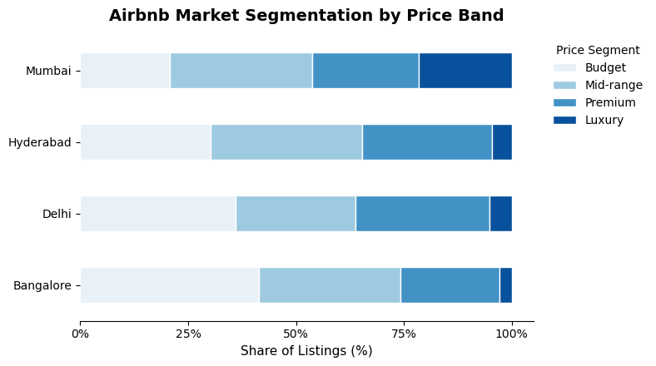
MULTIVARIATE ANALYSIS
Airbnb Market Segmentation Map
Interpretation:
Bangalore and Delhi are dominated by budget and mid-range listings, indicating value-focused and mass-market demand.
Hyderabad shows a strong premium segment, reflecting rising leisure demand and selective upscale positioning.
Mumbai has the highest concentration of premium and luxury listings, confirming its status as a high-cost, demand-driven market.
Luxury listings remain a minority across all cities, but their share is disproportionately higher in Mumbai compared to others.

Slide 21
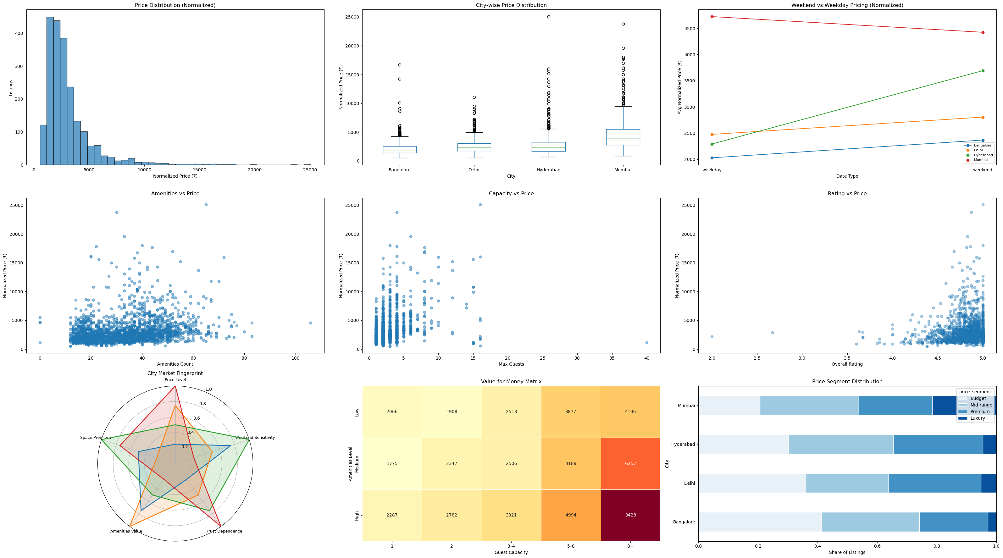

Slide 22
HYPOTHESIS 1: Weekend vs Weekday Price Difference
EDA Observation
Weekend and weekday prices differ even after per-night normalization. Hyderabad shows weekend-driven pricing, while Mumbai shows stronger weekday pricing.
Hypotheses
H₀: Normalized weekend and weekday prices are equal
H₁: Normalized weekend and weekday prices are different
Statistical Test
Independent two-sample t-test
Result & Interpretation
The p-value is well below 0.05, leading to rejection of H₀. Normalized weekend prices are significantly higher than weekday prices, confirming a real weekend pricing effect.
Business Insight
Weekend premiums reflect real leisure demand, enabling hosts to price higher on weekends, especially in leisure-oriented cities.

Slide 23
HYPOTHESIS 2: City vs Price (Location Effect)
EDA Observation
Airbnb prices appear substantially higher in Mumbai compared to other cities.
Hypotheses
H₀: Mean normalized prices are equal across cities
H₁: At least one city has a different mean price
Statistical Test
One-way ANOVA
Result & Interpretation
The p-value is far below 0.05, leading to rejection of H₀. Normalized Airbnb prices differ significantly across cities, indicating strong location-based price variation.
Business Insight
City is a dominant pricing driver independent of stay duration. Airbnb pricing must be evaluated within the same city, as cross-city price comparisons are misleading for both users and hosts.

Slide 24
HYPOTHESIS 3: Amenities vs Price
EDA Observation
Listings with more amenities tend to have higher prices, but the relationship appears weak.
Hypotheses
H₀: Amenities have no impact on price
H₁: Amenities significantly affect price
Statistical Test
Pearson correlation test
Result & Interpretation
The correlation is weakly positive (~0.23) but statistically significant, leading to rejection of H₀. Amenities are associated with higher prices, but they explain only a small portion of price variation.
Business Insight
Amenities add limited pricing power; beyond essentials, they don’t guarantee better value compared to factors like location, capacity, and timing.

Slide 25
HYPOTHESIS 4: Guest Capacity vs Price
EDA Observation
Listings with higher guest capacity are generally priced higher.
Hypotheses
H₀: Guest capacity has no impact on price
H₁: Higher guest capacity increases price
Statistical Test
Pearson correlation test
Result & Interpretation
The p-value is far below 0.05, leading to rejection of H₀. Guest capacity shows a moderate positive relationship with normalized price, stronger than amenities.
Business Insight
Capacity is a strong pricing driver; guests should only pay for extra space when needed, while hosts gain more pricing power from increasing usable capacity than from adding amenities.

Slide 26
HYPOTHESIS 5: Ratings vs Price
EDA Observation
Higher-rated listings are not consistently more expensive.Hypotheses
H₀: Ratings have no impact on price
H₁: Higher ratings increase price
Statistical Test
Pearson correlation test (rated listings only)
Result & Interpretation
The p-value is below 0.05, leading to rejection of H₀. Ratings are statistically associated with price, but the relationship is very weak, indicating minimal practical impact.
Business Insight
Ratings reflect trust, not pricing power; small rating differences don’t justify higher prices or guarantee better value.

Slide 27
KEY BUSINESS INSIGHTS
Airbnb pricing is systematic, not random, driven by location, demand timing, and listing structure, even after normalizing for stay duration.
Location is the strongest driver of Airbnb pricing across all cities.
Weekend pricing effects are city-specific, not universal, reflecting local travel behavior rather than a fixed weekend markup.
Mean prices remain inflated by luxury listings, while median normalized prices better represent typical booking costs.
Guest capacity has a stronger influence on normalized price than amenities, indicating space matters more than feature count.
Amenities and ratings show statistically significant but weak effects, offering limited practical pricing power.
Airbnb markets are clearly segmented into budget, mid-range, premium, and luxury tiers, even after price normalization.

Slide 28
RECOMMENDATIONS
For Value-Conscious Guests (like Rahul):
Location matters more than budget → the same money buys very different value in different cities.
Use median prices, not averages → averages are distorted by luxury listings.
Weekdays are often cheaper → weekend premiums depend on the city, not a rule.
Book only the space you need → larger capacity directly raises prices.
Ratings mean reliability, not luxury → small rating differences don’t justify big price jumps.
More amenities ≠ better value → extras rarely give proportional price benefits.
For Hosts:
Price locally, not uniformly → each city has its own demand and pricing behavior.
Discount early to build trust → new listings need slightly lower prices to offset missing reviews.
Invest in space over extras → more usable capacity boosts prices more than marginal amenities.
Use city-specific dynamic pricing → weekday vs weekend demand varies by city, not assumptions.

Slide 29
Conclusion
Airbnb pricing across Indian metro cities shows high variability and cannot be explained by a single factor.
Location is the dominant pricing driver, with each city operating as an independent and distinct Airbnb market.
Normalized price distributions are right-skewed, making median normalized price a more reliable indicator than averages.
Weekend vs weekday pricing effects are city-specific, reflecting local demand patterns rather than a universal weekend premium.
Amenities, ratings, and reviews show statistical significance but limited practical pricing impact beyond basic thresholds.
Guest capacity and property type act as core structural pricing factors, influencing price more consistently than cosmetic features.
The Airbnb market is clearly segmented into budget, mid-range, premium, and luxury tiers, with limited value overlap across segments.

Slide 30
Challenges
Messy web data → listings differ in format and terms, requiring heavy cleaning.
Missing values → new listings lack reviews, making fair comparison harder.
Changing prices → prices vary by date and demand, so snapshots aren’t perfect.
Luxury outliers → extreme listings distort averages, so medians are needed.
Coarse location data → inconsistent area names limit detailed geographic analysis.
Interlinked features → space, amenities, and property type influence prices together.
Stats vs reality gap → statistically significant results may have small real impact.

Slide 31


