Slide 1
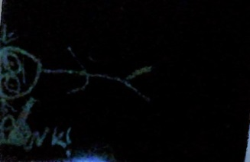
X
Black Hole Animations
AniProgram
TEST HERE
Version Alpha 1
Settings
MiniClips
Bonk!
Flipbook Animations
Movies and Other Animation Videos

Slide 2
Settings
General
Administrative Panel
BACK

Slide 3
General
About
BACK

Slide 4

Black Hole Animations AniProgram
BACK
Private Build
V.Pre-Alpha 1
Runs on Microsoft PowerPoint 2010
AniProgram Uses the MIT License.
GITHUB
Collab With DudeTech
Black Hole animations, AniProgram, and their logos are a KTCC trademark of D>STUDIO (KTCC-T3-DSTUDIO).

Slide 5
Administrative Panel
Open AniProgram Files
GitHub Repository
BACK

