Slide 1
Bike Sharing Demand Analysis using Excel
- DUDEKULA REHANA

Slide 2
Problem Statement
Bike demand varies based on weather, time, and holidays.
Goal: Identify patterns to improve planning.

Slide 3
Objectives
Analyze rental trends
Understand demand factors
Build dashboard

Slide 4
Dataset Overview
The project uses 3 datasets containing bike-sharing data, weather conditions, and user information.
hourly and daily intervals data is used
Key variables include:
1.Date & Time (dteday, hr)
2.Weather conditions (temperature, humidity windspeed, season)
3.User types (casual vs registered users)
4.Total bike rentals (count)

Slide 5
Data Cleaning
Removed duplicates using
handled missing values using “COUNTBLANK” and replaced with median values
Merged datasets using vlookup
Corrected data types

Slide 6
Feature Engineering
Created Day and Weather column using IF condition

Slide 7
Merging dataset
Cleaned dataset-1 , dataset-2 and dataset-3.
merged dataset-1 and dataset-2 and got a new dataset named new_dataset
Again cleaned the new_dataset and merged it with dataset-3 and named it as final_dataset and finally cleaned the final dataset
Converted all the dataset into tables

Slide 8
Analysis Techniques
Created pivot tables and pivot charts to summarize user demand by time, weather, or user type.
SUMIF, COUNTIF functions
Trend analysis

Slide 9
Key Insights
Peak demand during morning & evening hours
Weather significantly affects demand
Weekdays show different usage patterns

Slide 11
Dashboard Overview
Interactive dashboard created
Includes slicers and filters
Visualizes trends clearly

Slide 12
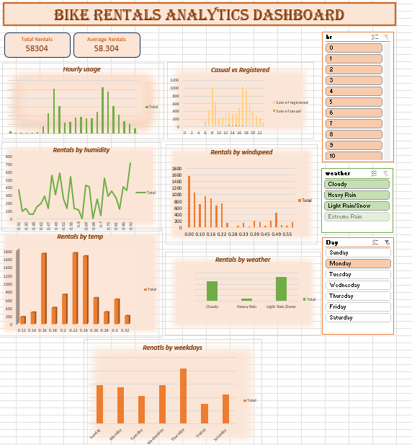

Slide 13
Recommendations
Increase bikes during peak hours
Adjust strategies based on weather like offering discount during heavy rains and ensuring bike availability during mild weather

Slide 14
Conclusion
Project identified key demand patterns
Enabled data-driven decisions
Improved operational planning

