Slide 1
Sales Forecasting Across Multiple Retail Stores
Rossmann Pharmaceuticals — End-to-End ML & Deep Learning Forecasting Pipeline
Prepared by Dudekula Rehana

Slide 2
Project Overview
Business need & scope
Rossmann Pharmaceuticals operates stores across several cities and needs daily sales forecasts up to 6 weeks ahead.
Store managers currently rely on personal judgement — the finance team wants a data-driven alternative.
Key factors identified by the business: promotions, competition, holidays, seasonality, and locality.
Goal: build and serve an end-to-end forecasting product for finance-team analysts.

Slide 3
Approach
Four project stages, each addressed in this work
1
2
3
4
Explore
Predict
Compare
Serve
Customer purchasing behaviour: promos, holidays, seasonality, competition
Feature-engineered ML models: Linear Regression, Random Forest, XGBoost
Same metrics, same hold-out — pick the best model on evidence, not assumption
Serialized model + interactive Streamlit dashboard for finance-team analysts

Slide 4
Dataset Overview
Three linked sources, 2013–2015 daily history
File | Rows | Description
train.csv | 1,017,209 | Daily Sales & Customers per store, with Promo/Holiday flags
test.csv | 41,088 | Same features, minus Sales/Customers — the forecasting target
store.csv | 1,115 | Static store metadata: type, assortment, competition, Promo2
No duplicate rows found in any of the three files.
Closed stores always show zero Sales — consistent, no data-quality flag.
Missing values concentrated in store-level competition/Promo2 fields (informative nulls, not random).

Slide 5
Data Preparation
Cleaning decisions, each with a documented rationale
Closed-store rows dropped from training — constant zero target, no forecasting signal.
3 missing CompetitionDistance values imputed with the median (robust to skew).
Missing CompetitionOpenSince*/Promo2Since* filled with 0, not the mean — the null itself is informative (no known competitor / not enrolled).
11 missing 'Open' values in test filled as open, matching each store's normal weekday pattern.
Extreme high-Sales days retained — verified as genuine promo/holiday spikes, not data errors.

Slide 6
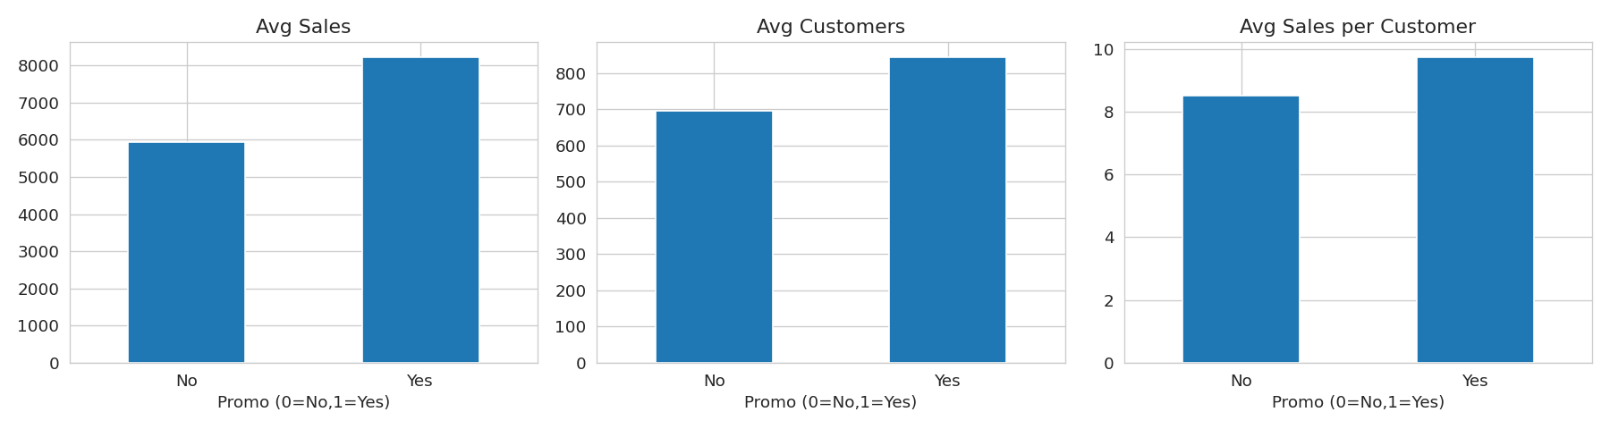
Finding 1 — Promotions Genuinely Grow Demand
Higher Sales, more Customers, and higher spend per customer
Promo days show higher average Sales AND more Customers.
Sales-per-Customer also rises on promo days.
Conclusion: promos attract new footfall and increase basket size — not just one or the other.

Slide 7
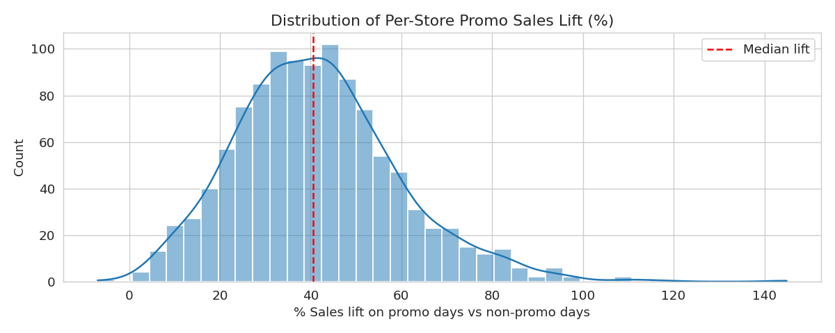
Finding 2 — Promo Lift Varies Widely by Store
A targeting opportunity, not a uniform policy
Per-store promo sales lift ranges from ~6% to 140%+.
Running promos uniformly across all stores leaves ROI on the table.
Recommendation: prioritize promo budget toward high-lift stores.

Slide 8
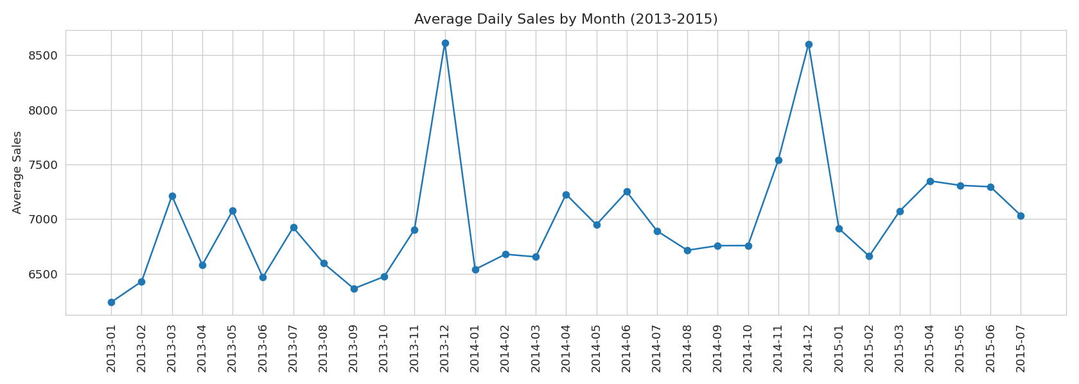
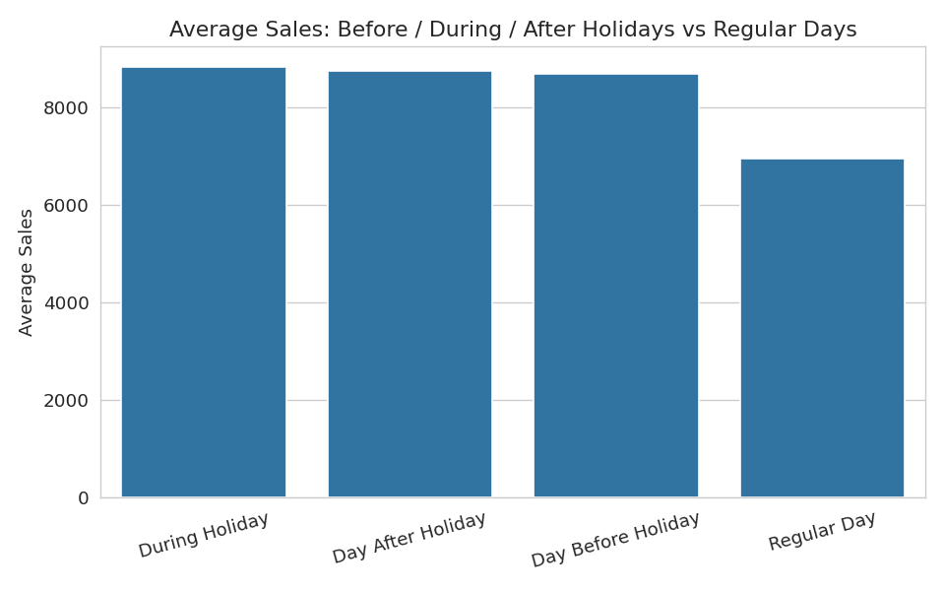
Finding 3 — Strong Seasonality & Holiday Effects
December peaks, pre-holiday stock-up behaviour
Clear December (Christmas) peak each year, smaller Easter lift.
Sales spike the day before a holiday, then drop during it (most stores closed).
Confirms the need for explicit holiday-proximity features in the model.

Slide 9
Feature Engineering & Modelling Approach
From raw dates to a production-style sklearn pipeline
Derived: weekday/weekend, days to/after nearest holiday, month position (begin/mid/end).
Derived: months since competitor opened, whether Promo2 is currently active.
Categorical encoding + scaling inside a single sklearn Pipeline (ColumnTransformer).
Three candidate models trained on identical features: Linear Regression, Random Forest, XGBoost.
Chronological 6-week hold-out split (matches the real forecast horizon) — avoids data leakage.
Primary loss metric: RMSPE (percentage error) — weights small and large stores fairly, unlike raw RMSE.

Slide 10
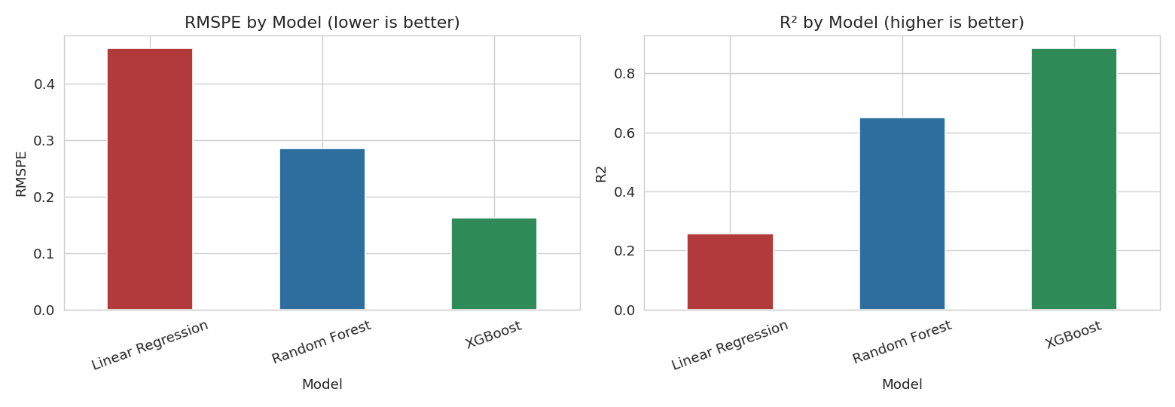
Comparing Candidate Models
Same features, same hold-out, same metrics
Linear Regression is clearly weakest — Sales is driven by non-linear, categorical effects it can't capture.
XGBoost is a large step up from Random Forest too: RMSPE 16.3% vs 28.5% — not a marginal gap.
XGBoost selected for production on accuracy; feature importances and a quantile-regression prediction interval are still produced for it.

Slide 11
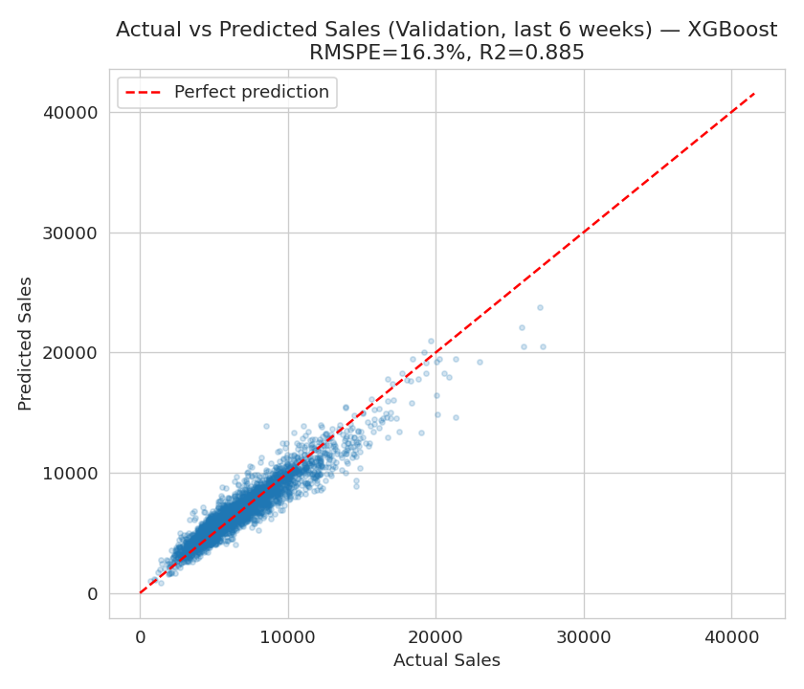
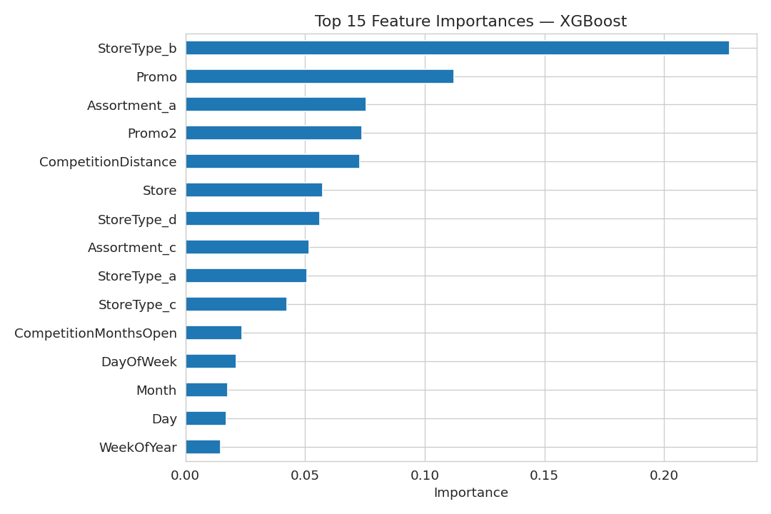
Selected Model — XGBoost Performance
Evaluated on a genuine 6-week forward hold-out
16.3%
0.88
722
RMSPE
R²
MAE (units)

Slide 12
Forecasts as a Range, Not a Single Number
Quantile-regression 90% prediction interval
Prediction spread comes from two extra XGBoost models trained with a quantile (pinball) loss to predict the 5th/95th percentile directly.
Average 90% interval width ≈ 86% of the predicted value (first-pass quantile models — tunable tighter).
Recommendation: communicate forecasts to store managers as a range, especially for staffing/stock decisions.
This also flags which forecasts are less certain and need more manual review.

Slide 13
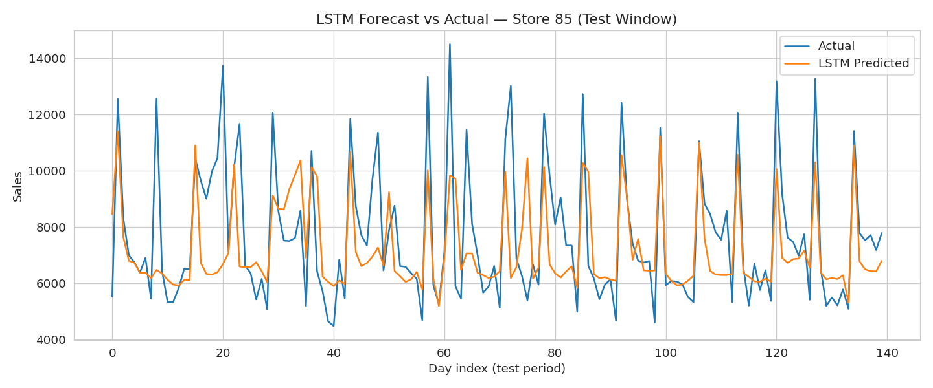
Deep Learning Approach — LSTM
A features-free time-series alternative
Series confirmed stationary (ADF test); strong weekly (7-day) autocorrelation.
14-day sliding window, 2-layer LSTM, trained on one representative store.
Captures the overall level and weekly rhythm well from raw sales history alone.
Misses some sharp promo/holiday spikes — the feature-aware XGBoost model handles those better.
Next step: extend to a multi-store, feature-rich LSTM with more compute.

Slide 14
Key Findings & Recommendations
Findings
Recommendations
Promo lift is highly store-specific (6%–140%+).
Sales-Customers correlation is strong (r≈0.82) but not sufficient alone.
Competitor distance is a weak, confounded predictor.
New competitor openings show ~flat average impact on sales.
Target promo budget at high-lift stores, not all stores uniformly.
Put the 6-week XGBoost forecast into daily production use, served via the interactive Streamlit dashboard.
Pilot Sunday openings at strong, currently-closed-on-Sunday stores.
Extend the LSTM to multi-store, feature-rich modelling over time.

Slide 15
Conclusion
This project delivered an end-to-end sales forecasting pipeline for Rossmann Pharmaceuticals — from raw data through exploratory analysis and feature engineering, to a head-to-head comparison of three models (Linear Regression, Random Forest, XGBoost), an LSTM deep-learning prototype, and an interactive Streamlit dashboard for finance-team analysts. XGBoost (RMSPE 16.3%, R² 0.88 on a true 6-week hold-out) is recommended for production — a clear, evidence-based win over both simpler baselines — with clear, data-backed levers identified for targeted promotions and Sunday-opening pilots.
Thank you

