Slide 1
DATABASE PROJECT PRESENTATION
E-Commerce Database Management System
MySQL • SQL • Relational Database Design
Presented by | D. Mastan Bee
PROJECT OVERVIEW • QUERIES • EXPECTED OUTPUTS

Slide 2
Problem Statement
Managing customer details, products, orders, and payments manually is difficult.
Maintaining product stock and tracking order statuses can lead to errors and data inconsistency.
Retrieving sales information and analysing business performance can be time-consuming.
A centralized MySQL database is developed to manage e-commerce operations efficiently and
generate business reports.
E-COMMERCE DATABASE MANAGEMENT SYSTEM

Slide 3
Objectives
Store and manage customer information.
Organize products under different categories.
Maintain customer order details and order statuses.
Track payment methods, amounts, and payment statuses.
Monitor and automatically update product stock.
Generate category-wise sales reports and identify best-selling products.
Use SQL queries, views, stored procedures, triggers, and transactions.
E-COMMERCE DATABASE MANAGEMENT SYSTEM

Slide 4
DATABASE DESIGN
Core Tables & Relationships
Customer_id (PK)
Customer_name
email
phone
city
Product_id (PK)
Category_id (FK)
product_name
price
stock_quantity
CUSTOMERS
CATEGORIES
PRODUCTS
Category_id (PK)
Category_name
ORDERS
Order_id (PK)
Customer_id (FK)
Product_id (FK)
quantity
Order_date
Order_status
Payment_id (PK)
Order_id (FK)
payment_method
payment_amount
Payment_status
Payment_date
PAYMENTS
E-COMMERCE DATABASE MANAGEMENT SYSTEM

Slide 5
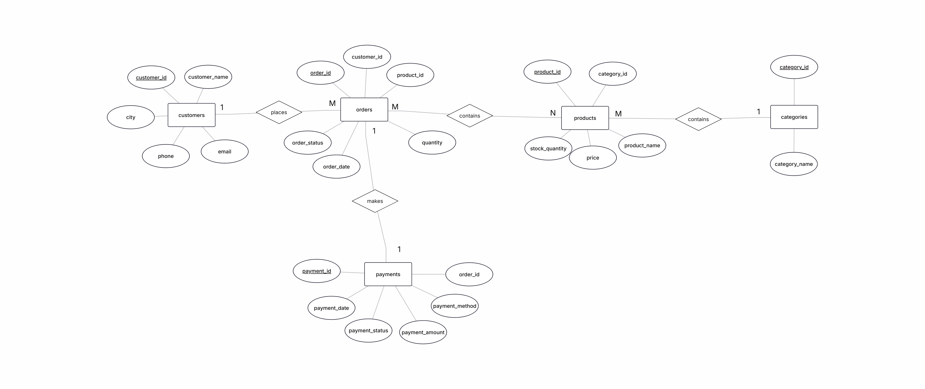
ENTITY RELATIONSHIP DIAGRAM
E-COMMERCE DATABASE MANAGEMENT SYSTEM

Slide 6
CRUD OPERATIONS
Definition: CRUD operations are the four basic operations used to manage data in a database.
Use: They are used to create, read, update, and delete records in database tables.
Advantage: They make data management simple, efficient, and organized.
INSERT (Create), SELECT (Read), UPDATE (Update), and DELETE (Delete).
E-COMMERCE DATABASE MANAGEMENT SYSTEM

Slide 7
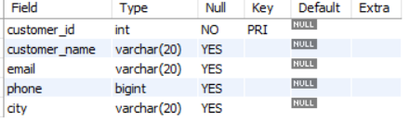
Customers Table
Create customers table
create table customers(customer_id int primary key,
customer_name varchar(20),
email varchar(20),
phone bigint,
city varchar(20));
describe customers;
E-COMMERCE DATABASE MANAGEMENT SYSTEM

Slide 8
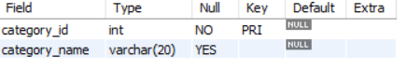
Categories Table
Create categories table
create table categories(category_id int primary key,
category_name varchar(20));
describe categories;
E-COMMERCE DATABASE MANAGEMENT SYSTEM

Slide 9
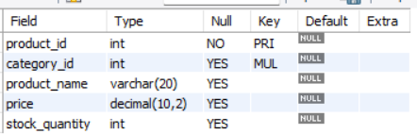
Products Table
Create products table
create table products(product_id int primary key,
category_id int, foreign key(category_id) references
categories(category_id),
product_name varchar(20),
price decimal(10,2),
stock_quantity int);
describe products;
E-COMMERCE DATABASE MANAGEMENT SYSTEM

Slide 10
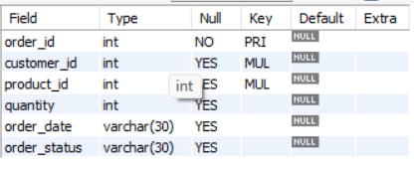
Orders Table
Create orders table
create table orders(order_id int primary key,
customer_id int, foreign key(customer_id) references
customers(customer_id),
product_id int, foreign key(product_id) references
products(product_id),
quantity int,
order_date varchar(30),
order_status varchar(30));
describe orders;
E-COMMERCE DATABASE MANAGEMENT SYSTEM

Slide 11
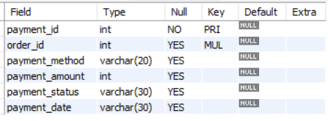
Payments Table
Create payments table
create table payments(payment_id int primary key,
order_id int, foreign key(order_id) references
orders(order_id),
payment_method varchar(20),
payment_amount int,
payment_status varchar(30),
payment_date varchar(30))
describe payments;
E-COMMERCE DATABASE MANAGEMENT SYSTEM

Slide 12
Customers Table
Insert and retrieve the inserted values from customers table
insert into customers values (101,'AaravSharma','aarav@gmail.com','9876500001','Hyderabad’),
(102,'Bhavya Reddy','bhavya@gmail.com','9876500002','Vijayawada’),
(103,'Charan Kumar','charan@gmail.com','9876500003','Visakhapatnam’),
(104,'Divya Patel',Gupta','esha'divya@gmail.com','9876500004','Bengaluru'),
select * from customers;
customer_id (PK) | customer_name | email | phone | city
101 | Aarav Sharma | aarav@gmail.com | 9876500001 | Hyderabad
102 | Bhavya Reddy | bhavya@gmail.com | 9876500002 | Vijayawada
103 | Charan Kumar | charan@gmail.com | 9876500003 | Visakhapatnam
104 | Divya Patel | divya@gmail.com | 9876500004 | Bengaluru
E-COMMERCE DATABASE MANAGEMENT SYSTEM

Slide 13
Categories Table
Insert and retrieve the inserted values from categories table
insert into categories values
(201,'Electronics’),
(202,'Fashion’),
(203,'Books’),
(204,'Home Appliances’),
(205,'Sports');
select * from categories;
category_id (PK) | category_name
201 | Electronics
202 | Fashion
203 | Books
204 | Home Appliances
205 | Sports
E-COMMERCE DATABASE MANAGEMENT SYSTEM

Slide 14
Products Table
Insert and retrieve the inserted values from products table
insert into products values
(301,201,'Laptop',65000,20),
(302,201,'Smartphone',25000,40),
(303,201,'Bluetooth Speaker',3000,50),
(304,202,'Running Shoes',4500,35),
select * from products;
product_id (PK) | category_id (FK) | product_name | price | stock_quantity
301 | 201 | Laptop | 65000 | 20
302 | 201 | Smartphone | 25000 | 40
303 | 201 | Bluetooth Speaker | 3000 | 50
304 | 202 | Running Shoes | 4500 | 35
E-COMMERCE DATABASE MANAGEMENT SYSTEM

Slide 15
Orders Table
Insert and retrieve the inserted values from orders table
insert into orders values
(401,101,301,1,'2026-07-01','Delivered’),
(402,102,302,1,'2026-07-02','Delivered’),
(403,103,304,2,'2026-07-03','Shipped’),
(404,104,306,1,'2026-07-04','Delivered'),
select * from orders;
order_id (PK) | customer_id (FK) | product_id (FK) | quantity | order_date | order_status
401 | 101 | 301 | 1 | 2026-07-01 | Delivered
402 | 102 | 302 | 1 | 2026-07-02 | Delivered
403 | 103 | 304 | 2 | 2026-07-03 | Shipped
404 | 104 | 306 | 1 | 2026-07-04 | Delivered
E-COMMERCE DATABASE MANAGEMENT SYSTEM

Slide 16
Payments Table
Insert and retrieve the inserted values from payments table
insert into payments values
(501,401,'UPI',65000,'Paid','2026-07-01’),
(502,402,'Credit Card',25000,'Paid','2026-07-02’),
(503,403,'Debit Card',9000,'Paid','2026-07-03'), (504,404,'UPI',700,'Paid','2026-07-04'),
select * from payments;
payment_id (PK) | order_id (FK) | payment_method | payment_amount | payment_status | payment_date
501 | 401 | UPI | 65000 | Paid | 2026-07-01
502 | 402 | Credit Card | 25000 | Paid | 2026-07-02
503 | 403 | Debit Card | 9000 | Paid | 2026-07-03
504 | 404 | UPI | 700 | Paid | 2026-07-04
E-COMMERCE DATABASE MANAGEMENT SYSTEM

Slide 17
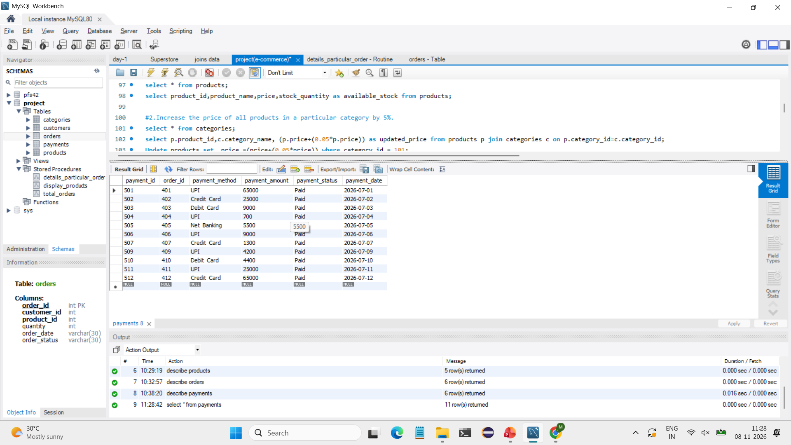
UPDATE AND DELETE QUERIES
Delete cancelled payments
EXPECTED OUTPUT
payment_id | order_id | method | amount | status
501 | 401 | UPI | 65000 | Paid
502 | 402 | Credit Card | 25000 | Paid
503 | 403 | Debit Card | 9000 | Paid
504 | 404 | UPI | 700 | Paid
SQL QUERY
DELETE FROM payments WHERE payment_status = 'Cancelled';
SELECT * FROM payments;
Change the payment status of a pending payment to Paid
EXPECTED OUTPUT
SQL QUERY
update payments set payment_status ='Paid' where payment_status='pending’;
SELECT * FROM payments;
E-COMMERCE DATABASE MANAGEMENT SYSTEM

Slide 18
AGGREGATE FUNCTIONS
Definition: Aggregate functions in SQL perform calculations on a group of rows and return a single value.
Use: They are used to summarize and analyse data in a table.
Advantage: They simplify data analysis by providing useful summary information quickly.
Example: COUNT(), SUM(), AVG(), MIN(), and MAX().
E-COMMERCE DATABASE MANAGEMENT SYSTEM

Slide 19
AGGREGATE FUNCTIONS
Find the average product price for each category
EXPECTED OUTPUT
SQL QUERY
category_id | average_price
201 | 31000.0
202 | 4500.0
SELECT category_id, AVG(price) AS average_price
FROM products
GROUP BY category_id;
Count products in each category
EXPECTED OUTPUT
SQL QUERY
category_id | product_count
201 | 3
202 | 1
SELECT category_id, COUNT(product_id) AS product_count
FROM products
GROUP BY category_id;
E-COMMERCE DATABASE MANAGEMENT SYSTEM

Slide 20
STRING FUNCTIONS
Definition: String functions in SQL are used to perform operations on character or text data.
Use: They are used to manipulate, modify, and retrieve specific parts of strings.
Advantage: They make text processing easier and help manage string data efficiently.
Example: UPPER(), LOWER(), LENGTH(), CONCAT(), and SUBSTRING().
E-COMMERCE DATABASE MANAGEMENT SYSTEM

Slide 21
STRING FUNCTIONS
Display customer names in uppercase and lowercase
EXPECTED OUTPUT
customer_name | uppercase | lowercase
Aarav Sharma | AARAV SHARMA | aarav sharma
Bhavya Reddy | BHAVYA REDDY | bhavya reddy
Charan Kumar | CHARAN KUMAR | charan kumar
Divya Patel | DIVYA PATEL | divya patel
Esha Gupta | ESHA GUPTA | esha gupta
SQL QUERY
SELECT customer_name,
UPPER(customer_name) AS uppercase,
LOWER(customer_name) AS lowercase
FROM customers;
Display the first five characters of each product name
EXPECTED OUTPUT
product_name | first_five_characters
Laptop | Lapto
Smartphone | Smart
Bluetooth Speaker | Bluet
Running Shoes | Runni
Backpack | Backp
SQL QUERY
SELECT distinct product_name,
LEFT(product_name, 5) AS
first_five_characters
FROM customers;
E-COMMERCE DATABASE MANAGEMENT SYSTEM

Slide 22
DATE FUNCTIONS
Definition: Date functions in SQL are used to perform operations on date and time values.
Use: They are used to retrieve, format, calculate, and manipulate dates.
Advantage: They make date and time calculations easier and help manage time-related data efficiently.
Example: CURDATE(), NOW(), DATE(), YEAR(), and MONTH().
E-COMMERCE DATABASE MANAGEMENT SYSTEM

Slide 23
DATE FUNCTIONS
Find the number of days since each order was placed
EXPECTED OUTPUT
Order_date | no_of_days
2026-07-01 | 129
2026-07-02 | 128
2026-07-03 | 127
2026-07-04 | 126
SQL QUERY
SELECT order_date,
DATEDIFF(CURDATE(), order_date) AS no_of_days
FROM orders;
Display payment dates in DD-Mon-YYYY format
EXPECTED OUTPUT
payment_date | formatted_date
2026-07-01 | 01-Jul-2026
2026-07-02 | 02-Jul-2026
2026-07-03 | 03-Jul-2026
2026-07-04 | 04-Jul-2026
SQL QUERY
SELECT payment_date,
DATE_FORMAT(payment_date, '%d-%b-%Y') AS
formatted_date
FROM payments;
E-COMMERCE DATABASE MANAGEMENT SYSTEM

Slide 24
CLAUESES
Definition: Clauses in SQL are specific parts of a query used to perform different operations on data.
Use: They are used to filter, sort, group, and retrieve records from tables.
Advantage: They make SQL queries more flexible and help retrieve specific data efficiently.
Example: WHERE, GROUP BY, HAVING, ORDER BY, and LIMIT.
E-COMMERCE DATABASE MANAGEMENT SYSTEM

Slide 25
CLAUESES
Find the highest-priced product.
EXPECTED OUTPUT
SQL QUERY
select * from products order by price desc limit 1;
Product_id | category_id | Product_name | price | Stock_qunatity
311 | 201 | laptop | 73500.00 | 60
Calculate total sales by payment method
EXPECTED OUTPUT
SQL QUERY
payment_method | total_sales
UPI | 65700
Credit Card | 25000
Debit Card | 9000
SELECT payment_method,
SUM(payment_amount) AS total_sales
FROM payments
GROUP BY payment_method;
E-COMMERCE DATABASE MANAGEMENT SYSTEM

Slide 26
JOINS
Definition: Joins in SQL are used to combine records from two or more tables based on a related column.
Use: They are used to retrieve related data from multiple tables in a single query.
Advantage: They reduce data duplication and help access related information easily.
Example: INNER JOIN, LEFT JOIN, RIGHT JOIN, and FULL JOIN.
E-COMMERCE DATABASE MANAGEMENT SYSTEM

Slide 27
JOINS
Display all products with their category names
EXPECTED OUTPUT
product_name | category_name
Laptop | Electronics
Smartphone | Electronics
Bluetooth Speaker | Electronics
Running Shoes | Fashion
SQL QUERY
SELECT p.product_name, c.category_name
FROM products p
LEFT JOIN categories c
ON p.category_id = c.category_id;
Display all customers and their order details
EXPECTED OUTPUT
SQL QUERY
customer_name | order_id | product_id | qty | order_date | status
Aarav Sharma | 401 | 301 | 1 | 2026-07-01 | Delivered
Bhavya Reddy | 402 | 302 | 1 | 2026-07-02 | Delivered
Charan Kumar | 403 | 304 | 2 | 2026-07-03 | Shipped
Divya Patel | 404 | 306 | 1 | 2026-07-04 | Delivered
SELECT c.customer_name, o.order_id, o.product_id, o.quantity, o.order_date, o.order_status FROM customers c
LEFT JOIN orders o ON c.customer_id = o.customer_id;
E-COMMERCE DATABASE MANAGEMENT SYSTEM

Slide 28
SUB-QUERIES
Definition: Subqueries in SQL are queries written inside another SQL query.
Use: They are used to retrieve data based on the results of another query.
Advantage: They simplify complex queries and help perform advanced data retrieval.
Example: SELECT, WHERE, and FROM clauses with nested queries.
E-COMMERCE DATABASE MANAGEMENT SYSTEM

Slide 29
SUB-QUERIES
Find customers whose payment exceeds the average payment
SQL QUERY
SELECT * FROM customers
WHERE customer_id IN (
SELECT customer_id FROM orders
WHERE order_id IN (
SELECT order_id FROM payments
WHERE payment_amount > (SELECT AVG(payment_amount) FROM payments)));
EXPECTED OUTPUT
customer_id |  | customer_name | email | city
101 |  | Aarav Sharma | aarav@gmail.com | Hyderabad
102 | Bhavya Reddy | bhavya@gmail.com | 9876500002 | Vijayawada
103 | Charan Kumar | charan@gmail.com | 9876500003 | Visakhapatnam
NOTE Average payment = 24,925. Only the 65,000 payment is greater than this average.
E-COMMERCE DATABASE MANAGEMENT SYSTEM

Slide 30
VIEW
Definition: Views in SQL are virtual tables created based on the results of an SQL query.
Use: They are used to display specific data from one or more tables.
Advantage: They improve data security and simplify complex queries.
Example: CREATE VIEW, SELECT, and DROP VIEW.
E-COMMERCE DATABASE MANAGEMENT SYSTEM

Slide 31
VIEW
Create a category-wise sales report view
SQL QUERY
CREATE VIEW Category_Sales_Report AS
SELECT c.category_name,
SUM(o.quantity) AS total_products_sold,
SUM(pa.payment_amount) AS total_sales_amount
FROM categories c
JOIN products p ON c.category_id = p.category_id
JOIN orders o ON o.product_id = p.product_id
JOIN payments pa ON pa.order_id = o.order_id
GROUP BY c.category_id;
Display the view:
SELECT * FROM Category_Sales_Report;
EXPECTED OUTPUT
category_name | total_products_sold | total_sales_amount
Electronics | 7 | 189000
Fashion | 2 | 9000
Books | 3 | 2000
NOTE Expected view output is calculated from the four reduced orders and their matching payments.
E-COMMERCE DATABASE MANAGEMENT SYSTEM

Slide 32
TCL (Transaction Control Language) COMMANDS
Definition: TCL (Transaction Control Language) commands in SQL are used to manage transactions in a database.
Use: They are used to save, undo, or control changes made to database records.
Advantage: They maintain data consistency and help manage transactions safely.
Example: COMMIT, ROLLBACK, and SAVEPOINT.
E-COMMERCE DATABASE MANAGEMENT SYSTEM

Slide 33
TCL (Transaction Control Language) COMMANDS
Use a transaction, savepoint, and rollback
EXPECTED OUTPUT
SQL QUERY
check | result after COMMIT
Product 301 stock | 50 (20 + 30)
Payment for order 403 | Paid (cancel update rolled back)
START TRANSACTION;
UPDATE products
SET stock_quantity = stock_quantity + 30
WHERE product_id = 301;
SAVEPOINT sp1;
UPDATE payments
SET payment_status = 'Cancelled'
WHERE order_id = 403;
ROLLBACK TO sp1;
COMMIT;
NOTE ROLLBACK TO sp1 undoes the payment update but keeps the stock update made before the savepoint.
E-COMMERCE DATABASE MANAGEMENT SYSTEM

Slide 34
STORED PROCEDURES
Definition: Stored procedures in SQL are a set of SQL statements stored in a database and executed when needed.
Use: They are used to perform repetitive database operations and execute multiple SQL statements.
Advantage: They improve code reusability, reduce repetition, and simplify database management.
Example: CREATE PROCEDURE, CALL, and DROP PROCEDURE.
E-COMMERCE DATABASE MANAGEMENT SYSTEM

Slide 35
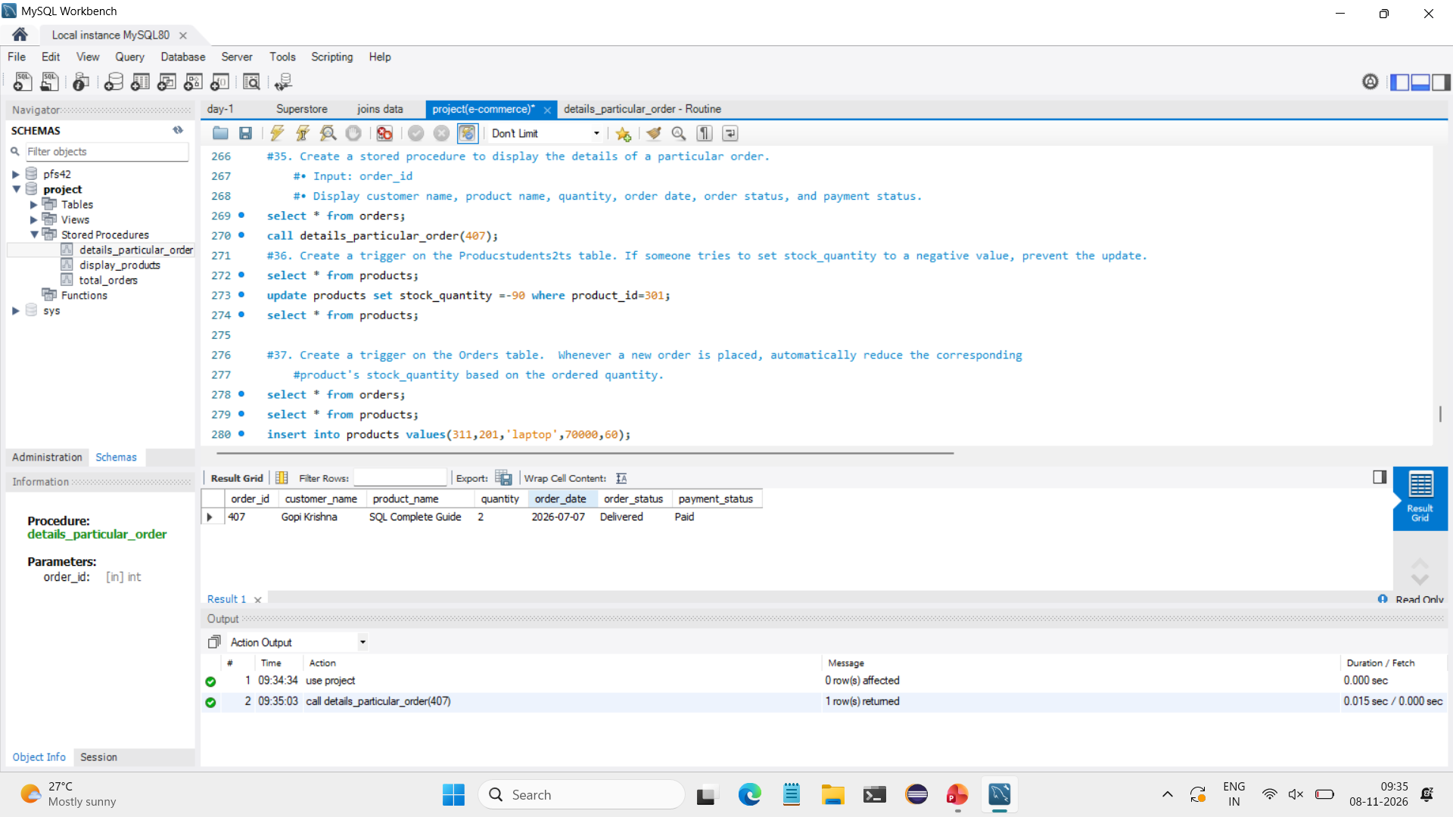
STORED PROCEDURES
create a stored procedure to display the details of a particular order.
• Input: order_id
• Display customer name, product name, quantity, order date, order status, and payment status.
SQL QUERY
CREATE DEFINER=`root`@`localhost` PROCEDURE `details_particular_order`(in order_id int)
BEGIN
select o.order_id,c.customer_name,p.product_name,o.quantity,o.order_date, o.order_status, pa.payment_status from customers c join orders o on c.customer_id=o.customer_id join products p on p.product_id=o.product_id join payments pa on pa.order_id= o.order_id where o.order_id=order_id;
END
call details_particular_order(407));
EXPECTED OUTPUT
NOTE With the reduced four-product data, no product has stock_quantity below 20.
E-COMMERCE DATABASE MANAGEMENT SYSTEM

Slide 36
TRIGGERS
Definition: Triggers in SQL are special stored programs that automatically execute when a specific
database event occurs.
Use: They are used to automatically perform actions during INSERT, UPDATE, or DELETE operations.
Advantage: They maintain data integrity and automate database operations.
Example: CREATE TRIGGER, BEFORE INSERT, AFTER UPDATE, and AFTER DELETE.
E-COMMERCE DATABASE MANAGEMENT SYSTEM

Slide 37
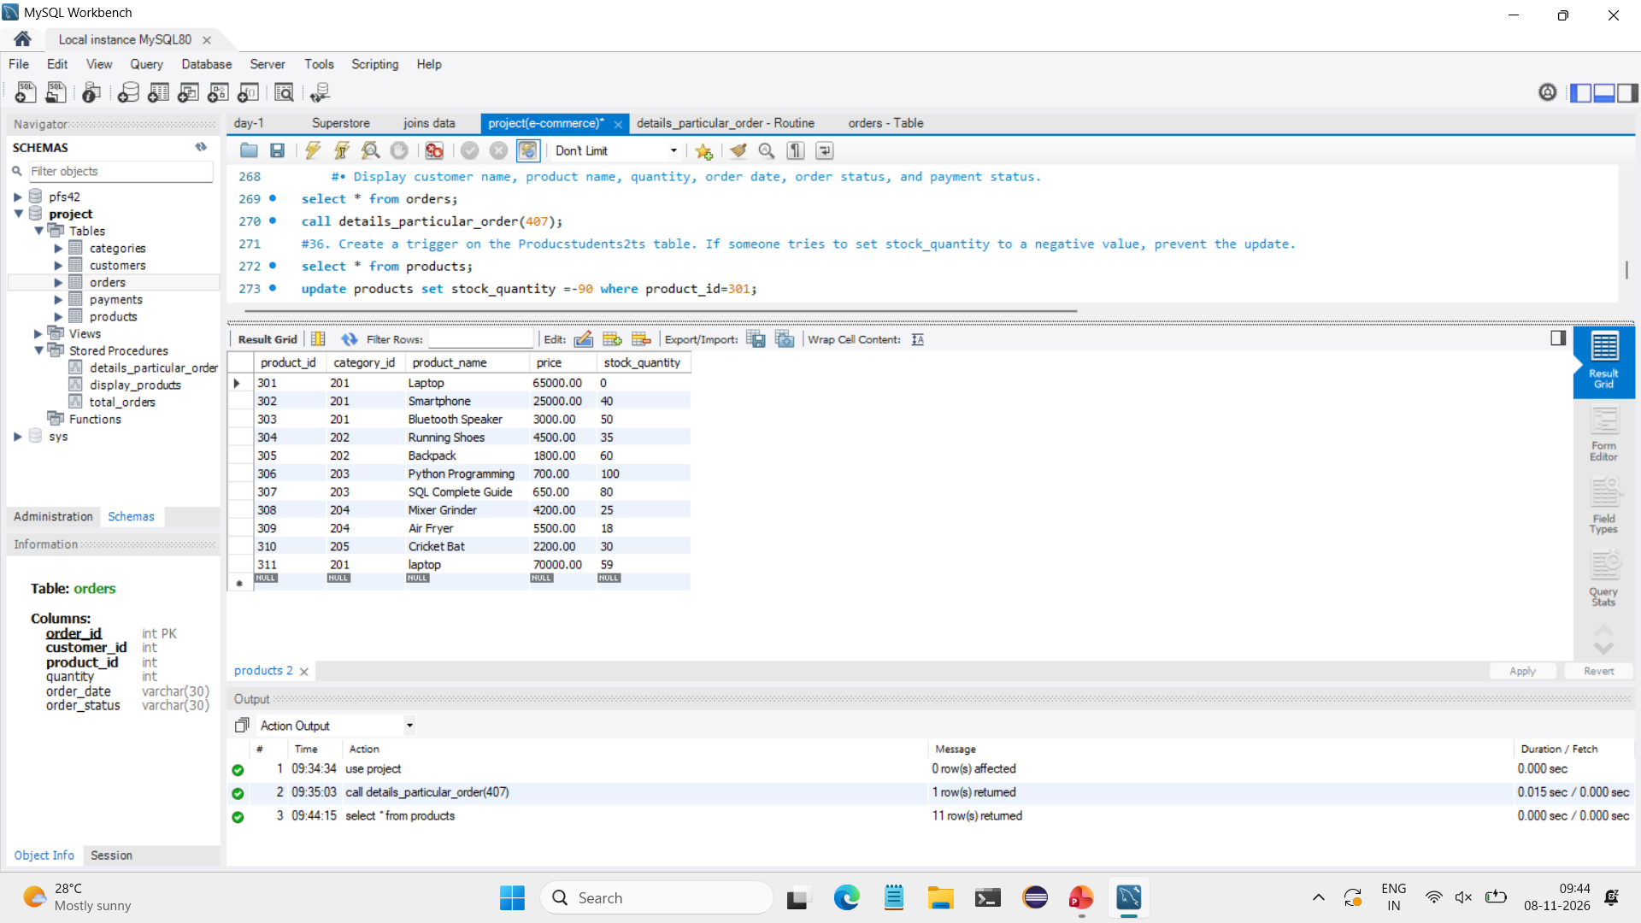
TRIGGERS
Automatically reduce stock after inserting an order
SQL QUERY
CREATE DEFINER=`root`@`localhost` TRIGGER `orders_AFTER_INSERT` AFTER INSERT ON `orders` FOR EACH ROW BEGIN
update products set stock_quantity = stock_quantity-new.quantity where product_id = new.product_id;
END
Inserting a new value table:
insert into orders values (413,103,311,1,'2026-07-12','Pending’);
select * from products;
EXPECTED OUTPUT
NOTE Expected result assumes the AFTER INSERT trigger subtracts the order quantity (1) from stock (60).
E-COMMERCE DATABASE MANAGEMENT SYSTEM

Slide 38
IMPLEMENTATION
Technology Stack
AREA | TECHNOLOGY
Database | MySQL
Query Language | SQL
Database Design | ER Diagram
Database Operations | DDL, DML, DQL, DCL, TCL
Advanced SQL | Joins, Subqueries, Views, Stored Procedures, Triggers
Transaction Management | COMMIT, ROLLBACK, SAVEPOINT
Data Management | RDBMS
E-COMMERCE DATABASE MANAGEMENT SYSTEM

Slide 39
Thank You
E-Commerce Database Management System
D. Mastan Bee

