Slide 1

Voice controlled snake
Thomas Duffy
kieran o'halloran

Slide 2
Research
First we had to research what would be the best method to build the game of snake but also leave us room to add voice commands.
First option we looked at was building the game in Python using pygame which is a cross-platform set of Python modules designed for writing video games.
We kept doing research and seen that unity has some built in voice command options and as we had just recently completed a module where we both used unity we felt this would be the best option for this project.
So we decided to go with Unity and build the scripts in C#

Slide 3
Challenges
We decided to build the game of snake first with keyboard controls and then add voice commands after
The first challenge we faced in game was building the area for the snake to move around in, we used two png images and set them with a box collider 2D, this will give the image the collision detection so if the snake hits it we can kill the snake.
Next, we created a food image ( a blue square ) prefab and set it to have a box collider 2D as well so if the snake makes contact we can destroy the food and make the snake longer.

Slide 4

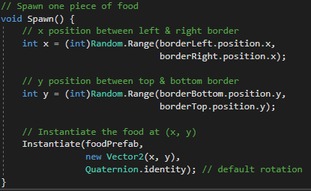
Coding snake
First we created borders, so the snake and the food would not go outside this area.
We then created a food prefab which would spawn in random places inside our borders, so we created a SpawnFood Script in C# to deal with the logic of this.

Slide 5
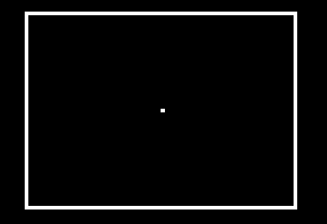
Coding snake
To create the Snake we used an image of a square white box which will get
bigger as the Snake eats the food.
Currently our game looks like this :
We then added movement to the head and created a tail
prefab which would be added to the head every time it ate
a piece of food.

Slide 6
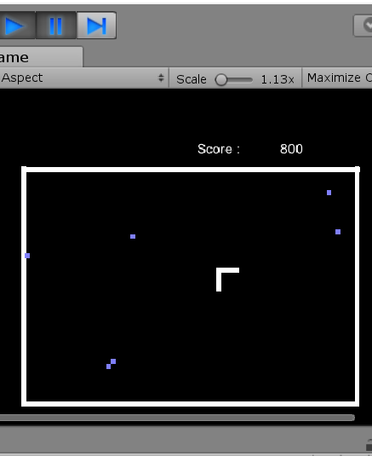
Coding snake
At first we used keyboard controls to move the snake.
We later changed this to Voice Controls.
We added a scoring system to the game. For every piece of
food the snake eat the user would receive 100 points.

Slide 7
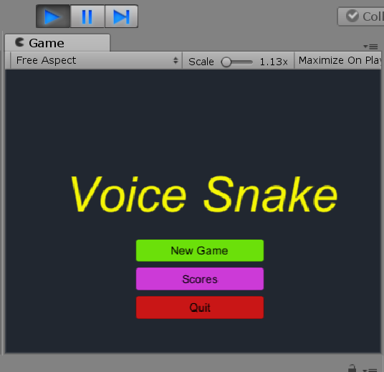
Coding Snake
We then added a main menu to the start of the game
where the user can choose to “Start New Game”,
View “Scores” or “Quit” the game.

Slide 8
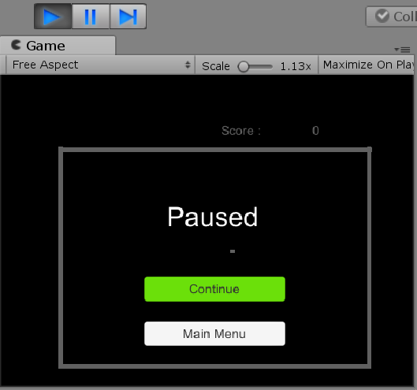
Coding snake
We also added a Pause menu to the game.
Where the user can choose to “Continue” the game or
Return to the “Main Menu”.

Slide 9

Voice commands
To add in the voice commands we used the built in voice command with unity.
using UnityEngine.Windows.Speech;
This allows us to set actions to keywords when
they are heard.
KeywordRecognizer listens for specified keywords
with the specified minimum confidence.
Phrases under the specified minimum level will be ignored.
Keyword recognizer is currently functional only on Windows 10.

Slide 10
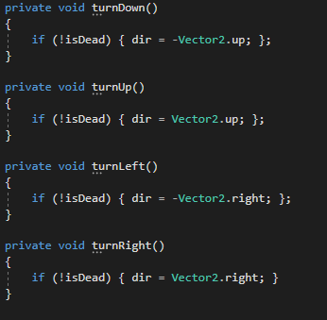
Voice commands
Those keywords call methods we have set up to move the snake
in a direction based on what command is picked up.

Slide 11
TODO
Add voice commands for the start and pause menu
Music
Add death screen

Slide 12

Thank You

