Slide 1

Final Project
Hockey Point predictor

Slide 2
Hockey point predictor
Step 1
Data Exploration/Cleaning
Step 2
Model Creation
Step 3
Model Predicting

Slide 3
Step 1 – data exploration/cleaning

Slide 4
Step 2 – model creation

Slide 5
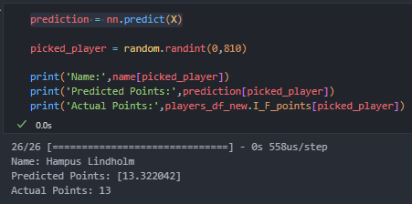
Step 3 – model predicting
Loaded data with Keras “load_model”
Created a variable for the players name before running the model
.info to find total amount of players
Y = “I_F_points”
X = all other columns in dataframe
Ran “predict” on the X : prediction = nn.predict(X)
Used Random library to randomly select 1 of the 810 players, created variable
Final tool prints the random player, their predicted points and their actual points

