Slide 1

Final Project
Hockey Point predictor

Slide 2
Hockey point predictor
Step 1
Data Exploration/Cleaning
Step 2
Model Creation
Step 3
Model Predicting

Slide 3
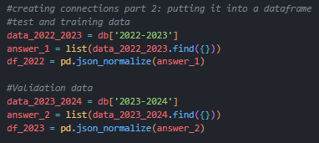
Step 1 – data exploration/cleaning
Data (CSV) found on MoneyPuck.com
CSV loaded into MongoDB
Connect to MongoDB to pull JSON data
Create Pandas DF with the data
Used Seaborn and Matplotlib to visualize the dataset and find what features to keep
Drop features that are not needed from the dataset
Save the new DF to a CSV file

Slide 4

Step 2 – model creation – Linear regression

Slide 5

Step 2 – model creation – Random forest

Slide 6
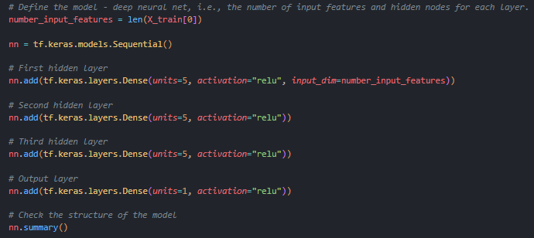
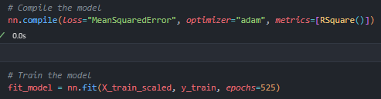
Step 2 – model creation - NN
RELU activation function used (prediction)
Mean Squared Error for loss calculation (prediction)
RSquare for evaluation (prediction)
Challenge: predict data was not averaged out over an entire season, we had to change to a complete season worth of data
Challenge: functions originally chosen were for classification

Slide 7
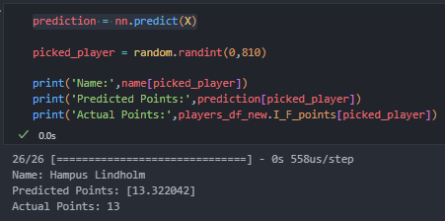
Step 3 – model predicting
Loaded data with Keras “load_model”
Created a variable for the players name before running the model
.info to find total amount of players
Y = “I_F_points”
X = all other columns in dataframe
Ran “predict” on the X : prediction = nn.predict(X)
Used Random library to randomly select 1 of the 810 players, created variable
Final tool prints the random player, their predicted points and their actual points

