Slide 1

Final Project
Hockey Point predictor

Slide 2
Hockey point predictor
Step 1
Data Exploration/Cleaning
Step 2
Model Creation
Step 3
Model Predicting

Slide 3
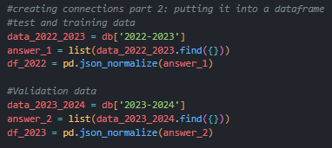
Step 1 – data exploration/cleaning
Data (CSV) found on MoneyPuck.com
CSV loaded into MongoDB
Connect to MongoDB to pull JSON data
Create Pandas DF with the data
Used Seaborn and Matplotlib to visualize the dataset and find what features to keep
Drop features that are not needed from the dataset
Save the new DF to a CSV file

Slide 4
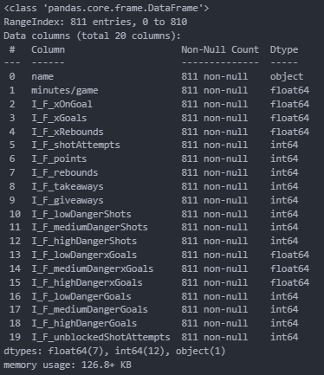
Step 1 – data exploration/cleaning

Slide 5
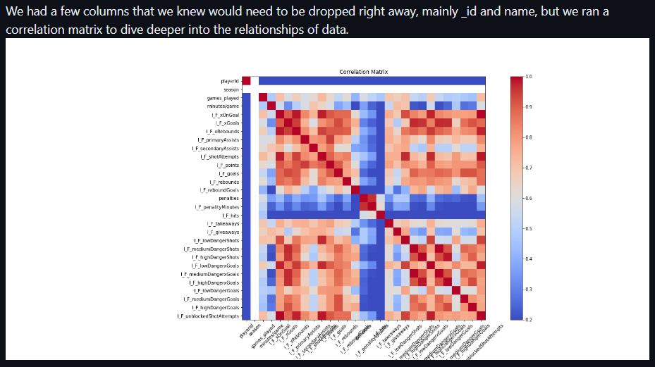
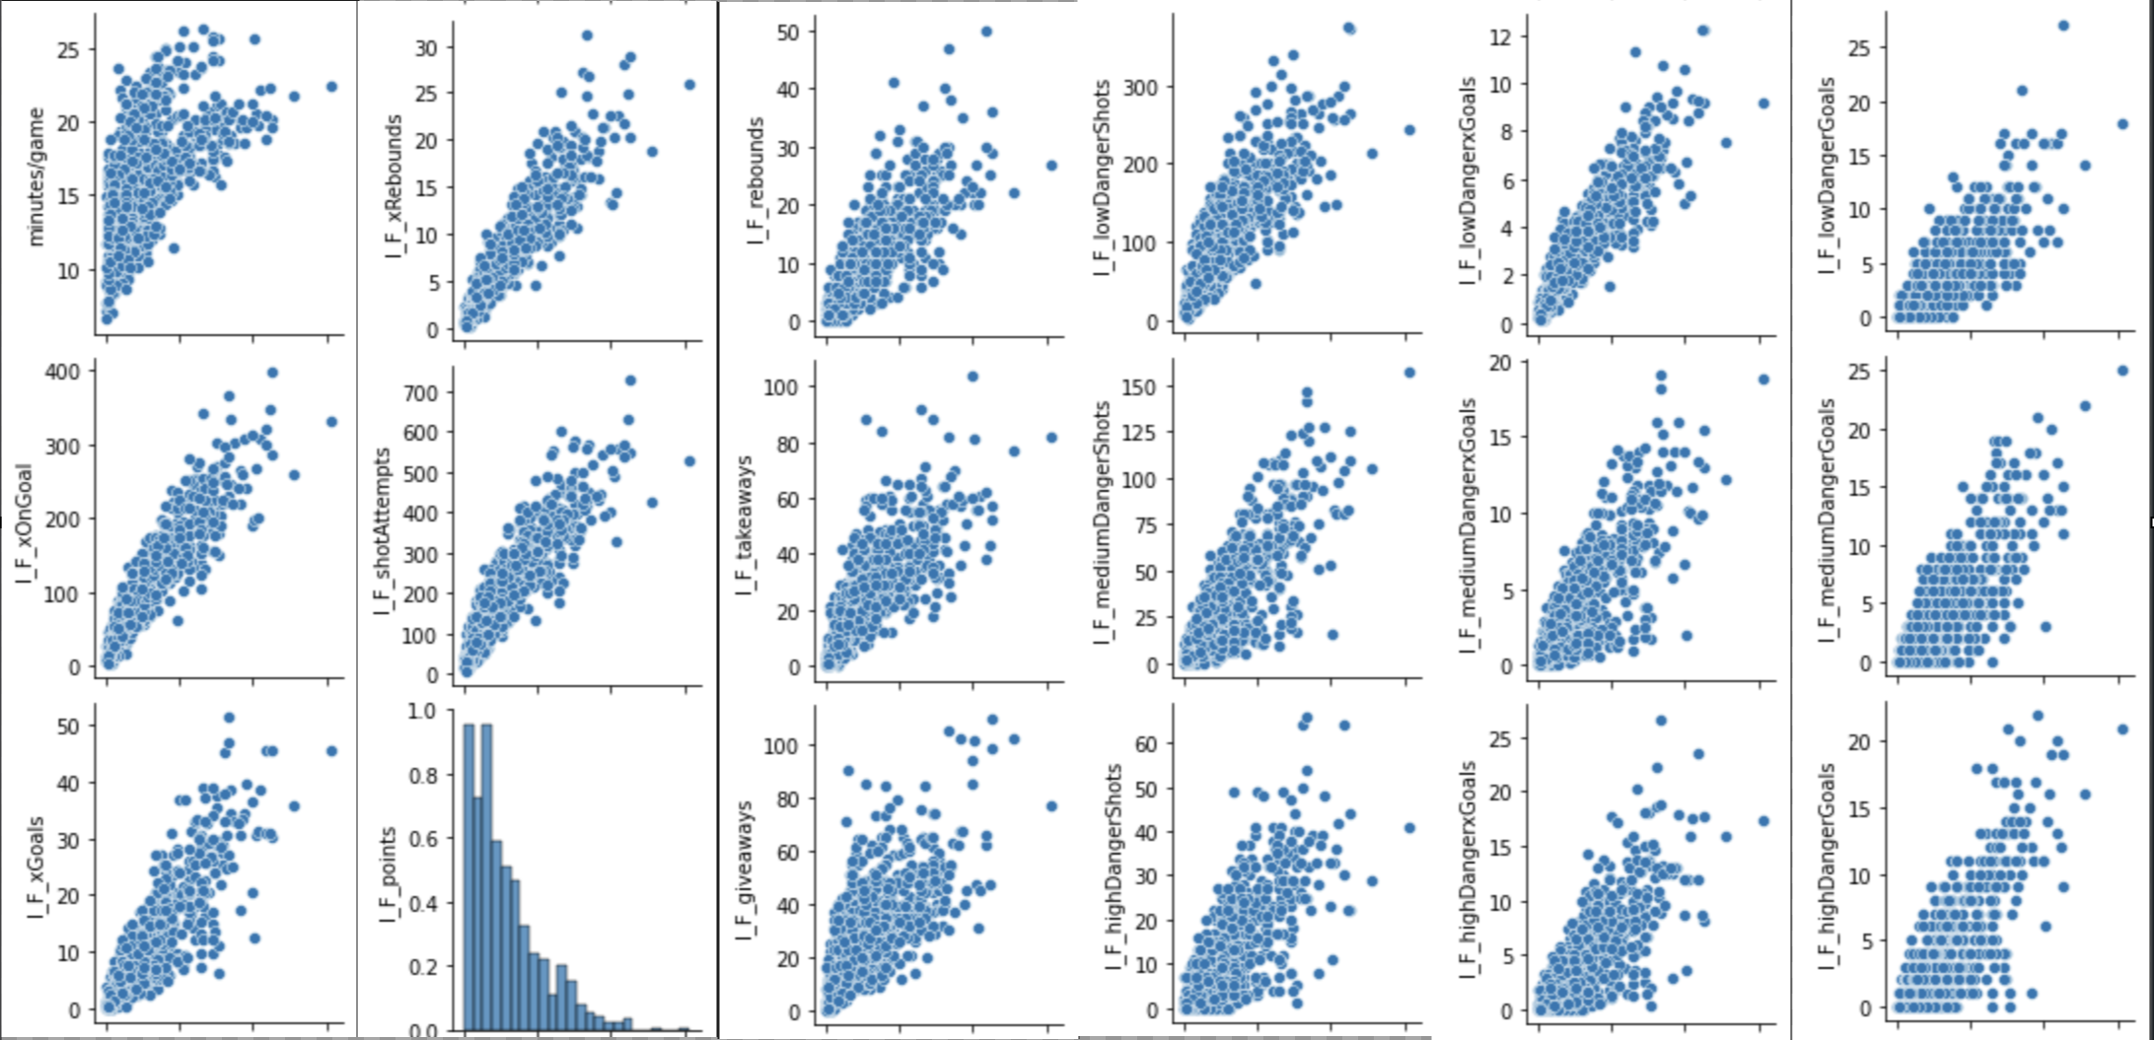
Step 1 – data exploration/cleaning
AFTER

Slide 6


Step 2 – model creation Linear regression and Random Forest
A linear regression model: We chose to run a Linear Regression as it is a prediction-based algorithm that can take in our features and use them to predict our dependent variable. Though simple in terms of machine learning algorithms, it can be used to great effect.
A random forest model: Another form of regressor, the random forest algorithm applies numerous decision trees for added accuracy. We decided to test this one out as it was another model that we had learned in class and found that it more robust than the linear regression

Slide 7
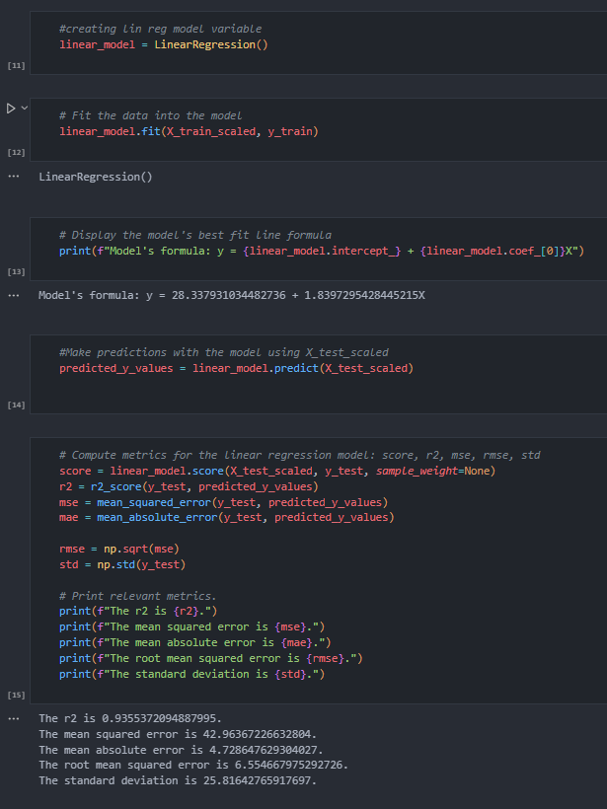
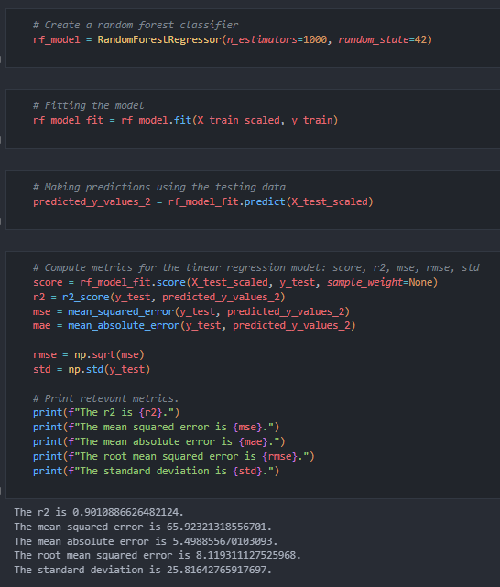
Step 2 – model creation Linear regression and Random Forest

Slide 8
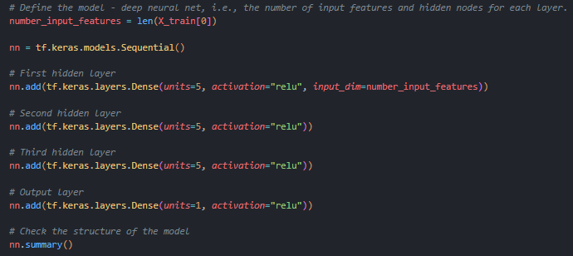
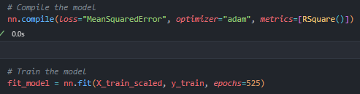
Step 2 – model creation Neural network
A Neural Network: The most advanced model we learnt in class, this was added for its complexity and customizability. The Neural Network had to be configured differently from what we had done in class as we used it to classify rather than predict and that brought us a good challenge.
RELU activation function used (prediction)
Mean Squared Error for loss calculation (prediction)
RSquare for evaluation (prediction)
Challenge: predict data was not averaged out over an entire season, we had to change to a complete season worth of data
Challenge: functions originally chosen were for classification

Slide 9
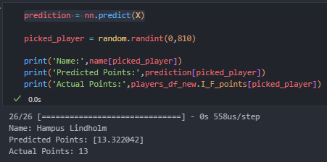
Step 3 – model predicting
Loaded data with Keras “load_model”
Created a variable for the players name before running the model
.info to find total amount of players
Y = “I_F_points”
X = all other columns in dataframe
Ran “predict” on the X : prediction = nn.predict(X)
Used Random library to randomly select 1 of the 810 players, created variable
Final tool prints the random player, their predicted points and their actual points

