Slide 1

Intership Bac3
Bio-informatic overview
Dugauquier Rémy

Slide 2
Goal : Compute a short targeted strategy of defense research by an analyze of some contigs to practise some concept in bioinformatic
To avoid waste time and to be sure that we’ll have the time to launch all works, I’ll create a folder with a short selection of contigs (some not prophage, some prophage, some with YR, some without YR, …).
As it’s only half day we’ll can’t write a lot of thing, so I’ll prepare some little and simple bash and R script.

Slide 3
Planning :
Day 1 (Tue 26/04 PM) : Introduction of the project (What do we study with Gipsi) and to the CECI cluster (MobaXterm)
Day 2 (Wed 27/04 AM) : working on a script into the cluster and some command line. R in bioinformatic
Day 3 (Wed 27/04 PM) : prophage prediction with Virsorter
Day 4 (Thur 28/04 PM) : functionnal prediction with PFAM database (HMM suite)
Day 5/6 (Fri 29/04 AM/PM) : R figure creation, alphafold/Dali and FLAGS
Day 7 (Mon 02/05 AM) : analyze of the result and some interesting R bioinformatic function

Slide 4
Day 1 : introduction and CECI cluster
Presentation of the project of defense system
Explanation of the essential concept : defense system, phage infection, prophage, defense islands, bioinformatic and experimental strategy,…
Presentation of our data and example of some results
Installation of MobaXterm
Downloading of a folder from github on which I added the data (contigs and genes constituting the contigs)

Slide 5
Step of our internship
- how to use the CECI cluster to analyze your data
- how to use command line to quick work on data, files, documents, …
- how to use seqkit for some sequences manipulations
- How to use R for some sequence informations extraction
Data from TARA Oceans
86 M contigs (154 M genes)
Extraction of 58 random contigs
Tue 26/04 – Wed 27/04 AM
Filtration of contigs with Command line in CECI cluster and Seqkit tools
Extraction of information on these data with command line and R/Rstudio

Slide 6
Step of our internship
How to use a module on CECI cluster and how to send a script to the Cluster to make big analyze
How to predict prophage
Data from TARA Oceans
86 M contigs (154 M genes)
Extraction of 58 random contigs
Tue 26/04 – Wed 27/04 AM
Filtration of contigs with Command line in CECI cluster and Seqkit tools
Extraction of information on these data with command line and R/Rstudio
Detection of prophages into our data with Virsorter
Wed 27/04 PM

Slide 7
Step of our internship
How to make a functionnal prediction with PFAM database
Filtration of best sequences for next step
Conservation of gene order with FLAGS
Data from TARA Oceans
86 M contigs (154 M genes)
Extraction of 58 random contigs
Tue 26/04 – Wed 27/04 AM
Filtration of contigs with Command line in CECI cluster and Seqkit tools
Functionnal prediction of sequence with PFAM and filtration of best sequences
Extraction of information on these data with command line and R/Rstudio
Thur 28/04 PM
Detection of prophages into our data with Virsorter
Wed 27/04 PM

Slide 8
Step of our internship
Data from TARA Oceans
86 M contigs (154 M genes)
Alphafold protein 3D structure prediction for interesting genes
Extraction of 58 random contigs
Fri 29/04 PM
Tue 26/04 – Wed 27/04 AM
FLAGS gene order conservation and contig figure creation
Filtration of contigs with Command line in CECI cluster and Seqkit tools
Fri 29/04 AM
Functionnal prediction of sequence with PFAM and filtration of best sequences
Extraction of information on these data with command line and R/Rstudio
Thur 28/04 PM
Detection of prophages into our data with Virsorter
Wed 27/04 PM

Slide 9
Step of our internship
Analyze of result and some useful R command
Data from TARA Oceans
86 M contigs (154 M genes)
Mon 02/04
Alphafold protein 3D structure prediction for interesting genes
Extraction of 58 random contigs
Fri 29/04 PM
Tue 26/04 – Wed 27/04 AM
FLAGS gene order conservation and contig figure creation
Filtration of contigs with Command line in CECI cluster and Seqkit tools
Fri 29/04 AM
Functionnal prediction of sequence with PFAM and filtration of best sequences
Extraction of information on these data with command line and R/Rstudio
Thur 28/04 PM
Detection of prophages into our data with Virsorter
Wed 27/04 PM

Slide 10
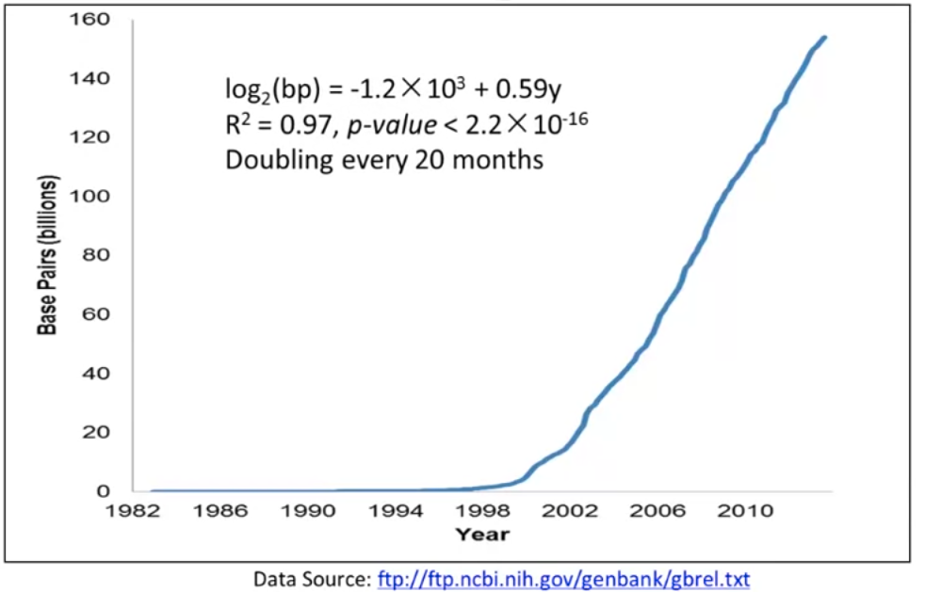
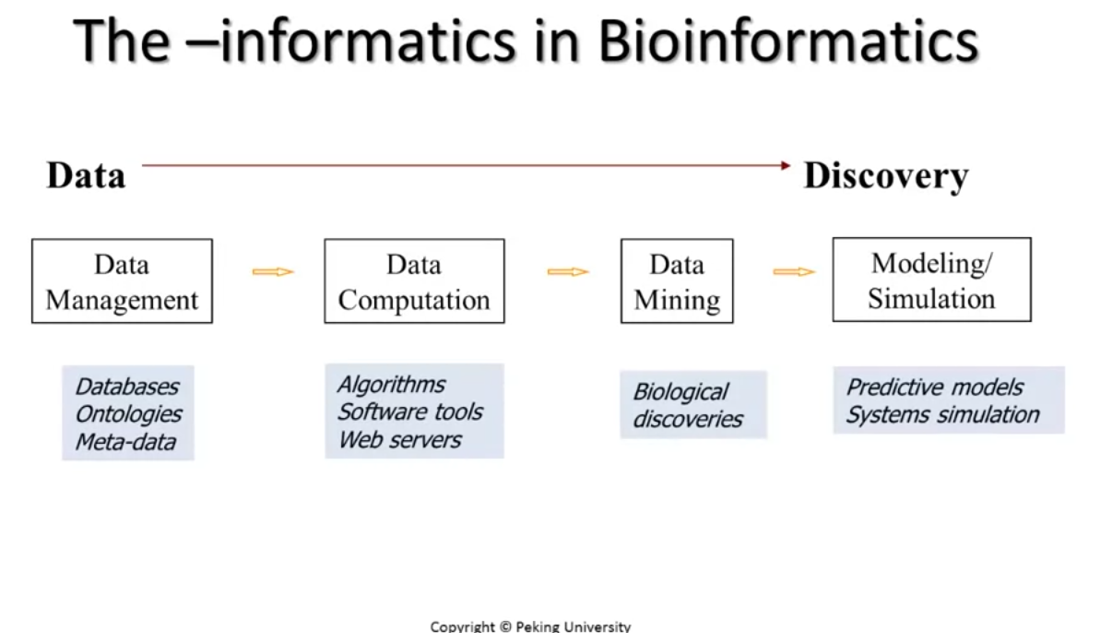
MobaXterm and the CECI cluster
Number of sequenced nucleotide into dataBase (Genbank)

Slide 11
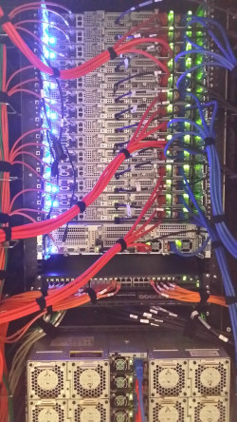
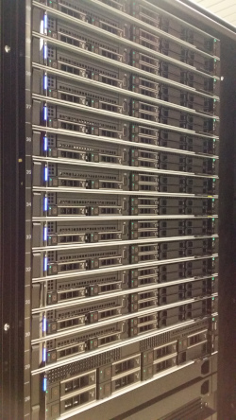
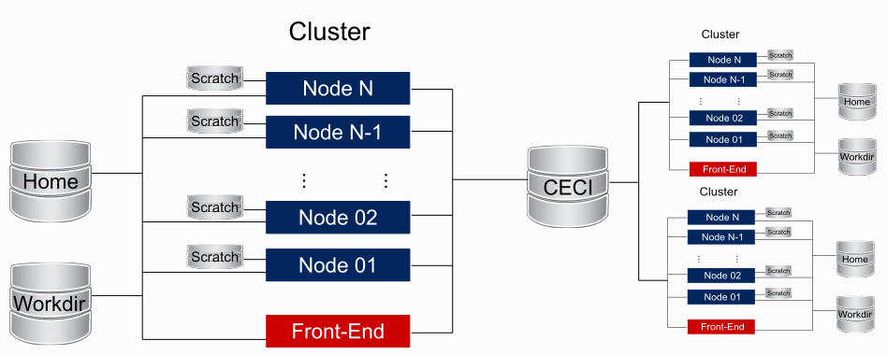
MobaXterm and the CECI cluster
For our project we use TARA data 154 millions of genes, 84 millions of contigs,… Impossible to work on our computer directly. So we work on the CECI cluster.

Slide 12
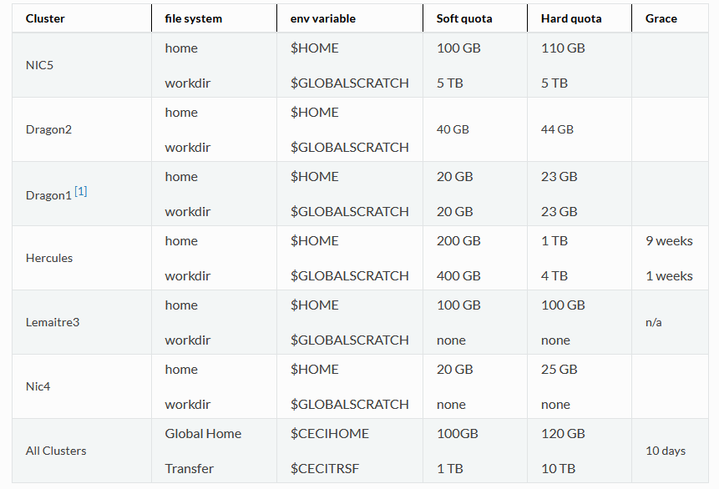
MobaXterm and the CECI cluster

Slide 13
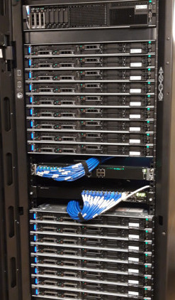


MobaXterm and the CECI cluster
So for this internship but also for our futur work we install MobaXterm to access to cluster.
https://support.ceci-hpc.be/doc/_contents/QuickStart/ConnectingToTheClusters/MobaXTerm.html
Users

Slide 14
Day 2 : cluster, command line & R on bioinformatic
We are going to download genetic data.
Learning of some command line that we can apply to our fasta file like grep, awk,… to count the number of sequences that we have, split the sequences,…
Use Rstudio to extract some informations of our data and prepare the files for further analyzes

Slide 15
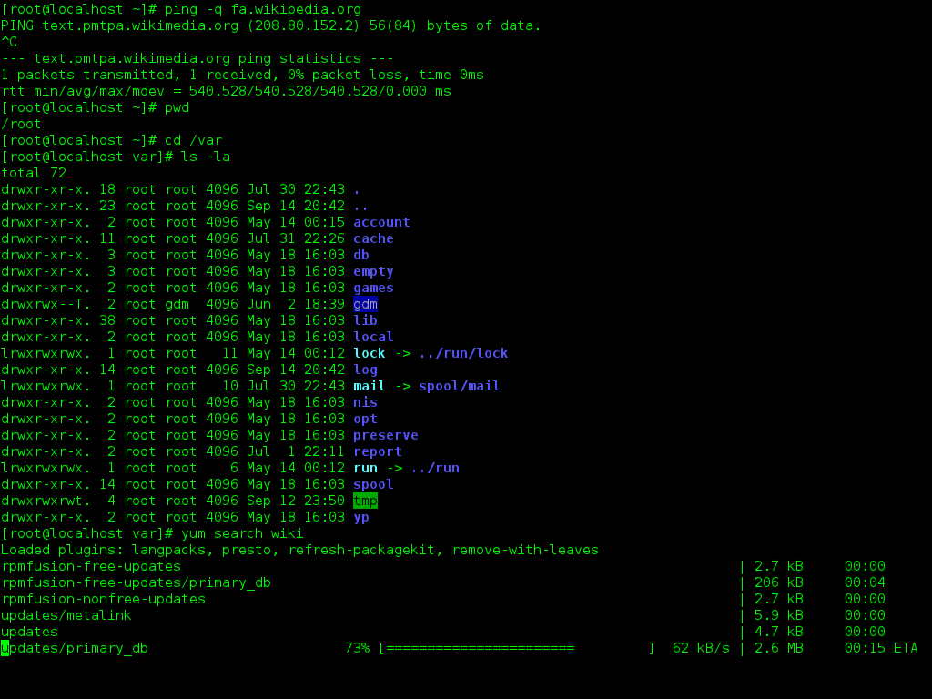
Command Line Interface
To work on MobaXterm (and so with the Cluster) we use a CLI (Command Line Interface).
It’s an interface to « discuss » between human and the computer.
We can launch some software, making some command to get action or collect informations and also travel accross folder, sub-folders,…

Slide 16
Data downloading
We go into the home repository of hercules.
We create a repository with mkdir command
mkdir bioinformatic_bac3_internship
We go to the repository with cd command
cd bioinformatic_bac3_internship
4) Then we import the data from github with wget command
wget https://github.com/DugauquierR/bac3_intership/archive/refs/heads/main.zip
We obtain a zip file, we unzip it with tar –xf
unzip main.zip
→ Now we have got a folder with all our data.

Slide 17
The first step of a work is to obtain, list and prepare the data.
For my project I simply started with the data from OMRGCV2 with all genes in TARA fasta file and the folder with all contig sequences. https://www.ocean-microbiome.org/
For this internship :
I extract 58 random contig name
With seqkit seq I extract all gene complete id and all contig complete id
With grep command I filter the complete id (genes and contigs) with the 58 contig name to obtain the list of all genes id and all contig id of interest
With Seqkit grep I extract from the contig fasta file and gene fasta file the sequence of interest
With transeq tools from EMBL I translate gene sequence into protein sequences
→ So I obtain different files with genes names and sequences into nucleotide and aa and also the complete contig sequences.

Slide 18
Now we simply extract some information about these data by using command line and seqkit tool.
Count the number of contigs and genes with grep
grep -c "^>" ~/bioinformatic_bac3_internship/bac3_intership-main/bac3_internship_contig_sequences.fasta
grep -c "^>" ~/bioinformatic_bac3_internship/bac3_intership-main/bac3_internship_gene_sequences.fna
For the next part we want to filter the contigs with a length more than 1500 pb. So we install seqkit, a tool to work on sequence and we are going to filter the sequence.
- Wget https://github.com/shenwei356/seqkit/releases/download/v2.2.0/seqkit_linux_amd64.tar.gz
- untar –xf seqkit_linux_amd64.tar.gz

Slide 19
Now we simply extract some information about these data :
3) We have got seqkit tools on our computer we are going to do some sequences manipulations
- first we simply print the name of all contigs
- we can see that some contigs are too short for our analyze, so we check with stat command
- we discard the contig with less than 1500 pb
- we can check if that work
./seqkit seq ~/bioinformatic_bac3_internship/bac3_intership-main/bac3_internship_contig_sequences.fasta -n
./seqkit stat ~/bioinformatic_bac3_internship/bac3_intership-main/bac3_internship_contig_sequences.fasta
./seqkit seq –m 1500 ~/bioinformatic_bac3_internship/bac3_intership-main/bac3_internship_contig_sequences.fasta > ~/bioinformatic_bac3_internship/bac3_intership-main/correct_contig_sequences.fasta
./seqkit stat ~/bioinformatic_bac3_internship/bac3_intership-main/correct_contig_sequences.fasta

Slide 20
Now we are going to extract our data from the cluster into our computer and analyze them on R.
We open Rstudio and we import all gene sequence of TARA.
Then we follow the Rmarckdown document
The goal is to obtain this kind of table
For that we are going to use the identifiant of genes from TARA :
TARA_B110000908_G_scaffold38417_1_gene46285
The red part of the gene ID correspond to the contig id
Gene ID | Contig ID | Gene length | Sequences | start | stop
→ RMQ if we have the time, already install Virsorter2

Slide 21
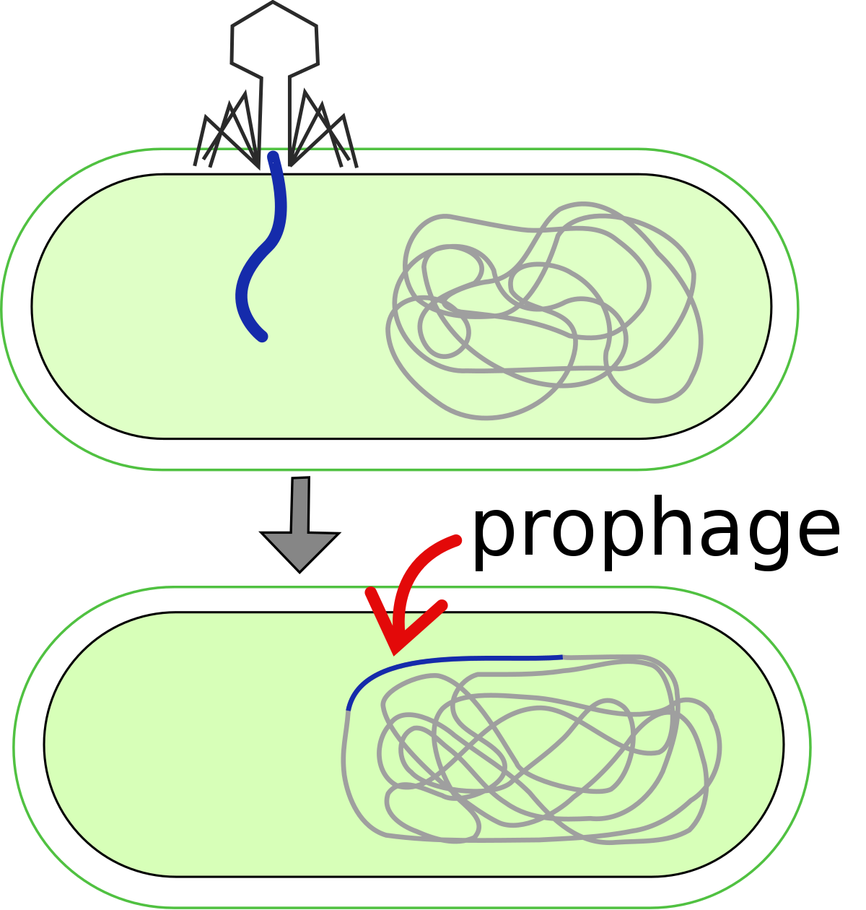
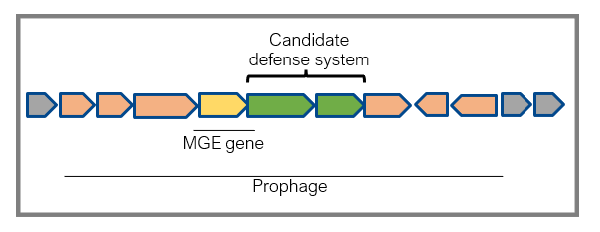
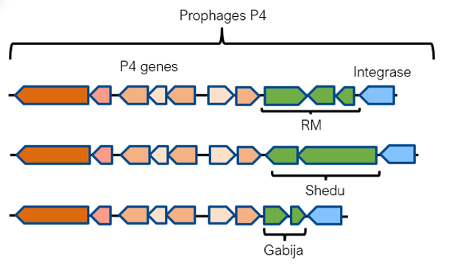
Day 3 : prophage prediction
The goal is to detect potential defence system into prophage.
So we need to detect contig which can be prophages.

Slide 22
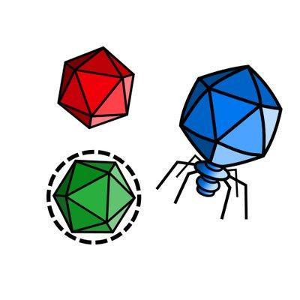
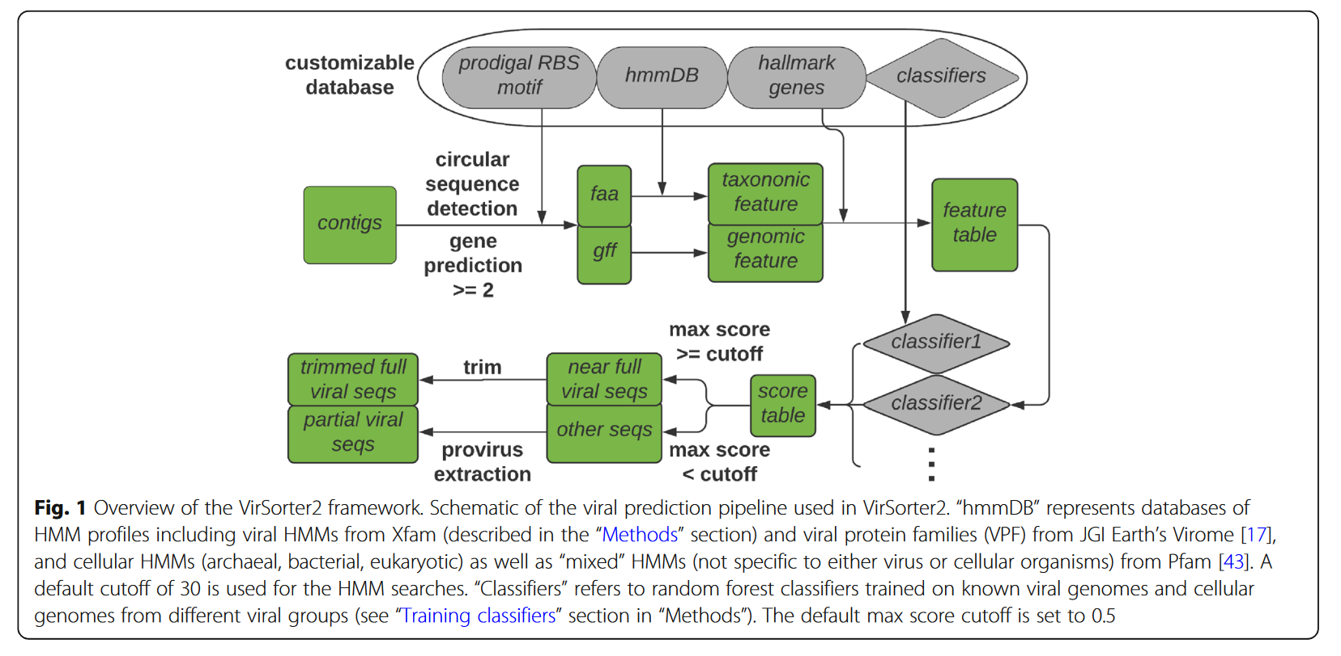
Virsorter2 a prophage prediction tool
« VirSorter2 applies a multi-classifier, expert-guided approach to detect diverse DNA and RNA virus genomes. It has made major updates to its previous version:
- work with more viral groups including dsDNA phages, ssDNA viruses, RNA viruses, NCLDV (Nucleocytoviricota), lavidaviridae (virophages);
- apply machine learning to estimate viralness using genomic features including structural/functional/taxonomic annotation and viral hallmark genes;
- train with high quality virus genomes from metagenomes or other sources. »
The identification of viral sequences with Virsorter2 takes place in 3 steps:
Input sequences are annotated and relevant features are extracted
Each sequence is graded via a score using a classifier set different for each viral group
The scores are gathered in a prediction list provided to the user

Slide 23

Installation of Anaconda
“Anaconda is a distribution of the Python and R programming languages for scientific computing (data science, machine learning applications, large-scale data processing, predictive analytics, etc.), that aims to simplify package management and deployment. The distribution includes data-science packages suitable for Windows, Linux, and macOS.” Wikipedia
So in other words, it’s like a big repository where we can install a lot of tools, including lare quantity of bioinformatic tools, to compute our analyse.
To install Anaconda, we are going to download the installer file with
wget https://repo.anaconda.com/archive/Anaconda3-2021.11-Linux-x86_64.sh
Then type bash and follow instructions
bash Anaconda3-2021.11-Linux-x86_64.sh

Slide 24
Installation of Virsorter2
To install Virsorter2 on the Cluster, we simply need to type these 2 commands and follow instruction :
conda create -n vs2 -c conda-forge -c bioconda virsorter=2
conda activate vs2
Then we install the database linked to Virsorter2
virsorter setup –d db –j 4
If that doesn’t work (often…)
wget https://osf.io/v46sc/download
tar -xzf downlad
virsorter config --init-source --db-dir=./db

Slide 25
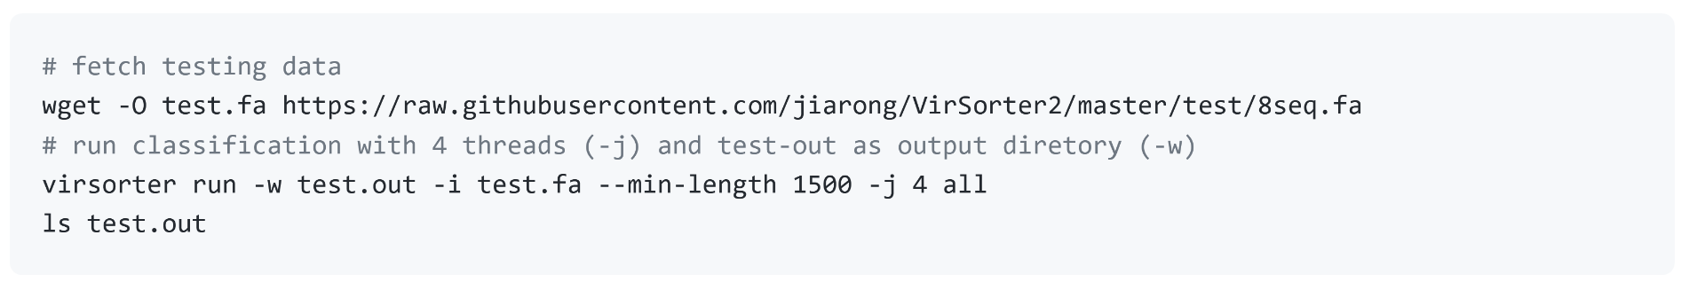
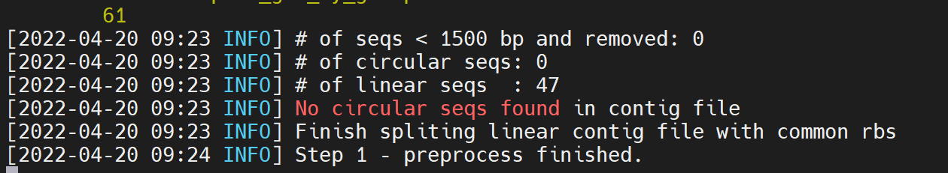
Launching of Virsorter2
And after we can launch quickly Virsorter2 on our data with these commands
We apply this command on our contig file.
After we can extract result of Virsorter2 from our contigs and analyze them on R with the Rmarckdown document.
The goal is to filter the prediction by quality and then extract contig assigned as prophages. With correct contig id we’ll use R to write a fasta file containing only correct gene sequences (once among prophage).

Slide 26
Day 4 : functionnal prediction, launch a module in CECI and send a script
At this step of the work we had selected the contig according to their size and extract the prophage.
Now we need to know if we can find some unknown genes into these contigs.
To do that we are going to launch a functionnal prediction by using module in CECI (HMM).
At the end, we also see how to write a little script that we launch on the cluster.

Slide 27

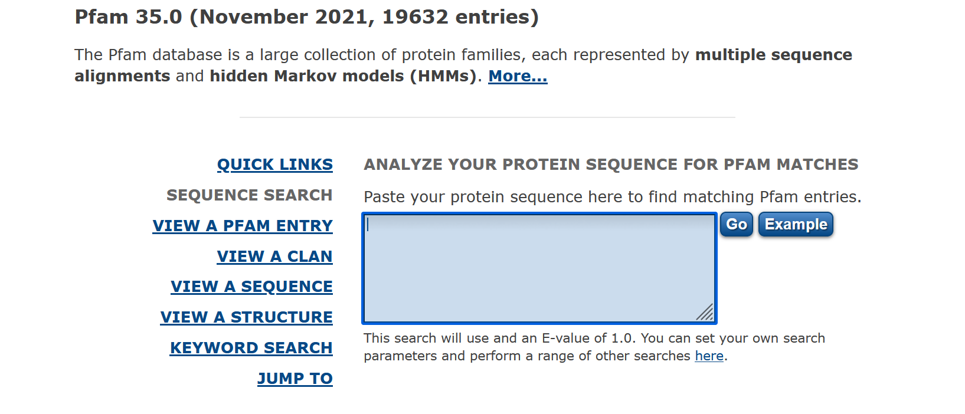
PFAM database
“Pfam is a database of protein families that includes their annotations and multiple sequence alignments generated using hidden Markov models.^{[1][2][3]} The most recent version, Pfam 34.0, was released in March 2021 and contains 19,179 families.^{[4]} “
If we want to know if a sequence can be find into the database, we can simply paste our sequence on the website.

Slide 28
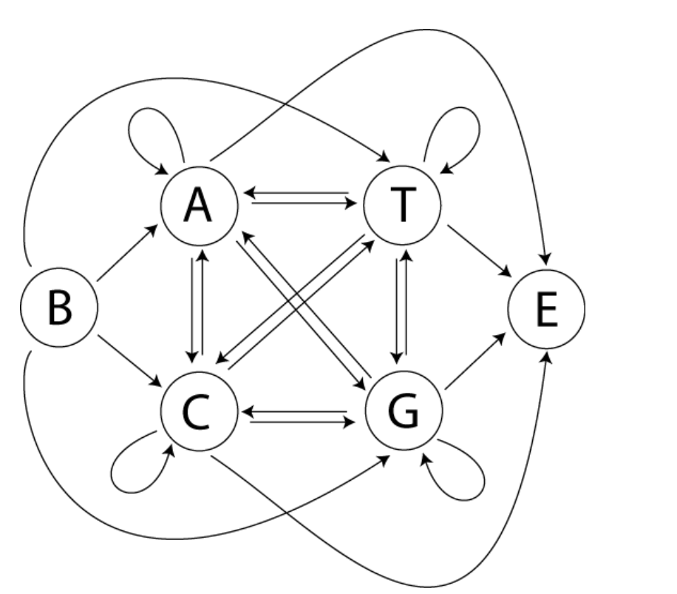
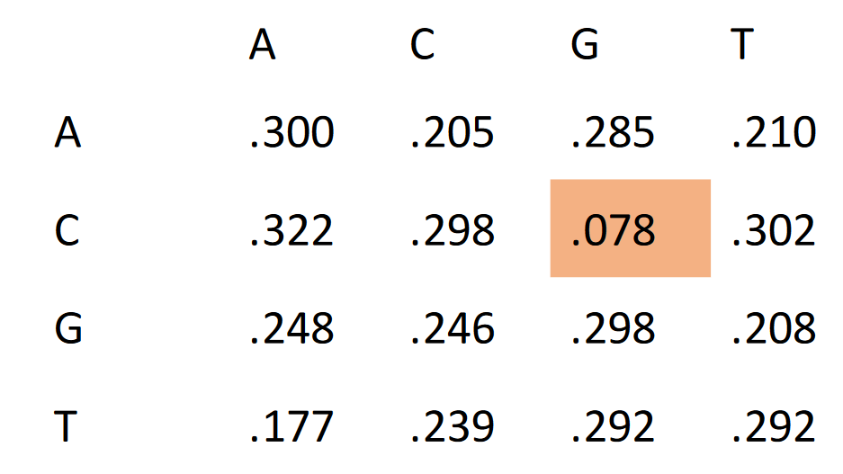
HHsuite
But it’s impossible to paste sequence by sequence, so we’ll analyse PFAM into the cluster with HMM (Hidden Markov Model).
The HHsuite is an open-source software for the search of very sensitive sequences and sequence alignment. Its two most important programs are HHsearch and HHblits. Both are based on pairwise comparison of Markov models at hidden profile (HMM). HMM profiles are a concise representation of alignments of multiple sequences (MSA) into similarity profiles. They contain for each position in the master sequence the probabilities of observing each of the 20 acids amino acids in homologous proteins.

Slide 29
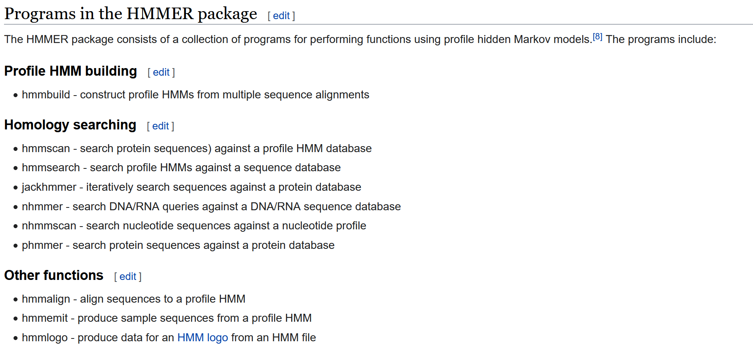
Hmmsearch
“HMMER is a free and commonly used software package for sequence analysis written by Sean Eddy.^{[2]} Its general usage is to identify homologous protein or nucleotide sequences, and to perform sequence alignments. It detects homology by comparing a profile-HMM (a Hidden Markov model constructed explicitly for a particular search) to either a single sequence or a database of sequences.”

Slide 30
Launch a module in CECI cluster
So we start by downloading the PFAM-A database in HMM file on our cluster.
wget ftp://ftp.epi.ac.uk/pub/databases/Pfam/current_release/Pfam-A.hmm.gz
gunzip Pfam-A.hmm.gz
During the downloading, we are going in R to create our input file with the Rmackdown document.
Then we launch a module HMM, to known the module of HMMsearch we go to this website https://support.ceci-hpc.be/doc/_contents/UsingSoftwareAndLibraries/SoftwareInstalled/modules_tables.html.
We select our module and write this kind of command :

Slide 31
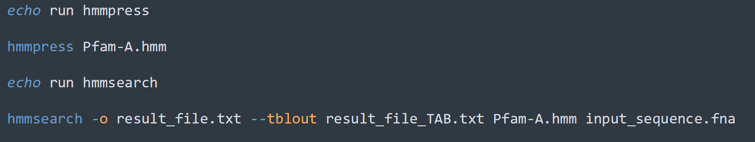
HMMsearch in CECI
Once the module is load, we just need to analyze all our sequence (protein) in front of the PFAM-A database to extract their functionnal annotation.
When we get result, we extract them (the TAB result) and we can analyze it in R to complete our table (follow Rmarckdown file).

Slide 32
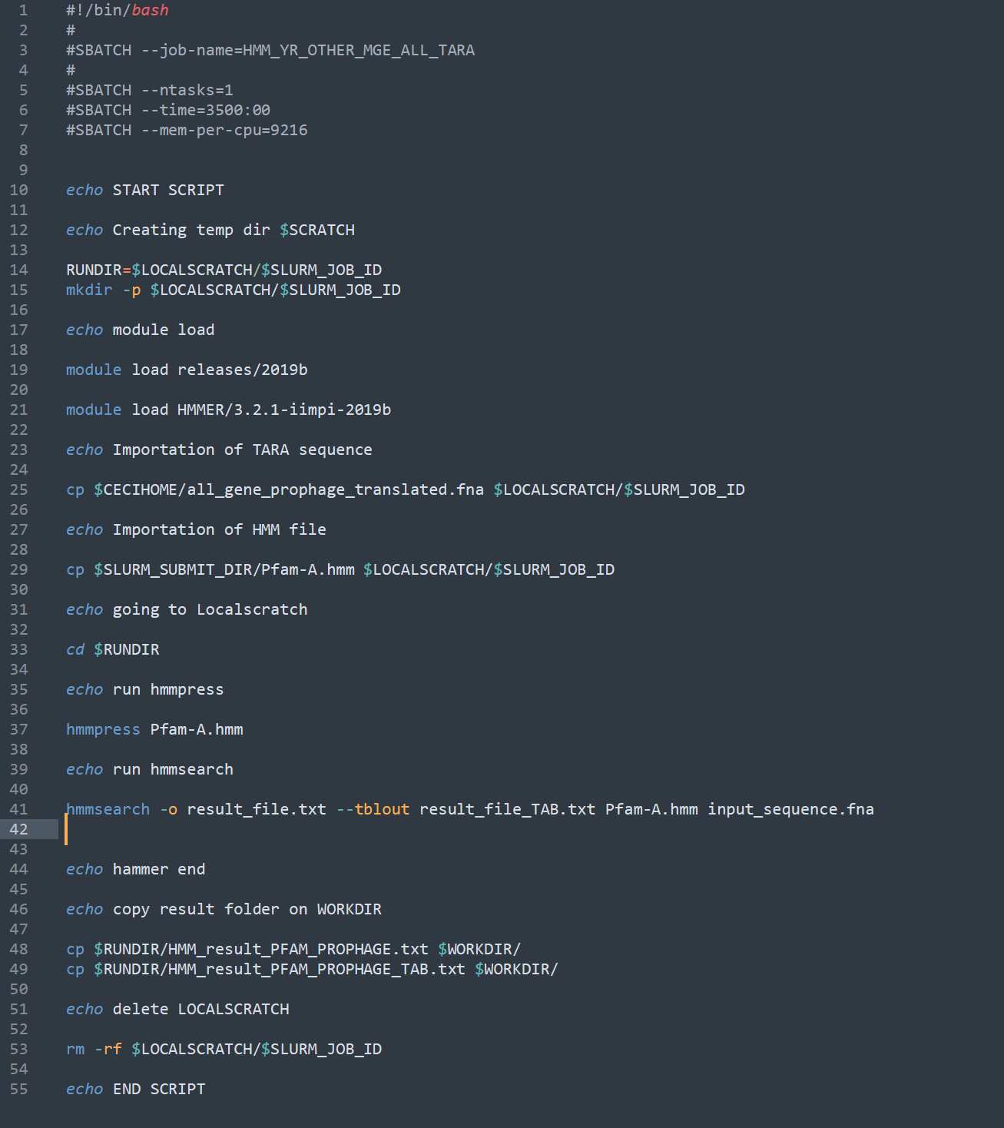
Send a script to CECI
Just before we launch a module directly into MobaXterm. So we use software frome CECI cluster but it’s our computer that doing the job. It’s possible only for little analyze. When the analyze is bigger, we need to write a bash script and send it to the cluster.
https://www.ceci-hpc.be/scriptgen.html

Slide 33
Day 5/6 : R figure creation – FLAGS - Alphafold
With all previously steps we have got extracted all genes in prophage from our contig list and see if they are unknown or not.
Now we are going to take some interesting genes based on figure that we create in R, and see if we can found them into other organism with NCBI and see if we can produce a 3D structure.

Slide 34
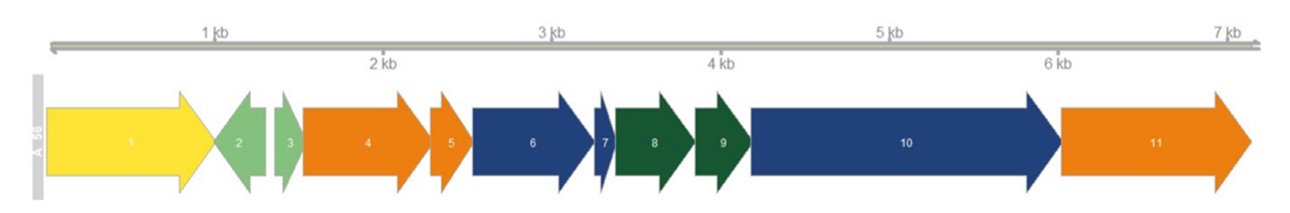
Figure creation
We have got a lot of contig with unknown genes. So we are going to create these kind of figure to select a potential good contig.

Slide 35
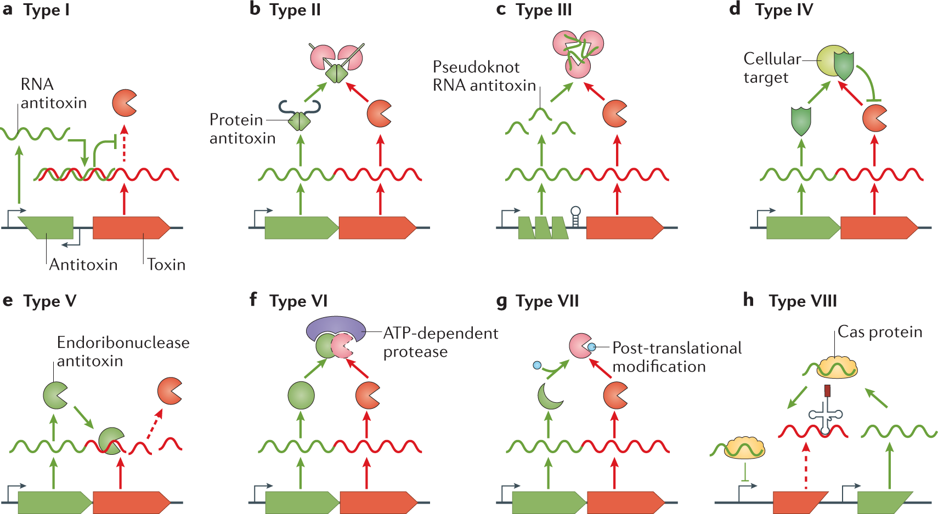
Focus on toxin/antitoxin
With figures we can select some interesting contigs according to multiple unkown genes.
For the beginning of our project, we focus on the potential toxine/antitoxine module. So we need to detect module of 2 genes, in the same strand and in the same operon.

Slide 36
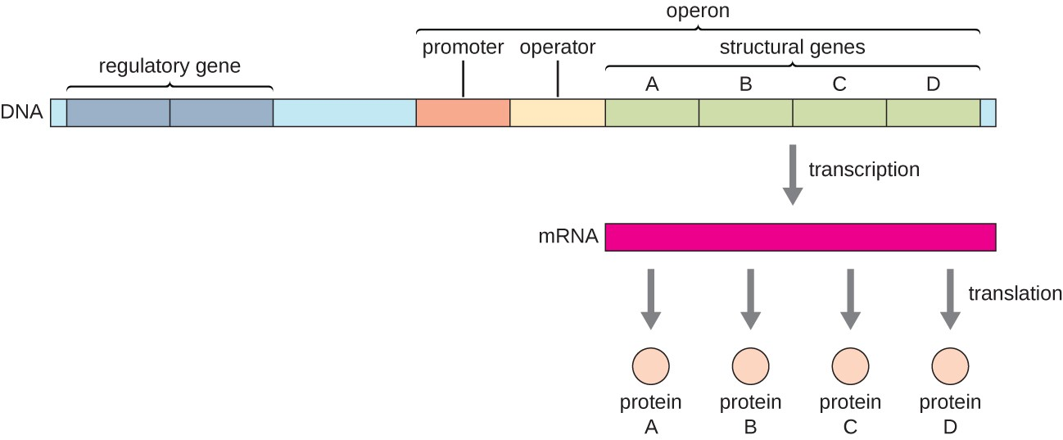
Operon detection
So we need to detect module of 2 «short» genes, in the same strand and in the same operon.
For the operon prediction we can use FgenesB tools.
http://www.softberry.com/berry.phtml?topic=fgenesb&group=programs&subgroup=gfindb

Slide 37
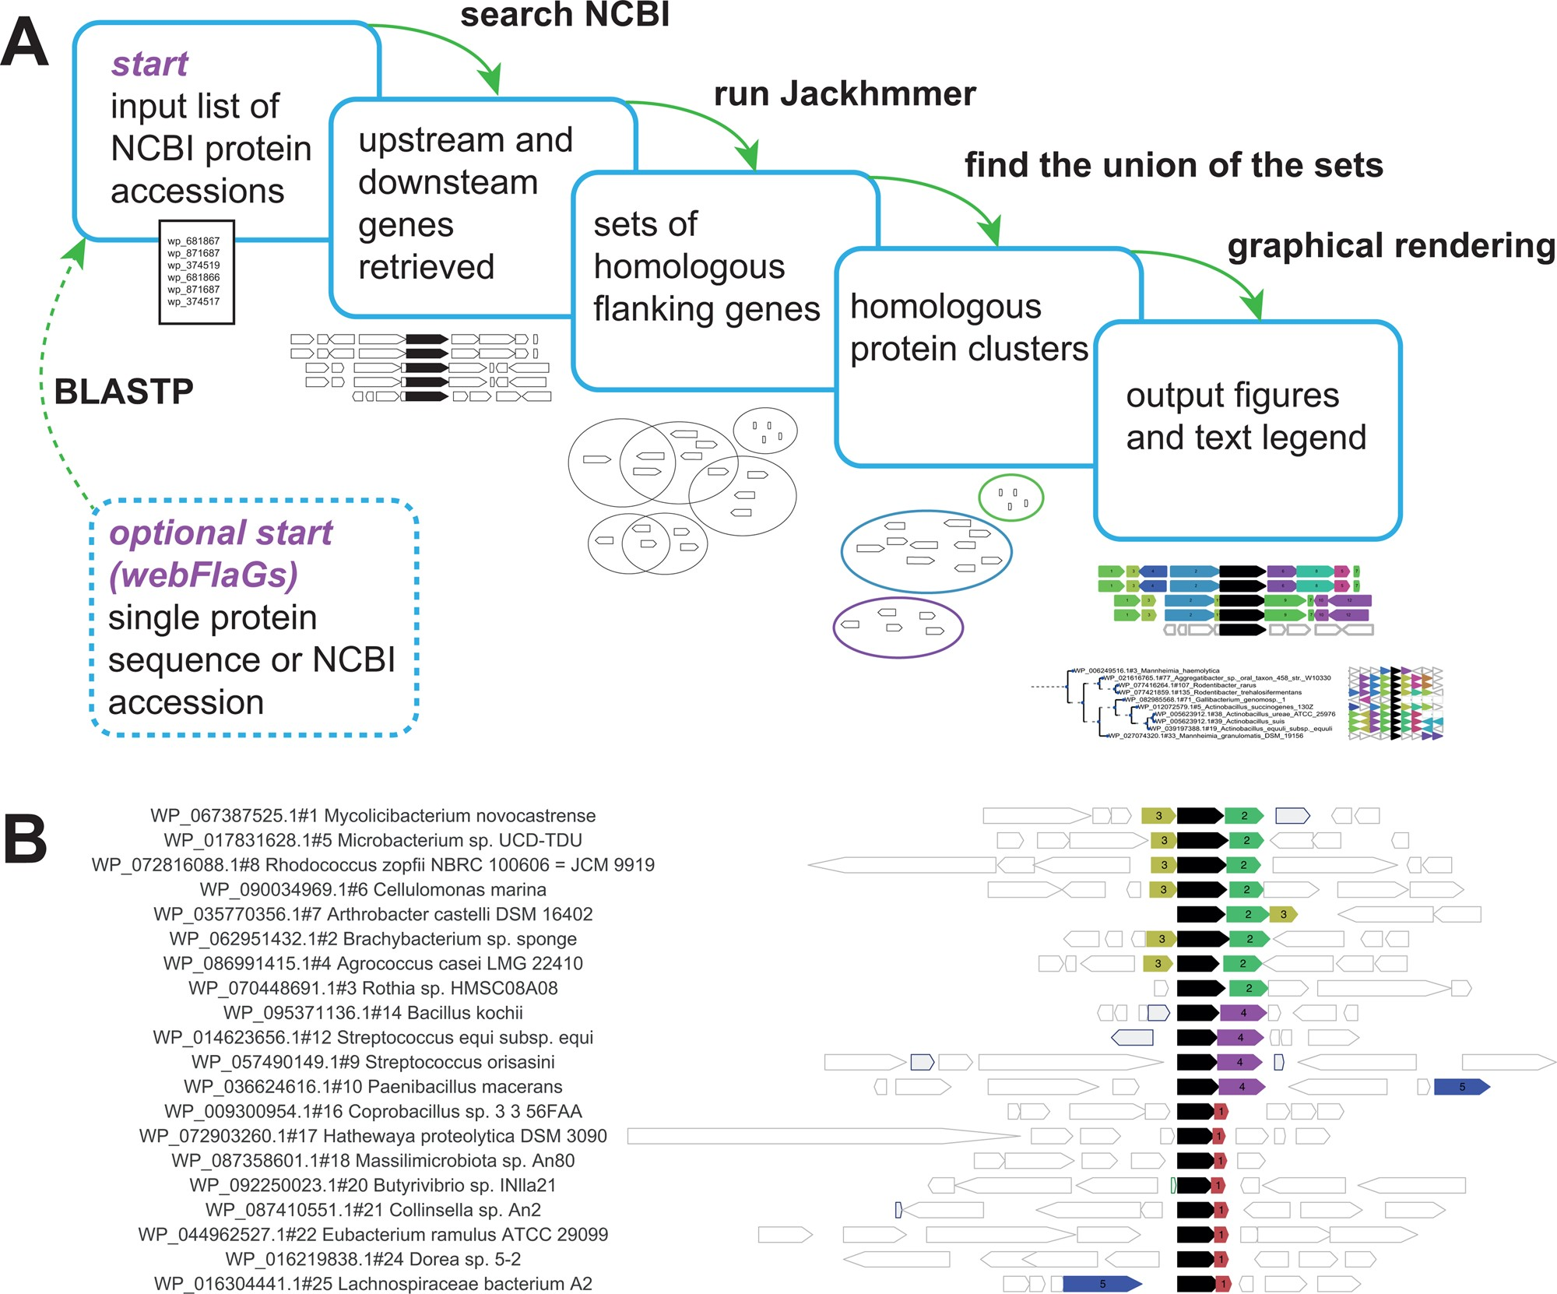
FLAG
So we selected some interesting couple of 2 genes. We need to know if they are together by « chance » or if we can find them together into other organism. For that we are going to use FLAGS.
http://www.webflags.se/
FLAGS : « Predicting protein functional association
by analysis of conservation of genomic context
(Flanking Genes).”

Slide 38
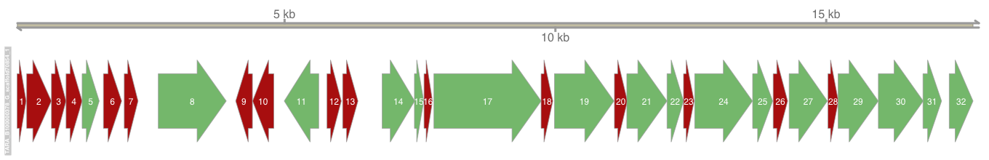
FLAG example
1) Take one figure with successive module of 2 short genes

Slide 39
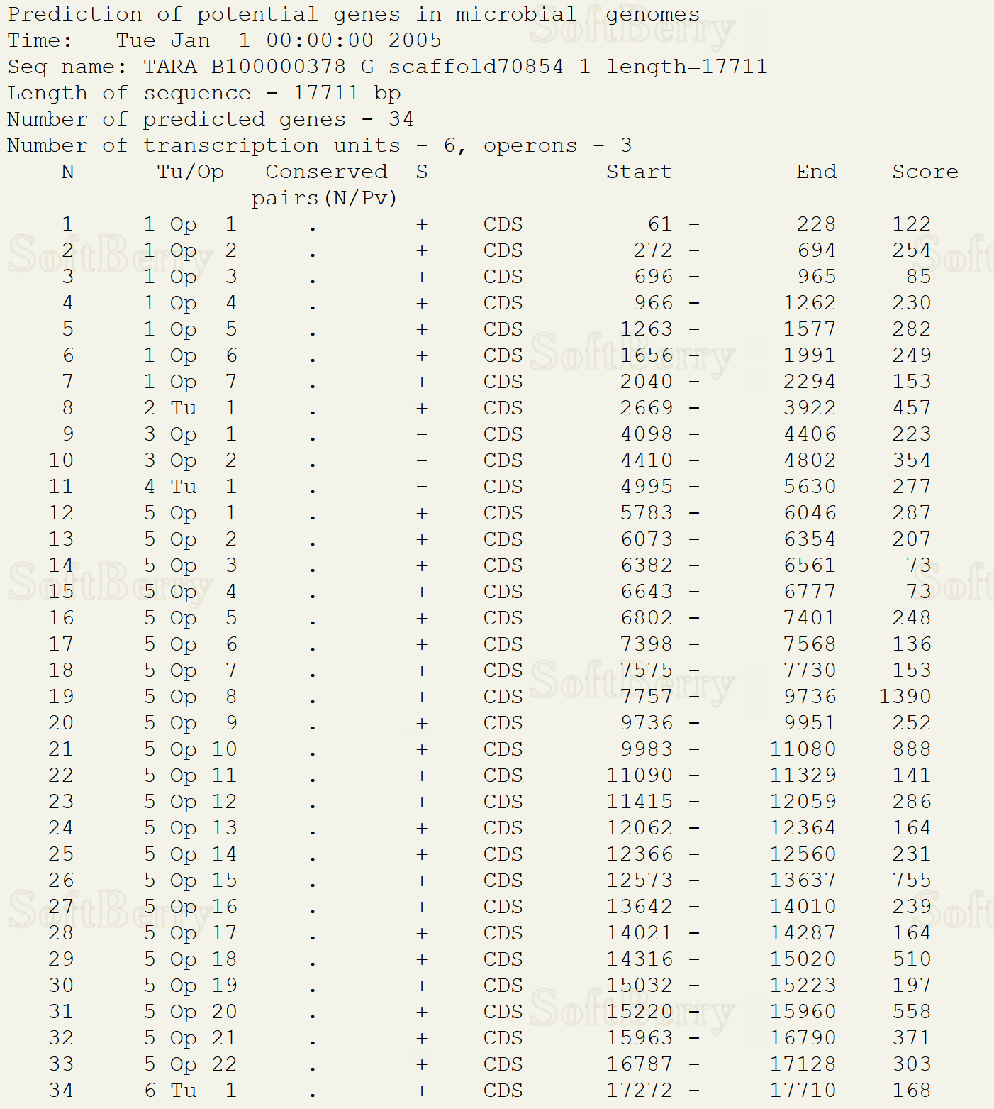
FLAG example
2) Check with FgenesB if they are part of the same operon

Slide 40
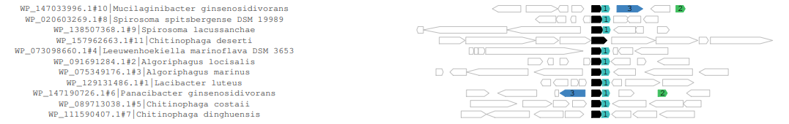
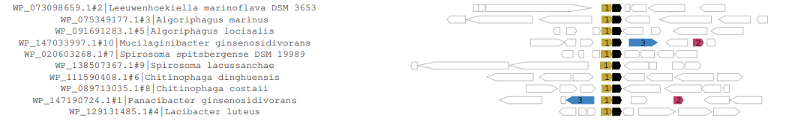
FLAG example
3) Launch webflags for these 2 genes
10
9

Slide 41
Work
Launch the same 3 steps with some interesting other couples of two genes
For example
Select good contigs based on figure
Check if they are on the same operon
We launch on Flags
We select the ones to launch on Alphafold

Slide 42
Alphafold

Slide 43
Day 7 :Results analyze
We take all result to analyze the figured and the unknown genes and select the potential defense system.
Maybe some explanation of experimental part (killing rescue test)

Slide 44
Annexe : identification of Tyrosine recombinase
As we saw in introduction, defense system are often near of mobile genetic element.
So we have got a hmm file of Tyrosine recombinase and we want to color our figure to detect tyrosine recombinase and so select best candidates for experimental validation.
How we can do that?

