Slide 1
SkillLift : A Platform for Skill-Based Job Matching
TEAM CREED
Team Member 1: Akhil Duggineni
Team Member 2 : Kuchipudi Yokshith Sairam Chowdary

Slide 2
AGENDA
1 Introduction to SkillLift
2 Identifying the Problem
3 User Personas
4 Research Insights
5 Skill-Based Profiles
6 Recruiter Features
7 Platform Features Overview
8 Benefits for Job Seekers
9 Benefits for Recruiters
10 Future Ideas and Enhancements
11 Success Metrics
12 Lessons Learned from Research
13 Conclusion and Call to Action

Slide 3

Introduction to SkillLift A Paradigm Shift in Job Matching
1.Overview of SkillLift concept: SkillLift revolutionizes the job marketplace by focusing on an individual's skills rather than traditional qualifications. This shift fosters a more inclusive environment that serves a diverse range of job seekers and empowers them with the tools necessary to connect effectively with potential employers.
2.Importance of skills over degrees: In an evolving job landscape, skills are becoming the new currency. Employers increasingly prioritize practical skills and experience over educational credentials. This approach aligns candidates with roles that truly match their capabilities, ultimately benefiting both parties.
3.Target audience: SkillLift caters to bootcamp graduates, self- learners, and career switchers-individuals who often possess relevant skills but lack formal requirements. By addressing their unique challenges, SkillLift aims to facilitate a smoother integration into the professional workforce

Slide 4

Identifying the Problem Challenges in the Modern Job Market
Challenges faced by job seekers
Job seekers today confront considerable barriers, from misalignment with job roles based on rigid criteria to a lack of visibility amidst a sea of applicants. Navigating this complex landscape can hinder their chances of securing desirable positions, leading to frustration and disengagement
Frustrations of recruiters
Recruiters often encounter difficulties due to the overwhelming volume of resumes that may not reflect true candidate fit. The traditional process can be time-consuming and inefficient, as many candidates lack the relevant skills or experience that align with open positions.
Statistics on job market trends Recent studies indicate a growing disconnect between employer expectations and candidate qualifications. For instance, over 70% of employers report challenges in finding suitable candidates, especially in tech and skilled labor sectors. This discrepancy highlights the urgent need for innovative hiring solutions.

Slide 5
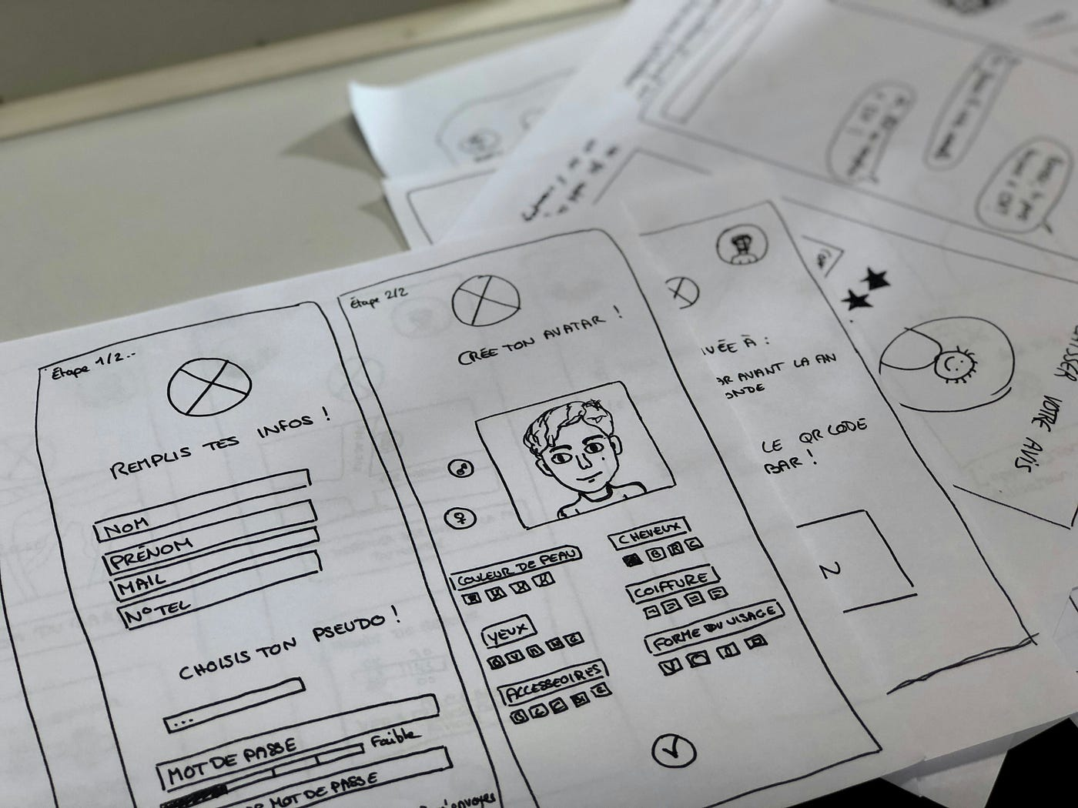
User Personas Understanding Our Audience
Profiles of job seekers: Our user personas encompass bootcamp graduates eager to enter the workforce, self-taught individuals showcasing their capabilities, and career switchers leveraging transferable skills. Each group presents distinct narratives that reveal their motivations, aspirations, and challenges in job searching.
Characteristics of recruiters: Recruiters are typically pressed for time, seeking effective tools that can streamline their hiring process. They prefer candidates who not only possess the right skills but also have demonstrable experience and cultural fit within their organizations.
Understanding user needs and pain points: By mapping out the needs and pain points of both job seekers and recruiters, we gain insights that inform the design and functionality of SkillLift, ensuring that it serves as an effective tool for overcoming barriers in the job matching process.

Slide 6



Research Insights Understanding Market Needs
Summary of research methods
A combination of qualitative and quantitative research methods was employed, including user interviews, digital surveys, and market trend analysis. This multifaceted approach ensures a well-rounded understanding of user desires and market gaps.
Key findings from reports and interviews
Our research highlights critical findings: a significant gap between skills possessed and those sought by employers, as well as a lack of awareness among job seekers about how to effectively present their skills to recruiters.
Common themes in user feedback Recurring themes emerged from user feedback, including a desire for greater visibility of skills, the need for validation through endorsements, and frustrations with traditional hiring practices that overlook diverse backgrounds.

Slide 7

Skill-Based Profiles Empowering Users Through Skills
Creating profiles based on skills and projects: SkillLift enables users to craft dynamic profiles centered around their skills and completed projects. This approach helps to highlight practical abilities that align more closely with potential job roles.
Importance of endorsements and badges: Endorsements and digital badges serve as social proof I proof of an individual's skills and work ethic, enhancing credibility. They also motivate users to engage more fully with the platform by showcasing their accomplishments.
User experience in profile creation: The platform emphasizes an intuitive user experience, providing guidance during profile creation. Users are supported in effectively articulating their skills and showcasing their work through an easy-to-navigate interface.

Slide 8

Recruiter Features Enhancing the Hiring Experience
Filters for skill-based searches SkillLift incorporates advanced search functionalities that allow recruiters to filter candidates based on specific skills and competencies. This targeted approach saves time and enhances accuracy in identifying suitable candidates.
Viewing real work and projects Recruiters can access a portfolio of real work and projects submitted by candidates, providing valuable insights into applicants' capabilities beyond traditional resumes. This functionality bridges the gap between skillsets and job requirements.
Streamlining the hiring process
By reducing time spent on unnecessary screenings, SkillLift allows recruiters to engage more deeply with potential candidates. This efficiency not only shortens hiring cycles but also enhances the overall quality of hires.

Slide 9
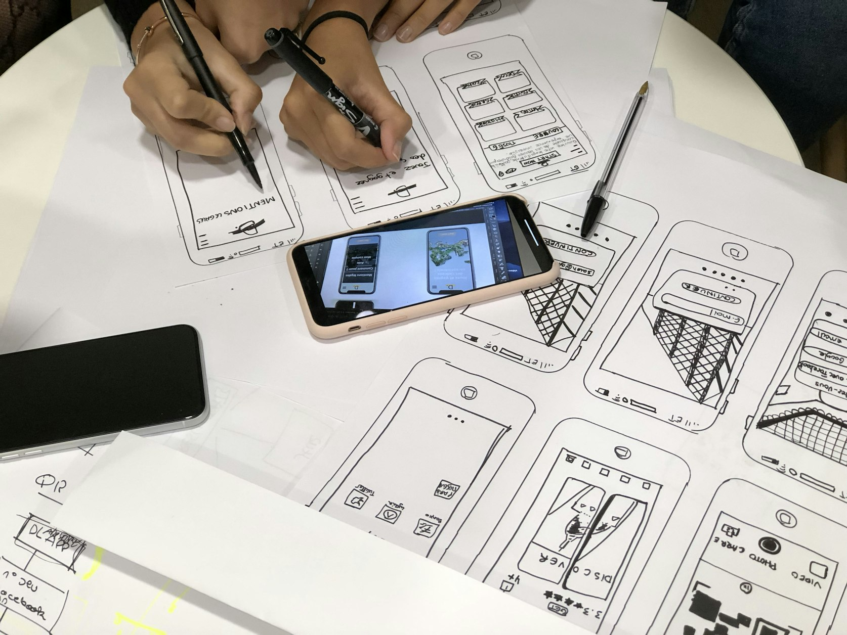
Platform Features Overview Core Functionalities of SkillLift
Key functionalities of SkillLift: SkillLift includes functionalities such as skill assessments, project showcases, and collaboration tools. These features enable both job seekers and recruiters to communicate and interact effectively, fostering a vibrant community.
User interface design: The platform prioritizes a clean, user-friendly interface that promotes accessibility. Attention to detail in UI design ensures a seamless experience for both job seekers and recruiters alike, encouraging engagement and usability.
Integration of feedback mechanisms: To continuously enhance the user experience, SkillLift incorporates feedback tools that allow both users and recruiters to voice their opinions and suggestions, driving ongoing improvements and adaptations.

Slide 10



Benefits for Job Seekers Unlocking Opportunities with SkillLift
Increased visibility for skilled individuals
By emphasizing skills and projects, job seekers gain increased visibility in a competitive job market. SkillLift allows them to rise above conventional resumes and present their true capabilities to potential employers.
Opportunities for showcasing real projects
Job seekers are empowered to display tangible evidence of their skills through real projects and portfolios, demonstrating their capabilities in practical contexts instead of relying solely on theoretical experience.
Building a professional network SkillLift fosters connections among users, allowing job seekers to network with peers and recruiters, significantly enhancing their opportunities for mentorship, collaboration, and career advancement.

Slide 11



Benefits for Recruiters Optimizing Your Talent Acquisition
Access to a pool of skilled candidates Recruiters gain direct access to a diverse, qualified talent pool that has been curated based on skills, experience, and project work, leading to a more efficient talent acquisition process.
Efficient hiring process
SkillLift streamlines the hiring process through precise filtering and advanced tools, reducing the time spent in unproductive searches and allowing recruiters to focus on engaging with top-tier candidates.
Reducing time to fill positions
By leveraging SkillLift's capabilities, recruiters can effectively decrease the time needed to fill job openings, improving their overall recruiting efficiency and enabling quicker onboarding of talent.

Slide 12



Future Ideas and Enhancements Strategic Direction for SkillLift
Potential features for future development
We envision the introduction of Al-powered matching algorithms that could better align candidates' skills with job openings, as well as enhanced training modules for skill development directly on the platform.
Long-term vision for SkillLift
SkillLift aims to establish itself as a leading platform in skill-based hiring, continuously adapting to the changing job market to deliver unmatched value to users and evolve with industry standards.
Adapting to market changes
By staying attuned to industry trends, SkillLift is poised to implement features that address emerging skills and competencies, ensuring that users remain competitive in an ever-evolving landscape.

Slide 13
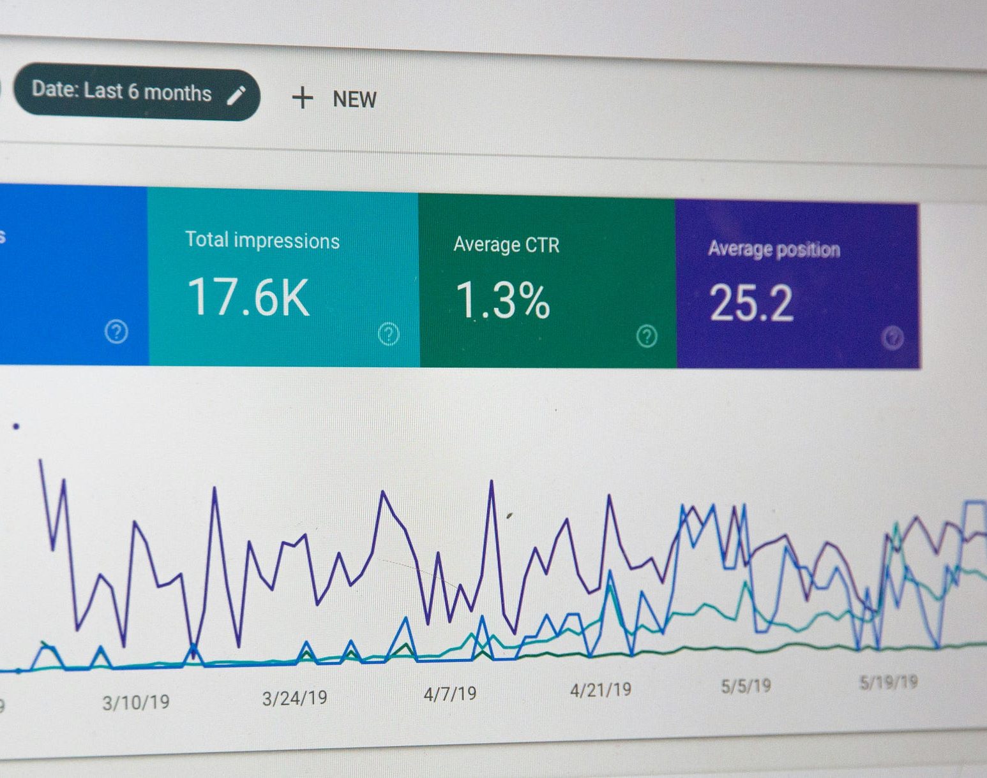
Success Metrics Tracking Our Growth
Key performance indicators for SkillLift: Success for SkillLift will be measured through various KPIs such as user registration rates, active engagement levels, and the number of successful job placements achieved through the platform.
Measuring user engagement and satisfaction: User feedback will be regularly collected and analyzed to ensure satisfaction levels remain high. Metrics such as profile completeness, frequency of interaction, and feedback scores will inform improvements.
Tracking hiring success rates: Metrics around hiring success-such as the average time to hire, candidate quality feedback from recruiters, and job offer acceptance rates-will provide valuable insights into the effectiveness of the platform.

Slide 14
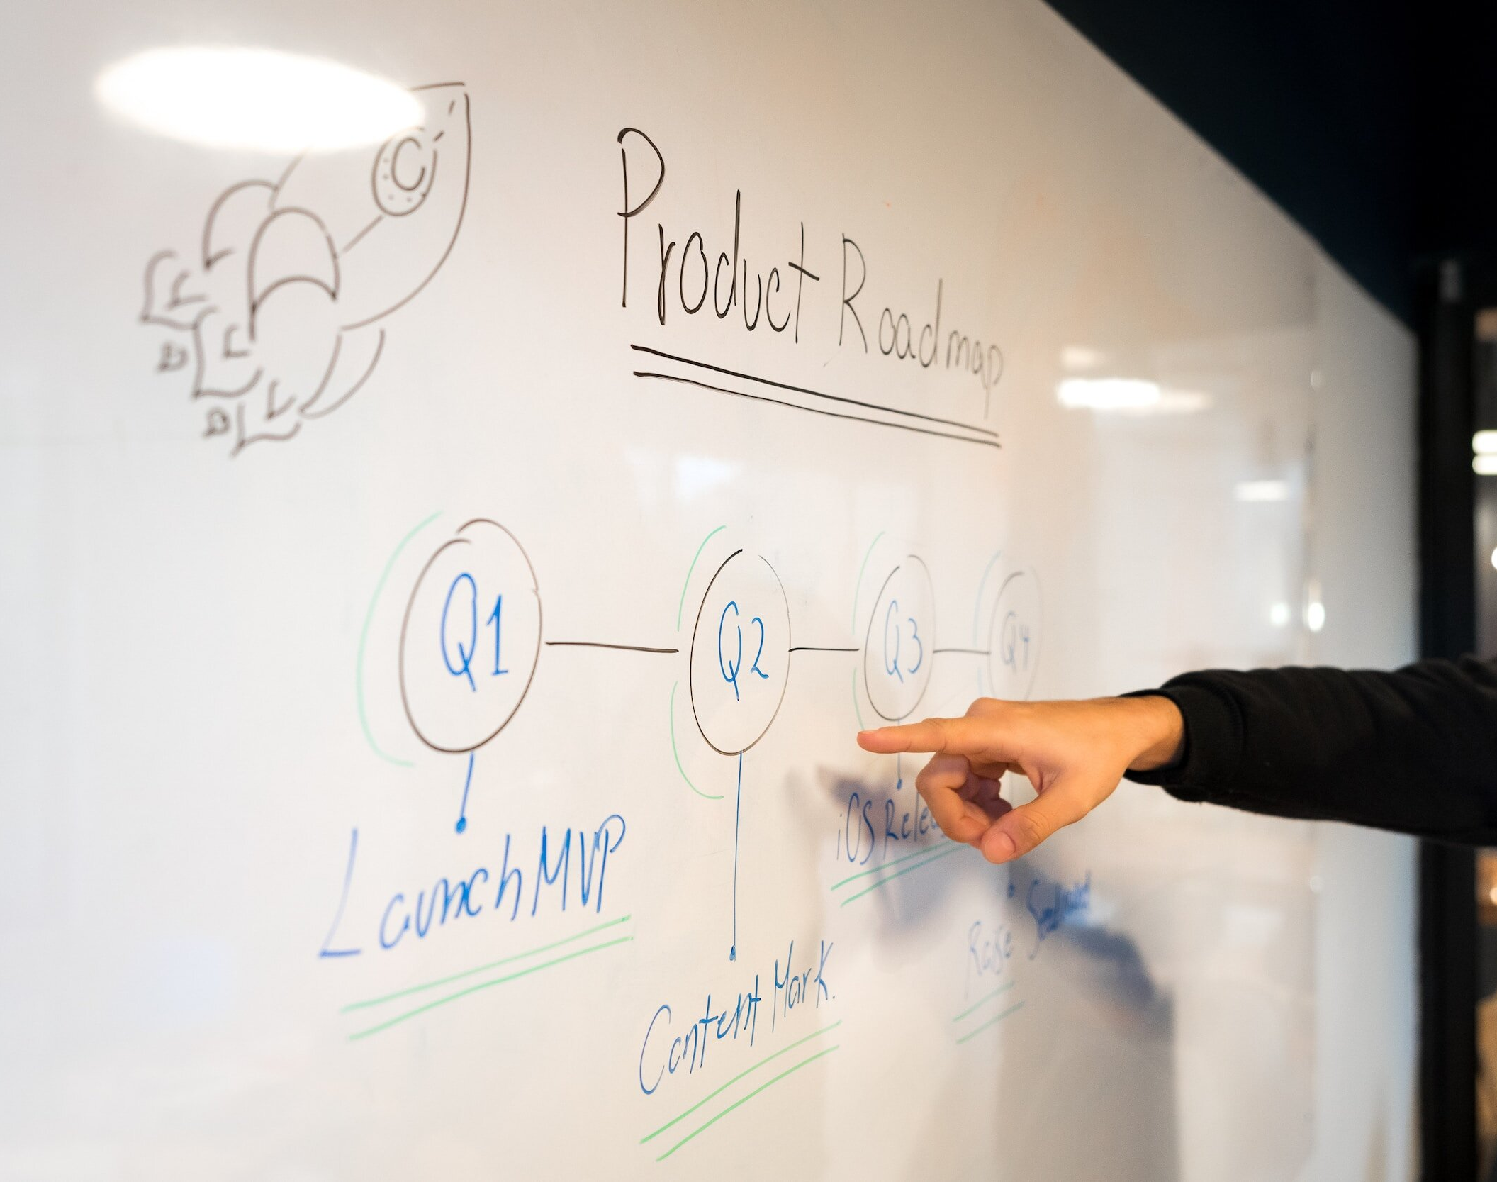
Lessons Learned from Research Embracing Growth and Adaptation
Insights gained from user interviews: Through direct interviews, we uncovered valuable insights into user priorities and concerns, helping us validate assumptions and align our platform with user expectations.
Adjustments made to the platform based on feedback: User feedback has already influenced platform adjustments, such as feature enhancements and user interface refinements, ensuring the development is user-centered.
Importance of continuous improvement: The dynamic nature of the job market necessitates perpetual adaptation. By championing a culture of ongoing feedback and responsiveness, SkillLift will evolve consistently to meet user needs.

Slide 15

Conclusion and Call to Action
Recap of SkillLift's mission: In summary, SkillLift is dedicated to bridging the gap between job seekers and employers by prioritizing skills over traditional qualifications, fostering a more equitable job market.
Encouragement for collaboration and investment: We invite stakeholders, investors, and partners to join us in this endeavor, contributing to the evolution of the job market and building a better future for skilled individuals.
Next steps for interested stakeholders: To those interested in shaping the future of SkillLift, we encourage dialogue and collaboration. Together, we can work towards innovative strategies that empower job seekers and refine recruitment processes.

