Slide 1

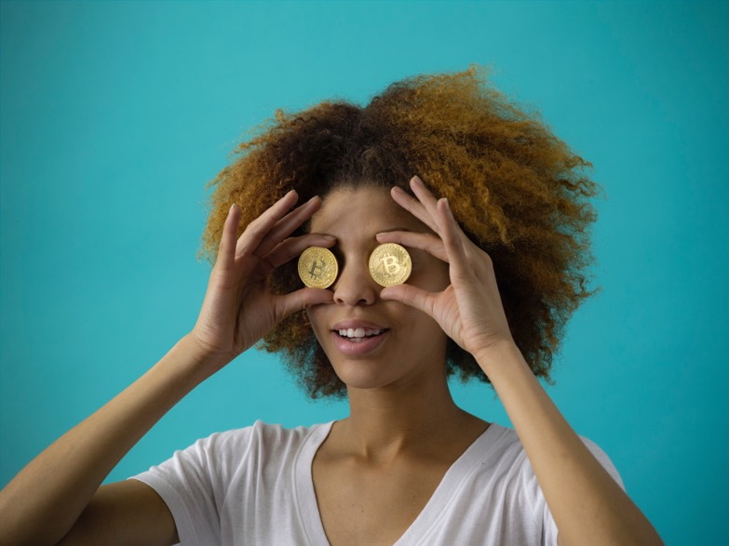
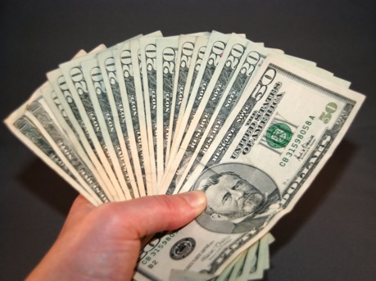


ESL-
OLOGY.
COM
Who’s a Pre-Intermediate Millionaire?
Hundred DOLLAR Question$!!

Slide 2
Past Tenses
Comparatives/
Superlatives
Present Perfect
Phrasal Verbs
Vocab
$100
$100
$100
$100
$100
$200
$200
$200
$200
$200
$300
$300
$300
$300
$300
$400
$400
$400
$400
$400

Slide 3
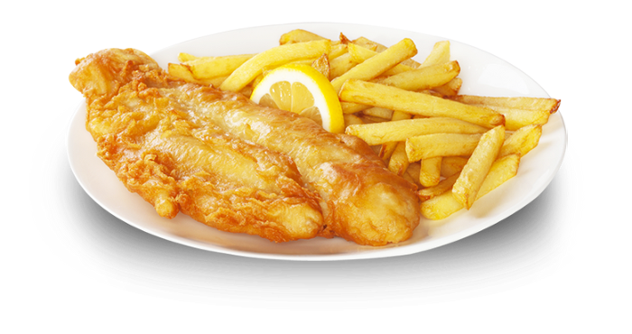
$100
_________________________________________ ?
(dinner?) They had fish and chips.

Slide 4
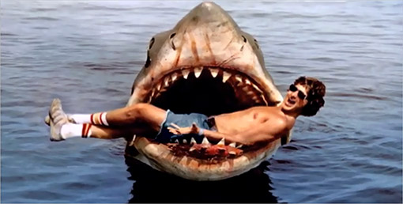
$200
________________________________________ ?
(film?) Yes, it was very exciting.

Slide 5
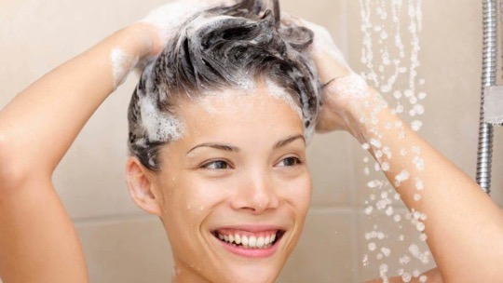
$300
________________________________________________ ?
(sleep / 11 p.m.?) No, she was washing her hair.

Slide 6
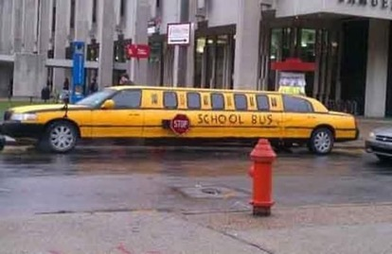
$400
___________________________________________ ?
(that school?) Yes, he used to go to that school.

Slide 7
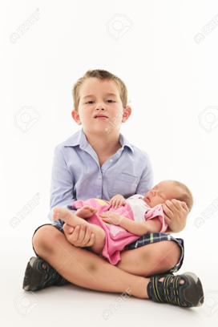
$100
My sister is younger than me.
My sister is ________ ________ old __________ me.

Slide 8
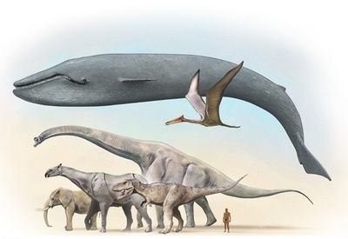
$200
All the other animals in the world are smaller than a blue whale.
The blue whale is __________ __________ animal in the world.

Slide 9
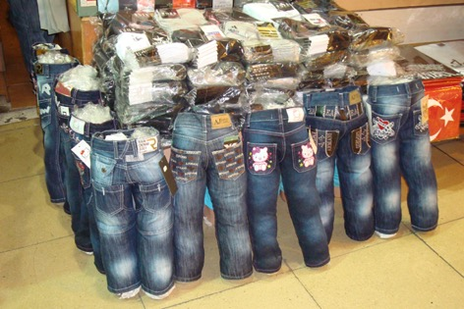
$300
All the other jeans in the shop are cheaper than these ones.
These are __________ __________ __________ jeans in the shop.

Slide 10
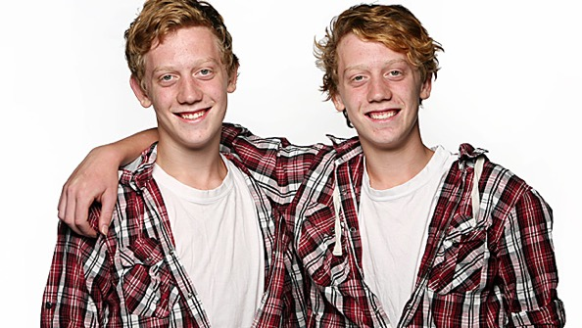
$400
My brother and I are exactly the same height.
I'm _________ __________ __________ my brother.

Slide 11

$100
____________________________________________ ?
(US?) No, he hasn’t. He’s never been abroad.

Slide 12
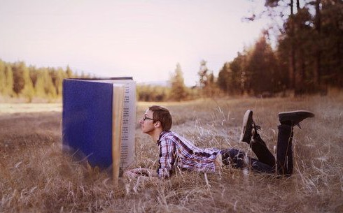
$200
I finished reading this book a few seconds ago.
I have __________ __________ reading this book.

Slide 13
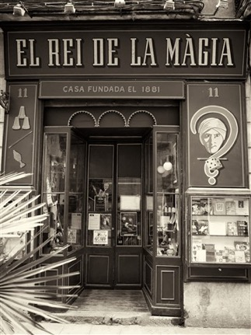
$300
There _____________ (be) a shop here ___________ 1881.

Slide 14
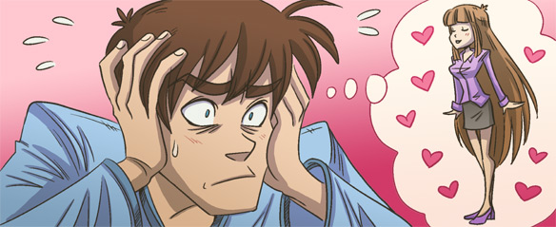
$400
He _______________ (try) to forget her ___________ she left him.

Slide 15


$100
They're giving _ _ _ _ a free DVD with this magazine.

Slide 16

$200
Has the new series of Stranger Things come _ _ _ yet?
I can't wait to see it.

Slide 17
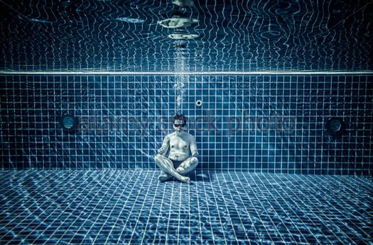
$300
I think I'm going to sign _ _ for swimming lessons.

Slide 18

$400
I check news websites, to keep up _ _ _ _ current affairs.

Slide 19
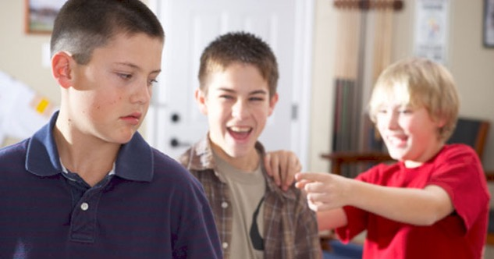
$100
1 Some children at school are being unkind to Kevin because his hair isn’t very cool.
___________________ (boasting bullying crying)

Slide 20
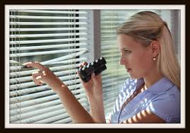
$200
Ruth is always trying to find out information about other people's lives. I don't really like her.
___________________ (active friendly nosy)

Slide 21
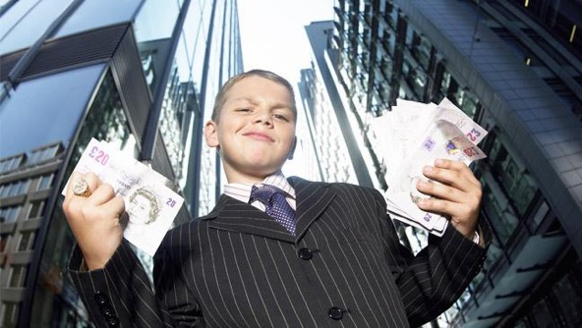
$300
Telling everyone how rich you are won't help you
to make friends. ___________________
(complaining generous boasting)

Slide 22
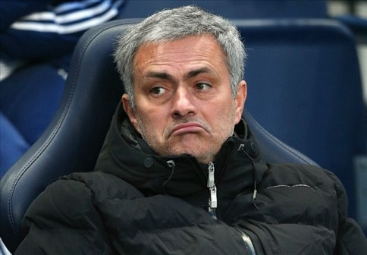
$400
I know that you hate losing games, but don't get really angry and refuse to talk to everyone.
___________________ (sulking friendly intelligent)

Slide 23
By Dug/Esl-ology.com/ Free to use with attribution icons made by Pixel Perfect and flatart_icons from www.flaticon.com.
Bitcoin woman photo by Thought Catalog on Unsplash.com

