Slide 1
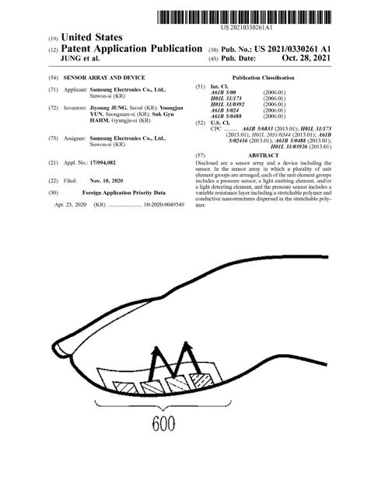

Slide 2
Patnet No:US20210330261A1 Title : Sensor array and device Inventor:['Jiyoung JUNG', 'Youngjun YUN', 'Suk Gyu HAHM'] Company: ['SamsungElectronicsCoLtd'] Filed Date : ['2020-11-10'] Abstract : Disclosed are a sensor array and a device including the sensor. In the sensor array in which a plurality of unit element groups are arranged each of the unit element groups includes a pressure sensor a light emitting element and/or a light detecting element and the pressure sensor includes a variable resistance layer including a stretchable polymer and conductive nanostructures dispersed in the stretchable polymer.

Slide 3
1. A sensor array, the sensor array comprising a plurality of unit element groups,wherein each of the unit element groups comprises a pressure sensor, a light emitting element, and a light detecting element, and the pressure sensor comprises a variable resistance layer comprising a stretchable polymer and conductive nanostructures dispersed in the stretchable polymer.
[' 2. The sensor array of claim 1 wherein the stretchable polymer comprises a polyorganosiloxane an elastomer comprising a butadiene moiety an elastomer comprising a urethane moiety an elastomer comprising an acrylic moiety an elastomer comprising an olefin moiety an inorganic elastomer a derivative thereof or a combination thereof.' ' 3. The sensor array of claim 1 wherein the conductive nanostructures comprise carbon nanotubes carbon nanowires carbon nanoplates carbon nanoflakes carbon nanofibers carbon nanocomposites carbon nanoparticles metal nanotubes metal nanowires metal nanoplates metal nanoflakes metal nanofibers metal nanocomposites metal nanoparticles graphene or a combination thereof.' ' 4. The sensor array of claim 3 wherein an aspect ratio of the conductive nanostructures be greater than or equal to about 10.' ' 5. The sensor array of claim 1 wherein the conductive nanostructures are included in an amount of about 0.001 wt % to about 50 wt % based on a total amount of the stretchable polymer and the conductive nanostructures.' ' 6. The sensor array of claim 1 wherein the pressure sensor further comprises a pair of electrodes.' ' 7. The sensor array of claim 1 wherein a resistance variation rate of the pressure sensor in a pressure range of about 15 kPa to 35 kPa is greater than or equal to about 20%.' ' 8. The sensor array of claim 1 wherein the light emitting element comprises a first light emitting element and a second light emitting element which is configured to emit light in different wavelength spectra from each other.' ' 9. The sensor array of claim 8 whereinthe first light emitting element is a red light emitting element configured to emit light in a red wavelength spectrum and the second light emitting element is a green light emitting element configured to emit light in a green wavelength spectrum. ' ' 10. The sensor array of claim 1 wherein the light emitting element comprises an inorganic light emitting diode an organic light emitting diode a micro light emitting diode or a combination thereof.' ' 11. The sensor array of claim 10 wherein the light emitting element is a stretchable light emitting element.' ' 12. The sensor array of claim 1 wherein the light detecting element comprises an inorganic photodiode an organic photoelectric conversion element or a combination thereof.' ' 13. The sensor array of claim 12 wherein the light detecting element is a stretchable light detecting element.' ' 14. The sensor array of claim 1 wherein each unit element group comprises one pressure sensor two light emitting elements and one light detecting element.' ' 15. The sensor array of claim 1 further comprising a stretchable substrate supporting the pressure sensor the light emitting element and the light detecting element.' ' 16. A device comprising the sensor array of claim 1.' ' 17. The device of claim 16 wherein the device is a skin-attachable patch type device or a skin-attachable band type device.' ' 18. The device of claim 16 wherein the device is a photoplethysmography sensor device an electromyography sensor device or a strain sensor device.']

Slide 4
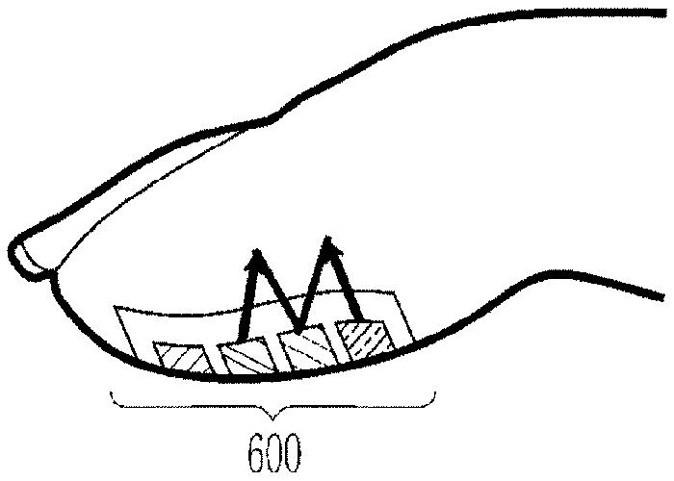

Slide 5
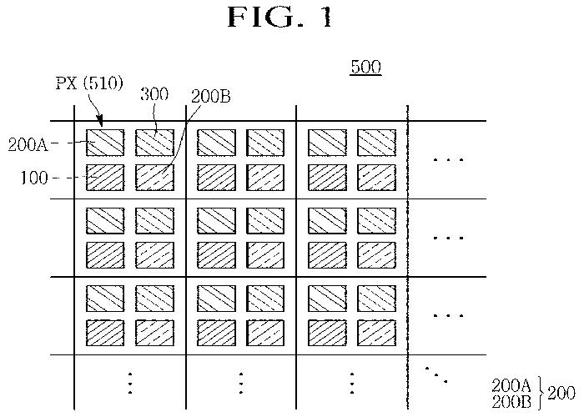
100 pressure sensor 200 light emitting element 300 light detecting element PX each pixel

Slide 6
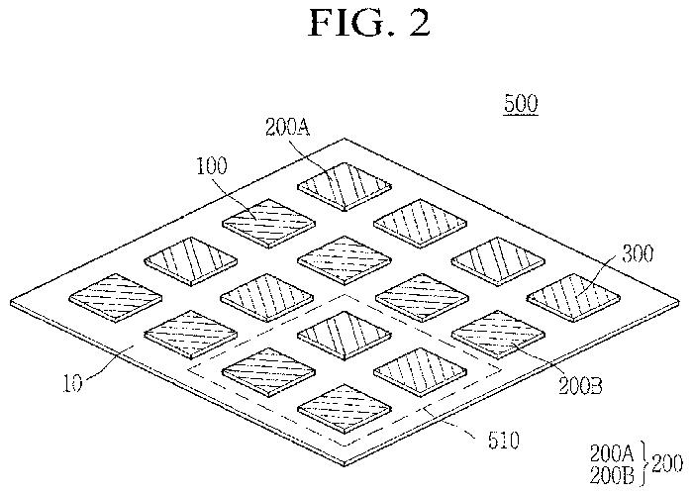
100 pressure sensor 300 light detecting element

Slide 7
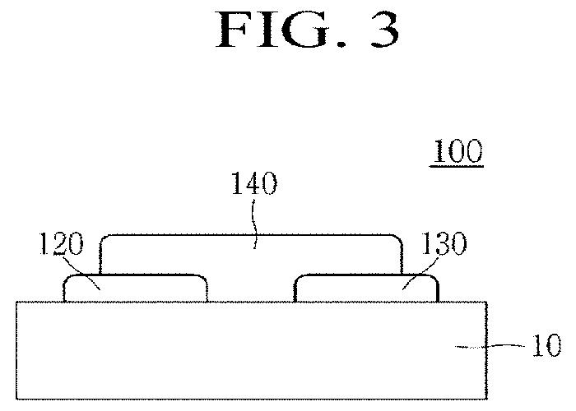
100 pressure sensor 130 electrodes 120

Slide 8
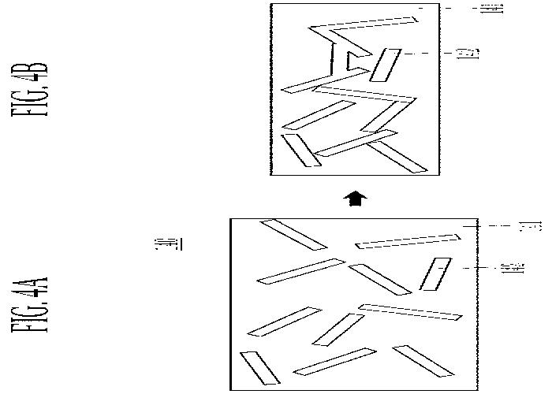

Slide 9
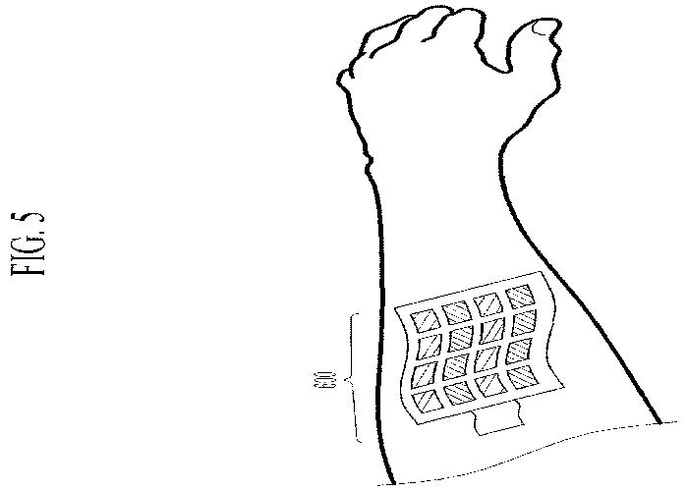

Slide 10
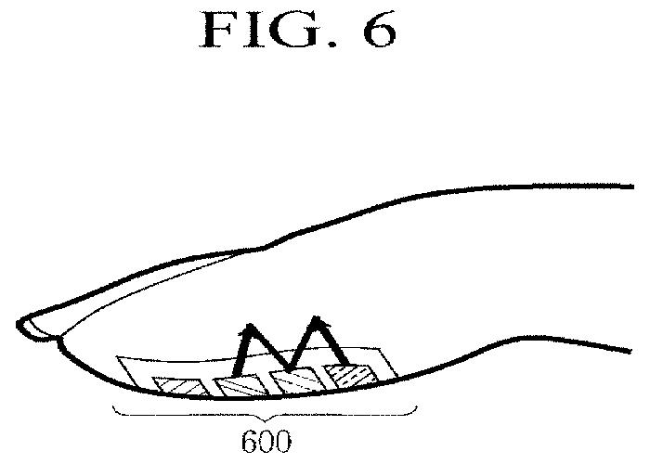

Slide 11
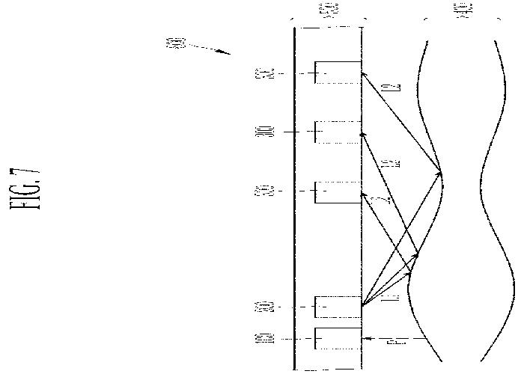

Slide 12
