Slide 1
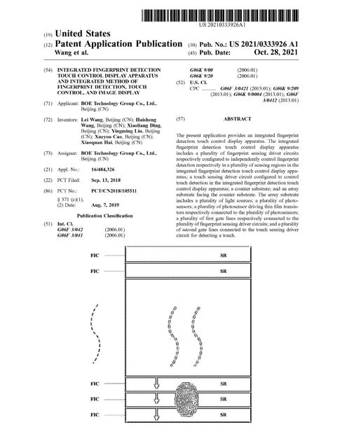

Slide 2
Patnet No:US20210333926A1 Title : Integrated fingerprint detection touch control display apparatus and integrated method of fingerprint detection, touch control, and image display Inventor:['Lei Wang', 'Haisheng Wang', 'Xiaoliang DING', 'Yingming Liu', 'Xueyou CAO', 'Xiaoquan HAI'] Company: ['BOETechnologyGroupCoLtd'] Filed Date : ['2018-09-13'] Abstract : The present application provides an integrated fingerprint detection touch control display apparatus. The integrated fingerprint detection touch control display apparatus includes a plurality of fingerprint sensing driver circuits respectively configured to independently control fingerprint detection respectively in a plurality of sensing regions in the integrated fingerprint detection touch control display apparatus; a touch sensing driver circuit configured to control touch detection in the integrated fingerprint detection touch control display apparatus; a counter substrate; and an array substrate facing the counter substrate. The array substrate includes a plurality of light sources; a plurality of photosensors; a plurality of photosensor driving thin film transistors respectively connected to the plurality of photosensors; a plurality of first gate lines respectively connected to the plurality of fingerprint sensing driver circuits; and a plurality of second gate lines connected to the touch sensing driver circuit for detecting a touch.

Slide 3
1. An integrated fingerprint detection touch control display apparatus, comprising:a plurality of fingerprint sensing driver circuits respectively configured to independently control fingerprint detection respectively in a plurality of sensing regions in the integrated fingerprint detection touch control display apparatus; a touch sensing driver circuit configured to control touch detection in the integrated fingerprint detection touch control display apparatus; a counter substrate; and an array substrate facing the counter substrate; wherein the array substrate comprises: a plurality of light sources configured to emit light toward the counter substrate, at least a portion of the light being totally reflected by a surface of the counter substrate facing away the array substrate; a plurality of photosensors configured to detect the at least the portion of the light being totally reflected by the surface of the counter substrate facing away the array substrate, thereby detecting a fingerprint information; a plurality of photosensor driving thin film transistors respectively connected to the plurality of photosensors, the plurality of photosensor driving thin film transistors and the plurality of photosensors being arranged in a plurality of rows; and a plurality of gate scanning lines respectively connected to the plurality of rows of the plurality of photosensor driving thin film transistors for providing gate scanning signals to the plurality of photosensor driving thin film transistors; and wherein the plurality of gate scanning lines comprise a plurality of first gate lines respectively connected to the plurality of fingerprint sensing driver circuits for independently detecting fingerprint information in each of the plurality of sensing regions, and a plurality of second gate lines connected to the touch sensing driver circuit for detecting a touch.
[' 2. The integrated fingerprint detection touch control display apparatus of claim 1 wherein gate lines of the plurality of first gate lines passing through a same one of the plurality of sensing regions are connected to a same one of the plurality of fingerprint sensing driver circuits; andgate lines of the plurality of first gate lines passing through different ones of the plurality of sensing regions are respectively connected to different ones of the plurality of fingerprint sensing driver circuits. ' ' 3. The integrated fingerprint detection touch control display apparatus of claim 1 wherein the plurality of second gate lines are respectively from the plurality of sensing regions each of the plurality of sensing regions having at least one of the plurality of second gate lines passing there-through.' ' 4. The integrated fingerprint detection touch control display apparatus of claim 1 wherein multiple ones of the plurality of photosensors corresponding to the plurality of second gate lines are configured to detect the touch by detecting an image of a touch object using ambient light as a light source.' ' 5. The integrated fingerprint detection touch control display apparatus of claim 1 wherein multiple ones of the plurality of photosensors corresponding to the plurality of second gate lines are configured to detect the touch by detecting an image of a touch object using light emitted from multiple ones of the plurality of light sources as a light source.' ' 6. The integrated fingerprint detection touch control display apparatus of claim 5 wherein the integrated fingerprint detection touch control display apparatus is operated in a time-division mode comprising a display mode and a touch sensing mode;the integrated fingerprint detection touch control display apparatus is configured to display an image during the display mode; and the plurality of light sources are configured to display an image having a grayscale higher than a threshold value for providing light for detecting the image of the touch object. ' ' 7. The integrated fingerprint detection touch control display apparatus of claim 1 further comprising one or more light sensors configured to detect a light intensity of ambient light;wherein in response to the light intensity of ambient light being no less than a threshold value multiple ones of the plurality of photosensors corresponding to the plurality of second gate lines are configured to detect the touch by detecting an image of a touch object using ambient light as a light source; and wherein in response to the light intensity of ambient light being below a threshold value multiple ones of the plurality of photosensors corresponding to the plurality of second gate lines are configured to detect the touch by detecting an image of a touch object using light emitted from multiple ones of the plurality of light sources as a light source. ' ' 8. The integrated fingerprint detection touch control display apparatus of claim 1 further comprising a processor configured to determine a touch region in which the touch occurs and determine one or more active fingerprint sensing driver circuits out of the plurality of fingerprint sensing driver circuits each of the one or more active fingerprint sensing driver circuits is connected to at least one gate line of the plurality of first gate lines passing through the touch region;wherein the one or more active fingerprint sensing driver circuits are configured to provide gate scanning signals to multiple rows of the plurality rows of the plurality of photosensor driving thin film transistors connected to the one or more active fingerprint sensing driver circuits. ' ' 9. The integrated fingerprint detection touch control display apparatus of claim 8 wherein the processor is further configured to determine one or more idle fingerprint sensing driver circuits out of the plurality of fingerprint sensing driver circuits gate lines connected to the one or more idle fingerprint sensing driver circuits passing through a region outside the touch region;wherein the one or more idle fingerprint sensing driver circuits are configured not to provide gate scanning signals. ' ' 10. The integrated fingerprint detection touch control display apparatus of claim 1 wherein the plurality of sensing regions are sequentially arranged along a direction perpendicular to the plurality of gate scanning lines.' ' 11. The integrated fingerprint detection touch control display apparatus of claim 1 wherein the plurality of second gate lines are respectively further connected to the plurality of fingerprint sensing driver circuits;wherein the integrated fingerprint detection touch control display apparatus is operated in a time-division mode comprising a touch sensing mode and a fingerprint detection mode; the plurality of second gate lines in the touch sensing mode are configured to detect a touch; and the plurality of first gate lines and the plurality of second gate lines in the fingerprint detection mode are configured to detect fingerprint information. ']

Slide 4
12. (canceled)
[]

Slide 5
13. An integrated method of fingerprint detection, touch control, and image display, comprising:independently controlling fingerprint detection respectively in a plurality of sensing regions in an integrated fingerprint detection touch control display apparatus by a plurality of fingerprint sensing driver circuits respectively; and controlling touch detection in the integrated fingerprint detection touch control display apparatus by a touch sensing driver circuit; wherein independently controlling fingerprint detection and controlling touch detection comprise: emitting light using a plurality of light sources in an array substrate of the integrated fingerprint detection touch control display apparatus toward a counter substrate facing the array substrate, at least a portion of the light being totally reflected by a surface of the counter substrate facing away the array substrate; detecting the at least the portion of the light being totally reflected by the surface of the counter substrate facing away the array substrate using a plurality of photosensors, thereby detecting a fingerprint information; and providing gate scanning signals respectively to a plurality of rows of a plurality of photosensor driving thin film transistors respectively connected to the plurality of photosensors in the plurality of rows; wherein providing gate scanning signals comprises: providing gate scanning signals from the plurality of fingerprint sensing driver circuits respectively through a plurality of first gate lines of the plurality of gate scanning lines, for independently detecting fingerprint information in each of the plurality of sensing regions; and providing second gate scanning signals from the touch sensing driver circuit to a plurality of second gate lines of the plurality of gate scanning lines respectively, for detecting a touch.
[' 14. The method of claim 13 wherein gate scanning signals from a same one of the plurality of fingerprint sensing driver circuits are provided to gate lines of the plurality of first gate lines passing through a same one of the plurality of sensing regions; andgate scanning signals from different ones of the plurality of fingerprint sensing driver circuits are provided to gate lines of the plurality of first gate lines passing through different ones of the plurality of sensing regions. ' ' 15. The method of claim 13 wherein the second gate scanning signals are provided to the plurality of second gate lines respectively in the plurality of sensing regions each of the plurality of sensing regions having at least one of the plurality of second gate lines passing there-through.' ' 16. The method of claim 13 wherein detecting the touch comprises detecting an image of a touch object by multiple ones of the plurality of photosensors corresponding to the plurality of second gate lines using ambient light as a light source.' ' 17. The method of claim 13 wherein detecting the touch comprises detecting an image of a touch object by multiple ones of the plurality of photosensors corresponding to the plurality of second gate lines using light emitted from multiple ones of the plurality of light sources as a light source.' ' 18. The method of claim 17 further comprising operating the integrated fingerprint detection touch control display apparatus in a time-division mode comprising a display mode and a touch sensing mode;displaying an image during the display mode; and displaying an image having a grayscale higher than a threshold value by the plurality of light sources for providing light for detecting the image of the touch object. ' ' 19. The method of claim 13 further comprising detecting a light intensity of ambient light by one or more light sensors;in response to the light intensity of ambient light being no less than a threshold value detecting the touch comprises detecting an image of a touch object by multiple ones of the plurality of photosensors corresponding to the plurality of second gate lines using ambient light as a light source; and in response to the light intensity of ambient light being below a threshold value detecting an image of a touch object using light emitted from multiple ones of the plurality of light sources as a light source by multiple ones of the plurality of photosensors corresponding to the plurality of second gate lines using ambient light as a light source. ' ' 20. The method of claim 13 subsequent to detecting the touch further comprising:determining a touch region in which the touch occurs; determining one or more active fingerprint sensing driver circuits out of the plurality of fingerprint sensing driver circuits each of the one or more active fingerprint sensing driver circuits is connected to at least one gate line of the plurality of first gate lines passing through the touch region; and providing gate scanning signals by the one or more active fingerprint sensing driver circuits to multiple rows of the plurality rows of the plurality of photosensor driving thin film transistors connected to the one or more active fingerprint sensing driver circuits. ']

Slide 6
21. (canceled)
[' 22. The method of claim 13 further comprising operating the integrated fingerprint detection touch control display apparatus in a time-division mode comprising a touch sensing mode and a fingerprint detection mode;wherein providing the second gate scanning signals from the touch sensing driver circuit is performed in the touch sensing mode; and providing the gate scanning signals from the plurality of fingerprint sensing driver circuits is performed in the fingerprint detection mode; wherein providing the gate scanning signals from the plurality of fingerprint sensing driver circuits comprises providing the gate scanning signals from the plurality of fingerprint sensing driver circuits respectively through the plurality of first gate lines and the plurality of second gate lines of the plurality of gate scanning lines for independently detecting fingerprint information in each of the plurality of sensing regions. ']

Slide 7
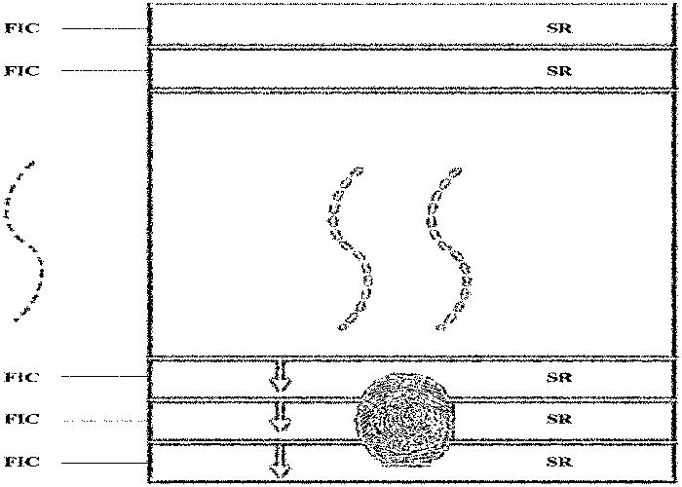
FIC sensing driver circuits SR sensing regions

Slide 8
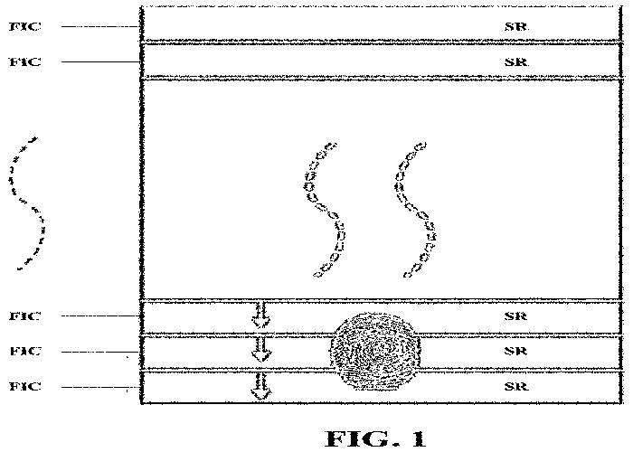
FIC sensing driver circuits SR sensing regions

Slide 9
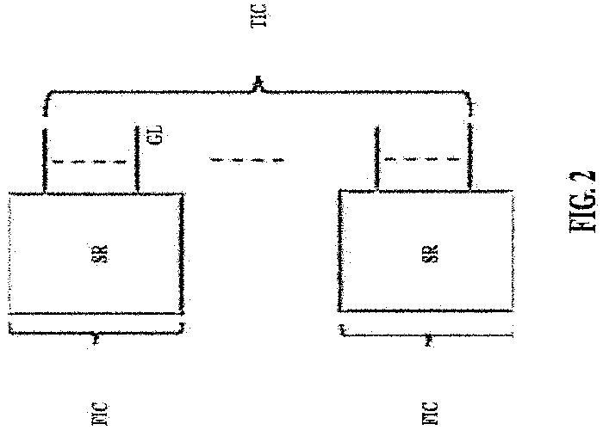

Slide 10
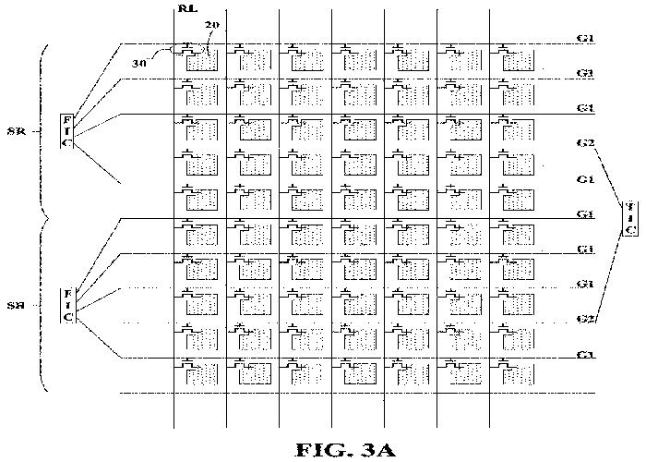

Slide 11
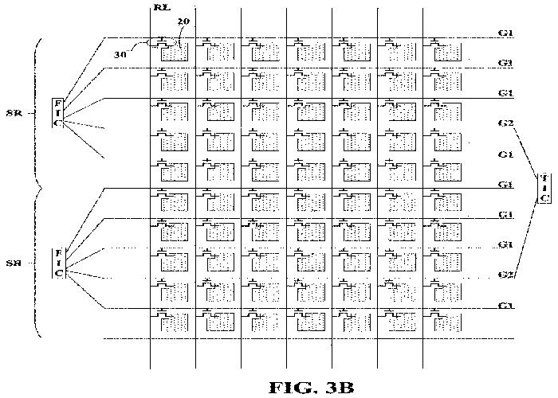

Slide 12
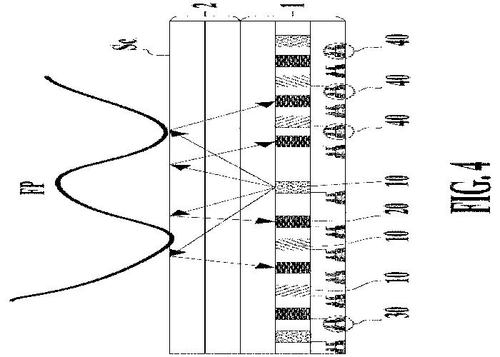

Slide 13
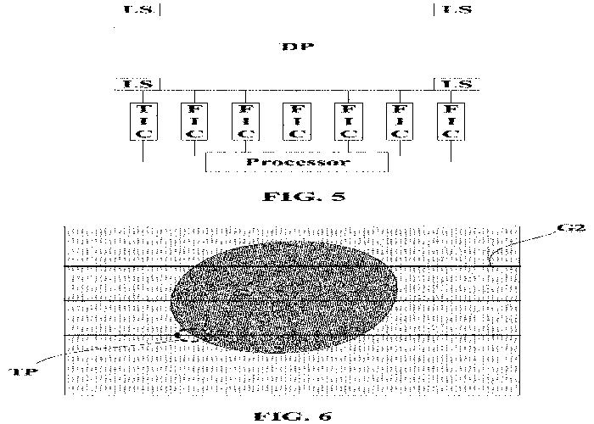
LS light sensors TP transition points

Slide 14
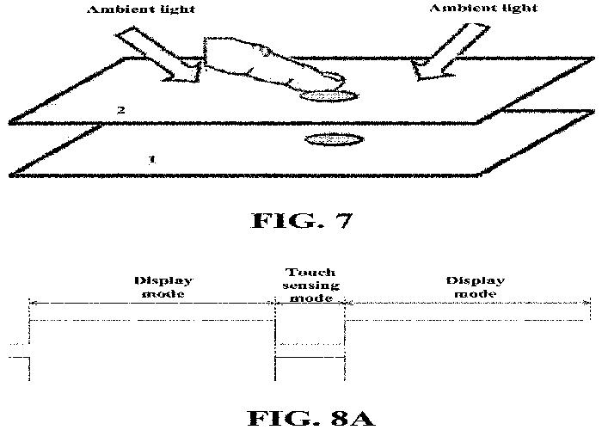

Slide 15
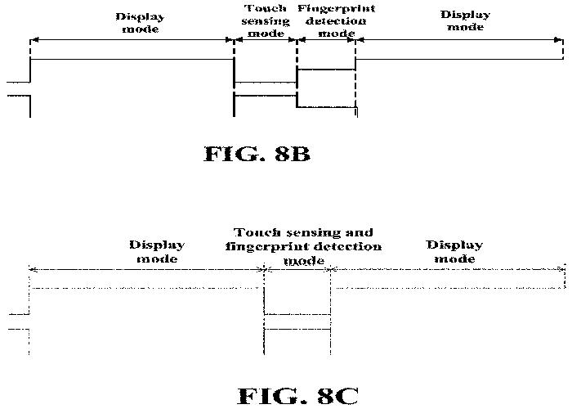

Slide 16
