Slide 1
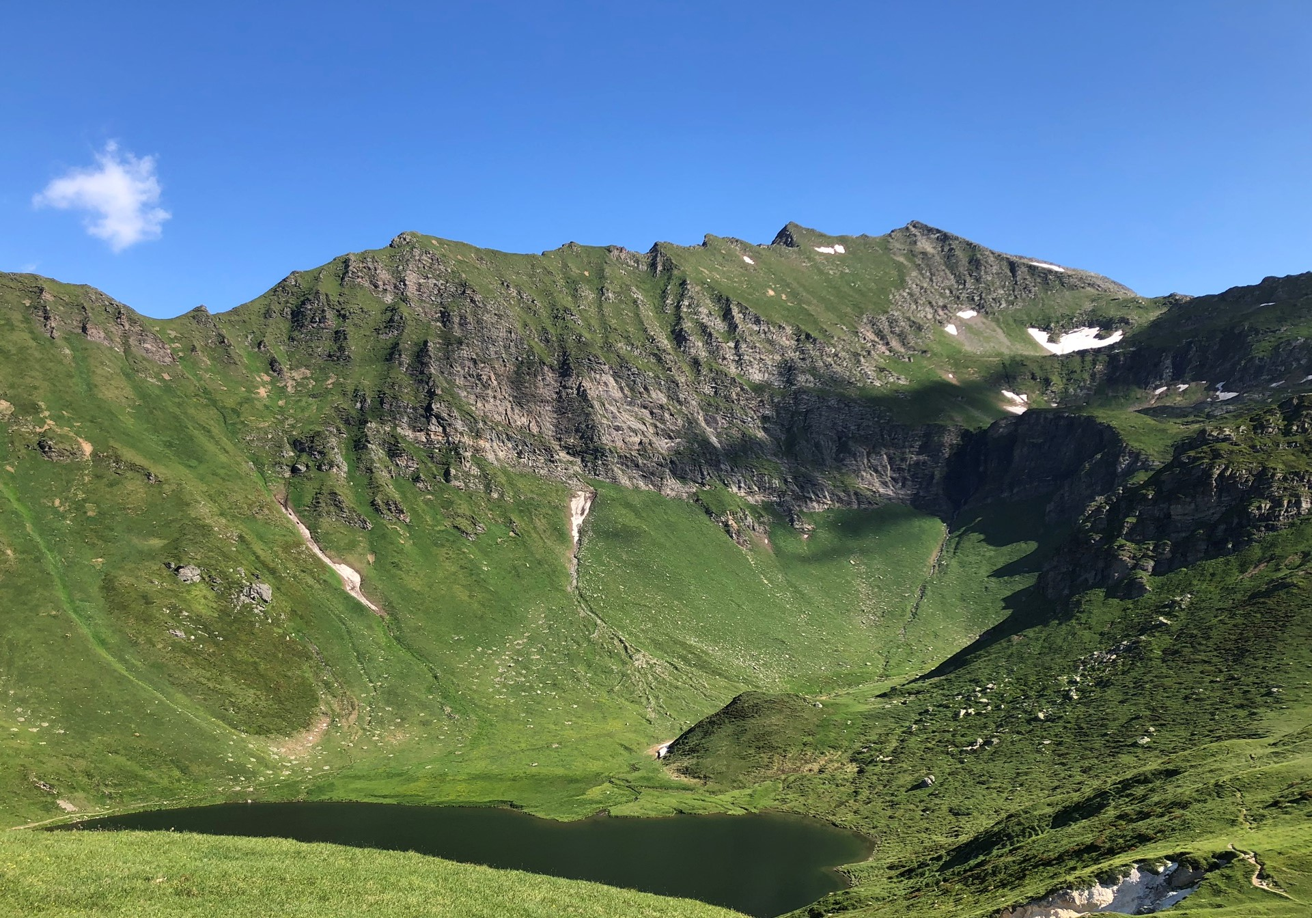

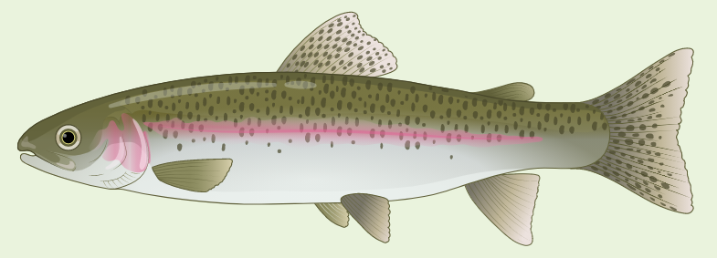
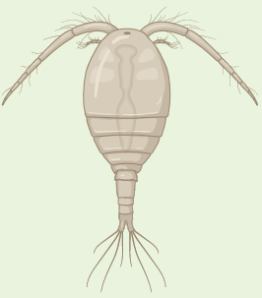












Microbial influence on Carbon Flow in Meromictic Lake Cadagno
CO₂ + O₂ + Light
3
Mixolimnion (Oxic)
5
A.
Oxygenic Photosynthesis
7
Phytoplankton
Depth (m)
Zooplankton
11
6CO₂ +6H₂O C₆H₁₂O₆ + 6O₂
J.
C.
13
DOC
B.
CO₂ + 2H₂S
Phytoplankton (Deep Chlorophyll Max)
Anoxygenic Primary Production
(POC, DOC, POS)
Heterotrophic bacteria
H.
C.
E.
Bacterial beta diversity shift
Microbial Biomass
Chemocline
Max bacterial alpha diversity
15.5
CH₂O + H₂O + 2S⁰
Phototrophic sulfur bacteria
(C:N:S)
D.
Secondary Production
Inorganic Nutrients
Minimum VMR
SO₄²⁻,NO₂−
G.
F.
I.
Aphotic + Anoxic Zone
19
Monimolimnion (H₂S, NH₄⁺)
21
Sinking particles
Sediments
*Courtesy to BioRender.com for icons

