Slide 1

UNIVERSAL
CONVERTER
Group 7

Slide 2
TABLE OF CONTENTS
01
02
Introduction
Demonstration
03
04
Logic & Function
Explanation
Panel Questions

Slide 3
01
Introduction

Slide 4
Project Description
Unit Converter: Build a GUI-based application that converts between different units of measurement, such as length, weight, volume, etc.
Users can input a value in one unit and see the equivalent value in other units instantly. For example, converting between meters, feet, inches, and centimeters for length conversion.

Slide 5
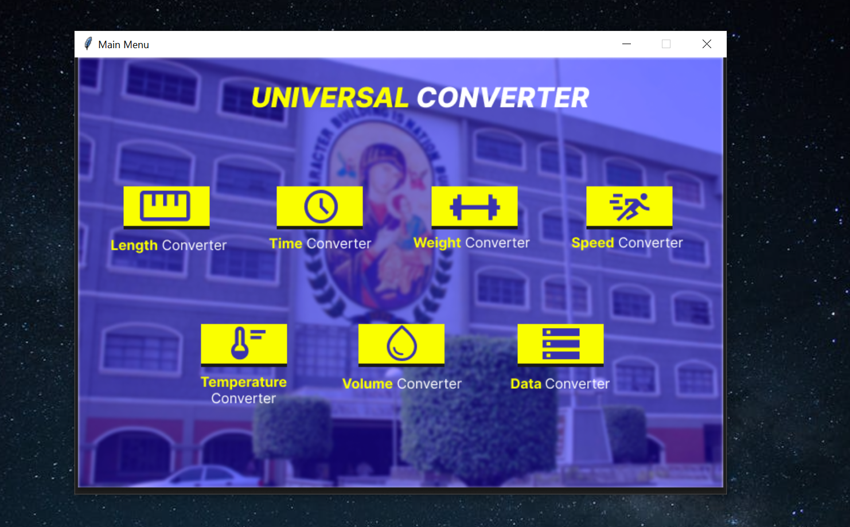
02 DEMO
Demonstration of our TKinter application.

Slide 6
02
Explanation

Slide 7

LOGICAL APPROACH
This program applied OOP to encapsulate different Converter Class with each respective calculation logic.
(e.g. The Length conversion calculations are different from Time conversion)
This greatly improves organization and modularity
**code independence

Slide 8
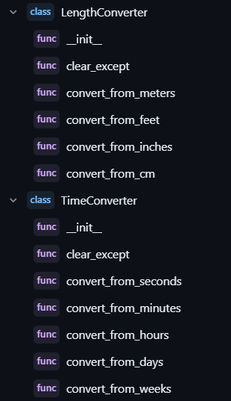

Slide 9
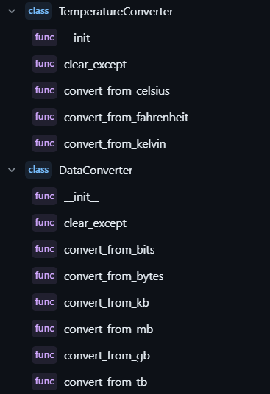

Slide 10
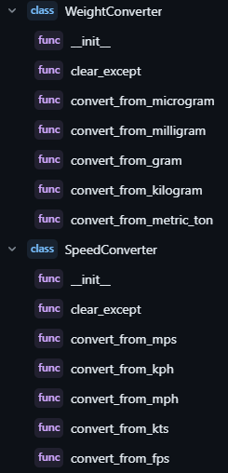

Slide 11

Function Explanation

Slide 12
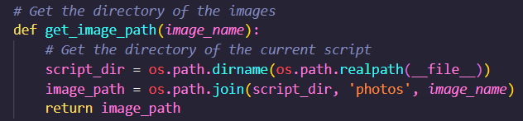
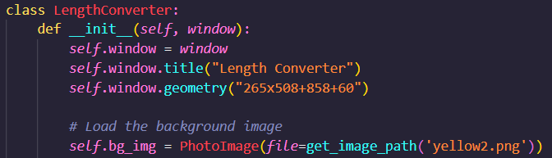
def get_image_path
Using the OS module, this function ensures that the application will get the correct file path for the background images

Slide 13
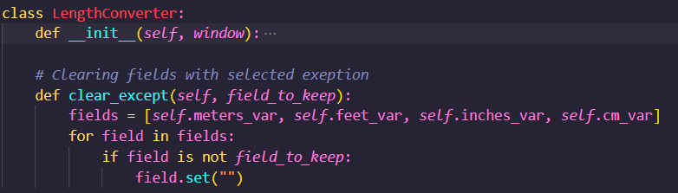

def clear_except
This function erases/resets all other entryfields if the current focused entry field is empty

Slide 14
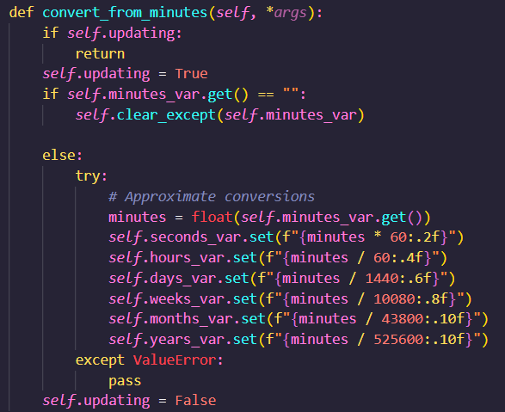
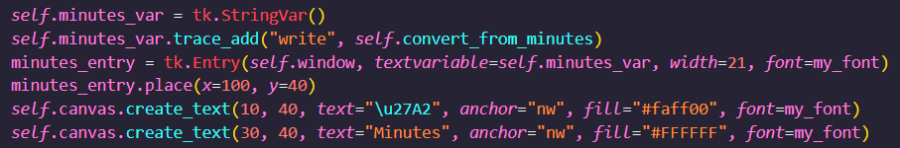

trace_add() method
This part is what makes the conversion automatic.
If the entry field gets written on, it automatically runs the conversion calculation function.

Slide 15


4. Panel Questions
___
Feel Free to Ask!

Slide 16


