Slide 1
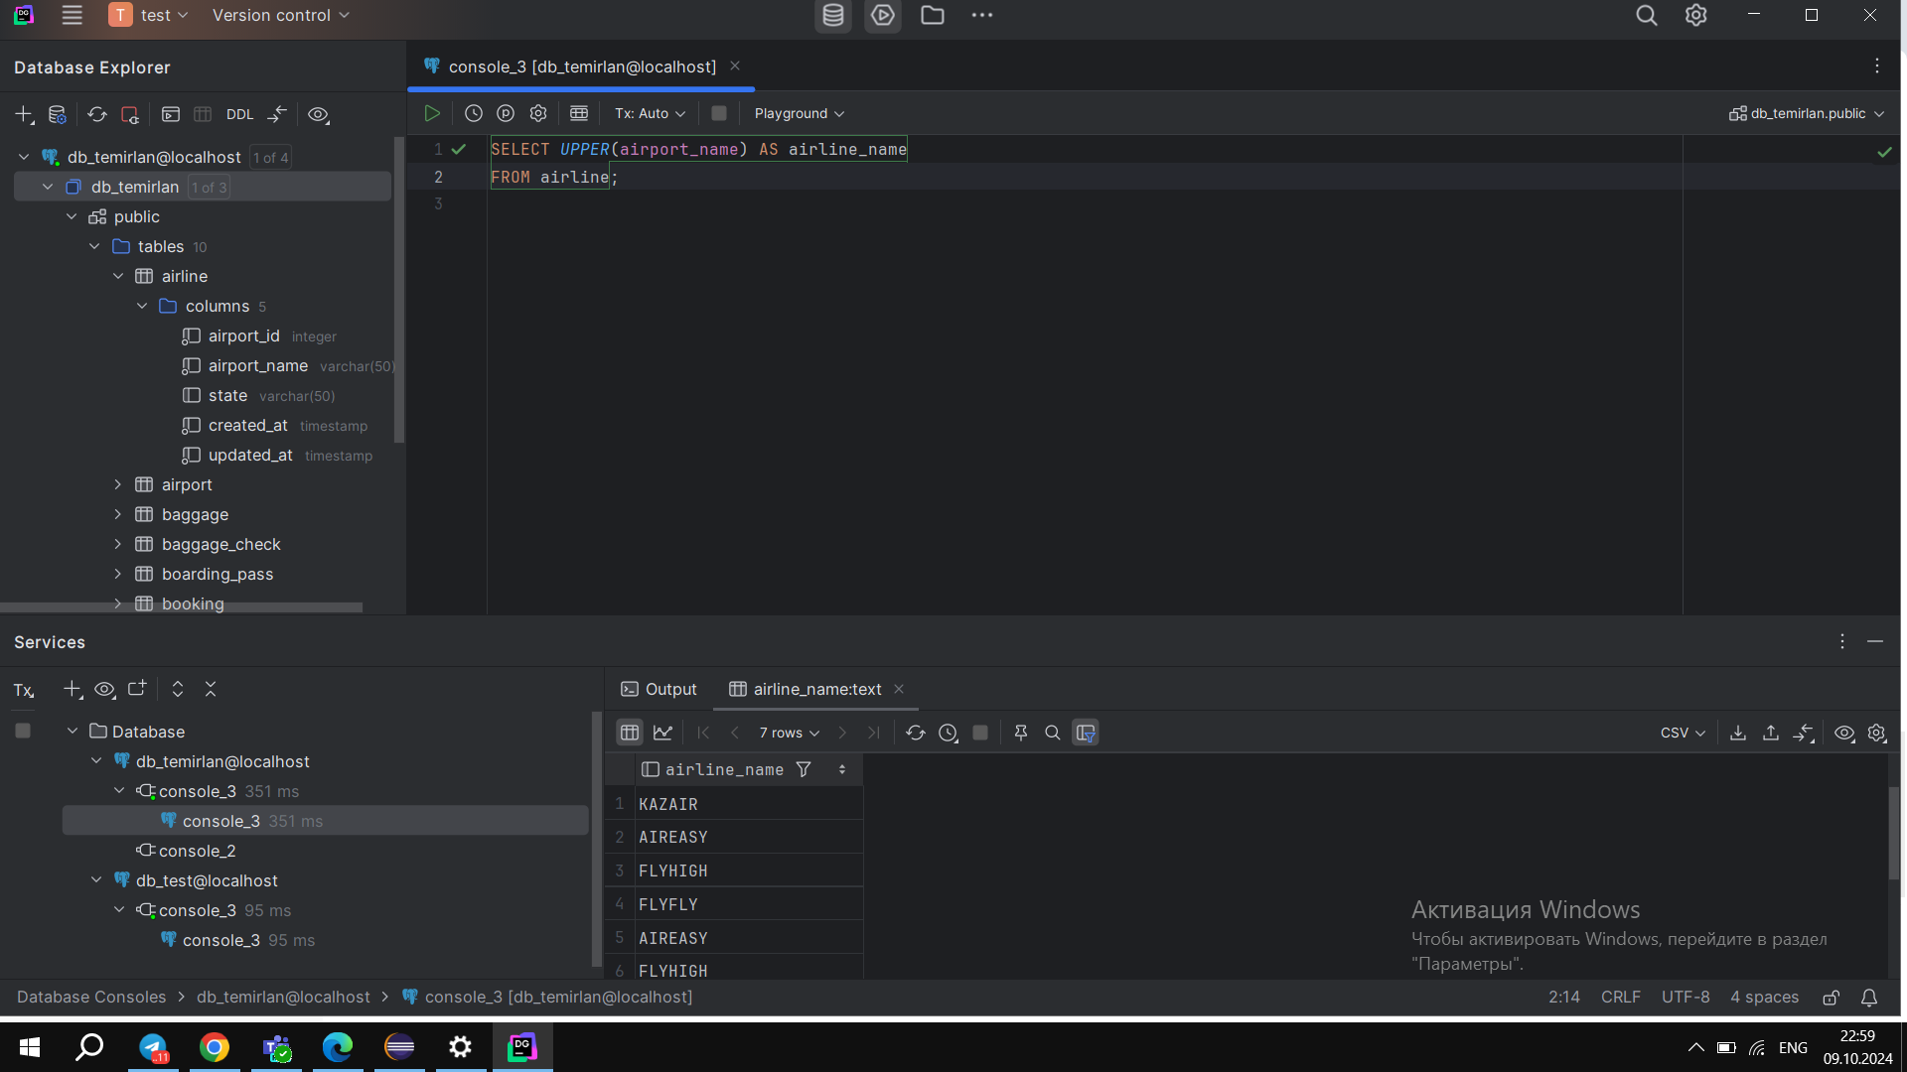
1. Retrieve all airline names in uppercase.

Slide 2
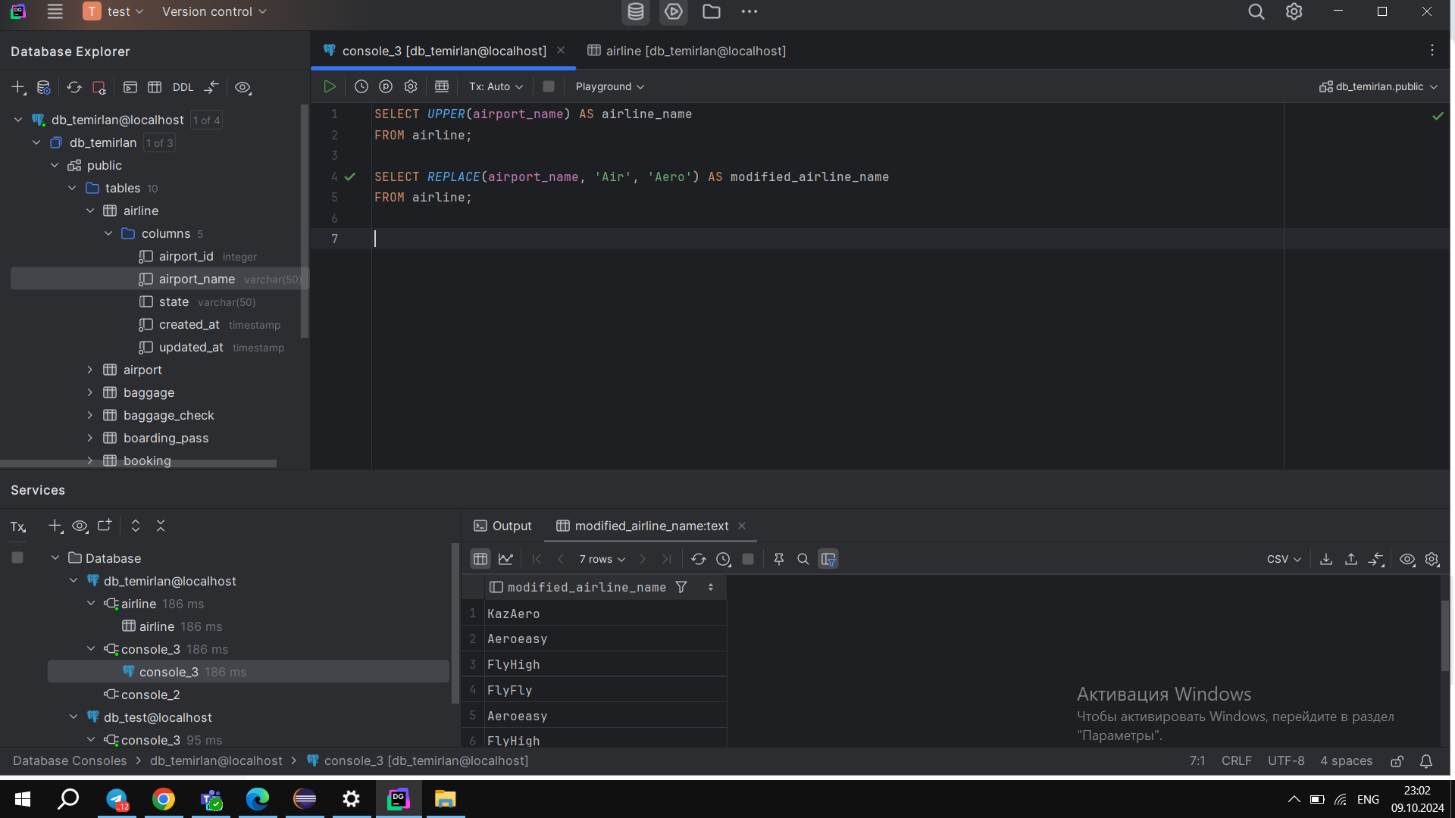
2. Replace any occurrence of the word "Air" in airline names with "Aero"

Slide 3
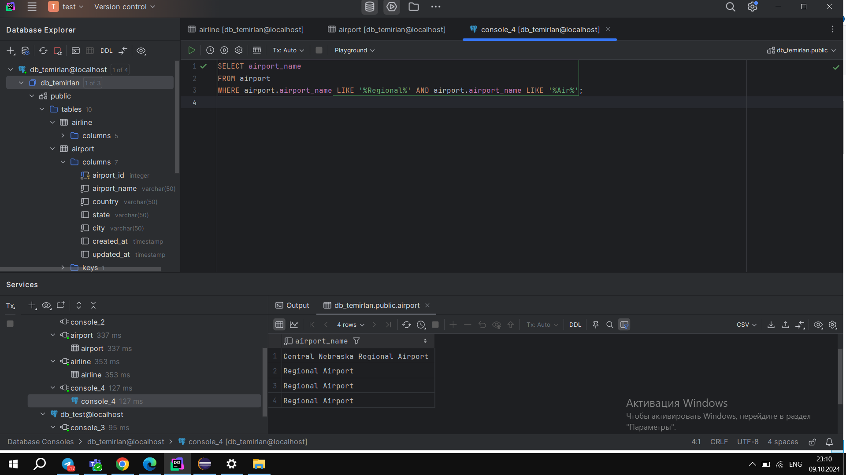
4. Retrieve airports that contain the word "Reginal" and "Air" in their names

Slide 4
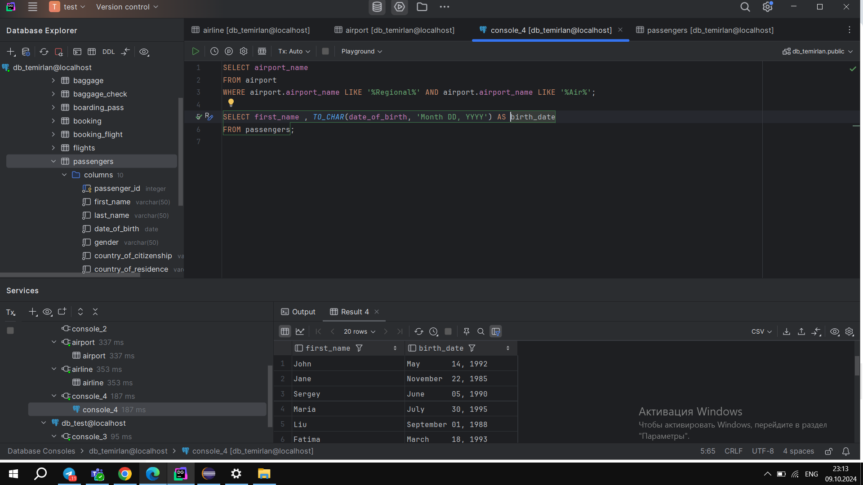
4. Retrieve airports that contain the word "Reginal" and "Air" in their names

Slide 5
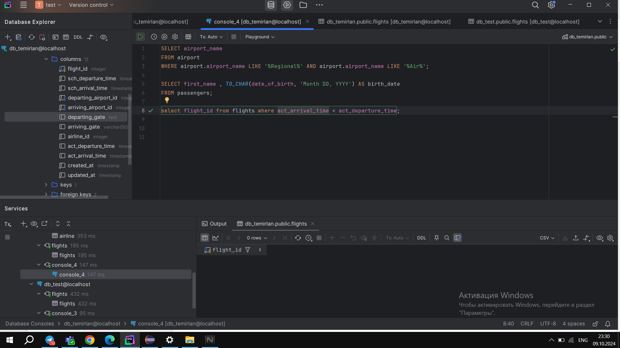
5. Retrieve passenger names and format their birth dates as 'Month DD, YYYY'.

Slide 6
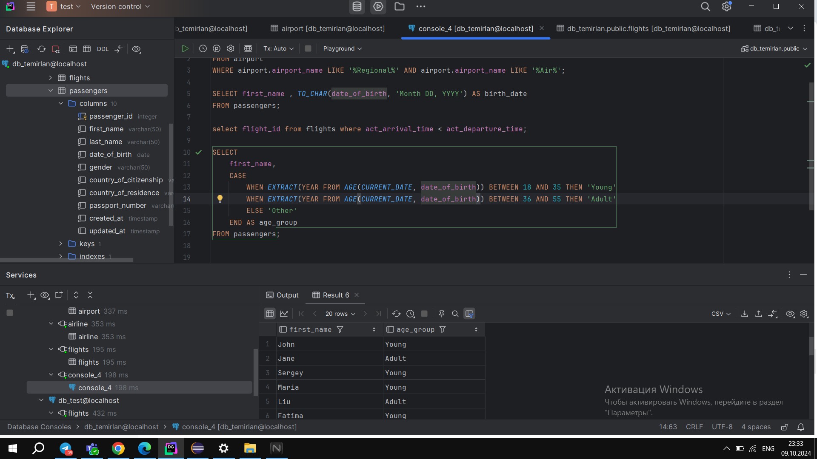
7. Create a query that divides passengers into age groups like ‘Young’ and ‘Adult’ based on their birth date. Young passengers age between 18 and 35, Adult passengers age between 36 and 55 "C

Slide 7
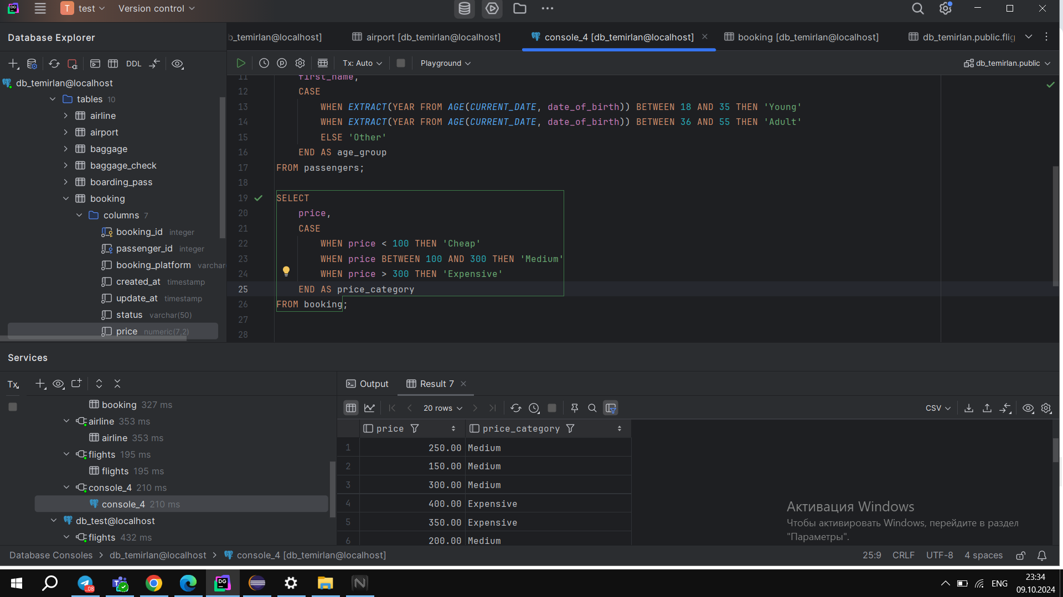
8. Create a query that categorizes ticket prices based on their price as "Cheap," "Medium" or "Expensive."

Slide 8
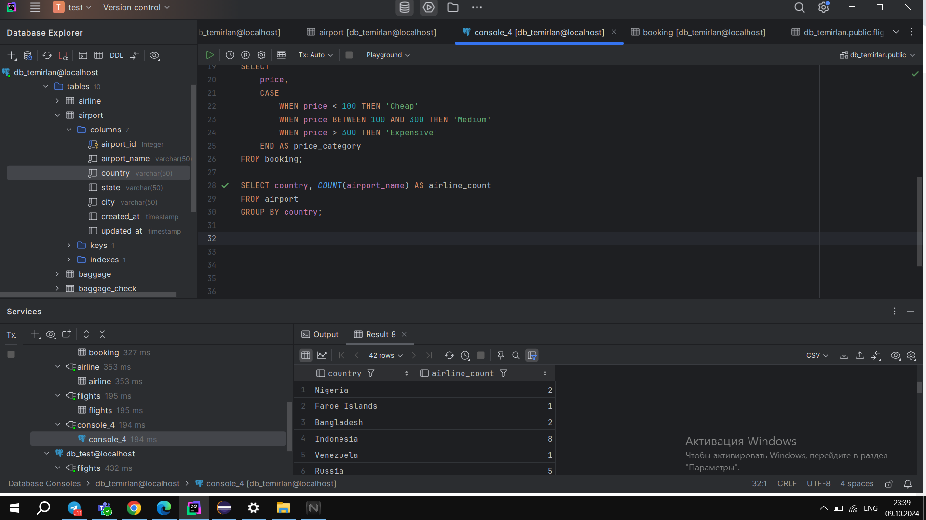
9. Find number of airline names in each airline country.

Slide 9
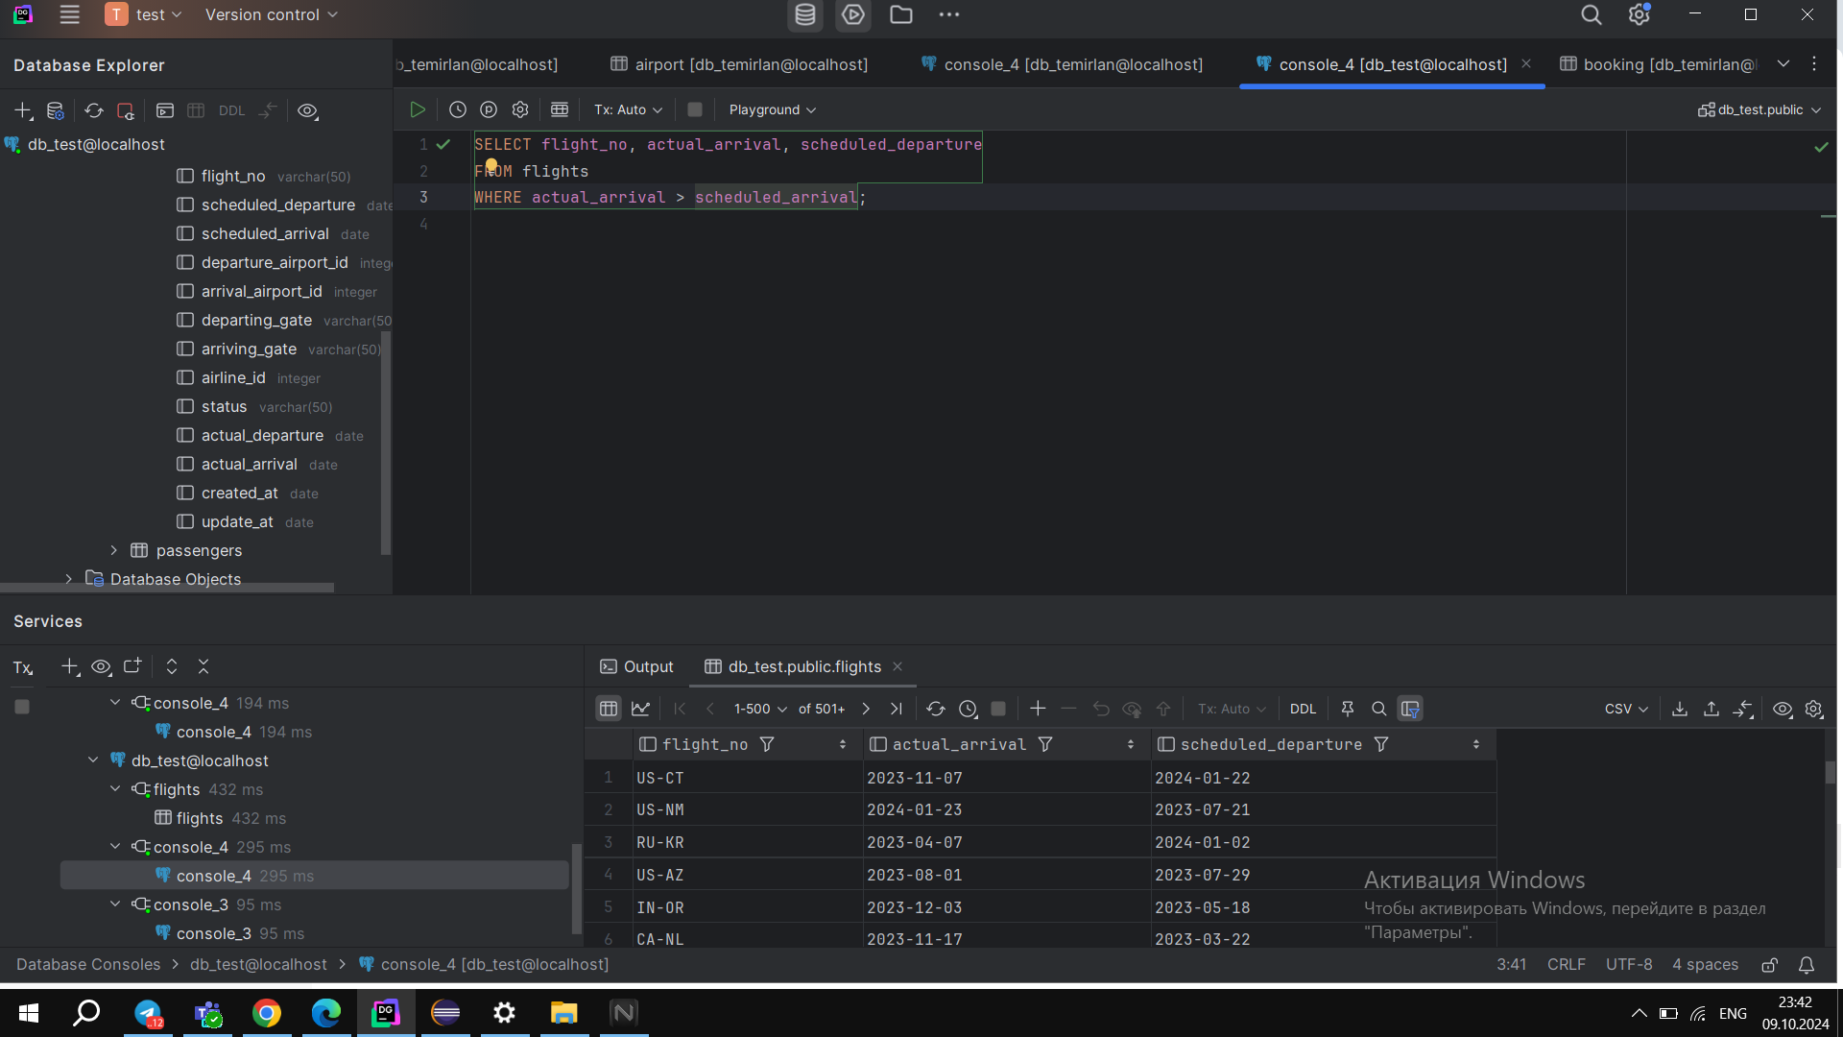
10. Find flights that arrived late according to their actual arrival time compared to the scheduled arrival time

