Slide 1
Universidade Federal do Amazonas - ICOMP
Clarice, Duivilly
Developer with Leap Motion
JavaScript

Slide 2
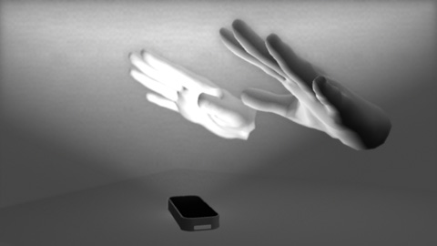
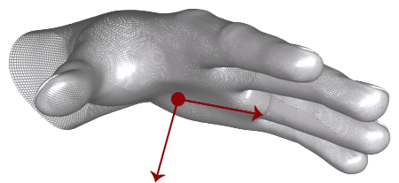
A few of the operation
The Leap Motion system recognizes and tracks hands and fingers.
Uses optical sensors and infrared light.
Sensor data is analyzed frame-by-frame.
The Hand palm_normal and direction vectors define the orientation of the hand.

Slide 3

View initial

Slide 4
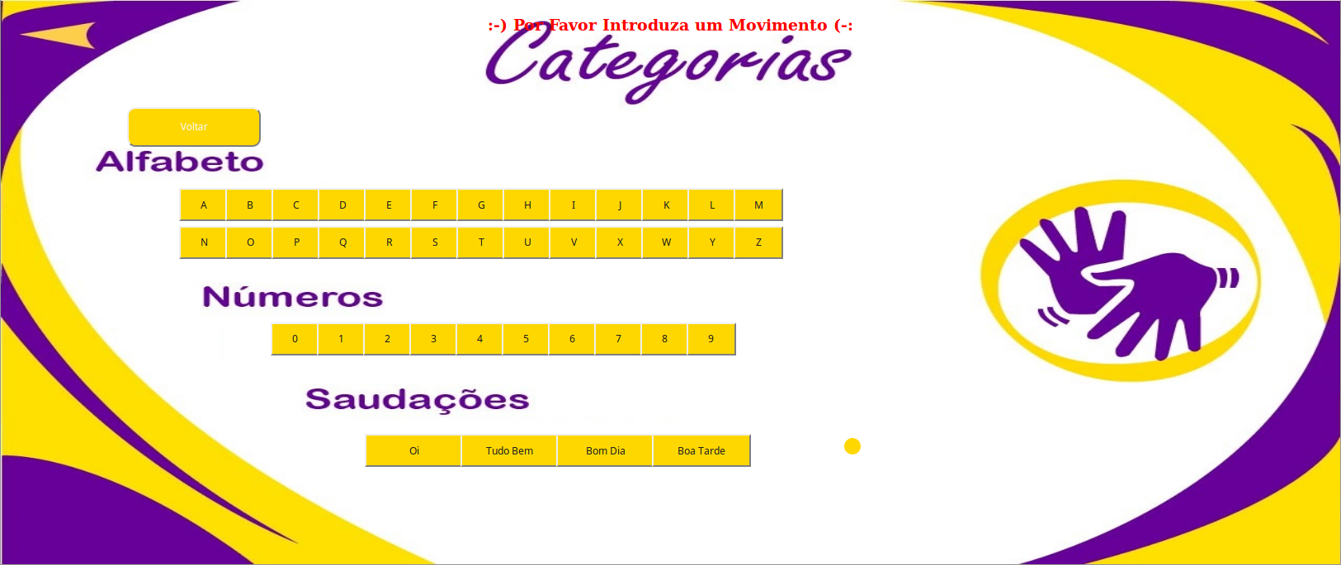
Options to select

Slide 5
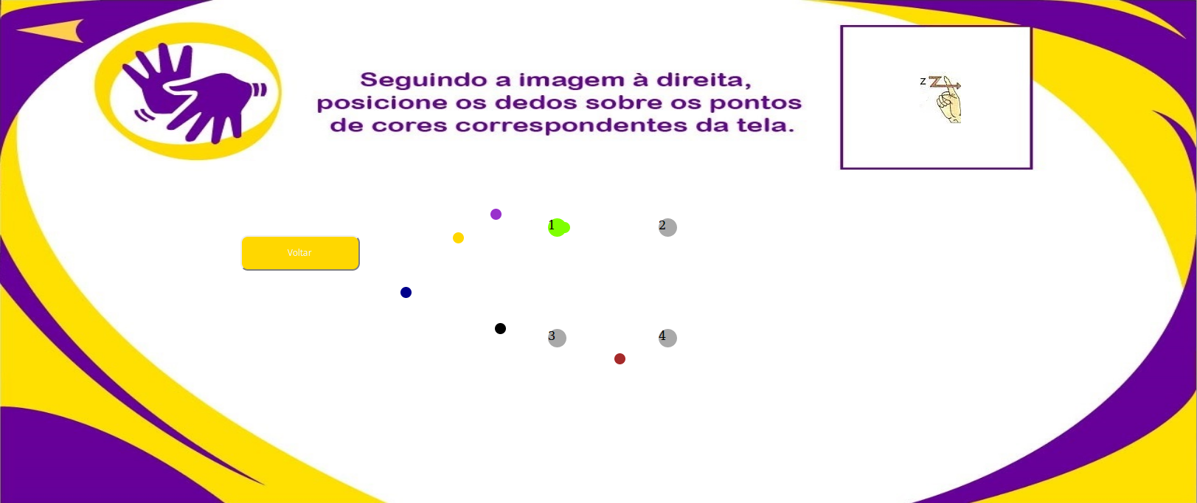
Connect the dots

Slide 6

Result of the operation

