Slide 1
2013年2-3月工作汇报
吴军

Slide 2

Report on the paper
progress
plan

Slide 3
progress
Patent similarly
Patent citation
patent content
Short of citation for Chinese patents
Semantic patent analysis
Semantic structure ：complexity，polytrope
Invention Function Tree：more Concept，less content
text mining：
Magerman

Slide 4
progress
Text mining
Cluster-less
Cluster-based:
IPC
陈芨熙
Patent model tree,
Weighted similarity of patent title and abstract
郭炜强:
the concept vectors of IPC
Larkey(1999):
n virtual documents
Not experimentally evaluated
刘玉琴

Slide 5
progress
Patent title & content
Disadvantage：
1、less corpora
2、distinction degree on section and class level
3、term weight
刘玉琴:
《Automated Categorization of Patent Based on IPC Knowledge
Construction》
Patent title & content
Patent title & content
A
A01
A01B
A01C
A01D
A02
IPC description

Slide 6
progress
Topic-based Reverse Generative Model
section
A
…
H
IPC knowledge
Patent documents
Term weight
Dynamic optimization
class
subclass
core
term
correlative
term

Slide 7
progress
Topic-based Reverse Generative Model
A
…
H
contribution
life cycle of Correlative term
core
term
correlative
term
Correlative term
Core term
Common term

Slide 8
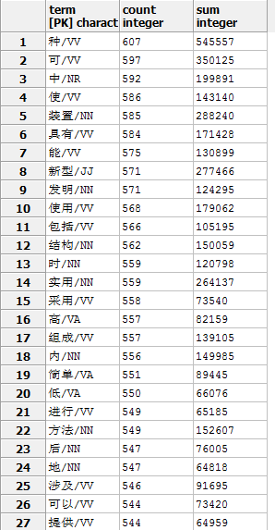
progress
Top K
Term contribution
Multi Information
Information Gain
Document Frequency
CHI

Slide 9
progress
System
Primary
retrieve
Patent
Patent
Patent
Patent
Second
retrieve
Feedback strategy

Slide 10
progress
Document number
Mix model query update method
Feedback strategy
Term number
Markov chain method
Feedback coefficient

Slide 11
plan
Correlative term
Core term
Common term
Avg_corr(topic)
Four feature exaction algorithm
Two Feedback strategies
IPC
Evaluation method

Slide 12
谢 谢

