Slide 1
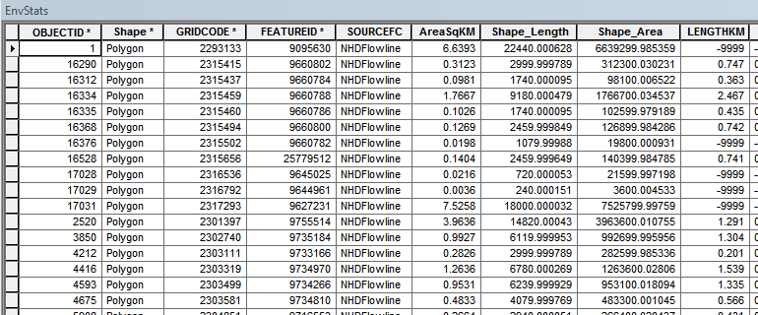
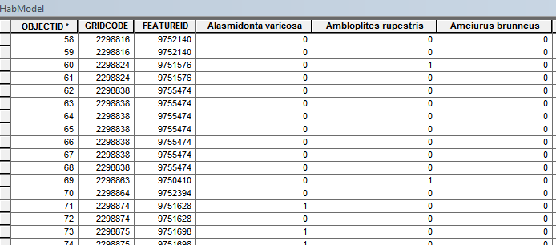
Data screening
Catchment Attributes
Select species
Select records in HUC 8s
Remove fields with NAs
Remove fields not correlated with presence
Identify redundant fields
Final field list
Identify HUC 8s
Catchment Species List
MaxEnt SWD
Remove redundant fields
GLM inputs

Slide 2
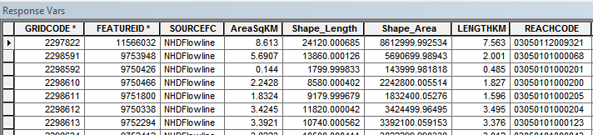
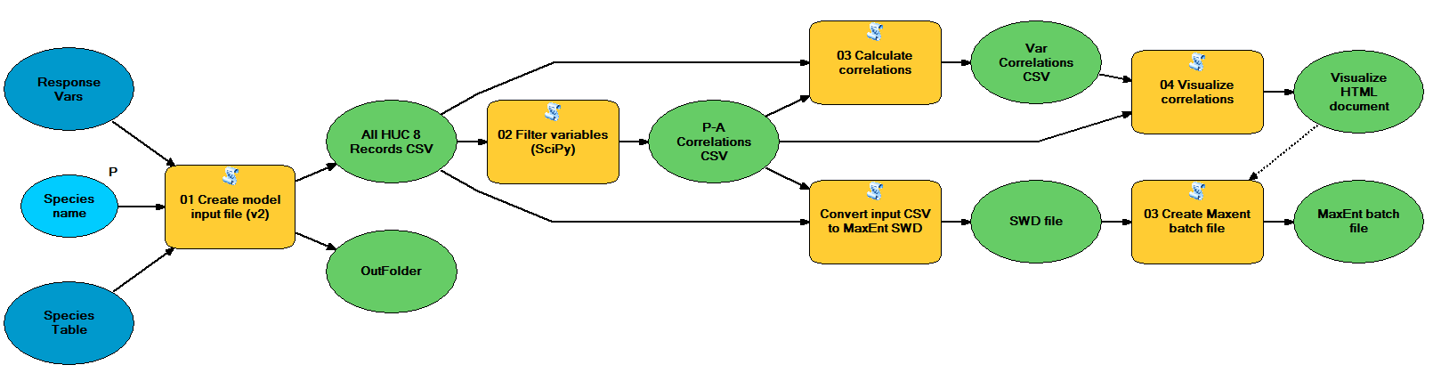

Slide 3
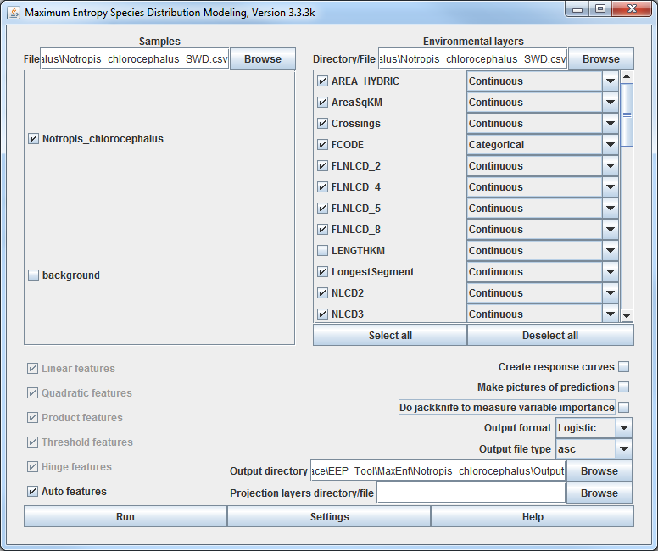
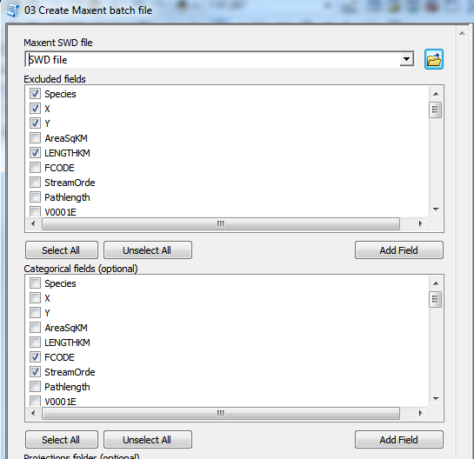

Slide 4
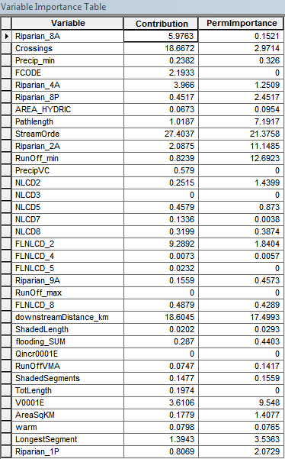
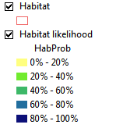
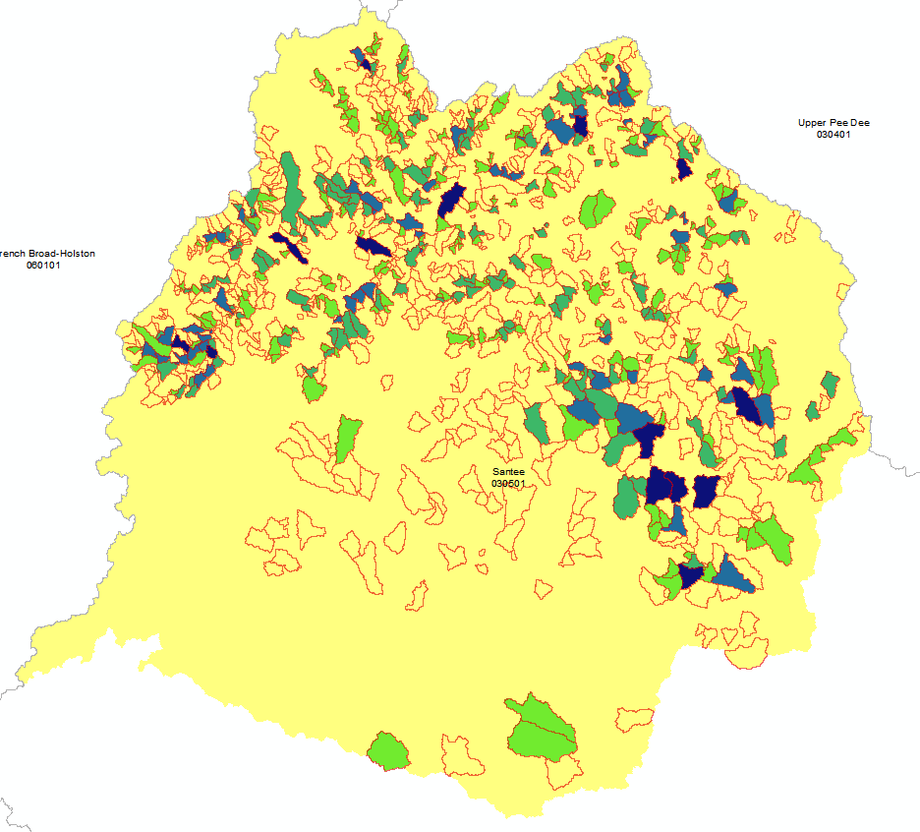
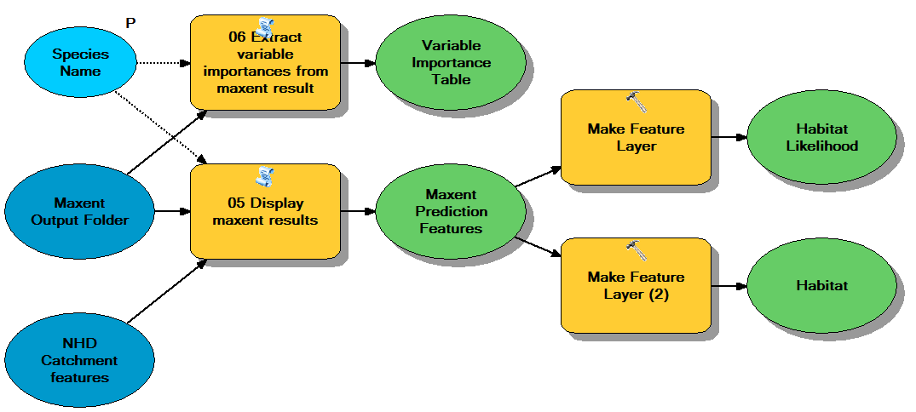

Slide 5
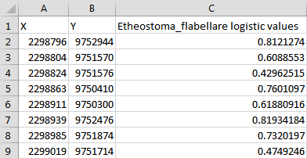
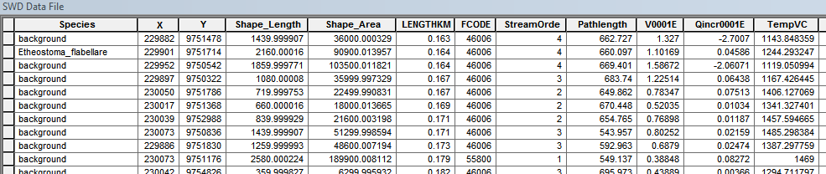
MaxEnt Analysis
Catchment habitat likelihood
Catchment Attributes
Final field list
Maxent BAT file
Maxent
MaxEnt SWD
Select species
MaxEnt SWD
Variable Importance
Catchment Species List
(FeatureID)
(GRIDCODE)

Slide 6
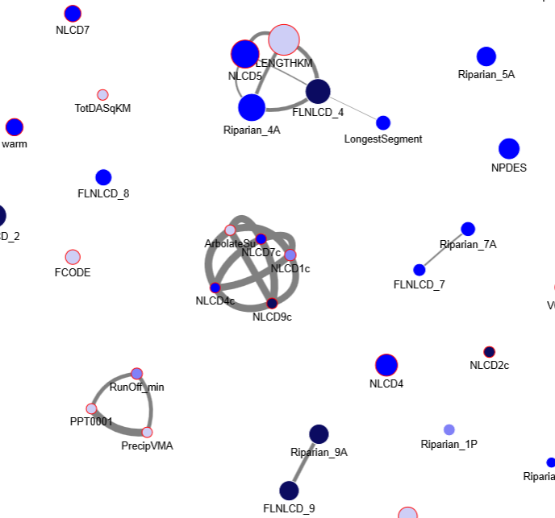
Etheostoma_olmstedi
X
X
X
X
X
X
X
X
X
X
X
X

Slide 7
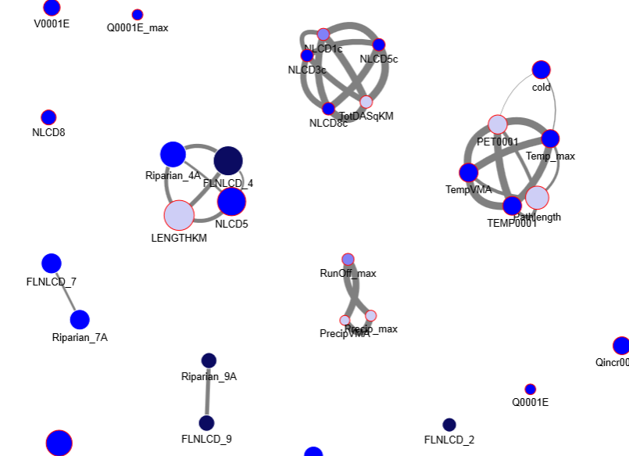
Clinostomus_funduloides
X
X
X
X
X
X
X
X
X
X
X
X
X
X
X

Slide 8
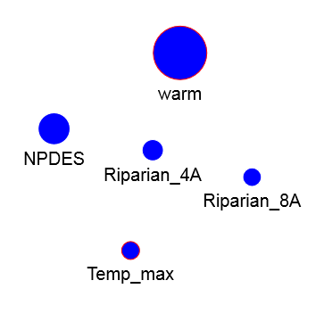
Notropis_altipinnis

Slide 9
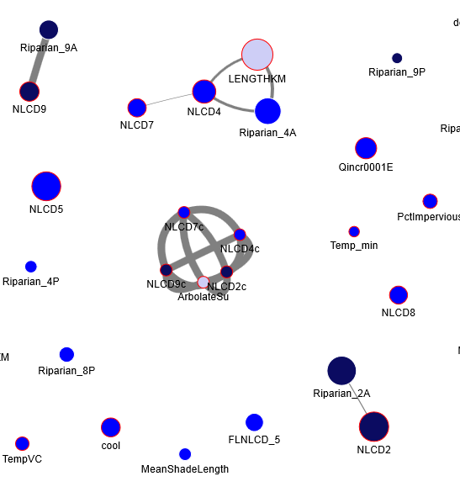
Lepomis_auritus
X
X
X
X
X
X
X
X
X

Slide 10
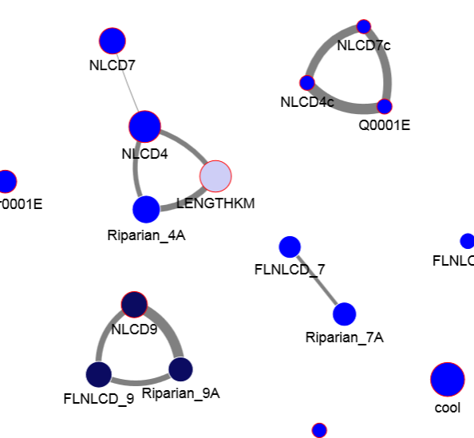
Moxostoma_collapsum
X
X
X
X
X
X
X

Slide 11
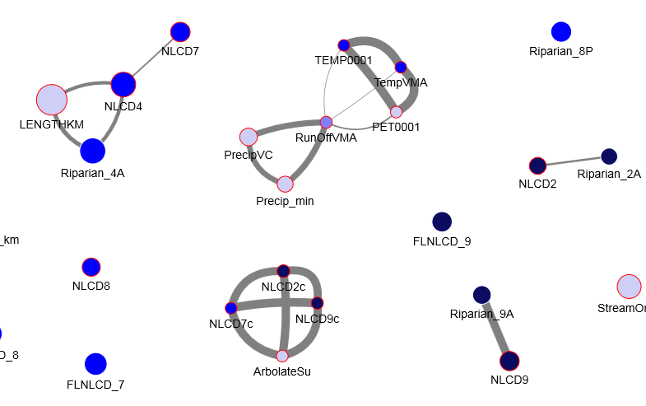
Noturus_insignis
X
X
X
X
X
X
X
X
X
X
X
X

Slide 12
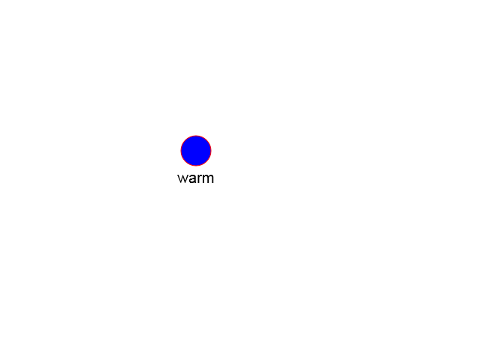
Aphredoderus_sayanus

Slide 13
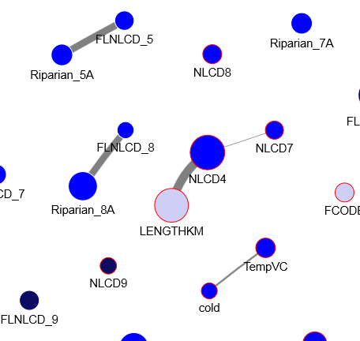
Etheostoma_flabellare
X
X
X
X
X

Slide 14
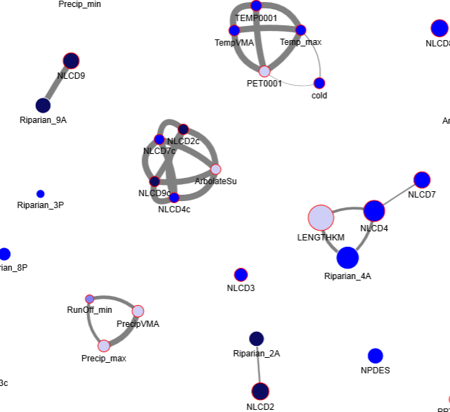
Nocomis_leptocephalus
X
X
X
X
X
X
X
X
X
X
X
X
X

