Slide 1
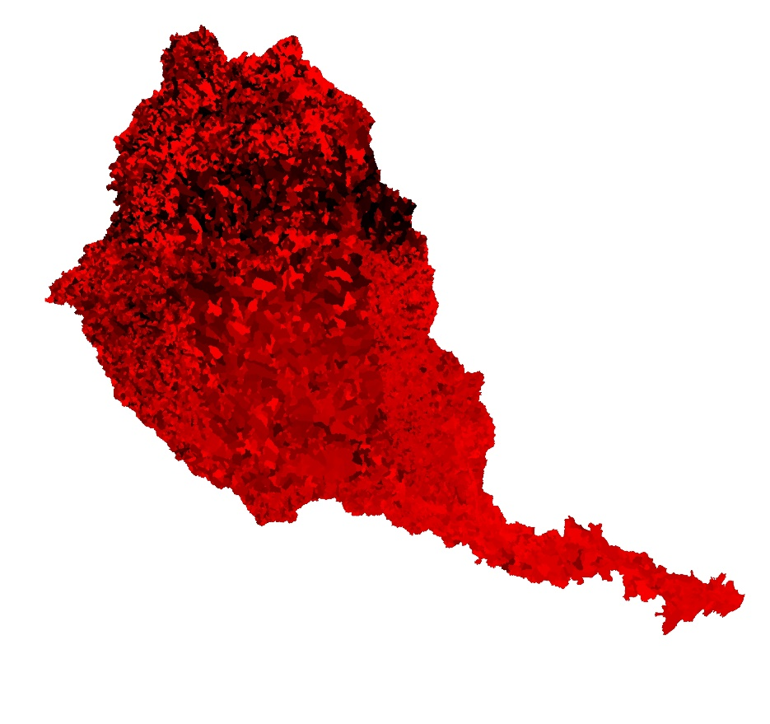
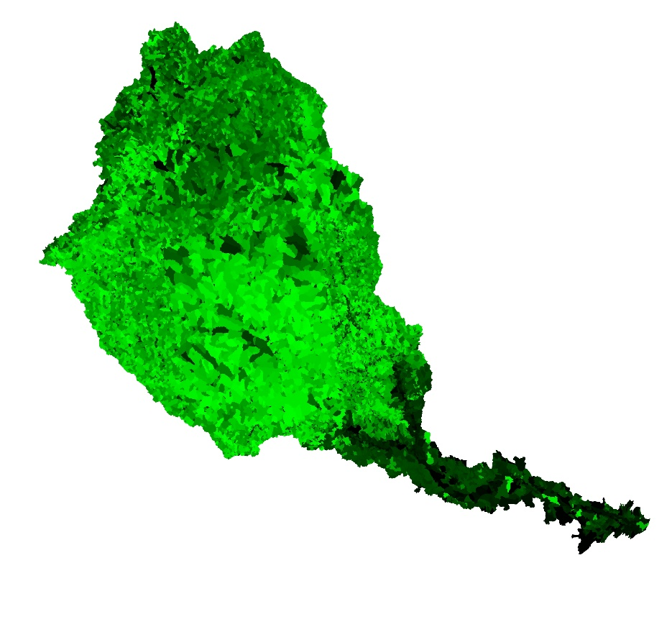
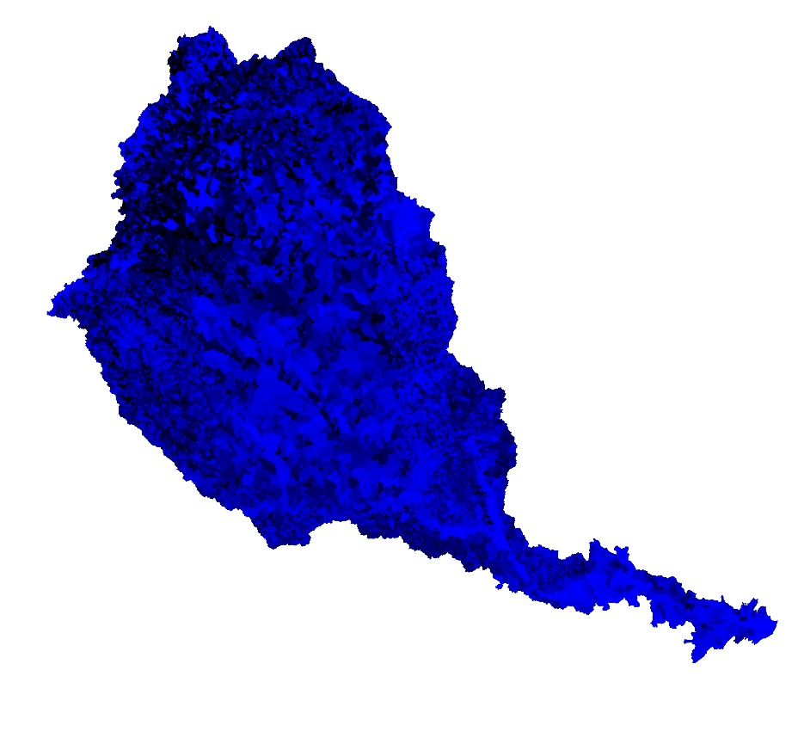
Convert all non-urban hydric soils to wetland
Maxent
GLM
Random Forest
Brighter colors = more uplift

Slide 2
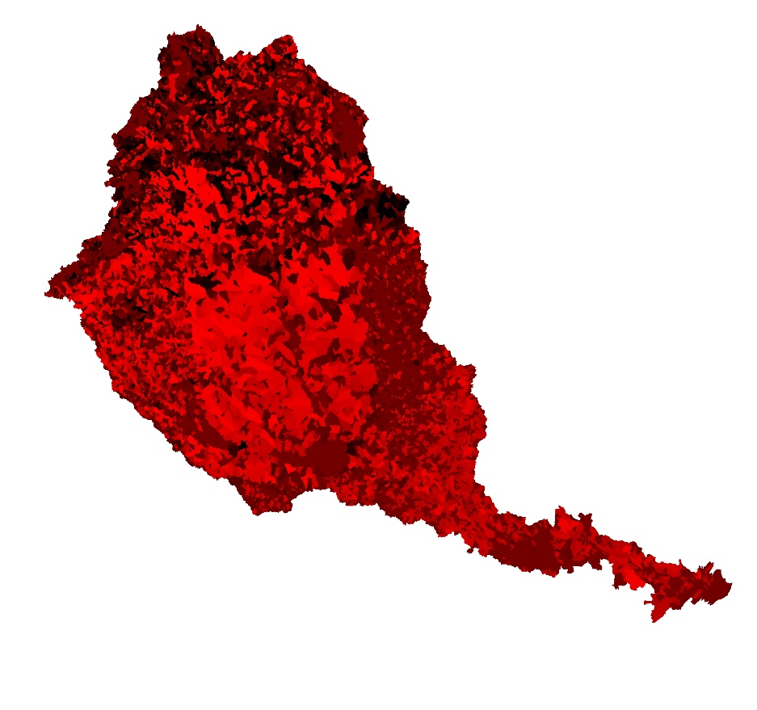
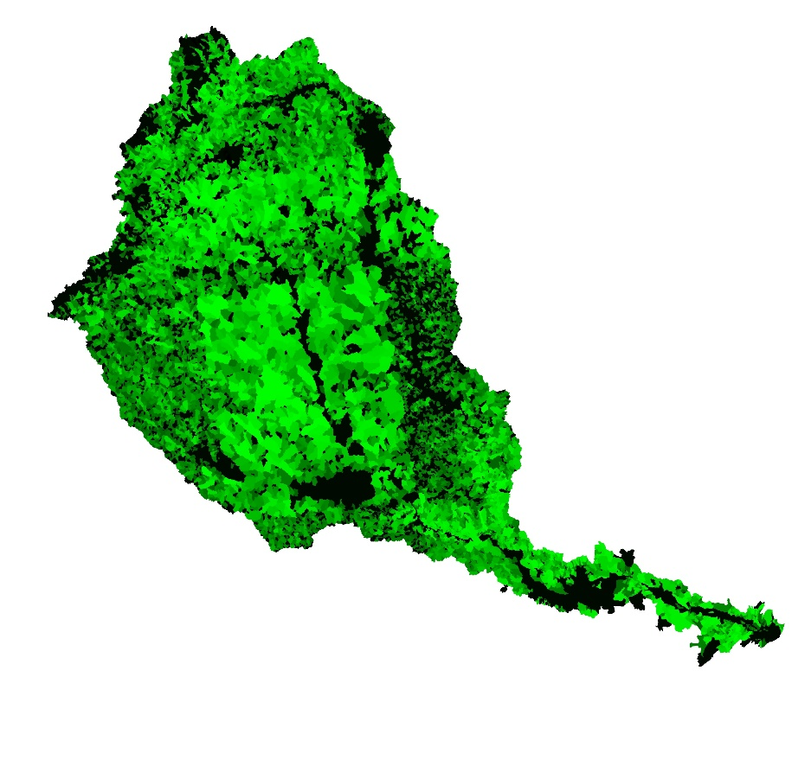
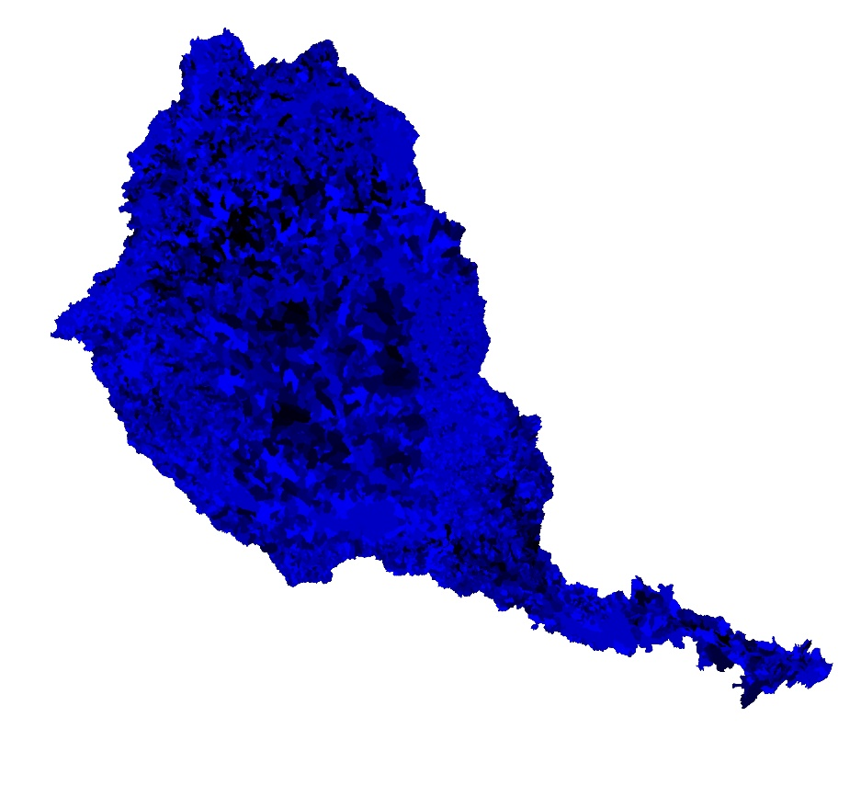
Convert flowline to forest
Maxent
GLM
Random Forest
Brighter colors = more uplift

Slide 3
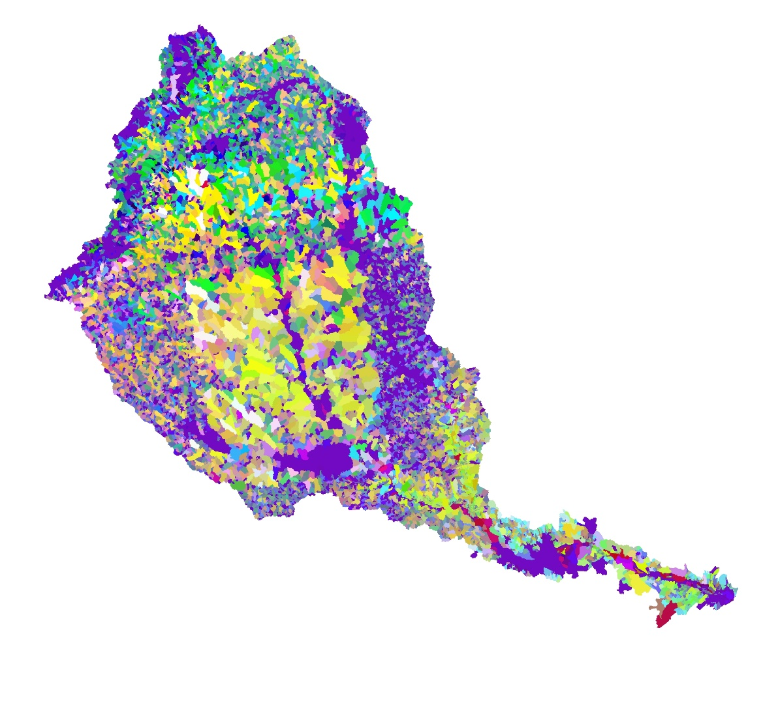
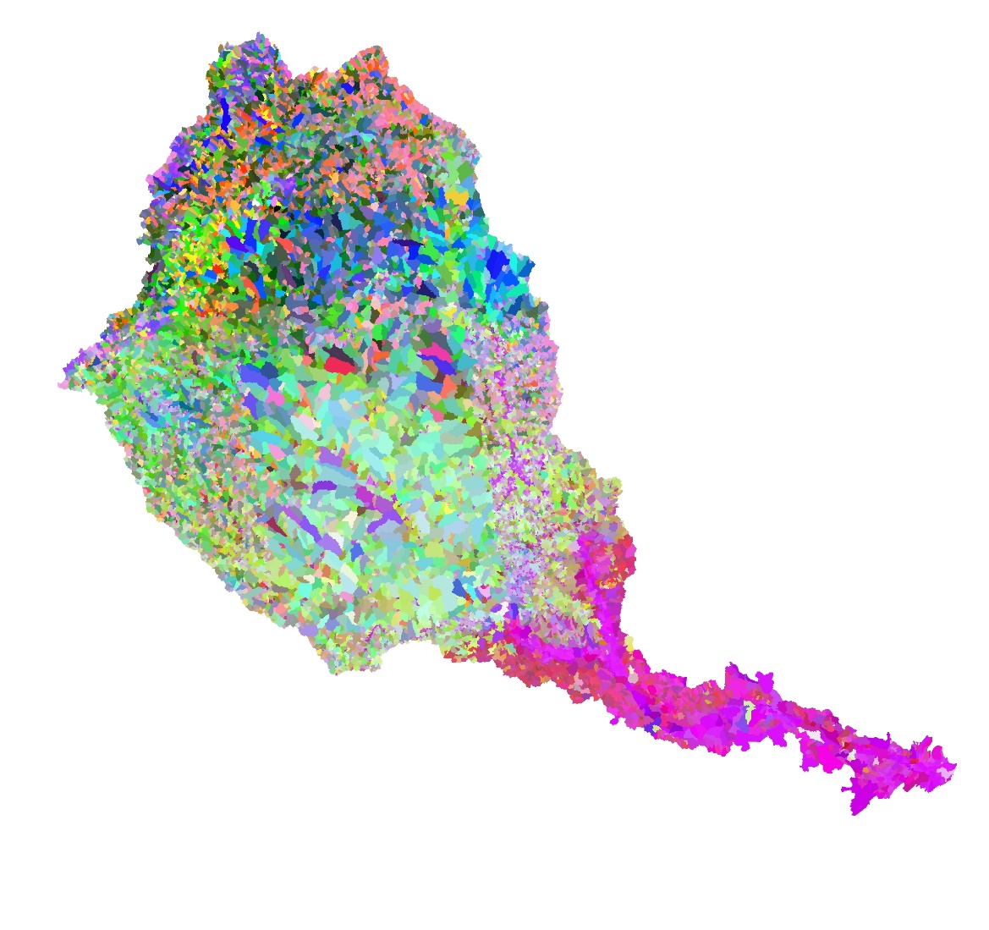
Model Composites
Flowline → Forest
Hydric Soils → Wetland

