Slide 1
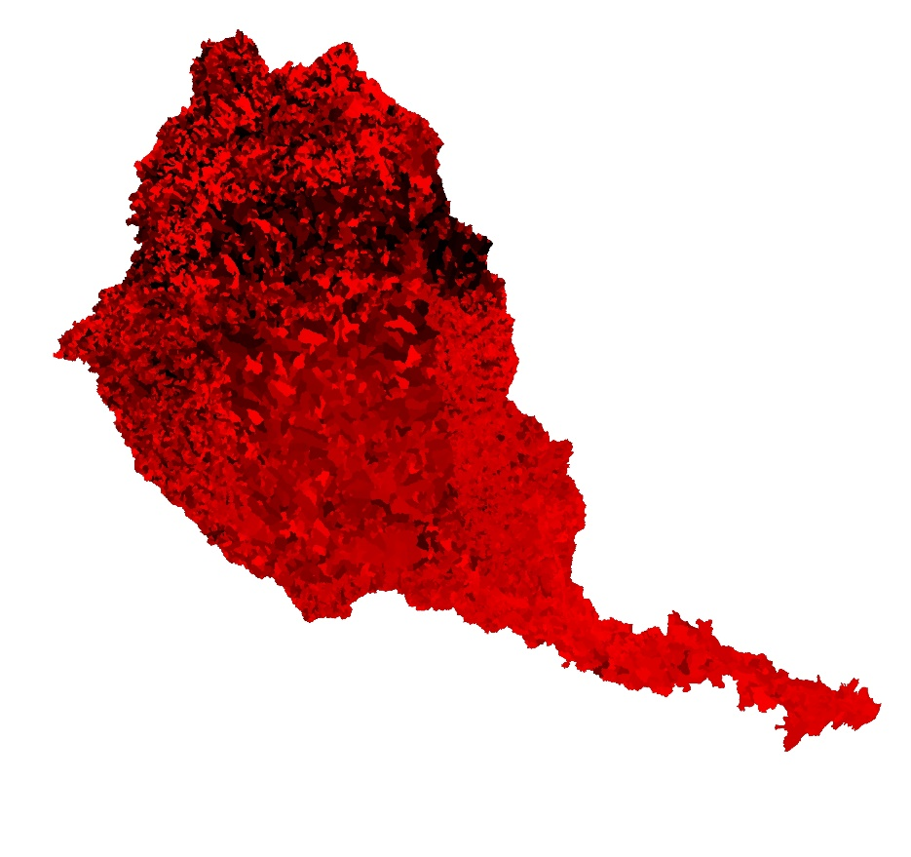
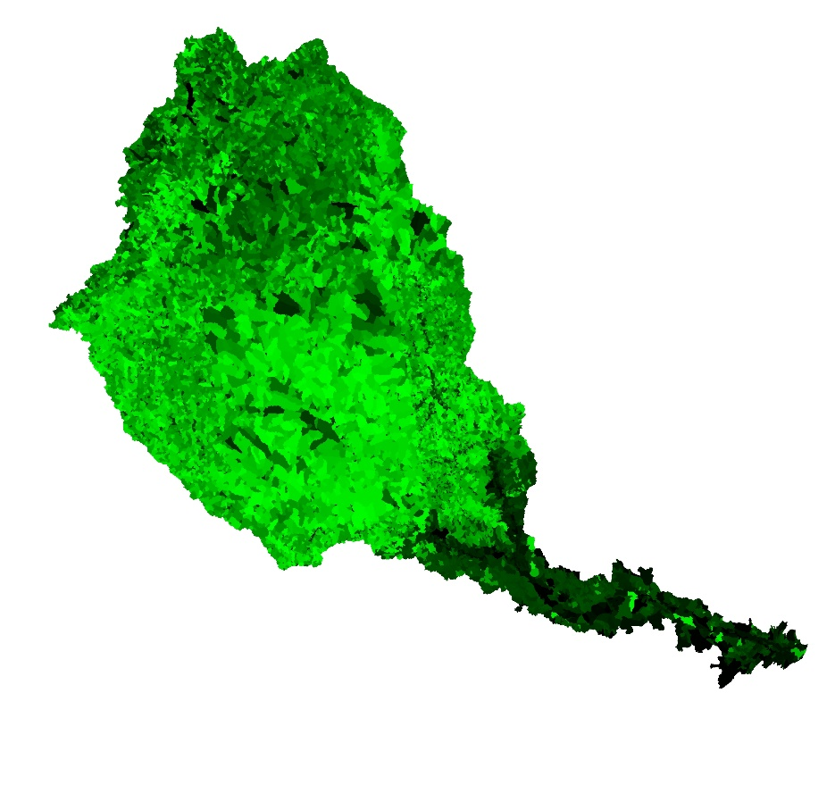
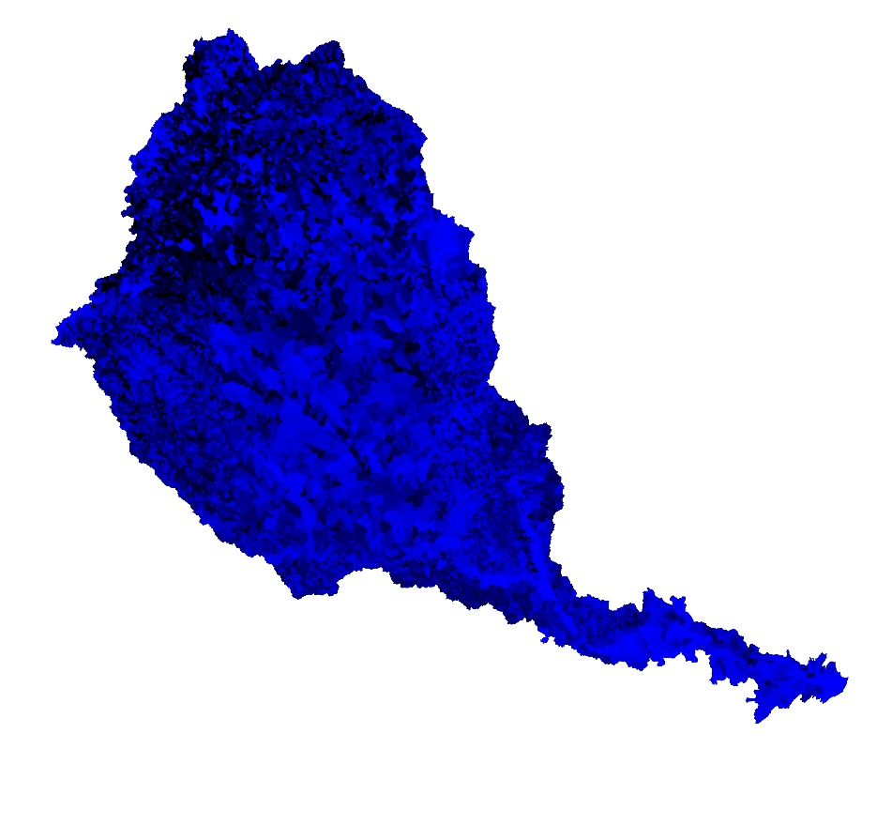
Convert all non-urban hydric soils to wetland
Maxent
GLM
Random Forest
Brighter colors = more uplift

Slide 2
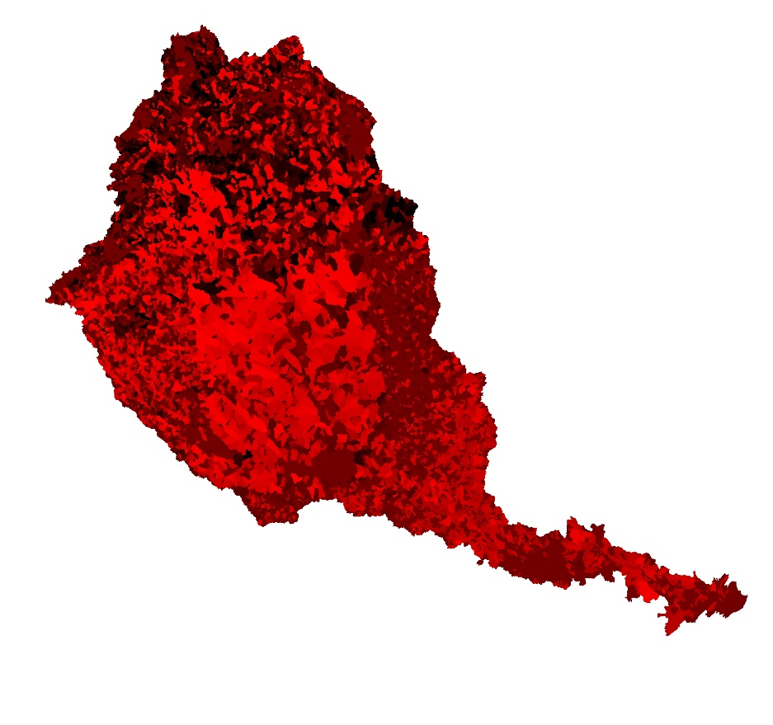
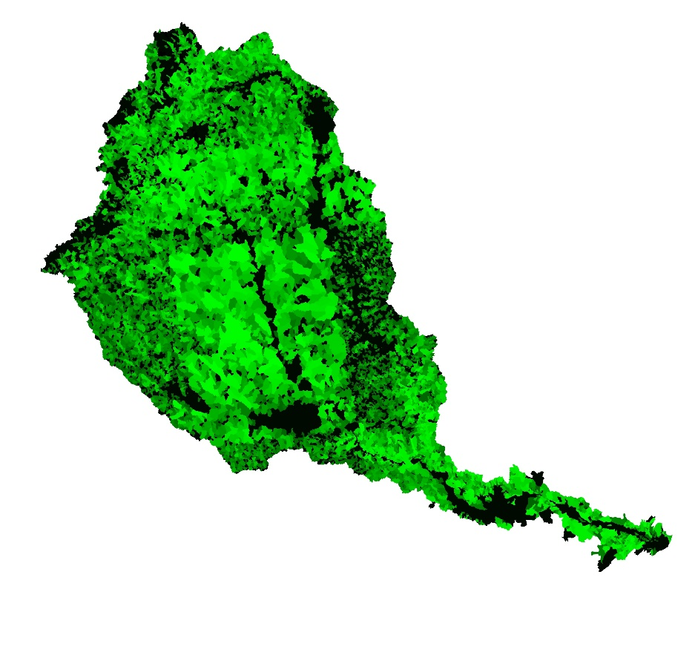
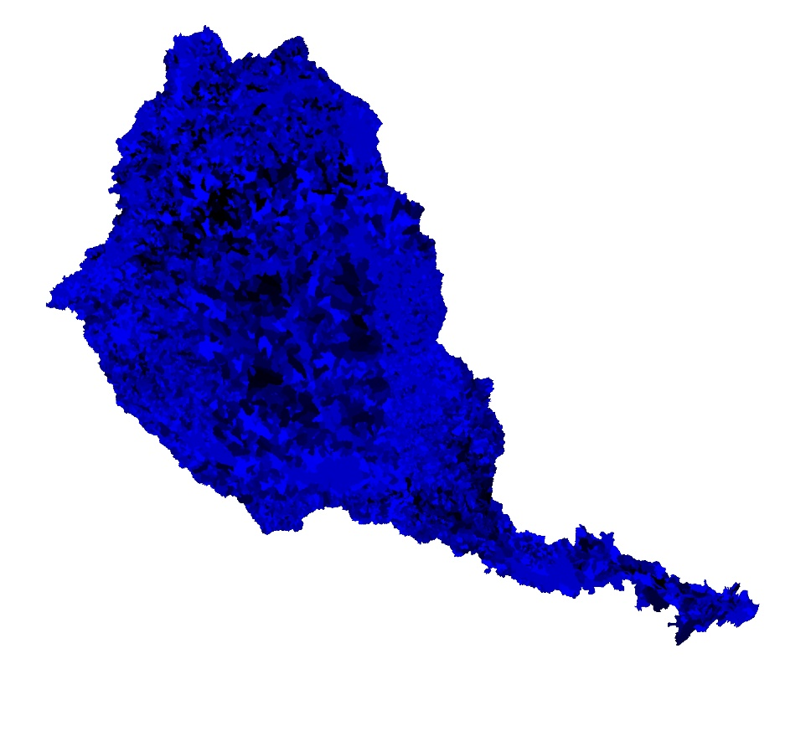
Convert flowline to forest
Maxent
GLM
Random Forest
Brighter colors = more uplift

Slide 3
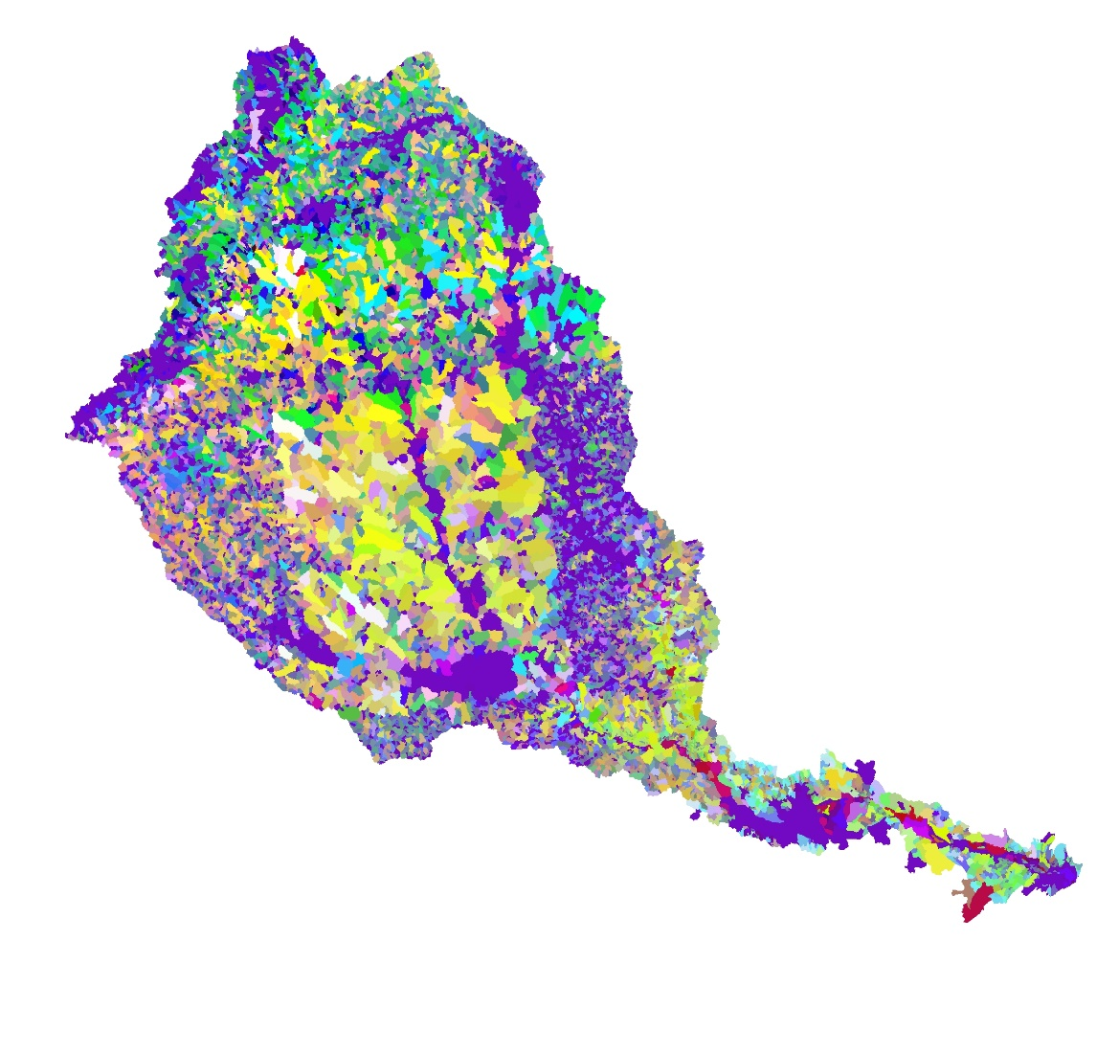
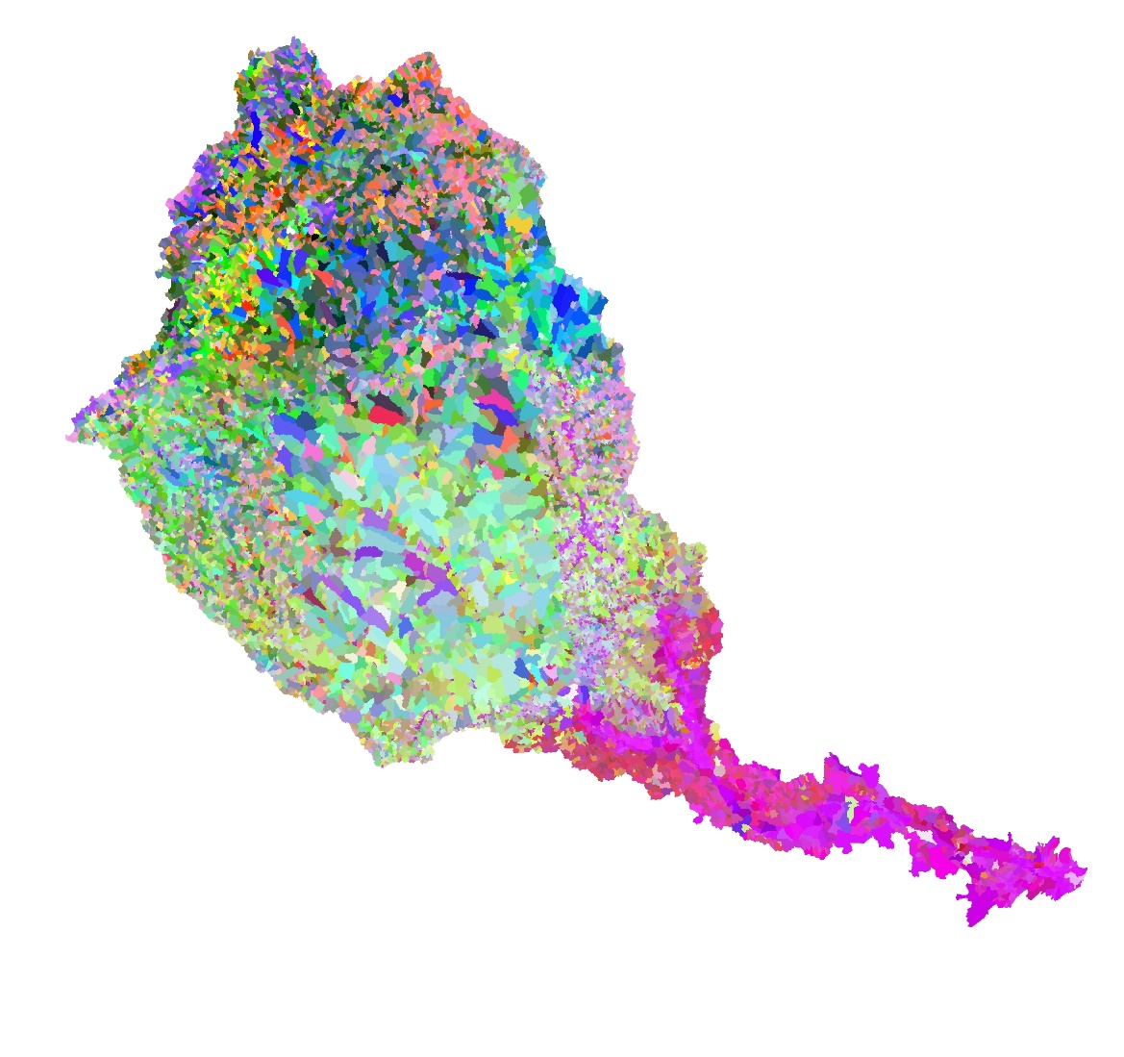
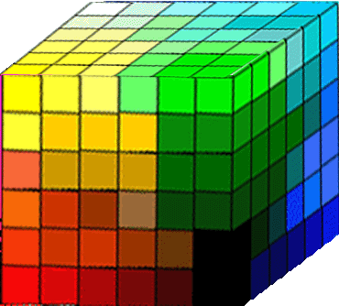
Model Composites
White: High uplift in all models
High GLM
High RF
High Maxent
Black: Low uplift in all models
Flowline → Forest
Hydric Soils → Wetland

