Slide 1
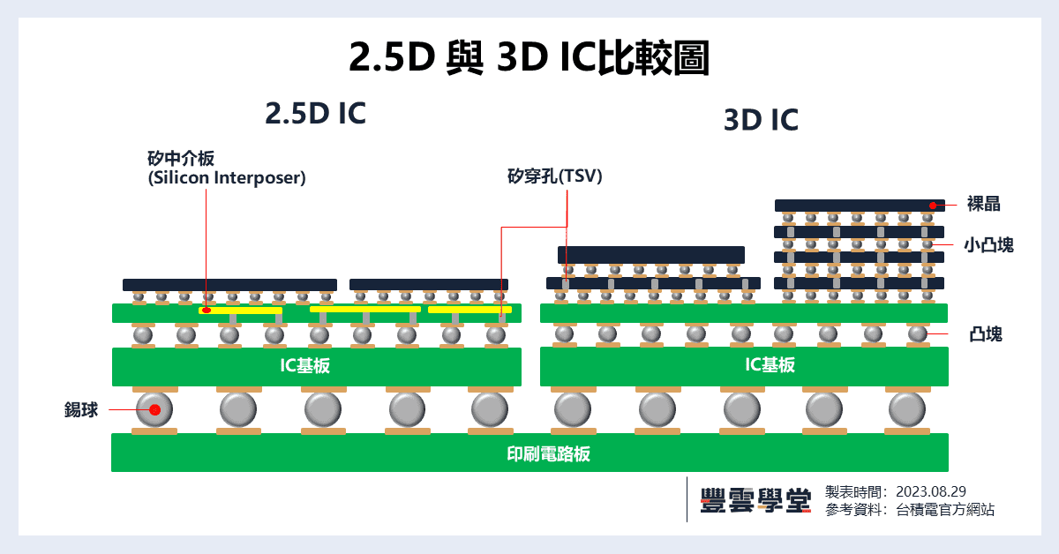
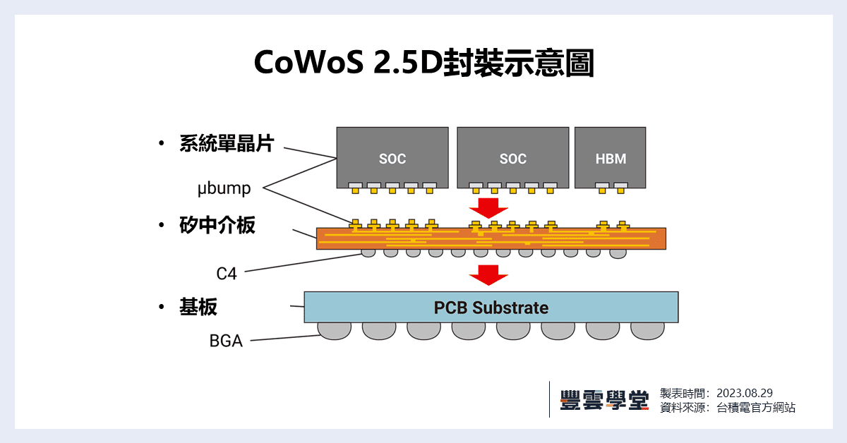
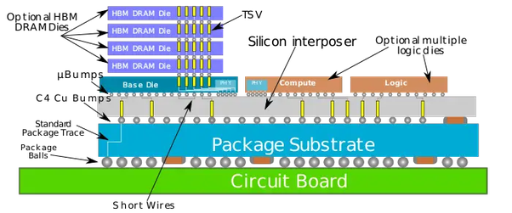
矽穿孔
SOC
SOC
HBM
Bumps
矽中介板
Package Substrate
Package balls
電路板

