Slide 1

Deep Learning: Convolutional Neural Networks
Notes:
This is an introductory lecture on deep learning with a special focus on image processing and convolutional neural networks.
It is helpful if you have some basic knowledge of neural networks, but not required. The first section provides a high-level overview of the most important concepts related to neural networks. This is included for review if the class is already familiar with basic neural networks, otherwise it provides a very brief introduction to neural networks.

Slide 2
Outline
Overview of Neural Networks
MNIST Data Set
Deep Learning Basics
Convolutional Neural Networks
Notes:
The lecture is divided into 4 sections to provide an easy-to-follow flow and a “soft” introduction to image procession with convolutional neural networks using the MNIST data set.

Slide 3
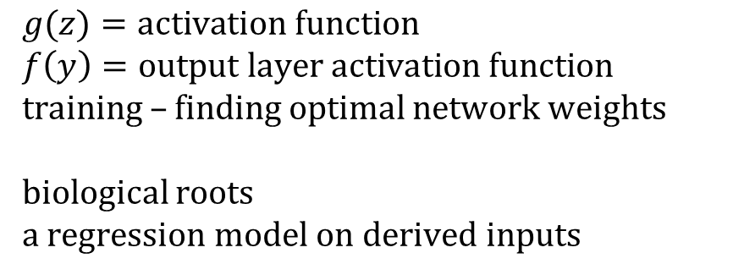
Architecture of a Neural Network
$f(\hat{y})=\hat{w}00+\hat{w}01H1+\hat{w}02H2+\hat{w}03H$₃
$$H1=g(\hat{w}10+\hat{w}11x1+\hat{w}12x2)$$
H₁
$$H2=g(\hat{w}20+\hat{w}21x1+\hat{w}22x2)$$
x₁
$$H3=g(\hat{w}30+\hat{w}31x1+\hat{w}32x2)$$
H₂
y
x₂
$$g(z)=activation function$$
$$f\left(y\right)=output layer activation function$$
training – finding optimal network weights
biological roots
a regression model on derived inputs
H₃
input layer
hidden layer
output layer
Notes:
There is an input layer (first layer), hidden layers (layers in the middle) and an output layer (layer at the end) in a neural network.
Forward pass:
In this architecture, each unit (neuron) in a layer is connection to each neuron in the next layer. If we want to compute the output of a specific neuron, we multiply each input to the neuron from the previous layer with its corresponding weight (represented by arrows) and sum together. This is passed through the activation function, g(z) and f(z) to compute a neuron’s output.
Activation Function:
For a multinominal classification problem, the sigmoid activation function is used for f(y). g(z) could be the hyperbolic tangent (tanh) activation function or one of many other activation functions.

Slide 4
Introduction to Deep Learning
Background:
Subset of machine learning
Neural network with three or more layers
Emerged in the late 2000s
Learns from large amounts of data
Made practical by the availability of more computing power
Applications of deep learning:
Speech recognition
Image recognition
Natural language processing
Virtual assistants
Self-driving cars
Notes:
Neural network forms the basis of the deep learning.
A deep learning neural network is basically a neural network as introduced on the previous slide, but with more layers.
There is some confusion in the literature whether the 1st layer is also counted. The illustrated neural network contains an input layer, two hidden layers and an output layer. If the input layer is not counted, the network therefore has three layers satisfying the criteria to be considered as a very, very basic deep learning neural network.

Slide 5
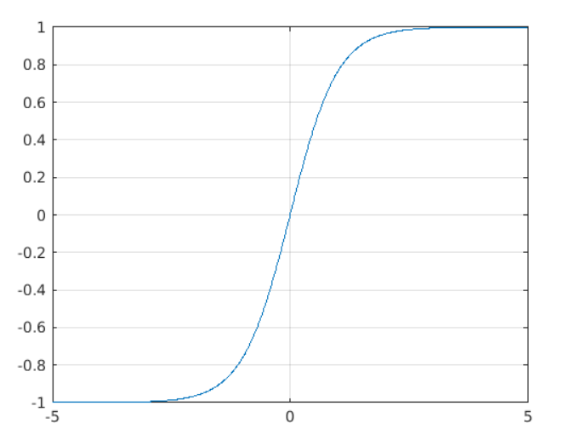
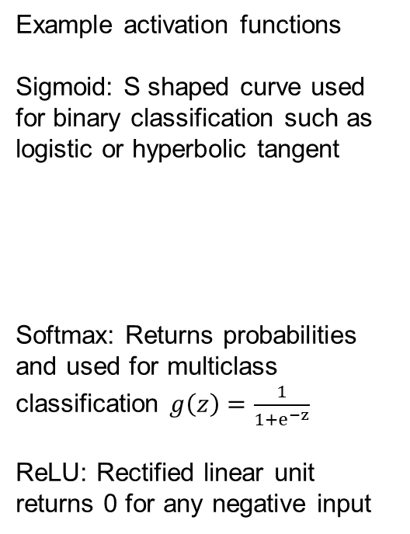
Activation Functions
Example activation functions
Sigmoid: S shaped curve used for binary classification such as logistic or hyperbolic tangent
Softmax: Returns probabilities and used for multiclass classification $g\left(z\right)=\frac{1}{1+e^{−z}}$
ReLU: Rectified linear unit returns 0 for any negative input
An activation function is:
A crucial component of deep learning
A simple function that transforms inputs into outputs within a certain range
Properties:
Monotonic (does not change direction)
Must be nonlinear (for training to be feasible)
Continuously differentiable
Support efficient computation
5
Notes:
Activation functions should have several properties to be useful and to allow training (see next slide).
Examples: relu, softmax, sigmoid, etc.

Slide 6
Training
What is neural network training?
Finding the appropriate (not always optimal) neural networks weights
An iterative procedure usually based on gradient descent optimization
Example training algorithms
Backpropagation
Stochastic gradient descent with momentum
RMSprop
Adam
Genetic algorithms
6
Notes:
Neural network training enables the neural network to find the optimal or near optimal network weights given a specific data set.
It is usually an iterative procedure based on gradient descent optimization (although a closed form solution exists for linear regression).

Slide 7
MNIST Data Set

Slide 8
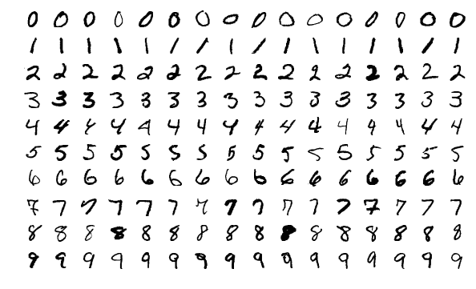
MNIST Image Classification Problem
A data set of handwritten digits
From the Modified National Institute of Standards and Technology database
Used to experiment with machine learning algorithms
Multinomial classification
Properties:
60000 training examples
10000 testing examples
28 x 28 grid of pixels
Black and white
Joseph Steppan, Sample images from MNIST test data set https://en.wikipedia.org/wiki/MNIST_database
8
Notes:
A ‘hello world’ problem in the field of deep learning (computer vision, image processing).
There are 60,000 training images and 10,000 test images in the dataset, while each image (example) has a dimension of 28x28. All images are 28x28 grayscale images associated with a label from 10 classes.
A variation of the MNIST data set is the fashion-MNIST data set that contains images of boots, trousers and bags.
It gets more complicated and training times increases dramatically when we work with color images and images with more pixels.

Slide 9
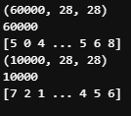
Data Exploration
from tensorflow.keras.datasets import mnist
(train_images, train_labels), (test_images, test_labels) = mnist.load_data()
print(train_images.shape)
print(len(train_labels))
print(train_labels)
print(test_images.shape)
print(len(test_labels))
print(test_labels)
There are 60000 greyscale images in the training set; each image represented by a 28 x 28 matrix. The label is represented by an integer from 0 – 9.
There are 10000 images in the test set.
9
Notes:
First, we need to import data from the keras.mnist API. This will import 60,000 training images and 10,000 test images as mentioned previously.
As shown in the console, the shape of the training images and test images are (60000, 28, 28) and (10000, 28, 28) respectively. Each image is represented by a 2D numpy array with a dimension of 28 x 28. There are 60,000 and 10,000 entries in this 2D numpy arrays for the training and testing data sets.
The labels are also imported. Their data type is integer. This is used to compare with our result generated by the neural network.

Slide 10
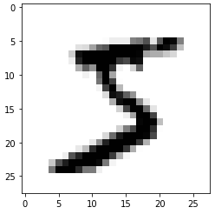
Example Image
import matplotlib.pyplot as plt
digit = train_images[0]
plt.imshow(digit, cmap=plt.cm.binary)
plt.show()
Display the 1st digit (index 0) using the imshow() matplotlib function with an appropriate colormap.
Find a good (intuitive) representation of your data in 2D black & white space.
10
Notes:
We could use the matplotlib API to show one of our training images.

Slide 11
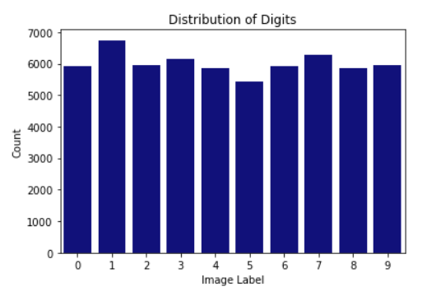
Data Distribution
import seaborn as sns
sns.countplot(x=train_labels, palette="darkblue")
plt.title("Distribution of Digits")
plt.xlabel("Image Label")
plt.ylabel("Count")
The digits occur with similar frequencies and although the digits are not uniformly distributed, each digit occurs between 5000 and 7000 times in the training data set
The actual frequencies are (0, 1, 2 … 9):
[5923, 6742, 5958, 6131, 5842, 5421, 5918, 6265, 5851, 5949]
11
Notes:
Without looking at the data you may expect that the 10 digits occur with the same frequencies, but that is not the case as can be seen from the bar chart.
So very important to visually inspect the distribution of variables in your data sets using histograms (for continuous variables) and bar charts (for categorical variables). This can easily be done using matplotlib or seaborn.

Slide 12
Deep Learning Basics

Slide 13
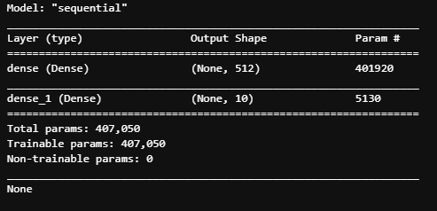
Creating Layers
from tensorflow.keras import models
from tensorflow.keras import layers
network = models.Sequential()
network.add(layers.Dense(512, activation='relu', input_shape=(28 * 28,)))
network.add(layers.Dense(10, activation='softmax'))
print(network.summary())
Very, very simple densely connected neural network with an input and two dense layers.
Notice the number of parameters that needs to be trained (even for this simple neural network)!!
13
Notes:
We will create the layers for the neural network (refer to NN).
In this case, we will simply create a dense layer (fully connected) NN.
The first layer will take in as input a 1D array of 28x28 entries and then output a 1D array of 512 entries. The activation function for this layer is ‘relu’.
The second layer will take in the 512 entries from the output of the previous layer and output a 1D array of 10 entries. The activation function of this layer is ‘softmax’. In this case, the index of entry with highest probability will be the predicted label from our NN model.

Slide 14
MNIST Layers Summary
We just created a fully connected neural network using dense layers.
For our first layer, the output would be an array of 512 elements. With “relu” activation function, all of the array elements will be non-negative (greater or equal to 0).
For our second layer, the output would be an array of 10 elements. With “softmax”, we will have a probability score on each of the entries.
14

Slide 15
Network Compilation
network.compile(optimizer='rmsprop’,
loss='categorical_crossentropy’,
metrics=['accuracy'])
The optimizer: the mechanism that the network uses to update the network weights based on the input data and loss function.
The loss function: it enables the network to measure its performance on the training data.
The metrics: used to evaluate the model during training and testing (accuracy in this case).
15
Notes:
We will compile the network by defining the loss function, optimizer, and the tracking metrics.
rmsprop is a Keras optimizer (Root Mean Square Propagation).
The cross-entropy loss function in Keras is used for multiclass classification problems.

Slide 16
Data Preprocessing
train_images = train_images.reshape((60000, 28 * 28))
train_images = train_images.astype('float32') / 255
test_images = test_images.reshape((10000, 28 * 28))
test_images = test_images.astype('float32') / 255
Reshaping the training image and test image data sets from:
a 3D array (tensor) of shape (60000, 28, 28), into
a 2D array (tensor) of (60000, 28 * 28)
Result:
an array of 60000 entries
each entry is an array with size of 28 * 28 (784) elements
Also, we need to convert the label from int8 to float32
16
Notes:
We will preprocess the data by first reshaping the training images and test images. We notice that we transform the 2D matrix used to represent the image to a 1D matrix. The number of images in both data sets remains the same. This step is to transform the input shape into the one the neural network expected.
Another thing that need to be done is to convert the value in the matrix from int8 (ranges from 0 to 225) to float32 (ranges from 0 to 1).

Slide 17
Categorical Encoding of the Labels
from tensorflow.keras.utils import to_categorical
train_labels = to_categorical(train_labels)
test_labels = to_categorical(test_labels)
Naive way of encoding 0 - 9 with a 1D array (vector):
0 -> [1,0,0,0,0,0,0,0,0,0]
1 -> [0,1,0,0,0,0,0,0,0,0]
2 -> [0,0,1,0,0,0,0,0,0,0]
……
9 -> [0,0,0,0,0,0,0,0,0,1]
One column for each categorical value (10 digits ⇒ 10 columns)
Do it for training and testing data set labels
17
Notes:
This is the naïve way of encoding labels. The result contains 10 new variables (columns), where each column contains a 1 if the image belongs to the category represented by the column, or a 0 otherwise.

Slide 18

Dimensions, Dimensions, Dimensions …
1
2
…
783
784
1 | 2 | … | 27 | 28
29 | 30 |  | 55 | 56
… |  |  |  | …
729 | 730 |  | 755 | 756
757 | 758 | … | 783 | 784
1
2
…
511
512
1
2
…
9
10
28 x 28 pixel image
reshaped image
dense layer
dense layer
18
Notes:
It is very important to understand the dimensions of the data sets, images and the various layers in the neural network. This slide tries to give a high-level overview of the dimensions, making you think more closely at what you are doing and why you are doing it.
Dimensions of original image (28 x 28), then flattened into an array of 784 elements, which becomes the input to a dense layer with 512 neurons that feeds into an output layer (which is also a dense layer) with 10 neurons.

Slide 19
Network Training
network.fit(train_images, train_labels, epochs=5, batch_size=128)
Procedure:
Compute the neural network output based on the training data (forward pass)
Compute the loss based on the loss function, which is a measurement of the mismatch between the prediction and the actual result
Update the network weights using the optimizer
Repeat the above procedure several times in order to get a trained network. Here we will iterate 5 times, which we typically refer to epochs.
19
Notes:
The above procedure will be repeated 5 times in our case, but this will depend on how many epochs we set.

Slide 20
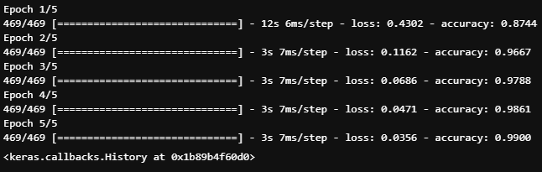
Network Training (Results)
5 epochs
Batch size = 128 (consider 128 images at a time before updating weights)
99% accuracy on training set (see Epoch 5/5 in output)
Results may differ each time you train the neural network!
20
Notes:
This might be a overfitting problem, which means the prediction is too close to a particular set of data. In our case, it is too close to out training set; however, a bit further from our test set (looking at accuracy).

Slide 21
Test Set Results (Accuracy)
test_loss, test_acc = network.evaluate(test_images, test_labels)
print('test_acc:', test_acc)
The test accuracy is 97.9%, which is different (worse) from our training accuracy of 99.0%
This may indicate overfitting: a model that corresponds too closely to the training data set
Early stopping is usually used to reduce overfitting (e.g. monitor accuracy on the validation data set and stop training when accuracy starts decreasing)
We will change the neural network architecture to try and reduce overfitting
21
Notes:
In general, overfitting can be reduced by using cross-validation and monitoring the assessment metric on a validation or testing data set while training. Stop training when the assessment metric becomes worse.

Slide 22
Possible Modification
As you might notice, there is a gap between our training result and test result (accuracy).
Is there any way to improve?
Yes, we will improve by introducing the Convolutional Neural Network.
Notes:
We will introduce convolutional neural networks (CNNs) in the rest of the module.

Slide 23
Convolutional Neural Networks

Slide 24
Computer Vision and Deep Learning
A convolutional Neural Network (CNN) may be better (more accurate)
Almost universally used in the field of computer vision applications
We will apply a CNN to our MNIST example
Notes:
Convnets has been popular and successful in the field of image processing.

Slide 25
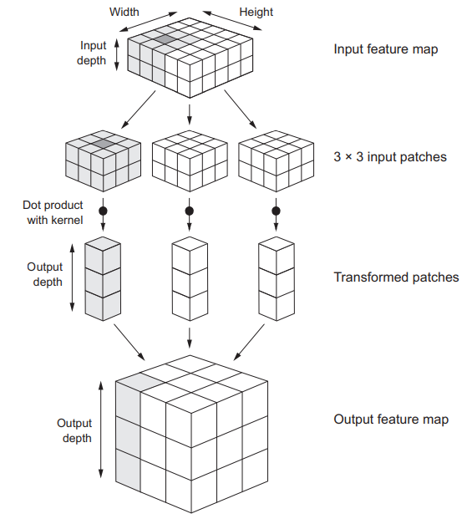
Convolutional Neural Networks (Intuition)
https://www.manning.com/books/deep-learning-with-python-second-edition
25
Notes:
Convolutional neural network diagram from the book by François Chollet: Deep Learning with Python (second edition), illustrating some of the operations of a convolutional neural network.
The next slides provides more information.

Slide 26
CNN versus Layered NN with Dense Layers
The convolutional neural network takes a 3D tensor with shape of (image_height, image_width, image_channel) as input
A color image has three channels (one for red, green, and blue), while a grayscale image has only one channel
No need to flatten (or reshape) the tensor
Based on the intuition, you might have noticed that dense layers learn global patterns while convolutional neural networks learn local patterns
26
Notes:
The dense layer learns global patterns, while convnets learns local patterns.

Slide 27
Convolution Operation
Two Key parameters:
Size of the patches extracted from the inputs: in this case, it is 3 x 3, which is commonly used. It can also be 5 x 5 or larger.
Depth of the output feature map: the number of filters generated by the computation. We typically choose 32 or 64.
Filters encode a certain aspect of the input data.
In Keras, the parameter is passed in the following form:
Conv2D(output_depth, (window_height, window_width))
where (window_height, window_width) refers to the size of the patches
Notes:
When using Keras to create a covnets layer, there are two key parameters, size of patches and the depth of the output feature map.

Slide 28
Operational Procedure
Step:
The (window_height x window_width) shaped window will traverse every possible location on the input feature map
Several (window_height x window_width) input patches will be formed.
Each of the patches will then be transformed into a vector of shape (output_depth,) by computing the dot product with the kernel (weight matrix) or filter.
These vectors will be spatially assembled into a 3D output tensor of shape (height, width, output_depth).
See upcoming slides for a more intuitive understanding
Notes:
These 4 steps on this slide articulates the four steps from the diagram on the slide with title “Convolutional Neural Networks (Intuition)”.

Slide 29
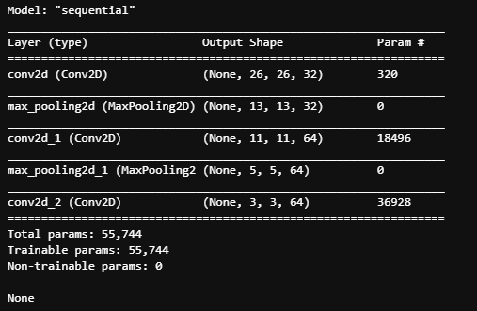
Implementation the CNN
model = models.Sequential()
model.add(layers.Conv2D(32, (3, 3), activation='relu', input_shape=(28, 28, 1)))
model.add(layers.MaxPooling2D((2, 2)))
model.add(layers.Conv2D(64, (3, 3), activation='relu'))
model.add(layers.MaxPooling2D((2, 2)))
model.add(layers.Conv2D(64, (3, 3), activation='relu'))
As we can observe, the first layer takes in an input shape of (28,28,1) and the output shape become (26,26,32). This is because there are 26*26 valid positions for 3x3 patch on 28x28 input feature map and 32 filters.
There will be things that will affect the valid position such as border effects, padding and stride (see next slides)
Notes:
The implementation of the CNN is shown by the python code.
It gets a little bit trickier when you take border effects into account. Padding may mitigate the border effects. These will be explained in the next slides.

Slide 30
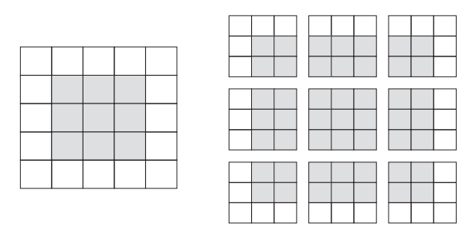
Border Effects
https://www.manning.com/books/deep-learning-with-python-second-edition
After a convolutional operation, the output feature map shrinks a little
The example shows valid locations of 3 × 3 patches in a 5 × 5 input feature map
Padding avoids shrinking
Grey area indicates shrunken output feature map
30
Notes:
The patches is formed by moving the specific sized patch around the image and stopping at every valid location. The images shows the valid locations for 3x3 patches on a 5x5 input (or feature map).
Padding will help to avoid shrinking, that is the input feature map in effect getting smaller and smaller with the application of a convolutional operation.

Slide 31
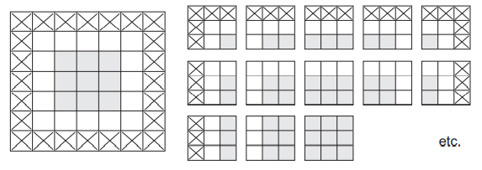
Padding
https://www.manning.com/books/deep-learning-with-python-second-edition
Padding resolves the border effects issue
With padding (crossed cells), there will be more patches to be formed
In total 25 patches
Output feature map is now the same size as the input feature map (5 x 5)
31
Notes:
Padding is to add appropriate number of rows and columns to each side of the input feature map in order to fit the patch window around every input tile.
After padding, we could notice that the output shape of the 5x5 input feature map becomes 5x5 which is not shrinking.

Slide 32
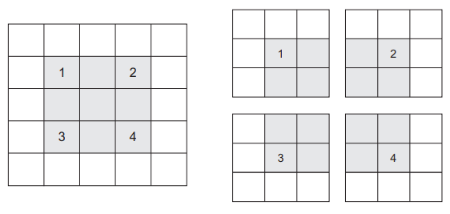
Stride
https://www.manning.com/books/deep-learning-with-python-second-edition
Stride refers to the number of pixels moved between successive patches (i.e. center tiles of all input patches do not need to be contiguous, but the default is 1)
Notice that each of these patches has one open pixel between them on the input feature map.
32
Notes:
Strides refer to the distance between two successive windows. This diagram shows an example of valid locations of 3 x 3 patches with 2 strides from 5 x 5 featured map. Using 2 means down sampling the width and height of the output feature map by factor 2.
It is rarely used in convnets.

Slide 33
Max Pooling Operation
Down sample feature maps by transforming local patches via selected tensor operations such as max or average pooling.
Max pooling will output the maximum for each patch.
As we could see from the summary, the output feature map is being halved.
33
Notes:
Generally, max pooling will use 2 x 2 patches with a stride of 2. These 2 x 2 patches will be transformed via hardcoded max tensor operation instead of using a kernel as in step 3.

Slide 34
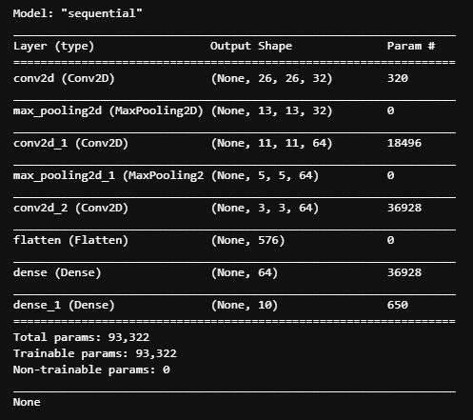
Adding Final Layers
model.add(layers.Flatten())
model.add(layers.Dense(64, activation='relu'))
model.add(layers.Dense(10, activation='softmax'))
print(model.summary())
We will be adding dense layers to the network after several convolutional operations.
The model summary shows the structure of our convolutional neural network.
Notice the number of parameters that needs to be trained.
Although this is a more complicated architecture, its is more suitable to image processing and the number of parameters decreased significantly!
Notes:
After the convolutional operation, we still need a dense layered NN to gather information from the operation and generate our desired output.

Slide 35
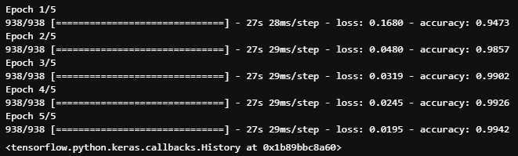
Data Importing, Preprocessing, Etc.
(train_images, train_labels), (test_images, test_labels) = mnist.load_data()
train_images = train_images.reshape((60000, 28, 28, 1))
train_images = train_images.astype('float32') / 255
test_images = test_images.reshape((10000, 28, 28, 1))
test_images = test_images.astype('float32') / 255
train_labels = to_categorical(train_labels)
test_labels = to_categorical(test_labels)
model.compile(optimizer='rmsprop’,
loss='categorical_crossentropy’,
metrics=['accuracy'])
model.fit(train_images, train_labels, epochs=5, batch_size=64)
35
Notes:
Adding previous code to import and preprocess the data. Define the loss function, optimizer and metrics. Then train the model for 5 epochs.

Slide 36
CNN Improvement
test_loss, test_acc = model.evaluate(test_images, test_labels)
>>> 313/313 [==============================] - 1s 4ms/step - loss: 0.0238 - accuracy: 0.9922
The accuracy on the data sets are:
Training 99.4%,
Testing 99.2%
This is an improvement on the test accuracy of 97.9% obtained in the previous section, although more improvements could still be made through adjustment of the network architecture or training parameters.
We made progress (improved accuracy) by utilizing a convolutional neural network.
Notes:
We have made a substantial improvement in accuracy by using convnets. We could still improve further by modifying the architecture and changing the parameters used (e.g., number of nodes, number of layers, parameters, etc.)

Slide 37
Summary
Convolutional Neural Networks are powerful
The default for image processing
Could have millions or 100s of millions of neural network weights
May take a very long time to train on large data sets
GPUs coming to the rescue!!
37

Slide 38
References
Chollet, Francois. 2017. Deep Learning with Python. New York, NY: Manning Publications.
Andrew, Trask. 2019. Grokking Deep Learning Manning Publications. -
38

