Slide 1
CompSci 190: Testing Hypotheses
Jeff Forbes
October 31, 2018

Slide 2
Sampling
Probability: Compute what will happen when you run an experiment
Statistics: Look at the outcome of the experiment and try to reason about the world
Sampling: Take the outcome of an experiment and use the rules of probability to reason about how it might have come out differently

Slide 3
Estimation
Statistical Inference:
Making conclusions based on data in random samples
fixed
Example:
Use the data to guess the value of an unknown number
depends on the random sample
Create an estimate of the unknown quantity

Slide 4
Terminology
Parameter
A number associated with the population
Statistic
A number calculated from the sample
A statistic can be used as an estimate of a parameter
(Demo)

Slide 5
How do we test a hypothesis?
Chocolate has no effect on cardiac disease.
Yes, chocolate has some effect on cardiac disease.
This jury panel was selected at random from eligible jurors.
No, it has too many people with college degrees.
Create a model for our set of assumptions about the data

Slide 6
How do we assess a model?
Simulate data according to the assumptions of the model
Learn what the model predicts.
Compare the predictions to the data that were observed.
If the data and the model’s predictions are not consistent, that is evidence against the model.

Slide 7
Robert Swain v. Alabama
1965 Supreme Court case about jury selection
In Talladega, Alabama, 26% of residents were black
In Swain's jury panel, 8 of 100 panelists were black
All 8 were struck from the jury by the prosecution (using peremptory challenges)
Ruling: "The overall percentage disparity has been small and reflects no studied attempt to include or exclude a specified number of [black men]."

Slide 8
Jury Panels
Eligible jurors in a county
List of eligible residents
Jury panel
Jury
Section 197 of California's Code of Civil Procedure: All persons selected for jury service shall be selected at random, from a source or sources inclusive of a representative cross section of the population of the area served by the court.
Sixth Amendment to the US Constitution: … the accused shall enjoy the right to a speedy and public trial, by an impartial jury of the state and district wherein the crime shall have been committed.

Slide 9
Sampling from a Distribution
Sample at random from a categorical distribution
sample_proportions(sample_size, pop_distribution)
Samples at random from the population
Returns an array containing the distribution of the categories in the sample

Slide 10
Perfect information
You want to know how many US voters support a particular policy.
You could ask everyone. That works.
But, sometimes we can't afford to do that. So, instead, we could ask some of them, and draw inferences about the general population.

Slide 11
A common scenario
You have to make a decision based on incomplete information.
The quality of your decision is affected by
the information that you have
the information that you don’t have
So, before making the decision, it is worth examining why and how your information came to be incomplete.

Slide 12
Terminology
Population: A collection of individuals
All United flights out of SFO in Summer 2015
Variable: Something that varies in the population
airline (categorical variable)
amount of delay in departure (quantitative variable)
Sample: A subset of the population

Slide 13
Why take a sample?
You want to understand the variable in the population,
but
you don’t have the resources to measure the variable on all the individuals in the population,
so
you just measure it on a subset of them.

Slide 14
“Tickets in a box”
sample
population

Slide 15
Best way to draw the sample
At random!

Slide 16
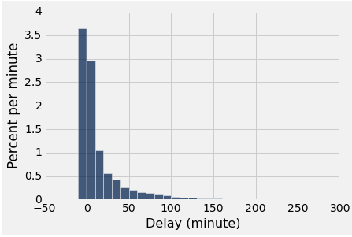
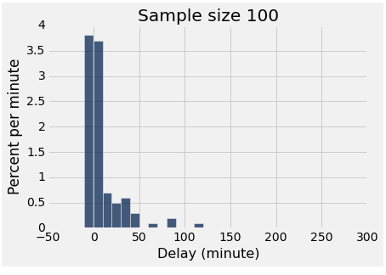
Two distributions
distribution of the population
empirical distribution of a sample

Slide 17
Why sample at random?
The empirical distribution
of a large random sample
is very likely to be close
to the distribution of the population.
That’s why.

Slide 18
The effect of sample size
Larger random samples are more likely to resemble the population than smaller ones.
However, if the method of sampling is not random, taking a larger sample isn’t necessarily better.
You could just end up with a big bad sample.

Slide 19
More terminology
Parameter: A number calculated using the values in the population
Median delay among all flights
Proportion of voters who are Republican
Statistic: A number calculated using the values in a sample
A statistic can be used as an estimate of a parameter.

Slide 20
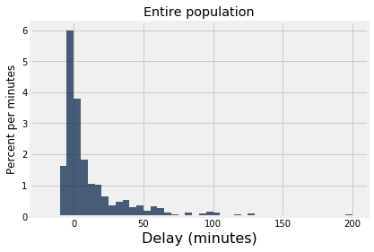
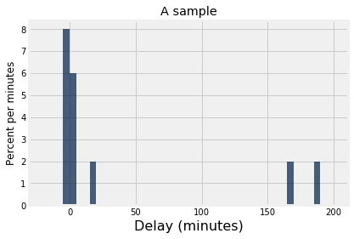
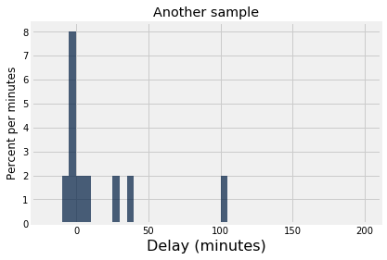
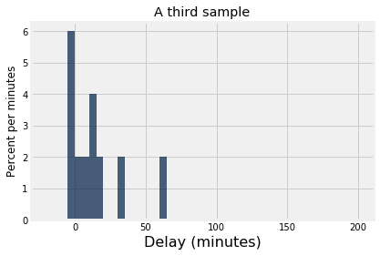
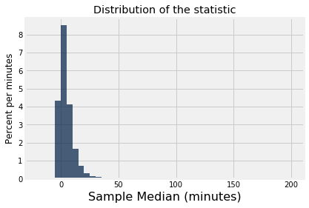
randomly sample
randomly sample
randomly sample
median = 2.0
median = -0.5
median = 9.5

Slide 21
HW5: Gary’s Game
Flip a fair (?) coin 10 times
If number of heads >= 5, we win
Else Gary wins
Play the game once
There’s one head
Was the game rigged?
http://bit.ly/FoDS-f18-1031

Slide 22
If you have the entire population...
Formulate a question you want to answer (a parameter of the population).
Visualize the data (the population).
Compute the answer.
Interpret the results, and explain them in language without statistical jargon.

Slide 23
If you don't...
Formulate a question you want to answer (a parameter of the population).
Select a method of inference.
Visualize the data (the sample).
Calculate the statistic on your sample, then apply the method to estimate the population parameter.
Interpret the results, and explain them in language without statistical jargon.

