Slide 1
CompSci 190: Visualization & Graphs
Jeff Forbes
September 17, 2018

Slide 2
Plan For The Week (PFTW)
Do Homework 2
Go back to Census example
Consider different methods for visualizations of data
Types of charts
Scatter, line & bar
Histograms
Distributions
Categorical
Numerical

Slide 3
Types of Data
Tables enforce constraints
All values in a column are the same type
Values in a column are comparable
Numerical — Each value is from a numerical scale
Numerical measurements are ordered
Differences are meaningful
Categorical — Each value is from a fixed inventory
May or may not have an ordering
Categories can be different

Slide 4
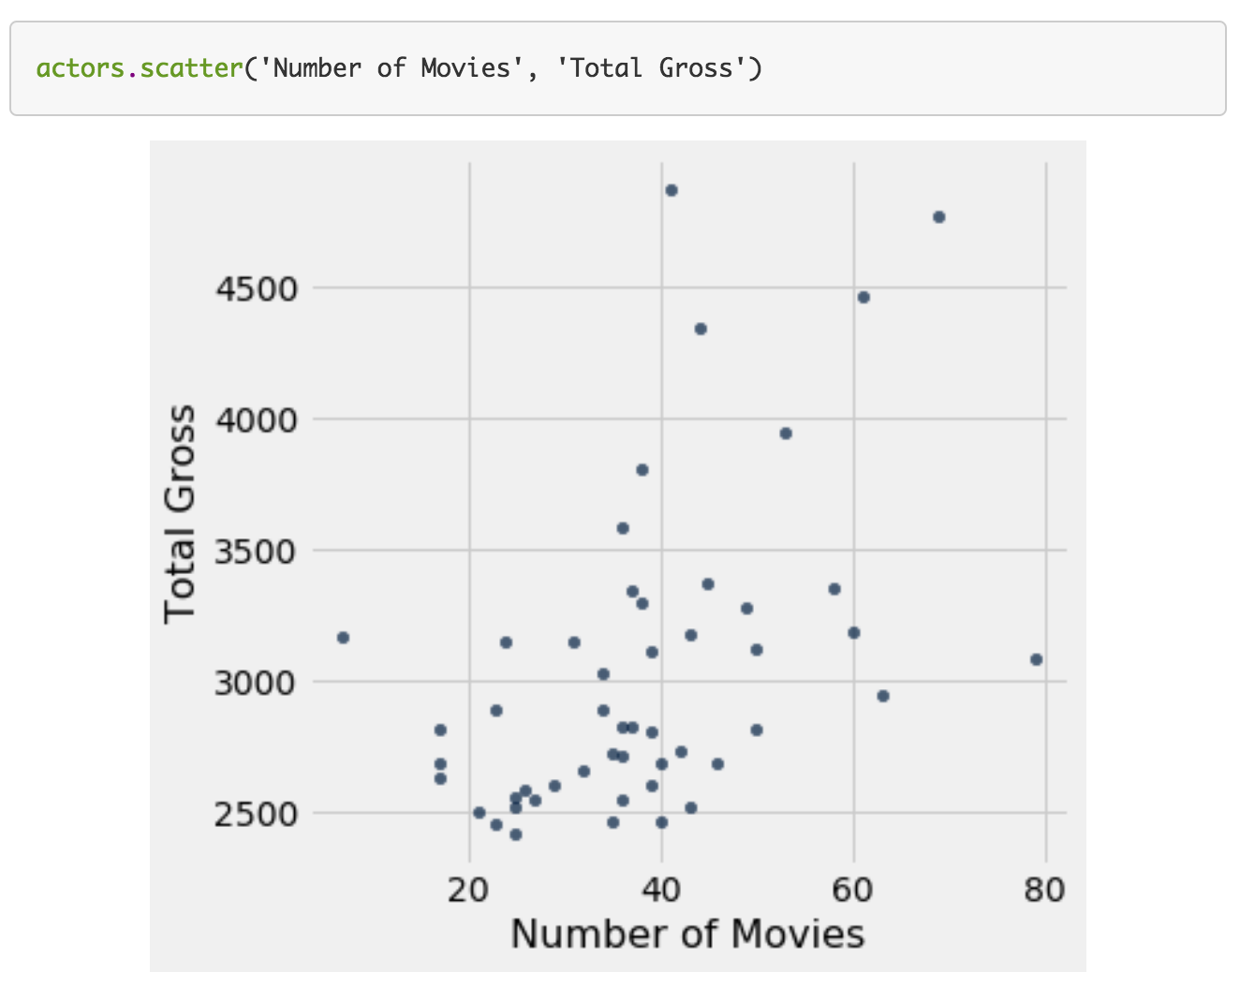
Scatter Plot
Relation/association between two numerical values
Arguments
Label of column for horizontal (x) axis
Label of column for vertical (y) axis

Slide 5
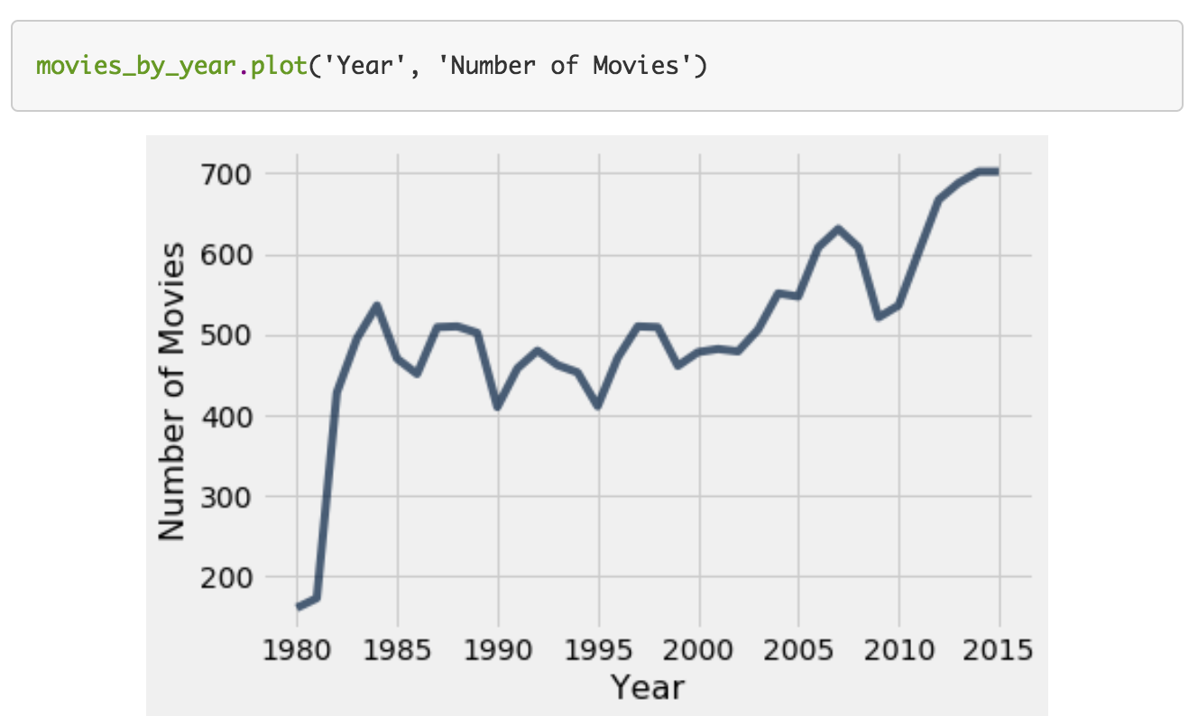
Line Graph
Use: chronological trends
Arguments
Label of column for horizontal (x) axis
Label of column for vertical (y) axis

Slide 6
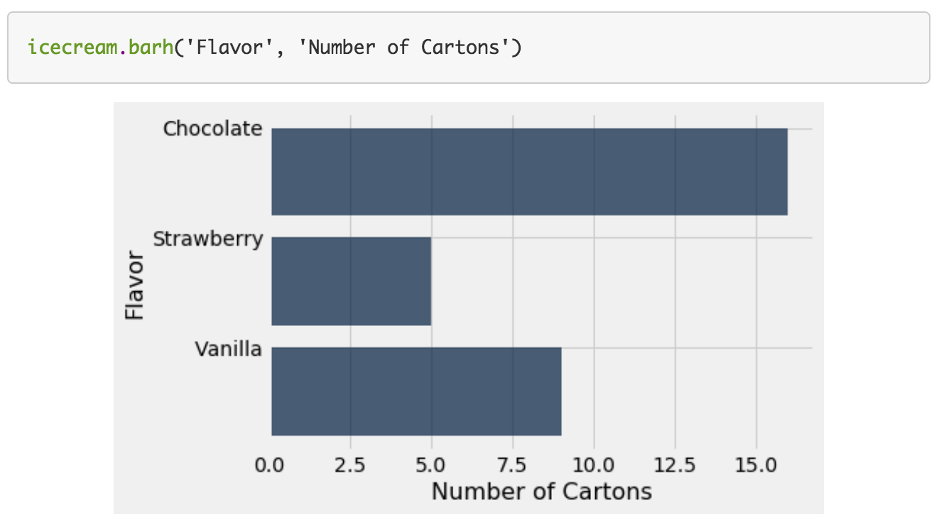
Bar Chart
Categorical distributions
Implications?
Width of bars
Ordering of categories
Arguments
Label of column for categories
Label of column for frequencies

Slide 7
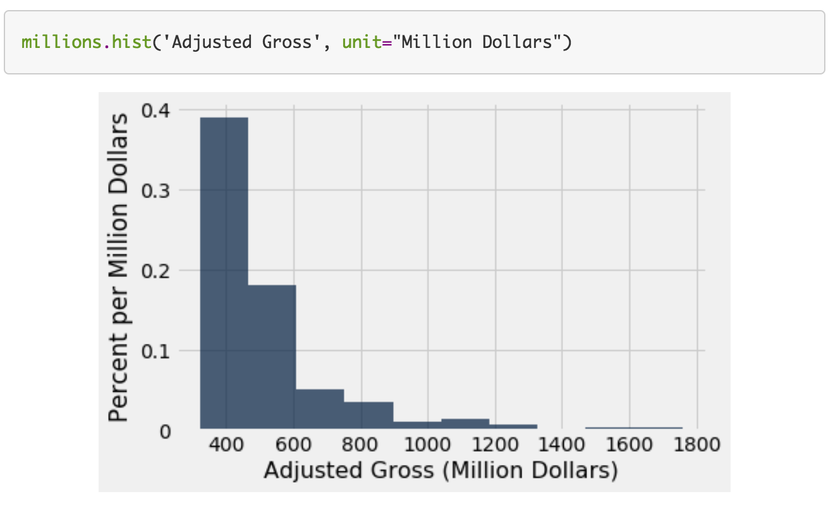
Histograms
Numerical distributions
Implications?
Width of bars
Arguments
Values to display
Optional arguments
unit: label for axes
bins: endpoints for buckets
normed: display proportion instead of counts

Slide 8
Binning numerical values
Binning: # of numerical values that lie within ranges (bins)
Bins are defined by their lower bounds (inclusive)
The upper bound is the lower bound of the next bin
188, 170, 189, 163, 183, 171, 185, 168, 173, ...
The [185,190) bin
160
165
170
175
180
185
190

Slide 9
Histogram Axes
By default, hist uses a scale (normed=True) that ensures the area of the chart sums to 100%
The horizontal axis is a number line (e.g., years)
The vertical axis is a rate (e.g., percent per year)
The area of a bar is a percentage of the whole

Slide 10
How to Calculate Height
The [20, 40) bin contains 59 out of 200 movies
“59 out of 200” is 29.5%
The bin is 40 - 20 = 20 years wide
29.5 percent
Height of bar = --------------------------
20 years
= 1.475 percent per year

Slide 11
Area Measures Percent
Name | 2016 Income (millions)
Jennifer Lawrence | 61.7
Scarlett Johansson | 57.5
Angelina Jolie | 40
Jennifer Aniston | 24.75
Anne Hathaway | 24
Melissa McCarthy | 24
Bingbing Fan | 20
Sandra Bullock | 20
Cara Delevingne | 15
Reese Witherspoon | 15
Amy Adams | 15
Kristen Stewart | 12
Amanda Seyfried | 10.5
Tina Fey | 10.5
Julia Roberts | 10
Emma Stone | 10
Natalie Portman | 8.5
Margot Robbie | 8
Meryl Streep | 6
Mila Kunis | 4.5
Area = % in bin = Height x width of bin
“How many individuals in the bin?” Use area.
“How crowded is the bin?” Use height.
What would the y-axis of a histogram of this table be?
http://bit.ly/FoDS-f18-0917-1

Slide 12
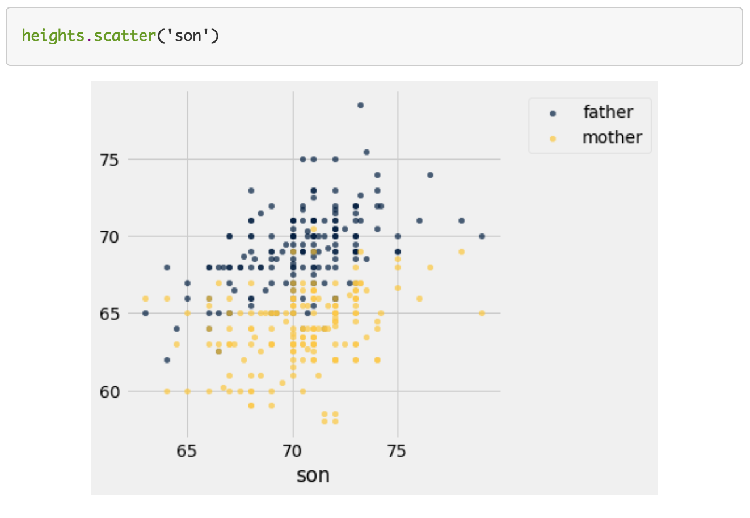
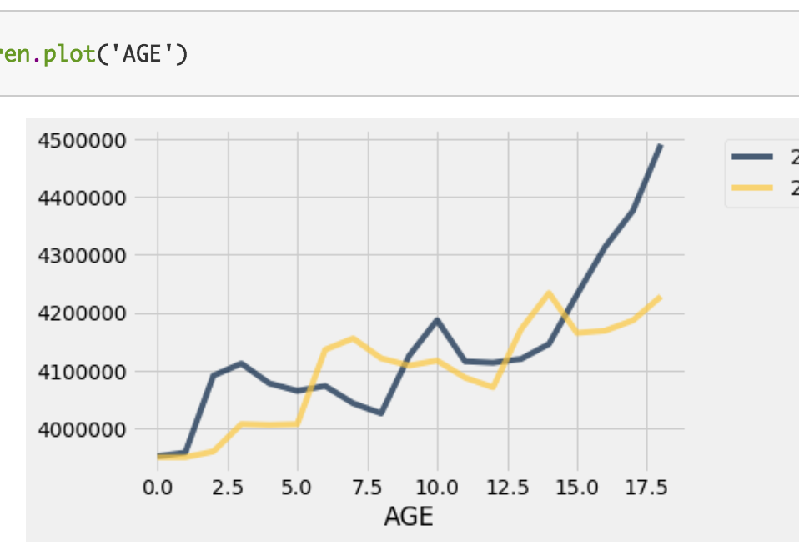
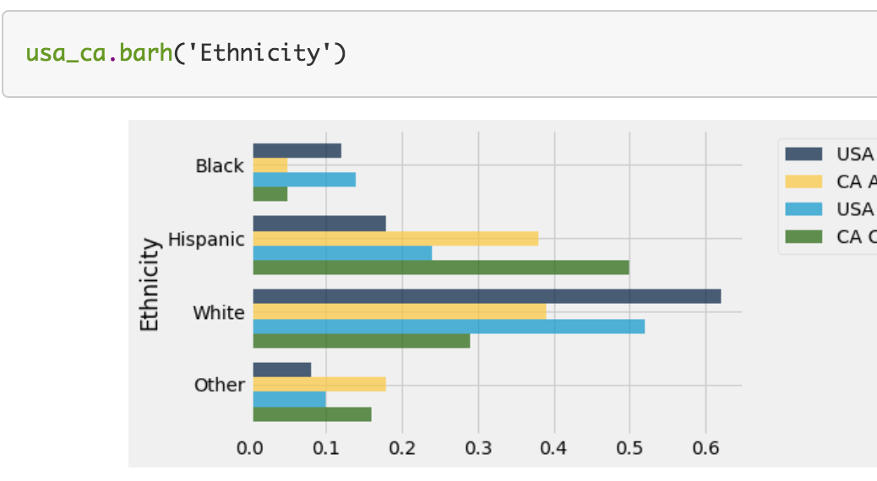
Overlaid Graphs

Slide 13
What’s next?
Read Chapter 8 of Computational and Inferential Thinking
Start working on Homework 2 (out tonight)

