Slide 1
CompSci 190: Lab 8: Resampling & Bootstap
Jeff Forbes
November 14, 2018

Slide 2
Computing Percentiles
The 80th percentile is the value in a set that is at least as large as 80% of the elements in the set
For s = [1, 7, 3, 9, 5], percentile(80, s) is 7
The 80th percentile is ordered element 4: (80/100) * 5
Percentile
Size of set
For a percentile that does not exactly correspond to an element, take the next greater element instead

Slide 3
The percentile Function
The pth percentile is the value in a set that is at least as large as p% of the elements in the set
Function in the datascience module:
percentile(p, values)
p is between 0 and 100
Returns the pth percentile of the array

Slide 4


How many enemy planes?

Slide 5
Assumptions
Planes have serial numbers 1, 2, 3, …, N.
We don’t know N.
We would like to estimate N based on the serial numbers of the planes that we see.
The main assumption
The serial numbers of the planes that we see are a uniform random sample drawn with replacement from 1, 2, 3, …, N.

Slide 6
Discussion question
If you saw these serial numbers, what would be your estimate of N?
170 271 285 290 48
235 24 90 291 19
One idea: 291. Just go with the largest one.

Slide 7
The largest number observed
Is it likely to be close to N?
How likely?
How close?
Option 1. We could try to calculate the probabilities and draw a probability histogram.
Option 2. We could simulate and draw an empirical histogram.

Slide 8
Verdict on the estimate
The largest serial number observed is likely to be close to N.
But it is also likely to underestimate N.
Another idea for an estimate:
Average of the serial numbers observed ~ N/2
New estimate: 2 times the average
(Lab)

Slide 9
Inference: Estimation
How big is an unknown parameter (e.g., number of planes)?
If you have a census (that is, the whole population):
Just calculate the parameter and you’re done
If you don’t have a census:
Take a random sample from the population
Use a statistic as an estimate of the parameter

Slide 10
Variability of the Estimate
One sample ➜ One estimate
But the random sample could have come out differently
And so the estimate could have been different
Main question:
How different could the estimate have been?
The variability of the estimate tells us something about how accurate the estimate is: estimate = parameter + error

Slide 11
Where to Get Another Sample?
One sample ➜ One estimate
To get many values of the estimate, we needed many random samples
Can’t go back and sample again from the population:
No time, no money
Stuck?

Slide 12
The Bootstrap
A technique for simulating repeated random sampling
All that we have is the original sample
… which is large and random
Therefore, it probably resembles the population
So we sample at random from the original sample!

Slide 13
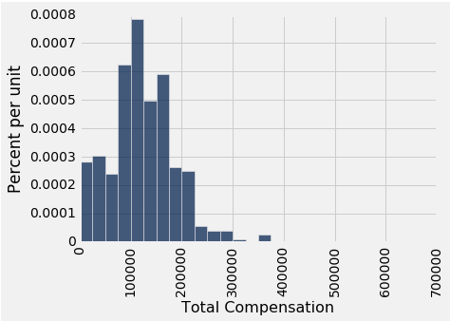
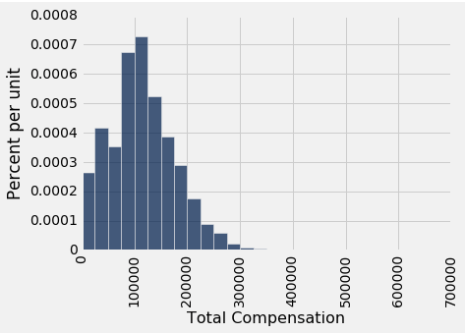
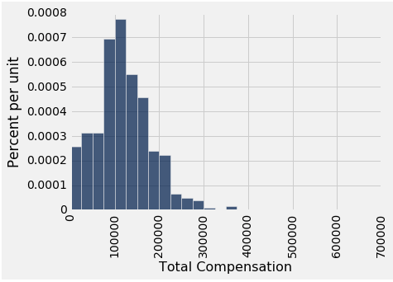
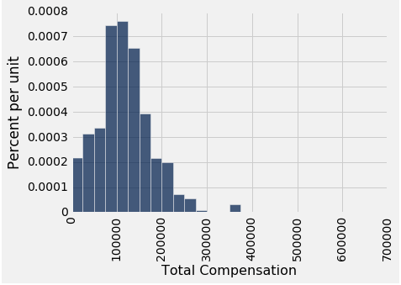
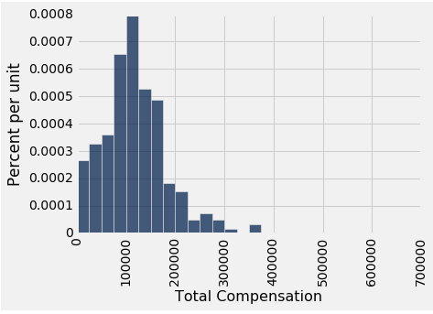
Why the Bootstrap Works
population
sample
All of these look pretty similar, most likely.
resamples

Slide 14
Key to Resampling
From the original sample,
draw at random
with replacement
as many values as the original sample contained
The size of the new sample has to be the same as the original one, so that the two estimates are comparable

