Slide 1
CompSci 190: Chance & Iteration
Jeff Forbes
October 15, 2018

Slide 2
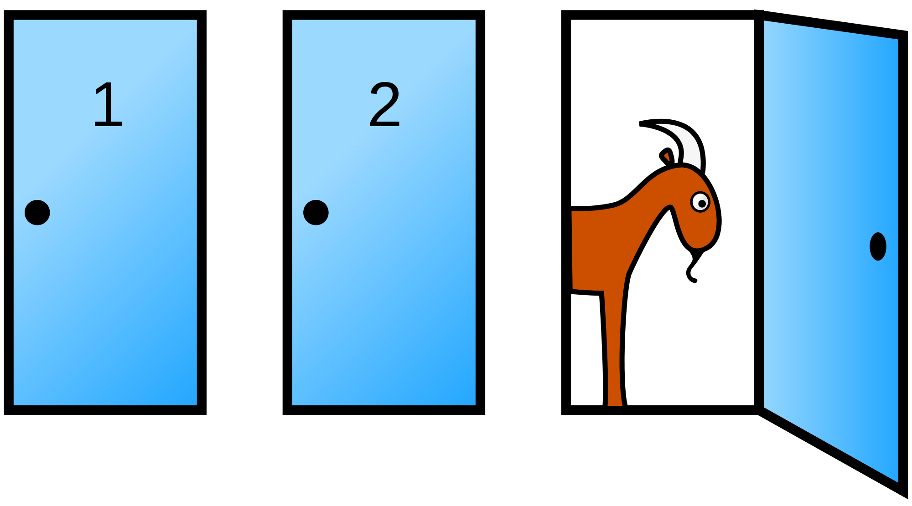
Monty Hall Problem

Slide 3
Random Selection
np.random.choice
Selects at random
with replacement
from an array
a specified number of times
np.random.choice(some_array, sample_size)
(Demo)

Slide 4
Discussion Question
d = np.arange(6) + 1
What results from evaluating the following 2 expressions? Are they the same? Do they describe the same process?
np.random.choice(d, 1000) + np.random.choice(d, 1000)
2 * np.random.choice(d, 1000)

Slide 5
Comparison Operators
The result of a comparison expression is a bool value
x = 2 y = 3
x > 1 x > y y >= 3
x == y x != 2 2 < x < 5
Assignment statements
Comparison expressions
(Demo)

Slide 6
Combining Comparisons
Boolean operators can be applied to bool values
a = True b = False
not b a or b a and not b
a and b not (a or b) b and b
Evaluate to True
Evaluate to False
(Demo)

Slide 7
Aggregating Comparisons
Summing an array or list of bool values will count the True values only.
1 + 0 + 1 == 2
True + False + True == 2
sum([1 , 0 , 1 )) == 2
sum([True, False, True)) == 2
np.count_nonzero(([True, False, True)) == ?
(Demo)

Slide 8
More Python Commands
Printing
Use print to display the value of a variable
Control Statements
The purpose of if is to define functions that choose different behavior based on their arguments
The purpose of for is to perform a computation for every element in a list or array
(Demo)

Slide 9
Probability
Lowest value: 0
Chance of event that is impossible
Highest value: 1 (or 100%)
Chance of event that is certain
If an event has chance 70%, then the chance that it doesn’t happen is
100% - 70% = 30%
1 - 0.7 = 0.3
(Demo)

Slide 10
Equally Likely Outcomes
Assuming all outcomes are equally likely, the chance of an event A is:
number of outcomes that make A happen
P(A) = -------------------------------------------------------------
total number of outcomes

Slide 11
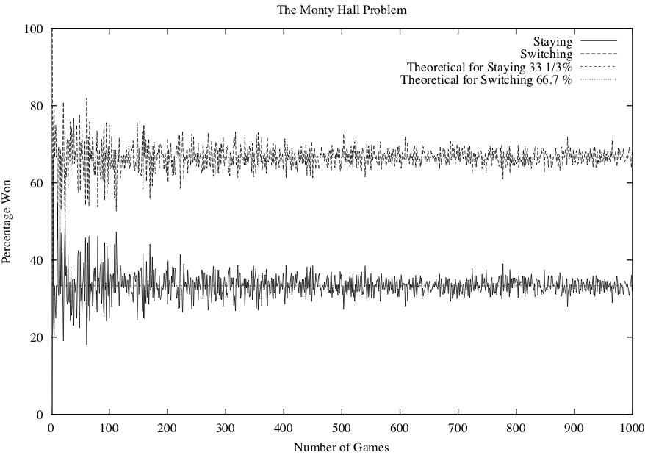
Simulating Monty Hall
x 1,000

Slide 12
Multiplication Rule
Chance that two events A and B both happen
= P(A happens) x P(B happens given that A has happened)
The answer is less than or equal to each of the two chances being multiplied
The more conditions you have to satisfy, the less likely you are to satisfy them all
(Demo)

Slide 13
Addition Rule
If event A can happen in exactly one of two ways, then
P(A) = P(first way) + P(second way)
The answer is greater than or equal to the chance of each individual way

Slide 14
Example: At Least One Head
In 3 tosses:
Any outcome except TTT
P(TTT) = (½) x (½) x (½) = ⅛
P(at least one head) = 1 - P(TTT) = ⅞ = 87.5%
In 10 tosses:
1 - (½)**10
99.9%
(Demo)

Slide 15
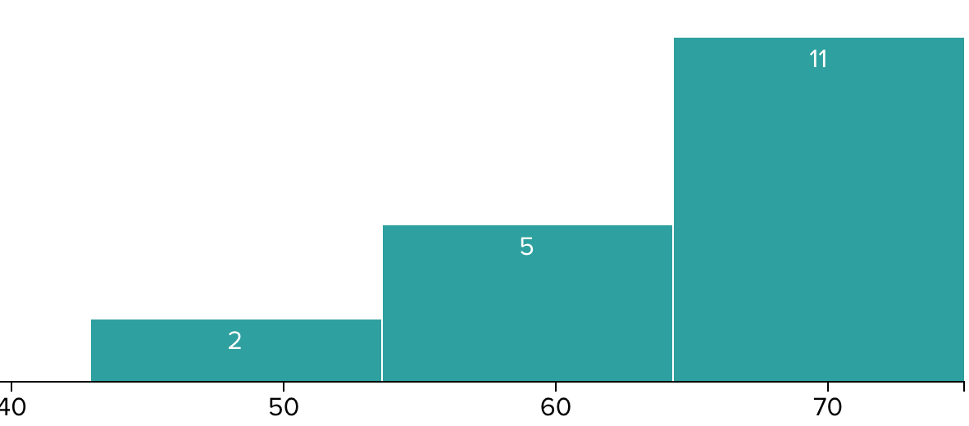
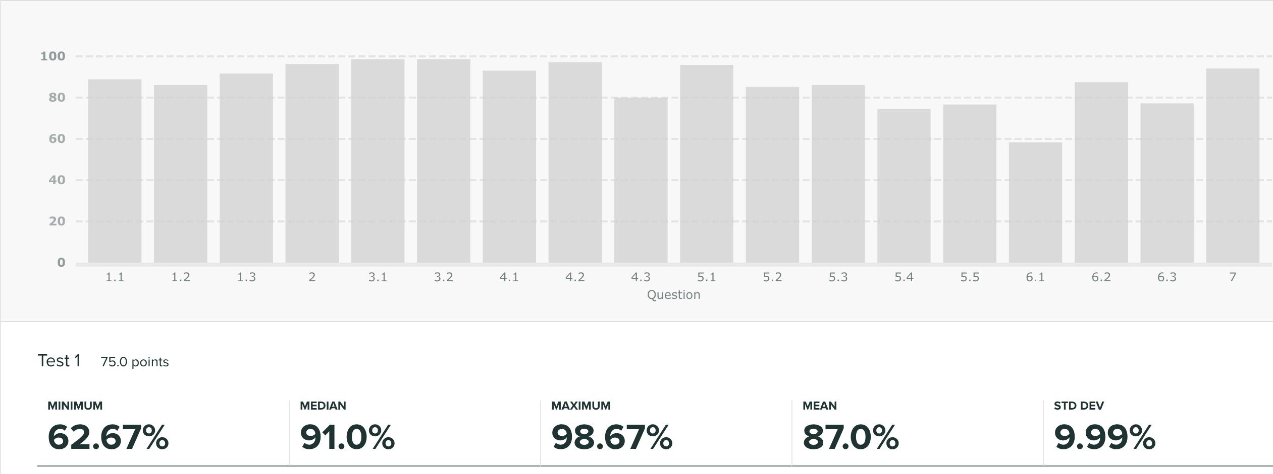
Test 1 Results
Median: 68

