Slide 1
CompSci 190: Cause & Effect
Jeff Forbes
August 27, 2018
Sit in the first six rows!

Slide 2
Plan For The Day (PFTD)
Be able to understand how association can lead to uncovering causaility
Be able to use a Jupyter notebook and the testing framework
Be able to compute values with some basic Python expressions

Slide 3
Causality

Slide 4
Cholera & John Snow?

Slide 5
Miasmas, miasmatism, miasmatists
Bad smells given off by waste and rotting matter
Believed to be the main source of disease
Suggested remedies:
“fly to clene air”
“a pocket full o’posies”
“fire off barrels of gunpowder”
Staunch believers:
Florence Nightingale
Edwin Chadwick, Commissioner of the General Board of Health

Slide 6
Observation
individuals, study subjects, participants, units
People living in 1854 London
treatment
Drinking water
outcome
Cholera
Is there any relation between water consumption and cholera?
association

Slide 7
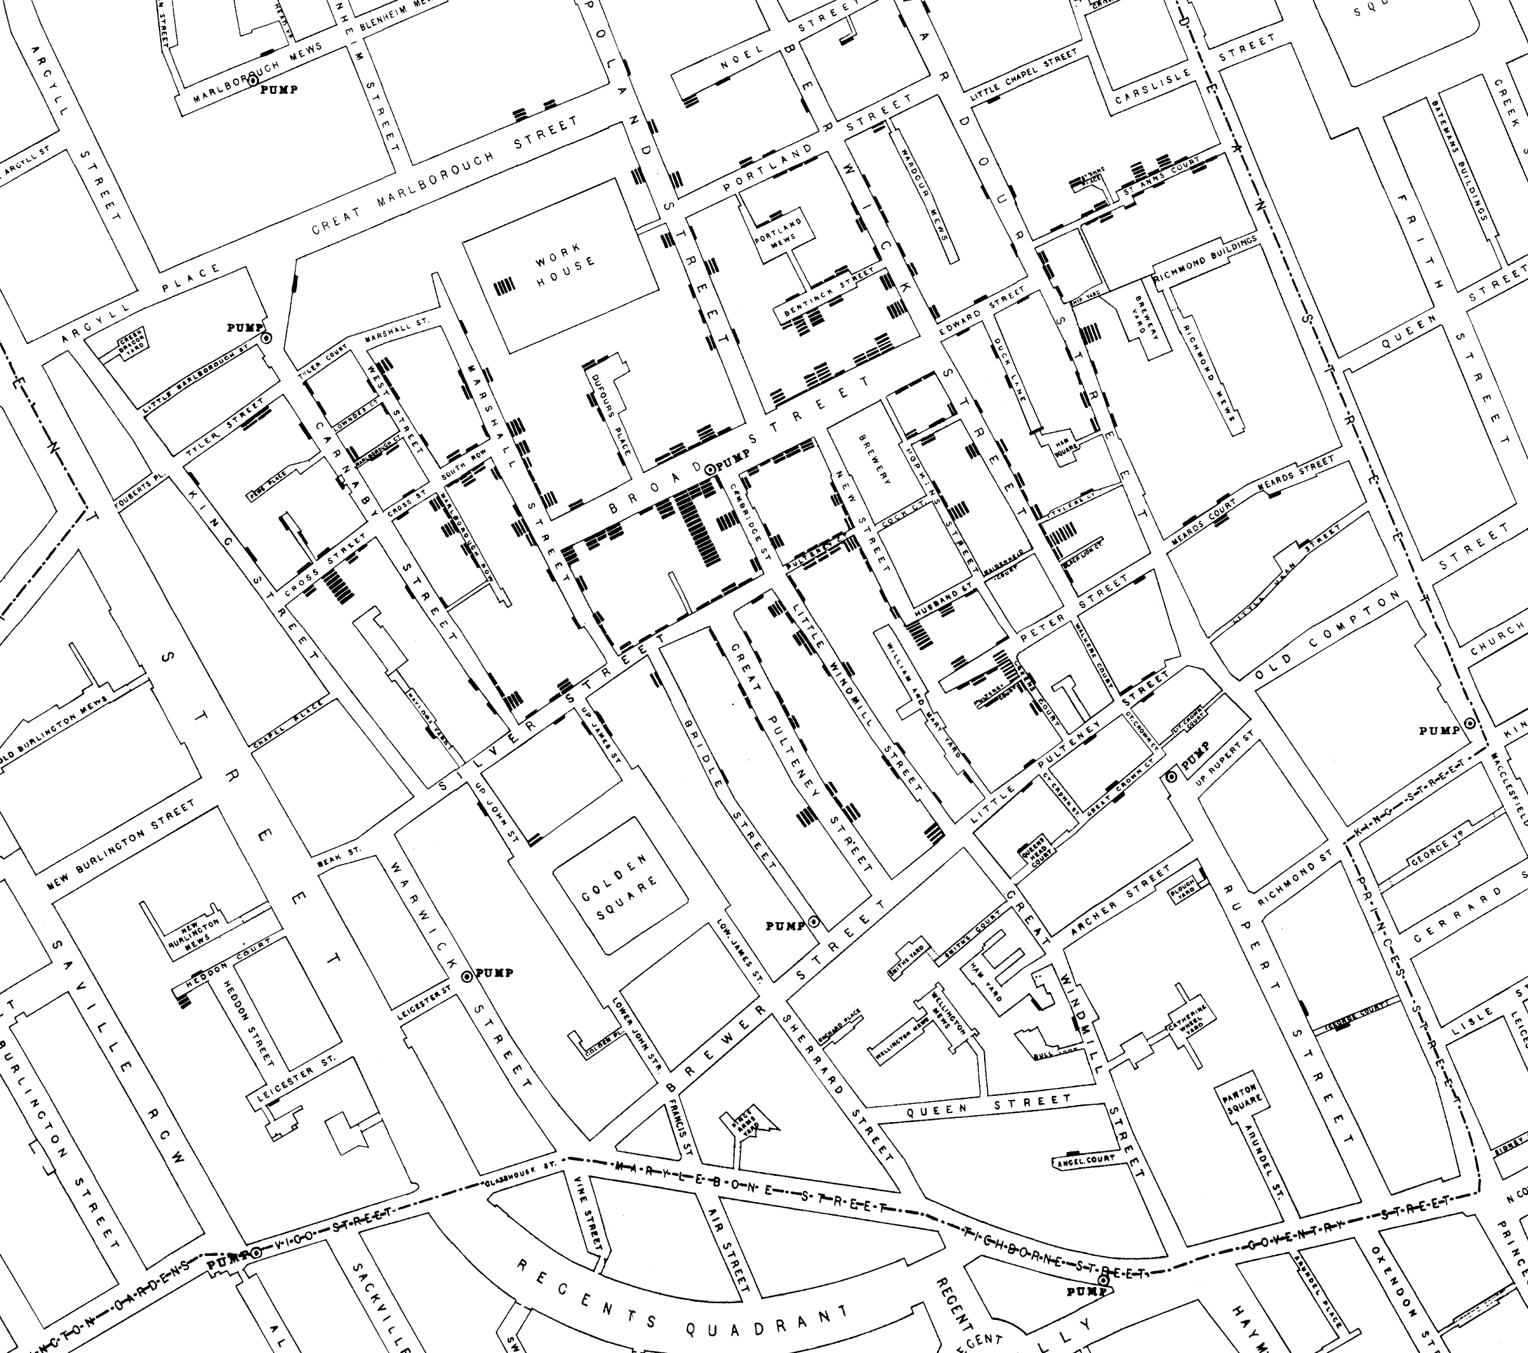

Slide 8
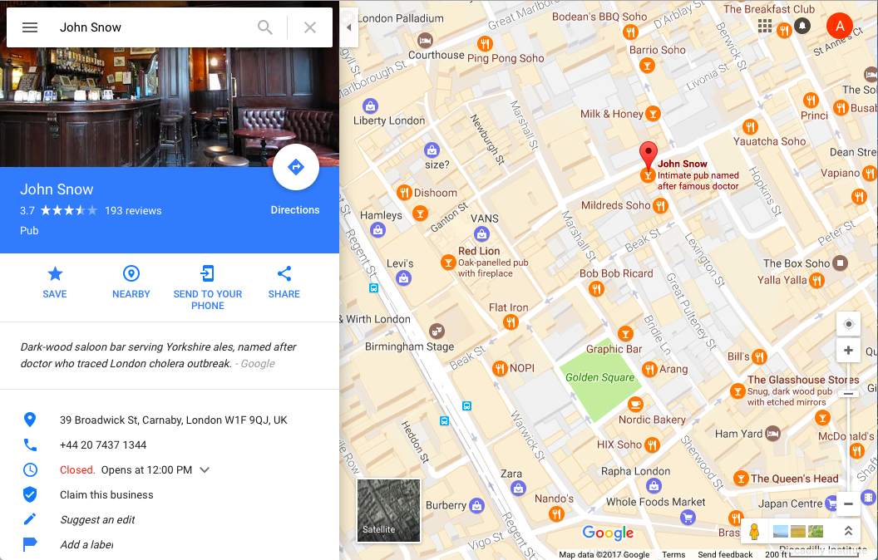

Slide 9
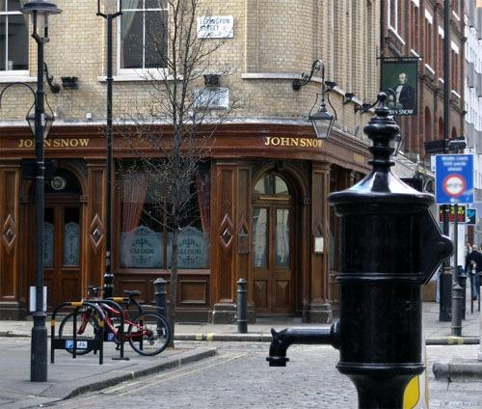

Slide 10
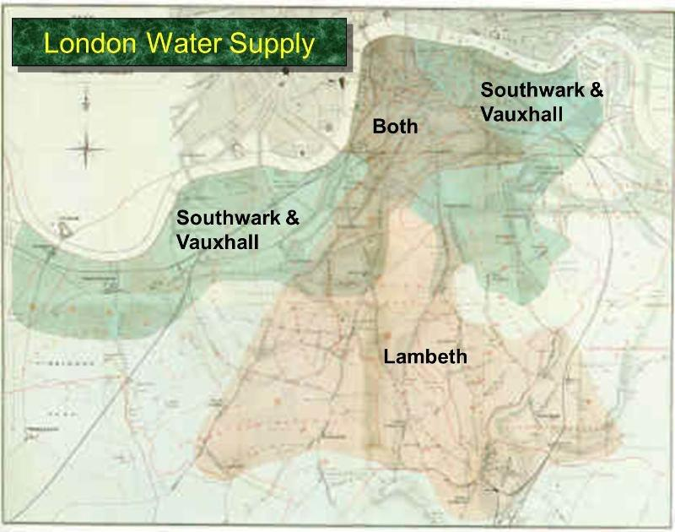

Slide 11
Establishing Causality
Does drinking tainted water lead to cholera?
Consider water from different water companies
Treatment group
Control group
does not receive the treatment

Slide 12
Snow’s “Grand Experiment”
“… there is no difference whatever in the houses or the people receiving the supply of the two Water Companies, or in any of the physical conditions with which they are surrounded …”
The two groups were similar except for the treatment.

Slide 13
Snow’s table
Supply Area | Number of houses | Cholera deaths | Deaths per 10,000 houses
S&V | 40,046 | 1,263 | 315
Lambeth | 26,107 | 98 | 37
Rest of London | 256,423 | 1,422 | 59
What does this table tell us about S&V vs. Lambeth?

Slide 14
Key to establishing causality
If the treatment and control groups are similar apart from the treatment, then differences between the outcomes in the two groups can be ascribed to the treatment.

Slide 15
Trouble
If the treatment and control groups have systematic differences other than the treatment, then it might be difficult to identify causality.
Such differences are often present in observational studies.
When they lead researchers astray, they are called confounding factors.
Solution: If you assign individuals to treatment and control at random, then the two groups are likely to be similar apart from the treatment.
Randomized Controlled Experiment

Slide 16
Lab 0: Notebooks & Expressions

Slide 17
Arithmetic Operators
Operation | Operator | Example | Value
Addition | + | 2 + 3 | 5
Subtraction | - | 2 - 3 | -1
Multiplication | * | 2 * 3 | 6
Division | / | 7 / 3 | 2.66667
Remainder | % | 7 % 3 | 1
Exponentiation | ** | 2 ** 0.5 | 1.41421
(Lab)

Slide 18
Ints and Floats
Python has two real number types
int: an integer of any size
float: a number with an optional fractional part
An int never has a decimal point; a float always does
A float might be printed using scientific notation
Limitations of float values:
They have limited size (but the limit is huge)
They have limited precision of 15-16 decimal places
After arithmetic, the final few decimal places can be wrong

Slide 19
Arithmetic Question
Rank the results of the following expressions in order from least to greatest
3 * 10 ** 10
10 * 3 ** 10
(10 * 3) ** 10
10 / 3 / 10
10 / (3 / 10)
http://bit.ly/ FoDS-f18-0829-1

Slide 20
What’s next?
Review Chapter 2 and 3 of Computational and Inferential Thinking
Complete the team-maker survey (Will be published to website on Thursday!)
Tell a friend
There’s still space!

