Slide 1
CompSci 190: Lecture 10: Predictions
Jeff Forbes
March 26, 2019

Slide 2
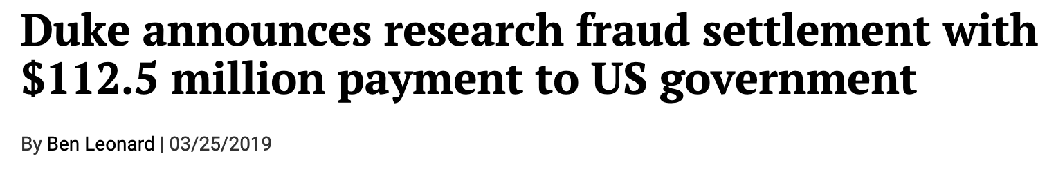
From the news
Research fraud!
Inadvertent research fraud via p-hacking
Determine how partisan control impacts the economy
How can you make statistically valid arguments that:
Democrats are good for the economy
Republicans are good for the economy
https://projects.fivethirtyeight.com/p-hacking/

Slide 3
Comparing Mean and Median
Mean: Balance point of the histogram
Median: Half-way point of data; half the area of histogram is on either side of median
Standard deviation (SD): Measures roughly how far the data are from their mean
Root mean square of deviations from average
SD has the same units as the data

Slide 4
How Big are Most of the Values?
No matter what the shape of the distribution,
the bulk of the data are in the range “average ± a few SDs”
Chebyshev’s Inequality
No matter what the shape of the distribution,
the proportion of values in the range “average ± z SDs” is
at least 1 - 1/z²

Slide 5
Chebyshev’s Bounds
Range | Proportion
average ± 2 SDs | at least 1 - 1/4 (75%)
average ± 3 SDs | at least 1 - 1/9 (88.888…%)
average ± 4 SDs | at least 1 - 1/16 (93.75%)
average ± 5 SDs | at least 1 - 1/25 (96%)
No matter what the distribution looks like

Slide 6
Standard Units
How many SDs above average?
z = (value - mean)/SD
Negative z: value below average
Positive z: value above average
z = 0: value equal to average
When values are in standard units: average = 0, SD = 1
Chebyshev: At least 96% of the values of z are between -5 and 5

Slide 7
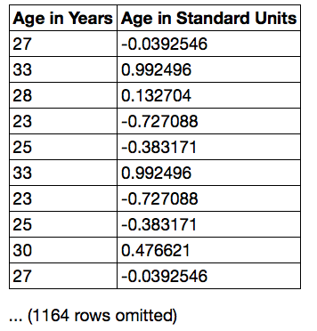
Discussion Question
Find whole numbers that are close to:
the average age
the SD of the ages
(Demo)

Slide 8
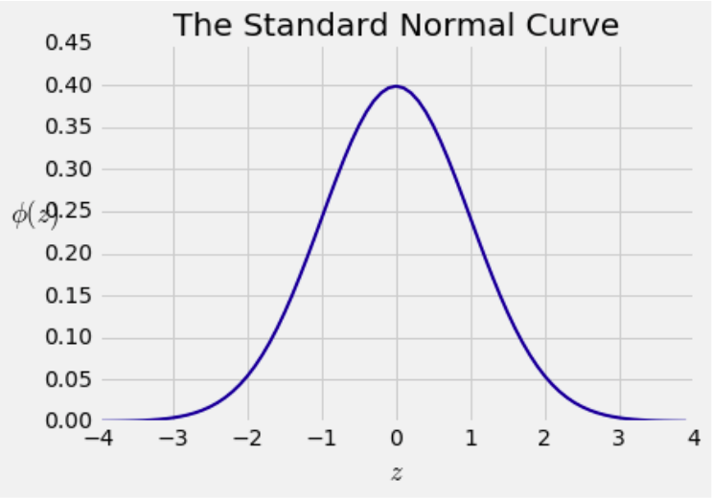
Bell Curve

Slide 9
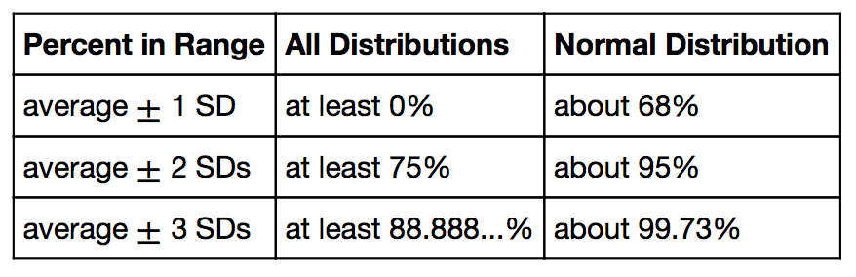
Bounds and Normal Approximations

Slide 10
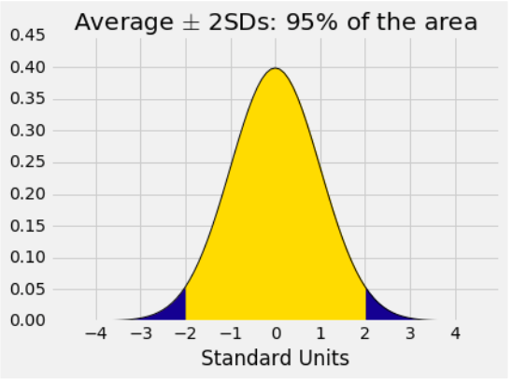
A “Central” Area
(Demo)

Slide 11
Prediction Problems
Predicting one characteristic based on another:
Given my height, how tall will I be next year?
Given my height, how tall will my kid be as an adult?
Given my height, how much will I sleep tonight?
Characteristics of an example: known and unknown
For some sample, we know all the characteristics

Slide 12
Relation Between Two Variables
Association
Trend
Positive association
Negative association
Pattern
Any discernible “shape”
Linear
Non-linear
Visualize then quantify
(Demo)

Slide 13
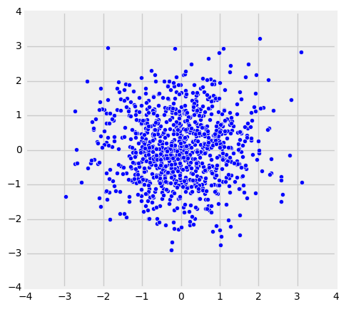
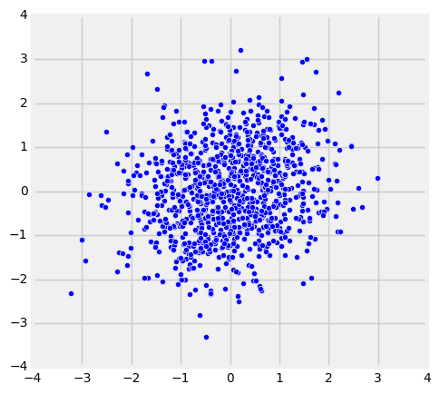
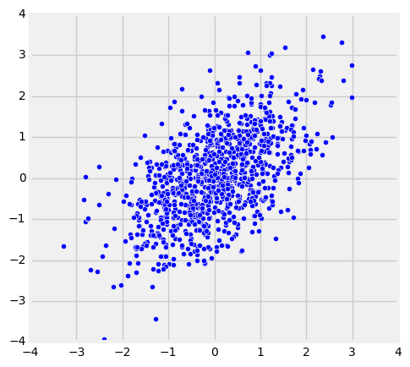
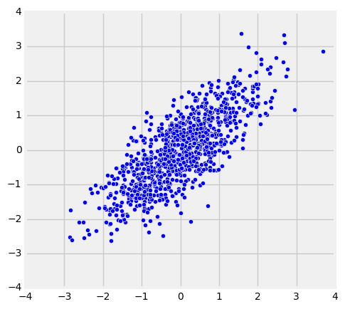
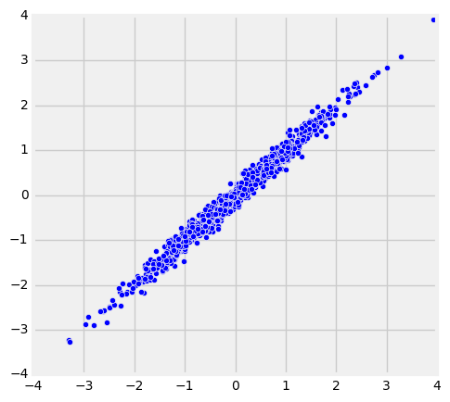
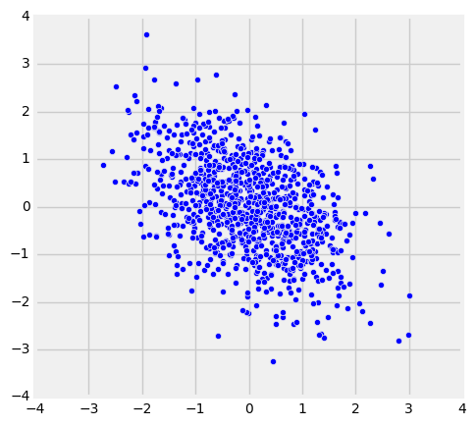
The Correlation Coefficient r
Measures linear association
Based on standard units
-1 ≤ r ≤ 1
r = 1: scatter is perfect straight line sloping up
r = -1: scatter is perfect straight line sloping down
r = 0: No linear association; uncorrelated
r = 0
r = 0.2
r = 0.5
r = 0.8
r = 0.99
r = -0.5

Slide 14
Definition of r
Correlation Coefficient (r) =
average of
x in standard units
times
y in standard units
Measures how clustered the scatter is around a straight line

Slide 15
Interpreting r
Don't jump to conclusions about causality

Slide 16
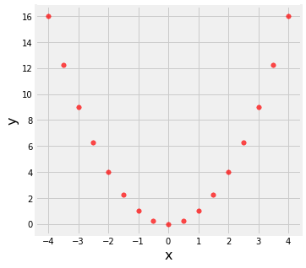
Interpreting r
Watch out for non-linearity.
r = 0.0

Slide 17
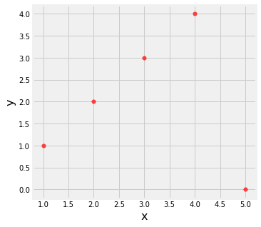
Interpreting r
Watch out for outliers.
r = 0.0

Slide 18
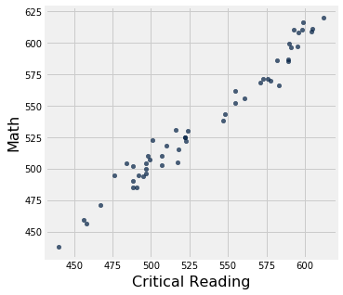
Interpreting r
Watch out for ecological correlations, based on aggregates or averaged data.
r = 0.98

Slide 19
Lab 8
Central Limit Theorem!
If the sample is
large, and
drawn at random with replacement,
Then, regardless of the distribution of the population,
the probability distribution of the sample sum
(or of the sample average) is roughly bell-shaped

