Slide 1
CompSci 190: Python & Tables
Jeff Forbes
January 17, 2019

Slide 2
Plan For The Day (PFTD)
Review the key concepts from Lab 0 & Chapter 3 about Python expressions
Be able to view data from files in tables

Slide 3
Programming Languages
Python is popular both for data science & general software development
Mastering the language fundamentals is critical
Learn through practice, not by reading or listening
Follow along in Jupyter notebook

Slide 4
Assignment Statements
hours_per_wk = 24*7
Name
Any expression
Statements don't have a value; they perform an action
An assignment statement changes the meaning of the name to the left of the = symbol
The name is bound to a value (not an equation)

Slide 5
Anatomy of a Call Expression
What function to call
Argument to the function
f ( 27)
“Call f on 27.”

Slide 6
Anatomy of a Call Expression
What function to call
First argument
Second argument
max ( 15 , 27 )
http://bit.ly/FoDS-f18-0903-1

Slide 7
Documenting Code
Why?
Communicate the algorithm to a human
Write a Markdown cell
Write comments
Use informative names
Use nouns
Abstraction: What does your code do?
Implementation: How does it do it?
Notes:
The human might be you
A bug is a piece of code which does not say what the programmer intended
Explain what the code accomplishes rather than repear what the code says

Slide 8
Table Structure
We organize our data in tables
A Table is a sequence of labeled columns
Data within a column should be of the same "type"
Label
Name | Code | Area (mi²)
North Carolina | NC | 53,819.16
South Carolina | SC | 32,020.49
Row
Column

Slide 9
Table Operations
t.select(label) - constructs a new table with just the specified columns
t.sort(label) - constructs a new table, with rows sorted by the specified column
t.where(label, condition) - constructs a new table with just the rows that match the condition

Slide 10
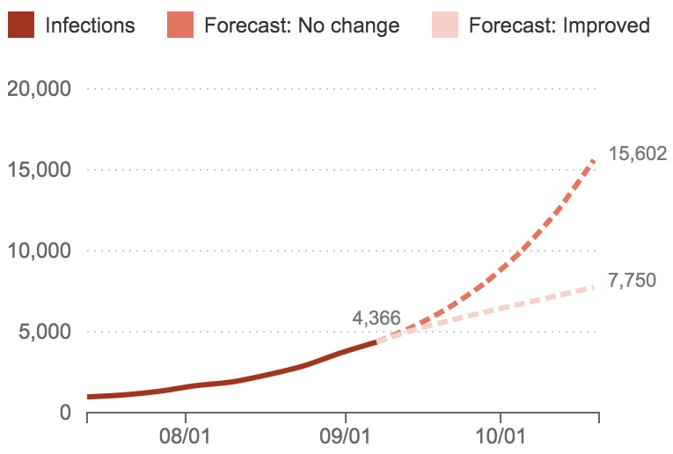
Ebola Epidemic, Sept. 2014
A Frightening Curve: How Fast Is The Ebola Outbreak Growing?
"It's spreading and growing exponentially," President Obama said.
"This is a disease outbreak that is advancing in an exponential fashion," said Dr. David Nabarro, who is heading the U.N.'s effort against Ebola.
http://www.npr.org/sections/goatsandsoda/2014/09/18/349341606/why-the-math-of-the-ebola-epidemic-is-so-scary
Source: Columbia Prediction of Infectious Diseases, World Health Organization

Slide 11
Growth Rate
The rate of increase per unit time
After one time unit, a quantity x growing at rate g will be
x * (1 + g)
After t time units, a quantity x growing at rate g will be
x * (1 + g) ** t
If after and before are measurements of the same quantity taken t time units apart, then the growth rate is
(after/before) ** (1/t) - 1
(Demo)

Slide 12
What’s next?
Read Chapter 4 of Computational and Inferential Thinking
Come ready on Tuesday for Lab

