Slide 1
CompSci 190: Visualization & Graphs
Jeff Forbes
January 31, 2019

Slide 2
Plan For Today
Principles of creating good visualizations of data
Consider different methods for visualizations of data
Types of charts
Scatter, line & bar
Histograms
Distributions
Categorical
Numerical
Do Homework 2

Slide 3
Principles of Visualization
Above all else, show the data
Comparison rather than just description
Maximize the data-ink ratio
Don’t be misleading
Watch your axes

Slide 4
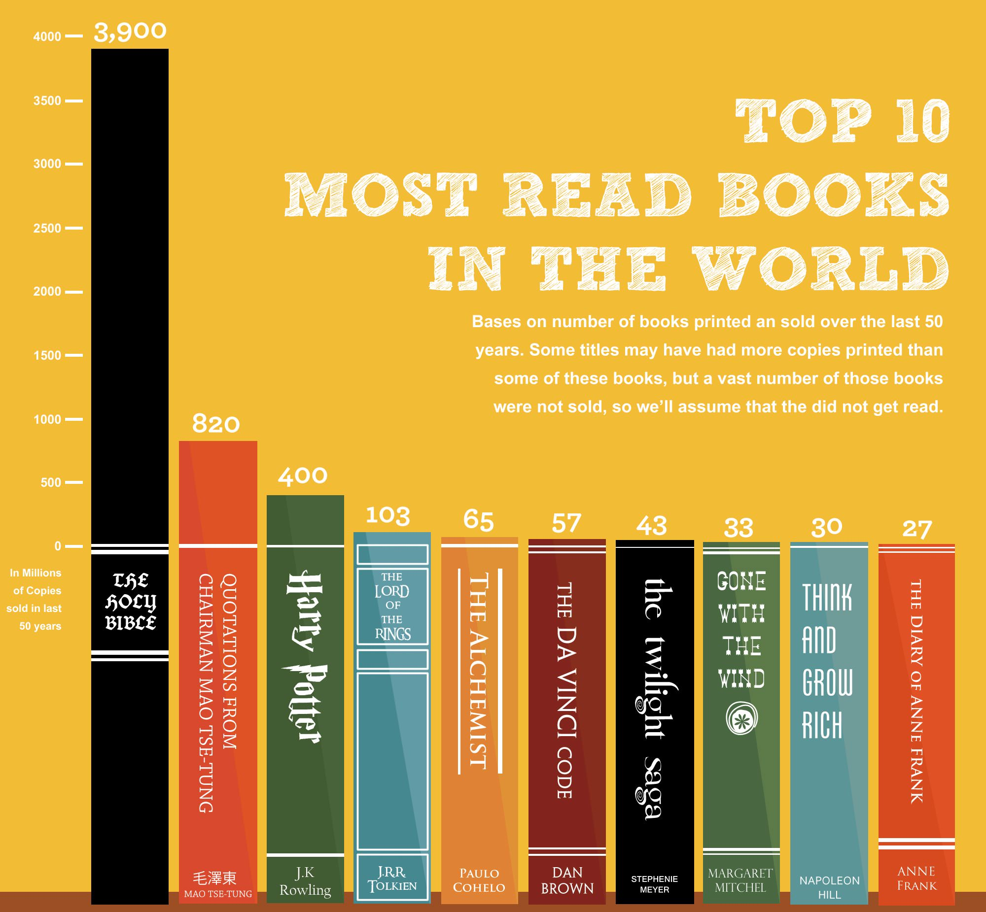
Bad Ink

Slide 5
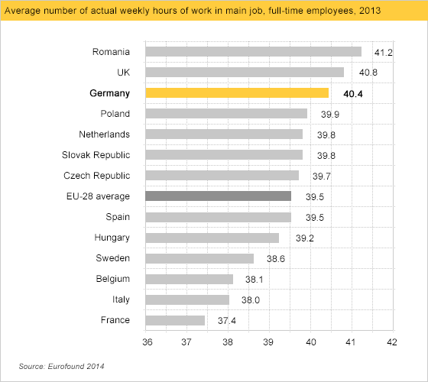
What’s up with your axes?
- callingbullsh#t.org

Slide 6
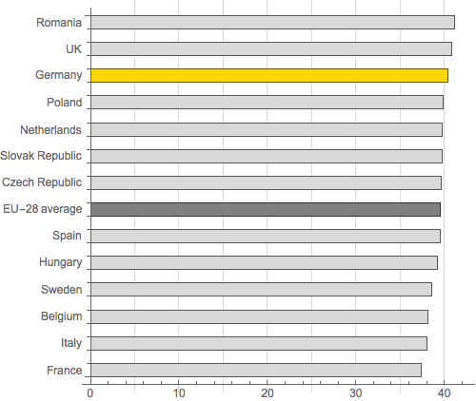
Better axes!
- callingbullsh#t.org

Slide 7
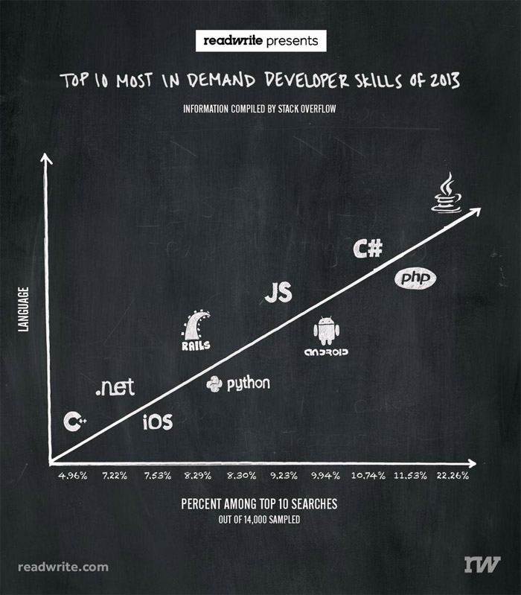
What’s up with your axes?
- callingbullsh#t.org

Slide 8
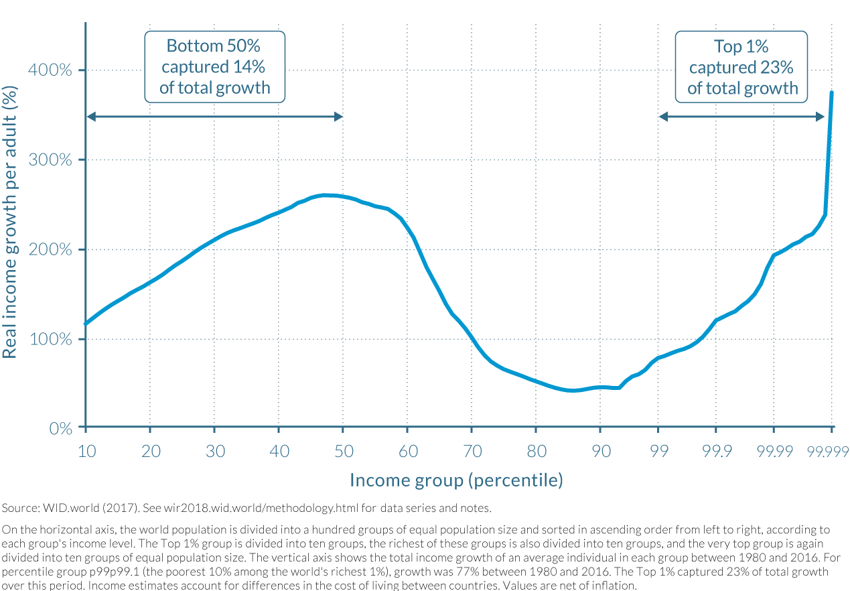
What’s up with your axes?
- callingbullsh#t.org

Slide 9
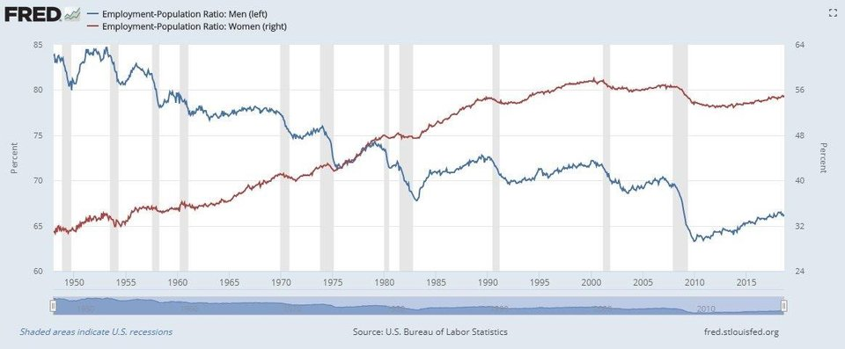
Bad Axes?

Slide 10
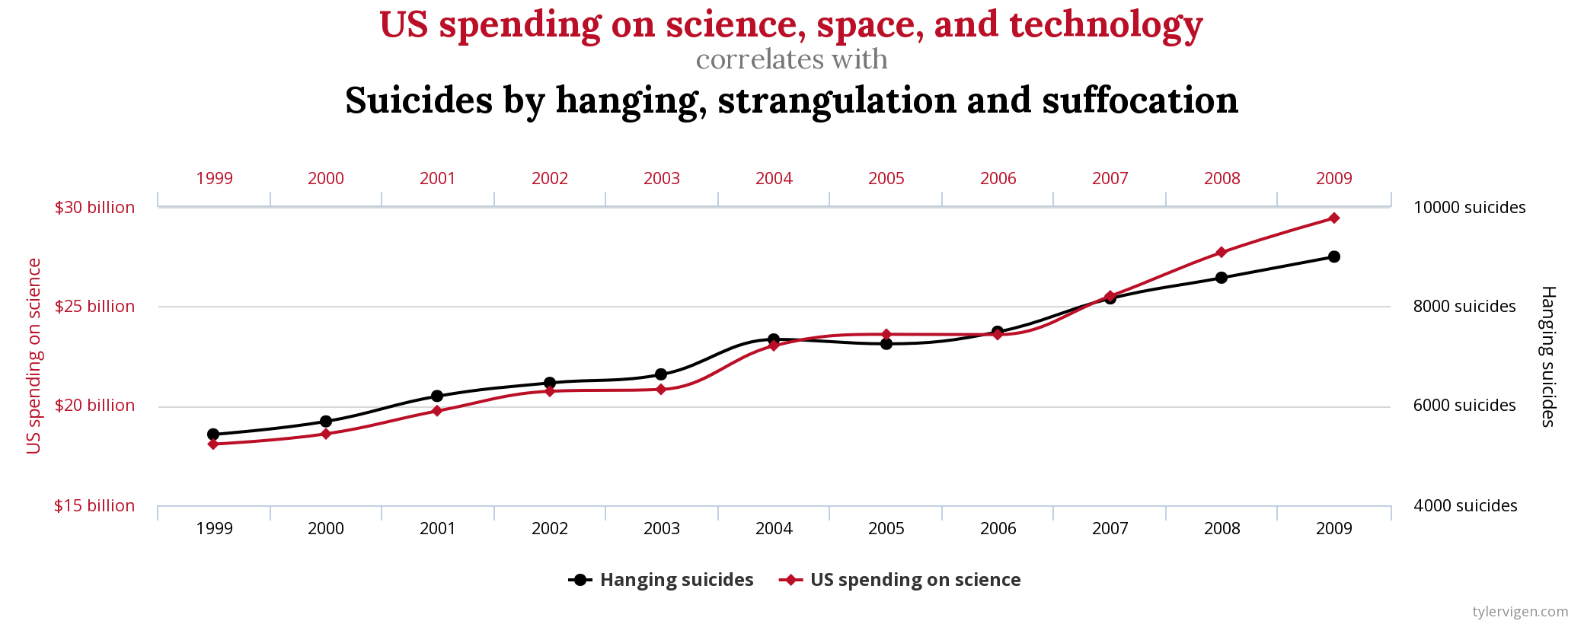
Bad Associations
-- Tyler Vigen

Slide 11
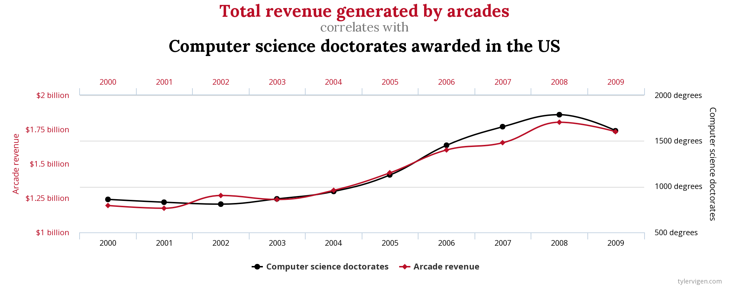
Bad Associations
-- Tyler Vigen

Slide 12
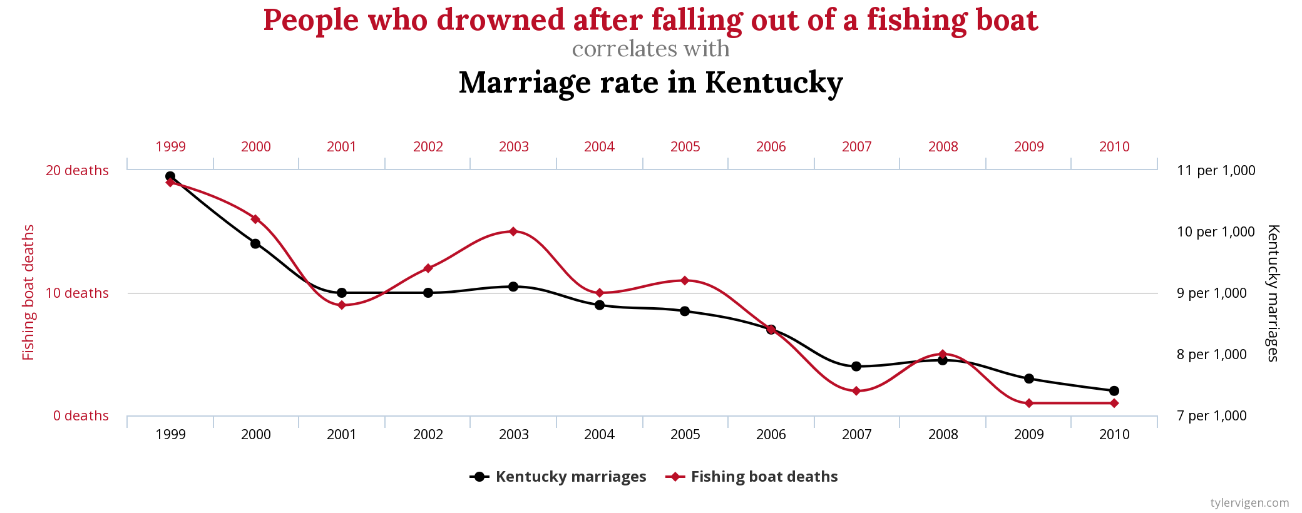
Bad Associations
-- Tyler Vigen

Slide 13
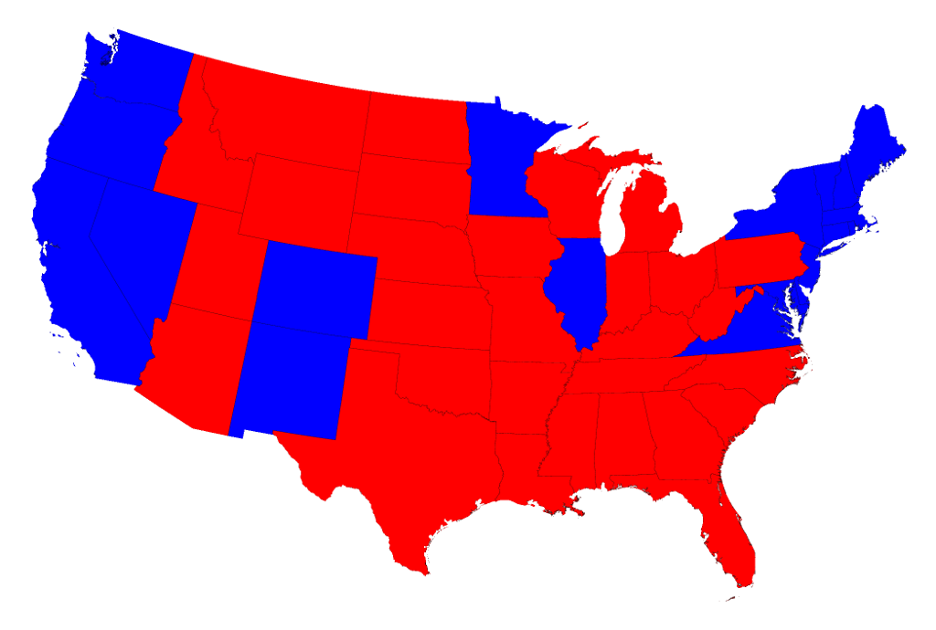
2016 Presidential Election Results
From Mark Newman, U of Michigan

Slide 14
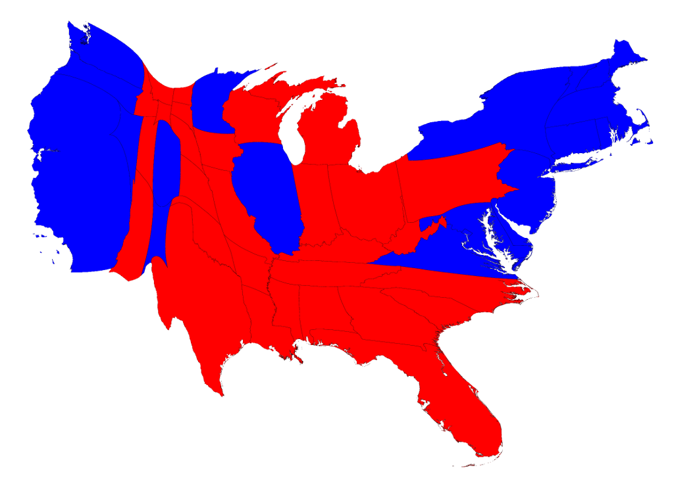
2016 Presidential Election Results
From Mark Newman, U of Michigan

Slide 15
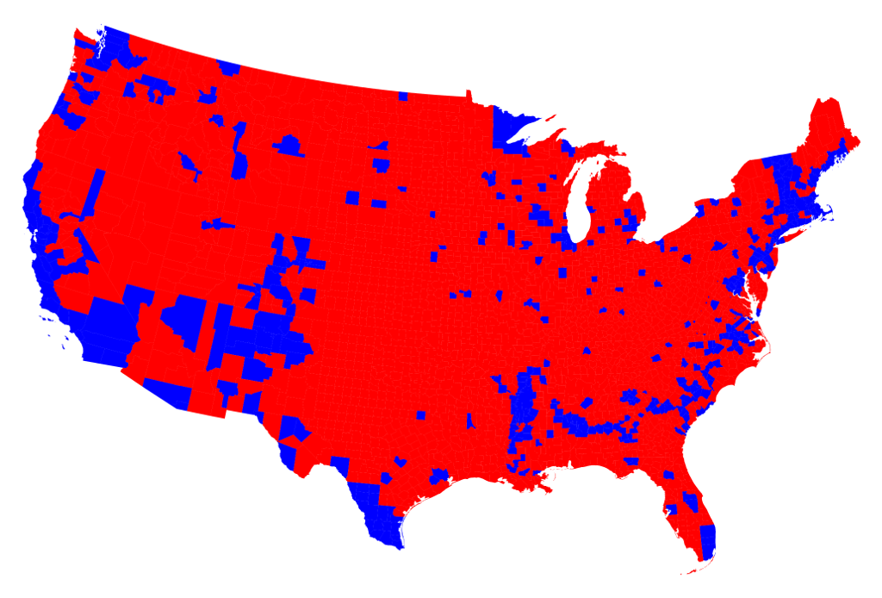
2016 Presidential Election Results by County
From Mark Newman, U of Michigan

Slide 16
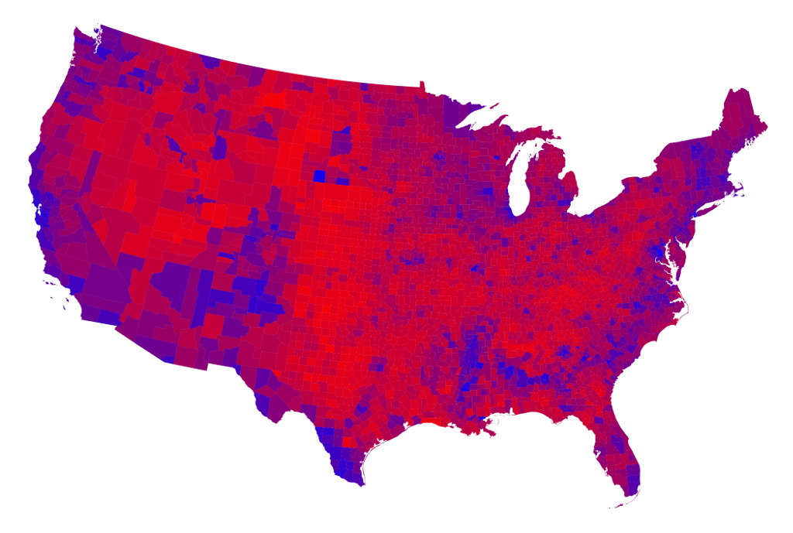
2016 Presidential Election Results by County
From Mark Newman, U of Michigan

Slide 17
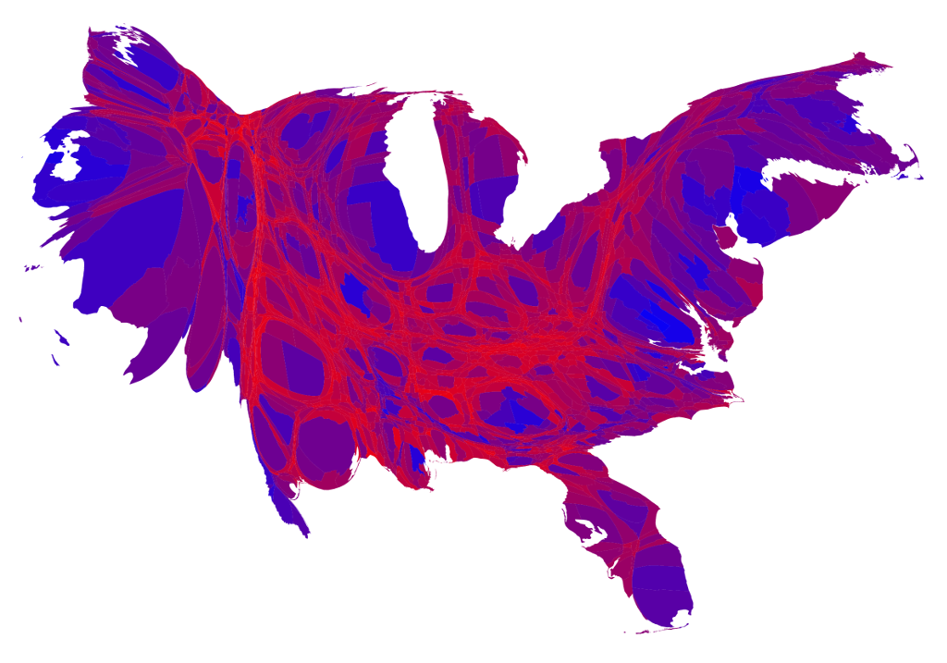
2016 Presidential Election Results by County
From Mark Newman, U of Michigan

Slide 18
Types of Data
Tables enforce constraints
All values in a column are the same type
Values in a column are comparable
Numerical — Each value is from a numerical scale
Numerical measurements are ordered
Differences are meaningful
Categorical — Each value is from a fixed inventory
May or may not have an ordering
Categories can be different

Slide 19
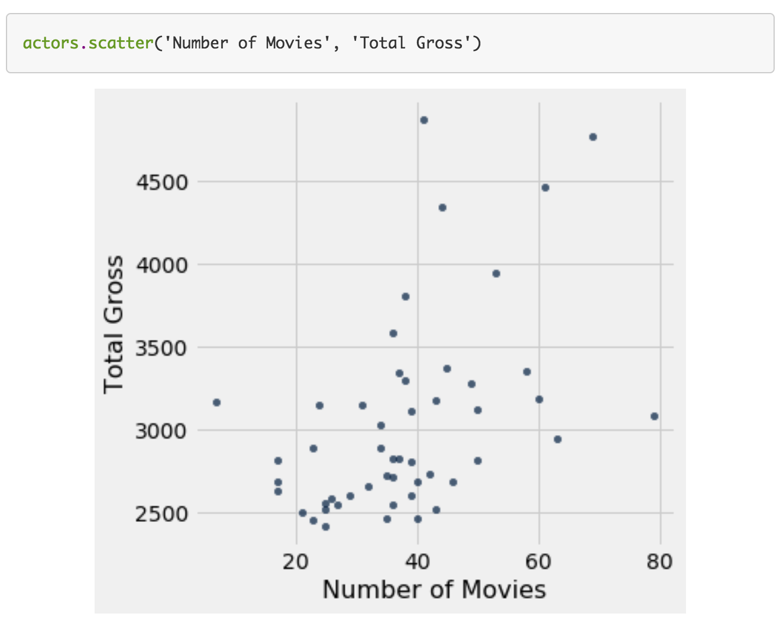
Scatter Plot
Relation/association between two numerical values
Arguments
Label of column for horizontal (x) axis
Label of column for vertical (y) axis

Slide 20
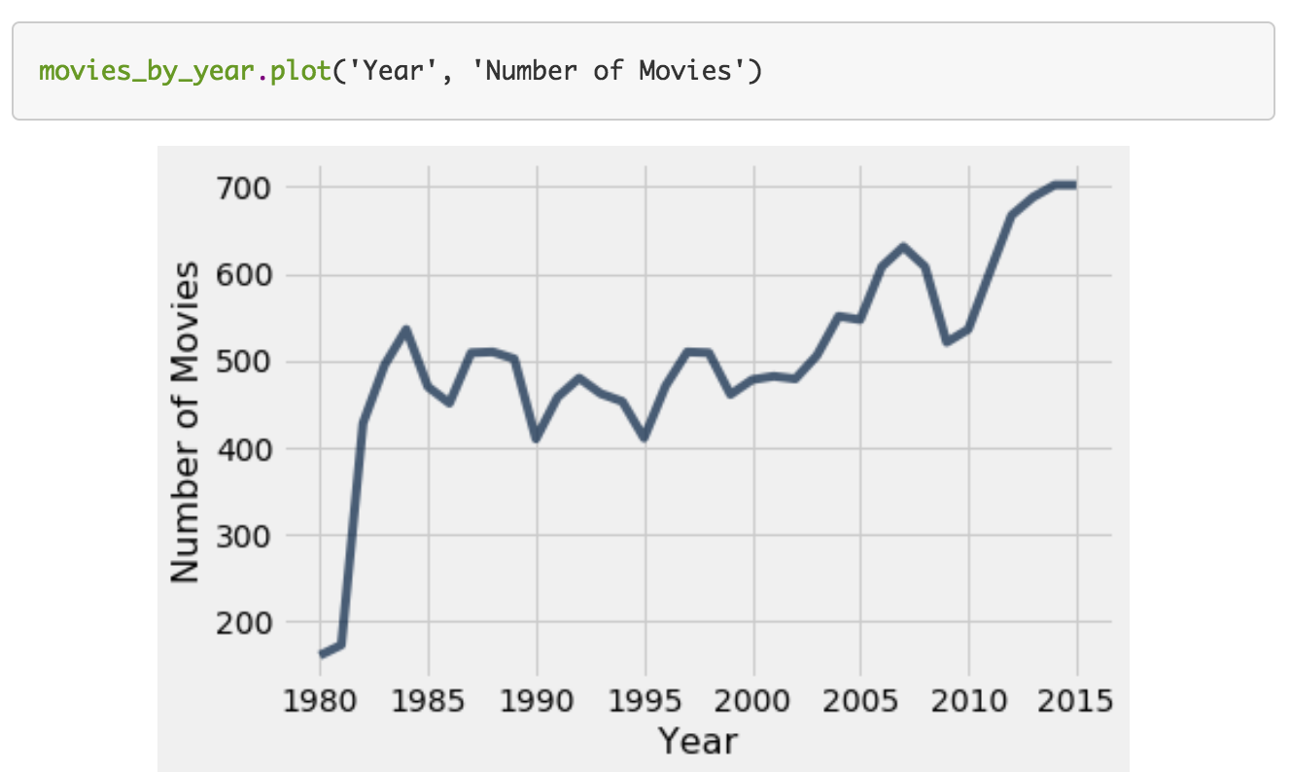
Line Graph
Use: chronological trends
Arguments
Label of column for horizontal (x) axis
Label of column for vertical (y) axis

Slide 21
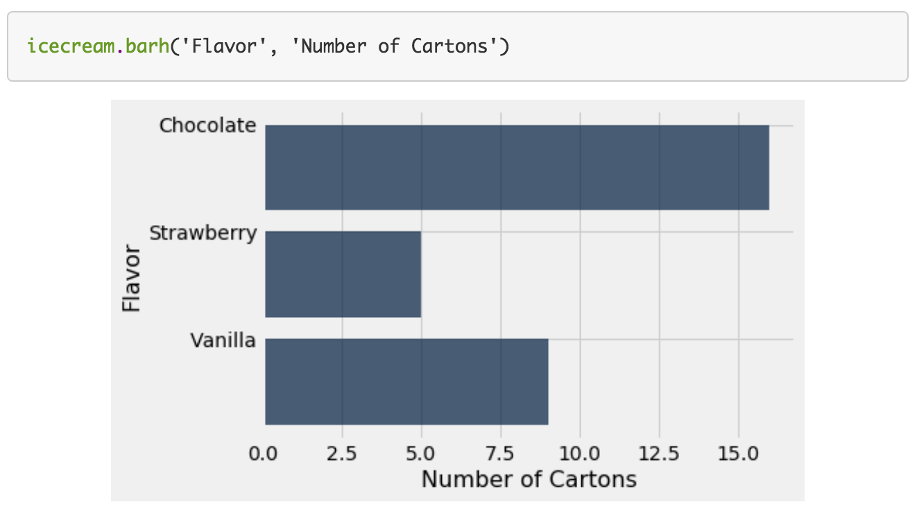
Bar Chart
Categorical distributions
Implications?
Width of bars
Ordering of categories
Arguments
Label of column for categories
Label of column for frequencies

Slide 22
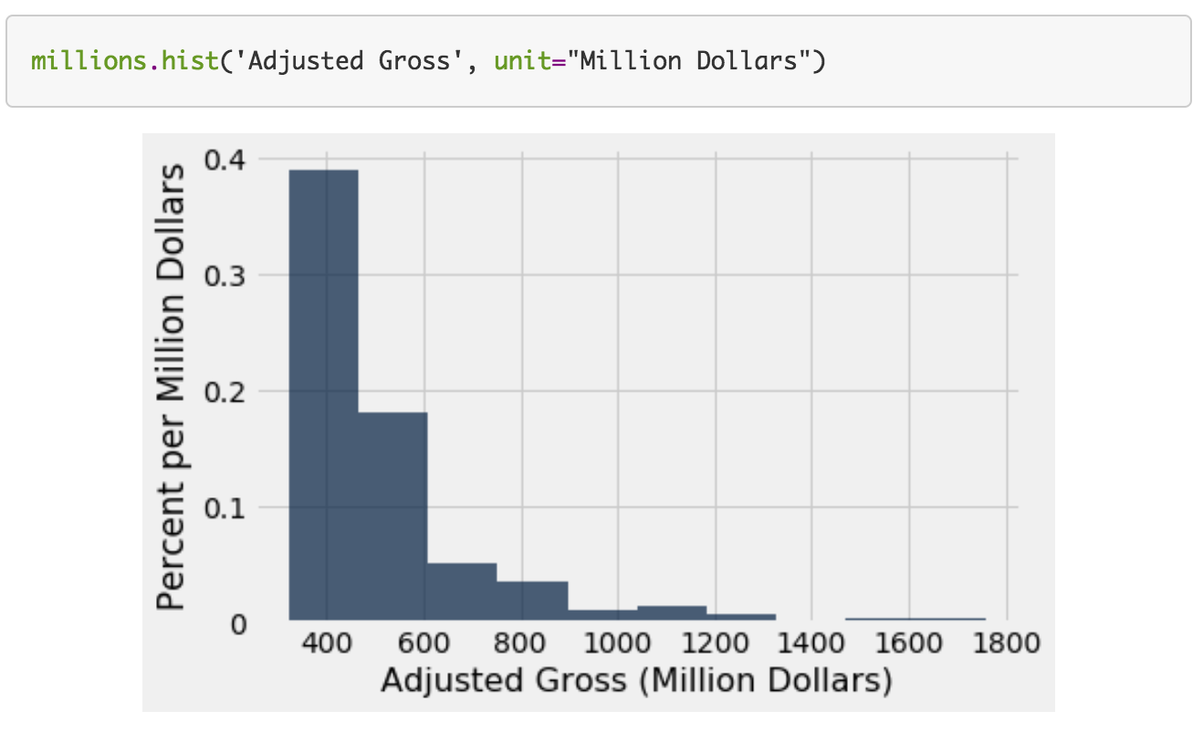
Histograms
Numerical distributions
Implications?
Width of bars
Arguments
Values to display
Optional arguments
unit: label for axes
bins: endpoints for buckets
normed: display proportion instead of counts

Slide 23
Binning numerical values
Binning: # of numerical values that lie within ranges (bins)
Bins are defined by their lower bounds (inclusive)
The upper bound is the lower bound of the next bin
188, 170, 189, 163, 183, 171, 185, 168, 173, ...
The [185,190) bin
160
165
170
175
180
185
190

Slide 24
Histogram Axes
By default, hist uses a scale (normed=True) that ensures the area of the chart sums to 100%
The horizontal axis is a number line (e.g., years)
The vertical axis is a rate (e.g., percent per year)
The area of a bar is a percentage of the whole

Slide 25
How to Calculate Height
The [20, 40) bin contains 59 out of 200 movies
“59 out of 200” is 29.5%
The bin is 40 - 20 = 20 years wide
29.5 percent
Height of bar = --------------------------
20 years
= 1.475 percent per year

Slide 26
Area Measures Percent
Name | 2016 Income (millions)
Jennifer Lawrence | 61.7
Scarlett Johansson | 57.5
Angelina Jolie | 40
Jennifer Aniston | 24.75
Anne Hathaway | 24
Melissa McCarthy | 24
Bingbing Fan | 20
Sandra Bullock | 20
Cara Delevingne | 15
Reese Witherspoon | 15
Amy Adams | 15
Kristen Stewart | 12
Amanda Seyfried | 10.5
Tina Fey | 10.5
Julia Roberts | 10
Emma Stone | 10
Natalie Portman | 8.5
Margot Robbie | 8
Meryl Streep | 6
Mila Kunis | 4.5
Area = % in bin = Height x width of bin
“How many individuals in the bin?” Use area.
“How crowded is the bin?” Use height.
What would the y-axis of a histogram of this table be?
http://bit.ly/FoDS-s19-0131-1

Slide 27
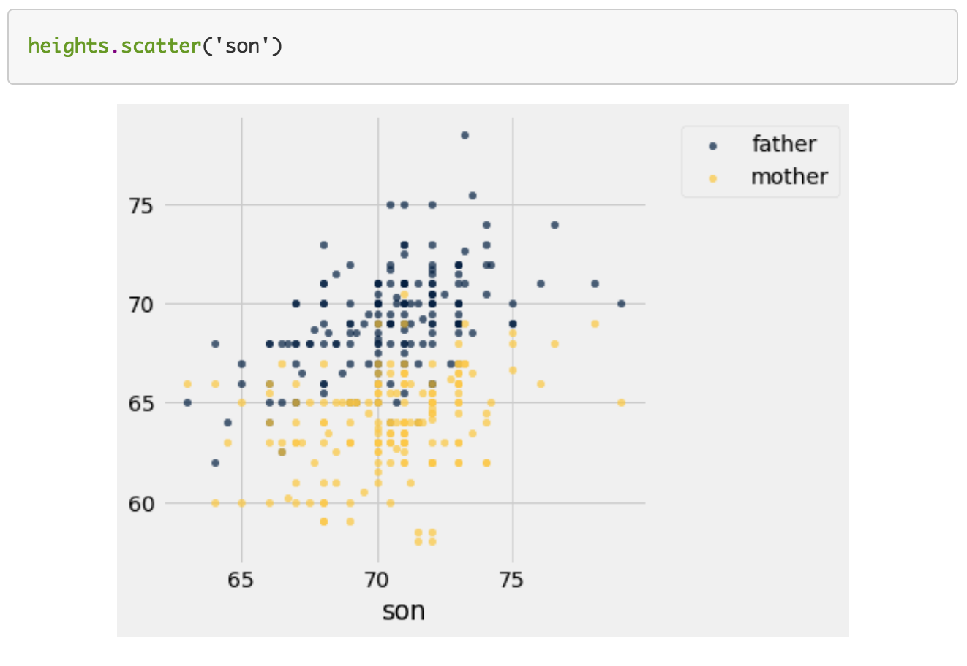
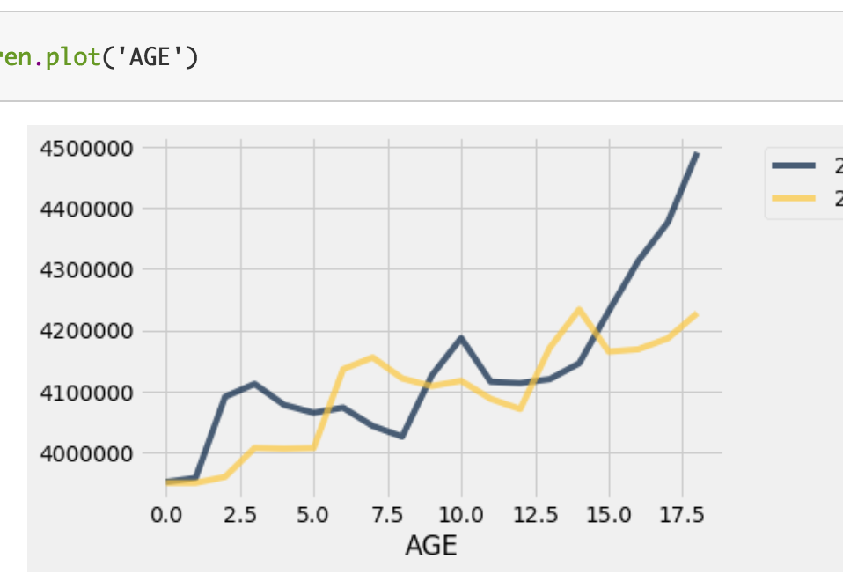
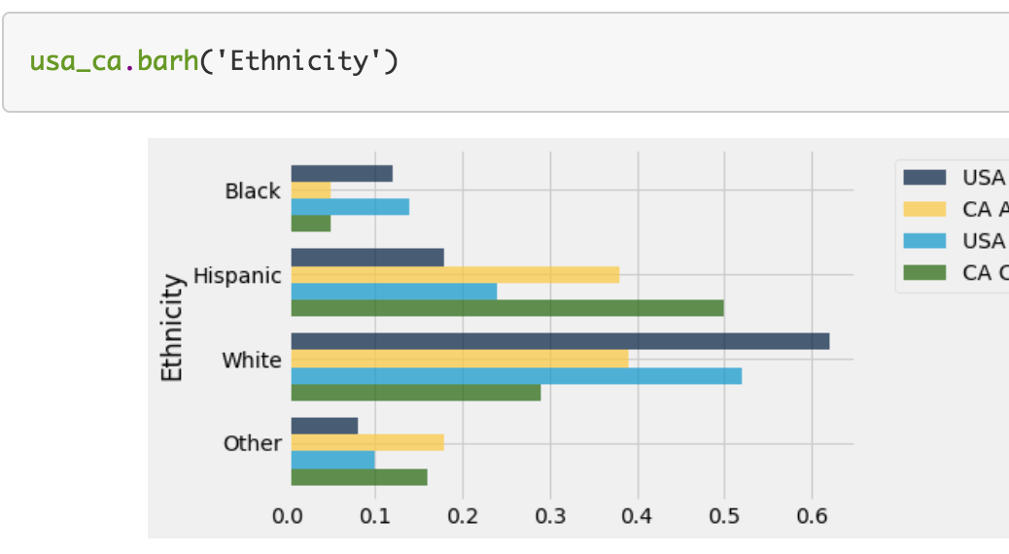
Overlaid Graphs

Slide 28
What’s next?
Read Chapter 8 of Computational and Inferential Thinking
Start working on Homework 2

