Slide 1
CompSci 190: Pivots, Joins & Probability
Jeff Forbes
February 14, 2019

Slide 2
Plan for Today
Pivot & Join
Probability & Monty Hall
Test 1

Slide 3
Pivot
Cross-classifies according to two categorical variables
Produces a grid of counts or aggregated values
Two required arguments:
First: variable that forms column labels of grid
Second: variable that forms row labels of grid
Two optional arguments (include both or neither)
values=’column_label_to_aggregate’
collect=function_with_which_to_aggregate
(Demo)

Slide 4
Joining Two Tables
Keep all rows in the table that have a match ...
drinks.join('Cafe', discounts, 'Location')
… for the value in this column ...
… somewhere in this other table's ...
… column that contains matching values.
drinks
discounts
Drink | Cafe | Price
Milk Tea | Tea One | 4
Espresso | Nefeli | 2
Latte | Nefeli | 3
Espresso | Abe's | 2
Coupon | Location
25% | Tea One
50% | Nefeli
5% | Tea One
Cafe | Drink | Price | Coupon
Nefeli | Espresso | 2 | 50%
Nefeli | Latte | 3 | 50%
Tea One | Milk Tea | 4 | 25%
Tea One | Milk Tea | 4 | 5%
The joined column is sorted automatically

Slide 5
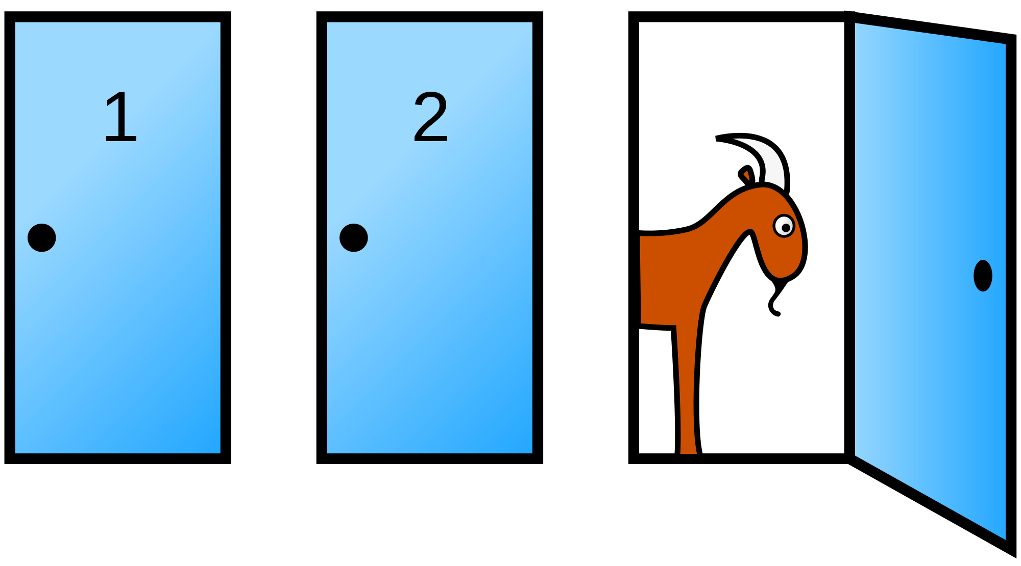
Monty Hall Problem

Slide 6
Random Selection
np.random.choice
Selects at random
with replacement
from an array
a specified number of times
np.random.choice(some_array, sample_size)

Slide 7
Discussion Question
d = np.arange(6) + 1
What results from evaluating the following 2 expressions? Are they the same? Do they describe the same process?
np.random.choice(d, 1000) + np.random.choice(d, 1000)
2 * np.random.choice(d, 1000)

Slide 8
Probability
Lowest value: 0
Chance of event that is impossible
Highest value: 1 (or 100%)
Chance of event that is certain
If an event has chance 70%, then the chance that it doesn’t happen is
100% - 70% = 30%
1 - 0.7 = 0.3
(Demo)

Slide 9
Equally Likely Outcomes
Assuming all outcomes are equally likely, the chance of an event A is:
number of outcomes that make A happen
P(A) = -------------------------------------------------------------
total number of outcomes

Slide 10
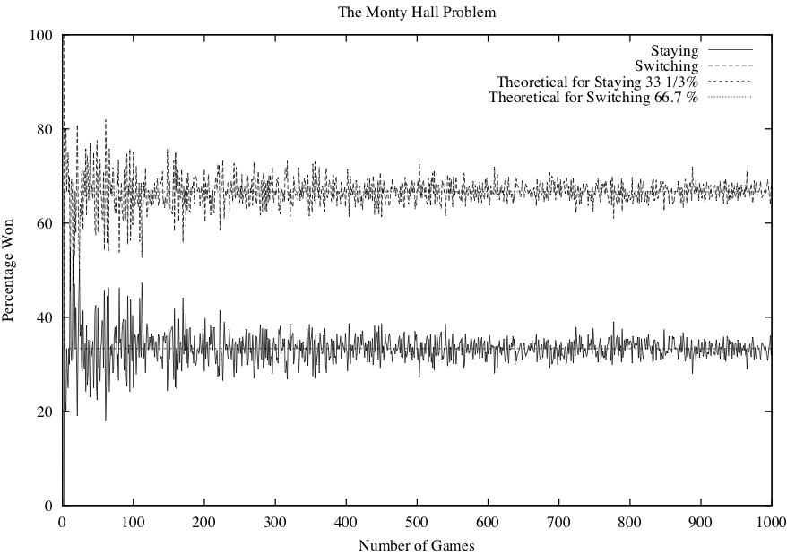
Simulating Monty Hall
x 1,000

Slide 11
Multiplication Rule
Chance that two events A and B both happen
= P(A happens) x P(B happens given that A has happened)
The answer is less than or equal to each of the two chances being multiplied
The more conditions you have to satisfy, the less likely you are to satisfy them all

Slide 12
Addition Rule
If event A can happen in exactly one of two ways, then
P(A) = P(first way) + P(second way)
The answer is greater than or equal to the chance of each individual way

Slide 13
Example: At Least One Head
In 3 tosses:
Any outcome except TTT
P(TTT) = (½) x (½) x (½) = ⅛
P(at least one head) = 1 - P(TTT) = ⅞ = 87.5%
In 10 tosses:
1 - (½)**10
99.9%
http://bit.ly/FoDS-s19-0214

Slide 14
Test 1
Topics
Causality
Python
Data (names, values & types)
Expressions (numbers, strings, arrays, & tables)
Functions
Probability
Visualization
Charts & Histograms
Do the review questions. Post questions to Piazza!
Bring 2 sheets of notes

