Slide 1
CompSci 116: Sampling & Hypotheses
Jeff Forbes
February 21, 2019

Slide 2
Plan and announcements
Sampling
Probability Distributions
Empirical Distrubutions
Using sampling to compute a statistic
Assignments
HW 3
Project 2
Start thinking about final project groups & topics
Day of Data

Slide 3




Day of Data at Duke!
CSbyUs is a Bass Connections project designing and sharing digital era education with under-empowered learning environments.
We are hosting Durham middle school girls at Duke TODAY, February 22, for a day-long exploration of data science.
tiny.cc/csbyusdayofdata1
tiny.cc/csbyusdayofdata2
tiny.cc/csbyusdayofdata3
tiny.cc/csbyusdayofdata4
tiny.cc/csbyusdayofdata5
Students: please help our middle schoolers collect data for their projects by filling out these short surveys from 11:30am-1:20pm:
Notes:
Survey slide for professor outreach

Slide 4

Day of Data at Duke!
And… join us for a showcase of their completed projects this afternoon!
Come support amazing middle school girls who, alongside their NC School of Science and Math and Duke mentors, will present their fantastic data science projects to the Duke community during a drop-in showcase.
Friday, February 22
2:30 - 3:00 PM 068 Brodhead Center light refreshments served
Questions? Please contact Aria Chernik at aria.chernik@duke.edu
Notes:
Publicity slide for professor outreach

Slide 5
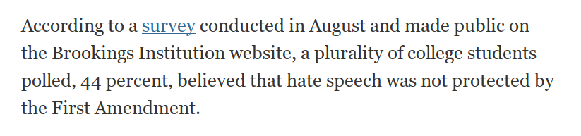
http://bit.ly/FoDS-brookings
Do you believe this result?
What questions do you have about the survey?
What would you want to know to consider the implications?

Slide 6
Sampling
Probability: Compute what will happen when you run an experiment
Statistics: Look at the outcome of the experiment and try to reason about the world
Sampling: Take the outcome of an experiment and use the rules of probability to reason about how it might have come out differently

Slide 7
Probability Distribution
Random quantity with various possible values
“Probability distribution”:
All the possible values of the quantity
The probability of each of those values
In some cases, the probability distribution can be worked out mathematically without ever generating (or simulating) the random quantity

Slide 8
Empirical Distribution
Based on observations
Observations can be from repetitions of an experiment
“Empirical Distribution”
All observed values
The proportion of counts of each value

Slide 9
Estimation
Statistical Inference:
Making conclusions based on data in random samples
fixed
Example:
Use the data to guess the value of an unknown number
depends on the random sample
Create an estimate of the unknown quantity

Slide 10
Terminology
Parameter
A number associated with the population
Statistic
A number calculated from the sample
A statistic can be used as an estimate of a parameter
(Demo)

Slide 11
How do we test a hypothesis?
Chocolate has no effect on cardiac disease.
Yes, chocolate has some effect on cardiac disease.
This jury panel was selected at random from eligible jurors.
No, it has too many people with college degrees.
Create a model for our set of assumptions about the data

Slide 12
How do we assess a model?
Simulate data according to the assumptions of the model
Learn what the model predicts.
Compare the predictions to the data that were observed.
If the data and the model’s predictions are not consistent, that is evidence against the model.

Slide 13
Robert Swain v. Alabama
1965 Supreme Court case about jury selection
In Talladega, Alabama, 26% of residents were black
In Swain's jury panel, 8 of 100 panelists were black
All 8 were struck from the jury by the prosecution (using peremptory challenges)
Ruling: "The overall percentage disparity has been small and reflects no studied attempt to include or exclude a specified number of [black men]."

Slide 14
Jury Panels
Eligible jurors in a county
List of eligible residents
Jury panel
Jury
Section 197 of California's Code of Civil Procedure: All persons selected for jury service shall be selected at random, from a source or sources inclusive of a representative cross section of the population of the area served by the court.
Sixth Amendment to the US Constitution: … the accused shall enjoy the right to a speedy and public trial, by an impartial jury of the state and district wherein the crime shall have been committed.

Slide 15
Sampling from a Distribution
Sample at random from a categorical distribution
sample_proportions(sample_size, pop_distribution)
Samples at random from the population
Returns an array containing the distribution of the categories in the sample

Slide 16
Perfect information
You want to know how many US voters support a particular policy.
You could ask everyone. That works.
But, sometimes we can't afford to do that. So, instead, we could ask some of them, and draw inferences about the general population.

Slide 17
A common scenario
You have to make a decision based on incomplete information.
The quality of your decision is affected by
the information that you have
the information that you don’t have
So, before making the decision, it is worth examining why and how your information came to be incomplete.

Slide 18
Terminology
Population: A collection of individuals
All United flights out of SFO in Summer 2015
Variable: Something that varies in the population
airline (categorical variable)
amount of delay in departure (quantitative variable)
Sample: A subset of the population

Slide 19
Why take a sample?
You want to understand the variable in the population,
but
you don’t have the resources to measure the variable on all the individuals in the population,
so
you just measure it on a subset of them.

Slide 20
“Tickets in a box”
sample
population

Slide 21
Best way to draw the sample
At random!

Slide 22
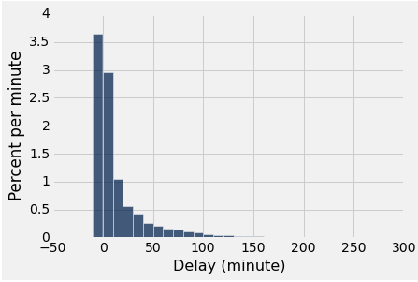
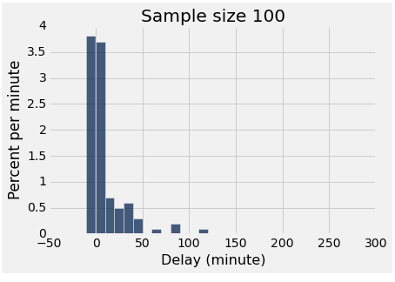
Two distributions
distribution of the population
empirical distribution of a sample

Slide 23
Large Random Samples
If the sample size is large,
then the empirical distribution of a uniform random sample
resembles the distribution of the population,
with high probability

Slide 24
The effect of sample size
Larger random samples are more likely to resemble the population than smaller ones.
However, if the method of sampling is not random, taking a larger sample isn’t necessarily better.
You could just end up with a big bad sample.

Slide 25
More terminology
Parameter: A number calculated using the values in the population
Median delay among all flights
Proportion of voters who are Republican
Statistic: A number calculated using the values in a sample
A statistic can be used as an estimate of a parameter.

Slide 26
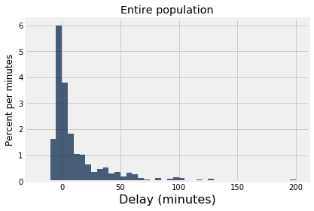
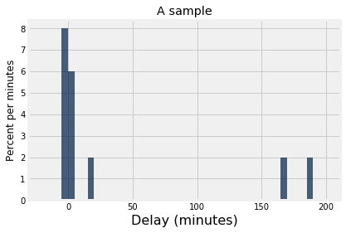
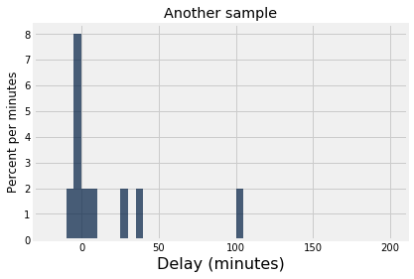
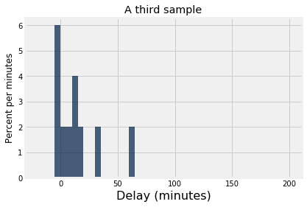
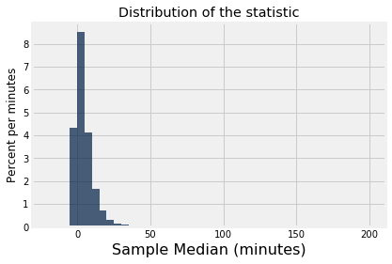
randomly sample
randomly sample
randomly sample
median = 2.0
median = -0.5
median = 9.5

Slide 27
Gary’s Game
Flip a fair (?) coin 10 times
if number of heads >= 5, we win
else Gary wins
Play the game once
There’s one head
Was the game rigged?

Slide 28
Final Project
Demonstrate proficiency in techniques from class applied to dataset of your choosing
Data!
Domain: ?
Scale: Large enough
Categorical and numerical variables
More than 100 observations
Accessible & Manageable

