Slide 1
CompSci 116: Hypotheses & Errors
Jeff Forbes
February 26, 2019

Slide 2
How do we assess a model?
Simulate data according to the assumptions of the model
Learn what the model predicts.
Compare the predictions to the data that were observed.
If the data and the model’s predictions are not consistent, that is evidence against the model.

Slide 3
Robert Swain v. Alabama
1965 Supreme Court case about jury selection
In Talladega, Alabama, 26% of residents were black
In Swain's jury panel, 8 of 100 panelists were black
All 8 were struck from the jury by the prosecution (using peremptory challenges)
Ruling: "The overall percentage disparity has been small and reflects no studied attempt to include or exclude a specified number of [black men]."

Slide 4
Jury Panels
Eligible jurors in a county
List of eligible residents
Jury panel
Jury
Section 197 of California's Code of Civil Procedure: All persons selected for jury service shall be selected at random, from a source or sources inclusive of a representative cross section of the population of the area served by the court.
Sixth Amendment to the US Constitution: … the accused shall enjoy the right to a speedy and public trial, by an impartial jury of the state and district wherein the crime shall have been committed.

Slide 5
Sampling from a Distribution
Sample at random from a categorical distribution
sample_proportions(sample_size, pop_distribution)
Samples at random from the population
Returns an array containing the distribution of the categories in the sample

Slide 6
Terminology
Population: A collection of individuals
All United flights out of SFO in Summer 2015
Variable: Something that varies in the population
airline (categorical variable)
amount of delay in departure (quantitative variable)
Sample: A subset of the population

Slide 7
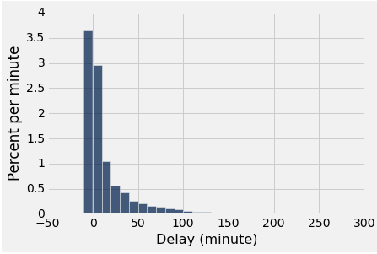
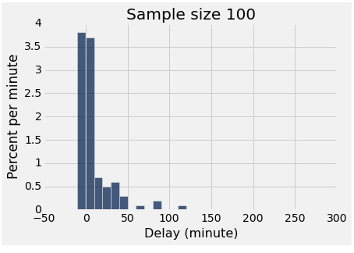
Two distributions
distribution of the population
empirical distribution of a sample

Slide 8
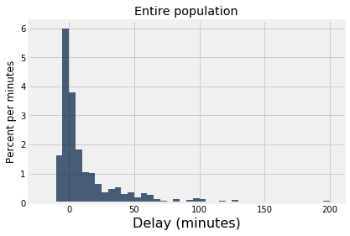
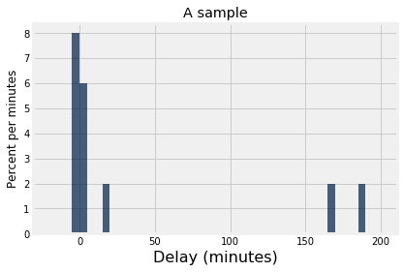
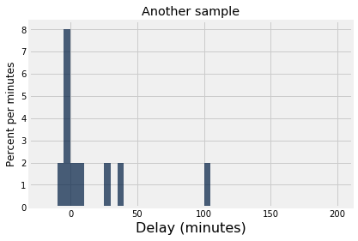
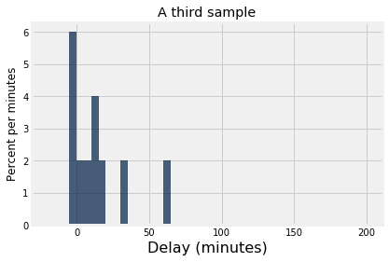
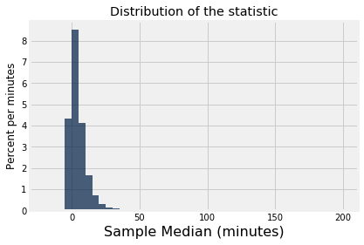
randomly sample
randomly sample
randomly sample
median = 2.0
median = -0.5
median = 9.5

Slide 9
Gary’s Game
Flip a fair (?) coin 10 times
if number of heads >= 5, we win
else Gary wins
Play the game once
There’s two heads
Was the game rigged?

Slide 10
Testing a Hypothesis
Step 1: Select Two Hypotheses
A test chooses between two views of how data were generated: Null hypothesis proposes that data were generated at random; Alternative hypothesis proposes some effect other than chance
Step 2: Choose a Test Statistic
A value that can be computed from the data
Step 3: Compute What The Null Hypothesis Predicts
Compute the distribution of the test statistic: what the test statistic might be if the null hypothesis were true.
Step 4: Compare the Prediction to the Observed Data

Slide 11
Step 1: Smoking and Babies
Researchers are interested in whether there is an association between smoking mothers and the health of their babies. For each birth, they record the baby's birth weight and whether the mother smokes or not.
Birth weights aren't affected by maternal smoking. The birthweight distribution for babies of smokers is same as that of babies of non-smokers.
They are affected.
Null
Alternative

Slide 12
Example: Smoking and Babies
Researchers are interested in whether there is an association between smoking mothers and the health of their babies. For each birth, they record the baby's birth weight and whether the mother smokes or not.
Birth weights aren't affected by maternal smoking. The birthweight distribution for babies of smokers is same as that of babies of non-smokers.
They are lower. Birthweight of babies of smokers are lower than birthweights of babies of non-smokers.

Slide 13
Step 2: Choosing a Test Statistic
Test statistic: The statistic that you have chosen to calculate, to help you decide between the two hypotheses
Goal: If the null hypothesis is false, then you expect that measuring the test statistic will allow you to reject the null

Slide 14
Choosing a Test Statistic
If the alternative hypothesis is true, will test statistic be larger than prediction, smaller, or could be either way?
For the baby birth weights experiment, which of the following would be reasonable test statistics? (Choose all that are OK.)
The average birth weight of all the babies.
The proportion of babies whose mother smoked.
The average birth weight of babies of smokers, minus the average birth weight of babies of non-smokers.
The absolute value of the previous difference.

Slide 15
Absolute Values & Alternatives
Choose a test statistic where alternative hypothesis suggests which direction statistic will go.
Alternative: Smoking causes poor health.
Test statistic: Average birth weight for smokers, minus average for non-smokers.
Alternative: Smoking has some relation to health.
Test statistic: Absolute value of that difference.

Slide 16
Conclusion of a Test
Resolve choice between null and alternative hypotheses
Compare observed test statistic to its empirical distribution under the null hypothesis
If the observed value is consistent with the distribution, then the test does not reject the null hypothesis
Whether a value is consistent with a distribution:
A visualization may be sufficient
Convention: The observed significance level (P-value)

Slide 17
Quantifying Conclusions
Step 0: Go find some data. These are the observations.
Step 1: Two descriptions of the world:
Null: Data come from a well-defined random process
Alternative: Something else is going on
We evaluate how unusual the data would be under the null
Step 2: Choose a test statistic to summarize the data.
Step 3: Compute the following probability (p-value)
P(the test statistic would be equal to or more extreme than the observed test statistic under the null hypothesis)

Slide 18
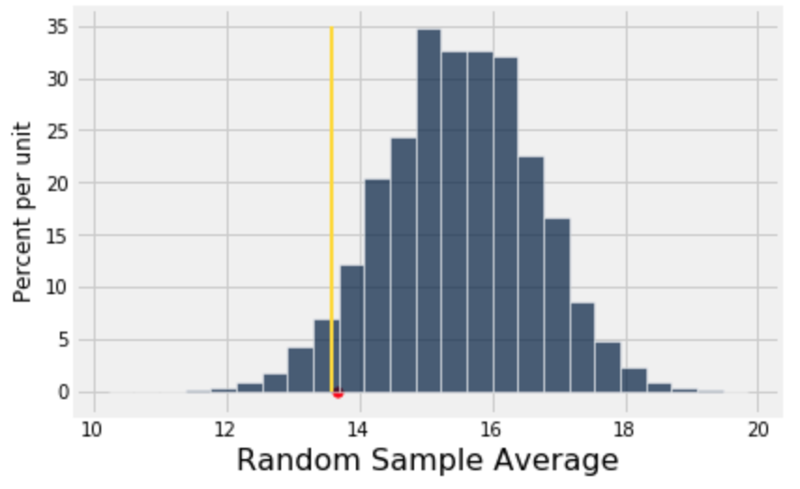
Definition of P-value
The P-value is the chance,
under the null hypothesis,
that the test statistic
is equal to the value that was observed in the data or is even further in the direction of the alternative.

Slide 19
Conventions of Consistency
“Inconsistent”: The test statistic is in the tail of the null distribution.
“In the tail,” first convention:
The area in the tail is less than 5%.
The result is “statistically significant.”
“In the tail,” second convention:
The area in the tail is less than 1%.
The result is “highly statistically significant.”

Slide 20
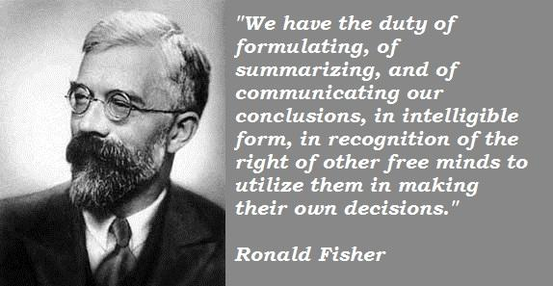
Sir Ronald Fisher, 1890-1962

Slide 21
Sir Ronald Fisher, 1925
“It is convenient to take this point [5%] as a limit in judging whether a deviation is to be considered significant or not.”
–– Statistical Methods for Research Workers

Slide 22
Sir Ronald Fisher, 1926
“If one in twenty does not seem high enough odds, we may, if we prefer it, draw the line at one in fifty (the 2 percent point), or one in a hundred (the 1 percent point). Personally, the author prefers to set a low standard of significance at the 5 percent point …”

Slide 23
Sir Ronald Fisher, 1935
“No isolated experiment, however significant in itself, can suffice for the experimental demonstration of any natural phenomenon.”

Slide 24
Can the Conclusion be Wrong?
Yes.
 | Null is true | Alternative is true
Test rejects the null | ❌ | ✅
Test doesn’t reject the null | ✅ | ❌

Slide 25
An Error Probability
The cutoff for the P-value is an error probability.
If:
your cutoff is 5%
and the null hypothesis happens to be true
(but you don’t know that)
then there is about a 5% chance that your test will reject the null hypothesis anyway.
(Demo)

