Slide 1
CompSci 116: Lecture 10: Prediction -Regression
Jeff Forbes
March 28, 2019

Slide 2
Up Next
HW 4 – Regression
Final Project Proposals

Slide 3
Project
http://bit.ly/FoDS-s19-0328-2
Exploration of question(s) of interest to you
Today
Who is on your project team?
What generally do you hope to address?
By April 4
Data source
What question will you address?
How will you address those questions?

Slide 4
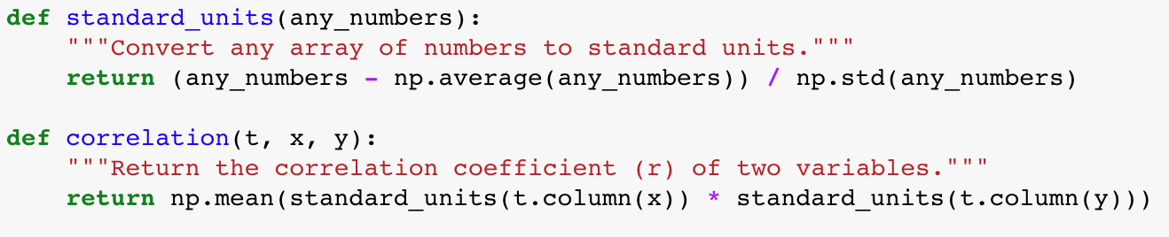
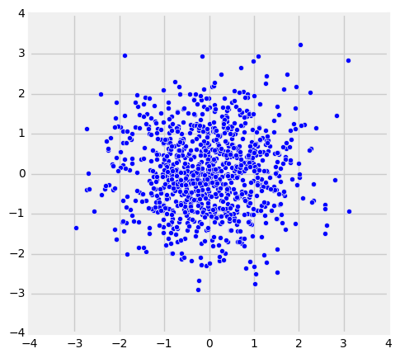
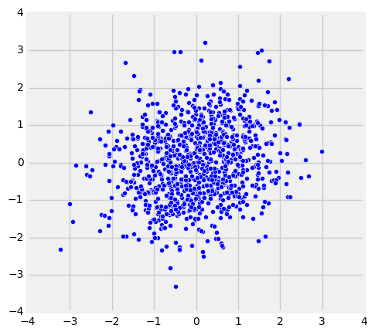
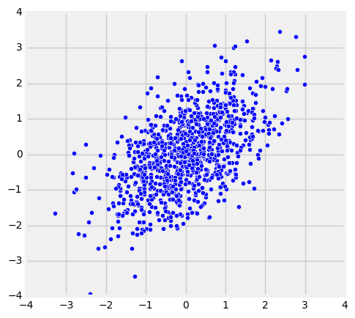
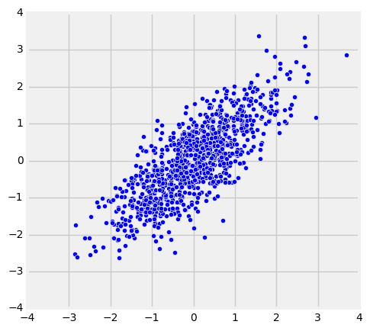
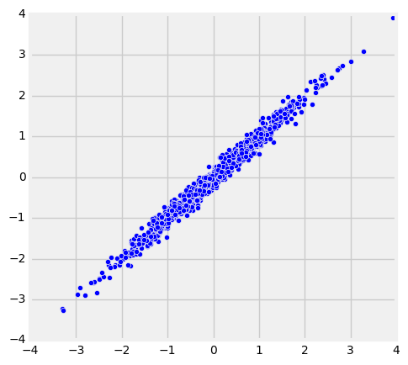
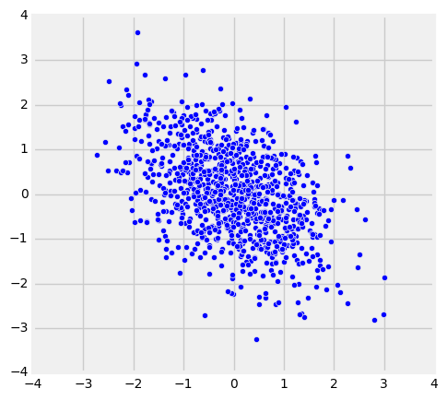
The Correlation Coefficient r
Correlation Coefficient (r) = average(x_{su} * y_{su})
r = 0
r = 0.2
r = 0.5
r = 0.8
r = 0.99
r = -0.5

Slide 5
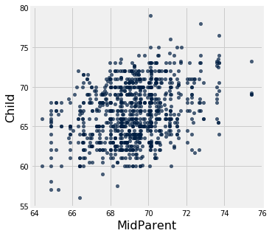
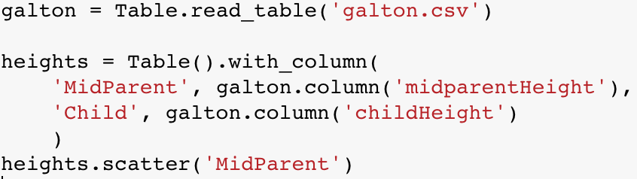
Galton's Heights

Slide 6
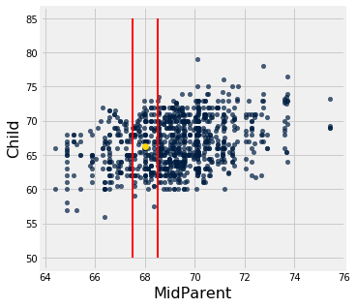
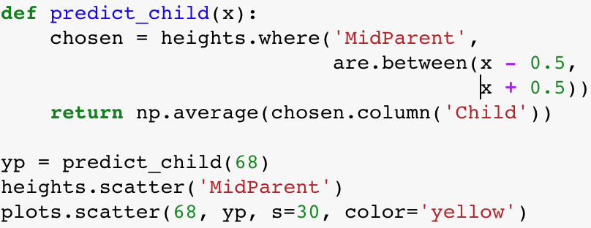
Galton's Heights

Slide 7
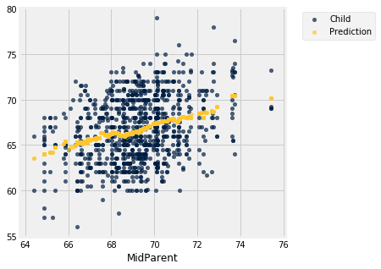
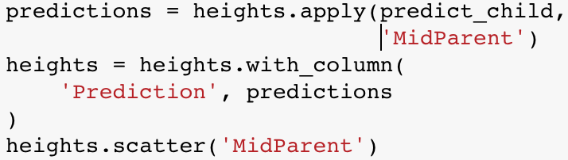
Galton's Heights

Slide 8
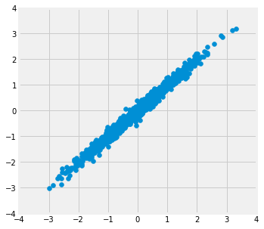
Where is the prediction line?
r = 0.99

Slide 9
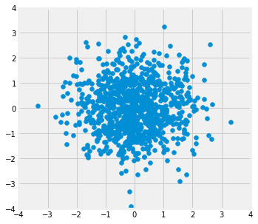
Where is the prediction line?
r = 0.0

Slide 10
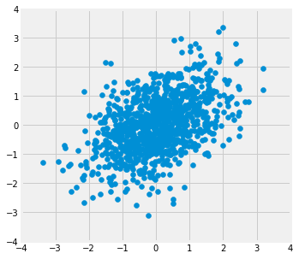
Where is the prediction line?
r = 0.5

Slide 11
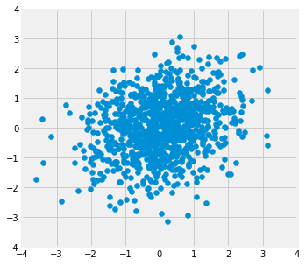
Where is the prediction line?
r = 0.2

Slide 12
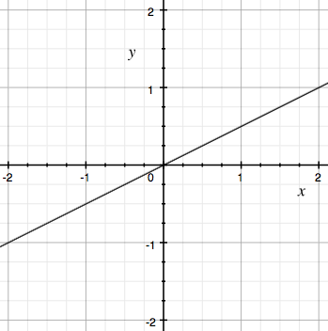
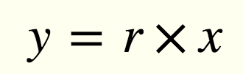
Algebra! Equation of a Line
(0, 0)
r
1

Slide 13
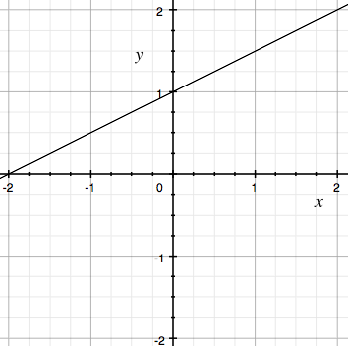
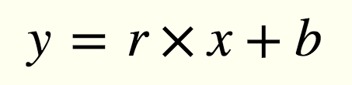
Algebra! Equation of a Line
(0, b)
r
1
b

Slide 14
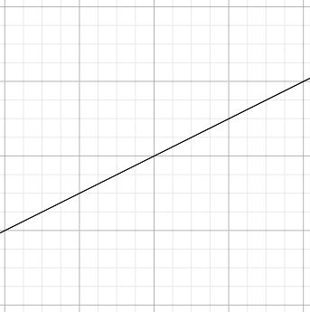
Regression Line
Standard Units
Original Units
(Average x, Average y)
(0, 0)
r
r * SD y
1
SD x

Slide 15
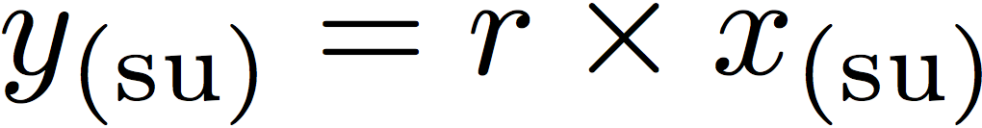
Regression Line Equation
In standard units, the equation of the regression line is:
Fitted value
Observed value
(0, 0)
r
1
Correlation coefficient

Slide 16
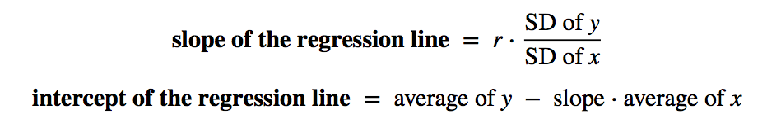
Regression Line Equation
In original units, the regression line has this equation:
y in standard units
x in standard units

Slide 17
Discussion Question
A course has a midterm (average 70; standard deviation 10) and a really hard final (average 50; standard deviation 12)
If the scatter diagram comparing midterm & final scores for students has a typical oval shape with correlation 0.75, then...
What do you expect the average final score would be for students who scored 90 on the midterm?
How about 60 on the midterm?
http://bit.ly/FoDS-s19-0328-1

Slide 18
Error in Estimation
error = actual value − estimate
Typically, some errors are positive and some negative
To measure the rough size of the errors
square the errors to eliminate cancellation
take the mean of the squared errors
take the square root to fix the units
Root Mean Square Error (rmse)
(Demo)

Slide 19
Least Squares Line
Minimizes the root mean squared error (rmse) among all lines
Equivalently, minimizes the mean squared error (mse) among all lines
Names:
“Best fit” line
Least squares line
Regression line
(Demo)

Slide 20
Numerical Optimization
Numerical minimization is approximate but effective
Lots of machine learning uses numerical minimization
If the function mse(a, b)returns the mse of estimation using the line “estimate = ax + b”,
then minimize(mse)returns array [a₀, b₀]
a₀ is the slope and b₀ the intercept of the line that minimizes the mse among lines with arbitrary slope a and arbitrary intercept b (that is, among all lines)
(Demo)

Slide 21
A “Model”: Signal + Noise
Distance drawn at random from normal distribution with mean 0
Another distance drawn independently from the same normal distribution

Slide 22
What We Get to See

Slide 23
Regression Prediction
If the data come from the regression model,
The regression line is close to true line
Given a new value of x, predict y by finding the point on the regression line at that x

Slide 24
Confidence Interval for Prediction
Bootstrap the scatter plot
Get a prediction for y using the regression line that goes through the resampled plot
Repeat the two steps above many times
Draw the empirical histogram of all the predictions.
Get the “middle 95%” interval.
That’s an approximate 95% confidence interval for the predicted value of y.

Slide 25
Predictions at Different Values of x
Since y is correlated with x, the predicted values of y depend on the value of x.
The width of the prediction interval also depends on x.
Typically, intervals are wider for values of x that are further away from the mean of x.

Slide 26
Confidence Interval for True Slope
Bootstrap the scatter plot.
Find the slope of the regression line through the bootstrapped plot.
Repeat.
Draw the empirical histogram of all the generated slopes.
Get the “middle 95%” interval.
That’s an approximate 95% confidence interval for the slope of the true line.

Slide 27



Rain on the Regression Parade
We observed a slope based on our sample of points.
But what if the sample scatter plot got its slope just by chance?
What if the true line is actually FLAT?

Slide 28
Test Whether There Really is a Slope
Null hypothesis: The slope of the true line is 0.
Alternative hypothesis: No, it’s not.
Method:
Construct a bootstrap confidence interval for the true slope.
If the interval doesn’t contain 0, reject the null hypothesis.
If the interval does contain 0, there isn’t enough evidence to reject the null hypothesis.

