Slide 1
CompSci 116: Lecture 12: Decisions
Jeff Forbes
April 11, 2019

Slide 2
Decisions Under Uncertainty
Interpretation by Physicians of Clinical Laboratory Results (1978)
"We asked 20 house officers, 20 fourth-year medical students and 20 attending physicians, selected in 67 consecutive hallway encounters at four Harvard Medical School teaching hospitals, the following question:
"If a test to detect a disease whose prevalence is 1/1000 has a false positive rate of 5%, what is the chance that a person found to have a positive result actually has the disease, assuming that you know nothing about the person's symptoms or signs?"

Slide 3
Decisions Under Uncertainty
Interpretation by Physicians of Clinical Laboratory Results (1978)
"Eleven of 60 participants, or 18%, gave the correct answer. These participants included four of 20 fourth-year students, three of 20 residents in internal medicine and four of 20 attending physicians. The most common answer, given by 27, was that [the chance that a person found to have a positive result actually has the disease] was 95%.

Slide 4
Probability Review
P(A): Probability of event A
Value in [0,1]
How likely is A to happen?
P(A) + P(not A ) = 1
P(A ∪ B) = P(A) + P(B) – P(A ∩ B)
e.g., x = roll of a 6-sided die; P(x is even ∪ x > 3) = P(x is even) + P(x > 3) – P(x is even ∩ x > 3) = 0.5 + 0.5 – 1/3 = 2/3

Slide 5
Question #1
http://bit.ly/FoDS-s19-0411-1
Assume 500 students enrolled in both Calculus and Physics. Of these students,
82 got an A in calculus,
73 got an A in physics, and
42 got an A in both courses.
Which of the following probabilities is the smallest?
The probability that a randomly chosen student:
Got an A in at least one of the two courses
Got less than an A in at least one of the two courses
Got an A in both courses
Got an A in calculus but not in physics
Got an A in physics but not calculus
From Derek Bruff, Vaanderbilt

Slide 6
Question 1 Solution
Total Students | 500
Got an A in at least one of the two courses | 82 + 73 – 42 = 113
Got less than an A in at least one of the two courses | 500-82
Got an A in both courses | 42
Got an A in calculus but not in physics | 82-42 = 40
Got an A in physics but not calculus | 73-42 = 31

Slide 7
Round One
Scenario:
Class consists of second years (60%) and third years (40%)
50% of the second years have declared their major
80% of the third years have declared their major
I pick one student at random.
Which is more likely: Second year or third year?
Second year, because they are 60% of the class

Slide 8
Round Two
Slightly different scenario:
Class consists of second years (60%) and third years (40%)
50% of the second years have declared their major
80% of the third years have declared their major
I pick one student at random... That student has declared a major!
Second Year or Third Year?
(Demo)

Slide 9
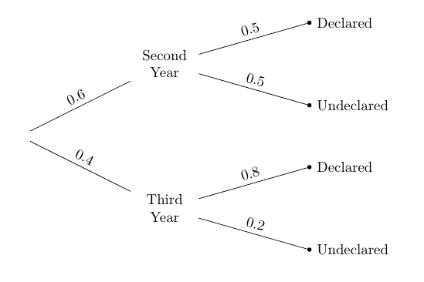
Terminology
P(B | A ) = P(A ∩ B) / P(A)
Likelihood/Conditional probability
Prior probability
Likelihood
Prior probability

Slide 10

Problem 2: Conditional Probability
http://bit.ly/FoDS-s19-0411-2
Hat with three cards,
Blue on both sides
Red on both sides
Red/Blue
A card is drawn at random from the hat and you see that one side is blue
What is the probability the other side is blue?
$1/3$
$1/2$
$2/3$

Slide 11
Bayes’ Rule
Posterior probability:
P(Third Year | Declared)
0.4 x 0.8
= ----------------------------------
(0.6 x 0.5) + (0.4 x 0.8)
= 0.5161…
Pick a student at random.

Slide 12
Purpose of Bayes’ Rule
Update your prediction based on new information
In a multi-stage experiment, find the chance of an event at an earlier stage, given the result of a later stage
(Demo)

Slide 13
Example: Doctors & Clinical Tests
Out of 1000 patients:
So only 1 / 50.95 of patients with positive test results have the disease.
 | Positive test result | Negative test result
Has disease | 1 | 0
Doesn't have disease | 49.95 | 949.05

