Slide 1

Mom’s ConnecT
A site for new Mom’s in Loudoun County, VA to Connect

Slide 2
Team Members
Morgan Chastain
Michael Megarbane
Jason Henry

Slide 3
Site concept/scope
Concept:
To address a problem many new mothers face, finding other new moms to connect with.
Becoming a parent can be exiting and terrifying at the same time. One of the best ways to navigate this experience is to find other new moms that you can share ideas, challenges, and allow your children to interact.
Time is the one thing that is of short supply when you are a new parent. This site will allow you to connect with others that are close to you so that logistics are kept simple.
Scope:
The first version of the site will be limited to the Loudoun County, VA region.
Future versions of the site will include the Northern Virginia area and then expanding even further to the DC metro area.

Slide 4
Technology
HTML
CSS
Bootsrap
Javascript/JQuery
Google Maps – Geocoding and real time mapping using an API
Meetup- API call to Meetup site
Firebase – NoSQL database service
Cookies
Collaboration:
Github-Repository

Slide 5
Features of the site
User Login
Validates and stores user information to Firebase data source.
User stays logged in throughout the site visit.
User Registration
Validates and saves new member information to Firebase data source.
View Members
Pulls Mom’s connect members from Firebase for review.
Parks listing
Pulls park information from Firebase.
Add a new park feature.
Calls google maps API to show location based on geocode reference data.
Local Meetup Groups
Pulls local group information from API call to MeetUp.

Slide 6
Mom’s connect navigation
Home/User Login
Registration
Resources
View Members
MeetUp
Groups
Top Rated Parks

Slide 7
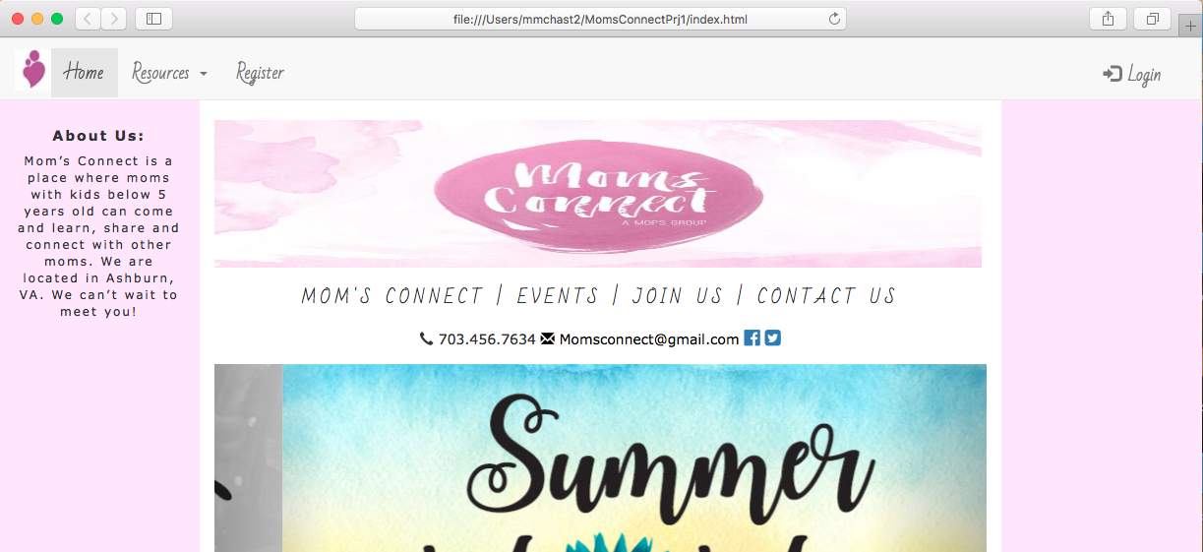
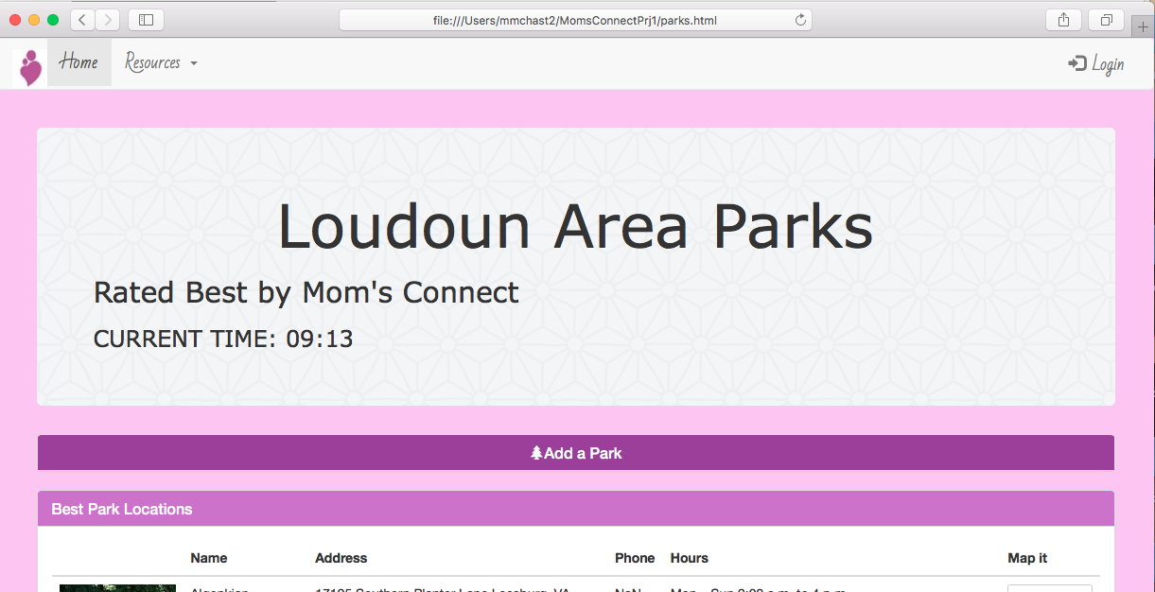
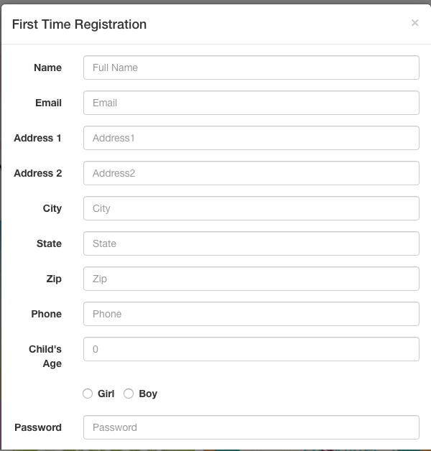
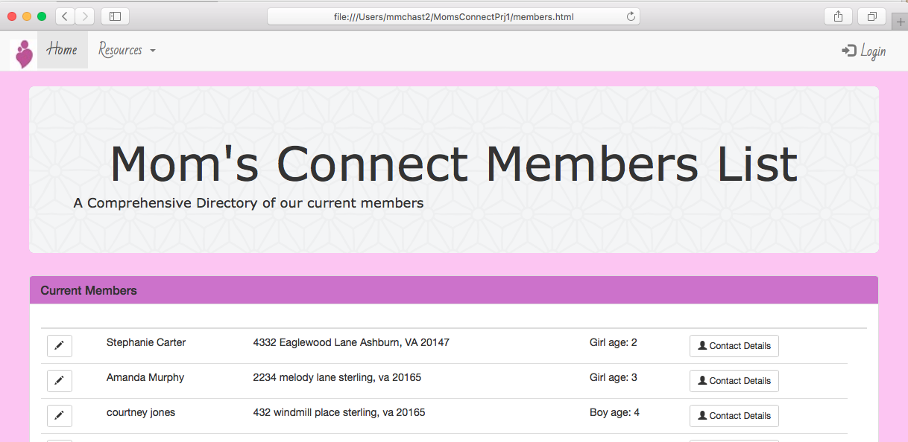
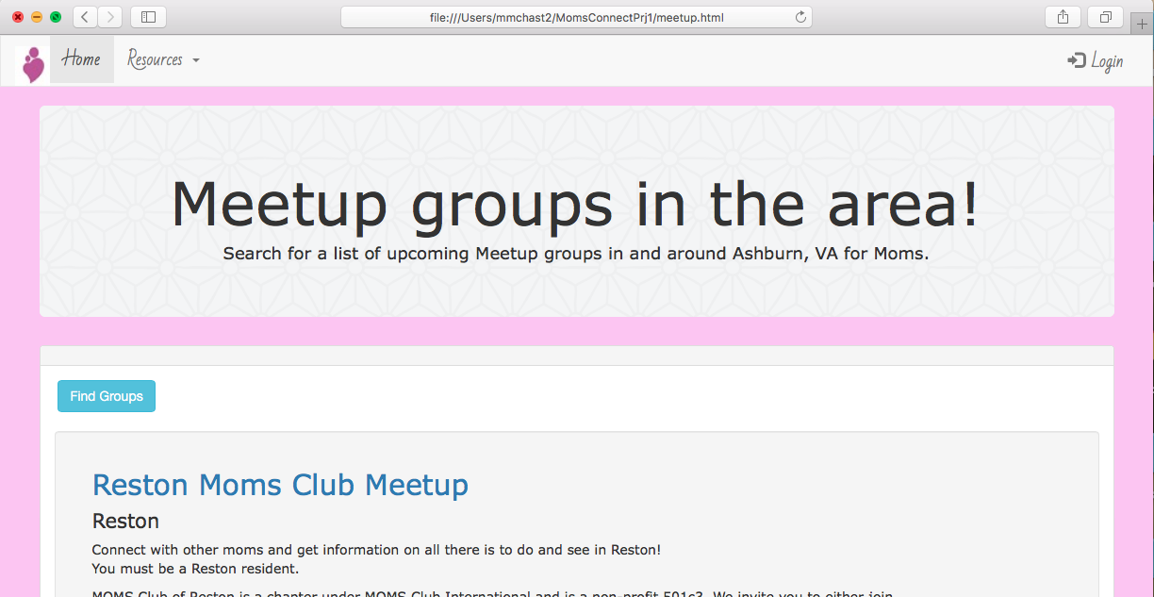
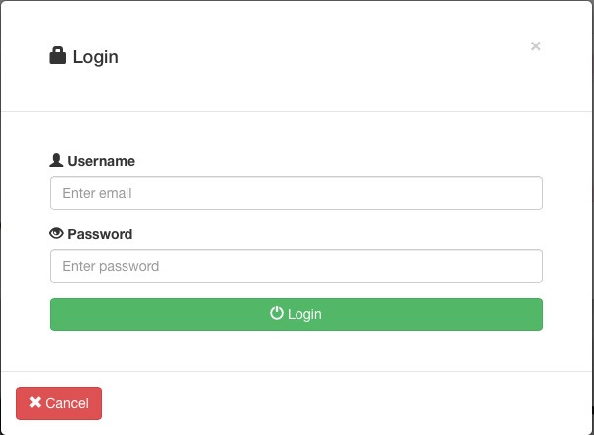
Demo
Notes:
Link to site:

Slide 8
Questions???

