Slide 1
Google Books APIs
Yuxuan Jiang

Slide 2
Overview
The Google Books API let you access Google Books features directly.
Functionalities include:
Search and browse through the list of books that match a given query.
View information about a book, including metadata, availability and price, links to the preview page.
Manage your own bookshelves.

Slide 3
API Concepts:
Volume: A volume represents the data that Google Books hosts about a book or magazine.
Bookshelf: A bookshelf is a collection of volumes.
Review: A review of a volume is a combination of a start rating and text.
Reading Position: A reading position indicates the last read position in a volume for a user. A user can only have one reading position per volume. If the user has not opened that volume before, then the reading position does not exist.

Slide 4
Authentication
Google Books API claims that it uses OAuth 2.0 or API keys for authentication.
To obtain an API key, sign up for a Google account for Google Cloud Platform, create a new project and create a new API key in the dashboard.

Slide 5
Performing a Search
We can perform a volumes search by sending an HTTP GET request to the endpoint via the following format: https://www.googleapis.com/books/v1/volumes?q=search+terms
curl -s https://www.googleapis.com/books/v1/volumes?q=search+pride | jq

Slide 6
Download Format
You can use the download parameter to restrict the returned results to volumes that have an available download formation of epub by setting it to epub
curl -s https://www.googleapis.com/books/v1/volumes?q=pride+prejudice&download=epub | jq

Slide 7
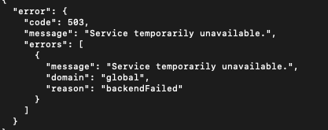
Working With Bookshelves
You can retrieve a list of a user's public bookshelves by sending an HTTP GET request to the URI with the following format
https://www.googleapis.com/books/v1/users/1112223334445556677/bookshelves&key=yourAPIKey
In my testing, this service is temporarily unavailable:

Slide 8
Additional Use Cases
Filtering
Pagination
Print Type
Projection
Sorting
Modify ”My Library”

