Slide 1
T-MATRIX PIPELINE · METHOD, VALIDATION, AND A DIAGNOSED LIMIT
Composing Metasurfaces from
Measured Meta-Atoms
Extract each meta-atom's transition matrix from one full-wave simulation, then predict whole
metasurfaces by linear algebra — where that works, where it breaks, and why the break is not fixable
inside the aggregation algorithm.
D:\Claude\T matrix · ten direct-CST benchmarks · cross-verified against treams (KIT) to 10⁻¹² · August 2026

Slide 2
METHOD · 1 OF 2
One full-wave solve per atom — then metasurfaces become linear algebra
1
Extract
2
Aggregate
3
Predict
once per meta-atom
per arrangement
milliseconds each
One CST solve of the isolated atom (PML, plane-wave illumination set)
Near fields sampled on a sphere, projected onto vector spherical waves (VSWFs)
Least-squares fit F = T·A → the atom's transition matrix T (30×30 at lmax 3)
Place measured atoms on any periodic cell — one species or several
Pair-resolved Ewald lattice sums couple every atom to every other, exactly
Solve the block Foldy–Lax system for the self-consistent excitations
Project onto Floquet orders → full complex S-parameters, all diffraction channels
No full-wave simulation of the composed array is ever run
64 min of CST per supercell benchmark vs milliseconds per composed design
The promise: simulate each atom once, then compose arbitrarily many metasurfaces from the measured parts — the repeated cell may hold one meta-atom or several different ones.
Composing metasurfaces from measured meta-atoms 2 / 16

Slide 3
METHOD · 2 OF 2
The algebra: block-Bloch Foldy–Lax with Ewald lattice sums
Atom response (VSWF basis)
Basis: vector spherical waves to lmax 3 → 30 modes per atom; a four-atom cell is a dense 120×120 solve.
Lattice sums by Ewald summation (via treams); an η-stability bracket refuses rather than guesses when the split disagrees.
Conventions measured identical to treams: VSWFs to 7×10⁻¹⁶, plane-wave expansion 6×10⁻¹⁶, translation operator 5×10⁻¹⁵.
Every propagating diffraction order is returned, power-normalized — supercells diffract inside the band.
p = T a
Pair-resolved Bloch lattice sum (Ewald)
Wₛₜ(k∥) = Σ′R A(ρₜ − ρₛ + R) · exp(i k∥·R)
Self-consistent block solve, M atoms per cell
(I − W T) a = a_inc , f = T a
Floquet output map, order G on either side
E_G ∝ (1/k_z,G) Σₛ exp(−i k_G·ρₛ) Fₛ(k̂_G)
Composing metasurfaces from measured meta-atoms 3 / 16

Slide 4
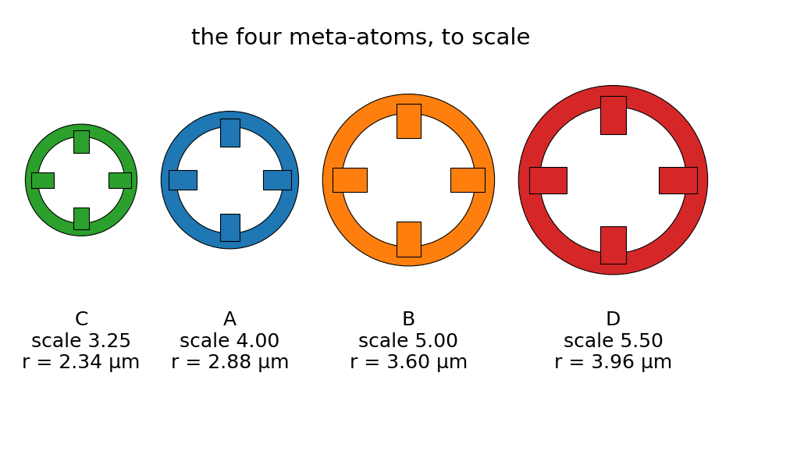
THE EXPERIMENT
Four measured gold meta-atoms, ten blind CST benchmarks
atom | scale | ring outer radius | isolated resonance / scale
C | 3.25 | 2.338 µm | 3.766
A | 4.00 | 2.877 µm | 3.770
B | 5.00 | 3.596 µm | 3.786
D | 5.50 | 3.956 µm | 3.782
Layout: 16×16 µm repeated cell, atoms on the 8 µm square sub-lattice — four single-atom lattices + six mixed supercells.
Every case has an independent direct-CST periodic reference: ten blind benchmarks in all.
Input imperfections are measured, not assumed: the extracted T's violate passivity by 2–5 % and reciprocity by up to ~18 % — the inputs, not the aggregation, set the error floor of the good cases.
The four spoke-and-wheel resonators, drawn to scale. All are 0.2 µm-thick gold, extracted in isolation over 10–34 THz (25 frequencies, stored at lmax 5).
Composing metasurfaces from measured meta-atoms 4 / 16

Slide 5
VALIDATION · THE CODE
The aggregation itself is exact to round-off
algebraic identity / independent implementation | residual
M = 1 cell reduces to the one-atom code (coupling, f, S11/S21) | bit-identical
2×2 cell of four identical atoms ≡ the primitive lattice | ≤ 8×10⁻¹⁶
basis-atom relabelling / whole-cell lattice shift | ≤ 7×10⁻¹⁶ / 0
checkerboard selection rule: power in odd (n₁+n₂) orders | ≤ 6×10⁻³³
all T = 0 → S = S_background exactly | 0
independent treams implementation of the whole chain, every cell, complex S | ≤ 1×10⁻¹²
What this rules out
coding errors in the block solve
lattice-sum convergence
basis conventions and normalization
the Floquet output map
Consequence: whatever error remains against full-wave CST lives in what a truncated single-centre T-matrix can represent — not in the code that manipulates it.
Composing metasurfaces from measured meta-atoms 5 / 16

Slide 6
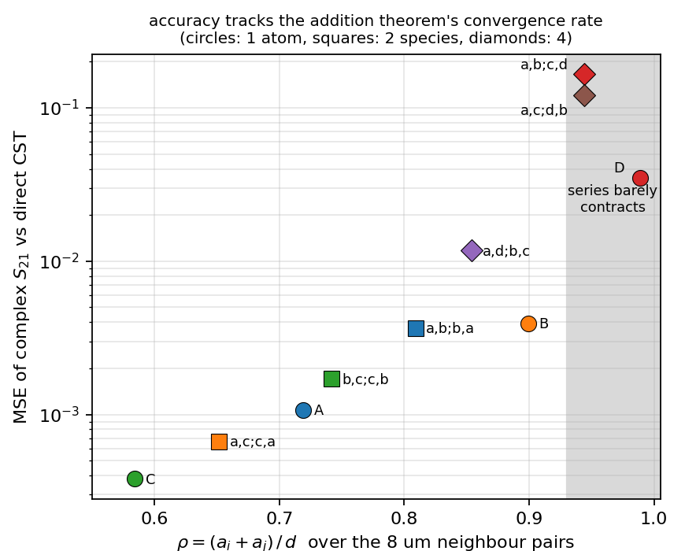
RESULTS · TEN BENCHMARKS
Accuracy is ordered by one geometric number, ρ = (aᵢ + aⱼ)/d
case | ρ (worst pair) | MSE of complex S21 | mean |ΔS21| | verdict
C alone | 0.584 | 0.00038 | 0.017 | good
a,c;c,a | 0.652 | 0.00067 | 0.019 | good
A alone | 0.719 | 0.00107 | 0.030 | good
b,c;c,b | 0.742 | 0.00171 | 0.036 | good
a,b;b,a | 0.809 | 0.00367 | 0.046 | good
a,d;b,c | 0.854 | 0.0118 | 0.080 | degrading
B alone | 0.899 | 0.0039 | 0.054 | degrading
a,c;d,b | 0.944 | 0.1207 | 0.244 | broken
a,b;c,d | 0.944 | 0.1654 | 0.308 | broken
D alone | 0.989 | 0.0351 | 0.149 | broken
MSE = mean |S21_pred − S21_CST|² over the band, on the complex amplitude, 0th order. Seven of ten land at mean |ΔS21| 0.017–0.080 — the level set by the input T-matrices.
Same data: MSE vs ρ. Above ρ ≈ 0.94 (shaded) the multipole series barely contracts.
Composing metasurfaces from measured meta-atoms 6 / 16

Slide 7
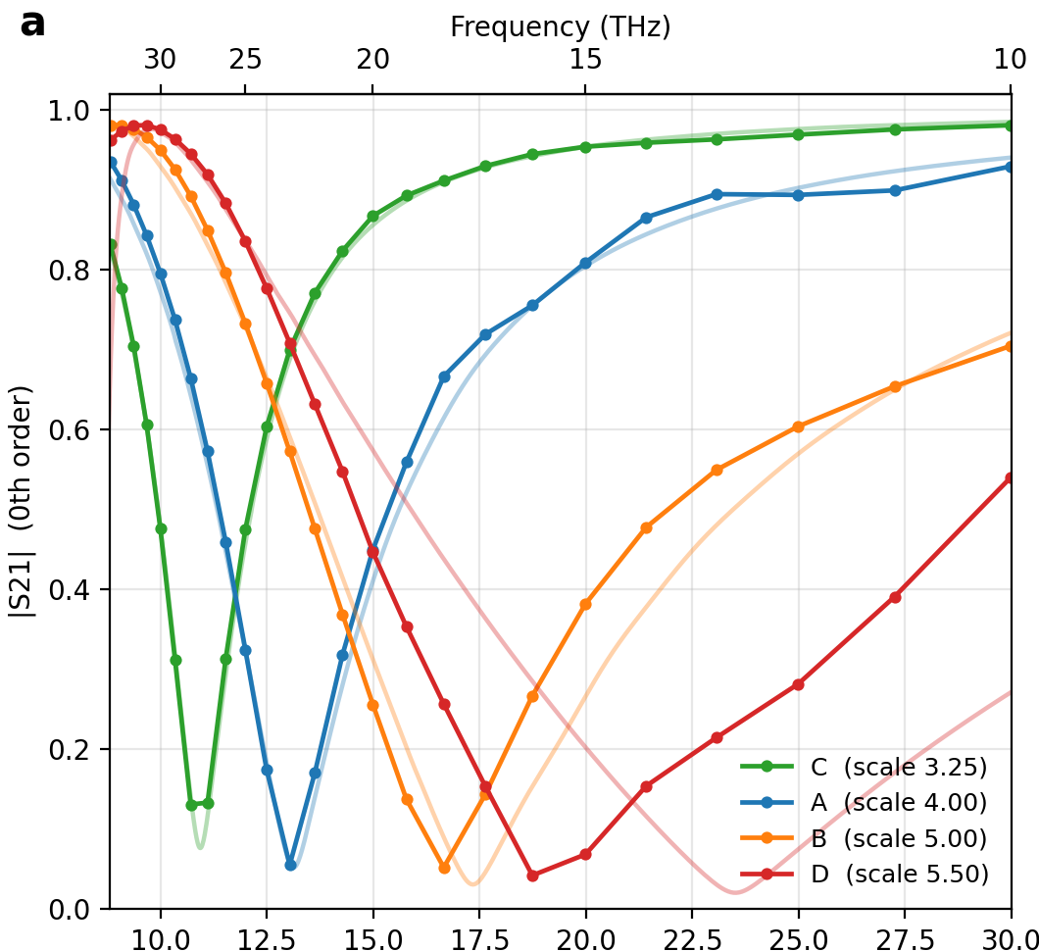
RESULTS · WHAT WORKS
Where ρ is moderate, composition is essentially free
Seven of ten benchmarks: mean |ΔS21| 0.017–0.080 — within the input T-matrices' own passivity / reciprocity error.
The supercell step adds nothing: a,b;b,a lands at 0.046, between its two pure lattices (0.030 and 0.054).
A dark lattice resonance at 16.00 µm — invisible to any single-atom model — was predicted and then confirmed by direct CST: dark-channel power 1.5×10⁻⁵ against a 0.987 carrier.
Its transmission window: predicted 15.57 µm / |S21| 0.68, measured 15.35 µm / 0.72.
Exact selection rule (odd diffraction orders extinguished) confirmed in every cell.
One atom per 8 µm cell: prediction (markers) vs direct CST (pale). C, A, B track closely — D, the largest, already fails. That failure is the subject of the rest of this deck.
Composing metasurfaces from measured meta-atoms 7 / 16

Slide 8
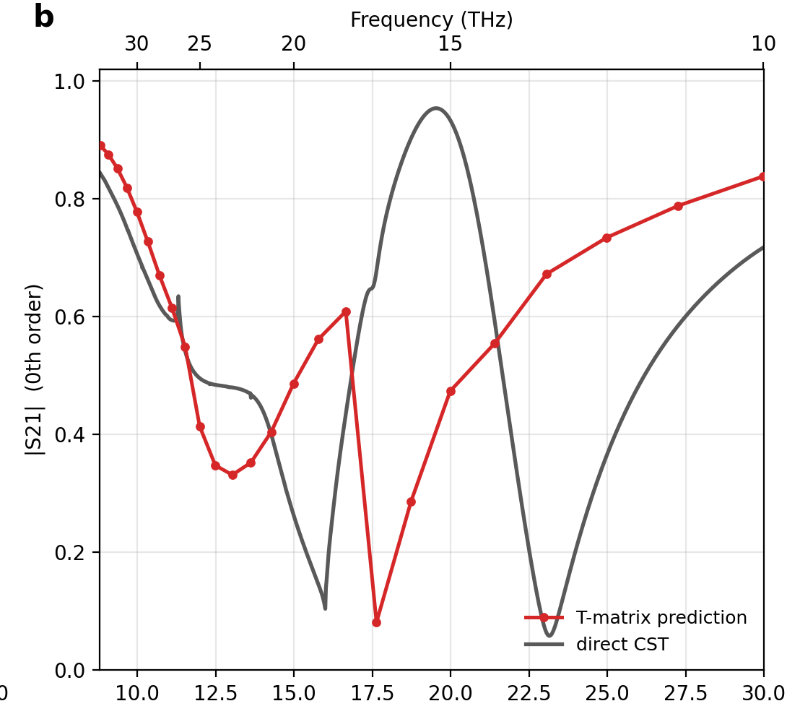
FAILURE 1 · THE A,B;C,D SUPERCELL
Same atoms, same lattice — 14× worse when B and D become neighbours
MSE 0.1654
vs 0.0118 for a,d;b,c — identical atoms, identical lattice, different adjacency
−5.51 µm / +4.92 µm
dip misplacement in a,b;c,d and its ρ-twin a,c;d,b — opposite signs, so no calibratable bias
0.409 vs 0.388
total diffracted power of a,b;c,d, predicted vs measured (5.4 %); the ρ-twin a,c;d,b keeps 1.0 % (0.407 vs 0.403) — the specular channel breaks first
a,b;c,d: predicted |S21| (red) vs direct CST (grey). The deepest dip is misplaced by −5.51 µm.
Composing metasurfaces from measured meta-atoms 8 / 16

Slide 9
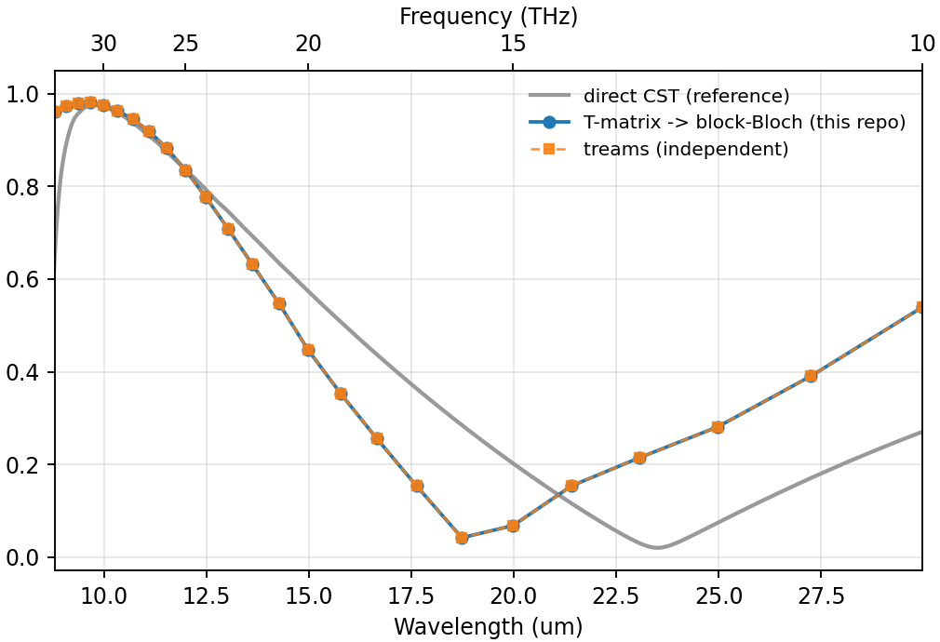
FAILURE 2 · ATOM D'S OWN LATTICE
Atom D alone: the resonance lands 19 % away — and red-shifted
A, B, C blue-shift from isolated to array resonance by a consistent 1.3–2.0 µm. D red-shifts by +2.74 µm — opposite sign.
Across the parametric sweep the anomaly tracks the closing gap, not the atom:
scale | gap to neighbour | CST array dip | dip / scale
4.00 | 2.246 µm | 13.13 µm | 3.283
4.50 | 1.526 µm | 14.90 µm | 3.311
5.00 | 0.807 µm | 17.34 µm | 3.468
5.50 (= D) | 0.088 µm | 23.51 µm | 4.275
88 nm apart at scale 5.5: the classic near-touching capacitive red-shift — a hybridized gap mode of the pair. Real physics, present in full-wave, absent from the prediction.
D alone on its 8 µm lattice: predicted dip 19.1 µm (repo = treams, indistinguishable) vs 23.5 µm measured; absorption goes negative.
Composing metasurfaces from measured meta-atoms 9 / 16

Slide 10
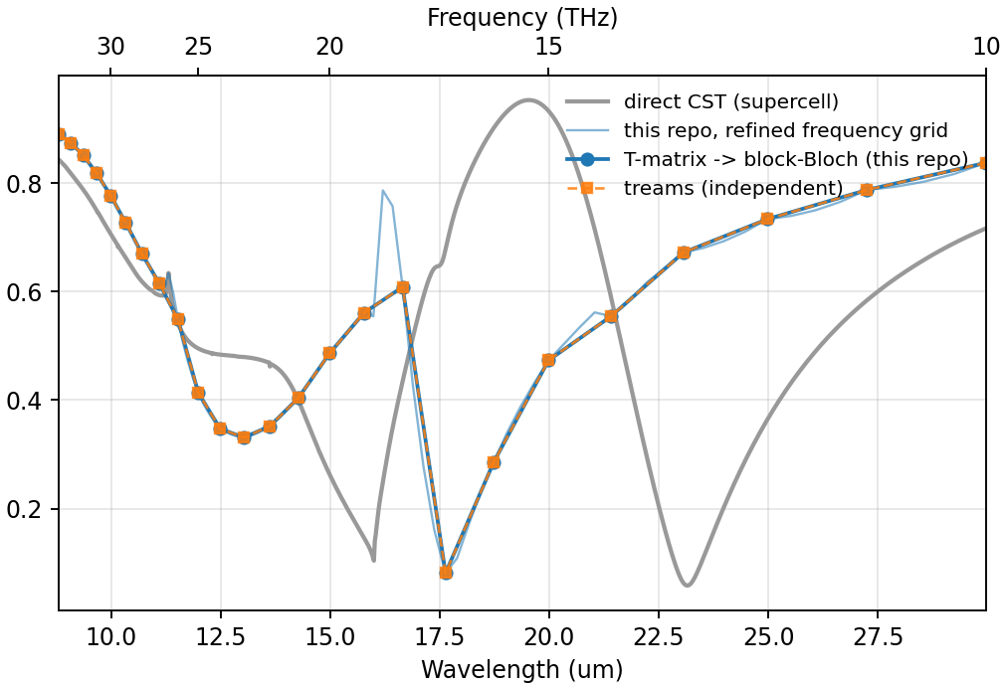
DIAGNOSIS · CLEARING SUSPECTS
The T-matrix is innocent — and so is the implementation
The input T-matrix is consistent
Isolated resonance / scale: 3.766, 3.770, 3.786, 3.782 for C, A, B, D — perfectly linear; D is no outlier.
D is the most dipolar of the four (96.5 % l = 1), so truncating its own multipoles is not the issue.
The code is consistent — twice over
treams — an independent implementation — reproduces D's wrong answer to 1.2×10⁻¹⁵.
It evaluates the same addition theorem at the same lmax, so it inherits the same limit.
a,b;c,d: this repo (blue) and treams (orange) are indistinguishable — and both sit far from CST (grey).
Cross-code agreement validates the implementation. Only full-wave validates the physics.
Composing metasurfaces from measured meta-atoms 10 / 16

Slide 11
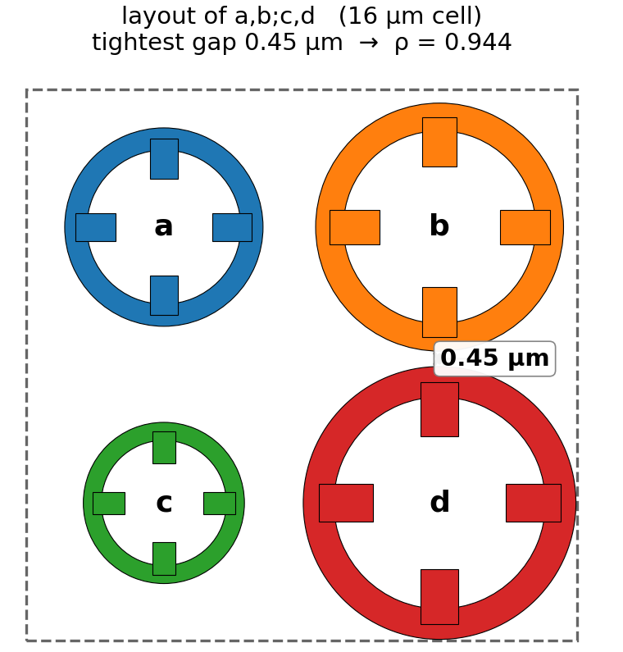
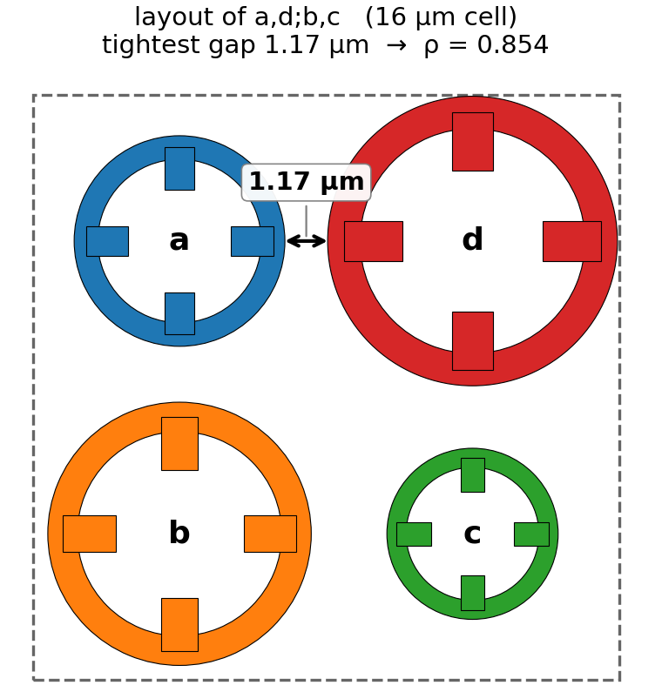
DIAGNOSIS · THE MECHANISM
Truncated addition theorem: error contracts by only ρ per order
A T-matrix describes its atom only outside the circumscribing sphere (radius a).
Re-expanding neighbour j's scattered field about atom i converges like a geometric series in ρ = (aᵢ + aⱼ)/d — truncation at lmax leaves an error ~ ρ^lmax.
ρ | case | lmax needed for ~1 %
0.652 | a,c;c,a | 11
0.809 | a,b;b,a | 22
0.944 | a,b;c,d (B–D pair) | 80
0.989 | D alone (D–D pair) | 416
The knob that matters: a,b;c,d puts B and D adjacent (gap 0.45 µm, ρ = 0.944); a,d;b,c re-pairs the same four atoms (tightest gap 1.17 µm, ρ = 0.854) and is 14× more accurate.
Used: lmax 3.
Silent by construction: the validity condition aᵢ + aⱼ < d is satisfied in every case (D–D: 7.912 vs 8.000 µm). Marginally satisfied is worse than violated — nothing warns.
Composing metasurfaces from measured meta-atoms 11 / 16

Slide 12
DIAGNOSIS · THE DILEMMA
Raising lmax makes it worse: two errors move in opposite directions
↓ truncation error
↑ noise amplification
Falls like ρ^lmax — at ρ = 0.944 each extra order buys a factor 0.944: lmax ≈ 80 for 1 %.
At lmax 3–5 the neglected remainder of the B–D coupling is of order 1.
The l = 4, 5 rows of the measured T sit at the extraction noise floor.
The near-field lattice sum amplifies exactly those rows: hₗ(kp) ~ (2l−1)!! / (kp)ˡ⁺¹ — |W| at l = 3 reaches 1025 at λ ≈ 30 µm vs 1.7 at 8.8 µm: 227× the dipole coupling there.
Both measured, not predicted:
Atom D's reconstruction is worse at lmax 5 than at lmax 3 — the noise term already dominates before truncation is fixed.
The obvious internal check fails too: the lmax 3→4→5 spread is largest for the most accurate cell (a,d;b,c), because the spread measures noise amplification, not geometry. There is no usable convergence warning.
Composing metasurfaces from measured meta-atoms 12 / 16

Slide 13
THE LIMITATION
The limit is representational, not algorithmic
gap 0.45 µm
A single-centre, lmax-3 T-matrix has 30 modes. The field in a 0.45 µm gap varies on the scale of the gap — that information does not exist in those 30 numbers.
ρ is fixed by geometry: circumscribing radii and centre distance. No solver setting, no lattice-sum method, no basis convention changes it.
The hybridized gap mode (the measured red-shift) is reachable by the formalism only at lmax ≈ 80–400 — far beyond what measured T-matrices support.
B
D
d = 8 µm
each T-matrix is valid only outside its dashed sphere — the gap region belongs to neither expansion
Composing metasurfaces from measured meta-atoms 13 / 16

Slide 14
WHY THE FIX IS NOT IN THE AGGREGATION
No modification of the aggregation alone can supply the missing physics
Proof in one line — the Neumann sandwich
f = T a + T C T a + T C T C T a + …
Every lattice operator C is sandwiched between two copies of the stored T. T is zero outside l ≤ 3, so any higher-order content added to C is annihilated on contact — computing C exactly, at any lmax, changes nothing.
The other obvious fix also dies — on geometry
Therefore
Merging the near-touching pair into one extracted super-atom makes a sphere that swallows the next neighbour:
The missing gap-scale information must enter upstream of the solve: the representation of each atom — i.e. the extraction — has to change, not the aggregation that consumes it.
merge | merged radius | worst ρ vs rest
B + D | 7.956 µm | 1.211 — invalid
A + B | 7.596 µm | 1.292 — invalid
C + D | 7.956 µm | 1.292 — invalid
(ρ ≥ 1 violates the validity condition outright — merging only works in sparse cells)
Composing metasurfaces from measured meta-atoms 14 / 16

Slide 15
THE PATH FORWARD
Multi-centre representation: make ρ an algorithmic choice again
Replace one 4 µm expansion centre by ~30 sub-centres of radius rₛ ≈ 0.5 µm tiling the ring. Since k·rₛ ≈ 0.24, each needs only dipoles (lmax 1): ~180 modes per atom, still a trivial dense solve.
The pair convergence ratio becomes ρ_sub = 2rₛ / (g + 2rₛ) — set by a chosen radius, no longer by the fixed geometry.
~80 % already built
Block lattice sums take arbitrary per-cell positions (treams shift list)
Multi-centre cluster operators exist (cluster_T)
Change needed: dense per-atom blocks instead of diagonal T’s — a data-model edit
pair | gap g | ρ today | ρ_sub at rₛ = 0.5 µm
B–D | 0.448 µm | 0.944 | 0.691
A–D | 1.167 µm | 0.854 | 0.461
D–D | 0.088 µm | 0.989 | 0.919 (graded radii near the gap)
The real cost: extraction
≥ 180 independent excitations per atom
Plane waves are too smooth — near-field (dipole) sources must join the illumination set
A new CST protocol; the existing conditioning machinery is the right design tool
B–D at ρ_sub = 0.691 would sit among the best-performing cells of the study (ρ ≈ 0.65–0.75).
Composing metasurfaces from measured meta-atoms 15 / 16

Slide 16
GUARDRAILS NOW · TAKEAWAYS
What to do while the representation is rebuilt
Gate on ρ
Design around it
Denoise, then lmax
Warn above 0.85, refuse above 0.95 (with --force). The η-split already refuses rather than guesses — extend the policy. Blocked only on storing the circumscribing radius in tmat.h5.
Never place the two largest atoms adjacent: a,d;b,c vs a,b;c,d is 14× better for free — same atoms, same lattice.
Symmetry-average the noisy l = 4, 5 rows before any lmax raise. Helps the ρ ≈ 0.85 band; cannot reach 0.944.
1
Validated: composing metasurfaces from measured atoms is essentially free below ρ ≈ 0.85 — accuracy is set by the inputs, not the method.
2
The failures (a,b;c,d, a,c;d,b, atom D) are one diagnosed mechanism — slow convergence of the truncated addition theorem across sub-µm gaps — not noise, and not a bug: treams reproduces them to 10⁻¹⁵.
3
The fix is representational, not algorithmic: the aggregation provably cannot supply the missing gap physics; a multi-centre extraction can.

