Slide 1
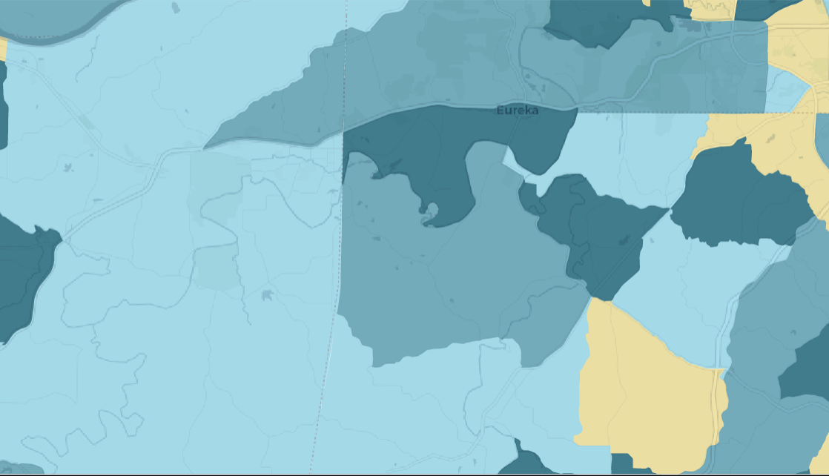
Evaluating Environmental Inequality in America through Public Data
Anne Driscoll

Slide 2
What is Environmental Justice?
The theory that minorities experience toxicity burden different from their white counterparts.
Research generally done side by side with community organizers using location and time specific data.
“In some specific areas, some ostensibly identifiable groups may, in some instances, live closer to some selected environmental hazards” (Bowen, 2002)
Notes:
This project is built around a few basic ideas

Slide 3
Goals
To show how minority experiences of toxicity in America differ by comparing distributions of experienced toxicity.
Goal is not to show how minorities experience toxicity differently, all else held constant.
Rather, to point out that histories of oppression have created many forms of injustice. Though toxicity experienced may be primarily linked to other factors, such as income or geographic area, those relationships still result in higher toxicities for minority communities.
To make this data accessible to the general public, as a tool for organizing and understanding local experiences.

Slide 4
Data
Toxic Release Inventory (TRI) reports on hazardous chemicals between 1988 & 2013.
Facilities that emit chemicals on that list, are within a mandated reporting industry, and are of a certain size have to report how much of each mandated chemical they release each year.
Travel through air/water of those emissions are estimated on an 800m by 800m grid across the US, reported as the Risk Screening Environmental Indicators (RSEI) model.
“Toxicity”?

Slide 5
Aggregated Microdata
X | Y | # Facilities | # Releases | # Chemicals | ToxConc | Score
1879 | 318 | 1 | 2 | 1 | 2.02E-03 | 0
1869 | 319 | 1 | 2 | 1 | 1.71E-03 | 0
1870 | 319 | 1 | 2 | 1 | 1.78E-03 | 0
1871 | 319 | 1 | 2 | 1 | 1.85E-03 | 0
1872 | 319 | 1 | 2 | 1 | 2.09E-03 | 0
 |  |  |  | …
Notes:
This is what the aggregated microdata looks like.
For each year, data is provided at the grid cell level, giving a cumulative toxicity with some info on number of facilities and chemicals.
Given that a large portion of my interest was to see how toxicity burden changed over time, continuity of the data is important. Here, the EPA has aggregated all reports in each grid cell for each year. Given that the reporting list changes (both for the industries that must report, the chemicals that must be reported, and the minimum facility size to report) the data will not be continuous over time.
When industries or chemicals are added (or removed) we will see artificial jumps or drops in the toxicity score. An obvious example is mining, which was added in the early 2000’s. Mining is an extremely polluting industry, and areas that had previously appeared clean showed huge jumps in toxicity when mining was added. This jump isn’t representative of a jump in toxicity experienced, rather a jump in toxicity measured.

Slide 6
Disagreggated Microdata
X | Y | Release # | Chemical # | Facility # | Media | Conc | ToxConc
1879 | 318 | 1021 | 312 | 18 |  | 0.0341932 | 1E-10
1879 | 318 | 3001 | 312 | 18 |  | 0.0352742 | 1E-10
1869 | 319 | 1021 | 312 | 18 |  | 0.0367126 | 1E-10
1869 | 319 | 3001 | 312 | 18 |  | 0.0365760 | 1E-10
 |  |  |  | …
Notes:
To eliminate that discontinuity in the data, we need to go to the disagreggated microdata. This data is much larger, giving an observation for every grid cell for each release that hit it. Where in the first dataset we would have an observation for an xy pair and a number with the number of releases that hit it, here we would have a row for each of those releases at that square.
This allows us to filter out the releases from the data that come from a chemical or industry that was not consistent over the full time period.
A small complication comes up now – that NAICS (North American Industry Classification System) codes are specific to a release, not a facility. RSEI data provides a list of the 6 most common NAICS codes for each facility, meaning we could filter out facilities that ever use one of the inconsistent codes, but we would lose a lot of data. Fortunately, the Release number provided links to a release table that provides document control numbers. These document control numbers link to the original self reported form submission to the EPA, which lists the NAICS code specific to the release. By incorporating the original TRI data, we are able to accurately filter by NAICS code.

Slide 7
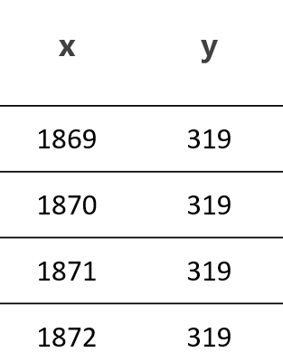
Filter each row by chemical released and NAICS code of release
2) Use crosswalk to turn into census block number
3) Aggregate to tract level.
4) Merge with census data:
tract | concentration | total_pop | black_pop | white_pop
1117030100 | 47426.7 | 5457 | 1290 | 4127
1117030201 | 77011.8 | 6416 | 124 | 6221
 |  | …
Notes:
So what is the entire process of converting the data to a useful form?
First remove the entries tied to a release that either contained a chemical not continuously reported, or came from a NAICS code not continuously reported.
Next, use a crosswalk to convert the grid to a census block. Aggregate across the grid cells to a block level, weighting by how much of the grid cell is within the block.
With data at the block level, we can aggregate to any census level we are interested in. From here on we are using data aggregated to the tract level.
This data can then be combined with any tract level data. We primarily use population counts within each tract for each minority group, and sometimes for income groups.
Extrapolated census data between 1990 and 2000, plus 2000 through 2010

Slide 8
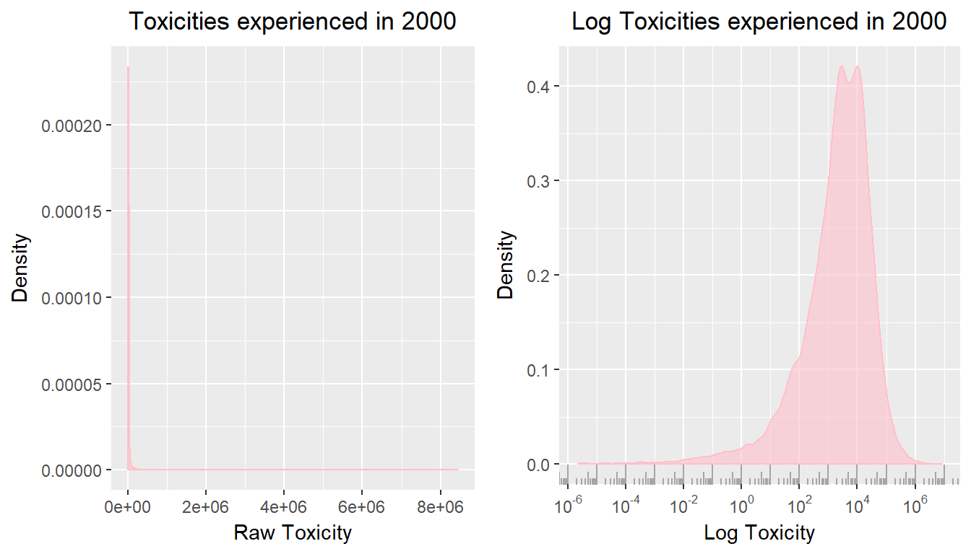
Building Distributions of Toxicity Experienced
tract | toxicity | total_pop
01117030100 | 47426.7 | 5457
01117030201 | 77011.8 | 6416
01117030301 | 11062.1 | 4032
 | …
Notes:
Using the data at the tract level, with information on population counts and toxicity within the tract, we are able to build the distribution of toxicity experienced across the united states.
This distribution of toxicities is created by weighting the toxicity experienced in each tract by the number of people residing in the tract.
The distribution of toxicities experienced by all American individuals is extremely right skewed, as there are some wells of toxicity that experience pollution orders of magnitude higher than others. Because of this, from here forward ‘Toxicity’ is the log of the toxicity measure presented by the EPA unless specified otherwise. As you can see, the distribution of logged toxicity is much more interpretable.
Because of the implications that toxicity has for health, and the relationship toxicity has to housing access, we are most interested in the 5th, 50th and 95th percentiles. The 5th percentile of the toxicity distribution for each race gives an idea of the level of access to safe toxicity areas that group has. The 95th percentile shows the level of toxicity well that a group commonly falls in to. The median is an interesting measure to look at to gain an idea of movement over time between the extremes.

Slide 9
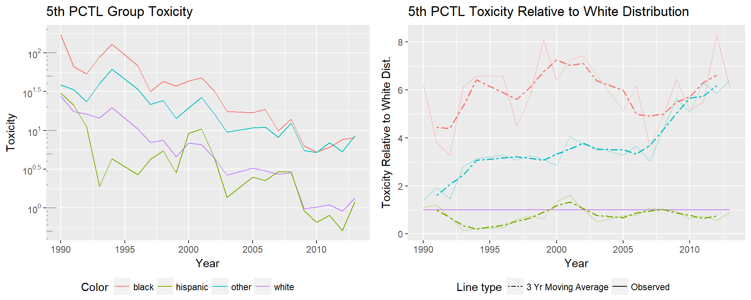

Slide 10
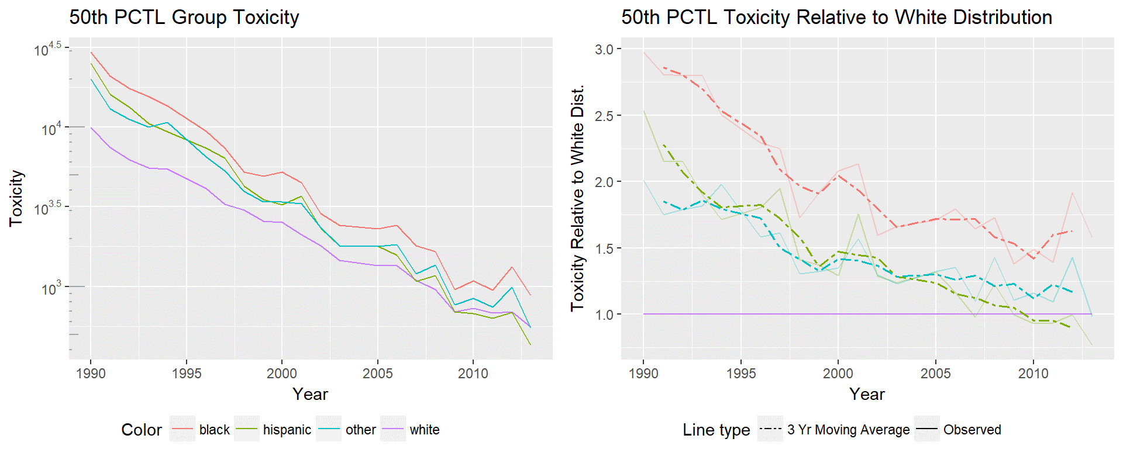

Slide 11
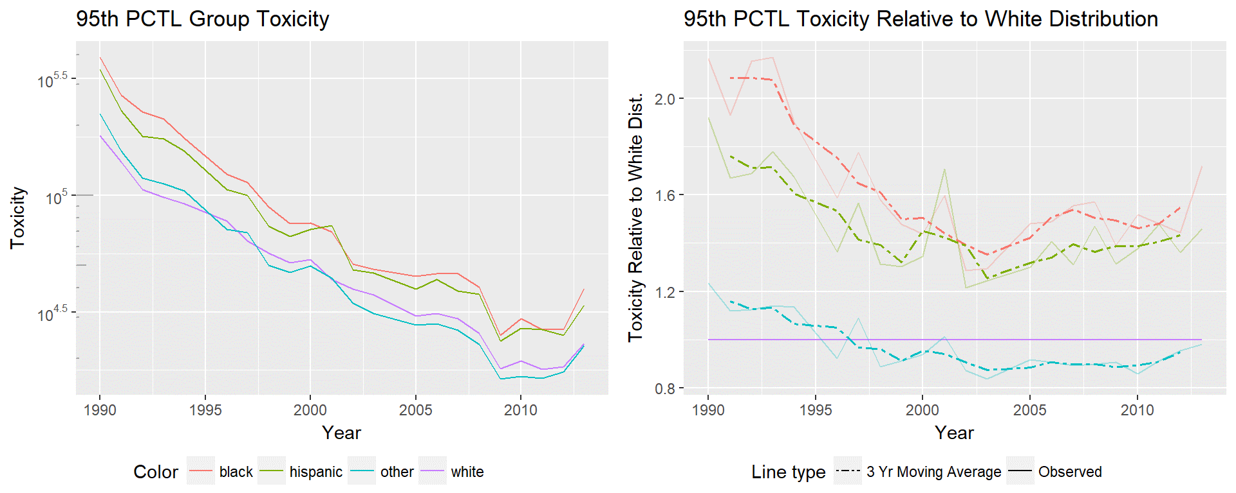

Slide 12
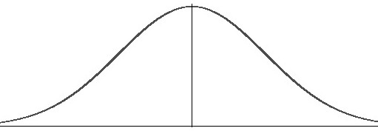
Distributional vs. Positional Convergence
Bayer & Charles, 2002

Slide 13
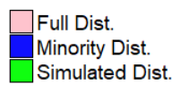
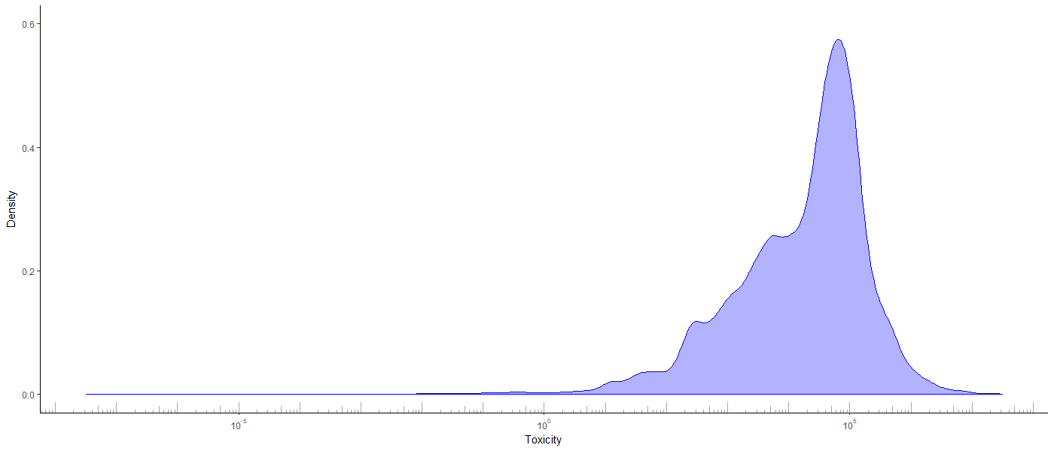
Simulation
1) Sample value from minority distribution in 1990

Slide 14
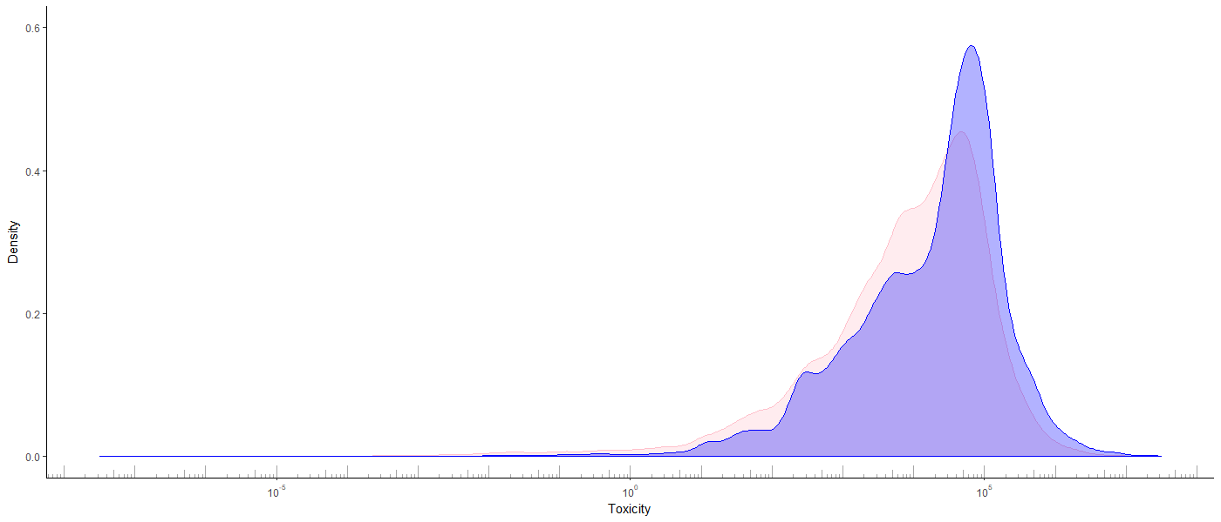
Simulation
2) Find percentile in overall distribution in 1990
95th
percentile

Slide 15
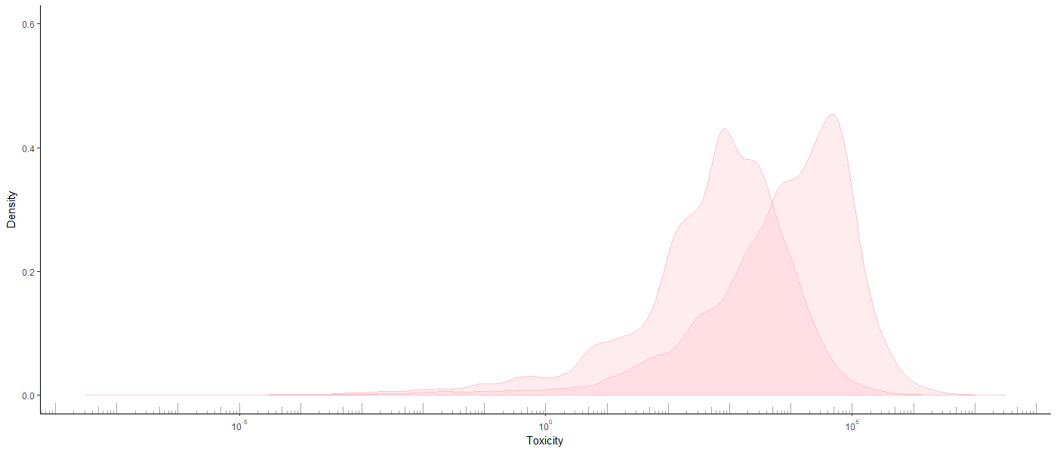
Simulation
3) Find value of percentile in overall distribution in 2010.
This represents value individual would have held in 2010
if they held their position in the overall distribution.
95th in 2010
95th in 1990

Slide 16
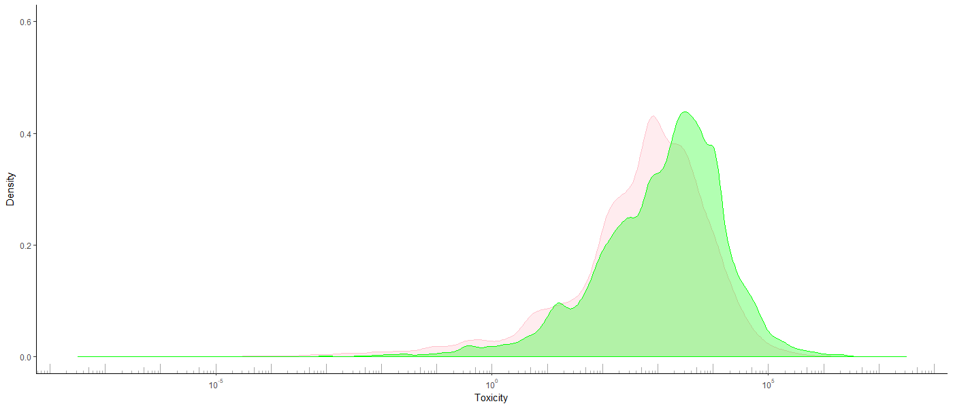
Simulation
4) Repeat to simulate what the distribution for the minority
would have been if place in distribution had been fixed.

Slide 17
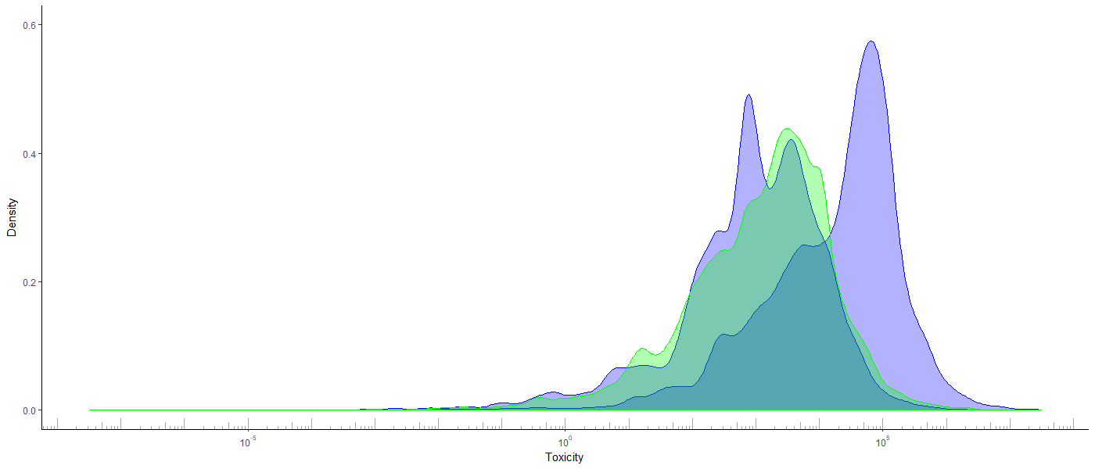
Simulation

Slide 18
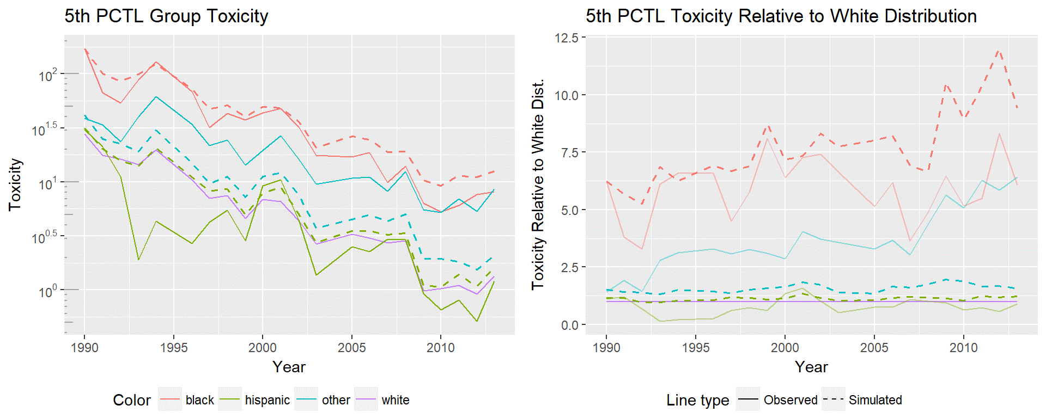

Slide 19
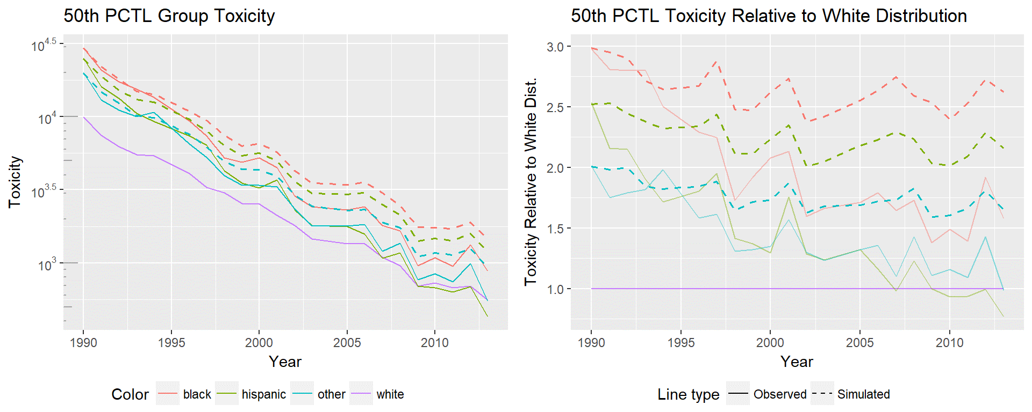

Slide 20
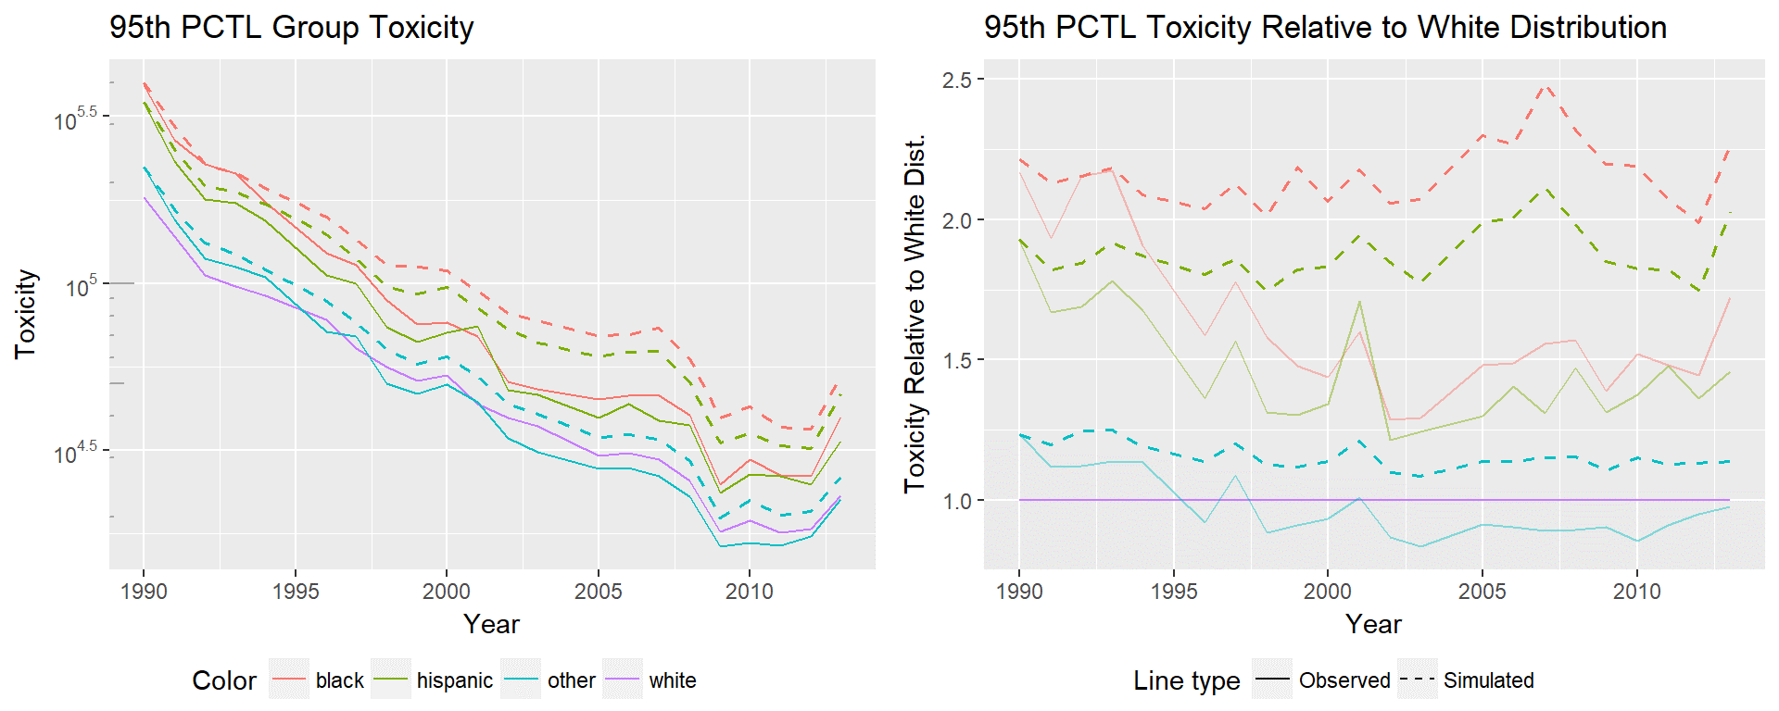

Slide 21
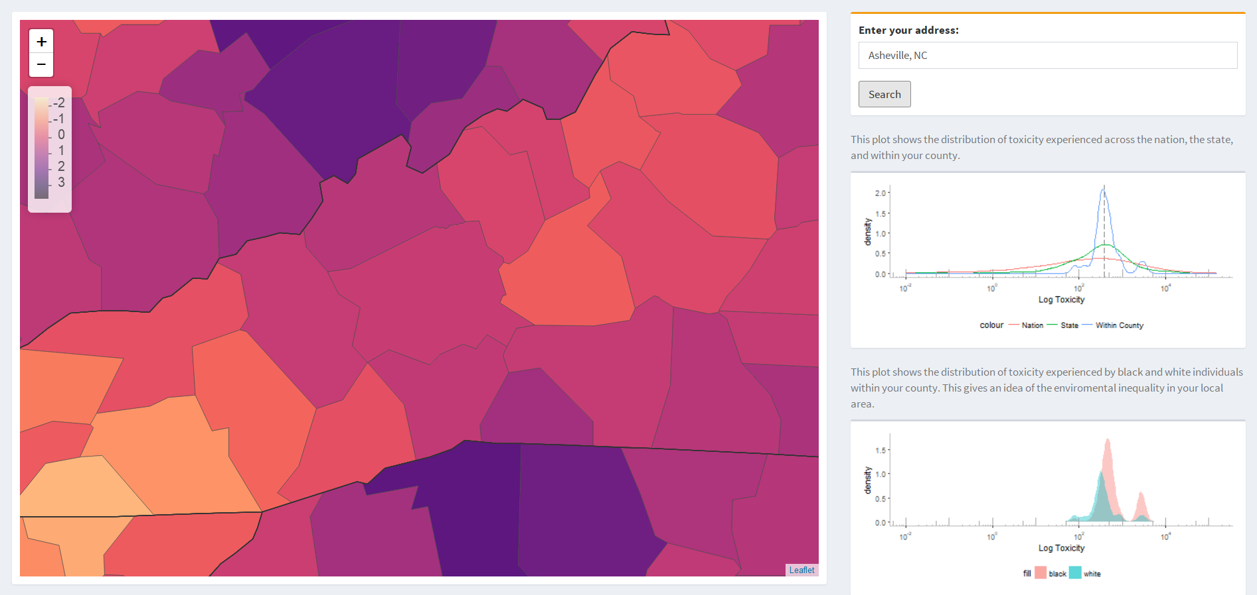
Public Interaction – Asheville 82% White, 12% Black, Higher burden on black population.

Slide 22
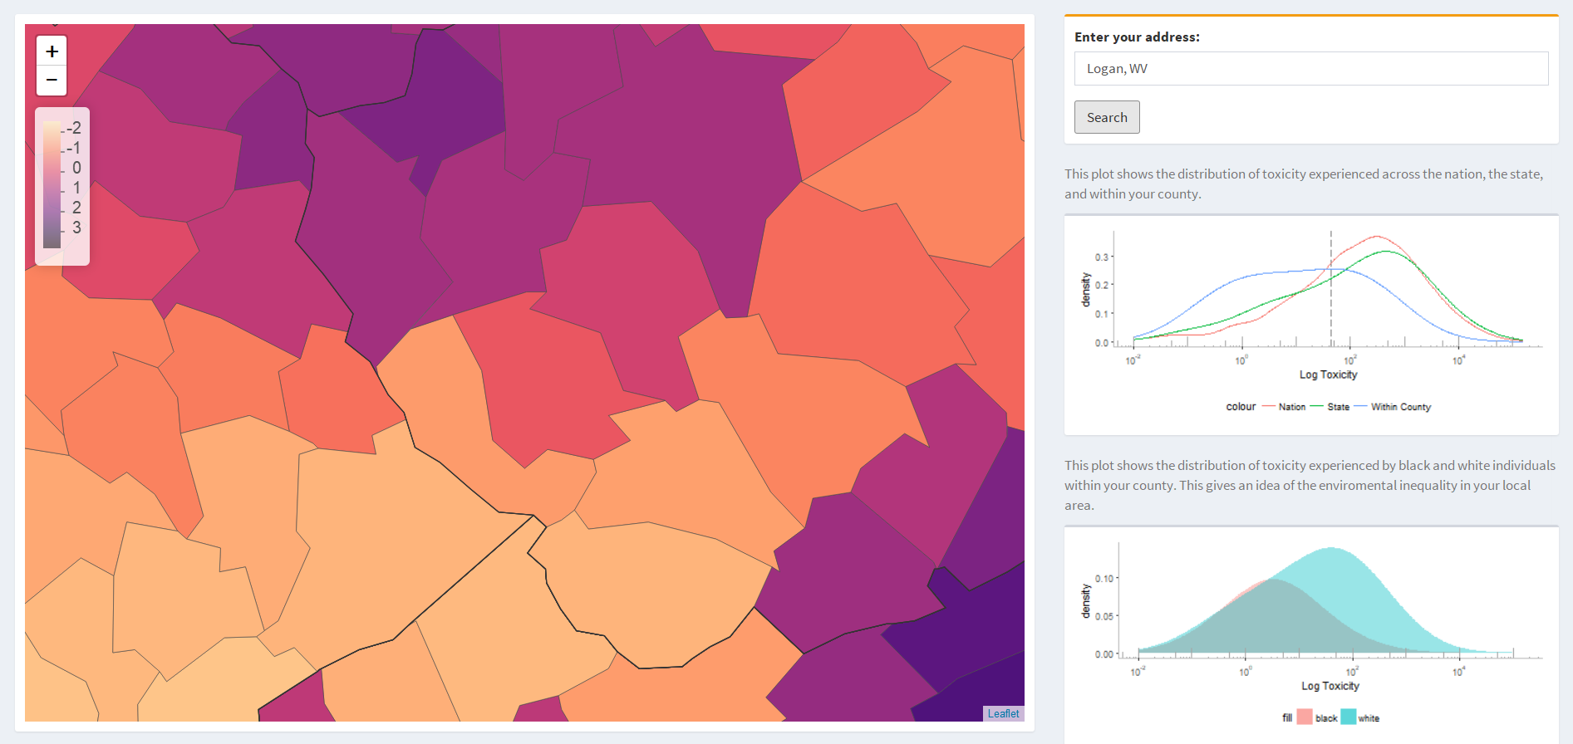
Public Interaction – Logan 88% White, 8% Black, Higher burden on white population.

Slide 23
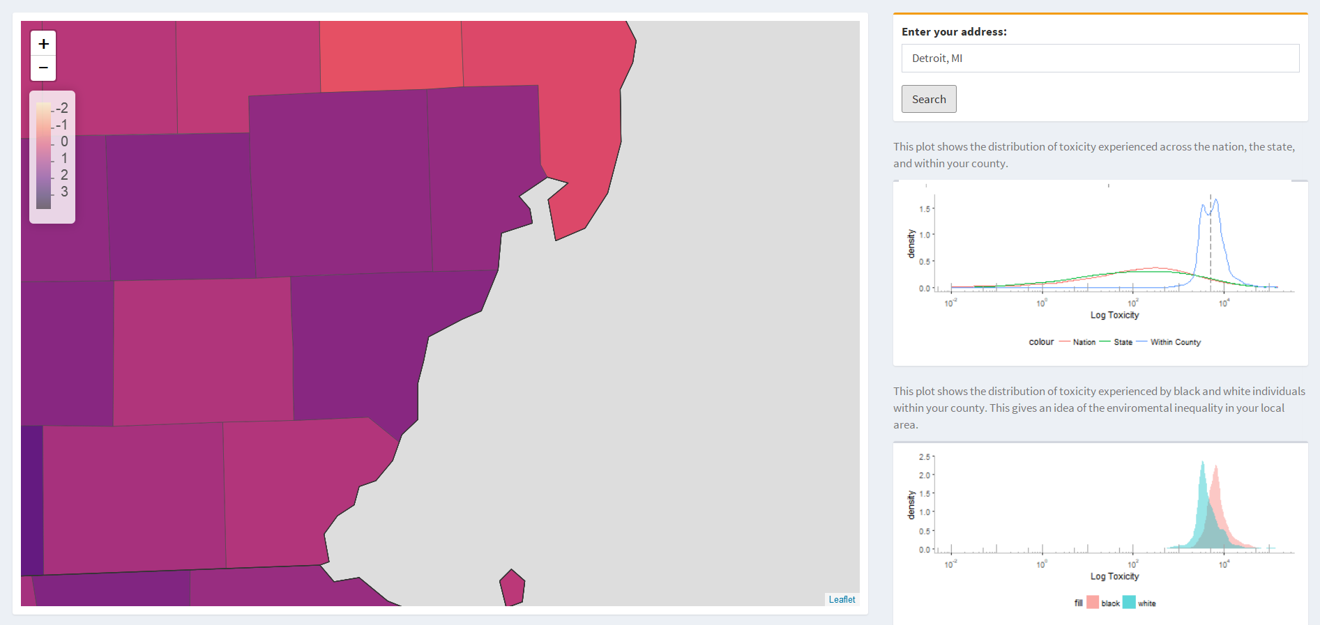
Public Interaction – Detroit 10% White, 84% Black, Higher burden on black population.

Slide 24
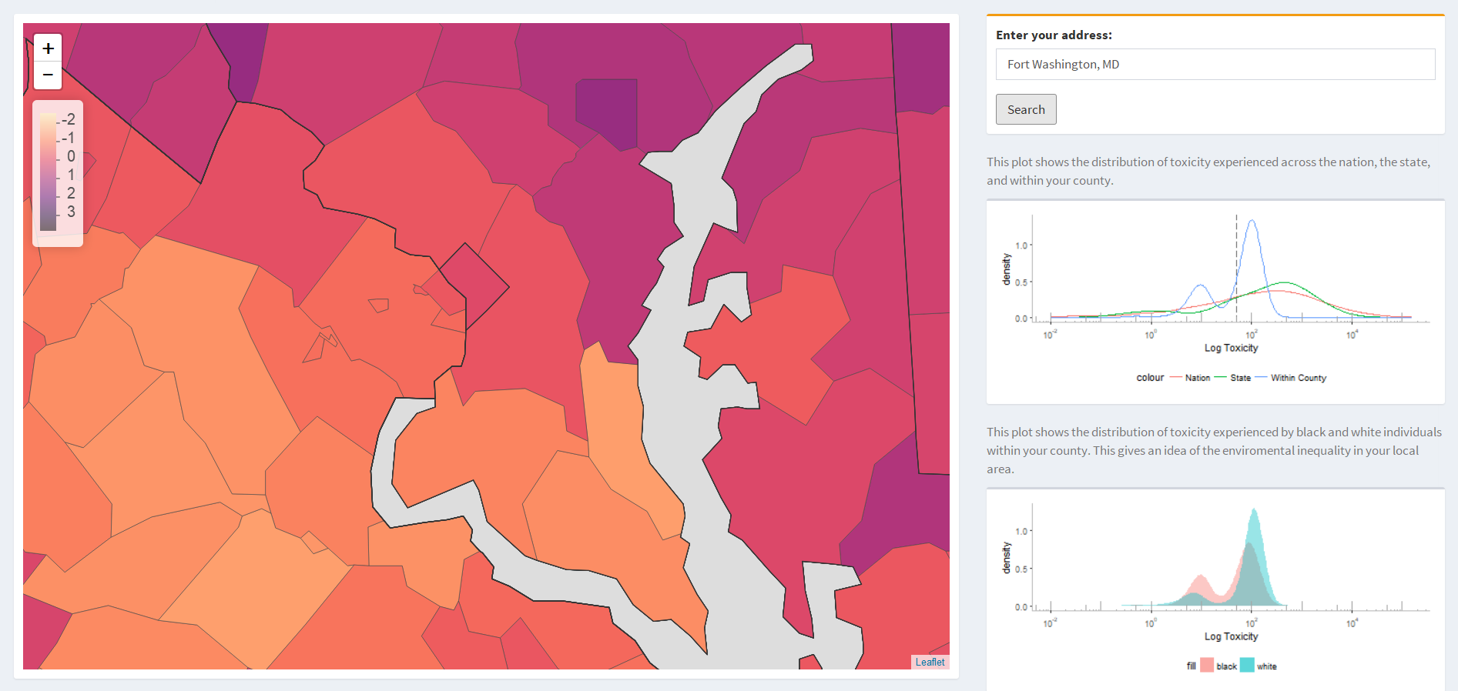
Public Interaction – Fort Washington 13% White, 71% Black, Higher burden on white population.

Slide 25
Questions?

