Slide 1
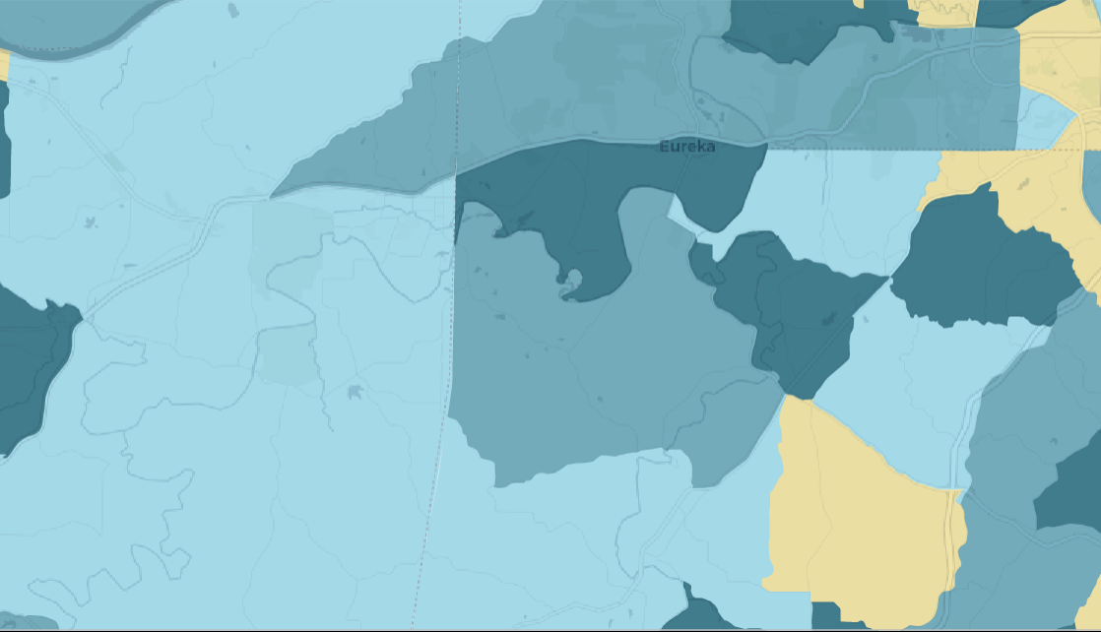
Evaluating Environmental Inequality in America through Public Data
Anne Driscoll
Notes:
Today I’m going to be talking about environmental inequality in America, and how we can use public data to evaluate it.

Slide 2
What is Environmental Justice (EJ)?
The theory that minorities experience toxicity burden different from their white counterparts.
Research generally done side by side with community organizers using location and time specific data.
“In some specific areas, some ostensibly identifiable groups may, in some instances, live closer to some selected environmental hazards” (Bowen, 2002)
Notes:
We’re going to start out with a quick intro on environmental justice. EJ is the theory that minority communities experience a different toxicity burden than their white counterparts.
The research done on EJ has been predominantly in the form of case studies. This is partially because of close interaction between EJ researchers and community organizers from communities experiencing high toxicity, and also due to data availability. The way research has gone hand in hand with communities has led to a body of research that is mostly composed of studies either examining specific locations or a specific group of people at a single time point.
The form that the body of research has taken has led to some discontent with the outcomes, especially since this set of case studies reaches a broad set of differing conclusions. A quote I love because it really embodies the way some people perceive the literature is here. It’s from a literature review published in 2002, and states that all the field has done is show that “in some specific areas, some ostensibly identifiable groups may, in some instances, live closer to some selected environmental hazards”

Slide 3
Goals
To show how minority experiences of toxicity in America differ by comparing distributions of experienced toxicity.
Goal is not to show how minorities experience toxicity differently, all else held constant.
Rather, to point out that histories of oppression have created many forms of injustice. Though toxicity experienced may be primarily linked to other factors, such as income or geographic area, those relationships still result in higher toxicities for minority communities.
To make this data accessible to the general public, as a tool for organizing and understanding local experiences.
Notes:
That quote leads me to one of the overarching goals of my thesis. Ideally, I’d like to provide a dataset that allows us to address this question in a way that would please the author of that quote. The data I’m working with spans an long period of time (1988-2013) that covers a lot of development in environmental regulation.
I’m using this data to try to show that minorities experience toxicity differently, not that minorities experience toxicity differently all else held constant. This is an important distinction statistically, but also conceptually. Histories of oppression in the US are complex, and have led to many forms of current oppression, some of which aren’t obvious, and aren’t discussed in day to day life. I, and the entire field of EJ, hypothesize that minorities experience toxicity differently. Though minority status may not be the best predictor of toxicity, and may not have a measurable effect separate from geographic area, education, income etc, those identities are all intertwined in meaningful ways at the level of individuals. The experience of communities as a whole is important regardless of separate measurable relationships between personal traits and toxicity experienced.
With that perspective in place, the way I’m looking at the data is by creating distributions of toxicity experienced for each race group, for each year in the time period and investigating how the empiric toxicity of minority groups relative to the white group changes over the time period.
The second part looks at how we can make this data available at a fine enough grain that people are able to learn about their surrounding areas. I created an applet, which through visualizing a map of toxicity, and the distribution of experienced toxicity nationally, contextualizes local experiences.

Slide 4
Data
Toxic Release Inventory (TRI) reports on hazardous chemicals between 1988 & 2013.
Facilities that emit chemicals on that list, are within a mandated reporting industry, and are of a certain size have to report how much of each mandated chemical they release each year.
Travel through air/water of those emissions are estimated on an 800m by 800m grid across the US, reported as the Risk Screening Environmental Indicators (RSEI) model.
“Toxicity”?
Notes:
So lets jump in to what the data looks like
TRI mandatory reporting from facilities about the things they release in environment
What does a release have to fulfill to be mandated reporting
What does this mean for how we interpret it? What isn’t included?
Converting to RSEI: What does that mean for how we interpret it? What isn’t included?
Toxicity: What does that mean for how we interpret it?

Slide 5
Aggregated Microdata
X | Y | # Facilities | # Releases | # Chemicals | ToxConc | Score
1879 | 318 | 1 | 2 | 1 | 2.02E-03 | 0
1869 | 319 | 1 | 2 | 1 | 1.71E-03 | 0
1870 | 319 | 1 | 2 | 1 | 1.78E-03 | 0
1871 | 319 | 1 | 2 | 1 | 1.85E-03 | 0
1872 | 319 | 1 | 2 | 1 | 2.09E-03 | 0
 |  |  |  | …
Notes:
This is what the aggregated microdata looks like.
For each year, data is provided at the grid cell level, giving a cumulative toxicity with some info on number of facilities and chemicals.
- continuity of data is important.
- why does aggregated data not give that
Given that a large portion of my interest was to see how toxicity burden changed over time, continuity of the data is important. Here, the EPA has aggregated all reports in each grid cell for each year. Given that the reporting list changes (both for the industries that must report, the chemicals that must be reported, and the minimum facility size to report) the data will not be continuous over time.
- what jumps will we see if we use the aggregated data?
When industries or chemicals are added (or removed) we will see artificial jumps or drops in the toxicity score. An obvious example is mining, which was added in the early 2000’s. Mining is an extremely polluting industry, and areas that had previously appeared clean showed huge jumps in toxicity when mining was added. This jump isn’t representative of a jump in toxicity experienced, rather a jump in toxicity measured.

Slide 6
Disagreggated Microdata
X | Y | Release # | Chemical # | Facility # | Media | Conc | ToxConc
1879 | 318 | 1021 | 312 | 18 |  | 0.0341932 | 1E-10
1879 | 318 | 3001 | 312 | 18 |  | 0.0352742 | 1E-10
1869 | 319 | 1021 | 312 | 18 |  | 0.0367126 | 1E-10
1869 | 319 | 3001 | 312 | 18 |  | 0.0365760 | 1E-10
 |  |  |  | …
Notes:
- Instead use disaggregated data
To eliminate that discontinuity in the data, we need to go to the disagreggated microdata. This data is much larger, giving an observation for every grid cell for each release that hit it. Where in the first dataset we would have an observation for an xy pair and a number with the number of releases that hit it, here we would have a row for each of those releases at that square.
This allows us to filter out the releases from the data that come from a chemical or industry that was not consistent over the full time period.
NAICS are actually release level, not facility level.
How do we get at that NAICS data
A small complication comes up now – that NAICS (North American Industry Classification System) codes are specific to a release, not a facility. RSEI data provides a list of the 6 most common NAICS codes for each facility, meaning we could filter out facilities that ever use one of the inconsistent codes, but we would lose a lot of data. Fortunately, the Release number provided links to a release table that provides document control numbers. These document control numbers link to the original self reported form submission to the EPA, which lists the NAICS code specific to the release. By incorporating the original TRI data, we are able to accurately filter by NAICS code.

Slide 7
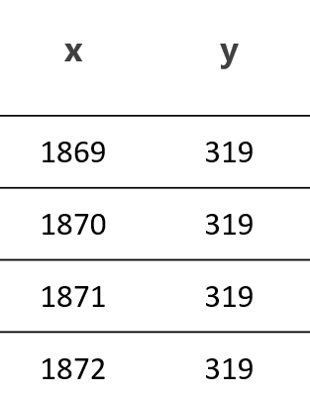
Filter each row by chemical released and NAICS code of release
2) Use crosswalk to turn into census block number
3) Aggregate to tract level.
4) Merge with census data:
tract | concentration | total_pop | black_pop | white_pop
1117030100 | 47426.7 | 5457 | 1290 | 4127
1117030201 | 77011.8 | 6416 | 124 | 6221
 |  | …
Notes:
So what is the entire process of converting the data to a useful form?
First remove the entries tied to a release that either contained a chemical not continuously reported, or came from a NAICS code not continuously reported.
Next, use a crosswalk to convert the grid to a census block. Aggregate across the grid cells to a block level, weighting by how much of the grid cell is within the block.
With data at the block level, we can aggregate to any census level we are interested in. From here on we are using data aggregated to the tract level.
This data can then be combined with any tract level data. We primarily use population counts within each tract for each minority group, and sometimes for income groups.
Extrapolated census data between 1990 and 2000, plus 2000 through 2010!!!!!!!!!!!!!!!!!!!!!!!!!

Slide 8
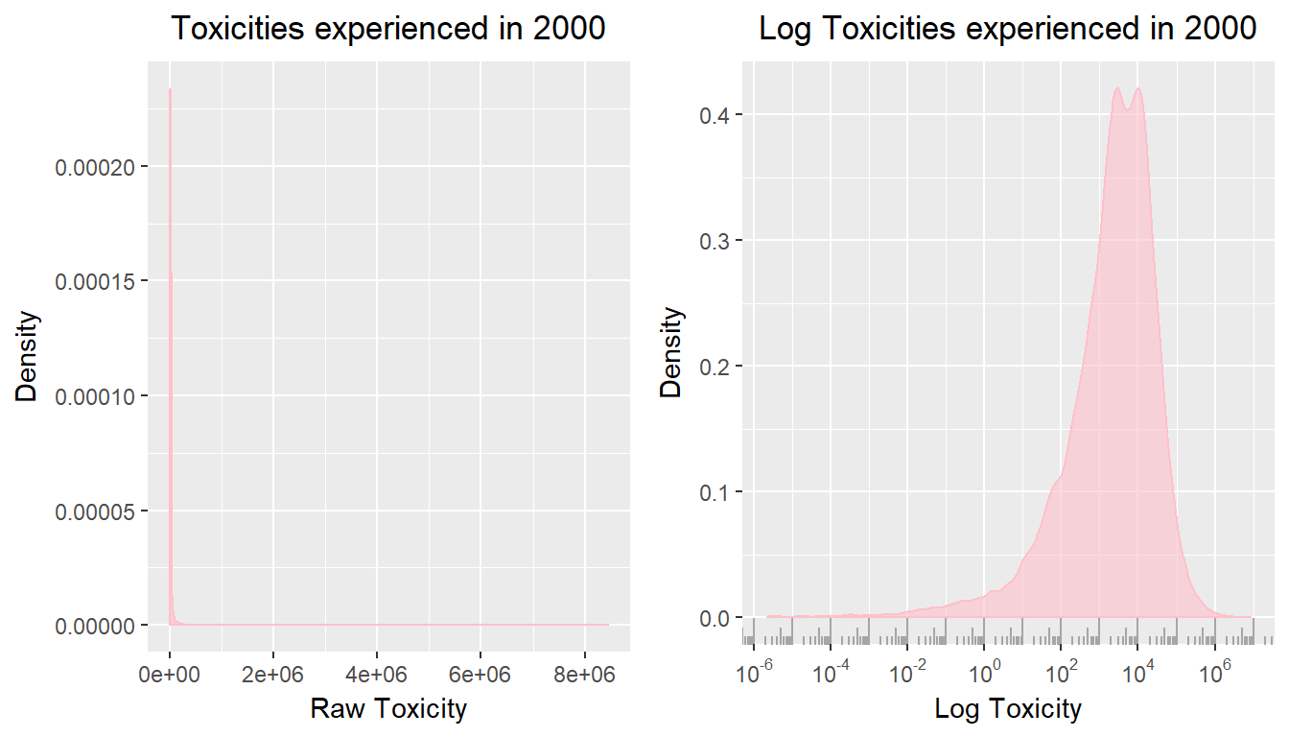
Building Distributions of Toxicity Experienced
tract | toxicity | total_pop
01117030100 | 47426.7 | 5457
01117030201 | 77011.8 | 6416
01117030301 | 11062.1 | 4032
 | …
Notes:
Using the data at the tract level, with information on population counts and toxicity within the tract, we are able to build the distribution of toxicity experienced across the united states.
This distribution of toxicities is created by weighting the toxicity experienced in each tract by the number of people residing in the tract.
- Right skew due to wells, will be logged
The distribution of toxicities experienced by all American individuals is extremely right skewed, as there are some wells of toxicity that experience pollution orders of magnitude higher than others. Because of this, from here forward ‘Toxicity’ is the log of the toxicity measure presented by the EPA unless specified otherwise. As you can see, the distribution of logged toxicity is much more interpretable.
- We are going to look at 5th, 50th, and 95th percentiles. Why?
Because of the implications that toxicity has for health, and the relationship toxicity has to housing access, we are most interested in the 5th, 50th and 95th percentiles. The 5th percentile of the toxicity distribution for each race gives an idea of the level of access to safe toxicity areas that group has. The 95th percentile shows the level of toxicity well that a group commonly falls in to. The median is an interesting measure to look at to gain an idea of movement over time between the extremes.

Slide 9
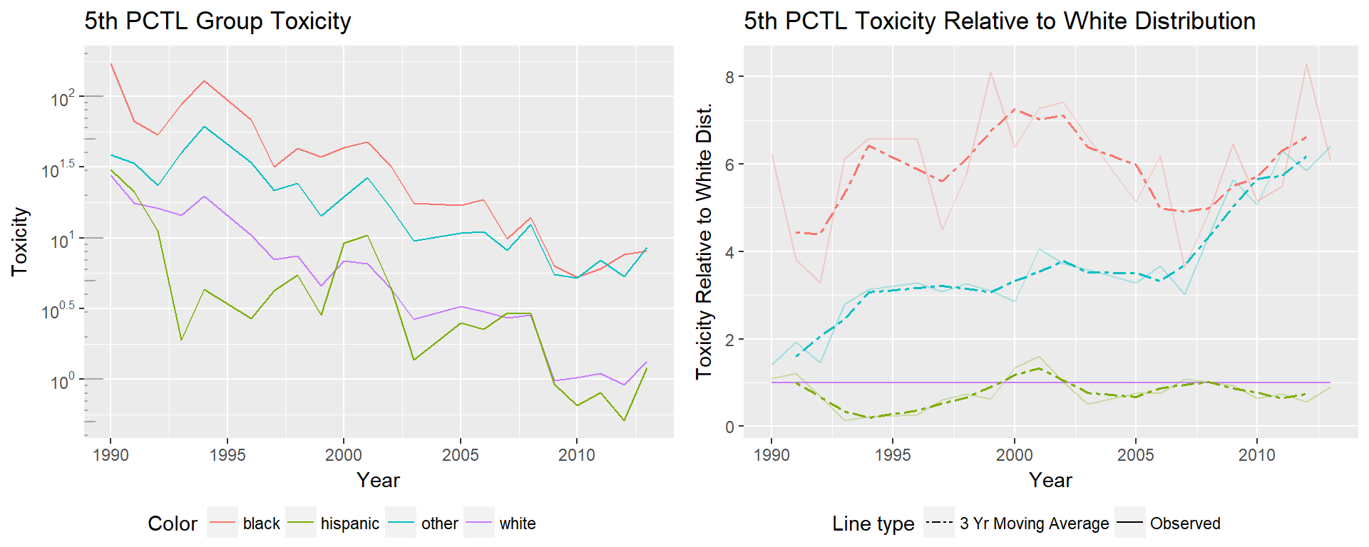

Slide 10
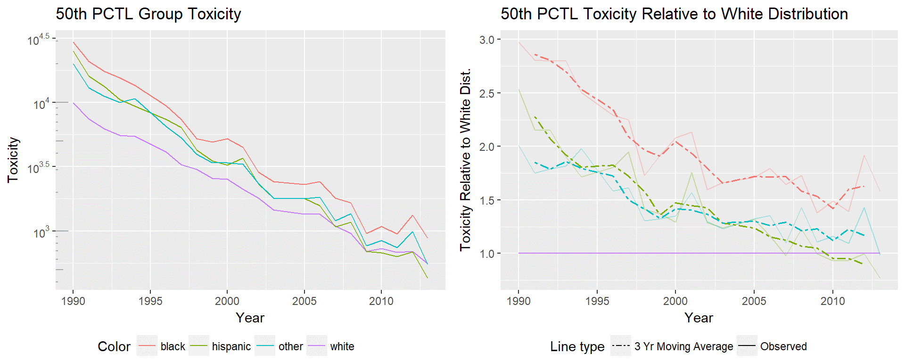

Slide 11
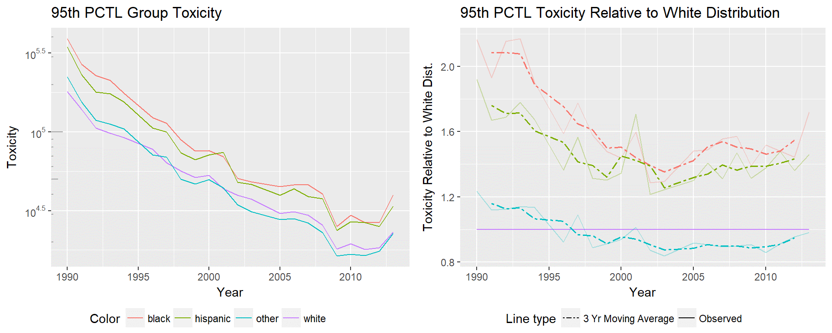

Slide 12
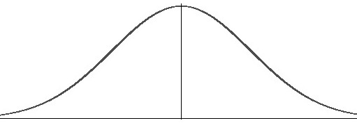
Distributional vs. Positional Convergence
Bayer & Charles, 2002
Notes:
Until here, we’ve been looking at the raw “observed” data on toxicities experienced. But really what’s of interest is how much the position of minorities has truly changed as compared to their white counterparts.
- Paper introduced idea of distributional vs Positional convergence
As discussed in a 2002 paper by Bayer and Charles in the context of the black white wage gap, there are two types of convergence. The first, distributional convergence, happens when the overall distribution condenses as a whole. Though this results in a smaller differences in the means of the two distributions, it’s only because there’s an overall change in the range of experienced toxicities.
- We are interested in positional convergence
The type of change that is of primary interest is positional convergence, which is when the distribution of the subpopulation shifts towards the mean of the other subpopulation. In this case, the percentiles occupied by the subpopulation are changing, aka their position in the overall group is changing. In the case of distributional convergence, their relative position in the overall distribution is not changing, but the values they experience are closer to that of the majority group.
- We are going to simulate what dist would have been without positional convergence.
To tease apart the type of change that is being experienced here, we simulate how minority distributions would have changed over time if the positions minorities held in the overall distribution were held constant, but the overall distribution was allowed to change with time. That’s a confusing statement, so I’m going to work through the step by step process to explain better what I mean.

Slide 13
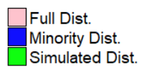
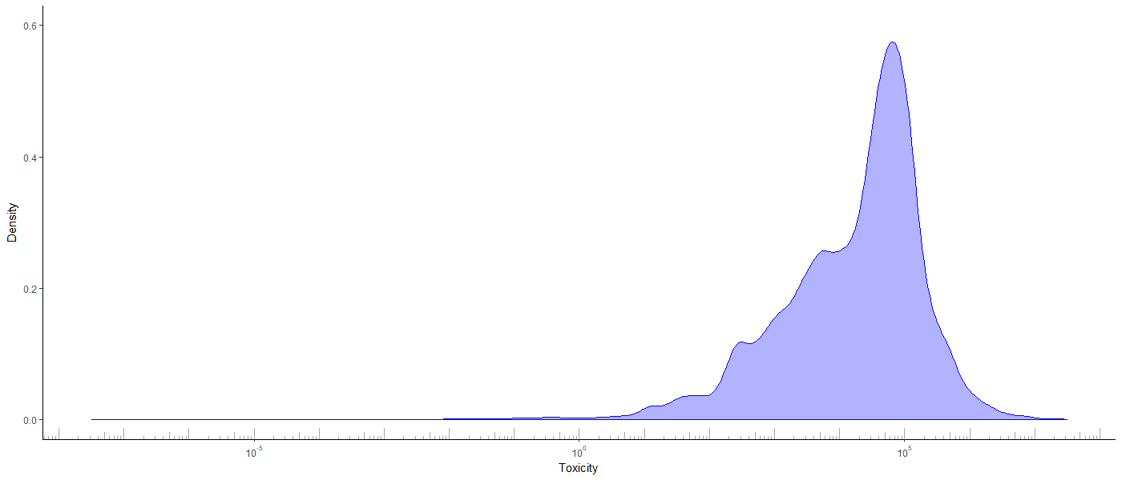
Simulation
1) Sample value from minority distribution in 1990
Notes:
Starting with the 1990 data, which is the beginning of the period we are investigating, we sample a value from a minority distribution of interest. Here I’m showing the distribution of toxicities experienced by the black population in 1990.
The line I’ve added to the chart is representative of a value I sampled.

Slide 14
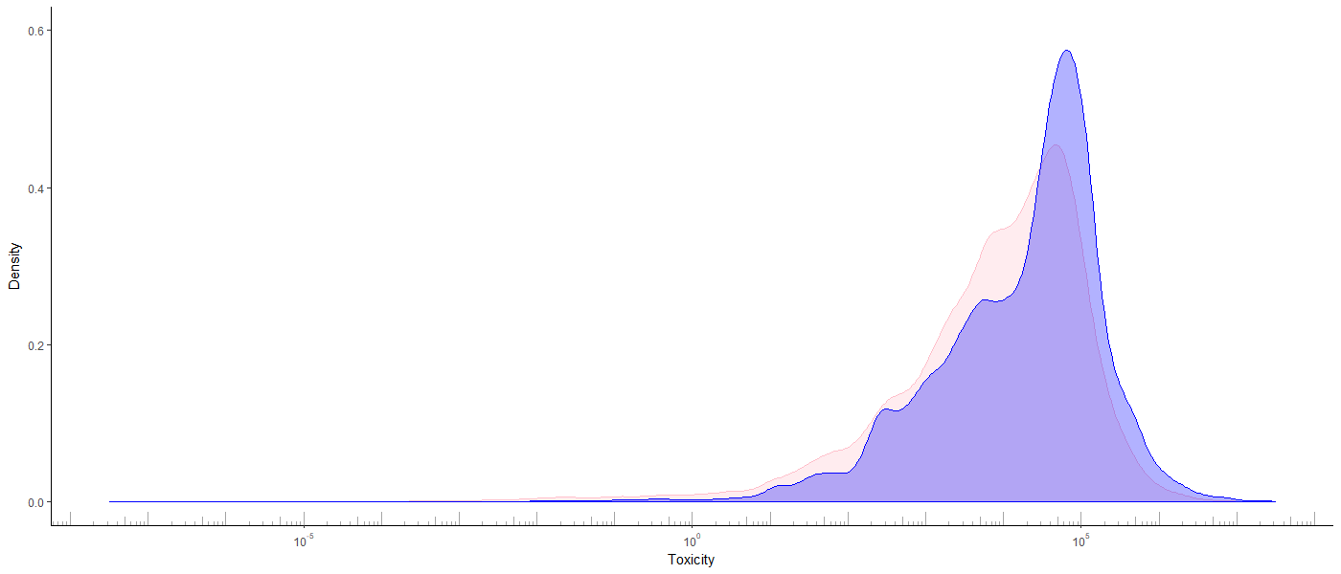
Simulation
2) Find percentile in overall distribution in 1990
95th
percentile
Notes:
With that sampled value, we find the percentile it occupies in the overall distribution of the same year.
So this value is the 90th percentile in the black distribution of 1990, but the 95th percentile in the full population distribution of 1990.

Slide 15
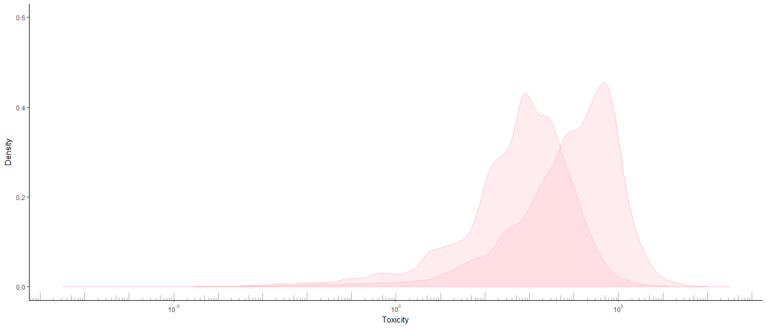
Simulation
3) Find value of percentile in overall distribution in 2010.
This represents value individual would have held in 2010
if they held their position in the overall distribution.
95th in 2010
95th in 1990
Notes:
Using the percentile that the sampled value has in the overall distribution of the starting year, we find the value that occupies the same percentile in the ending year.
Here I’ve marked the 95th percentile in 1990 and 2010, which is the ending year in this example. Holding the percentile static is how we ensure the value has the same relative position in the ending year.
The value that the 95th percentile holds in the ending year is our final sampled value.

Slide 16
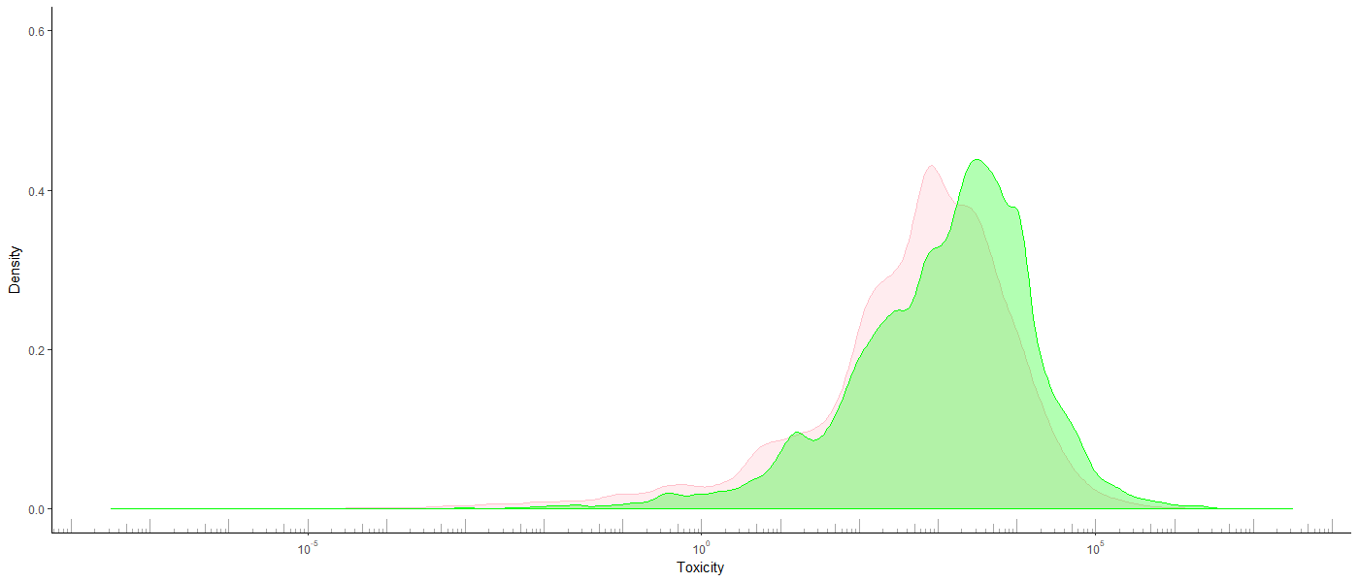
Simulation
4) Repeat to simulate what the distribution for the minority
would have been if place in distribution had been fixed.
Notes:
By repeating that process on the order of n = 50,000 times, we’re able to build a distribution that represents how the minority distribution would have looked in the ending year, if all members of the minority had held constant their relative position in the overall distribution, but the overall distribution had continued to improve.

Slide 17
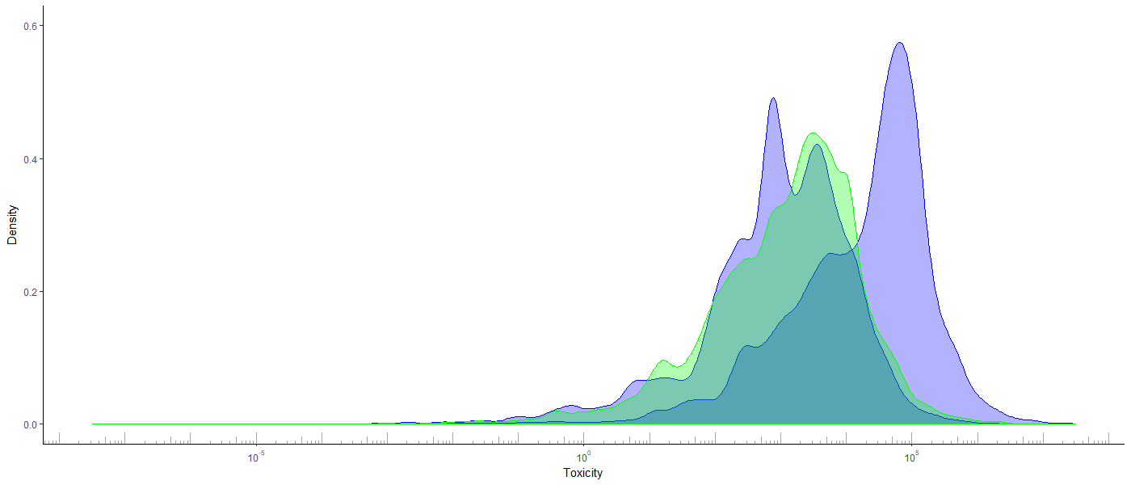
Simulation
Notes:
This gives you an idea of how the simulated and true distributions compare. The rightmost distribution is the true distribution of black toxicities in 1990, the green is the simulated distribution in 2010, and the leftmost blue distribution is the true experienced toxicities in 2010.
I’m just gonna pause a second to make sure there are no questions.

Slide 18
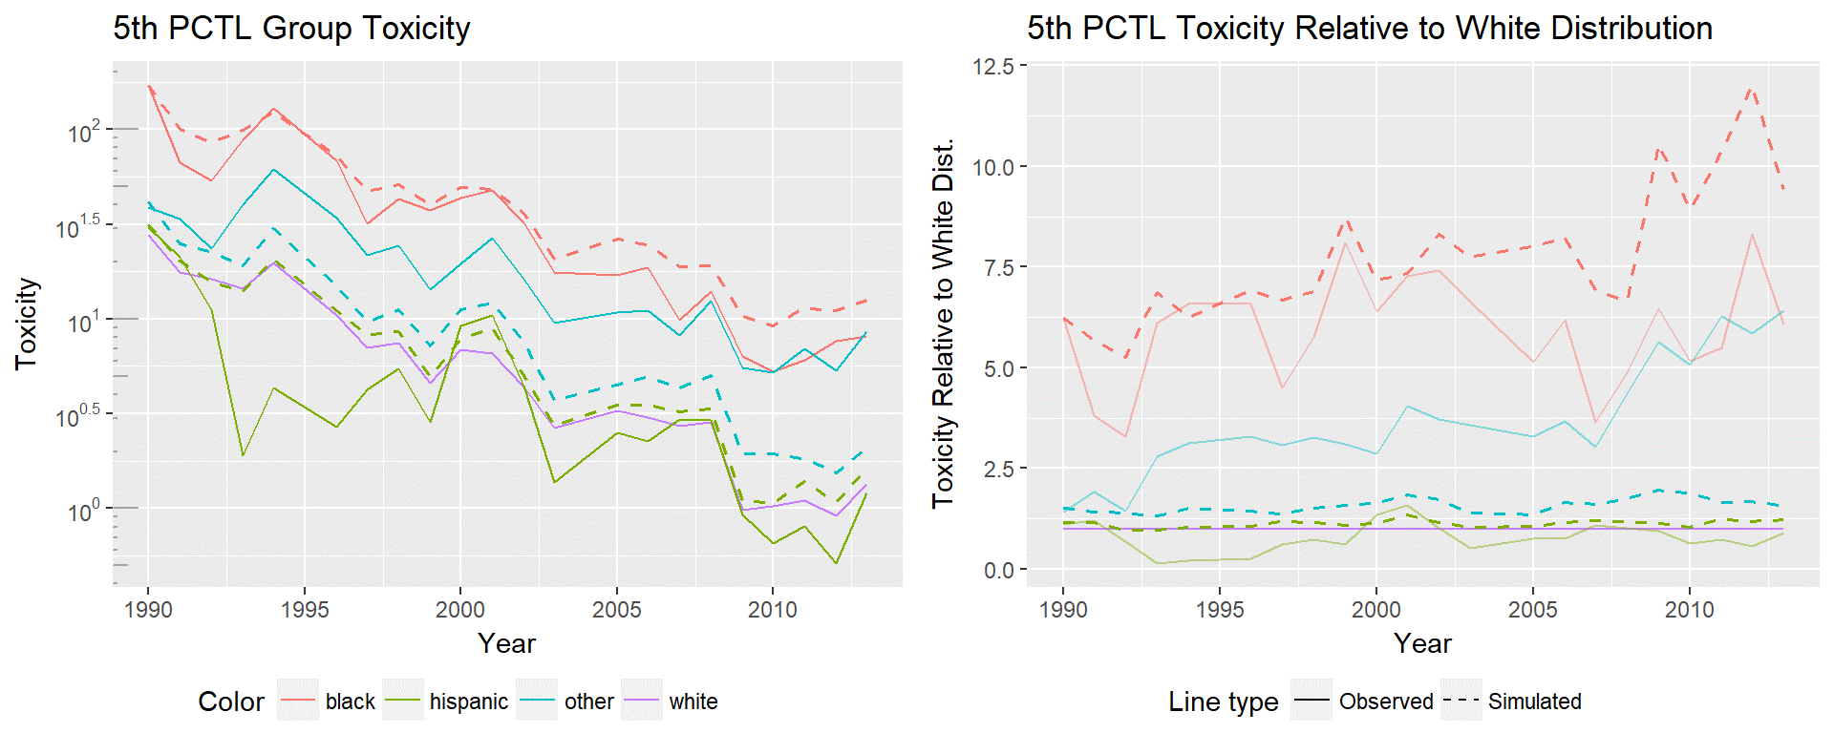
Notes:
So, in an ideal world we would expect to see the simulations showing much higher toxicities than the observed values, as that means that minorities have been able to move to relatively lower positions in the distribution.
NOTE: Important to note that the ‘other’ distribution shows a simulated value much lower than the true value. Keeping in mind that ‘other’ contains many groups it means that either the communities dominated by

Slide 19
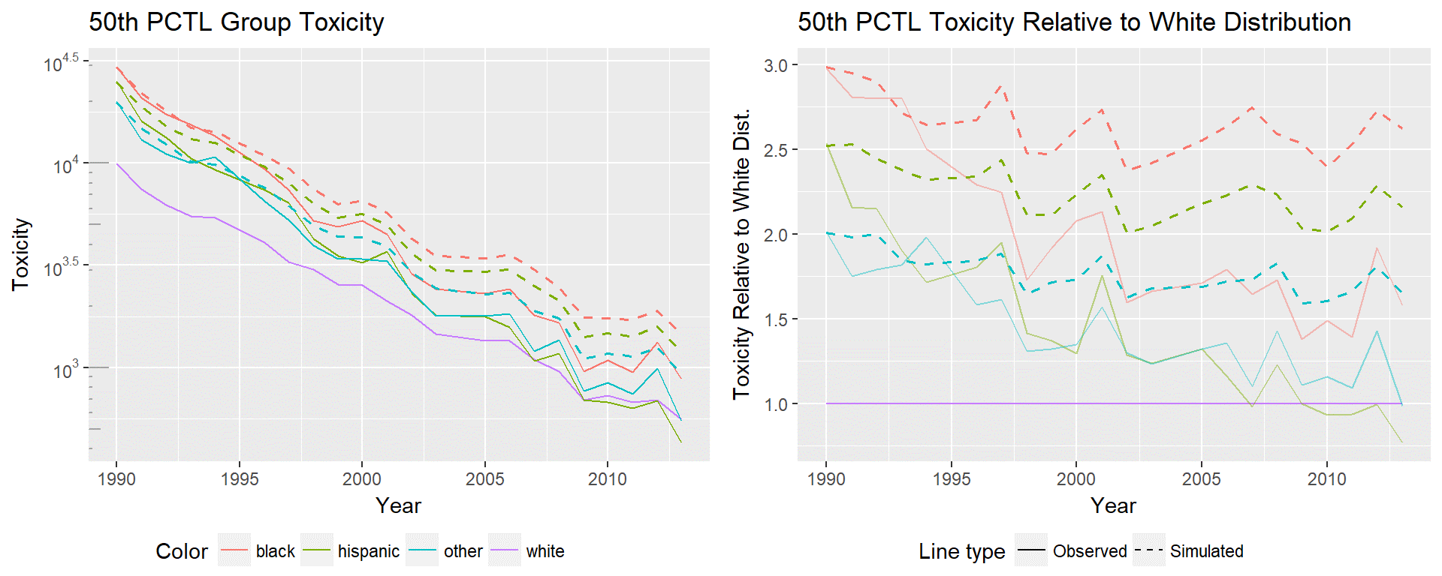

Slide 20
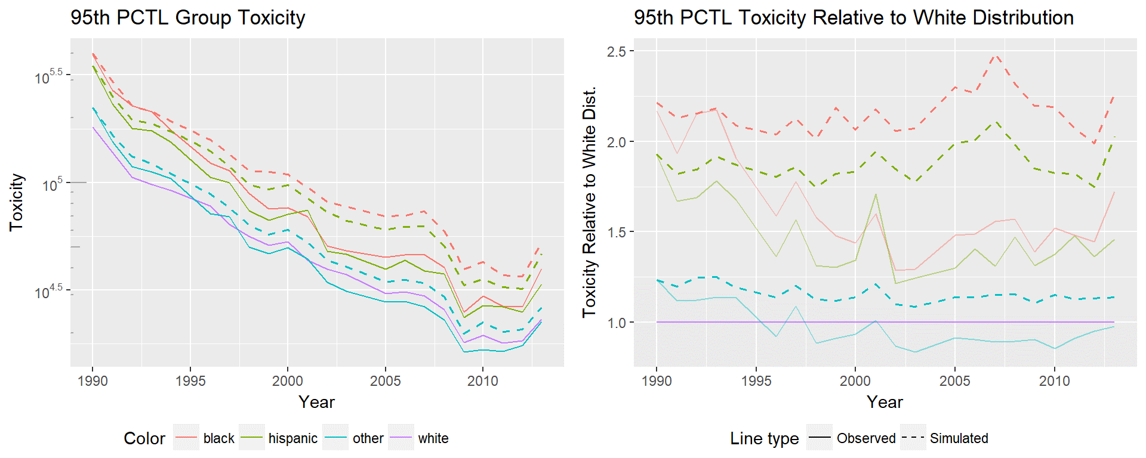

Slide 21
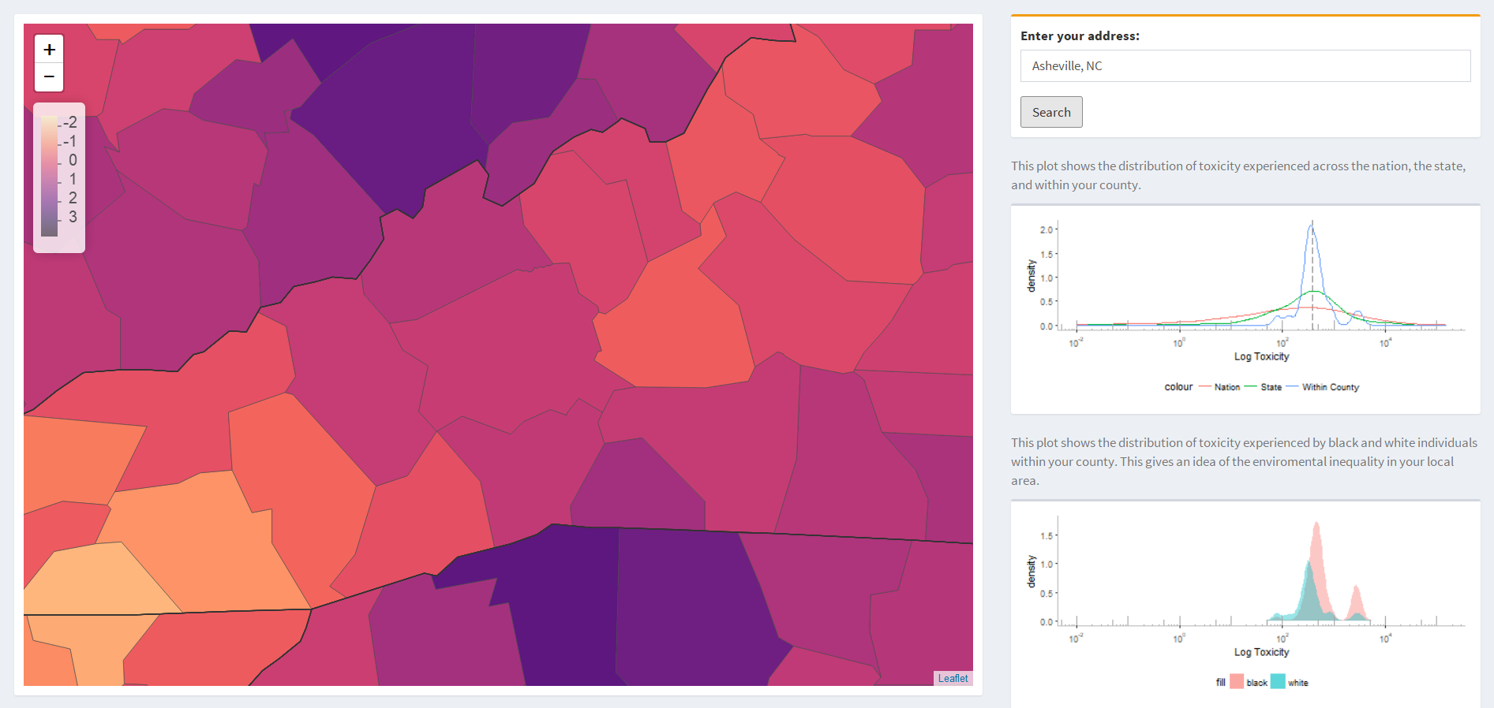
Public Interaction – Asheville 82% White, 12% Black, Higher burden on black population.
Notes:
The second part of this project is making this data accessible. Though the data is all publicly available, creating these measures and going through the process of understanding TRI reporting requirements, and data context is non-trivial.
In order to make the work I’ve done accessible to all, I’ve created an applet that allows users to map toxicity and see the distribution of toxicity experienced across the US.
The centerpiece of course is the map, which can be panned through to look at surrounding areas, and a search bar that gives access to additional data on an area. By searching for your address, you generate two additional charts. The first plot shows the toxicity densities for the nation, the state, and your county. The second shows the distribution of toxicity experienced by black and white populations within your county.
This is a snapshot of Asheville, a predominantly white city. We see that Asheville has slightly higher toxicity than many of the surrounding counties. We also see that in Asheville the black population experiences higher toxicity.

Slide 22
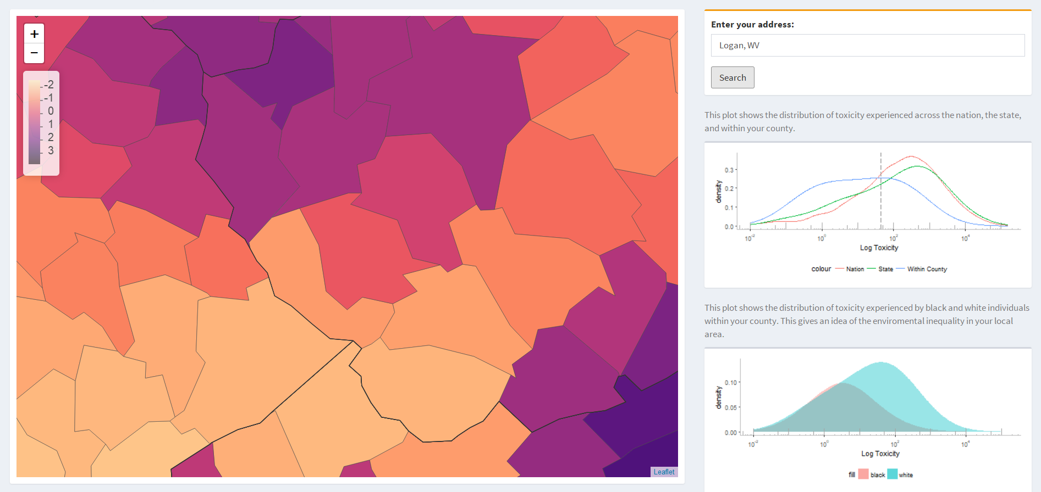
Public Interaction – Logan 88% White, 8% Black, Higher burden on white population.
Notes:
This is a snapshot of Logan, west virginia. Logan is also predominantly white, and shows a significantly higher toxicity than the surrounding counties, but Logan shows significantly higher toxicity for the white population.

Slide 23
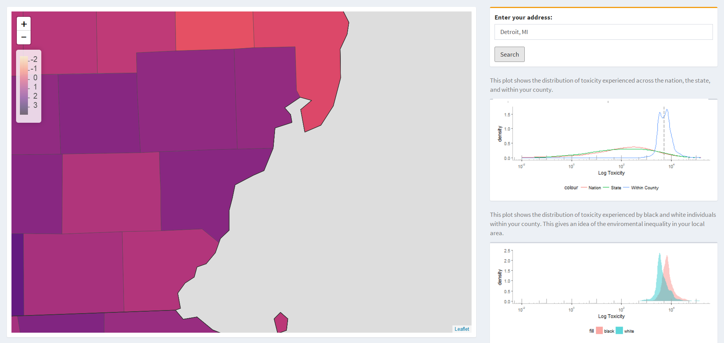
Public Interaction – Detroit 10% White, 84% Black, Higher burden on black population.
Notes:
Detroit is predominantly black, and again, shows relatively high toxicity compared to its surroundings, and especially compared to the rest of the nation. In Detroit we see that the black population experiences higher toxicity.

Slide 24
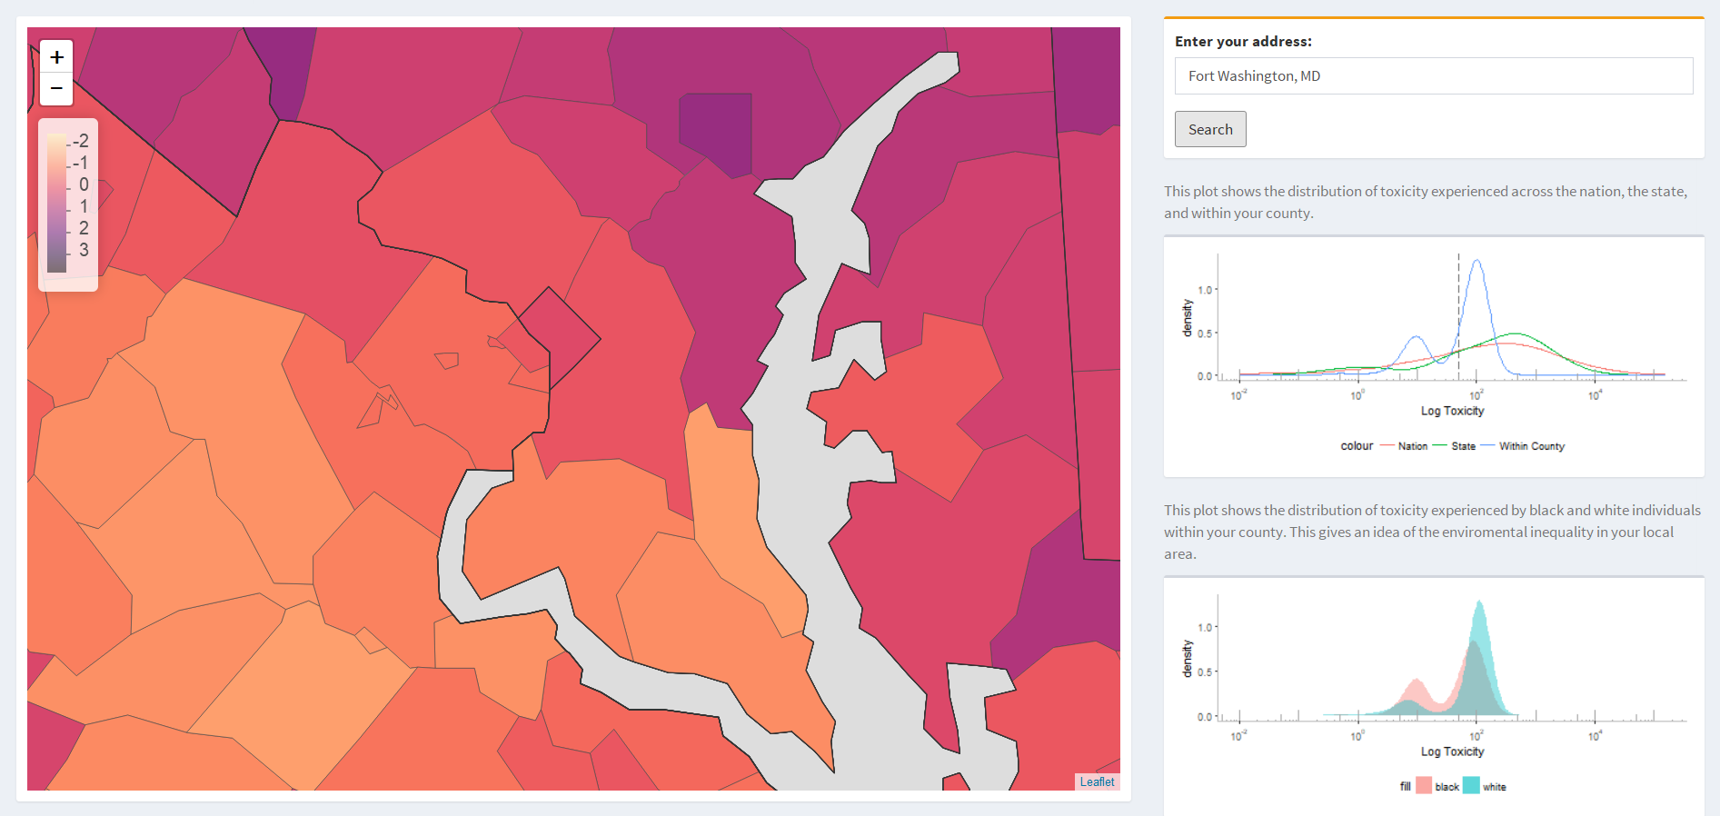
Public Interaction – Fort Washington 13% White, 71% Black, Higher burden on white population.
Notes:
Fort Washington has a relatively low toxicity compared to surrounding counties. A predominantly black community, it has relatively low toxicity compared to the nation at large, and we see higher toxicities for the white population.

Slide 25
Conclusion
Built a data framework that allows us to think about environmental justice as a national issue rather than case by case
First steps to making the data publicly accessible and interpretable.
Giving people the ability to use national public data in a meaningful way

Slide 26
Questions?

