Slide 1
Large-n, High Dimension Fixed Effects OLS
Efficient Computation
Tom Balmat, Social Science Research Institute
Jerome P. Reiter, Department of Statistical Science
Duke University, Durham, North Carolina, USA
efficient computation, large-n, high dimension fixed effects models | useR!2017 | thomas.balmat@duke.edu

Slide 2
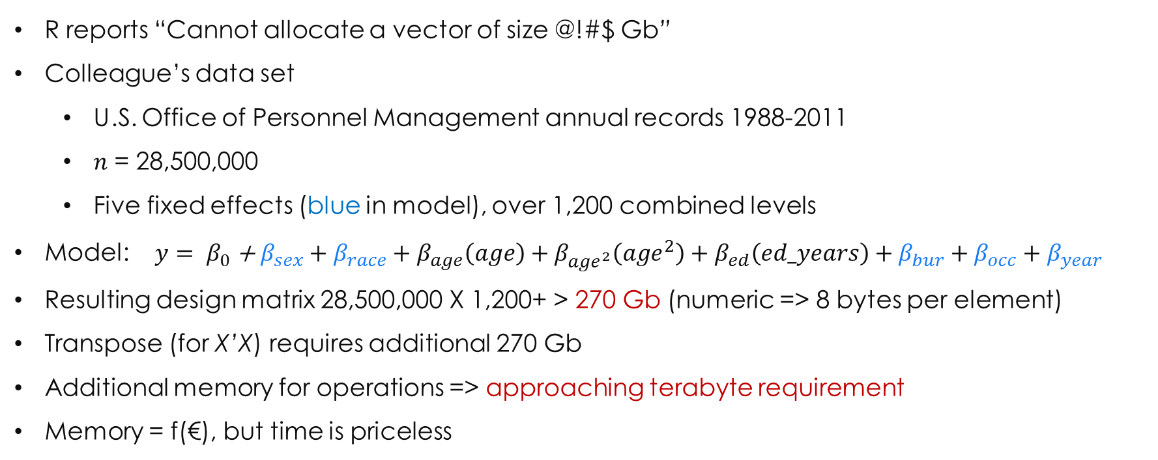
The problem
R reports “Cannot allocate a vector of size @!#$ Gb”
Colleague’s data set
U.S. Office of Personnel Management annual records 1988-2011
$n$ = 28,500,000
Five fixed effects (blue in model), over 1,200 combined levels
Model: $y= β_{0}$ + $β_{sex}+β_{race}+β_{age}\left(age\right)+β_{{age}^{2}}\left({age}^{2}\right)+β_{ed}\left(ed_years\right)+β_{bur}+β_{occ}+β_{year}$
Resulting design matrix 28,500,000 X 1,200+ > 270 Gb (numeric => 8 bytes per element)
Transpose (for X’X) requires additional 270 Gb
Additional memory for operations => approaching terabyte requirement
Memory = f(€), but time is priceless
efficient computation, large-n, high dimension fixed effects models | useR!2017 | thomas.balmat@duke.edu

Slide 3
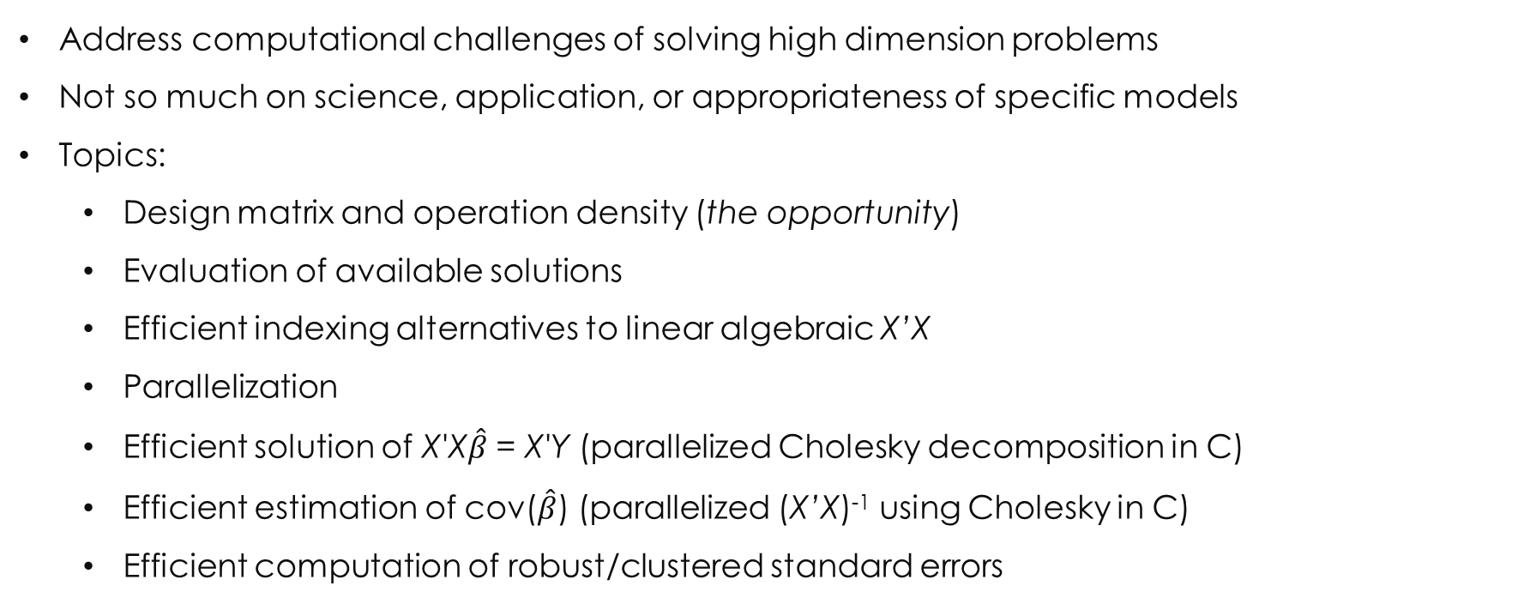
purpose of talk
Address computational challenges of solving high dimension problems
Not so much on science, application, or appropriateness of specific models
Topics:
Design matrix and operation density (the opportunity)
Evaluation of available solutions
Efficient indexing alternatives to linear algebraic X’X
Parallelization
Efficient solution of X'X$\hat{β}$ = X'Y (parallelized Cholesky decomposition in C)
Efficient estimation of cov($\hat{β}$) (parallelized (X’X)⁻¹ using Cholesky in C)
Efficient computation of robust/clustered standard errors
efficient computation, large-n, high dimension fixed effects models | useR!2017 | thomas.balmat@duke.edu

Slide 4
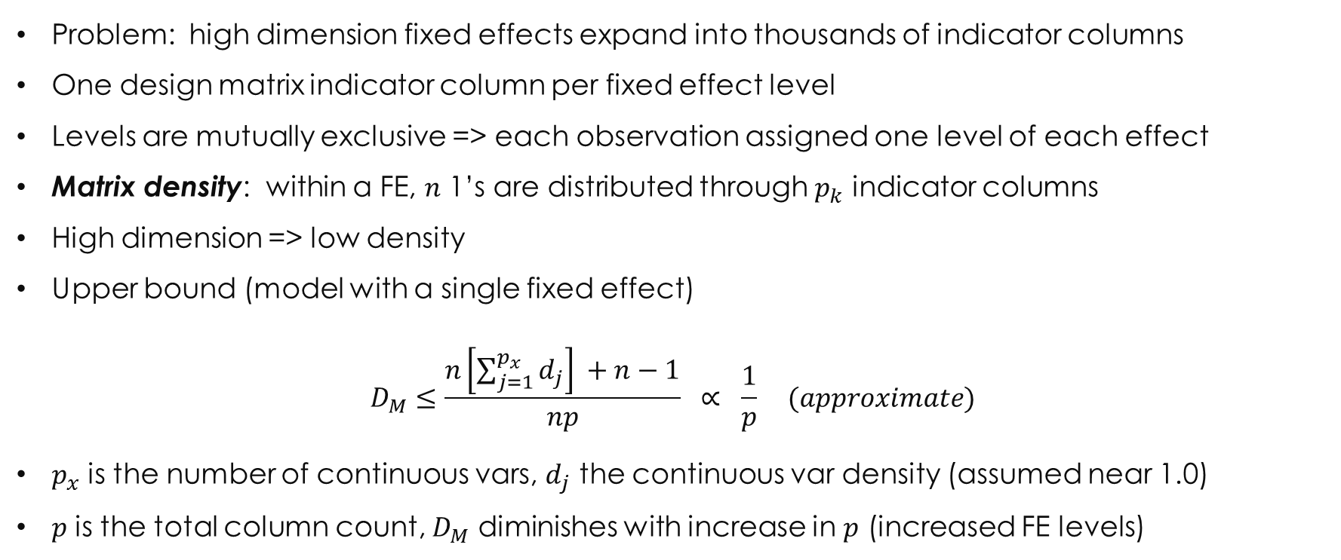
design matrix density
Problem: high dimension fixed effects expand into thousands of indicator columns
One design matrix indicator column per fixed effect level
Levels are mutually exclusive => each observation assigned one level of each effect
Matrix density: within a FE, $n$ 1’s are distributed through $p_{k}$ indicator columns
High dimension => low density
Upper bound (model with a single fixed effect)
$$D_{M}≤\frac{n\left[\sum_{j=1}^{p_{x}}{d_{j}}\right] +n−1}{np} ∝ \frac{1}{p} (approximate)$$
$p_{x}$ is the number of continuous vars, $d_{j}$ the continuous var density (assumed near 1.0)
$p$ is the total column count, $D_{M}$ diminishes with increase in $p$ (increased FE levels)
efficient computation, large-n, high dimension fixed effects models | useR!2017 | thomas.balmat@duke.edu

Slide 5
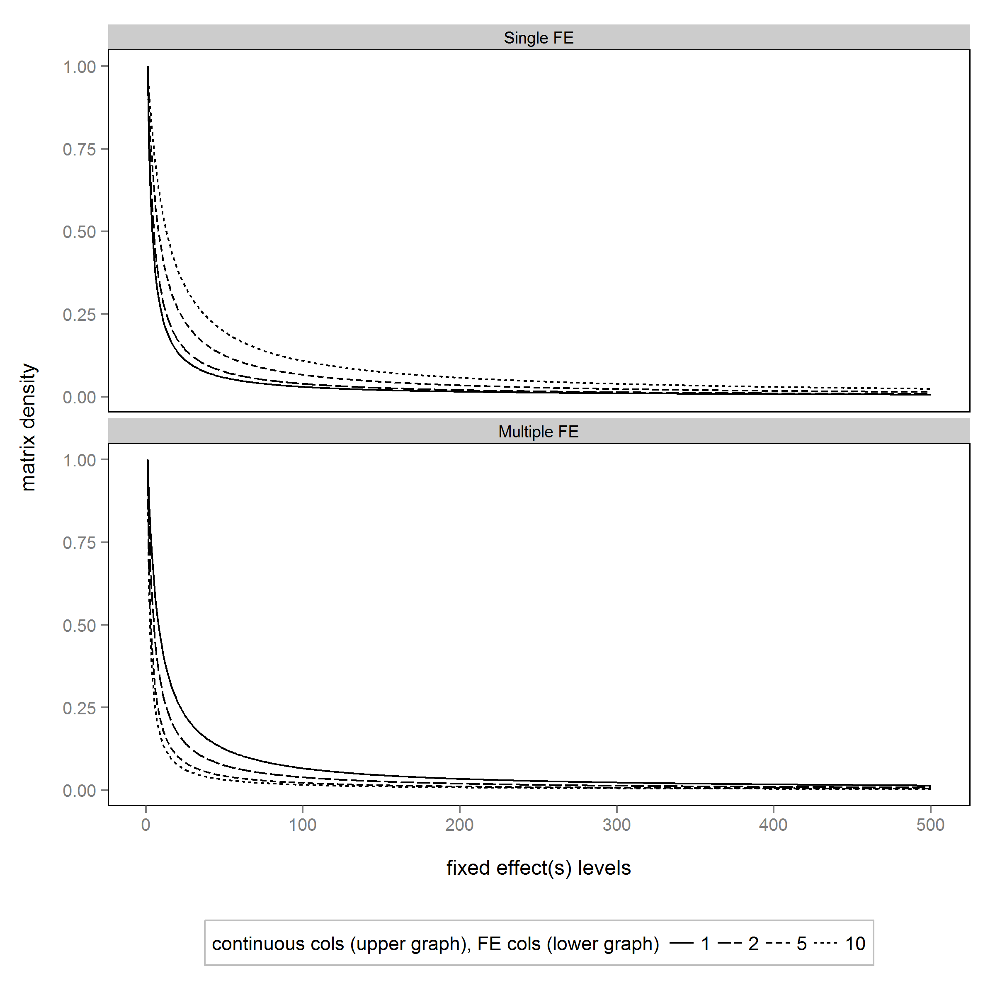
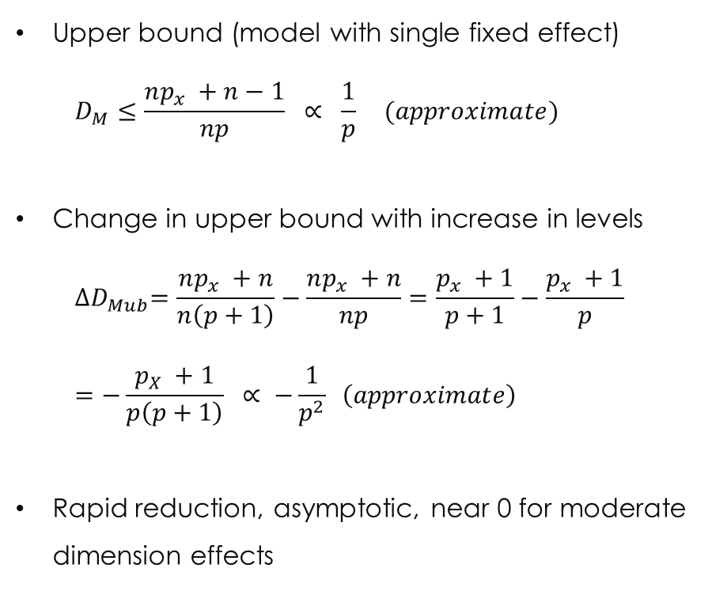
design matrix density
Upper bound (model with single fixed effect)
$$D_{M}≤\frac{np_{x} +n−1}{np} ∝ \frac{1}{p} (approximate)$$
Change in upper bound with increase in levels
$${∆D}_{Mub}=\frac{np_{x} +n}{n\left(p+1\right)}−\frac{np_{x} +n}{np}=\frac{p_{x} +1}{p+1}−\frac{p_{x} +1}{p}$$
$$=−\frac{p_{X} +1}{p\left(p+1\right)} ∝ −\frac{1}{p^{2}} \left(approximate\right)$$
Rapid reduction, asymptotic, near 0 for moderate dimension effects
Upper panel, model with single FE; Lower panel, 1-10 FEs
efficient computation, large-n, high dimension fixed effects models | useR!2017 | thomas.balmat@duke.edu

Slide 6
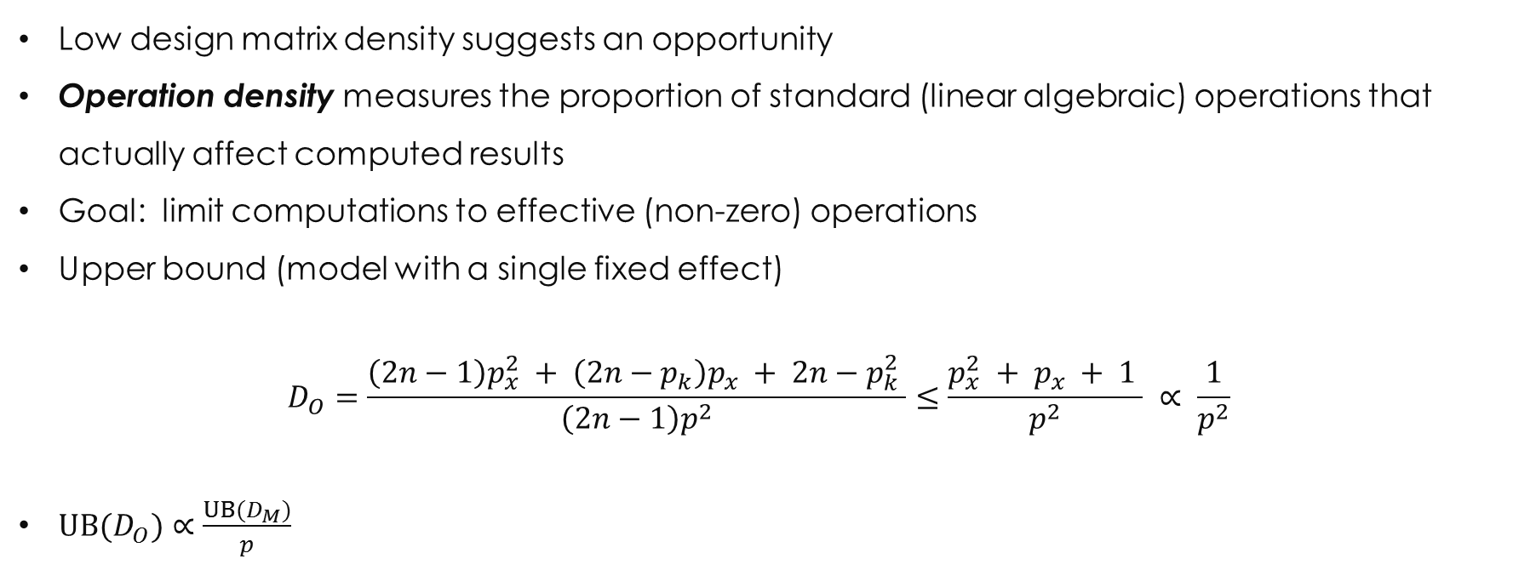
operation density density
Low design matrix density suggests an opportunity
Operation density measures the proportion of standard (linear algebraic) operations that actually affect computed results
Goal: limit computations to effective (non-zero) operations
Upper bound (model with a single fixed effect)
$$D_{O}=\frac{\left(2n−1\right)p_{x}^{2} + \left(2n−p_{k}\right)p_{x} + 2n−p_{k}^{2} }{\left(2n−1\right)p^{2}}≤\frac{p_{x}^{2} + p_{x} + 1 }{p^{2}} ∝ \frac{1}{p^{2}}$$
$UB(D_{O})∝\frac{{UB(D}_{M})}{p}$
efficient computation, large-n, high dimension fixed effects models | useR!2017 | thomas.balmat@duke.edu

Slide 7
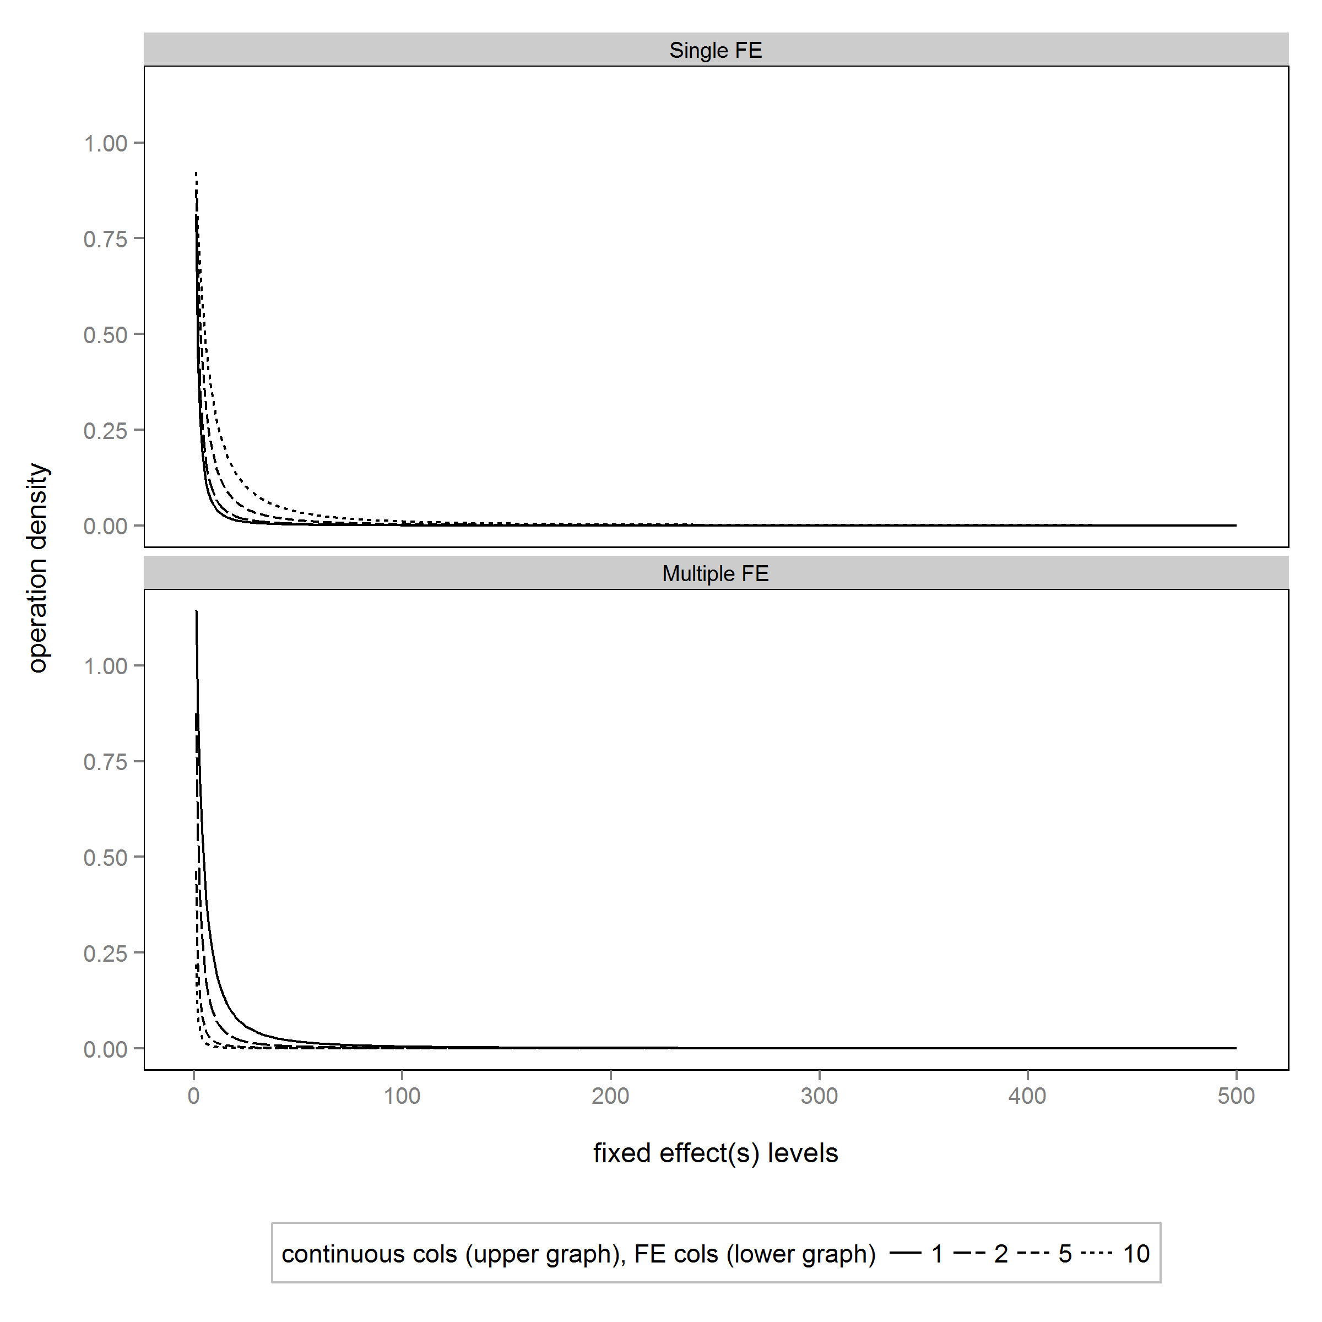
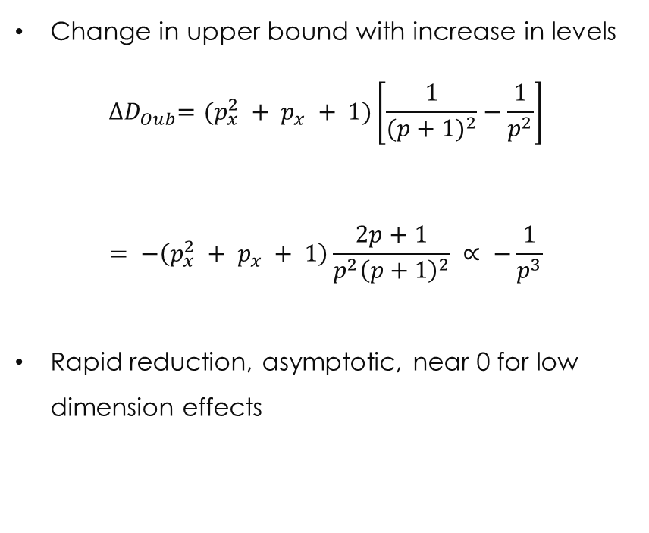
operation density density
Change in upper bound with increase in levels
$${∆D}_{Oub}=(p_{x}^{2} + p_{x} + 1)\left[\frac{1}{{(p+1)}^{2}}−\frac{1}{p^{2}}\right]$$
$$= −\left(p_{x}^{2} + p_{x} + 1\right)\frac{2p+1}{{p^{2}\left(p+1\right)}^{2}} ∝ −\frac{1}{p^{3}}$$
Rapid reduction, asymptotic, near 0 for low dimension effects
Upper panel, model with single FE; Lower panel, 1-10 FEs
efficient computation, large-n, high dimension fixed effects models | useR!2017 | thomas.balmat@duke.edu

Slide 8
Density Example
From the Human Capital Project at Duke University
Model wage disparity by gender and race in U.S. federal workforce, controlling for human capital (experience, education) and other FEs (bureau, occupation, year)
Matrix Density of OPM Data by Fixed Effect
Overall design matrix density is 0.006, operation density is less than 0.0001
Fewer than 0.01% of standard algebraic operations are needed –
OPPORTUNITY!
efficient computation, large-n, high dimension fixed effects models | useR!2017 | thomas.balmat@duke.edu

Slide 9
solutions evaluated
In no particular order:
lm()
biglm()
bigglm()
biglm.big.matrix()
SparseM.sml.fit()
speedlm()
lfe()
Each address memory usage and computational efficiency differently and all have advantages, but none solve the problems considered in “reasonable” time
Analysis and data at https://github.com/DukeSynthProj/SyntheticDataXTXResources
efficient computation, large-n, high dimension fixed effects models | useR!2017 | thomas.balmat@duke.edu

Slide 10
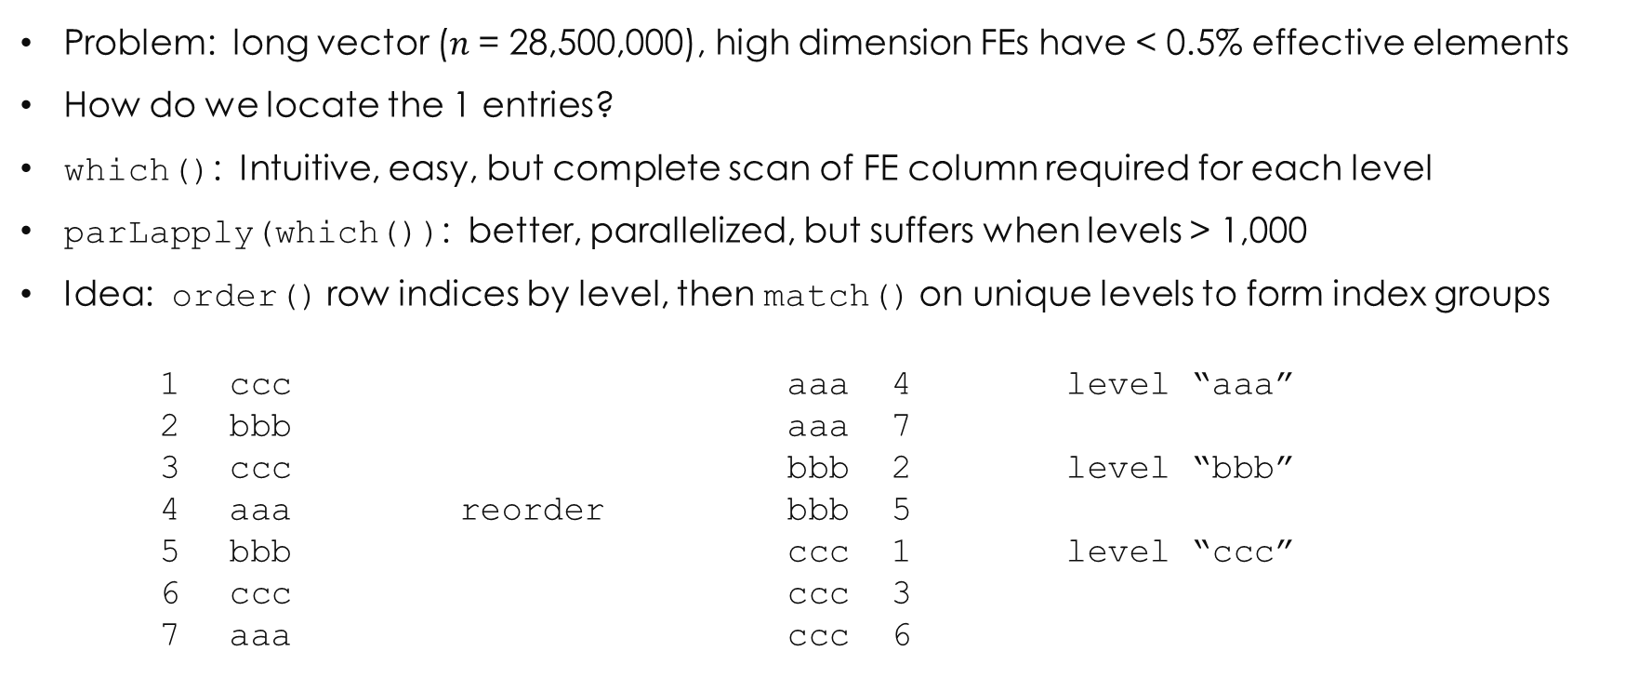
solution, part 1: efficient indexing of sparse vectors
Problem: long vector ($n$= 28,500,000), high dimension FEs have < 0.5% effective elements
How do we locate the 1 entries?
which(): Intuitive, easy, but complete scan of FE column required for each level
parLapply(which()): better, parallelized, but suffers when levels > 1,000
Idea: order() row indices by level, then match() on unique levels to form index groups
1 ccc aaa 4 level “aaa”
2 bbb aaa 7
3 ccc bbb 2 level “bbb”
4 aaa reorder bbb 5
5 bbb ccc 1 level “ccc”
6 ccc ccc 3
7 aaa ccc 6
efficient computation, large-n, high dimension fixed effects models | useR!2017 | thomas.balmat@duke.edu

Slide 11
solution, part 1: efficient indexing of sparse vectors
Problem: default order() behavior is to sort characters (our levels) as, well, characters
Better: sort.list(method=“quick”)
Fast, but requires numeric vector
So, use factor() to generate a numeric vector, then sort.list(method=“quick”) followed by match() to generate blocks of level indices
Base R and FAST!
# order observation indices by level
obsIndices <- sort.list(as.integer(factor(FE)), method="quick", na.last=NA)
# locate first observation index for each level
firstObs <- match(uniqueLevel, FE[obsIndices])
# parse sets of observation indices for each level
lapply(1:(length(firstObs)-1), function(i) obsIndices[firstObs[i]:(firstObs[i+1]-1)])
efficient computation, large-n, high dimension fixed effects models | useR!2017 | thomas.balmat@duke.edu

Slide 12
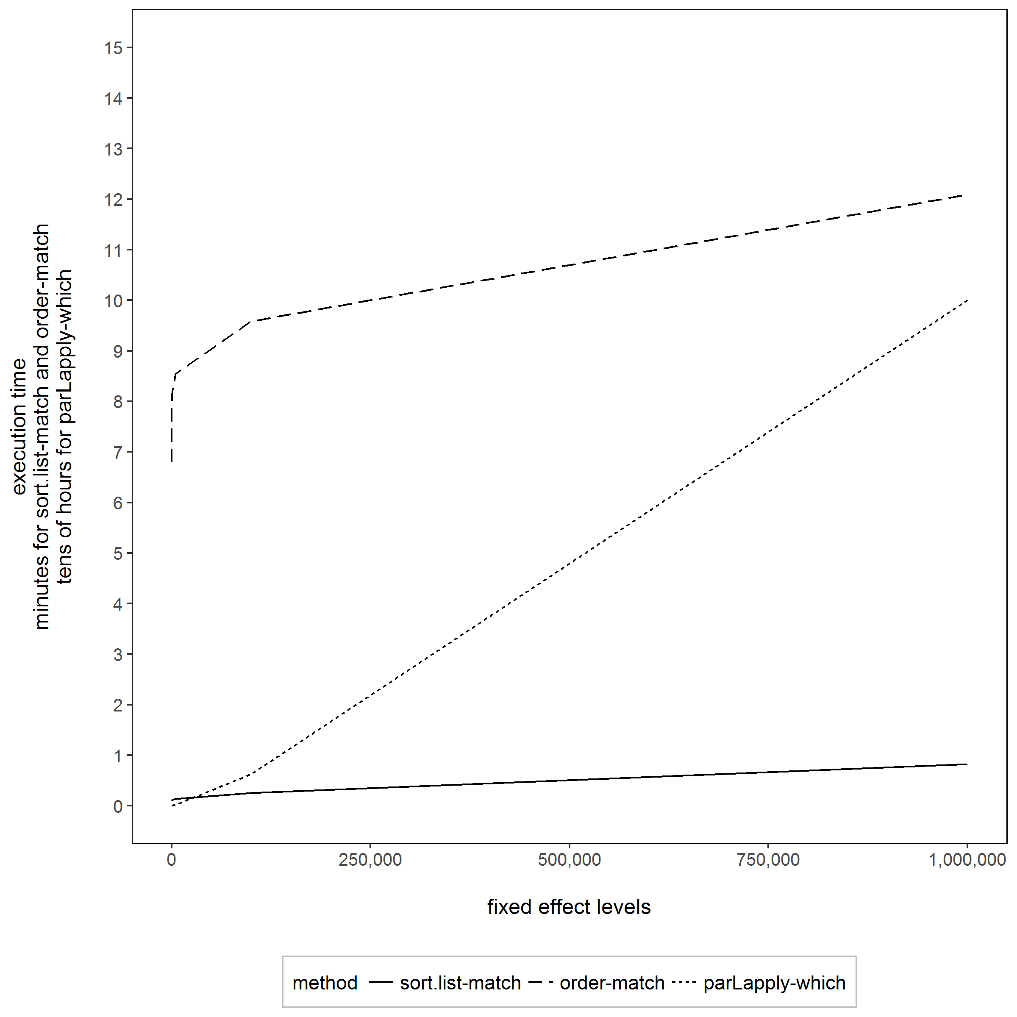
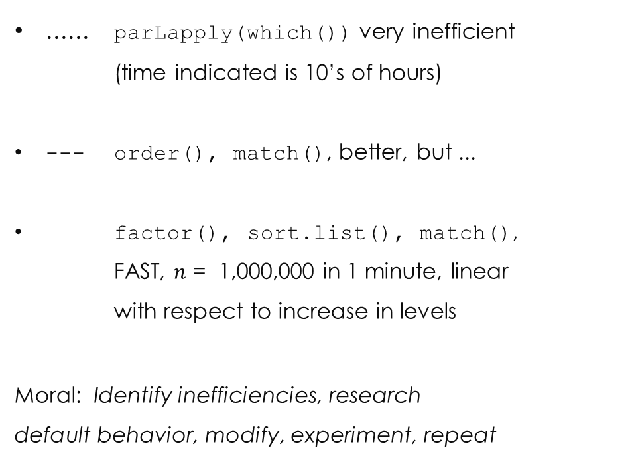
indexing methods
...... parLapply(which()) very inefficient
(time indicated is 10’s of hours)
--- order(), match(), better, but ...
factor(), sort.list(), match(),
FAST, $n$ = 1,000,000 in 1 minute, linear
with respect to increase in levels
Moral: Identify inefficiencies, research
default behavior, modify, experiment, repeat
Execution time (mean of five iterations, one for Order-Match)
efficient computation, large-n, high dimension fixed effects models | useR!2017 | thomas.balmat@duke.edu

Slide 13
solution, part 2: Composing X'X
A sparse index exists for each level of each fixed effect
Now what?
We want X'X, with minimal use of column (dot) products
There exist three “product” types (for a model without interactions):
Continuous X continuous → standard dot product
Continuous X fixed effect → sum of indexed continuous positions
Fixed effect X fixed effect → length of intersection of FE index vectors
1 is unavoidable (but number of continuous columns are relatively few)
2 and 3 use efficient base R sum(), intersect(), and length() on sparse vectors
Row and column operations are independent, so parallel implementation prescribed
efficient computation, large-n, high dimension fixed effects models | useR!2017 | thomas.balmat@duke.edu

Slide 14
implementation of X'X “products”
Continuous column X fixed effect:
mapply(1:nLevel, FUN=function(k) sum(continuousX[indexFE[[k]]]))
Fixed effect X fixed effect (parallelized):
parApply(cl, as.matrix(1:nLevel), 1,
function(jLevel, iLevel)
length(intersect(indexFEi[[iLevel]], indexFEj[[jLevel]])), currLevi)
Please be efficient ... make your mother proud
efficient computation, large-n, high dimension fixed effects models | useR!2017 | thomas.balmat@duke.edu

Slide 15
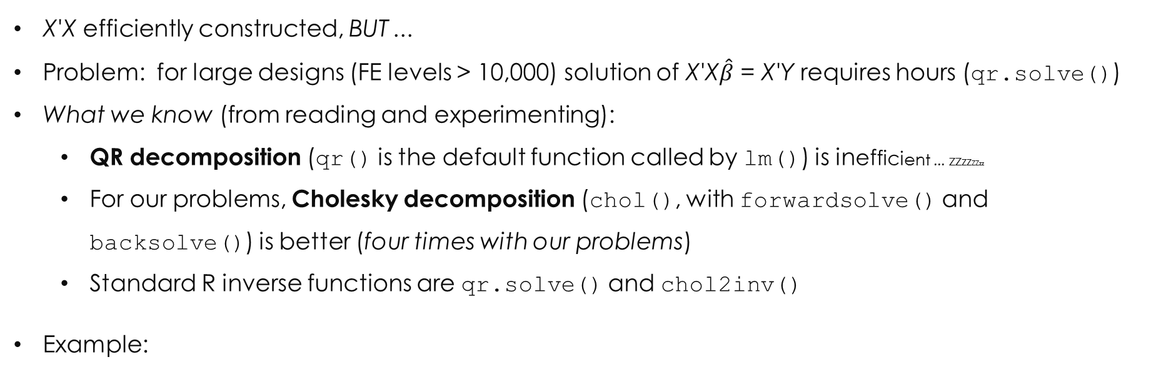
solution, part 3: solve X'X$\hat{β}$ = X'Y and cov($\hat{β}$) = ${\hat{σ}}^{2}$(X'X)⁻¹
X'X efficiently constructed, BUT ...
Problem: for large designs (FE levels > 10,000) solution of X'X$\hat{β}$ = X'Y requires hours (qr.solve())
What we know (from reading and experimenting):
QR decomposition (qr() is the default function called by lm()) is inefficient ... zzzzzzzz
For our problems, Cholesky decomposition (chol(), with forwardsolve() and backsolve()) is better (four times with our problems)
Standard R inverse functions are qr.solve() and chol2inv()
Example:
Time to compute decomposition and inverse of X'X using QR and Cholesky methods
Mean of five iterations, in minutes
Method | p_{k} = 6,200 matrix | p_{k} = 16,000 matrix
qr() + qr.solve() | 10.0 | 172.7
chol() + chol2inv() | 2.5 | 44.1
efficient computation, large-n, high dimension fixed effects models | useR!2017 | thomas.balmat@duke.edu

Slide 16
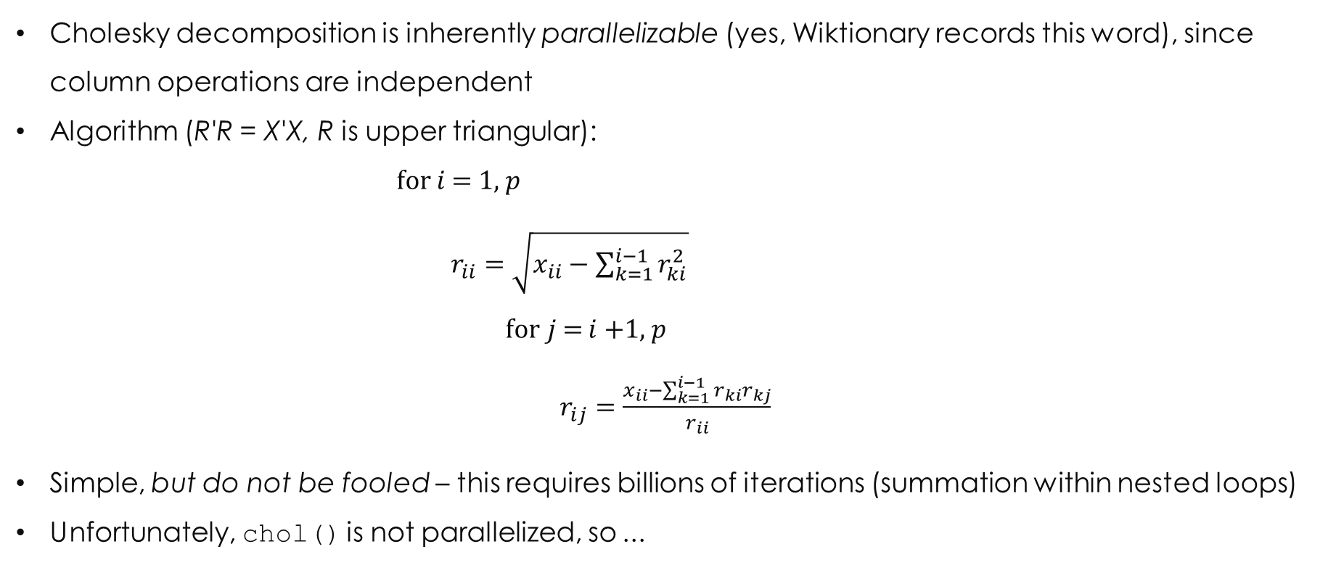
still solving X'X$\hat{β}$ = X'Y and cov($\hat{β}$) = ${\hat{σ}}^{2}$(X'X)⁻¹
Cholesky decomposition is inherently parallelizable (yes, Wiktionary records this word), since column operations are independent
Algorithm (R'R = X'X, R is upper triangular):
for $i$ = 1, $p$
$r_{ii}=\sqrt{x_{ii}−\sum_{k=1}^{i−1}{r_{ki}^{2}}}$
for$j$= $i$+1, $p$
$r_{ij}=\frac{x_{ii}−\sum_{k=1}^{i−1}{r_{ki}r_{kj}}}{r_{ii}}$
Simple, but do not be fooled – this requires billions of iterations (summation within nested loops)
Unfortunately, chol() is not parallelized, so ...
efficient computation, large-n, high dimension fixed effects models | useR!2017 | thomas.balmat@duke.edu

Slide 17
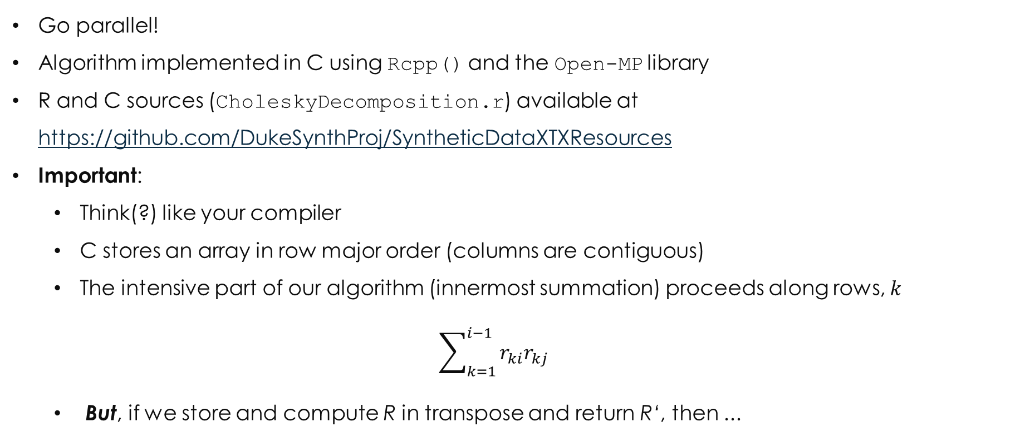
still solving X'X$\hat{β}$ = X'Y and var($\hat{β}$) = ${\hat{σ}}^{2}$(X'X)⁻¹
Go parallel!
Algorithm implemented in C using Rcpp() and the Open-MP library
R and C sources (CholeskyDecomposition.r) available at https://github.com/DukeSynthProj/SyntheticDataXTXResources
Important:
Think(?) like your compiler
C stores an array in row major order (columns are contiguous)
The intensive part of our algorithm (innermost summation) proceeds along rows, $k$
$$\sum_{k=1}^{i−1}{r_{ki}r_{kj}}$$
But, if we store and compute R in transpose and return R‘, then ...
efficient computation, large-n, high dimension fixed effects models | useR!2017 | thomas.balmat@duke.edu

Slide 18
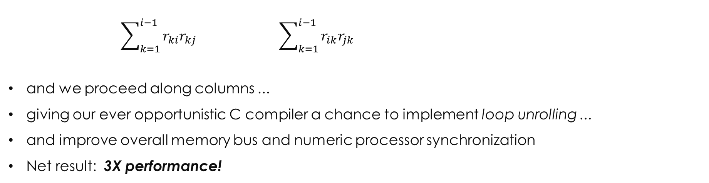
still solving X'X$\hat{β}$ = X'Y and var($\hat{β}$) = ${\hat{σ}}^{2}$(X'X)⁻¹
$$\sum_{k=1}^{i−1}{r_{ki}r_{kj}} \sum_{k=1}^{i−1}{r_{ik}r_{jk}}$$
and we proceed along columns ...
giving our ever opportunistic C compiler a chance to implement loop unrolling ...
and improve overall memory bus and numeric processor synchronization
Net result: 3X performance!
#pragma omp parallel for private(j, k, s)
for(j=i; j<p; j++) {
// accumulate prior computed Rki*Rkj products
s=0;
for(k=0; k<i; k++)
s+=R[k][i]*R[k][j];
}
#pragma omp parallel for private(j, k, s)
for(j=i; j<p; j++) {
// accumulate prior computed Rki*Rkj products
s=0;
for(k=0; k<i; k++)
s+=R[i][k]*R[j][k];
}
efficient computation, large-n, high dimension fixed effects models | useR!2017 | thomas.balmat@duke.edu

Slide 19
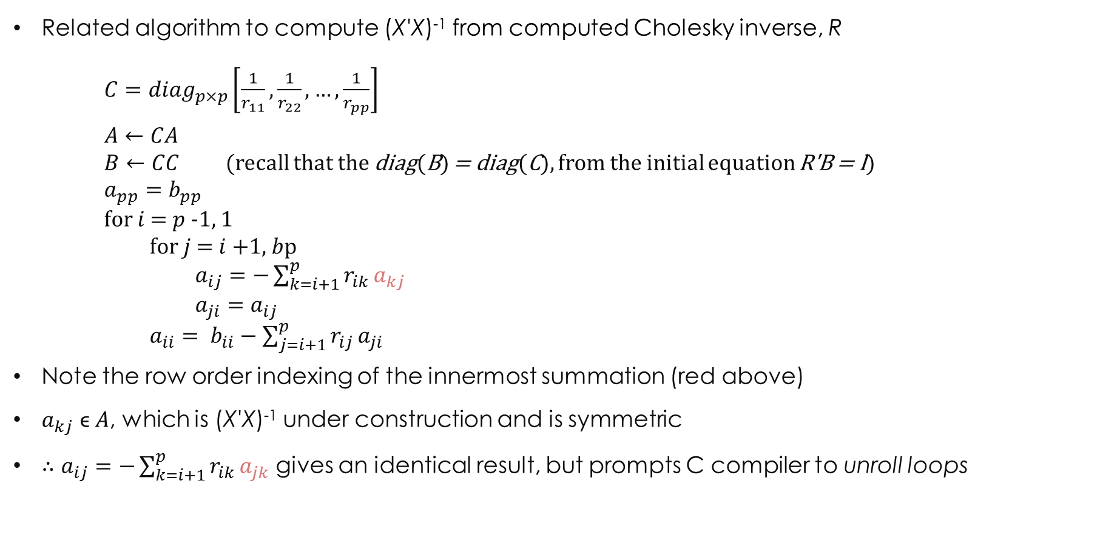
solving cov($\hat{β}$) = ${\hat{σ}}^{2}$(X'X)⁻¹
Related algorithm to compute (X'X)⁻¹ from computed Cholesky inverse, R
$C={diag}_{p×p}\left[\frac{1}{r_{11}}, \frac{1}{r_{22}}, …, \frac{1}{r_{pp}}\right]$
$A←CA$
$B←CC$ (recall that the diag(B) = diag(C), from the initial equation R'B = I)
$a_{pp}=b_{pp}$
for $i$ = $p$-1, 1
for $j$ = $i$+1, $b$p
$a_{ij}=−\sum_{k=i+1}^{p}{r_{ik}}a_{kj}$
$a_{ji}=a_{ij}$
$a_{ii}= b_{ii}−\sum_{j=i+1}^{p}{r_{ij}}a_{ji}$
Note the row order indexing of the innermost summation (red above)
$a_{kj}$ ϵ $A$, which is (X'X)⁻¹ under construction and is symmetric
$∴$ $a_{ij}=−\sum_{k=i+1}^{p}{r_{ik}}a_{jk}$ gives an identical result, but prompts C compiler to unroll loops
efficient computation, large-n, high dimension fixed effects models | useR!2017 | thomas.balmat@duke.edu

Slide 20
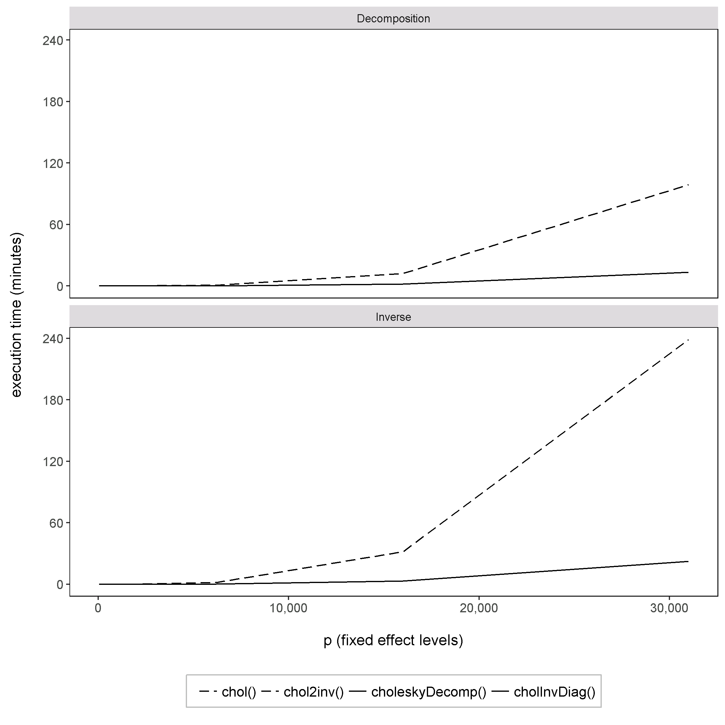
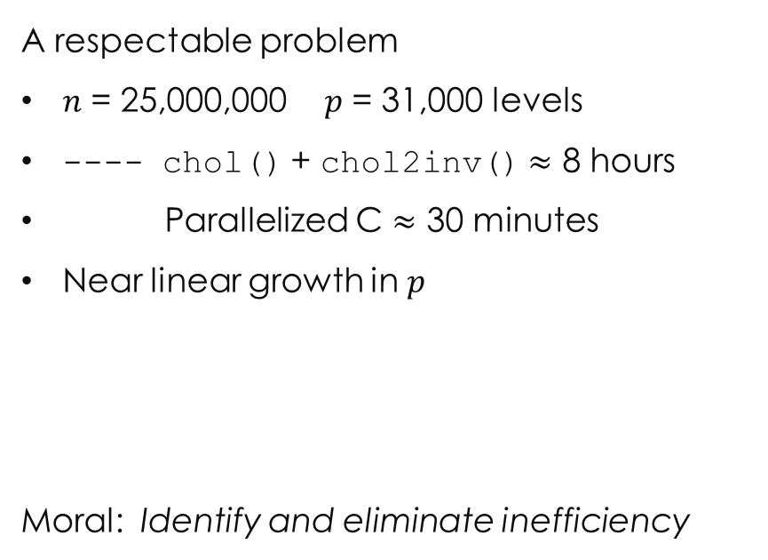
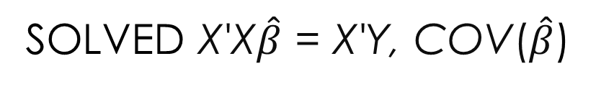
solved X'X$\hat{β}$ = X'Y, cov($\hat{β}$)
A respectable problem
$n$ = 25,000,000 $p$ = 31,000 levels
---- chol() + chol2inv() $≈$ 8 hours
Parallelized C $≈$ 30 minutes
Near linear growth in $p$
Moral: Identify and eliminate inefficiency
efficient computation, large-n, high dimension fixed effects models | useR!2017 | thomas.balmat@duke.edu

Slide 21
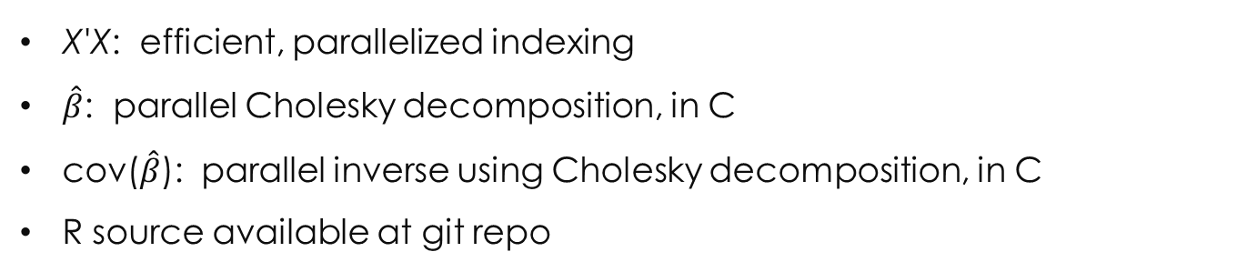
Our fixed effects solution
feXTX()
X'X: efficient, parallelized indexing
$\hat{β}$: parallel Cholesky decomposition, in C
cov($\hat{β}$): parallel inverse using Cholesky decomposition, in C
R source available at git repo
efficient computation, large-n, high dimension fixed effects models | useR!2017 | thomas.balmat@duke.edu

Slide 22
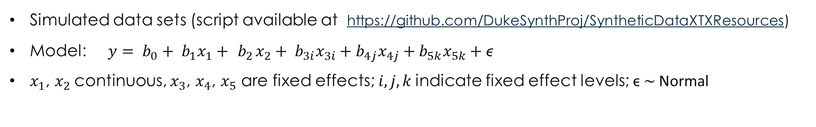
Solution evaluation
Simulated data sets (script available at https://github.com/DukeSynthProj/SyntheticDataXTXResources)
Model: $y= b_{0}+ b_{1}x_{1}+ { b}_{2}x_{2}+ b_{3i}x_{3i}+b_{4j}x_{4j}+b_{5k}x_{5k}+\text{ϵ}$
$x_{1}$, $x_{2}$continuous, $x_{3}$, $x_{4}$, $x_{5}$ are fixed effects; $i, j,k$indicate fixed effect levels; $\text{ϵ} \sim$Normal
Simulated Data Set Parameters for Execution Time Evaluation
Parameter Set | n (Observations) | Levels X₃ | Levels X₄ | Levels X₅
1 | 10,000 | 10 | 15 | 20
2 | 25,000 | 10 | 20 | 40
3 | 50,000 | 15 | 30 | 50
4 | 100,000 | 15 | 40 | 60
5 | 150,000 | 25 | 40 | 60
6 | 250,000 | 25 | 50 | 75
7 | 500,000 | 50 | 75 | 100
8 | 1,000,000 | 75 | 150 | 250
9 | 1,500,000 | 100 | 250 | 500
efficient computation, large-n, high dimension fixed effects models | useR!2017 | thomas.balmat@duke.edu

Slide 23
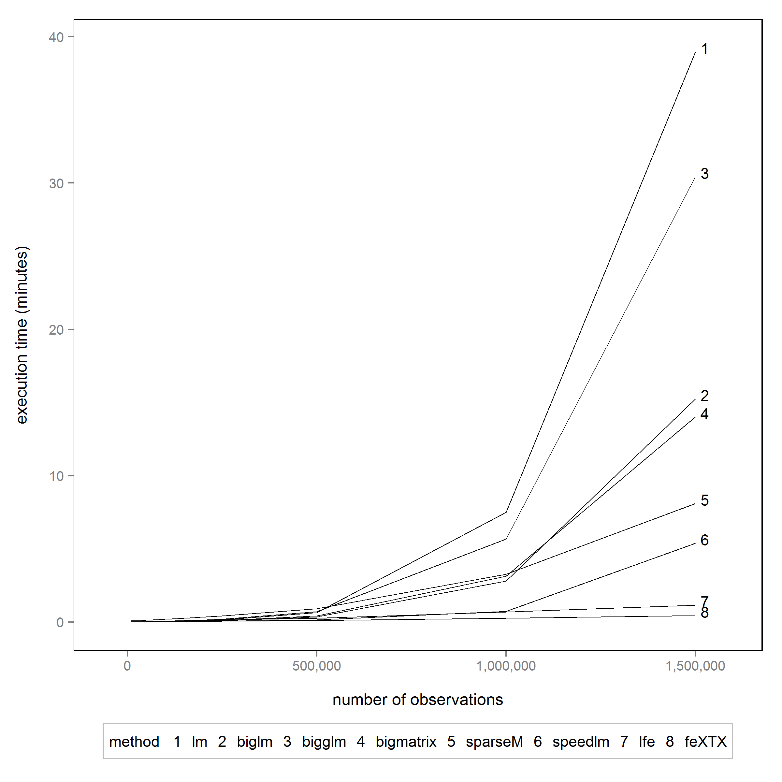
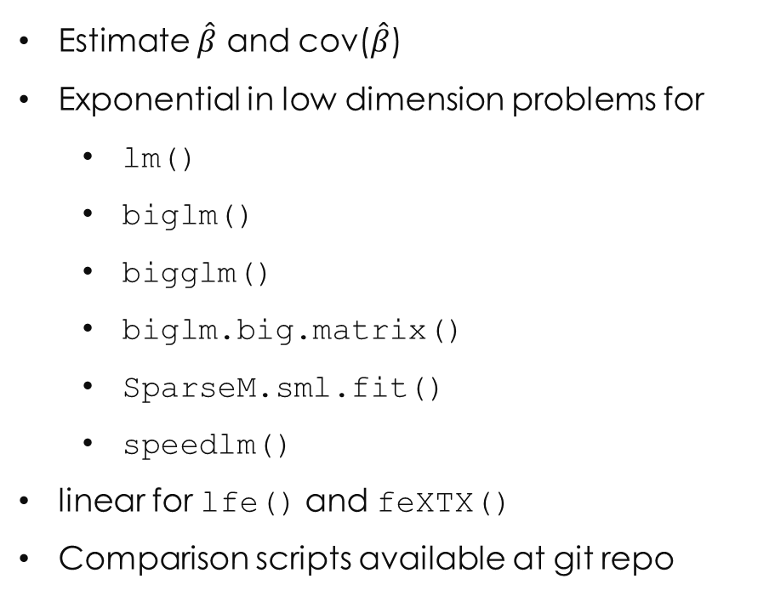
Solution evaluation
Estimate $\hat{β}$ and cov($\hat{β}$)
Exponential in low dimension problems for
lm()
biglm()
bigglm()
biglm.big.matrix()
SparseM.sml.fit()
speedlm()
linear for lfe() and feXTX()
Comparison scripts available at git repo
efficient computation, large-n, high dimension fixed effects models | useR!2017 | thomas.balmat@duke.edu

Slide 24
Solution evaluation
Higher Dimension Problems
Simulated Data Set Parameters for Execution Time Evaluation
Parameter Set | n (Observations) | Levels X₃ | Levels X₄ | Levels X₅
10 | 2,000,000 | 100 | 500 | 1,000
11 | 5,000,000 | 200 | 1,000 | 5,000
12 | 10,000,000 | 1,000 | 5,000 | 10,000
13 | 25,000,000 | 1,000 | 5,000 | 25,000
efficient computation, large-n, high dimension fixed effects models | useR!2017 | thomas.balmat@duke.edu

Slide 25
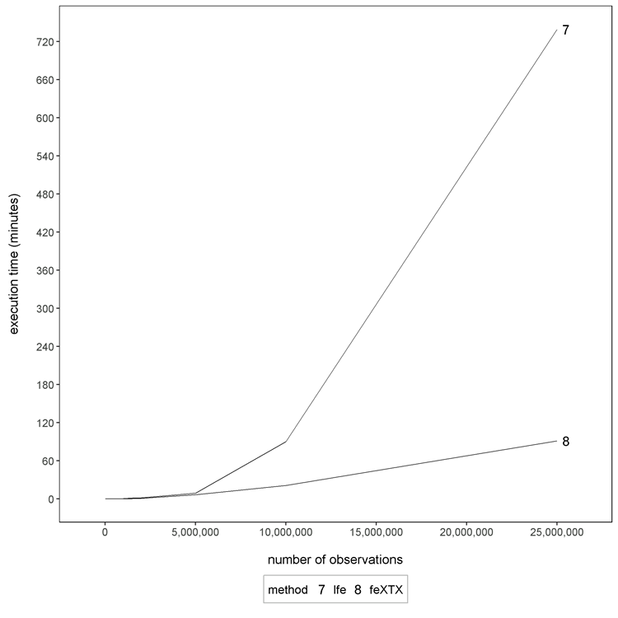
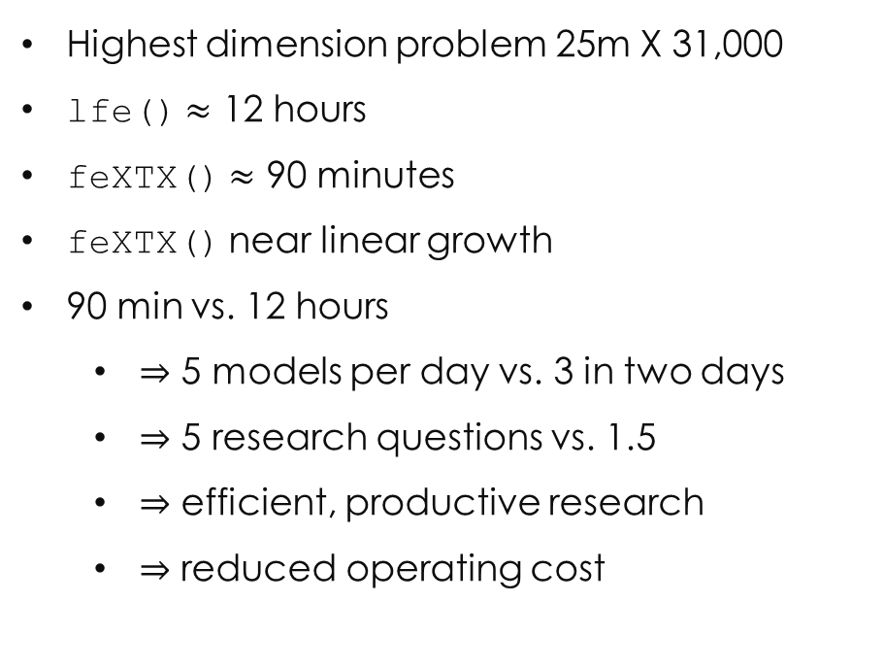
Solution evaluation
Higher Dimension Problems
Highest dimension problem 25m X 31,000
lfe() $≈$ 12 hours
feXTX() $≈$ 90 minutes
feXTX() near linear growth
90 min vs. 12 hours
$⇒$ 5 models per day vs. 3 in two days
$⇒$ 5 research questions vs. 1.5
$⇒$ efficient, productive research
$⇒$ reduced operating cost
efficient computation, large-n, high dimension fixed effects models | useR!2017 | thomas.balmat@duke.edu

Slide 26
Solution evaluation
Verification of Estimates (by consensus)
Comparison of Parameter Estimates, Evaluated Solutions vs. feXTX()
Number of estimates that differ in absolute value by range
Single iteration using simulation parameter set 9
Method | 0 < 10⁻¹² | 10⁻¹² < 10⁻¹⁰ | 10⁻¹⁰ < 10⁻⁷ | 10⁻⁷ < 10⁻⁵ | > 10⁻⁵
lm() | 369 | 478 | 3 | 0 | 0
biglm() | 339 | 508 | 3 | 0 | 0
bigglm() | 339 | 508 | 3 | 0 | 0
bigmatrix() | 339 | 508 | 3 | 0 | 0
sparseM() | 0 | 2 | 848 | 0 | 0
speedlm() | 0 | 2 | 848 | 0 | 0
lfe() | 0 | 0 | 2 | 1 | 847*
* lfe() requires estimable function specification for intercept and ref level estimation, not pursued
efficient computation, large-n, high dimension fixed effects models | useR!2017 | thomas.balmat@duke.edu

Slide 27
Solution evaluation
Memory Requirements
Maximum On-line Memory Used While Fitting Simulation Parameter Set 9
* backing file created
efficient computation, large-n, high dimension fixed effects models | useR!2017 | thomas.balmat@duke.edu

Slide 28
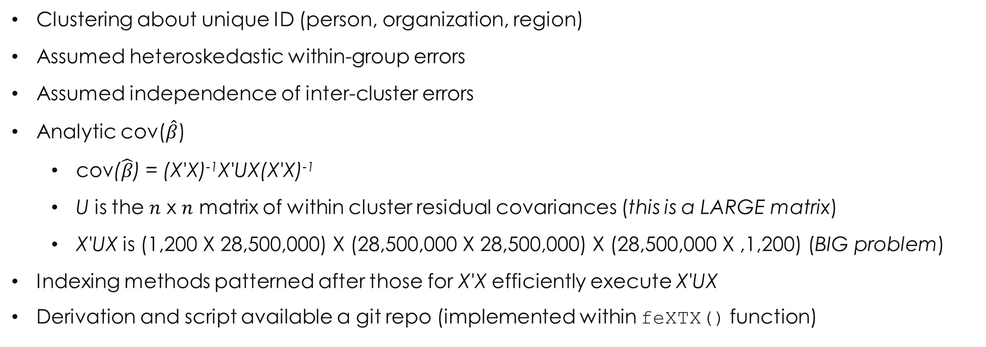
clustered standard errors
Clustering about unique ID (person, organization, region)
Assumed heteroskedastic within-group errors
Assumed independence of inter-cluster errors
Analytic cov($\hat{β}$)
cov($\hat{β}$) = (X'X)⁻¹X'UX(X'X)⁻¹
U is the $n$ x $n$ matrix of within cluster residual covariances (this is a LARGE matrix)
X'UX is (1,200 X 28,500,000) X (28,500,000 X 28,500,000) X (28,500,000 X ,1,200) (BIG problem)
Indexing methods patterned after those for X'X efficiently execute X'UX
Derivation and script available a git repo (implemented within feXTX() function)
efficient computation, large-n, high dimension fixed effects models | useR!2017 | thomas.balmat@duke.edu

Slide 29
clustered standard performance comparison
Robust/clustered errors unavailable in most packages reviewed
lfe() computes, but estimable function specification is required
Stata has good reputation for efficient robust/clustered SE computation
Absolute pair-wise Stata and feXTX() deviations were within five significant digits
lfe() estimates not compared due to known differences arising from estimable function req
Execution Time (in minutes) to Fit OPM Pay Disparity Model and Compute Robust and Clustered Standard Errors
Method | Robust SE Time (min) | Clustered SE Time (min) | Memory (Gb)
lfe()* | - | 51.9 | 128
Stata** | 51.5 | 55.5 | 20
feXTX()*** | 13.2 | 27.6 | 20/38
* bootstrap estimates computed; robust standard errors require use of ancillary bootstrap estimation functions which were not pursued
** Using Stata/MP Version 13.1
*** SEs are the result of evaluation of analytical standard error equation
efficient computation, large-n, high dimension fixed effects models | useR!2017 | thomas.balmat@duke.edu

Slide 30
what’s next?
Parallelize interaction indexing instructions in X'X composition
Implement shared memory in parallel operations under Windows
Evaluate rank of X'X, address collinearity (qr() offers these)
Implement parallel forward and backsolve solution using Cholesky decomposition
Develop feXTX() R package
efficient computation, large-n, high dimension fixed effects models | useR!2017 | thomas.balmat@duke.edu

Slide 31
resources
git repo: https://github.com/DukeSynthProj/SyntheticDataXTXResources
Paper: Efficient Indexing Algorithm for Large Fixed Effects Problems (currently draft)
Scripts: feXTX(), Cholesky functions, sample data generator, method evaluation functions, clustered SE function (within feXTX())
Related research (utilizing methods presented)
Bolton and de Figueiredo (2017), Measuring and explaining the gender wage gap in the U. S. federal government. Tech. rep., Duke University Law School
Duke Synthetic Data Project (2017), A Framework for Sharing Confidential Research Data, Applied to Investigating Differential Pay by Race in the U. S. Government, NBER working paper, http://www.nber.org/papers/w23534, submitted to JASA
Contact
Tom Balmat, Research Statistics and Data Support, SSRI, Duke University, thomas.balmat@duke.edu
Jerry Reiter, Professor, Department of Statistical Science, Duke University, jerry@stat.duke.edu
efficient computation, large-n, high dimension fixed effects models | useR!2017 | thomas.balmat@duke.edu

