Slide 1
High Dimension computational problems
Strategies for Efficiency
Tom Balmat, Social Science Research Institute
Jerome P. Reiter, Department of Statistical Science
Duke University, Durham, North Carolina, USA
high dimension computational problems, strategies for efficiency | JSM 2017 | thomas.balmat@duke.edu

Slide 2
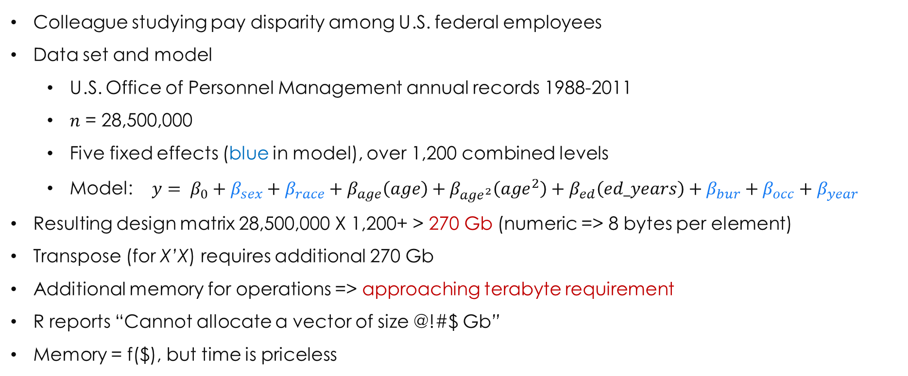
The problem
Colleague studying pay disparity among U.S. federal employees
Data set and model
U.S. Office of Personnel Management annual records 1988-2011
$n$ = 28,500,000
Five fixed effects (blue in model), over 1,200 combined levels
Model: $y= β_{0}$ + $β_{sex}+β_{race}+β_{age}\left(age\right)+β_{{age}^{2}}\left({age}^{2}\right)+β_{ed}\left(ed_years\right)+β_{bur}+β_{occ}+β_{year}$
Resulting design matrix 28,500,000 X 1,200+ > 270 Gb (numeric => 8 bytes per element)
Transpose (for X’X) requires additional 270 Gb
Additional memory for operations => approaching terabyte requirement
R reports “Cannot allocate a vector of size @!#$ Gb”
Memory = f($), but time is priceless
high dimension computational problems, strategies for efficiency | JSM 2017 | thomas.balmat@duke.edu

Slide 3
purpose of talk
Address computational challenges to solving large, high dimension problems
Present efficiency strategies developed while solving large problems
Not so much on science, application, or appropriateness of specific models
Topics:
Efficiency measurement
Inefficient operation identification
Review theory underlying methods
Explore alternative solutions
Measure efficiency gains – with an exit strategy
Examine and certify accuracy of results
high dimension computational problems, strategies for efficiency | JSM 2017 | thomas.balmat@duke.edu

Slide 4
efficiency measurement
Example:
t0 <- proc.time()
m <- lm(y~x, data=d)
proc.time() – t0
Also:
system.time(lm(y~x, data=d))
Use dedicated host
high dimension computational problems, strategies for efficiency | JSM 2017 | thomas.balmat@duke.edu

Slide 5
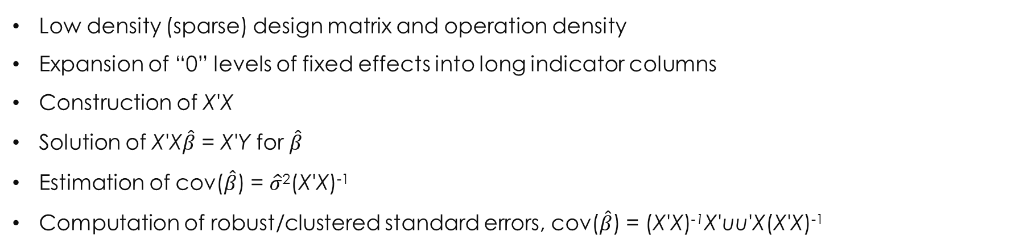
inefficiencies identified IN solving hd FE PROBLEMS
Low density (sparse) design matrix and operation density
Expansion of “0” levels of fixed effects into long indicator columns
Construction of X'X
Solution of X'X$\hat{β}$ = X'Y for $\hat{β}$
Estimation of cov($\hat{β}$) = $\hat{σ}$²(X'X)⁻¹
Computation of robust/clustered standard errors, cov($\hat{β}$) = (X'X)⁻¹X'uu'X(X'X)⁻¹
high dimension computational problems, strategies for efficiency | JSM 2017 | thomas.balmat@duke.edu

Slide 6
solutions evaluated
In no particular order:
lm()
biglm()
bigglm()
biglm.big.matrix()
SparseM.sml.fit()
speedlm()
lfe()
Each address memory usage and computational efficiency differently and all have advantages, but none solve the problems considered in “reasonable” time
Analysis and data at https://github.com/DukeSynthProj/SyntheticDataXTXResources
high dimension computational problems, strategies for efficiency | JSM 2017 | thomas.balmat@duke.edu

Slide 7
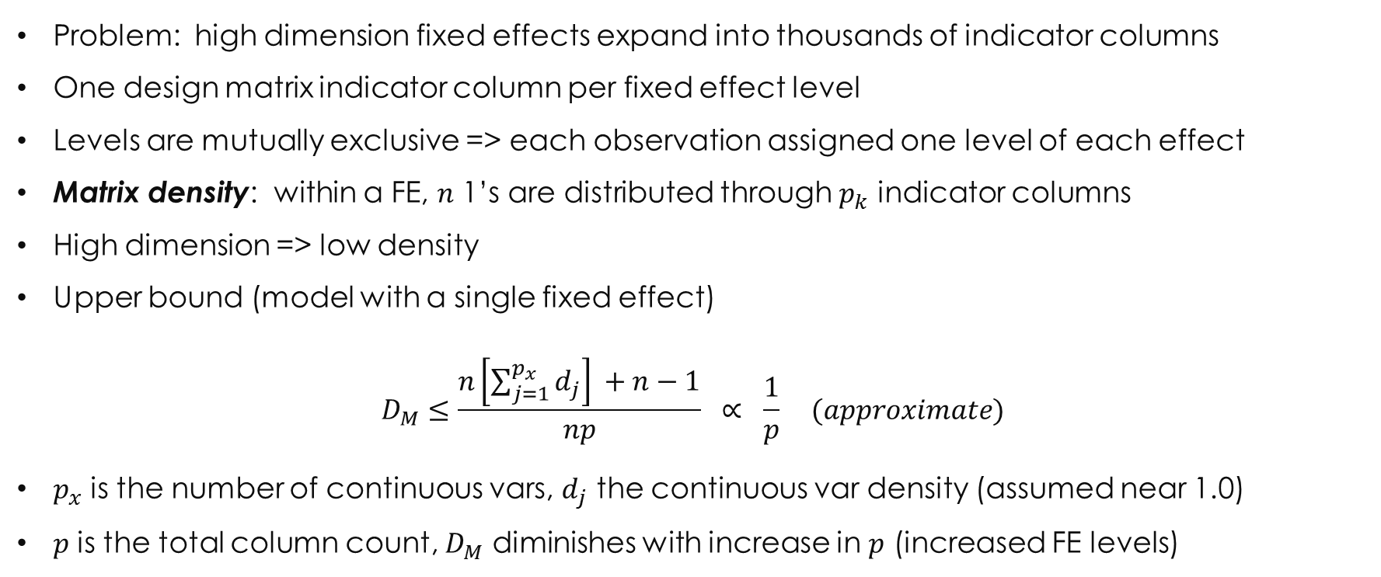
design matrix density
Problem: high dimension fixed effects expand into thousands of indicator columns
One design matrix indicator column per fixed effect level
Levels are mutually exclusive => each observation assigned one level of each effect
Matrix density: within a FE, $n$ 1’s are distributed through $p_{k}$ indicator columns
High dimension => low density
Upper bound (model with a single fixed effect)
$$D_{M}≤\frac{n\left[\sum_{j=1}^{p_{x}}{d_{j}}\right] +n−1}{np} ∝ \frac{1}{p} (approximate)$$
$p_{x}$ is the number of continuous vars, $d_{j}$ the continuous var density (assumed near 1.0)
$p$ is the total column count, $D_{M}$ diminishes with increase in $p$ (increased FE levels)
high dimension computational problems, strategies for efficiency | JSM 2017 | thomas.balmat@duke.edu

Slide 8
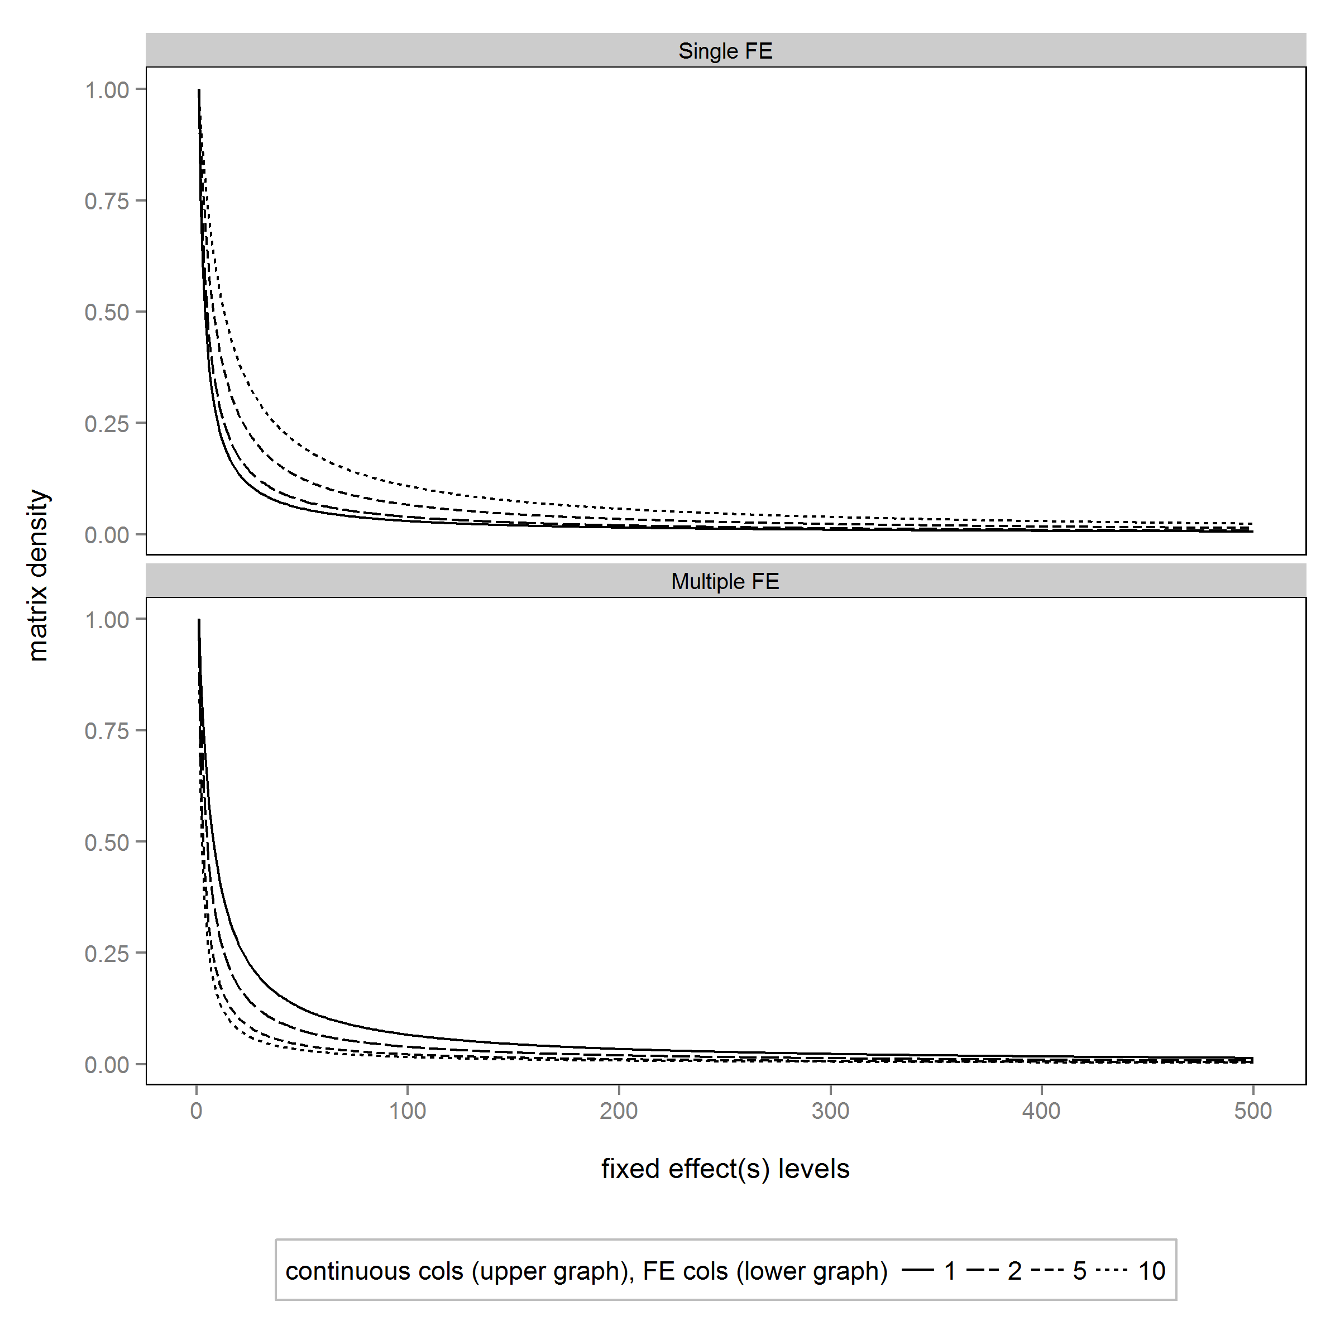
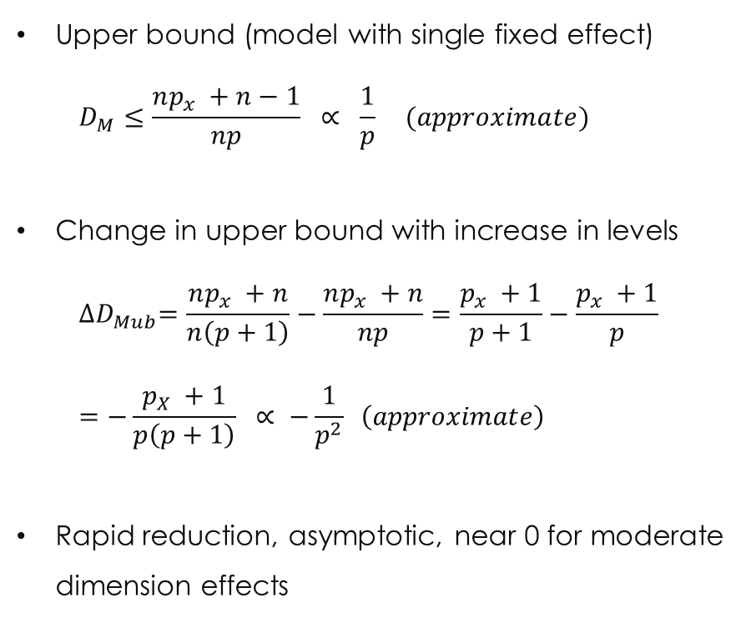
design matrix density
Upper bound (model with single fixed effect)
$$D_{M}≤\frac{np_{x} +n−1}{np} ∝ \frac{1}{p} (approximate)$$
Change in upper bound with increase in levels
$${∆D}_{Mub}=\frac{np_{x} +n}{n\left(p+1\right)}−\frac{np_{x} +n}{np}=\frac{p_{x} +1}{p+1}−\frac{p_{x} +1}{p}$$
$$=−\frac{p_{X} +1}{p\left(p+1\right)} ∝ −\frac{1}{p^{2}} \left(approximate\right)$$
Rapid reduction, asymptotic, near 0 for moderate dimension effects
Upper panel, model with single FE; Lower panel, 1-10 FEs
high dimension computational problems, strategies for efficiency | JSM 2017 | thomas.balmat@duke.edu

Slide 9
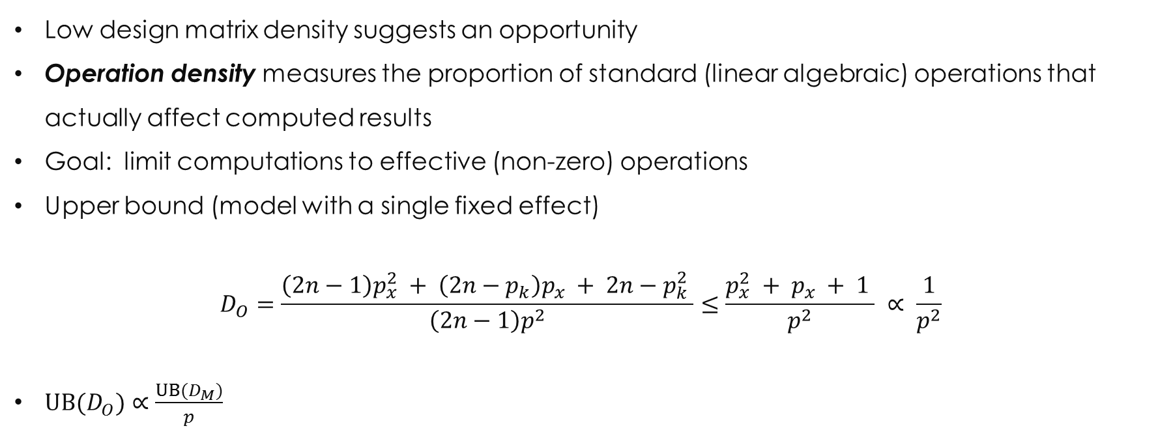
operation density density
Low design matrix density suggests an opportunity
Operation density measures the proportion of standard (linear algebraic) operations that actually affect computed results
Goal: limit computations to effective (non-zero) operations
Upper bound (model with a single fixed effect)
$$D_{O}=\frac{\left(2n−1\right)p_{x}^{2} + \left(2n−p_{k}\right)p_{x} + 2n−p_{k}^{2} }{\left(2n−1\right)p^{2}}≤\frac{p_{x}^{2} + p_{x} + 1 }{p^{2}} ∝ \frac{1}{p^{2}}$$
$UB(D_{O})∝\frac{{UB(D}_{M})}{p}$
high dimension computational problems, strategies for efficiency | JSM 2017 | thomas.balmat@duke.edu

Slide 10
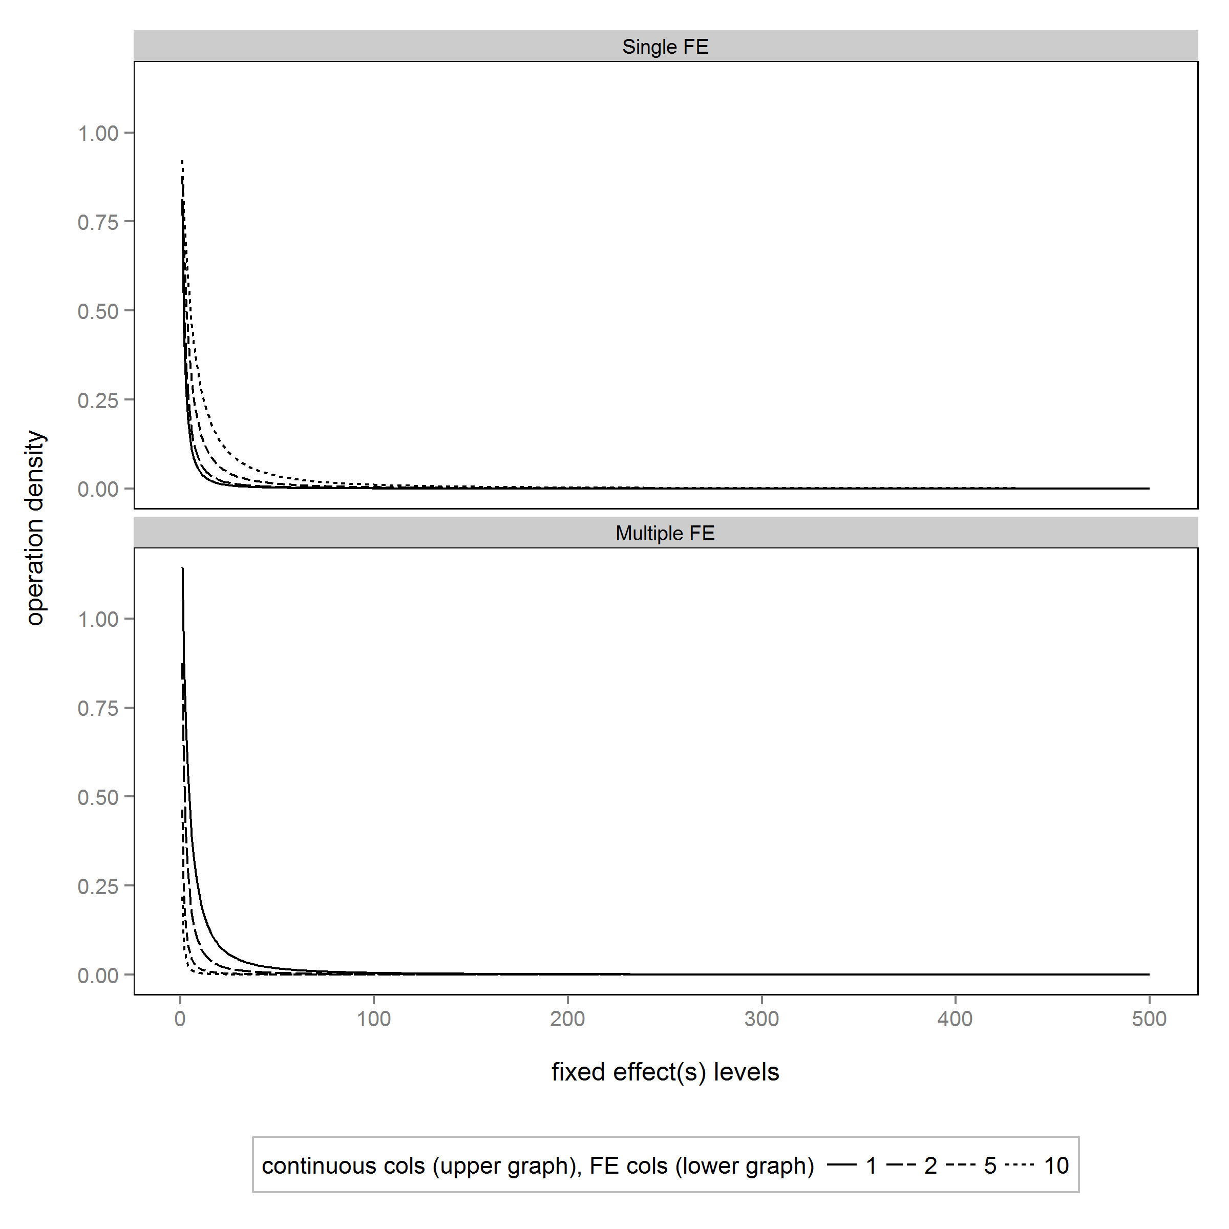
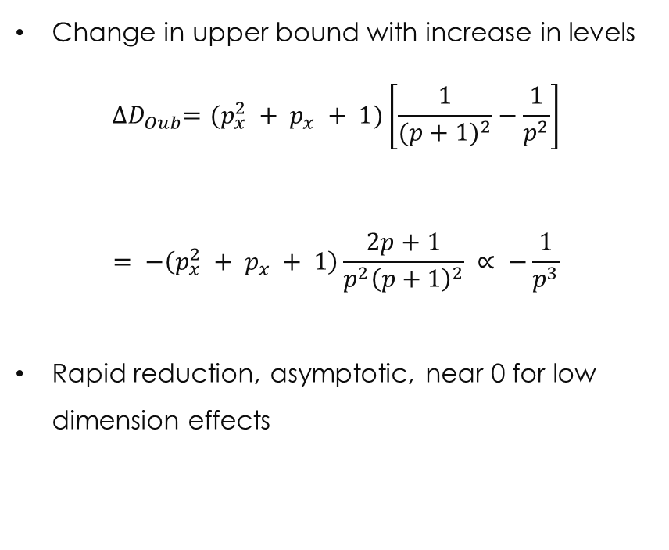
operation density density
Change in upper bound with increase in levels
$${∆D}_{Oub}=(p_{x}^{2} + p_{x} + 1)\left[\frac{1}{{(p+1)}^{2}}−\frac{1}{p^{2}}\right]$$
$$= −\left(p_{x}^{2} + p_{x} + 1\right)\frac{2p+1}{{p^{2}\left(p+1\right)}^{2}} ∝ −\frac{1}{p^{3}}$$
Rapid reduction, asymptotic, near 0 for low dimension effects
Upper panel, model with single FE; Lower panel, 1-10 FEs
high dimension computational problems, strategies for efficiency | JSM 2017 | thomas.balmat@duke.edu

Slide 11
Density Example
From the Human Capital Project at Duke University
Model wage disparity by gender and race in U.S. federal workforce, controlling for human capital (experience, education) and other FEs (bureau, occupation, year)
Matrix Density of OPM Data by Fixed Effect
Overall design matrix density is 0.006, operation density is less than 0.0001
Fewer than 0.01% of standard algebraic operations are needed –
OPPORTUNITY!
high dimension computational problems, strategies for efficiency | JSM 2017 | thomas.balmat@duke.edu

Slide 12
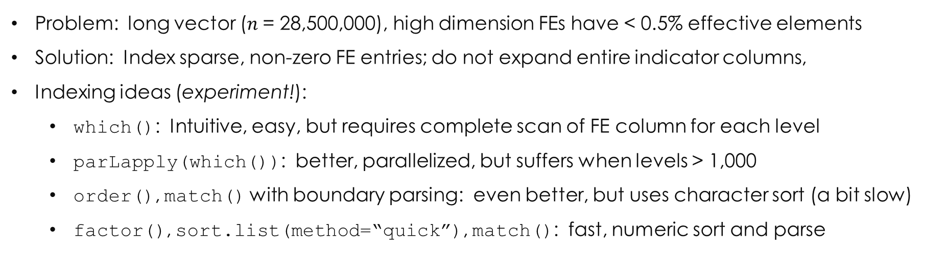
efficiency obstacle: expand fe to indicator columns
Problem: long vector ($n$= 28,500,000), high dimension FEs have < 0.5% effective elements
Solution: Index sparse, non-zero FE entries; do not expand entire indicator columns,
Indexing ideas (experiment!):
which(): Intuitive, easy, but requires complete scan of FE column for each level
parLapply(which()): better, parallelized, but suffers when levels > 1,000
order(), match() with boundary parsing: even better, but uses character sort (a bit slow)
factor(), sort.list(method=“quick”), match(): fast, numeric sort and parse
high dimension computational problems, strategies for efficiency | JSM 2017 | thomas.balmat@duke.edu

Slide 13
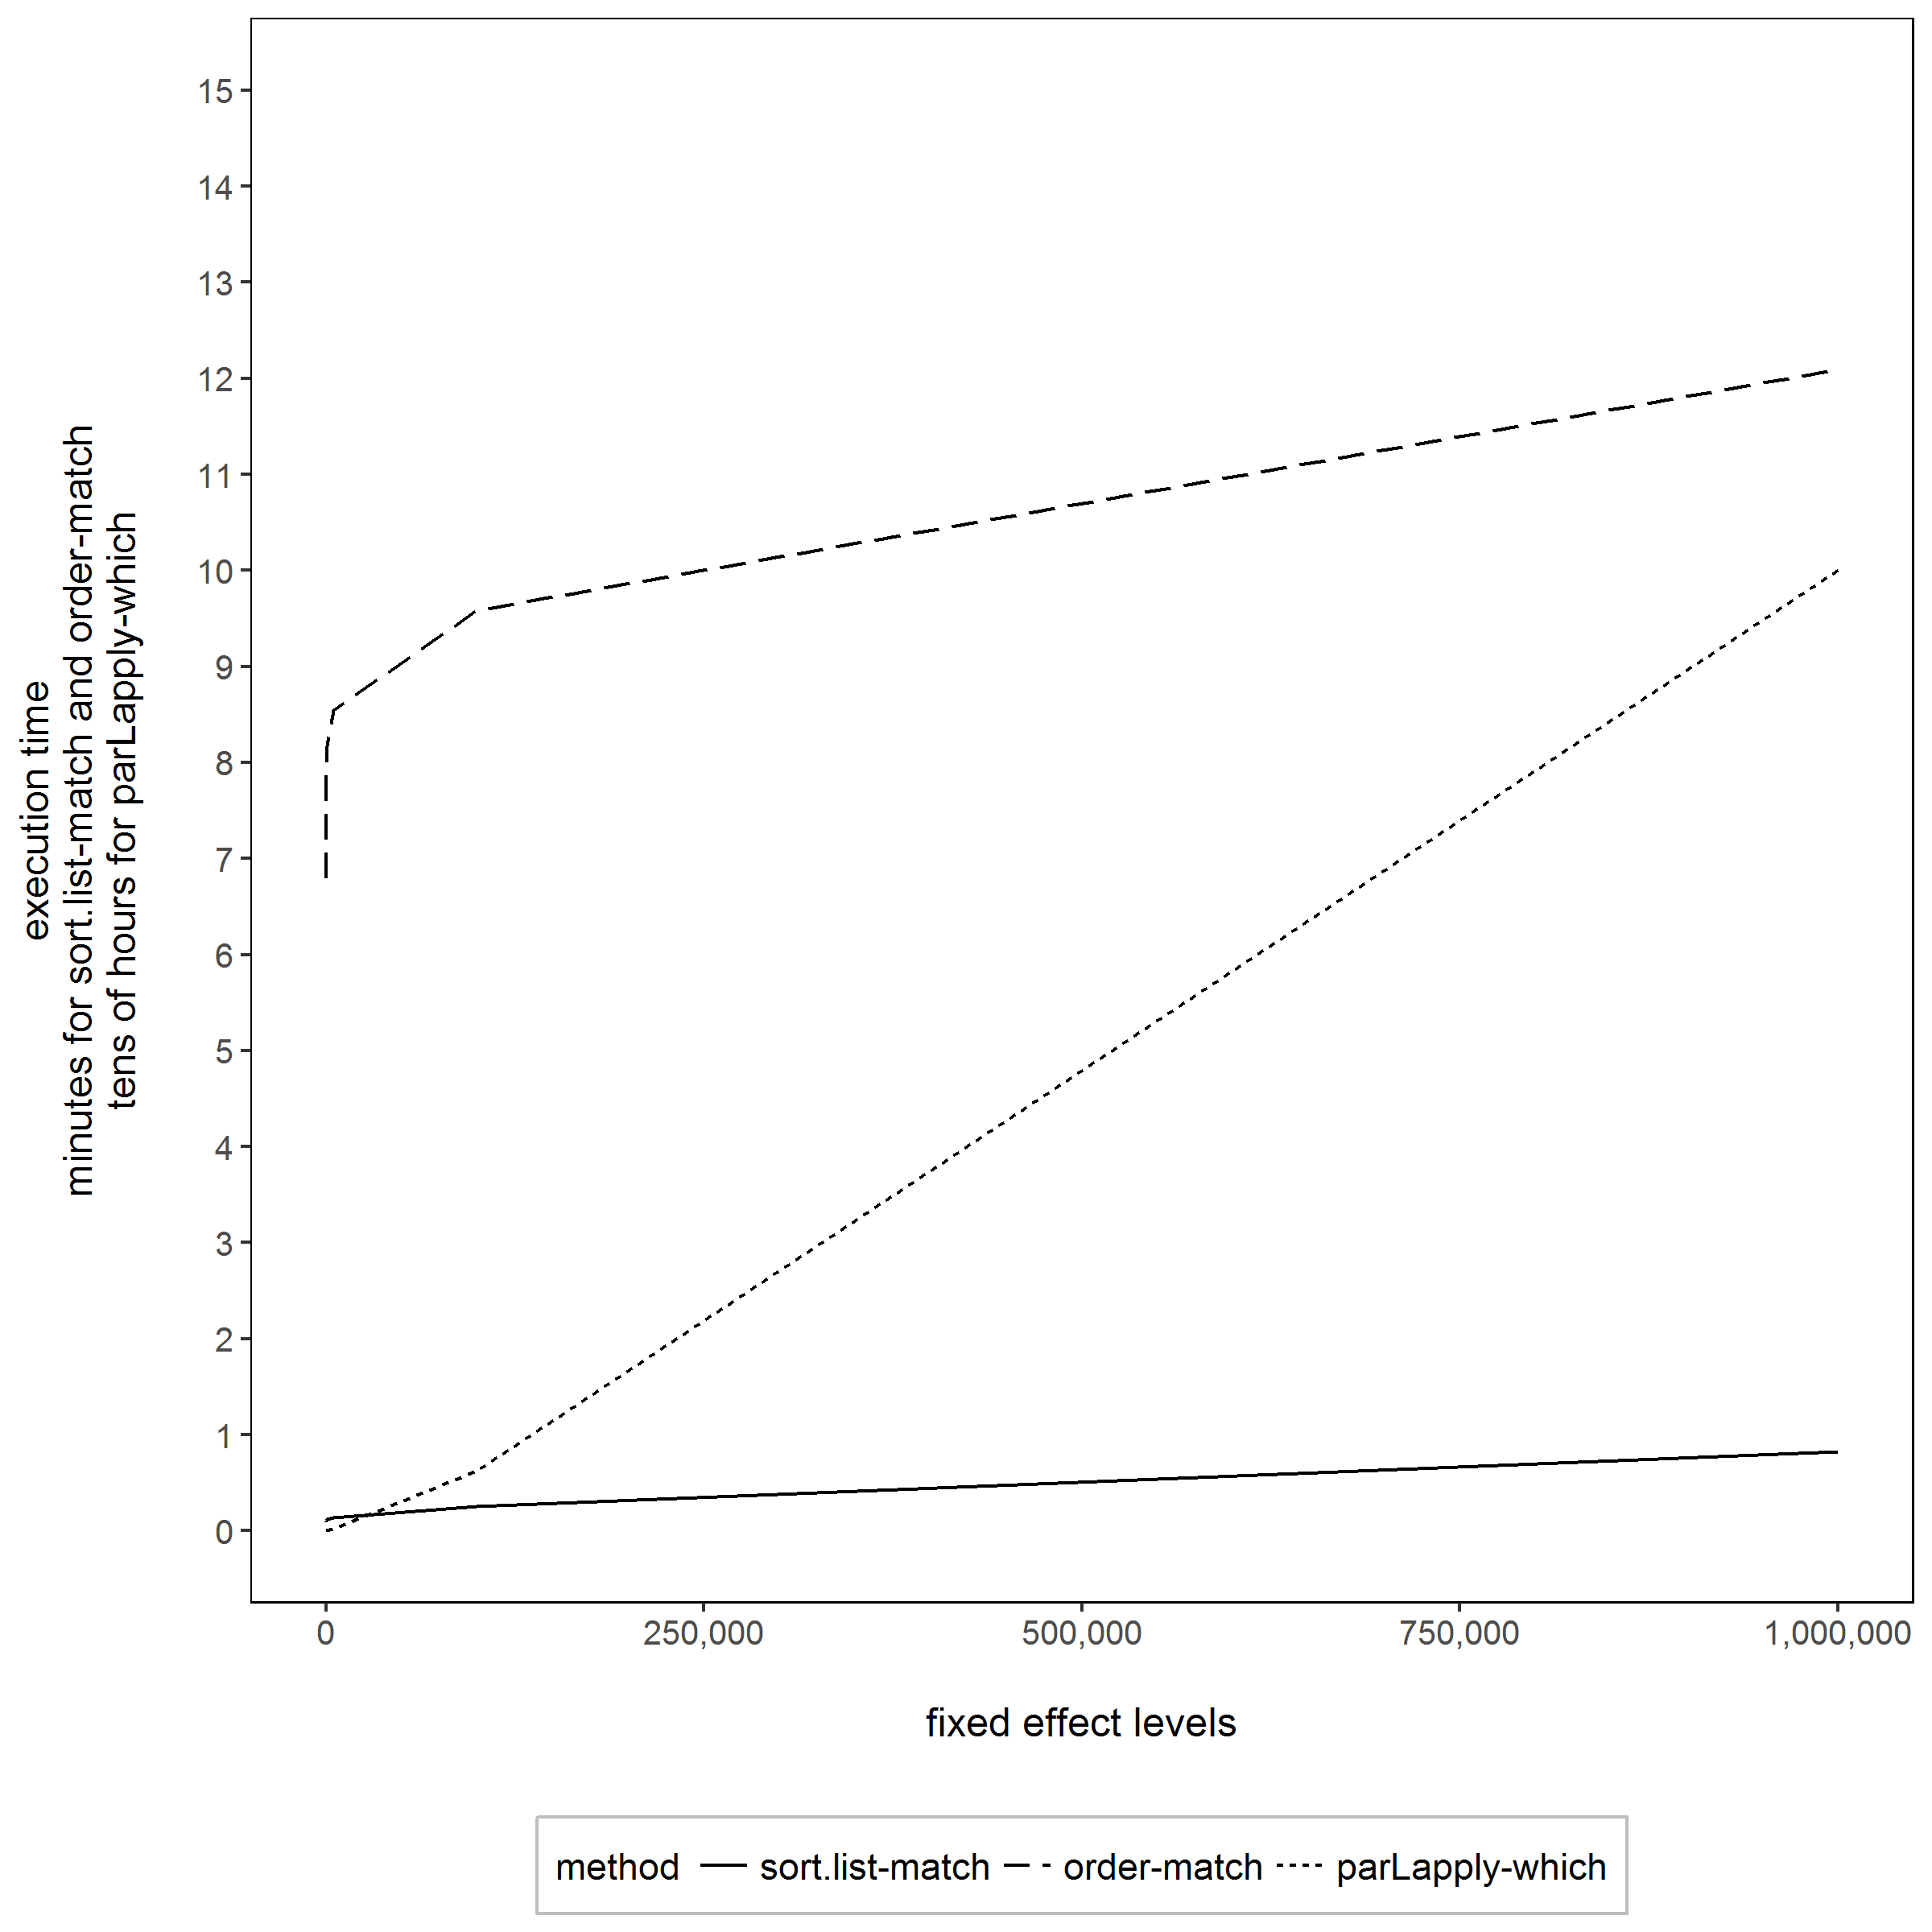
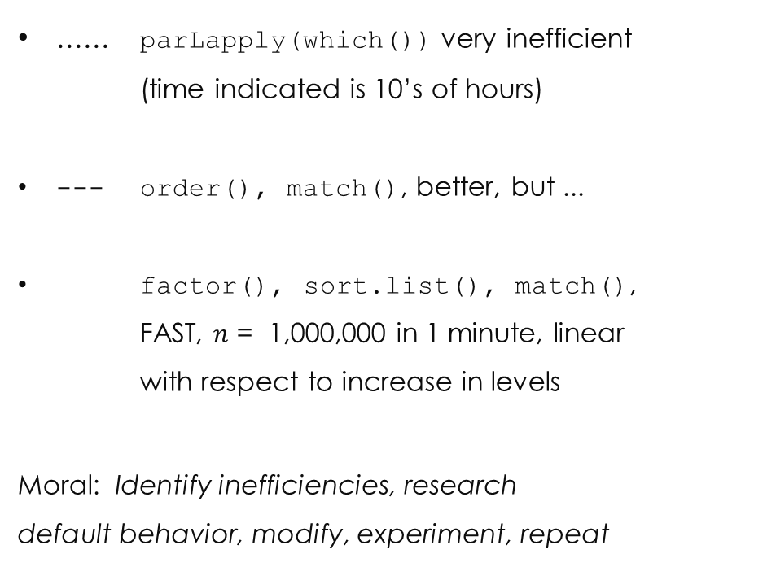
indexing methods
...... parLapply(which()) very inefficient
(time indicated is 10’s of hours)
--- order(), match(), better, but ...
factor(), sort.list(), match(),
FAST, $n$ = 1,000,000 in 1 minute, linear
with respect to increase in levels
Moral: Identify inefficiencies, research
default behavior, modify, experiment, repeat
Execution time (mean of five iterations, one for par-which()
high dimension computational problems, strategies for efficiency | JSM 2017 | thomas.balmat@duke.edu

Slide 14
efficiency obstacle: Compose X'X
We have constructed sparse index vectors for each level of each fixed effect
Now what?
We want X'X, with minimal use of column (dot) products
There exist three “product” types (for a model without interactions):
Continuous X continuous → standard dot product
Continuous X fixed effect → sum of indexed continuous positions
Fixed effect X fixed effect → length of intersection of FE index vectors
1 is unavoidable (but number of continuous columns are relatively few)
2 and 3 use efficient base R sum(), intersect(), and length() on sparse vectors
Row and column operations are independent, so parallel implementation prescribed
high dimension computational problems, strategies for efficiency | JSM 2017 | thomas.balmat@duke.edu

Slide 15
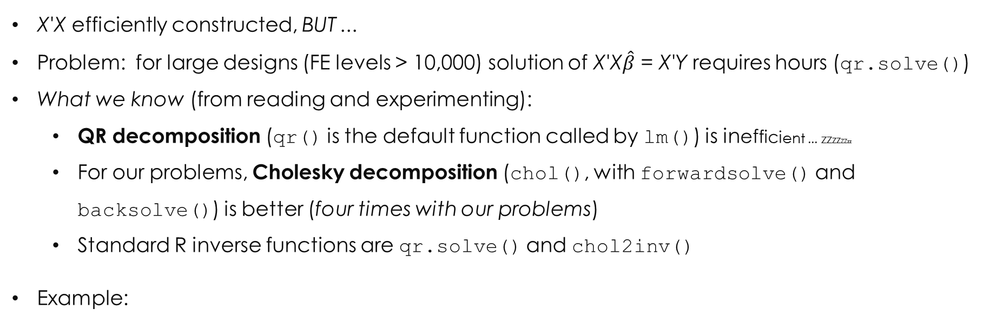
efficiency obstacle: solve X'X$\hat{β}$ = X'Y and cov($\hat{β}$) = ${\hat{σ}}^{2}$(X'X)⁻¹
X'X efficiently constructed, BUT ...
Problem: for large designs (FE levels > 10,000) solution of X'X$\hat{β}$ = X'Y requires hours (qr.solve())
What we know (from reading and experimenting):
QR decomposition (qr() is the default function called by lm()) is inefficient ... zzzzzzzz
For our problems, Cholesky decomposition (chol(), with forwardsolve() and backsolve()) is better (four times with our problems)
Standard R inverse functions are qr.solve() and chol2inv()
Example:
Time to compute decomposition and inverse of X'X using QR and Cholesky methods
Mean of five iterations, in minutes
Method | p_{k} = 6,200 matrix | p_{k} = 16,000 matrix
qr() + qr.solve() | 10.0 | 172.7
chol() + chol2inv() | 2.5 | 44.1
high dimension computational problems, strategies for efficiency | JSM 2017 | thomas.balmat@duke.edu

Slide 16
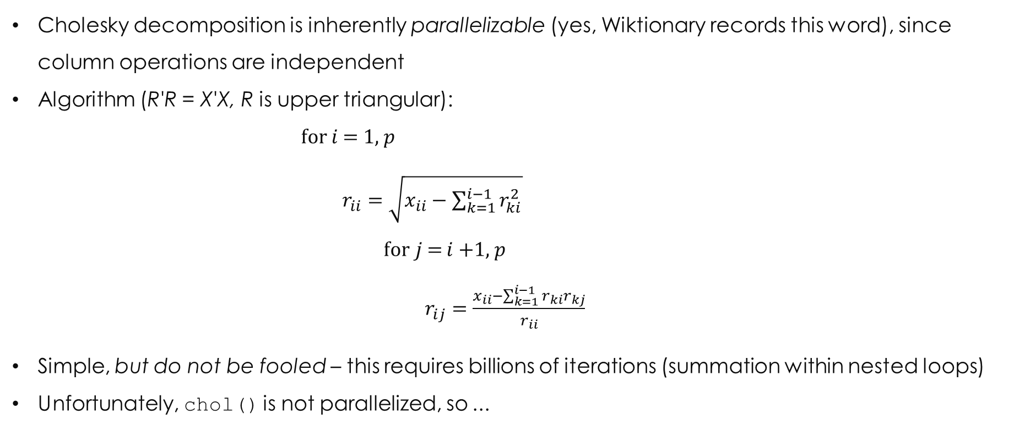
understand the algebra in your solution
Cholesky decomposition is inherently parallelizable (yes, Wiktionary records this word), since column operations are independent
Algorithm (R'R = X'X, R is upper triangular):
for $i$ = 1, $p$
$r_{ii}=\sqrt{x_{ii}−\sum_{k=1}^{i−1}{r_{ki}^{2}}}$
for$j$= $i$+1, $p$
$r_{ij}=\frac{x_{ii}−\sum_{k=1}^{i−1}{r_{ki}r_{kj}}}{r_{ii}}$
Simple, but do not be fooled – this requires billions of iterations (summation within nested loops)
Unfortunately, chol() is not parallelized, so ...
high dimension computational problems, strategies for efficiency | JSM 2017 | thomas.balmat@duke.edu

Slide 17
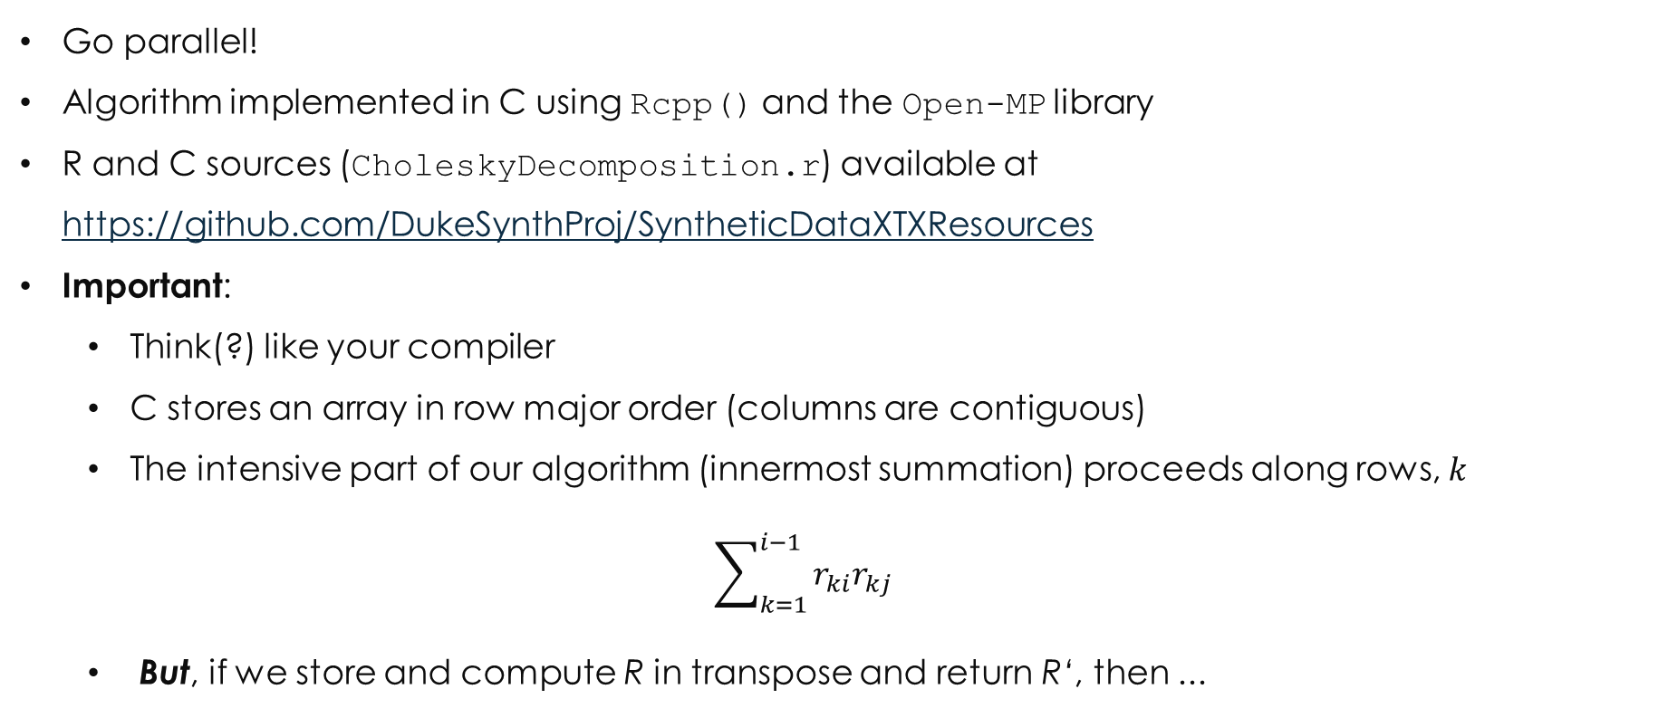
improve solution: C and openmp (parallel)
Go parallel!
Algorithm implemented in C using Rcpp() and the Open-MP library
R and C sources (CholeskyDecomposition.r) available at https://github.com/DukeSynthProj/SyntheticDataXTXResources
Important:
Think(?) like your compiler
C stores an array in row major order (columns are contiguous)
The intensive part of our algorithm (innermost summation) proceeds along rows, $k$
$$\sum_{k=1}^{i−1}{r_{ki}r_{kj}}$$
But, if we store and compute R in transpose and return R‘, then ...
high dimension computational problems, strategies for efficiency | JSM 2017 | thomas.balmat@duke.edu

Slide 18
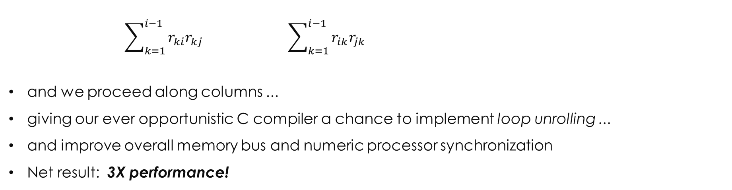
further Improvement: team up with your compiler
$$\sum_{k=1}^{i−1}{r_{ki}r_{kj}} \sum_{k=1}^{i−1}{r_{ik}r_{jk}}$$
and we proceed along columns ...
giving our ever opportunistic C compiler a chance to implement loop unrolling ...
and improve overall memory bus and numeric processor synchronization
Net result: 3X performance!
#pragma omp parallel for private(j, k, s)
for(j=i; j<p; j++) {
// accumulate prior computed Rki*Rkj products
s=0;
for(k=0; k<i; k++)
s+=R[k][i]*R[k][j];
}
#pragma omp parallel for private(j, k, s)
for(j=i; j<p; j++) {
// accumulate prior computed Rki*Rkj products
s=0;
for(k=0; k<i; k++)
s+=R[i][k]*R[j][k];
}
high dimension computational problems, strategies for efficiency | JSM 2017 | thomas.balmat@duke.edu

Slide 19
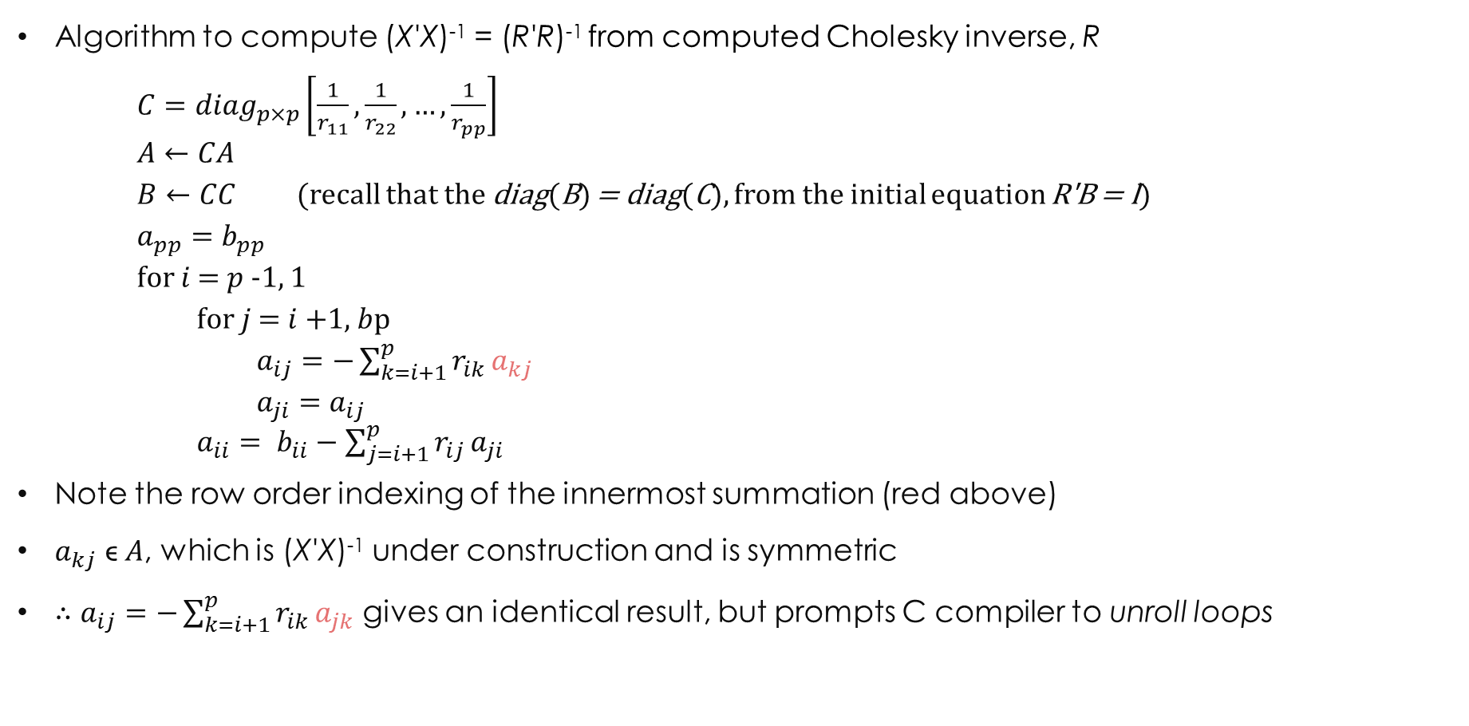
understand the math: R'R = X'X ⇒ cov($\hat{β}$) = ${\hat{σ}}^{2}$(R'R)⁻¹
Algorithm to compute (X'X)⁻¹ = (R'R)⁻¹ from computed Cholesky inverse, R
$C={diag}_{p×p}\left[\frac{1}{r_{11}}, \frac{1}{r_{22}}, …, \frac{1}{r_{pp}}\right]$
$A←CA$
$B←CC$ (recall that the diag(B) = diag(C), from the initial equation R'B = I)
$a_{pp}=b_{pp}$
for $i$ = $p$-1, 1
for $j$ = $i$+1, $b$p
$a_{ij}=−\sum_{k=i+1}^{p}{r_{ik}}a_{kj}$
$a_{ji}=a_{ij}$
$a_{ii}= b_{ii}−\sum_{j=i+1}^{p}{r_{ij}}a_{ji}$
Note the row order indexing of the innermost summation (red above)
$a_{kj}$ ϵ $A$, which is (X'X)⁻¹ under construction and is symmetric
$∴$ $a_{ij}=−\sum_{k=i+1}^{p}{r_{ik}}a_{jk}$ gives an identical result, but prompts C compiler to unroll loops
high dimension computational problems, strategies for efficiency | JSM 2017 | thomas.balmat@duke.edu

Slide 20
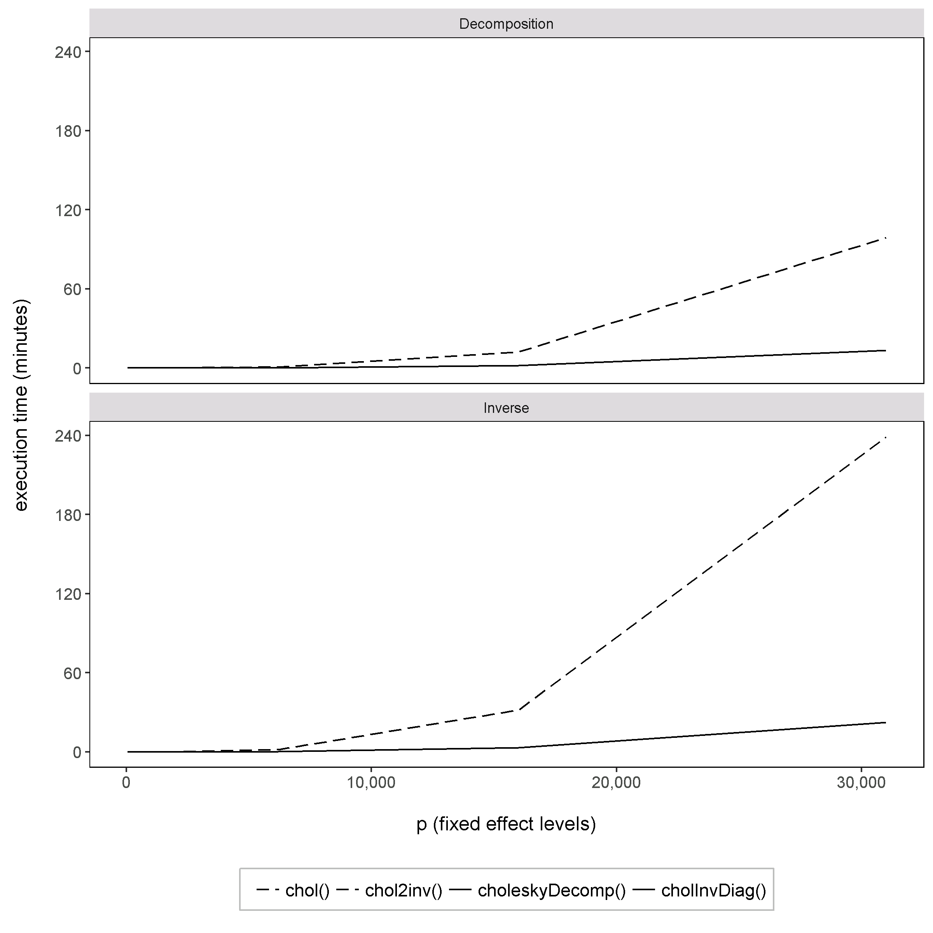
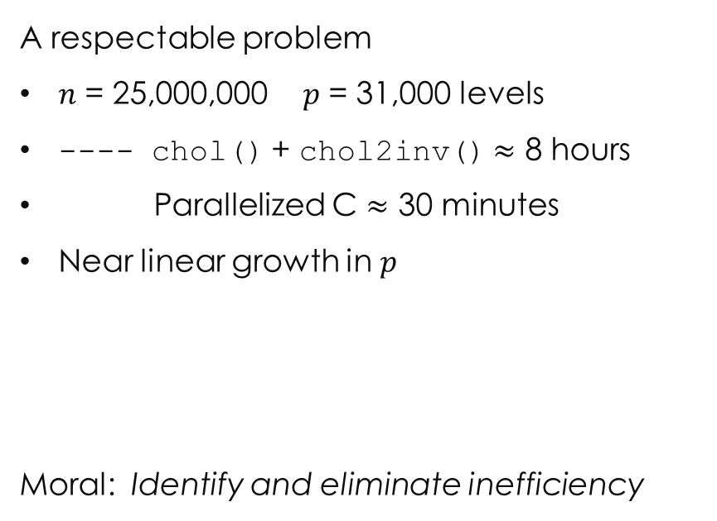
Evaluate Performance
A respectable problem
$n$ = 25,000,000 $p$ = 31,000 levels
---- chol() + chol2inv() $≈$ 8 hours
Parallelized C $≈$ 30 minutes
Near linear growth in $p$
Moral: Identify and eliminate inefficiency
high dimension computational problems, strategies for efficiency | JSM 2017 | thomas.balmat@duke.edu

Slide 21
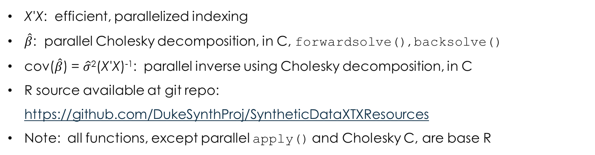
Our fixed effects solution
feXTX()
X'X: efficient, parallelized indexing
$\hat{β}$: parallel Cholesky decomposition, in C, forwardsolve(), backsolve()
cov($\hat{β}$) = $\hat{σ}$²(X'X)⁻¹: parallel inverse using Cholesky decomposition, in C
R source available at git repo: https://github.com/DukeSynthProj/SyntheticDataXTXResources
Note: all functions, except parallel apply() and Cholesky C, are base R
high dimension computational problems, strategies for efficiency | JSM 2017 | thomas.balmat@duke.edu

Slide 22
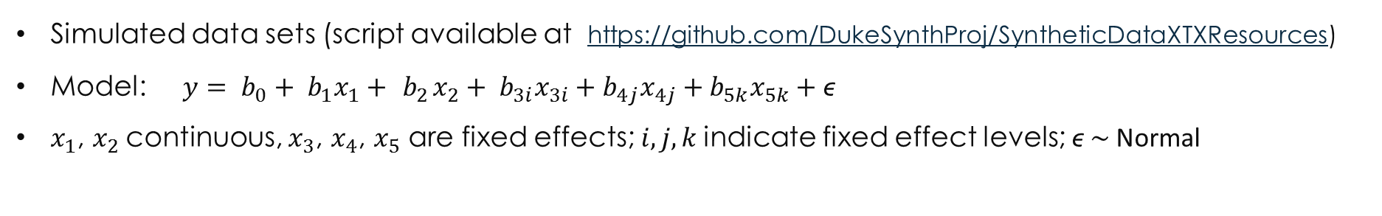
Solution evaluation
Simulated data sets (script available at https://github.com/DukeSynthProj/SyntheticDataXTXResources)
Model: $y= b_{0}+ b_{1}x_{1}+ { b}_{2}x_{2}+ b_{3i}x_{3i}+b_{4j}x_{4j}+b_{5k}x_{5k}+\text{ϵ}$
$x_{1}$, $x_{2}$continuous, $x_{3}$, $x_{4}$, $x_{5}$ are fixed effects; $i, j,k$indicate fixed effect levels; $\text{ϵ} \sim$Normal
Simulated Data Set Parameters for Execution Time Evaluation
Parameter Set | n (Observations) | Levels X₃ | Levels X₄ | Levels X₅
1 | 10,000 | 10 | 15 | 20
2 | 25,000 | 10 | 20 | 40
3 | 50,000 | 15 | 30 | 50
4 | 100,000 | 15 | 40 | 60
5 | 150,000 | 25 | 40 | 60
6 | 250,000 | 25 | 50 | 75
7 | 500,000 | 50 | 75 | 100
8 | 1,000,000 | 75 | 150 | 250
9 | 1,500,000 | 100 | 250 | 500
high dimension computational problems, strategies for efficiency | JSM 2017 | thomas.balmat@duke.edu

Slide 23
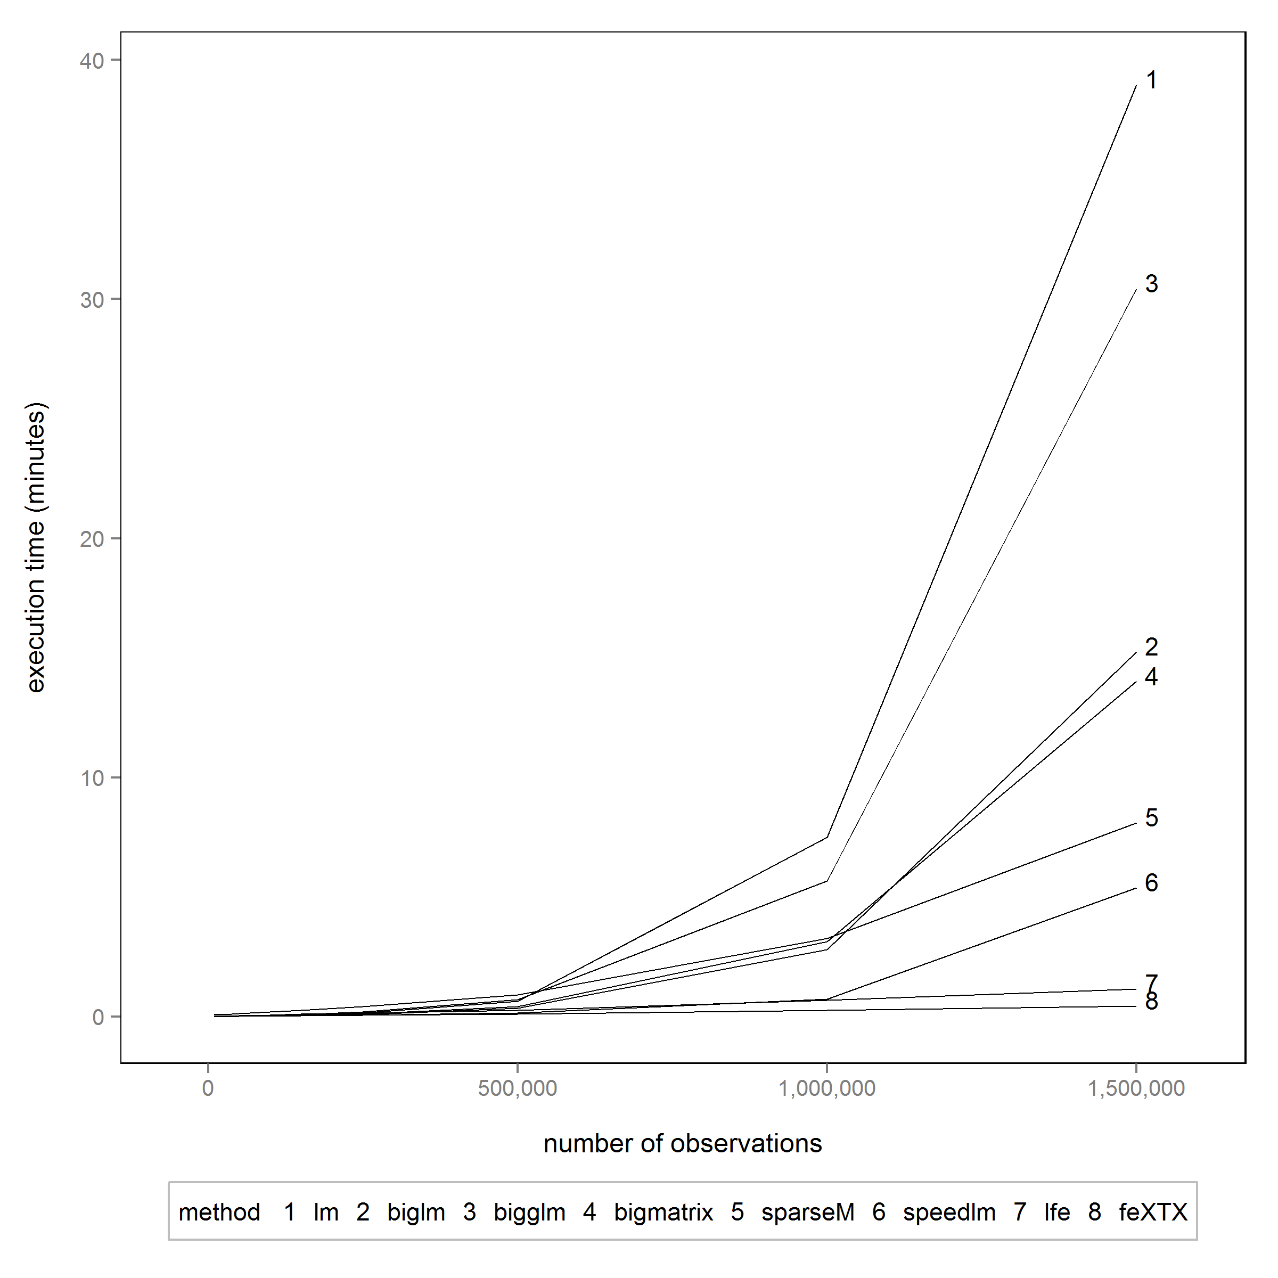
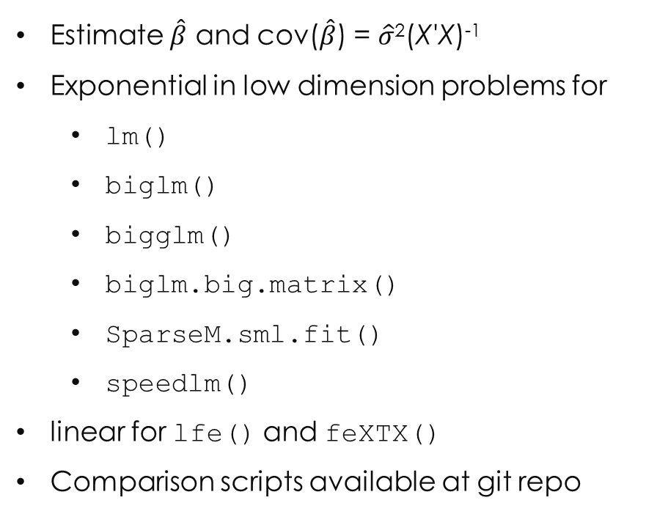
Solution evaluation
Estimate $\hat{β}$ and cov($\hat{β}$) = $\hat{σ}$²(X'X)⁻¹
Exponential in low dimension problems for
lm()
biglm()
bigglm()
biglm.big.matrix()
SparseM.sml.fit()
speedlm()
linear for lfe() and feXTX()
Comparison scripts available at git repo
high dimension computational problems, strategies for efficiency | JSM 2017 | thomas.balmat@duke.edu

Slide 24
Solution evaluation
Higher Dimension Problems
Simulated Data Set Parameters for Execution Time Evaluation
Parameter Set | n (Observations) | Levels X₃ | Levels X₄ | Levels X₅
10 | 2,000,000 | 100 | 500 | 1,000
11 | 5,000,000 | 200 | 1,000 | 5,000
12 | 10,000,000 | 1,000 | 5,000 | 10,000
13 | 25,000,000 | 1,000 | 5,000 | 25,000
high dimension computational problems, strategies for efficiency | JSM 2017 | thomas.balmat@duke.edu

Slide 25
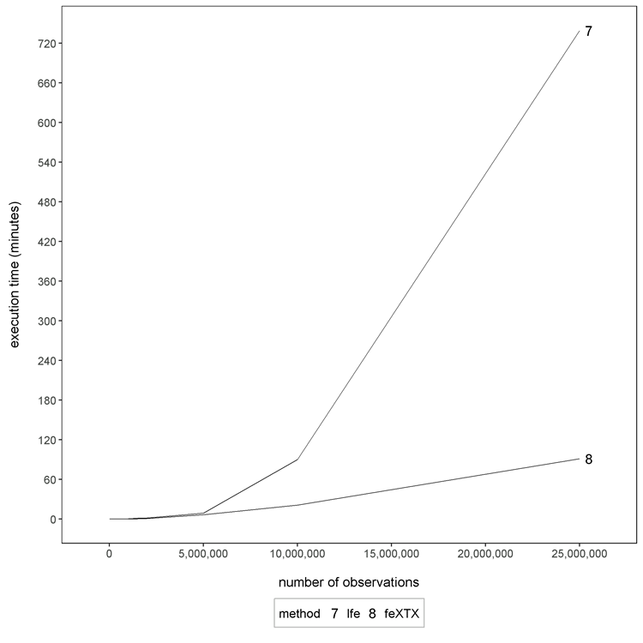
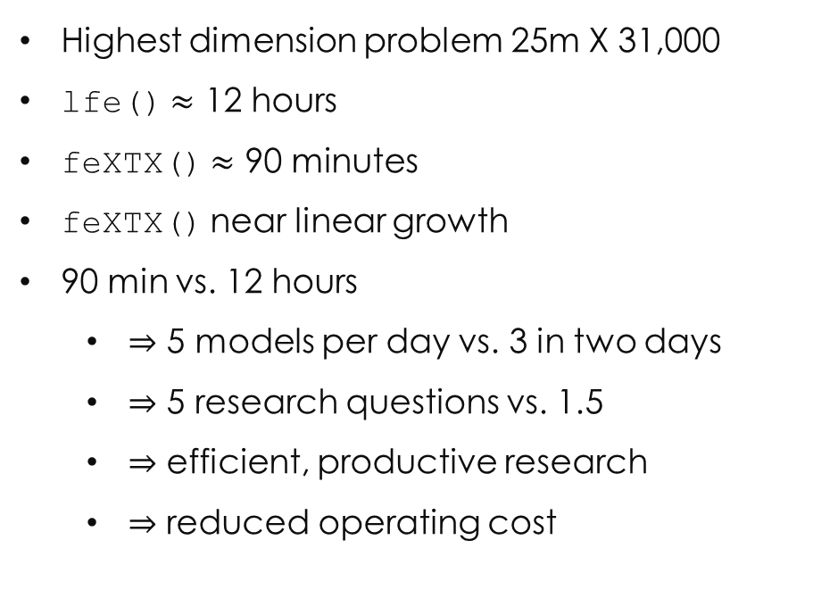
Solution evaluation
Higher Dimension Problems
Highest dimension problem 25m X 31,000
lfe() $≈$ 12 hours
feXTX() $≈$ 90 minutes
feXTX() near linear growth
90 min vs. 12 hours
$⇒$ 5 models per day vs. 3 in two days
$⇒$ 5 research questions vs. 1.5
$⇒$ efficient, productive research
$⇒$ reduced operating cost
high dimension computational problems, strategies for efficiency | JSM 2017 | thomas.balmat@duke.edu

Slide 26
evaluation of accuracy
Verification of Estimates (by consensus)
Comparison of Parameter Estimates, Evaluated Solutions vs. feXTX()
Number of estimates that differ in absolute value by range
Single iteration using simulation parameter set 9
Method | 0 < 10⁻¹² | 10⁻¹² < 10⁻¹⁰ | 10⁻¹⁰ < 10⁻⁷ | 10⁻⁷ < 10⁻⁵ | > 10⁻⁵
lm() | 369 | 478 | 3 | 0 | 0
biglm() | 339 | 508 | 3 | 0 | 0
bigglm() | 339 | 508 | 3 | 0 | 0
bigmatrix() | 339 | 508 | 3 | 0 | 0
sparseM() | 0 | 2 | 848 | 0 | 0
speedlm() | 0 | 2 | 848 | 0 | 0
lfe() | 0 | 0 | 2 | 1 | 847*
* lfe() requires estimable function specification for intercept and ref level estimation, not pursued
high dimension computational problems, strategies for efficiency | JSM 2017 | thomas.balmat@duke.edu

Slide 27
evaluation of memory efficiency
Maximum On-line Memory Used While Fitting Simulation Parameter Set 9
* backing file created
high dimension computational problems, strategies for efficiency | JSM 2017 | thomas.balmat@duke.edu

Slide 28
exit strategy – when are you efficient?
Define your own limit
Understand the math being implemented
Identify inefficient operations
Research available solutions
Develop custom scripts to exploit greatest opportunities
Repeat until efficiency limit achieved (10’s of hours → 10’s of minutes with example problems)
high dimension computational problems, strategies for efficiency | JSM 2017 | thomas.balmat@duke.edu

Slide 29
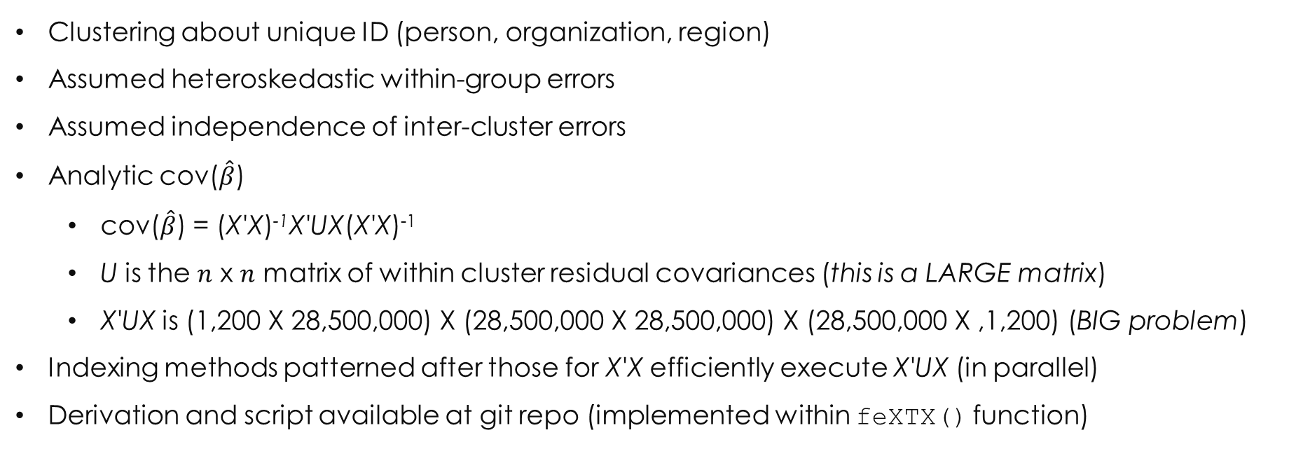
clustered standard errors
Clustering about unique ID (person, organization, region)
Assumed heteroskedastic within-group errors
Assumed independence of inter-cluster errors
Analytic cov($\hat{β}$)
cov($\hat{β}$) = (X'X)⁻¹X'UX(X'X)⁻¹
U is the $n$ x $n$ matrix of within cluster residual covariances (this is a LARGE matrix)
X'UX is (1,200 X 28,500,000) X (28,500,000 X 28,500,000) X (28,500,000 X ,1,200) (BIG problem)
Indexing methods patterned after those for X'X efficiently execute X'UX (in parallel)
Derivation and script available at git repo (implemented within feXTX() function)
high dimension computational problems, strategies for efficiency | JSM 2017 | thomas.balmat@duke.edu

Slide 30
clustered standard performance comparison
Robust/clustered errors unavailable in most packages reviewed
lfe() computes, but estimable function specification is required
Stata has good reputation for efficient robust/clustered SE computation
Absolute pair-wise Stata and feXTX() deviations were within five significant digits
lfe() estimates not compared due to known differences arising from estimable function req
Execution Time (in minutes) to Fit OPM Pay Disparity Model and Compute Robust and Clustered Standard Errors
Method | Robust SE Time (min) | Clustered SE Time (min) | Memory (Gb)
lfe()* | - | 51.9 | 128
Stata** | 51.5 | 55.5 | 20
feXTX()*** | 13.2 | 27.6 | 20/38
* bootstrap estimates computed; robust standard errors require use of ancillary bootstrap estimation functions which were not pursued
** Using Stata/MP Version 13.1
*** SEs are the result of evaluation of analytical standard error equation
high dimension computational problems, strategies for efficiency | JSM 2017 | thomas.balmat@duke.edu

Slide 31
what’s next?
Replace character oriented model specification with R model specification
Parallelize interaction indexing instructions in X'X composition
Implement shared memory in parallel operations under Windows
Evaluate rank of X'X, address collinearity (qr() offers these)
Implement parallel forward and backsolve solution using Cholesky decomposition
Develop feXTX() R package
high dimension computational problems, strategies for efficiency | JSM 2017 | thomas.balmat@duke.edu

Slide 32
resources
git repo: https://github.com/DukeSynthProj/SyntheticDataXTXResources
Paper: Efficient Algorithm for Large Fixed Effects Problems (currently draft)
Scripts: feXTX(), Cholesky functions, sample data generator, method evaluation functions, clustered SE function (within feXTX())
Related research (utilizing methods presented)
Bolton and de Figueiredo (2017), Measuring and explaining the gender wage gap in the U. S. federal government. Tech. rep., Duke University Law School
Duke Synthetic Data Project (2017), A Framework for Sharing Confidential Research Data, Applied to Investigating Differential Pay by Race in the U. S. Government, NBER working paper, http://www.nber.org/papers/w23534, submitted to JASA
Contact
Tom Balmat, Research Statistics and Data Support, SSRI, Duke University, thomas.balmat@duke.edu
Jerry Reiter, Professor, Department of Statistical Science, Duke University, jerry@stat.duke.edu
high dimension computational problems, strategies for efficiency | JSM 2017 | thomas.balmat@duke.edu

