Slide 1
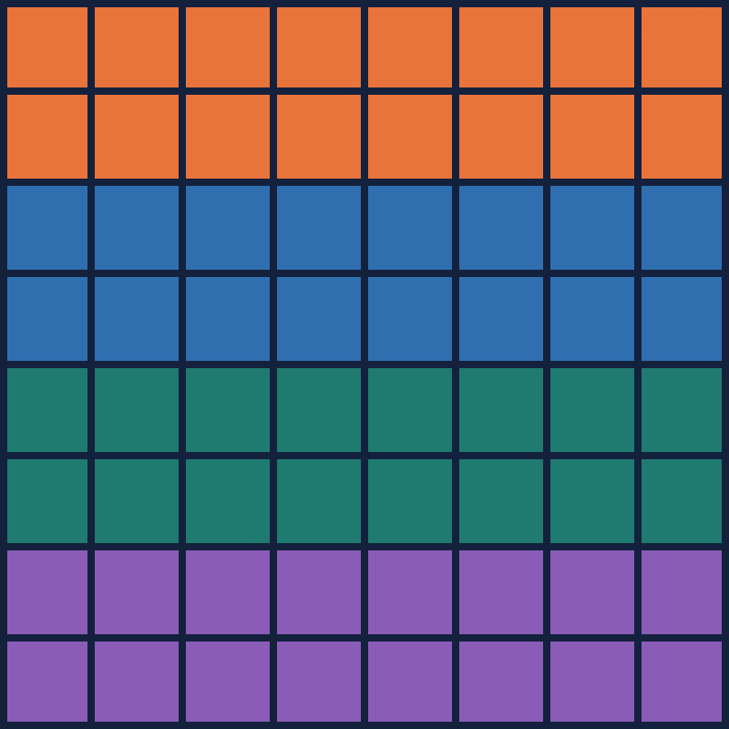
Splitting matrices across processes
HANDS-ON MPI · LAB 2 · EXERCISES 2 & 3
Matrix × vector and matrix × matrix with MPI_Send / MPI_Recv: who gets which rows, who needs what, and how the results come home.
Université Internationale de Rabat · 2026–2027
Notes:
Today we parallelize two classic kernels: y = A·x (Exercise 2) and C = A·B (Exercise 3). The picture on the right is the whole idea of the session: one matrix, its rows split into four colored blocks, one block per MPI process. Keep these four colors in mind: orange is rank 0, blue rank 1, green rank 2, purple rank 3. They stay the same on every slide.

Slide 2
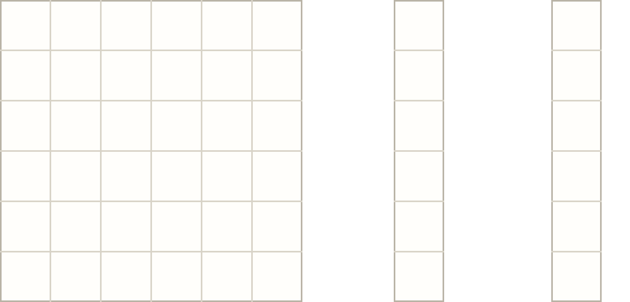



y = A · x is computed one row at a time
EXERCISE 2 · MATRIX × VECTOR
A
x
y
To compute one y[i] you need:
row i of A (N numbers)
y[2]
all of x (N numbers)
×
=
Rows never depend on each other, so each process can take its own block of rows.
y[i] = Σj A[i][j] · x[j]
Hands-on MPI · Lab 2 · 2 / 10
Notes:
Click through the builds. 1: highlight row 2 of A. 2: highlight x, all of it. 3: they meet in one number, y[2], the dot product of row 2 with x. Ask the class: to compute y[2], do I need row 3? Row 0? No. Each y[i] only needs its own row plus the whole x. That independence is what makes this easy to parallelize. The lightbulb card is the plan for the next slides: give each process a block of rows.

Slide 3





Split A by rows, give everyone x
EXERCISE 2 · MATRIX × VECTOR
rank 0
Rank 0 (master)
Rank 1
keeps rows 0–1 + x
→ computes y[0], y[1]
gets rows 2–3 + x
→ computes y[2], y[3]
rank 1
rank 2
Rank 2
Rank 3
rank 3
gets rows 4–5 + x
→ computes y[4], y[5]
gets rows 6–7 + x
→ computes y[6], y[7]
N = 8 rows, p = 4 ranks → N / p = 2 rows each
Hands-on MPI · Lab 2 · 3 / 10
Notes:
Each click reveals one rank: its band of rows on the matrix and its card on the right. Point out three things. First, rank 0 is both the master and a worker: it keeps a block for itself instead of sitting idle. Second, every rank receives the WHOLE x, not a piece of it, because every row needs all of x (previous slide). Third, each rank produces only its own slice of y. Ask: what if N = 10 and p = 4? 10/4 is not an integer. Answer comes on the checklist slide: the last rank takes the leftover rows.

Slide 4
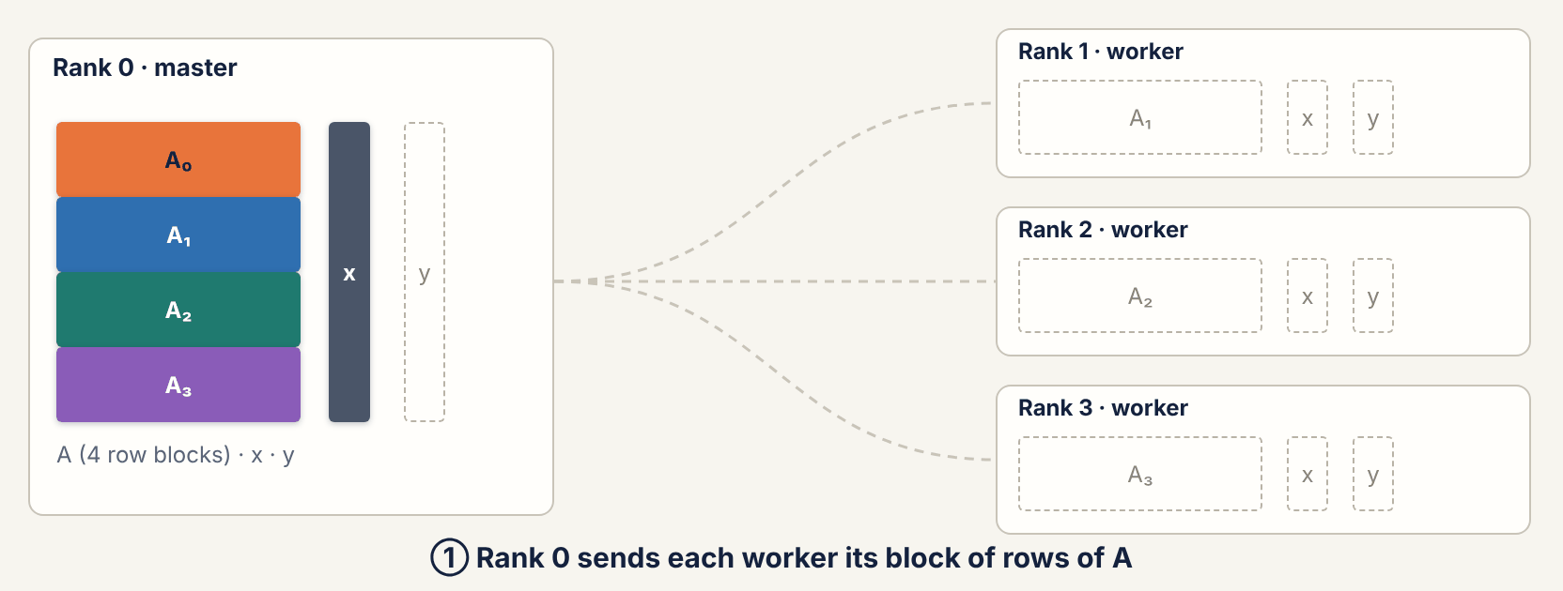
Who sends what to whom
EXERCISE 2 · DATA TRANSFER, ANIMATED
Hands-on MPI · Lab 2 · 4 / 10
Notes:
This animation loops by itself (about 14 seconds). Narrate the four steps as the caption changes. ① Three messages leave rank 0: one block of rows per worker. Note rank 0 keeps block A₀. ② Three more messages: a full copy of x for each worker. ③ No messages at all: everyone, rank 0 included, computes at the same time. This is the only part that actually runs in parallel. ④ Three small messages come back: each worker's piece of y. Count with the class: 3 + 3 + 3 = 9 messages for p = 4, so 3(p − 1) in general. Ask: which messages are the biggest? The row blocks: N²/p numbers each.

Slide 5



The same steps, in MPI_Send / MPI_Recv
EXERCISE 2 · THE CODE
Rank 0 (master)
Ranks 1 … p−1 (workers)
// ① + ② send the work out
for (r = 1; r < size; r++) {
MPI_Send(&A[r*rows*N], rows*N, MPI_DOUBLE,
r, 0, MPI_COMM_WORLD);
MPI_Send(x, N, MPI_DOUBLE, r, 1, MPI_COMM_WORLD);
}
matvec(A, x, y, rows); // ③ own block
for (r = 1; r < size; r++) // ④
MPI_Recv(&y[r*rows], rows, MPI_DOUBLE, r, 2,
MPI_COMM_WORLD, MPI_STATUS_IGNORE);
// ① + ② receive my rows and x
MPI_Recv(A_loc, rows*N, MPI_DOUBLE, 0, 0,
MPI_COMM_WORLD, MPI_STATUS_IGNORE);
MPI_Recv(x, N, MPI_DOUBLE, 0, 1,
MPI_COMM_WORLD, MPI_STATUS_IGNORE);
// ③ compute my slice of y
matvec(A_loc, x, y_loc, rows);
// ④ send it back
MPI_Send(y_loc, rows, MPI_DOUBLE, 0, 2,
MPI_COMM_WORLD);
rows = N / size, matrices stored as 1D arrays A[i*N + j]. Exercise 3 uses the same pattern: send B (N*N doubles) instead of x, receive C blocks (rows*N doubles) instead of y.
Hands-on MPI · Lab 2 · 5 / 10
Notes:
Map each line to the animation: the numbers ① to ④ in the comments are the same steps. Make students notice the tags: 0 for rows of A, 1 for x, 2 for results; sender and receiver must agree. Point at &A[r*rows*N]: because A is a 1D row-major array, rank r's block of rows is one contiguous chunk, so one MPI_Send moves it all. matvec is an ordinary sequential loop over its rows; no MPI inside. If students ask: later they'll see MPI_Scatter, MPI_Bcast and MPI_Gather, which do exactly these loops in one call each. Today we write the loops by hand so they see every message.

Slide 6



C = A · B: what does one row of C need?
EXERCISE 3 · MATRIX × MATRIX
A
B
C
One full row of C needs:
×
=
row i of A: N numbers
ALL of B: N² numbers
C[i][j] = Σk A[i][k] · B[k][j]
Split A by rows, but every rank gets the whole of B.
Hands-on MPI · Lab 2 · 6 / 10
Notes:
Same game as Exercise 2. Build 1: row 1 of A. Build 2: column 3 of B. Build 3: they meet in one cell, C[1][3]. Build 4 is the key moment: to fill the WHOLE row 1 of C, you need every column of B, so all of B. Ask the class before clicking: if I own row 1 of A, which part of B do I need? Most will guess one column. Then reveal. Conclusion: same row split as before, x is replaced by B, and B is N² numbers instead of N. Bigger messages, but as we'll see, much more work to do with them.

Slide 7
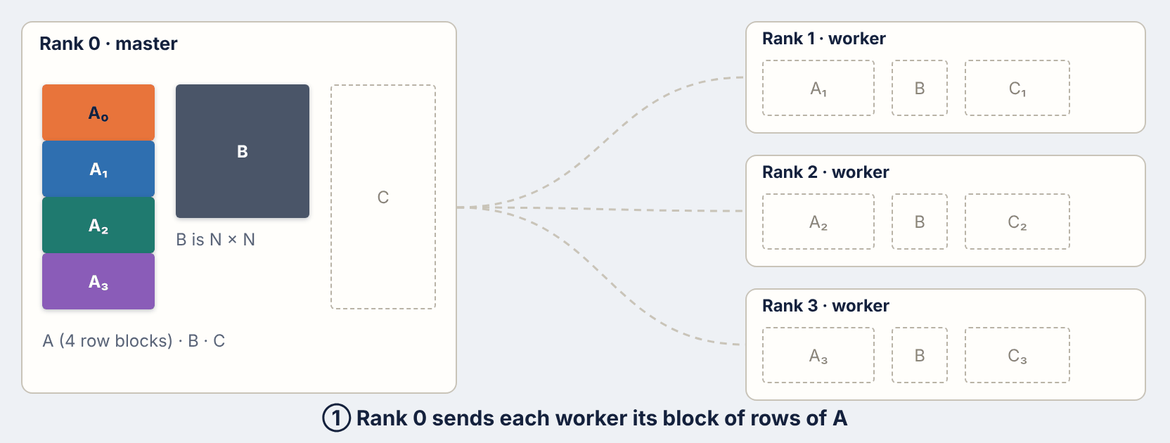
Rows of A go out, all of B goes everywhere
EXERCISE 3 · DATA TRANSFER, ANIMATED
Hands-on MPI · Lab 2 · 7 / 10
Notes:
Same four steps as Exercise 2; let students predict each step before the caption appears. The difference is step ②: the grey B block is the full N × N matrix, and it is sent three times, once per worker (the orange warning). For N = 1000 that's a million doubles, 8 MB, per worker. Then step ③: each worker computes N/p full rows of C, which is a lot of arithmetic. Step ④: C blocks come back the same way y pieces did. Ask: if B is so expensive to send, why is this still worth it? That's the next slide.

Slide 8


Time it, then vary N and p
MEASURE · EXERCISES 2 AND 3
Time it on rank 0
Fill T(p) in seconds, per exercise
double t0 = MPI_Wtime();
/* send blocks, compute, gather */
double t1 = MPI_Wtime();
if (rank == 0)
printf("N=%d p=%d T=%.4f\n", N, size, t1-t0);
N \ p | 1 | 2 | 4 | 8
256 | … | … | … | …
512 | … | … | … | …
1024 | … | … | … | …
2048 | … | … | … | …
Speedup
Efficiency
S(p) = T(1) / T(p)
E(p) = S(p) / p
Run: mpirun -np p ./matvec N. Plot S(p) next to the ideal line S = p.
Hands-on MPI · Lab 2 · 9 / 10
Notes:
This is what goes in the report. Timing: start the clock on rank 0 before the first send and stop it after the last receive, so the time includes communication; that's the honest number. T(1) is the same program run with -np 1. Suggest reading N from argv so they don't recompile for every size. Each run is noisy: take the best or the average of 3 runs. For Ex 3, N = 2048 can be slow sequentially; they can stop at 1024 if needed. Expected result: Ex 2 speedup stays low; Ex 3 gets closer to p as N grows. Ask them to explain the gap in the report using slide 8.

Slide 9





Four traps to avoid
BEFORE YOU START CODING
N not divisible by p
Store matrices as 1D arrays
rows = N / p for everyone, and the last rank takes the leftover rows: N − (p − 1) · rows.
A[i*N + j] keeps a block of rows contiguous: one MPI_Send per block. Columns are not contiguous.
One tag per kind of message
Check before you time
0 = rows of A, 1 = x or B, 2 = results. Sender and receiver must use the same tag.
Compare with a sequential version on a 4 × 4 case you can print, then remove the prints.
To submit: report (5 pages max) + .c sources + test cases in nom-prenom-TP2.zip
Hands-on MPI · Lab 2 · 10 / 10
Notes:
Leave this slide up while they start working. The remainder case: with N = 10 and p = 4, rows = 2, so ranks 0 to 2 take 2 rows and rank 3 takes 10 − 6 = 4. Rank 0 must send rank 3 the bigger count too. On 1D arrays: if someone uses double A[N][N] on the stack, large N will crash with a stack overflow; use malloc. Columns not contiguous is also why we split by rows rather than columns. Testing: printing a small case and comparing to a sequential loop catches 90% of bugs in two minutes. Submission format comes from the handout: report max 5 pages, sources and tests, nom-prenom-TP2.zip.

